Slide 1
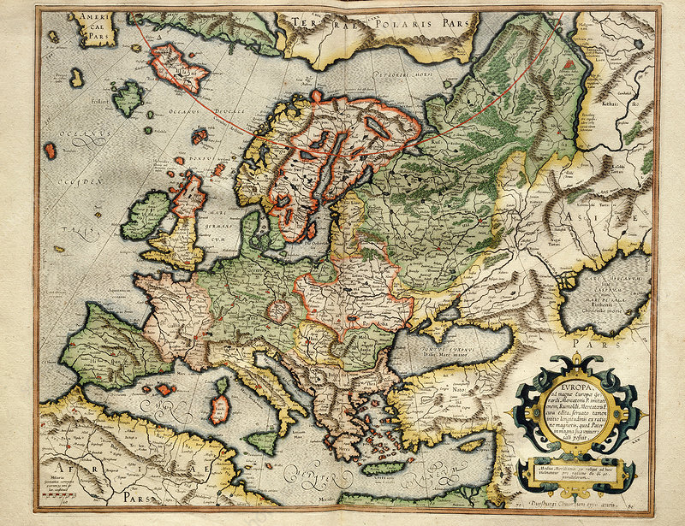
European Identities and the Identity of Europe
Peter Marshall

Slide 2
Seminar preparation
For the seminar, you will be reading extracts from Montesquieu’s Persian Letters.
and Anthony Pagden’s essay ‘Prologue: Europe and the World Around’, in Euan Cameron (ed.), Early Modern Europe (Oxford, 2001), pp. 1-28
These are essential reading for the seminar
The seminar webpage lists many books and articles which help us to understand what was meant by ‘Europe’ and ‘European’.

Slide 3
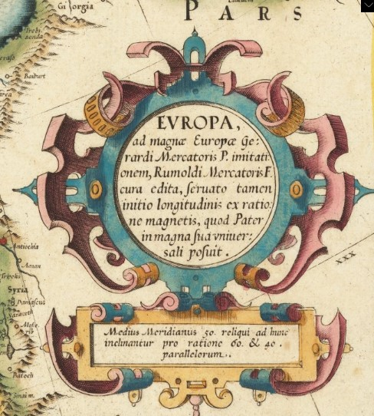
Lecture themes
Pick up some issues raised last week: ‘Europe’ as a construct that evolved over time; the relationship between Europe and the ‘other’; Europe as an imagined space
What are the geographical units of historians’ study? What are the dangers of ‘Eurocentricism’?
How do we think about a concept such as ‘Europe’ – is it a singular thing with unity or a plural one (were there different Europes? How do different viewpoints change its nature?)
How conscious were Europeans of being European? What did that identity entail?
Is European identity static or in flux? How stable over time?
We can view these questions via:
The conceptualisation of Europe through maps
The Enlightenment project, the French revolution and rethinking Europe

Slide 4
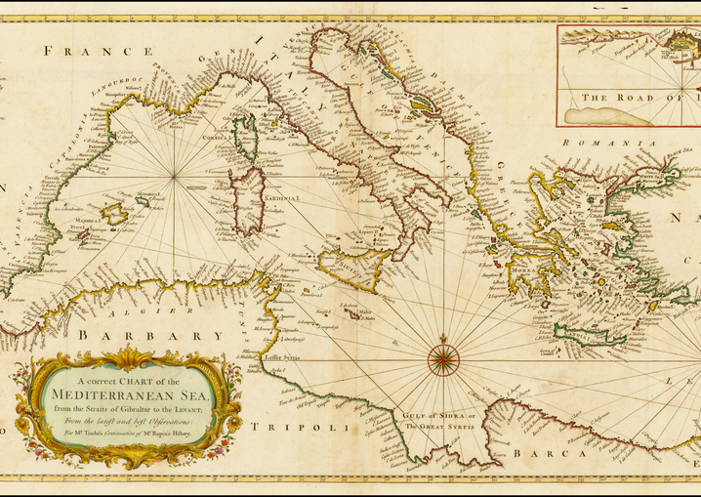
Europe as a Geographical unit of study
Jack Goody argues that Eurasia (treating Europe and Asia together) might be better than a focus on Europe alone. Indo-European languages (most have roots in Sanskrit), social hierarchy (those who pray, fight and work), economies (connected).
Forces us to think comparatively and about what made Europe distinct (or not)
Is water more important than land? Fernand Braudel organized book on the age of Philip II around the Mediterranean (background map is 1746). The Baltic is another key region.

Slide 5
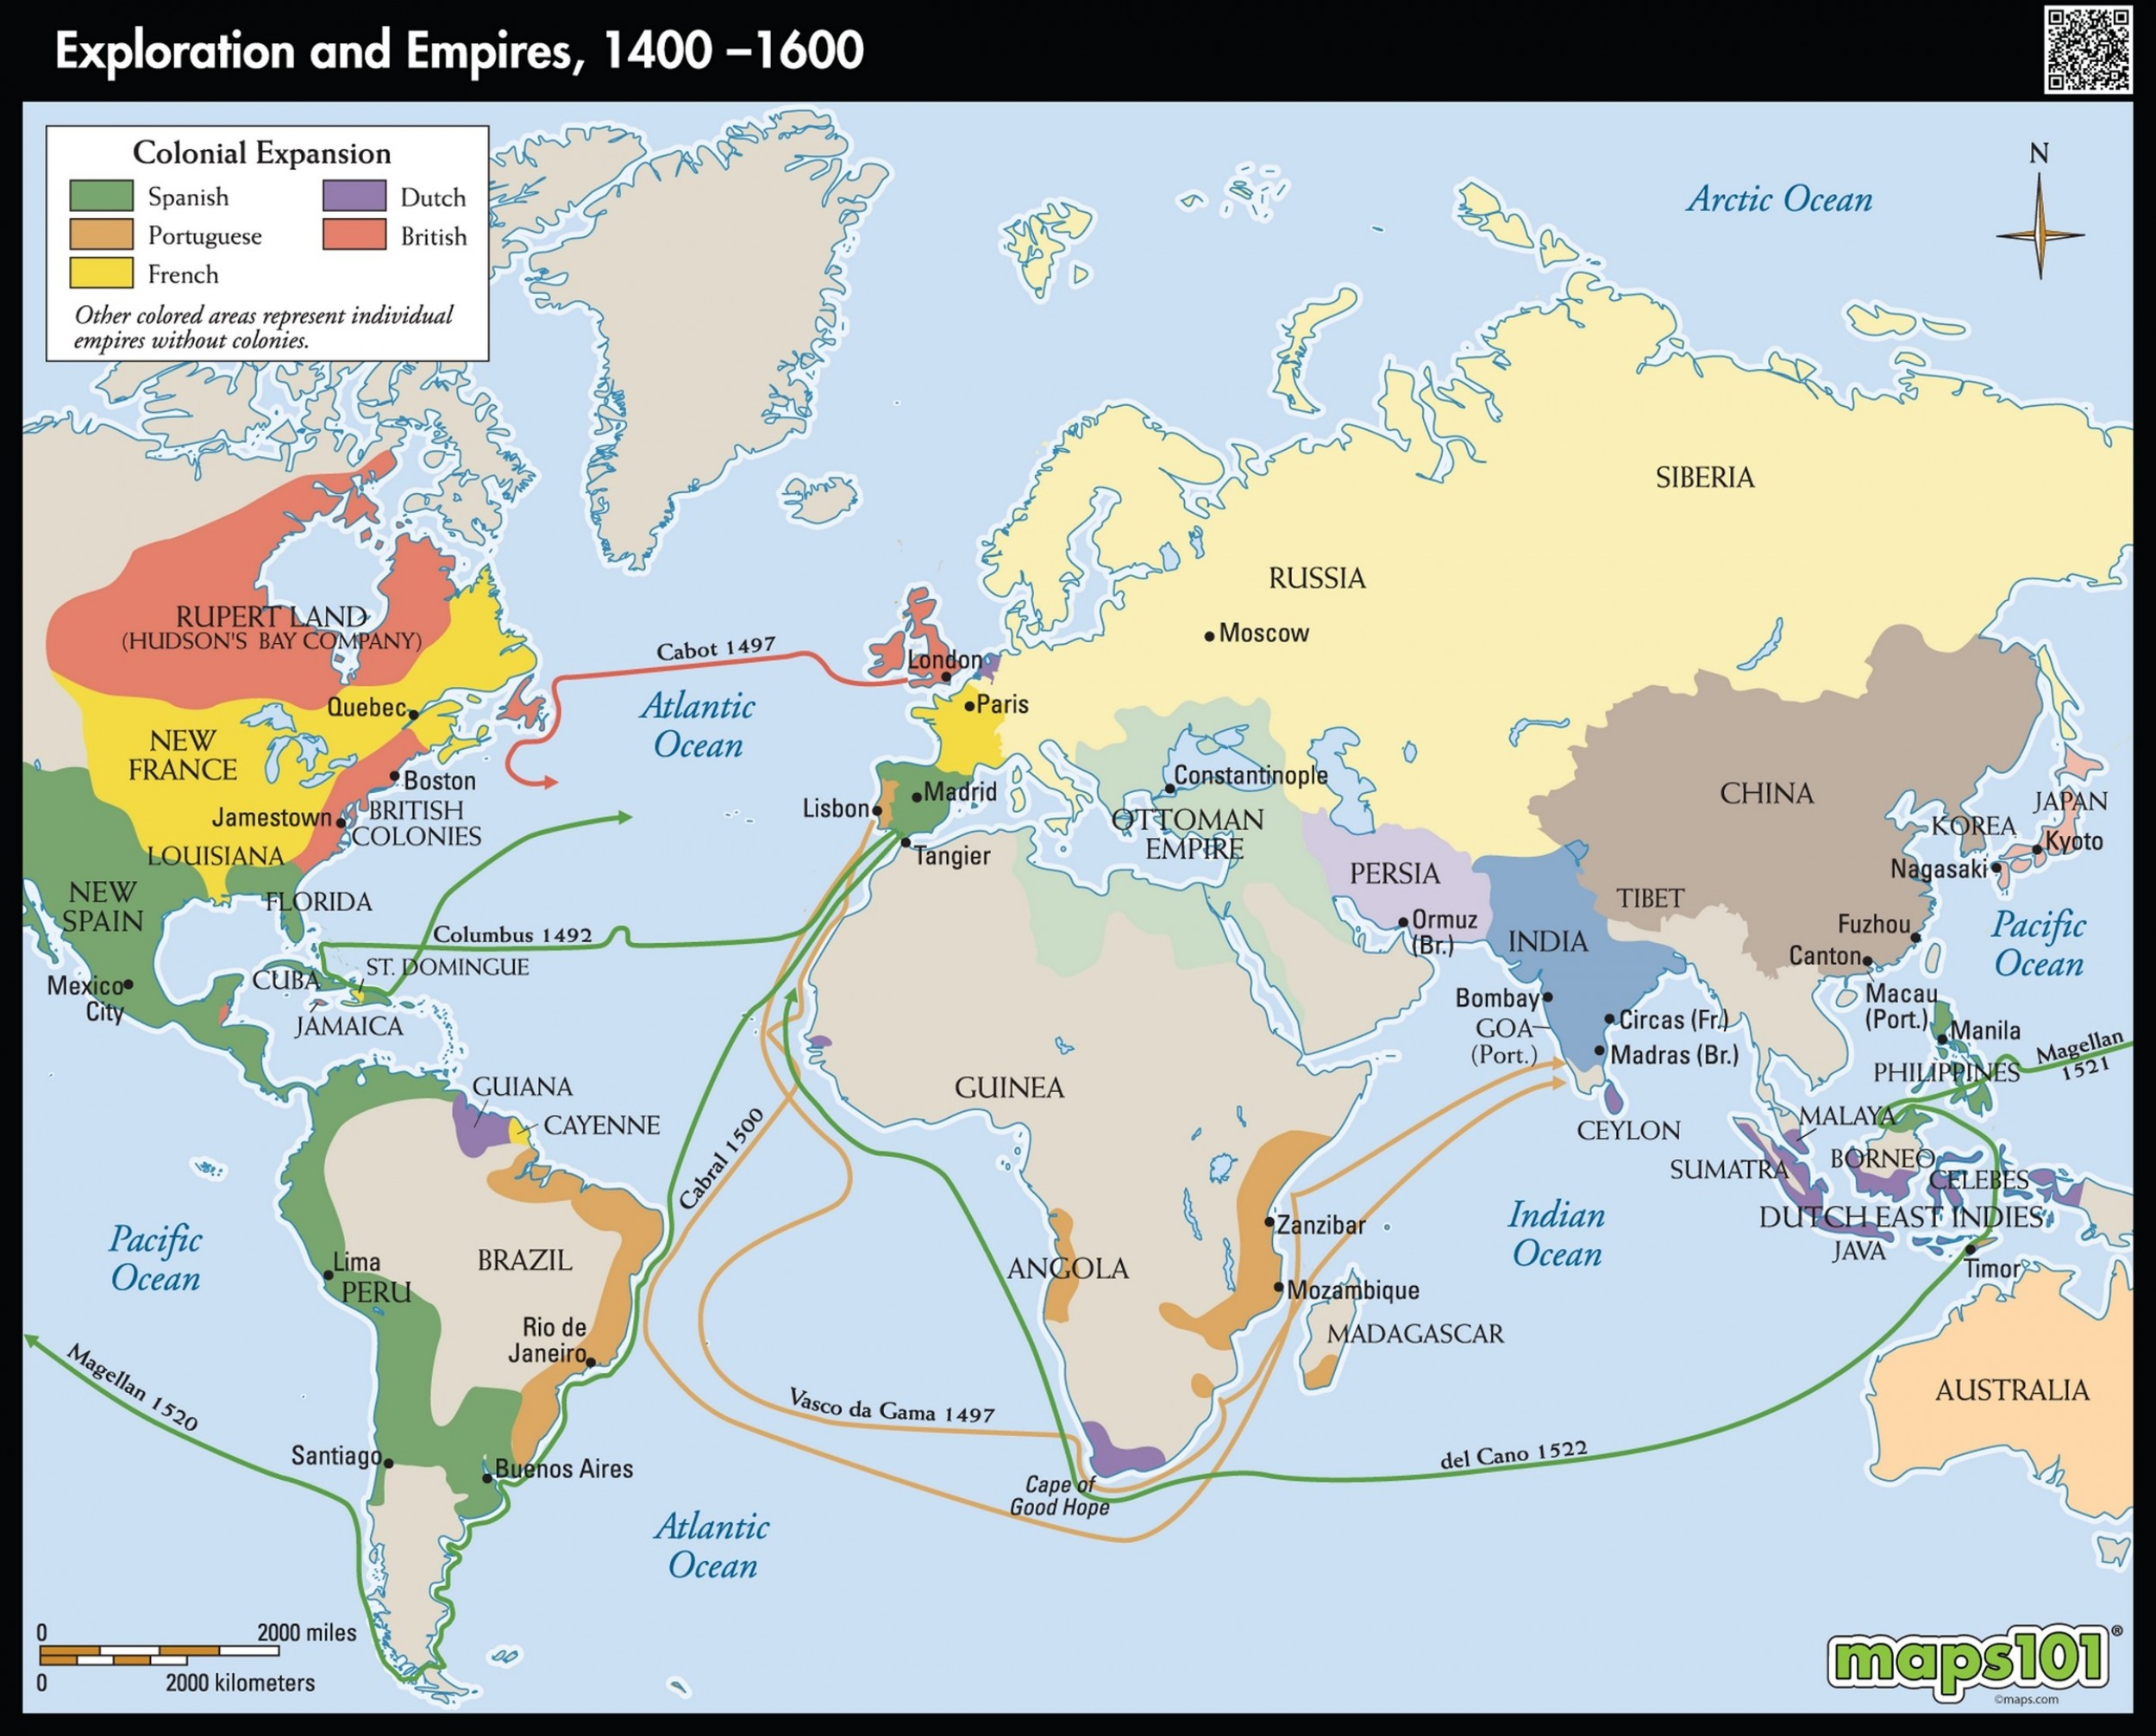
Europe’s empires
interactions with the Americas. Columbus, 1492 (though the Vikings had been there before!).
‘Atlantic World’

Slide 6
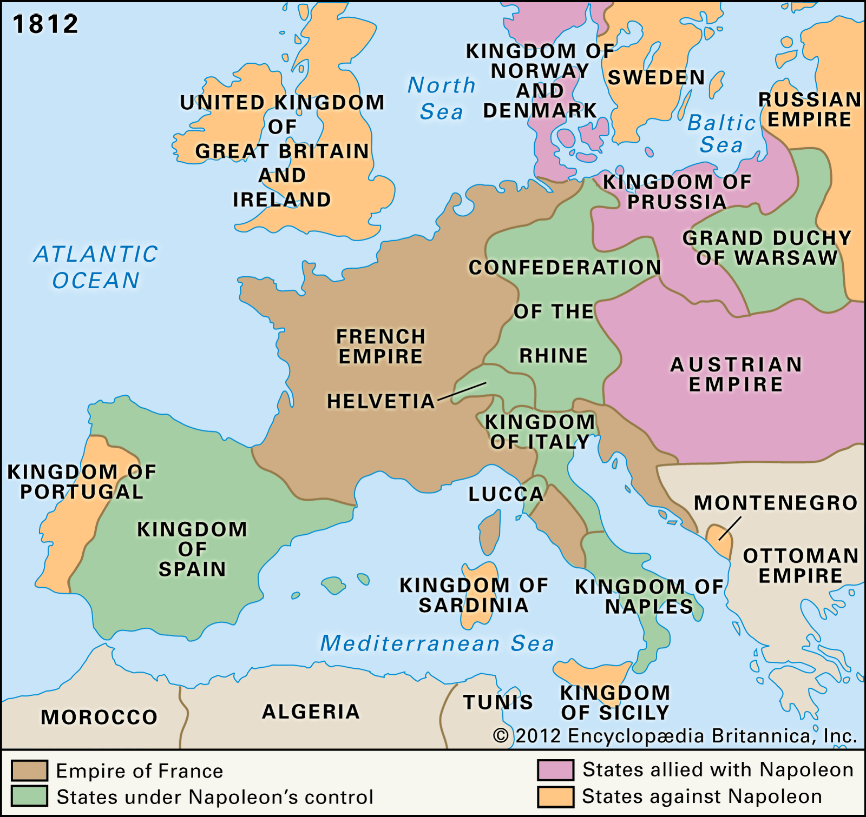
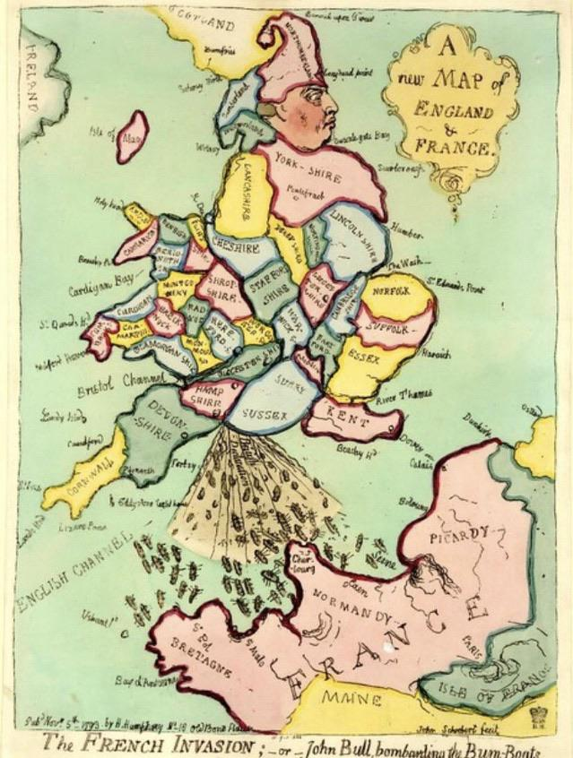
French revolution reconfigured Europe

Slide 7
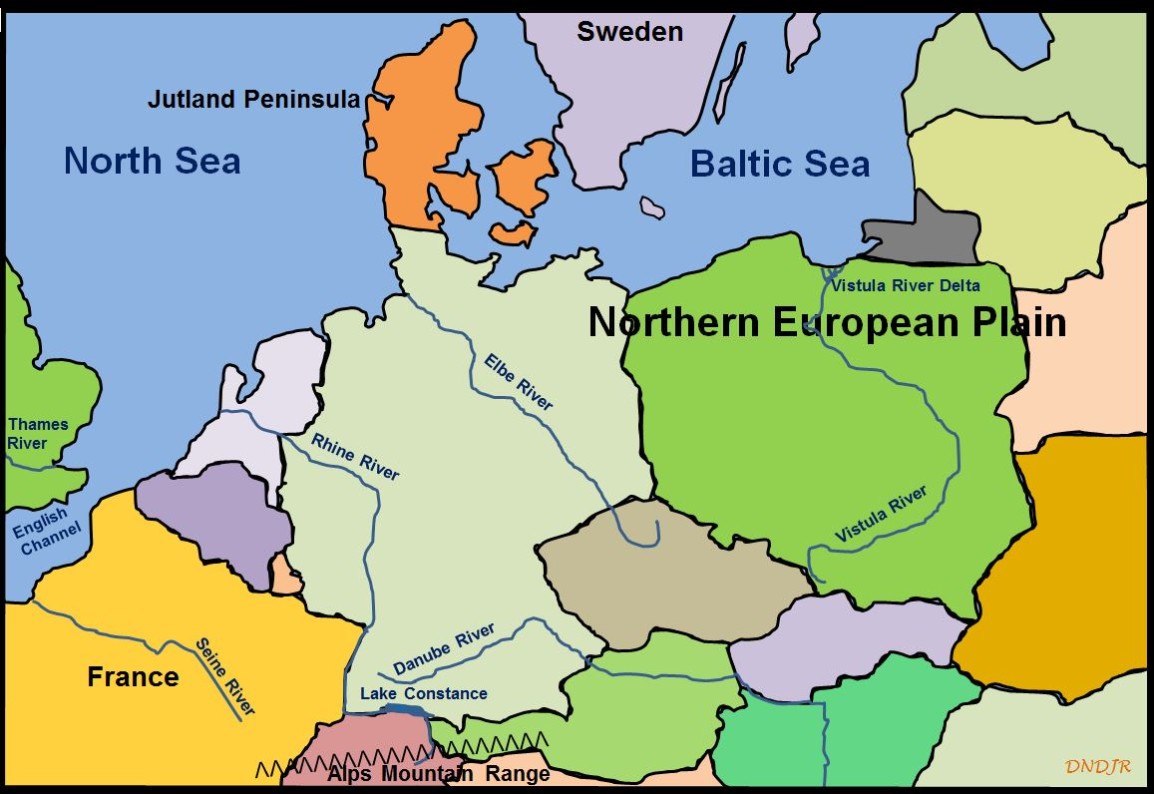
Europe: Single or Multiple?
just one: Montesquieu (1689-1755) said ‘Europe is a state composed of several provinces’
Diversity – but if plural, how many?
2: divided by River Elbe into East and West or (Ranke) Latin and Germanic
3: Jenő Szűcs (1928-88), a medievalist, distinguished between three regions: West, East and ‘East-Central’ (Hungary, Poland, Bohemia)
5: Hugo Hassinger (1877-1952), cultural geographer: N, S, E, W and Centre
How does time change our unit of study? Were there more ‘Europes’ at the start of our period than at the end? More diversity as single Christian church split and Latin ceased to be the common language; but other centralising forces – Renaissance, Enlightenment, state formation

Slide 8
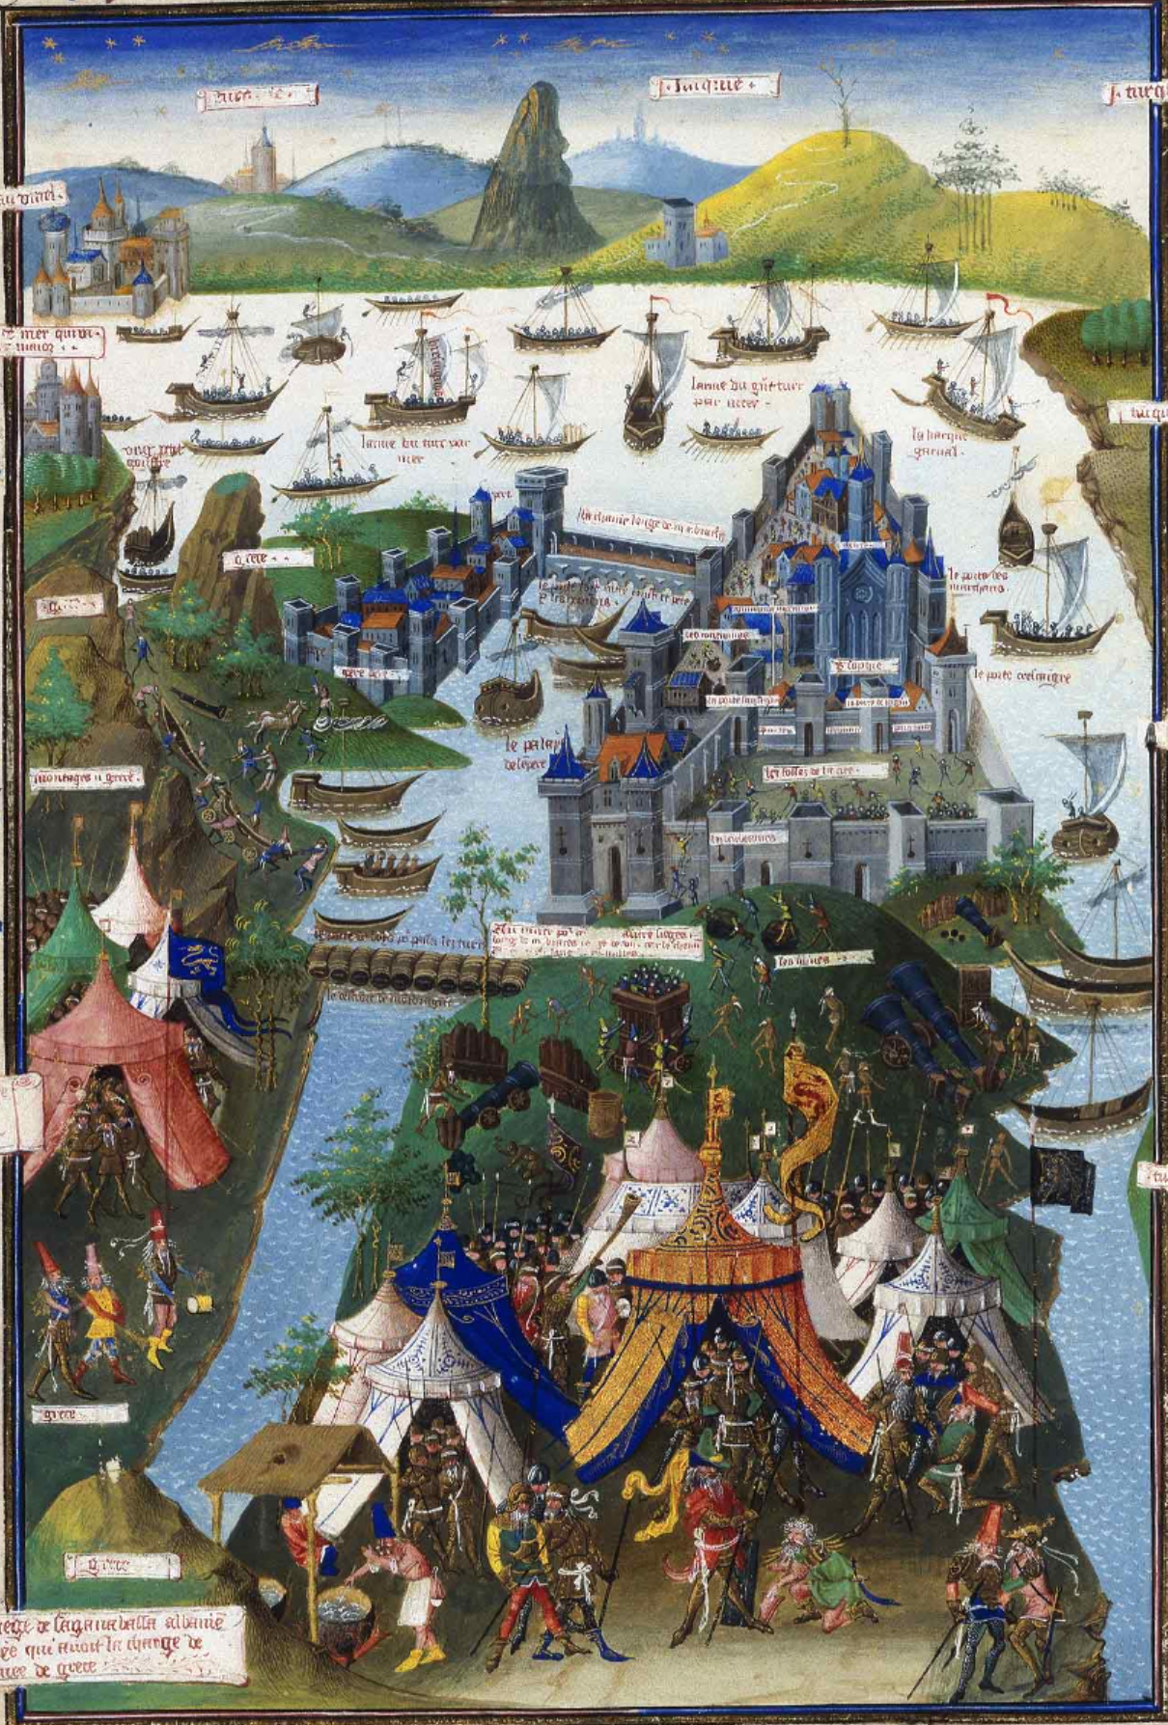
When did ‘Europe’ emerge?
Classical and medieval heritage
the term ‘Europe’ does not make a regular appearance in texts until the thirteenth and fourteenth centuries – but still sporadic usage
Greater frequency from the later fifteenth century. When Pope Pius II heard the news that the Turks had taken Constantinople (1453), he remarked: ‘now we have really been struck in Europe, that is, at home’. Pius frequently used not only the old noun ‘Europa’ but also the new adjective Europaeus.
C16th saw increasing usage. Histories of Europe began to be written, starting with the Florentine Pierfrancesco Giambullari’s Historia dell’Europa, published in 1566
The siege of Constantinople (1453), French miniature by Jean Le Tavernier after 1455

Slide 9
Europe as a cultural construct
Peter Burke: “Europe is not so much a ‘thing’ as an idea, image, myth, or in the language of the 21st century, a ‘cultural construct’”
Sees C17th as key for emergence of European consciousness eg the writing of monographs on Europe as a historical or geographical unit
The German jurist Samuel Pufendorf published a best-selling introduction to European history in 1680, which by 1718 had been translated into seven languages (German, Swedish, Dutch, French, Latin, English and Russian). Textbooks of European geography included Pierre D’Avity’s L’Europe (1660) and Samuel Chappuzeau’s L’Europe vivante (1666–71)
Print as an important disseminator esp periodicals giving European news (first printed newspaper 1605 Strassburg)
War across Europe – fear of ‘universal monarchy’ of Spanish (Philip II) or French (Louis XIV) kings. William of Orange described himself as the defender of ‘European freedom’ (der Europese vrijheid), and an English pamphlet of 1677 is entitled Europe a Slave unless England break her Chains.
And political construct. Early ideas of league of nations: Emeric Crucé, Le Nouveau Cynée (1623): permanent gathering of princely representatives in Venice. Europe as a political system – ‘balance of power’

Slide 10
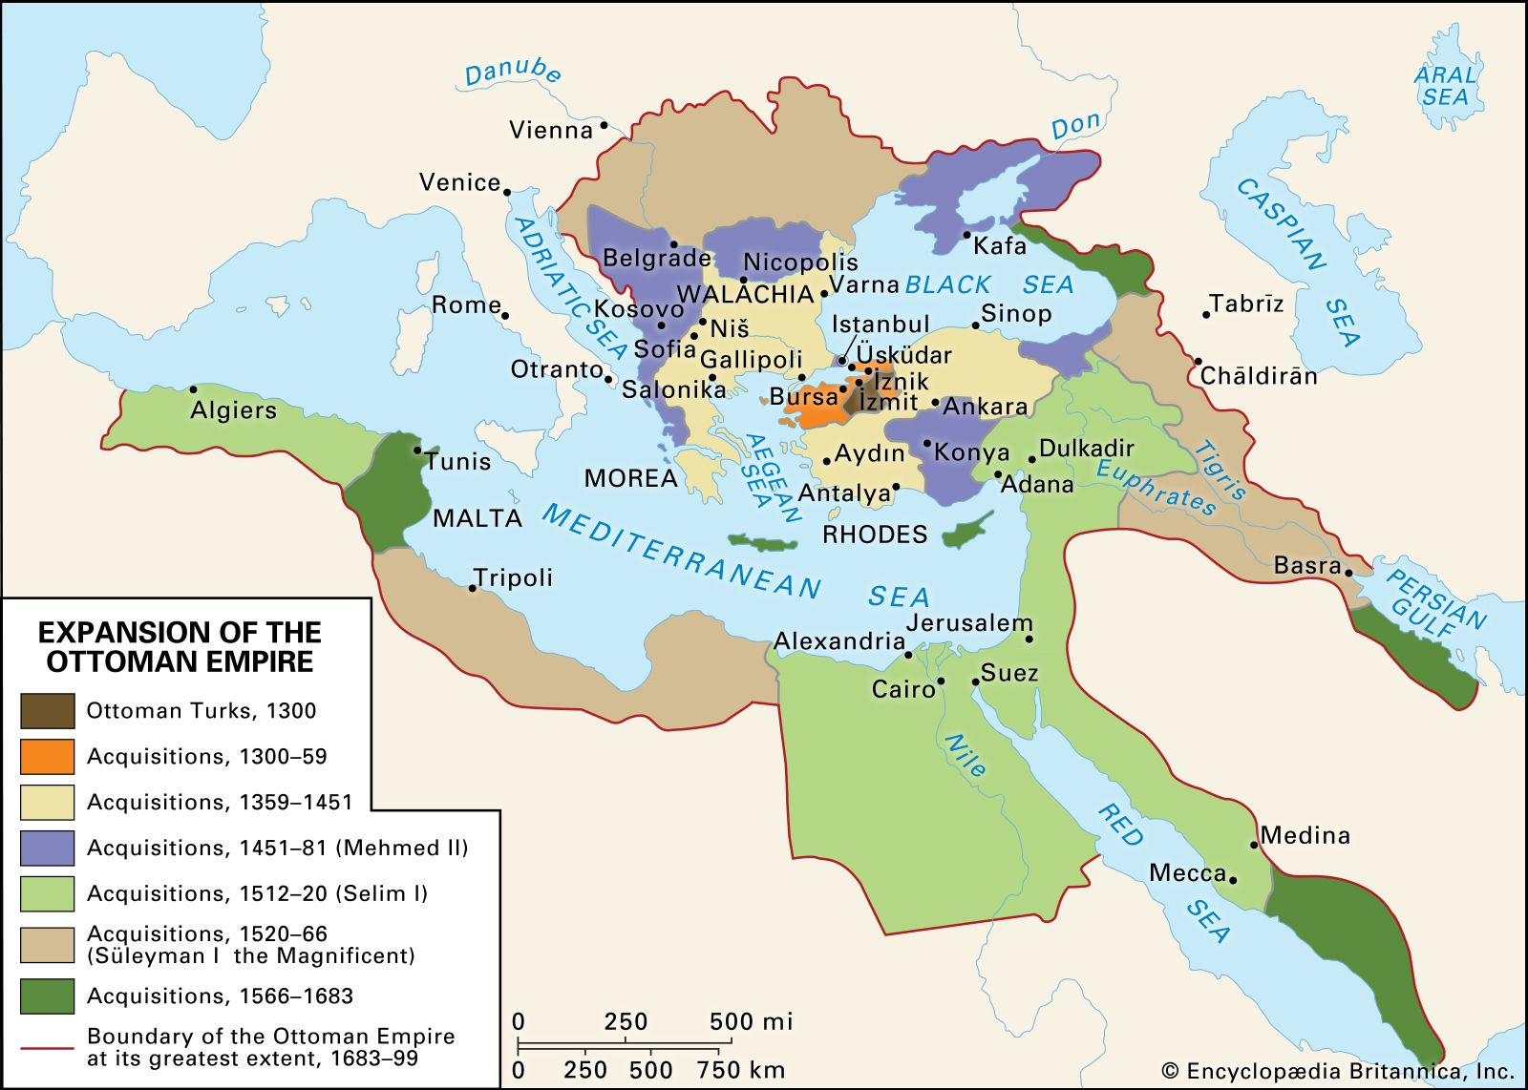
Identity defined in opposition to an ‘other’
barbarian, heathen, skin colour, the ‘East’ (Turks: Muslim, despotic; South Americans)
As a civilisation: Christianity, democracy, freedom, white skin, the ‘West’
But whose consciousness/identity? Elite or everyone?
Single consciousness/identity? locality (town or village), region, nation, Christians, Europeans, Westerners? Overlapping identities?

Slide 11
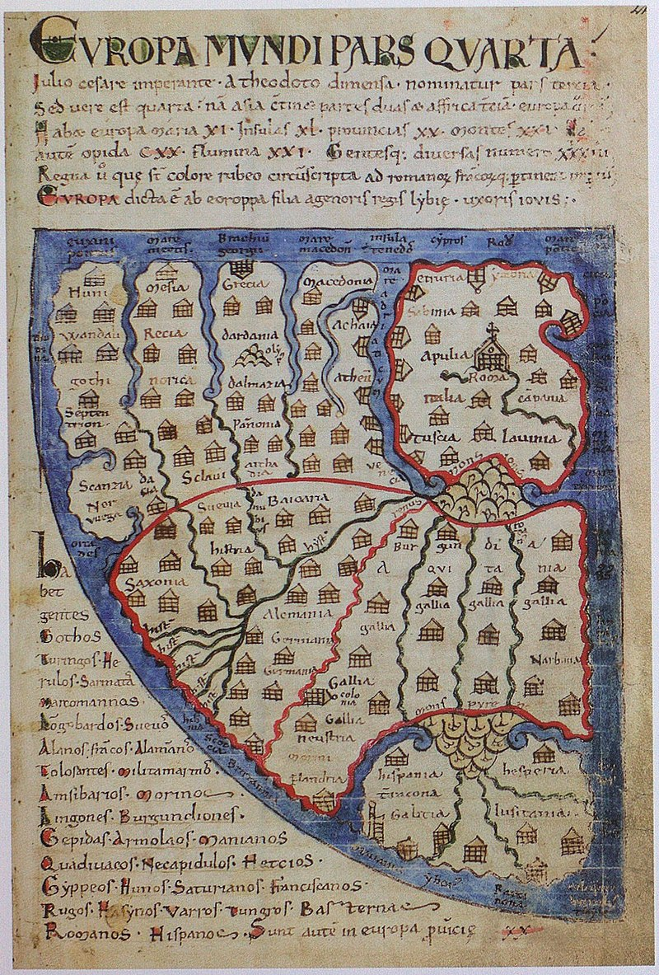
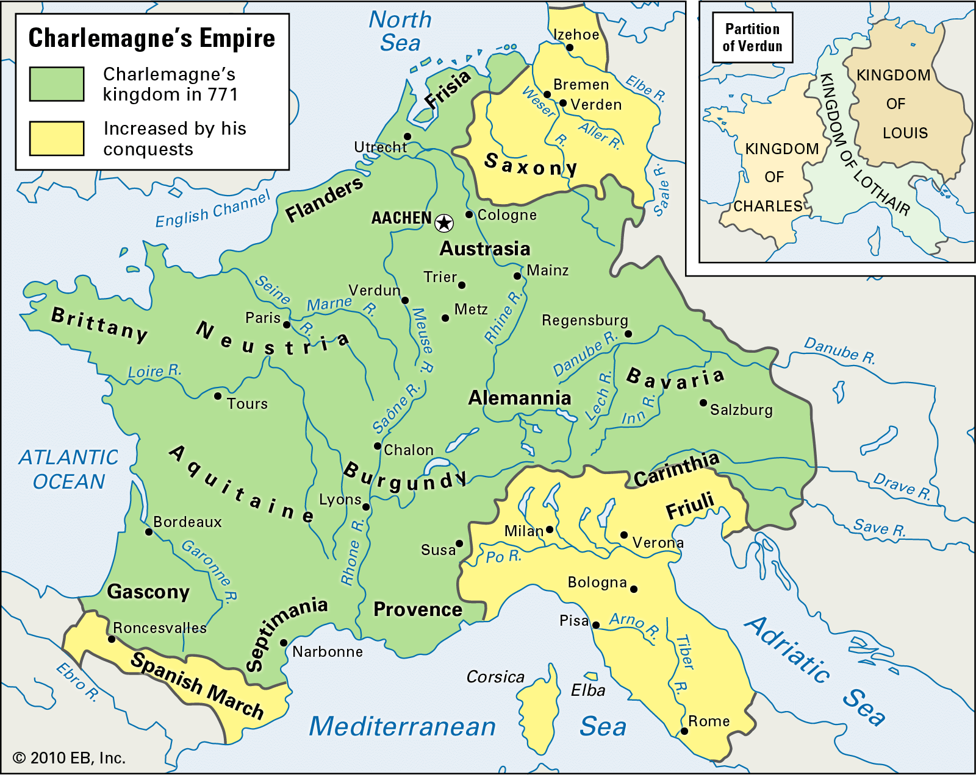
What can maps of Europe tell us?
The oldest single-sheet map (1090-1120) was probably drawn by Lambert, a canon of Saint-Omer, and is to be found in his Liber Floridus, a sort of encyclopaedia
Core of ‘Europa’ encircled in red includes Italia, Gallia, Flandria, Alemania, and Saxonia: in other words, roughly the Carolingian Empire of Charlemagne (late C8th).
Britain is excluded, as are Britain, Scandinavia, Spain and the whole area to the east of the Adriatic from Venice down to Greece and Macedonia

Slide 12
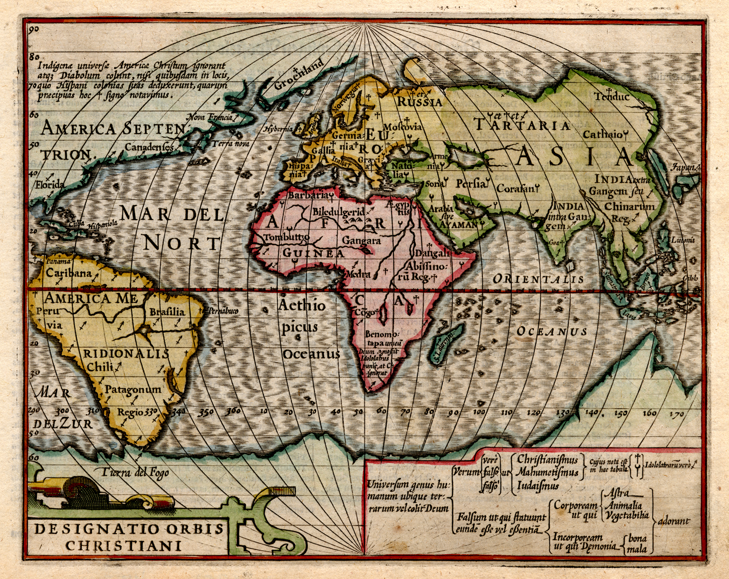
Renaissance maps: Europe as Christendom
Overseas exploration greatly encouraged the further development of mapmaking.
In addition, the invention of printing increased the distribution of maps.
The Low Countries became a centre of mapmaking eg Gerard De Cremer/Gerardus Mercator’s world map of 1569; 1570 first atlas by Abraham Ortelius in Antwerp, collecting all known maps in one place
Mercator’s grandson sold the plates engraved with Mercator’s maps to Jodocus Hondius
The Atlas Minor published by Hondius in Amsterdam in 1607 shows Europe as the leading continent because of its fertility, population and the illustrious deeds of its inhabitants
The atlas includes texts as well as images. These texts consider Europe to be interchangeable with Christendom, the area where Christianity dominated
Jodocus Hondius,
Designatio orbis christiani, 1607

Slide 13
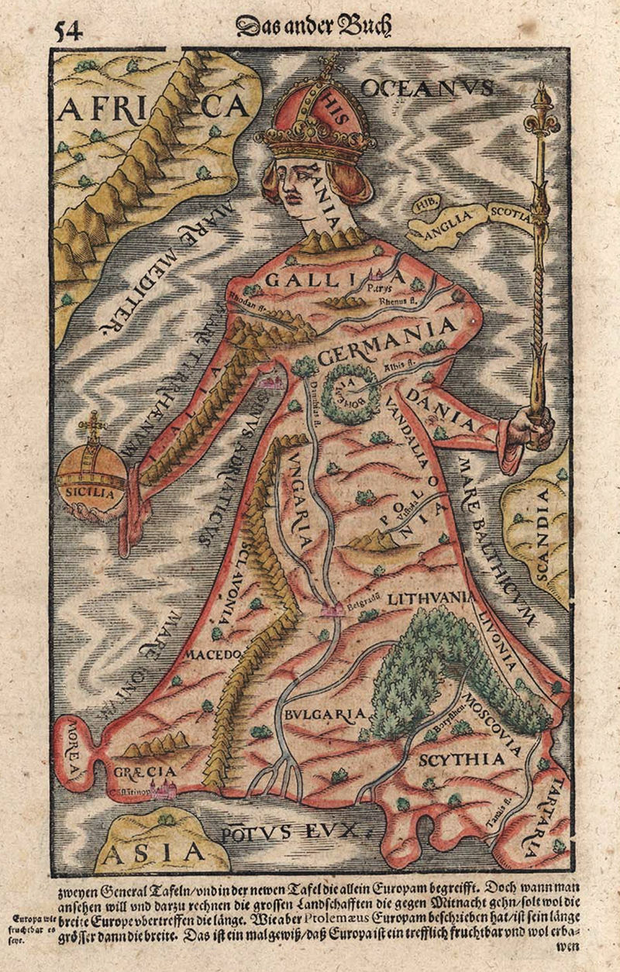
Allegorical representations: Europa Regina
In the mid- to late sixteenth century allegorical representations of continents (a total of four at that time) with standard attributes and symbols became popular.
in 1537, first map of Europe in the form of a queen, was produced by the Innsbruck humanist Johannes Putsch and presented to the Holy Roman Emperor, Charles V. [1544 version shown, by Sebastian Münster]. Iberia as head – perhaps depicting Europe as spouse of Charles V.

Slide 14
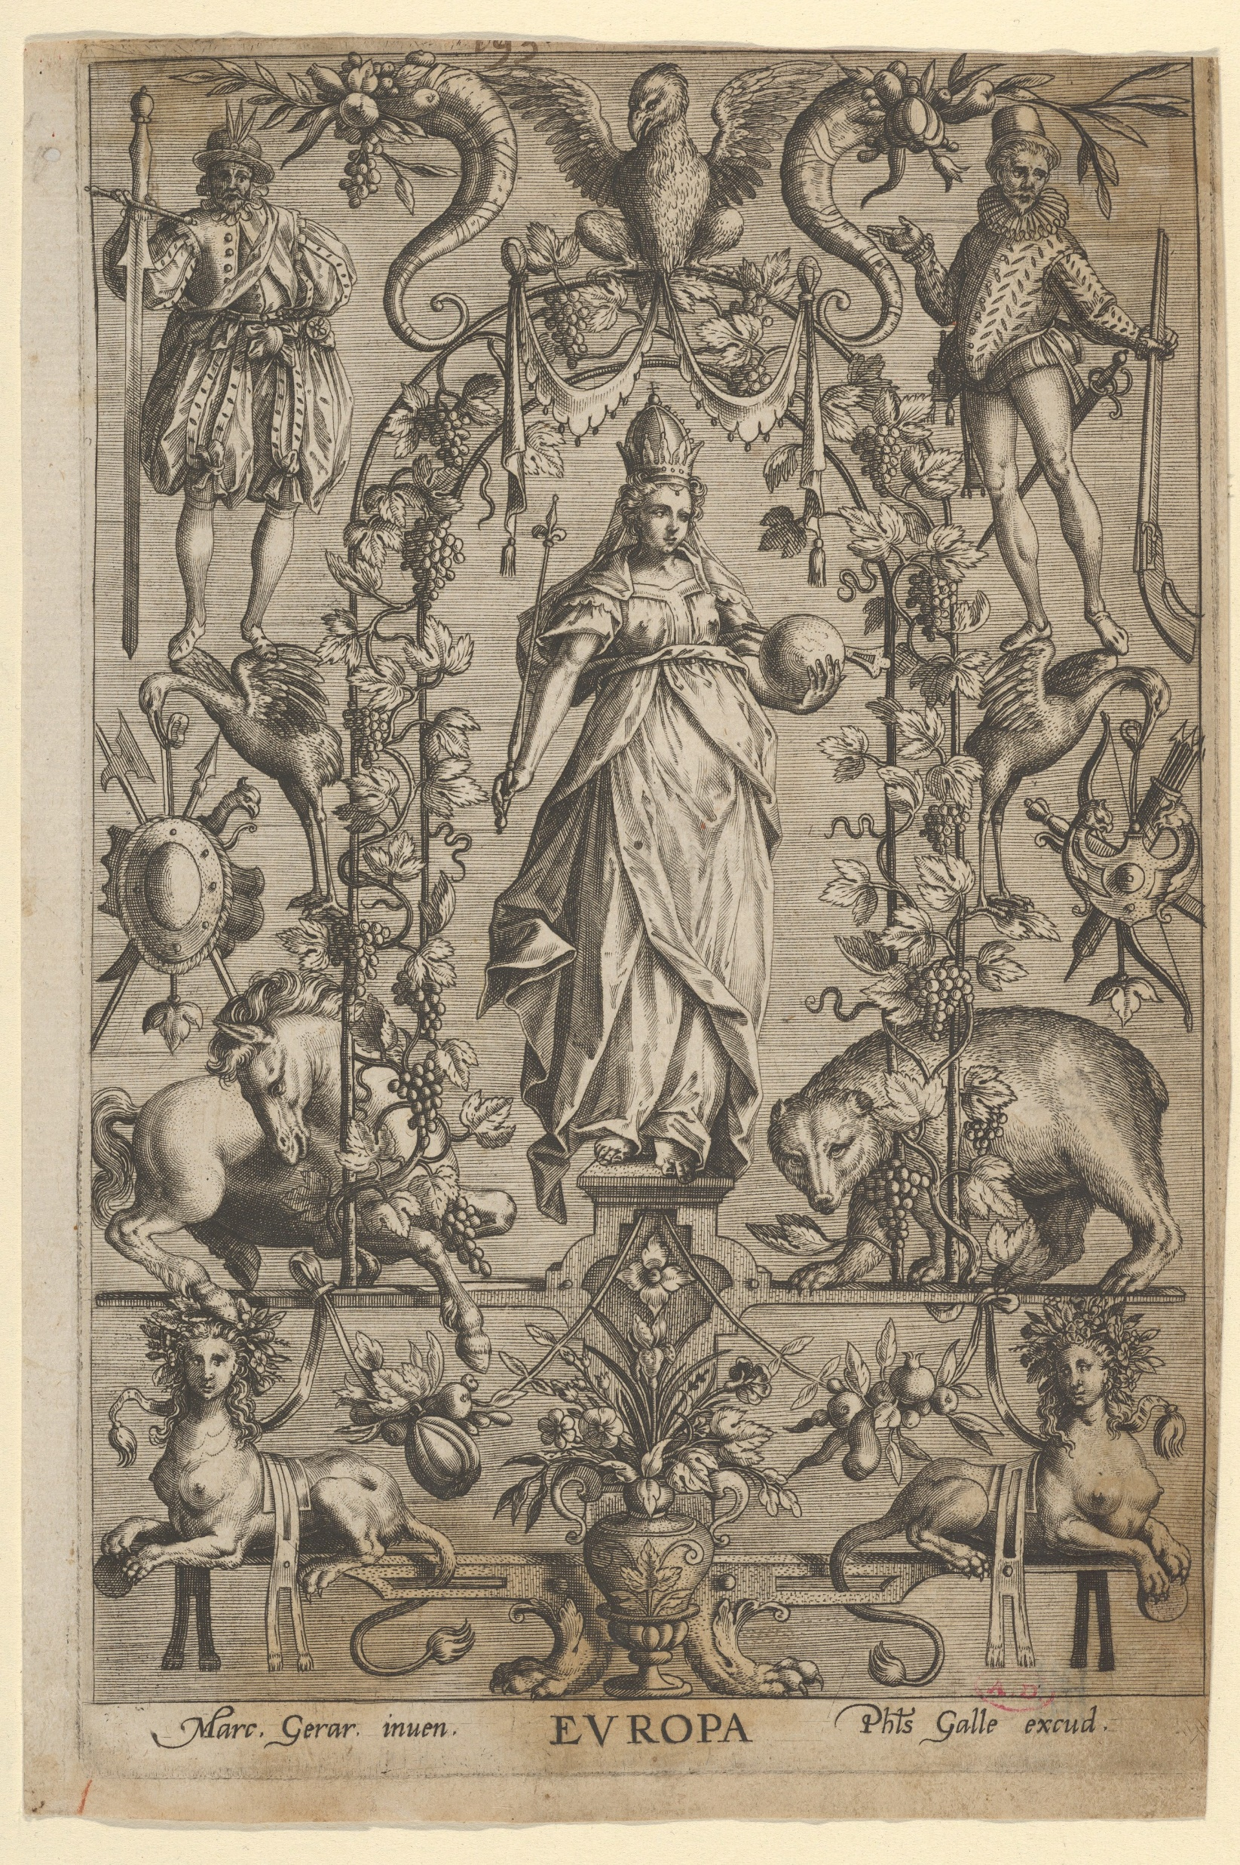
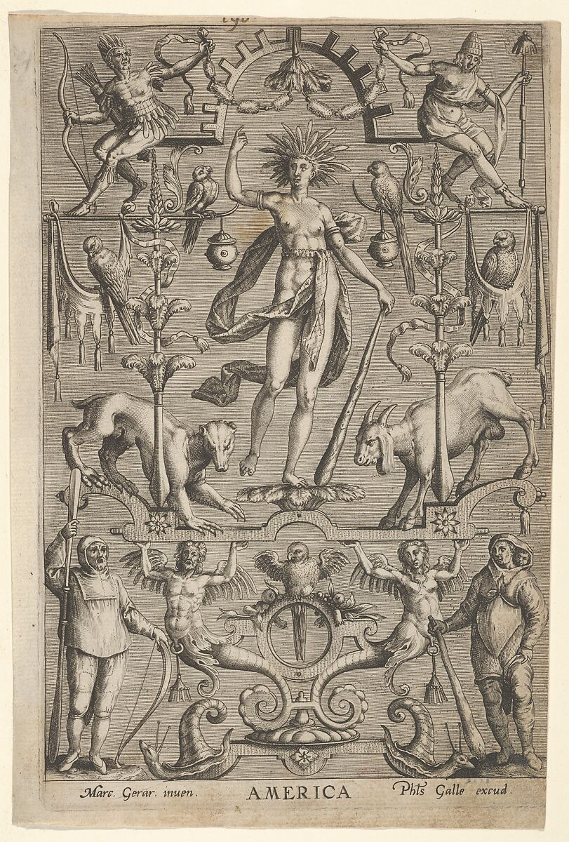
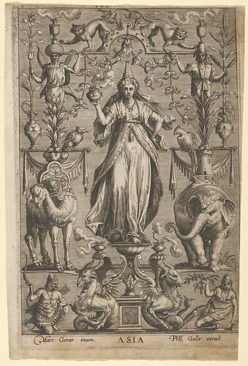
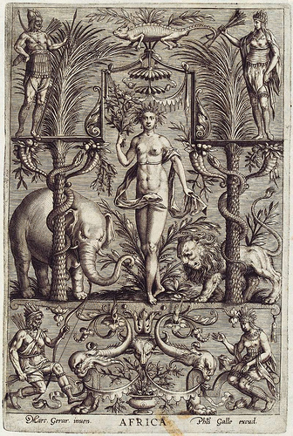
Philips Galle, ‘Allegory of the Four Continents’, c. 1595-1600
Only Europe is crowned, the other continents are not.
By around 1580 ‘Europe crowned’ had become a frequent motif in prints
‘Motherland’. Fruitfulness

Slide 15
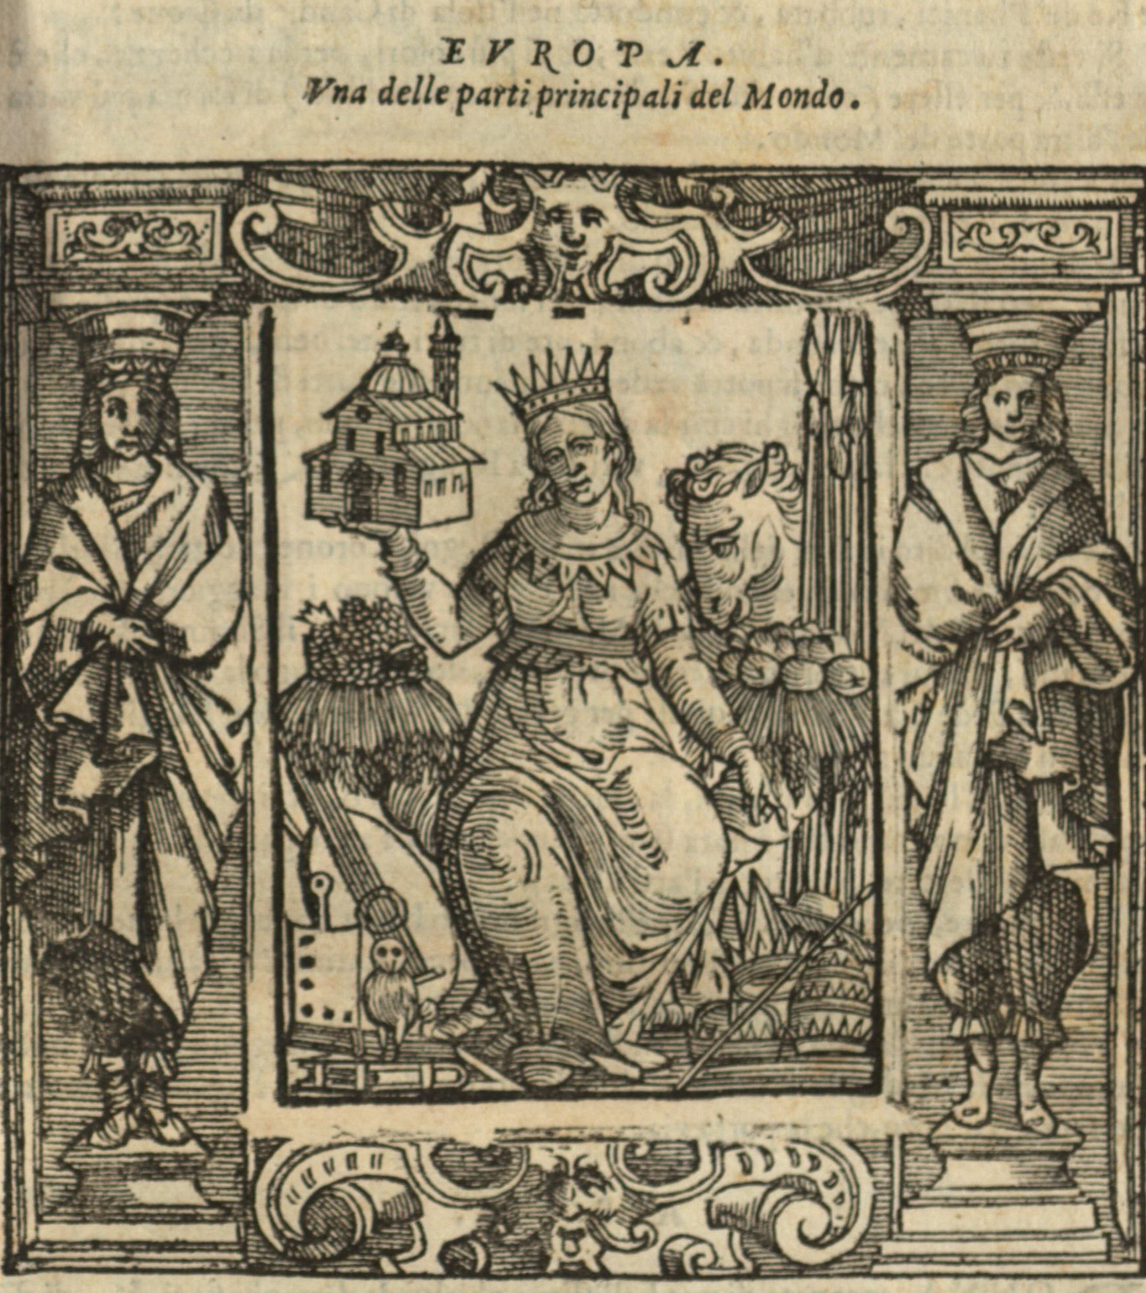
Cesare Ripa, Iconologia, 1593
  ‘one of the principal parts of the world’
  To either side of her are Horns of Plenty, one filled with fruit and grain, the other with white and blue grapes, symbols of fertility.
  She carries a temple in one hand as a sign of perfect religion. With her other hand she points to crowns and sceptres to demonstrate that it is in Europe that the most powerful of potentates and princes reside, the Emperor and the Pope.
  Text notes that pope’s authority comes from “the most holy and catholic Christian faith which, by the grace of the Lord God, came to the new world.”
  The horse and pikes (top right) stand for military valour, the book and the owl for scholarship (bottom left), the musical instruments for the liberal arts.

Slide 16
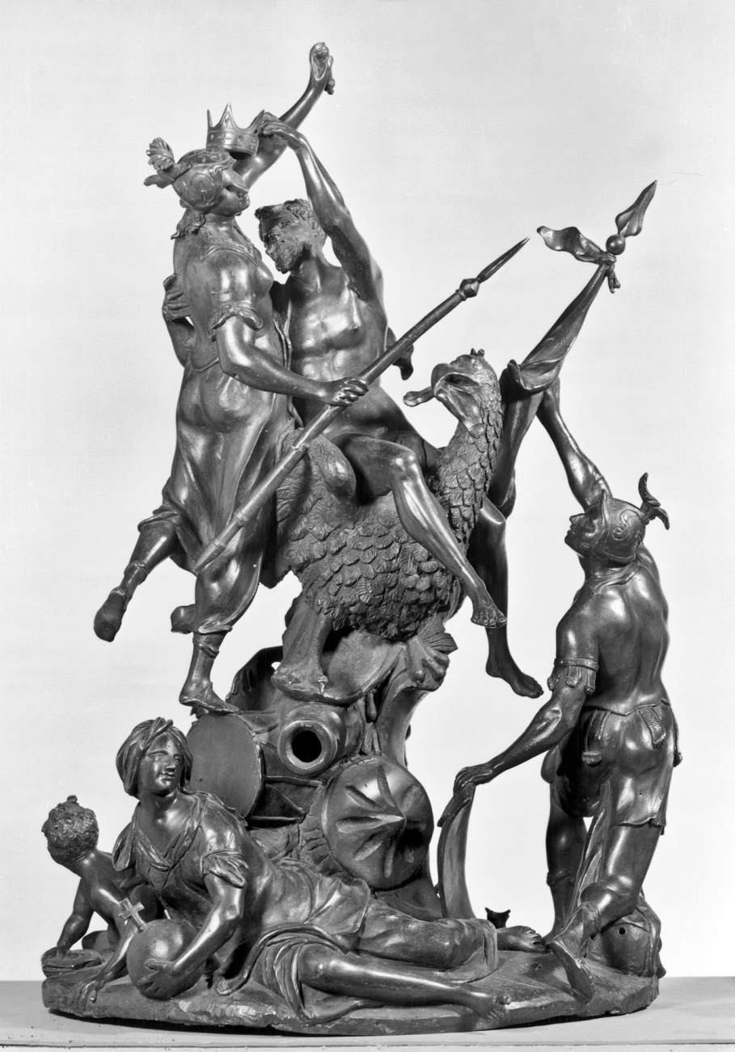
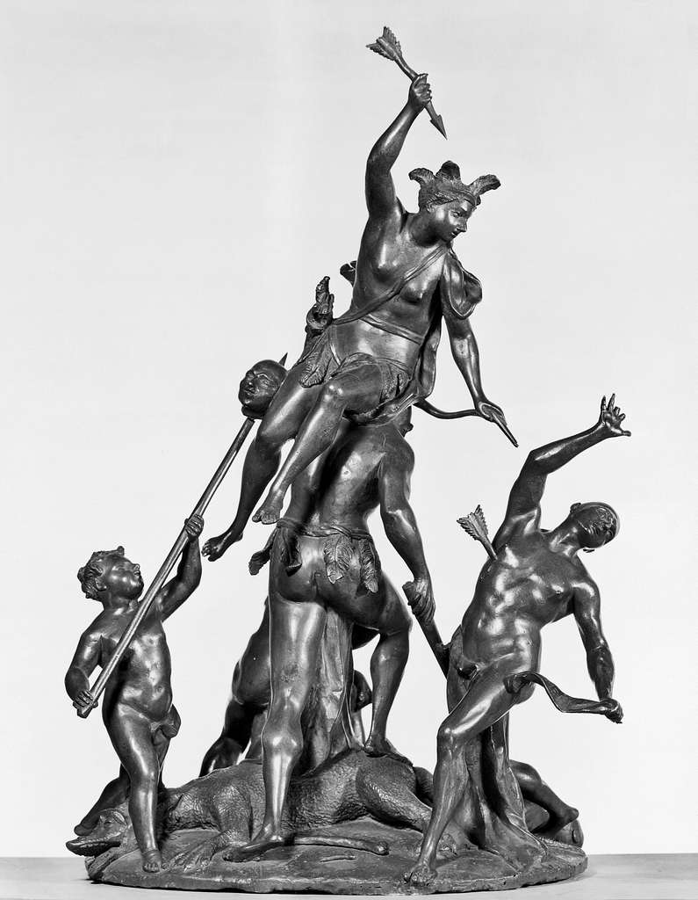
18th c. Superiority
In the eighteenth century we find the superiority of Europe expressed more often and more directly. When the continents are depicted together, their posture clearly indicates their subordination to Europe.
We can see this in four bronze sculptures of the continents made between 1710 and 1725 by Francesco Bertos.
  In the allegory of Europe (right), Jupiter, the king of the gods, crowns the goddess of war. Jupiter's eagle rests on objects used in war: canon, shield, and drum. Europe is thus represented as the leader of the world through her military prowess. The figure of Religion on the ground reveals that the Christian faith is the source of Europe's superior position.
  Contrast with America (on right), emphasising ‘savagery’

Slide 17
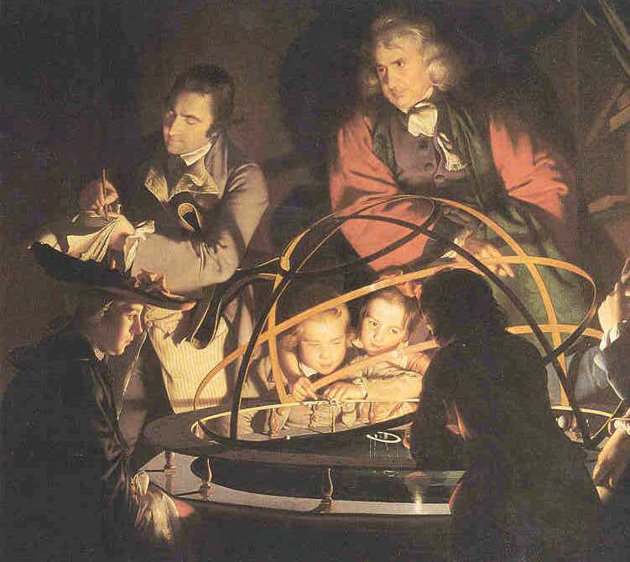
Enlightenment: towards a common European identity and European superiority?
Christianity continued to play a role in the self-image of Europeans during the eighteenth century but it was no longer the all-dominant force that it had been in previous centuries.
By the end of the eighteenth century Europe and Christendom were no longer synonyms.
European feelings of superiority were based on a conglomeration of ideas proceeding from the Enlightenment
The Enlightenment was a (C17th-C18th) cultural movement that affected ideas about religion, politics, economics, law, reason, nature (including human nature)
It sought a common set of principles and values: reason and progress; science and exploration; natural rights; the promotion of wealth and the good life; the eradication of superstition; the separation of church and state; freedom of expression.
Joseph Wright: A Philosopher with an orrery

Slide 18
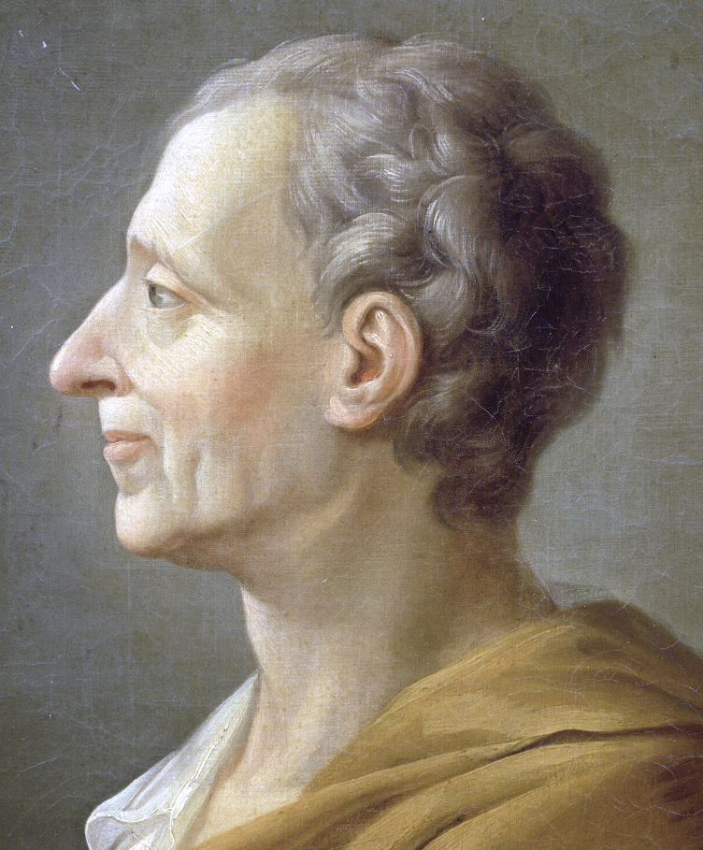
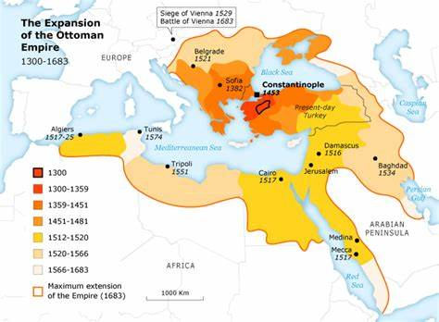
But what constituted identity and the self-confidence of the superiority was always uncertain
How did thinking about the ‘other’ help to shape European identity?
Was the ‘other’ always inferior?
Was ‘Europe’ always superior?
We can recover some of this ambiguity by looking at the work of Charles-Louis de Secondat, Baron de La Brède et de Montesquieu
(1689-1755)
judge, a man of letters, and a political philosopher

Slide 19
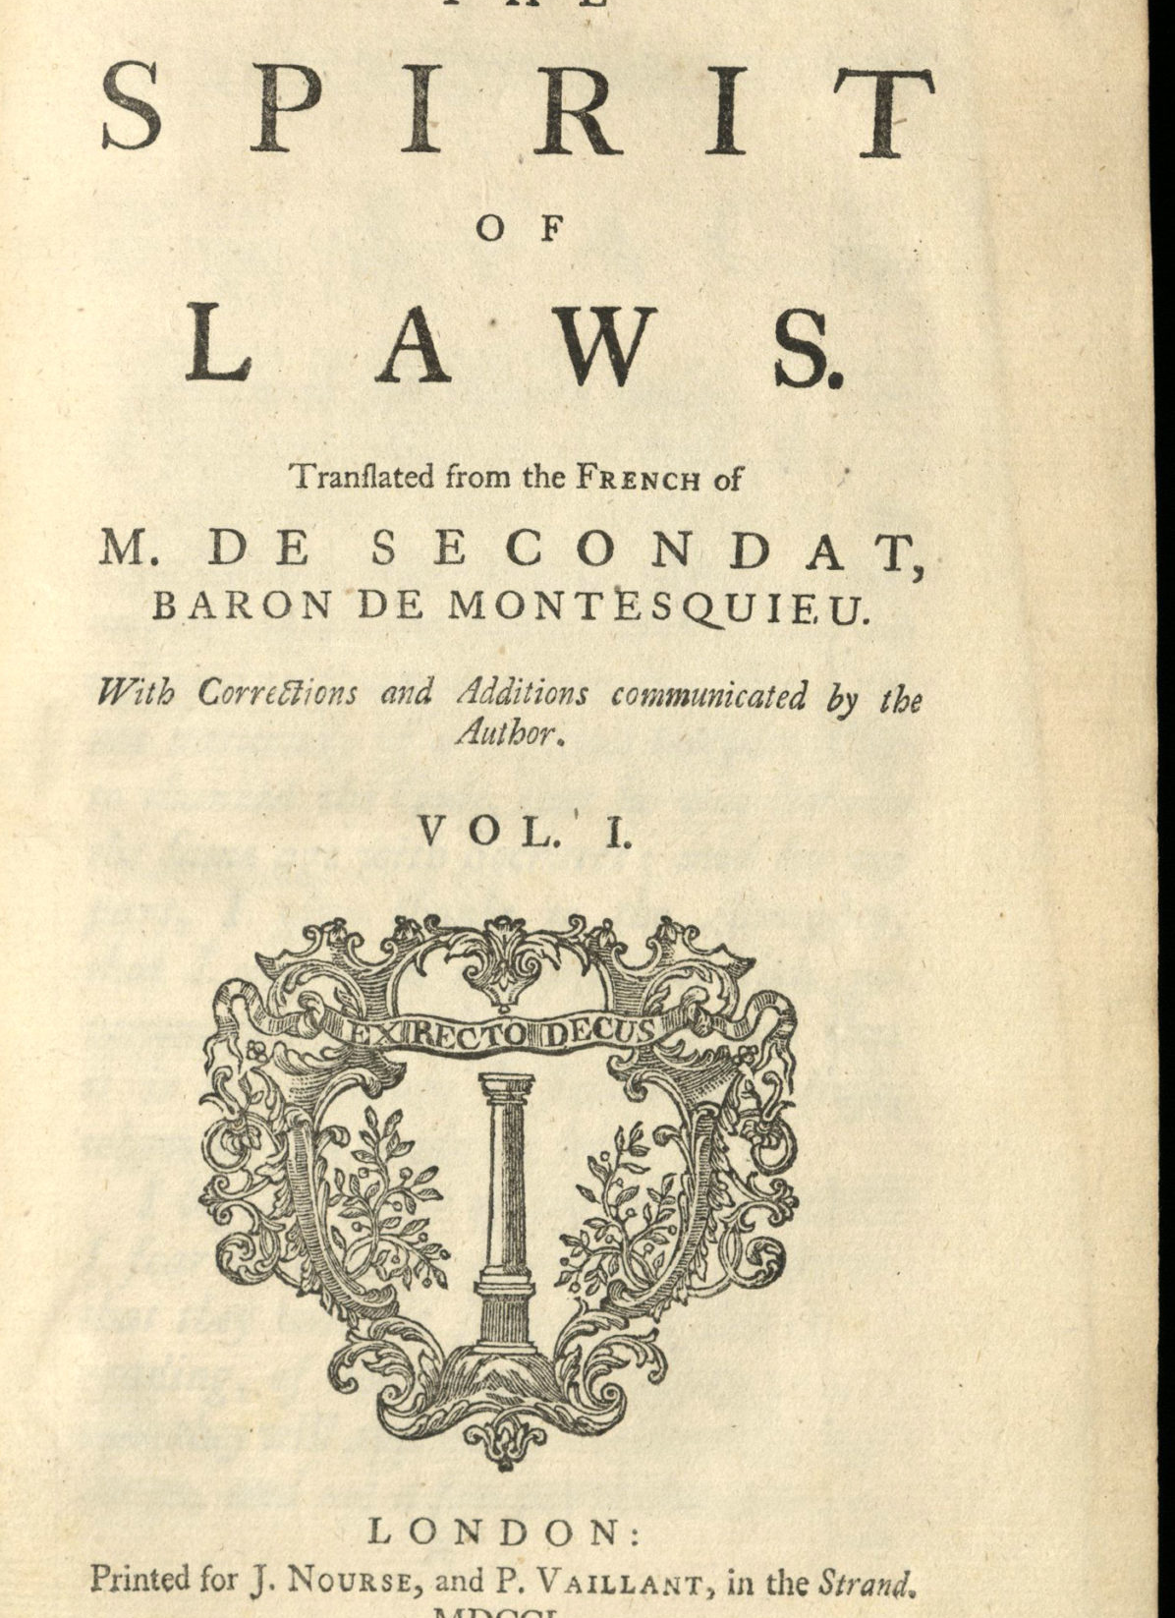
Montesquieu and the European character
The Spirit of Laws (1748) tried to explain the peculiar nature of Europe, especially by comparison with Asia.
Montesquieu addressed the question of ‘how noticeably peoples differ from one another according to the climate in which they live’. The quality of land also shaped forms of government.
In Asia, there were weak, despotic nations in hot climate with large plains. Those who live there are more fearful, more amorous, and more susceptible both to the temptations of pleasure and to real or imagined pain; they are less resolute, and less capable of sustained or decisive action
In Europe, on the other hand, strong nations are next to one another within the same temperate climate and is divided geographically into small regions. Contrasting with “Oriental despotism”, Europe appears as the breeding ground of moderation and political freedom. Its “spirit of freedom” contrasts with the Asiatic “genius of servitude”
Europe is a unit of economic power based on the spirit of commerce, a civil society united by her customs, having emerged into modernity as a true motor of history

Slide 20
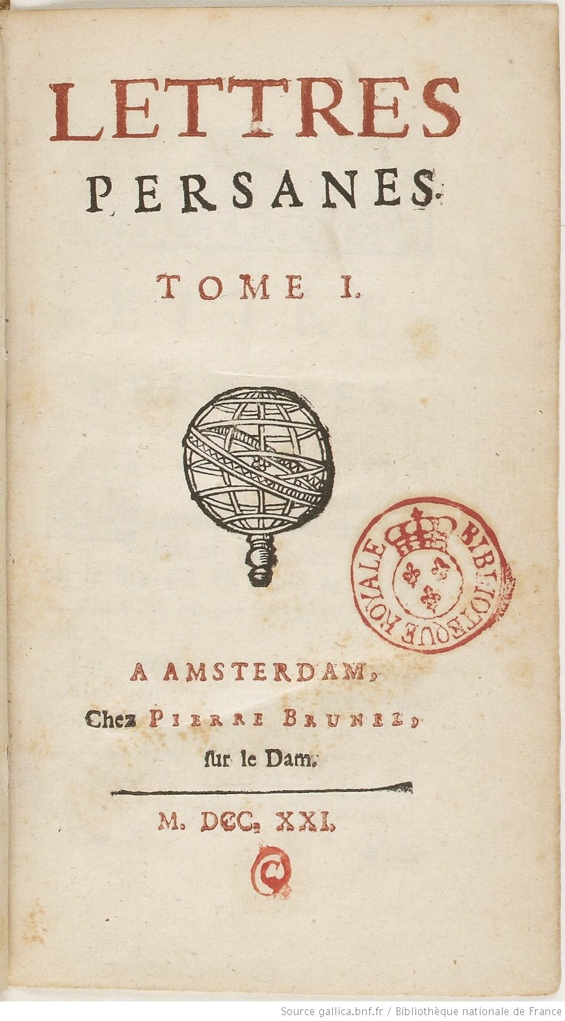
Montesquieu, Persian Letters (1721)
But was he a cultural supremacist?
This earlier work was published anonymously, earlier
Explores cultural differences between Europeans and non-Europeans
satire is in the form of letters which were supposedly written by two Persian, Muslim visitors from Isfahan (in modern Iran, under the Safavid dynasty/empire) to Paris
Persians speak of the European urge to work and the passion to enrich themselves: one sees nothing but work and industriousness in Paris.
early examples of an alleged opposition between the dynamism, work ethic, and even capitalism of Europe and the inertia and immobility of Asia
Montesquieu believed that Asians and Europeans had different mentalities but
The Persian gaze brings out the corruption, mutilation, or alienation constitutive of modernity in the West – its essential ambiguities and deceptions
As you read the Persian Letters, can you find examples where you think Montesquieu is critical of Europeans?

Slide 21
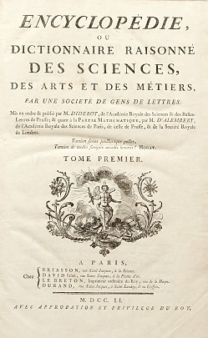
Ignoring such ambiguities and compiling several passages from The Spirit of Law, the Chevalier de Jaucourt in his short article for the Encyclopédie ou Dictionnaire raisonné des sciences et des arts (1751-1772, volume published in 1756) ’Europe’ sets out a “grand narrative” of European exceptionalism.
He argues that Europe, whilst being one of the smallest parts of the world, had become powerful, wealthy, knowledgeable industrious and enlightened, and religion itself – conceived as morally beneficial – has become subordinate to the well-being of civil society
‘History has almost nothing to compare it with’
ENCCRE – Article « EUROPE » (academie-sciences.fr)

Slide 22
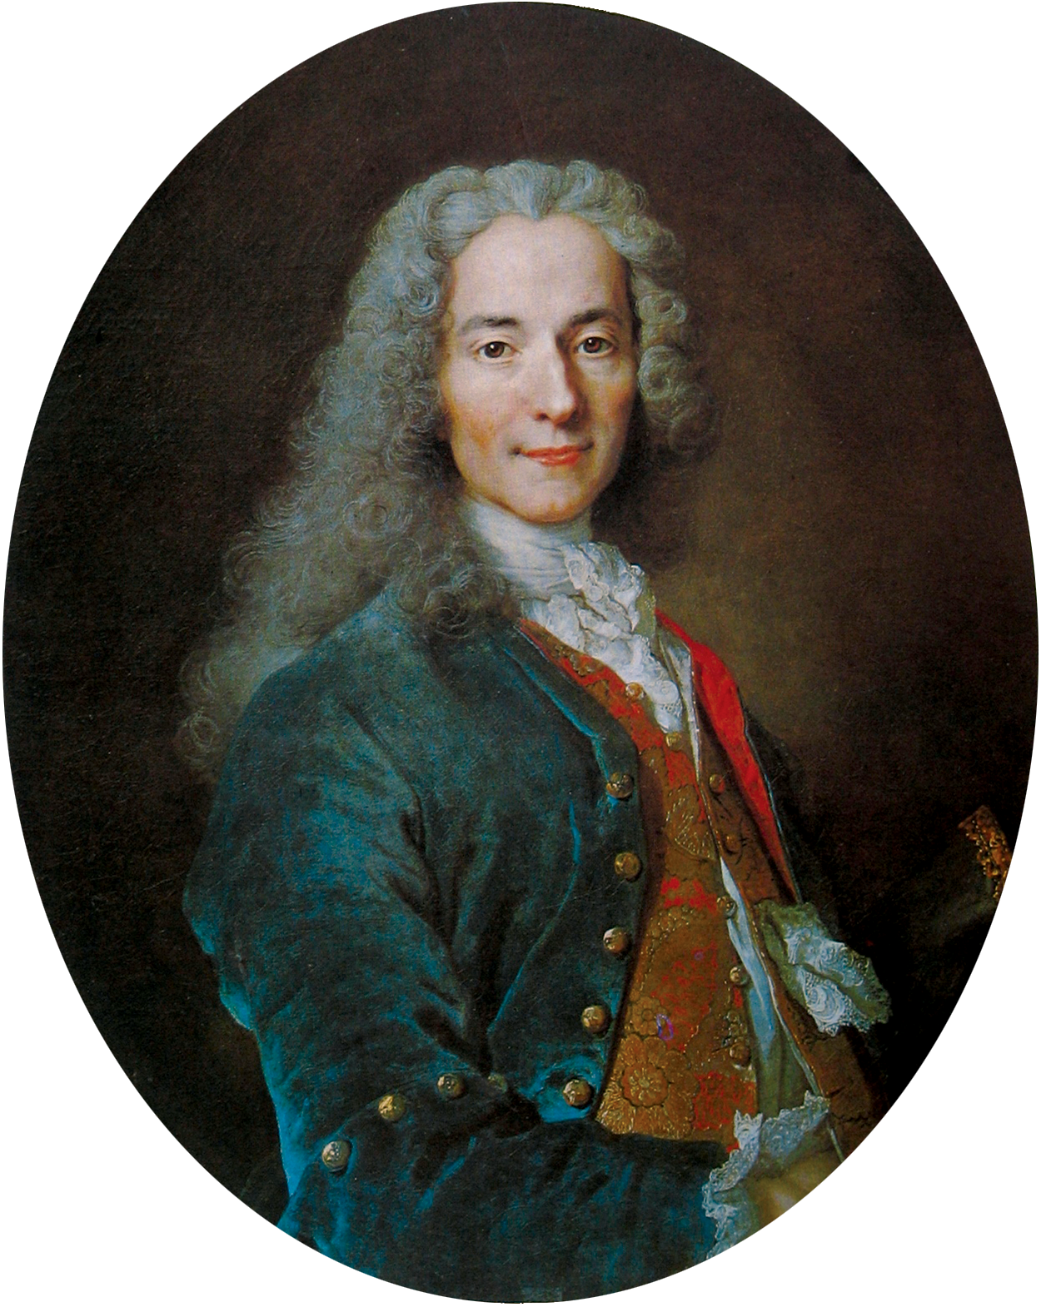
Voltaire
The idea of shared European customs and manners is found in the works of Voltaire (1694-1778) but also with ambiguities
prolific writer, historian, and philosopher
In The Century of Louis XIV (1751), Voltaire wrote that ‘Christian Europe’ can be viewed as a large commonwealth of different states. Some of them were monarchies. Others had a mixed system of government. But all of them were connected by Christianity and also by the same principles of civil law and politics. These are unknown in other parts of the world.
Despite wars and religious divisions, Europe has seen the rise of a Republic of Letters. The academies in the various states together form a European republic of artists and scholars

Slide 23
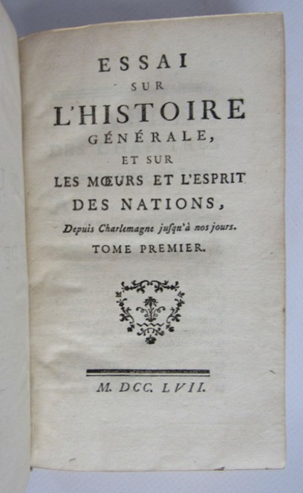
European spirit
1756 Voltaire published his Essay on the Customs and Spirit of the Nations. This is the first attempt to provide a general overview of the whole of human history up to the century of Louis XIV. Voltaire’s framework is the history of civilization
He did emphasise the achievements of non-Europeans – ancient Egypt and China as important, and development of science and scholarship had originated in East.
  Re Confucius (who lived 2300 years earlier): ‘The happiest and most respectable time ever on the earth was when his laws were followed’ - contrasting with the fanaticism and idolatry of the Pope
European development was much more recent and the process was still underway but it was now the most civilised continent
Voltaire believed that human nature is basically the same all over the world. For him, the differences between peoples depends on how much they have cultivated reason

Slide 24
Conclusion
‘Europe’ is a contested, imagined, plural space, the boundaries of which shifted over time and there were different ways in which it could be conceptualised
‘Europe’ is a cultural, political, religious and economic construct with an identity that changed over time but tended to become more frequently cited over the period we are studying
‘Europe’ was constructed in opposition to an ‘other’ (the identity of which could also change over time) and tended to acquire a sense of superiority over other parts of the world but European identity could be ambiguous and self-critical

