Slide 1
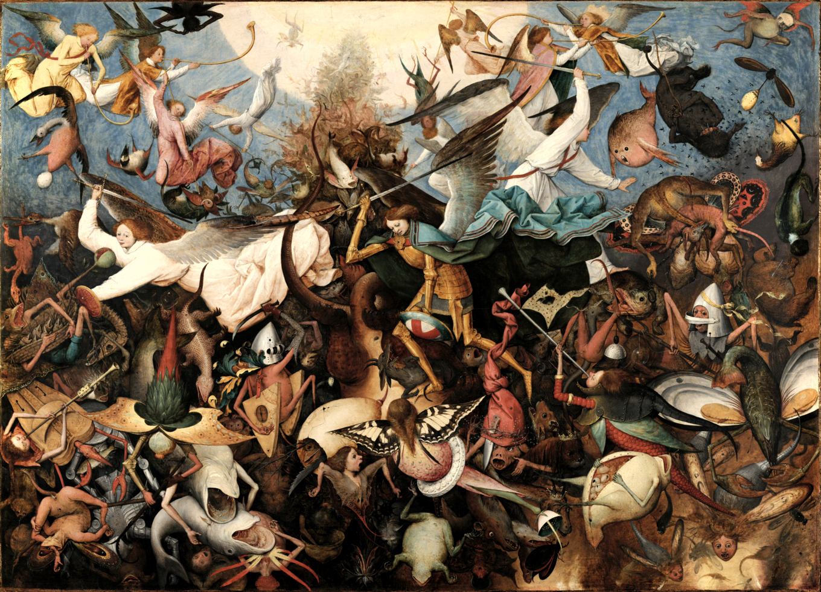
EUROPE IN THE MAKING 1450-1800
Introduction and Rationale
Peter Marshall

Slide 2
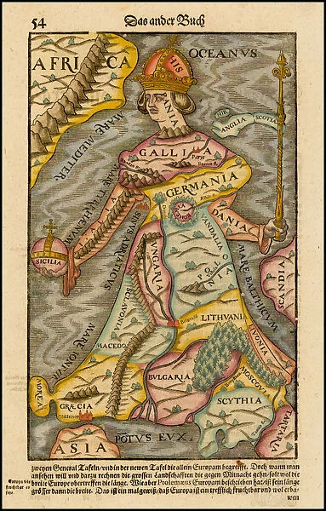
What is the module about?
Why c.1450-c.1800?
What themes will we cover?
Why ‘Europe in the Making’?
Practicalities
Sebastian Munster, Cosmographia, 1570

Slide 3

What is the module about, and why do we want you to take it?
A 30-CATS ‘core’ module; a team-taught survey
Europe 1450-1800: long period & lots of (unfamiliar?) themes!
How history is made: emphasis on primary sources and historiographical interpretations/debates
Why ‘Europe in the Making’, not ‘History of Europe’?
Problematising ‘Europe’ – not a given, but an ideologically imagined space; a moving target, changing over time
Europe something which can’t be studied in isolation, but as result of economic, cultural and religious encounters, exchanges and dialogues with other parts of the world

Slide 4
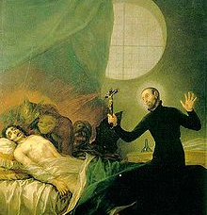
Why ‘early modernity’ is interesting
Period of change – yet also of continuity. How and why does change happen? Why don’t things change?
Taking the ‘long view’
Unfamiliar yet familiar – parts seem quite modern (state formation, war, science), but other parts don’t (witchcraft; intense religiosity). Historical imagination.
Good to think with – lots of different approaches to history, many of them generated by historians of this period eg material culture; global history; linguistic turn; microhistory.
Some of this is very contested terrain eg gender (when did ‘patriarchy’ end?!). Debate is important!

Slide 5
Why the term(and concept) ‘early modern’?
‘Periodisation’ – how historians divide up the past
Classical; medieval; ‘modern’
Medieval and Renaissance as constructs (‘Rinascita’ c.1550 by Vasari, but ‘Renaissance’ 1830s)
‘Early modern’: first used in 1869 lecture. The first text-book to use ‘early modern’ was G.N.Clark’s Early Modern Europe from about 1450 to about 1720 (1957) – not very sure!
Gained currency in the 1970s.
Eugene Rice, Foundations of Early Modern Europe 1460-1559 (1970); Peter Burke, Popular Culture in Early Modern Europe (1972) and Economy and Society in Early Modern Europe (1978); Natalie Zemon Davis, Society and Culture in Early Modern France (1975).
How useful? Jack A. Goldstone calls it ‘a wholly meaningless term’ and Randolph Starn refers to ‘the early modern muddle’
Periodisation a tool, not an end in itself

Slide 6
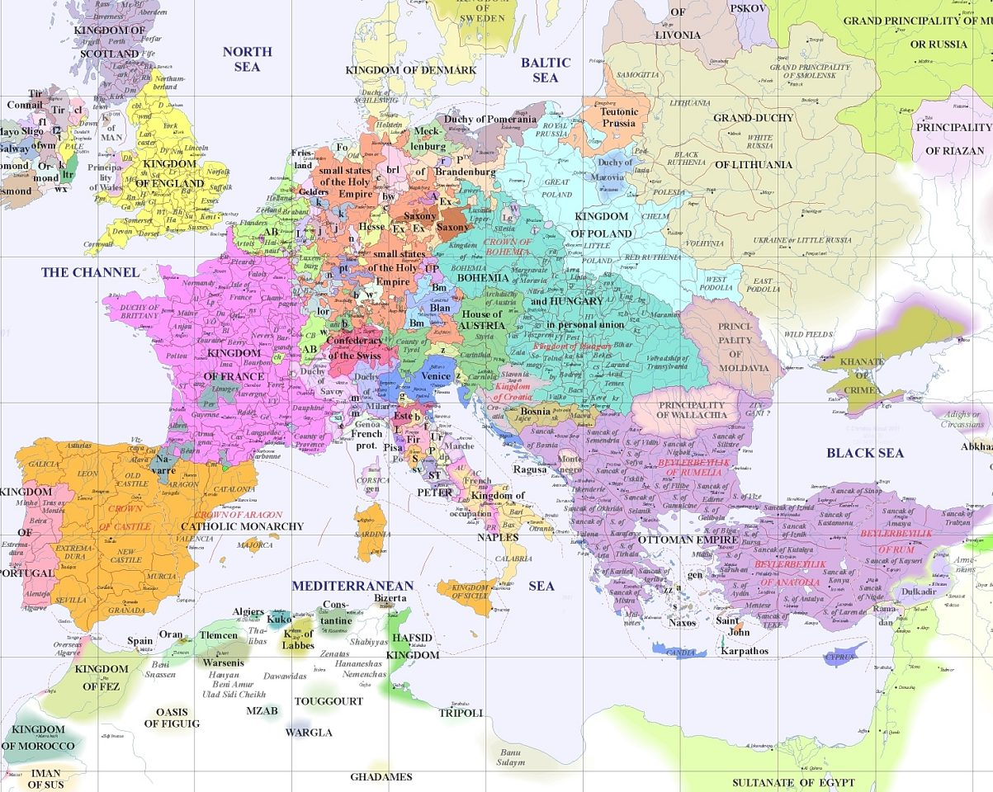
Notes:
The political topography of Europe c. 1500, including the familiar (England), less familiar (Holy Roman Empire) and unexpected (Ottoman Empire)
The village of Artigat in South-West France (setting for ‘Martin Guerre’)

Slide 7
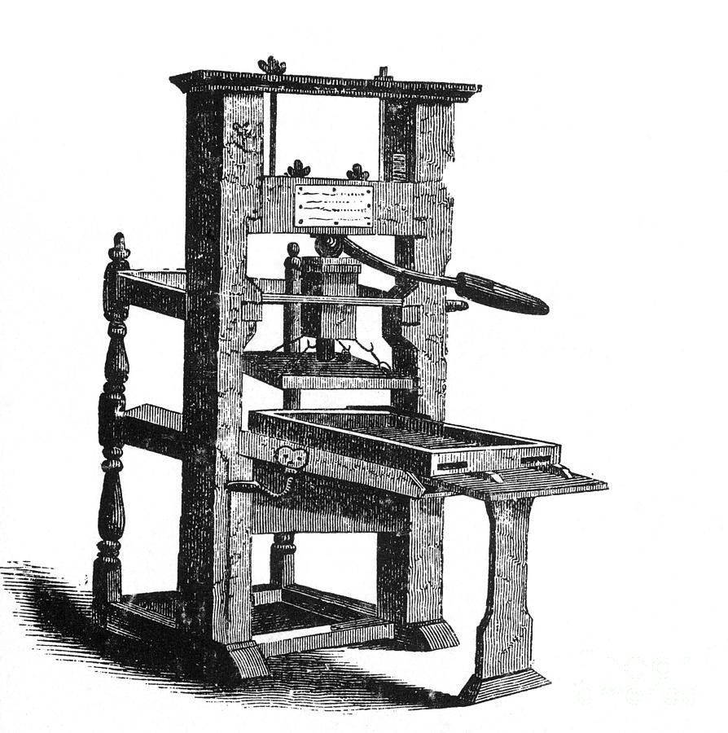
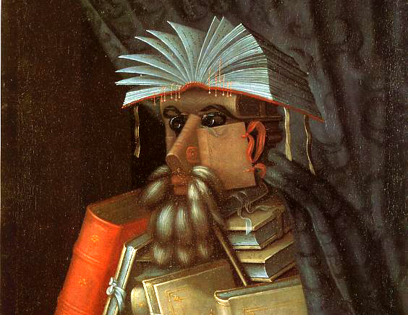
‘Early Modern’: Some dates and developments
1450 – Johannes Gutenberg printing press with moveable type; new possibilities for diffusion of knowledge and standardization of texts (and survival of texts)
Other technology eg telescope (1608); microscope (1590): ‘scientific revolution’?
1453 – Fall of Constantinople; Christian confrontation with Islamic ‘Other’
1492 – Fall of Granada and expulsion of Muslims from Spain; Columbus’s ‘discovery’ of America; economic, political and cultural implications of a more globally connected world; beginnings of transatlantic slave trade
1517 – Martin Luther’s challenge to the papacy; fragmentation of a unified ‘Christendom’ and era of new ideological conflict. Reformations. Leading eventually to pluralism and freedom of worship?

Slide 8
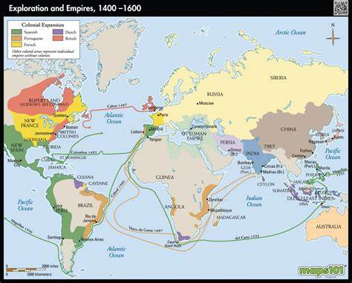
Themes that give some coherence –
Social change: a rising population that put pressure on resources
Economy: The emergence of Europe-centred networks of production and exchange; growing ‘consumer’ demand
Culture: a ‘long Renaissance’ that changed the nature and exchange of knowledge; moves from received knowledge towards experimentation; frictions between social disciplining and local customs (‘elite’ and ‘popular’ culture)
Politics: The emergence of a European state and imperial system; ever larger-scale warfare, state formation and a power shift away from the periphery towards the centre

Slide 9
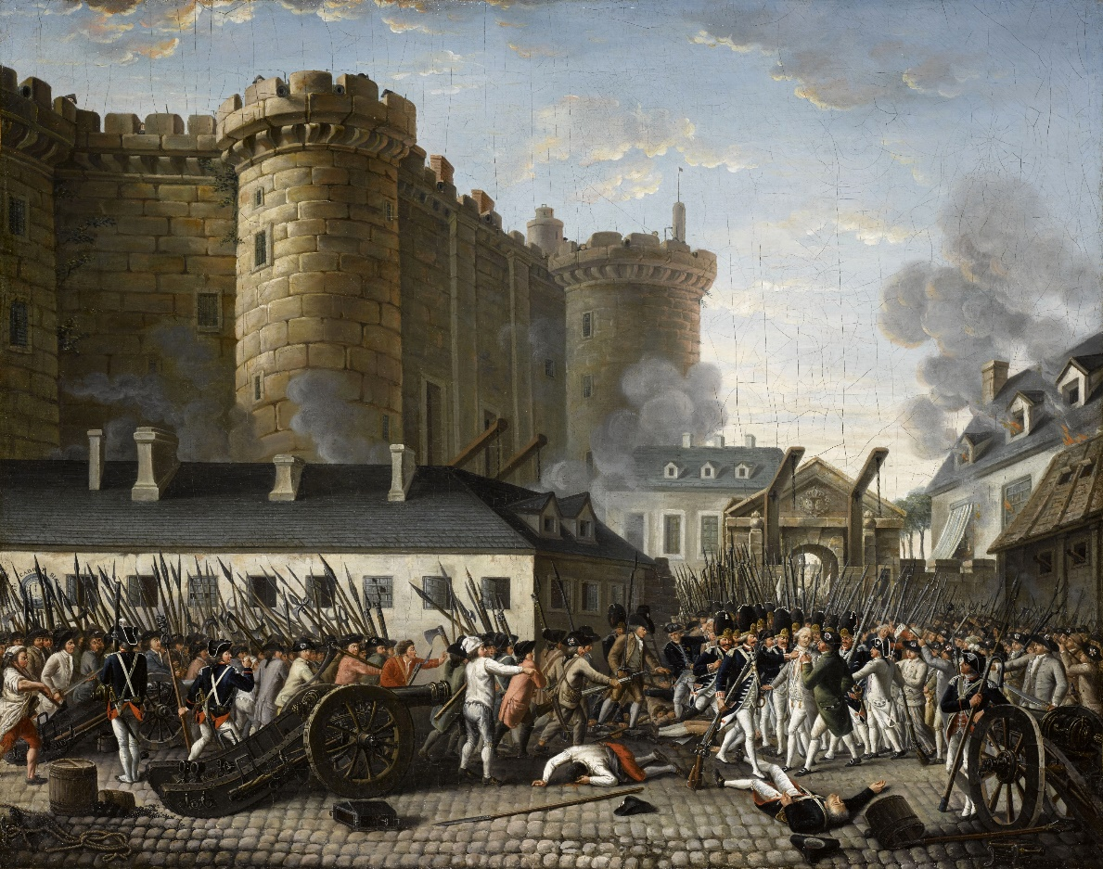
End points
Sense of turning points around end of 18th century: political Revolutions (1776 America; 1789 France); industrialisation and urbanisation on larger than ever scale – beginnings of ‘modernity’?
‘Enlightenment’
National variations - Russia did not abolish serfdom until 1861 and arguably remained pre-modern until 1917.
But also important to think about what does not change in ‘early modern’ period, or changes very slowly:
Basic life expectancy and conditions of material existence?
Social hierarchies of rank, age and gender?
Assessing balance of continuity and change the key historical challenge?
The storming of the Bastille

Slide 10

Practicalities
Europe in the Making 1450-1800 (HI113) (warwick.ac.uk)
Lectures
Seminar preparation
Come prepared for discussion!
Primary source; essential reading; additional reading
Assessment
Questions??

