Slide 1
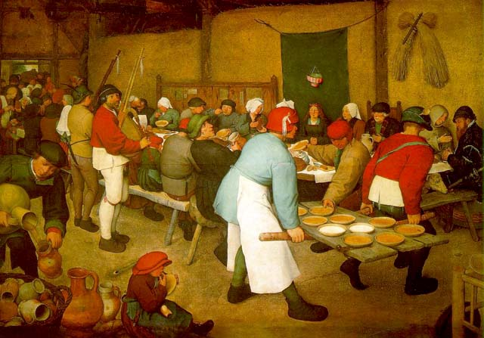
Popular Culture(s) Beat Kümin
Peter Breugel,
‘Peasant Wedding’ (1568)
Week 14 Lecture
EUROPE IN THE MAKING

Slide 2
OUTLINE
Prelude
1. Definition and sources
2. Scholarly approaches
3. Features, meanings & shifts

Slide 3
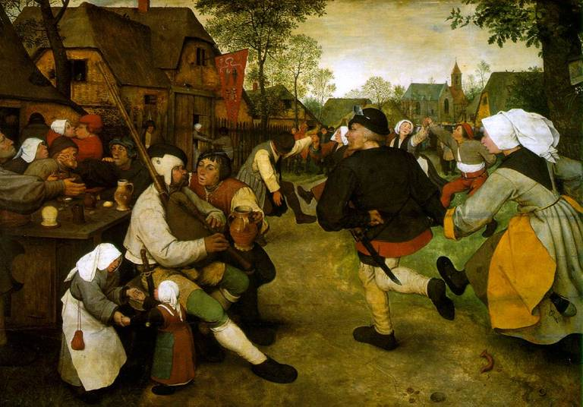
Prelude A complex phenomenon reflected in multiple sources
Visual
Evidence
Pieter Bruegel, ‘The Peasant Dance’ (1568) Kunsthistorisches Museum, Vienna

Slide 4
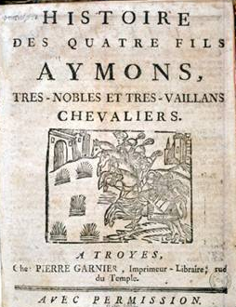
The Hybridity of Print Media Title page of a knights’ tale Bibliothèque bleue (1726) Adam Fox on interaction oral / literate culture

Slide 5
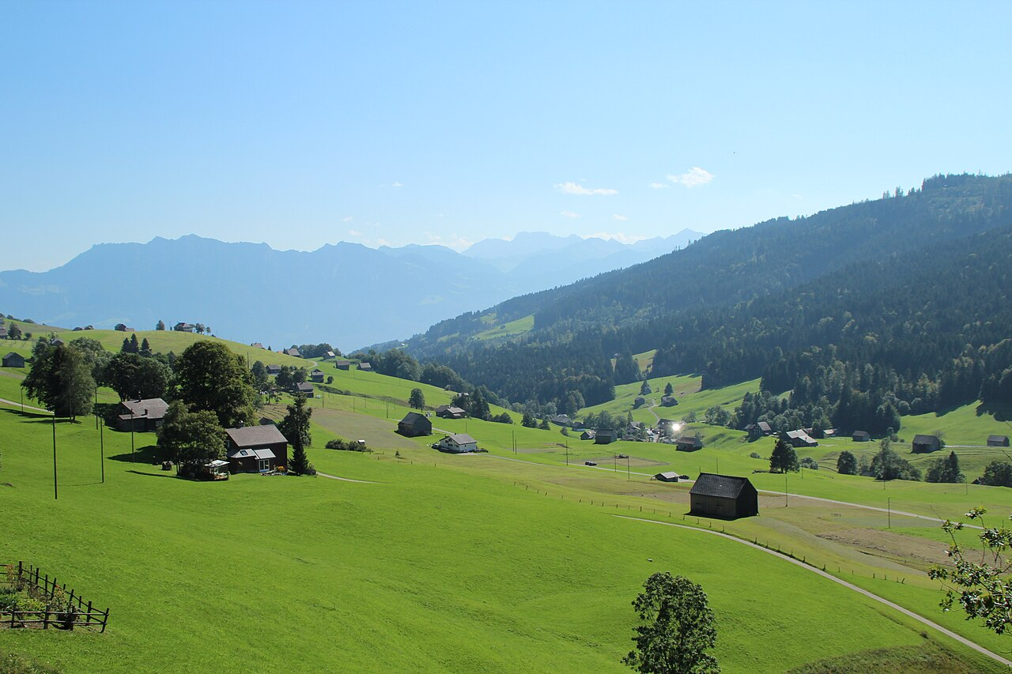
[Our hamlet contained] only two houses. … My grandmother and the woman next door were sisters, devout old ladies whom other godly women from the area often visited. There were many pious people, then. … Their teacher was a tall man who lived off a little spinning and alms. … My grandmother often took me along to their meetings. I cannot remember what exactly went on, only that I got incredibly bored. I had to sit quietly or even kneel. … Now and then, however, my grandfather snatched me away up the mountain to where our cows were grazing. Here he showed me different kinds of birds, beetles and worms, while he cleaned the fields. … I cannot remember whether other boys attended, but do recall some adolescent girls playing with me.
Memories of growing up in the
Alpine valley of Toggenburg during the 1740s, taken from the diary of small trader Ulrich Bräker (1789)
Manuscripts
‘Ego’ Documents

Slide 6
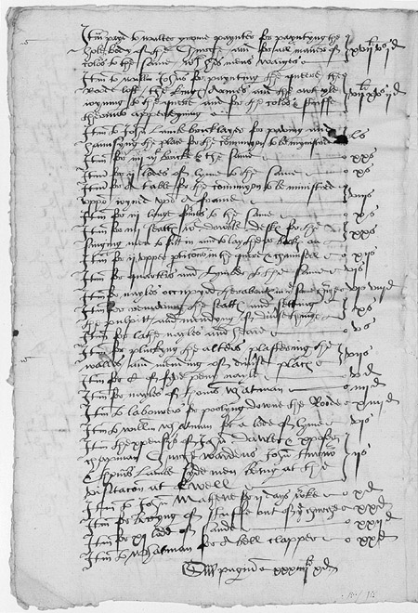
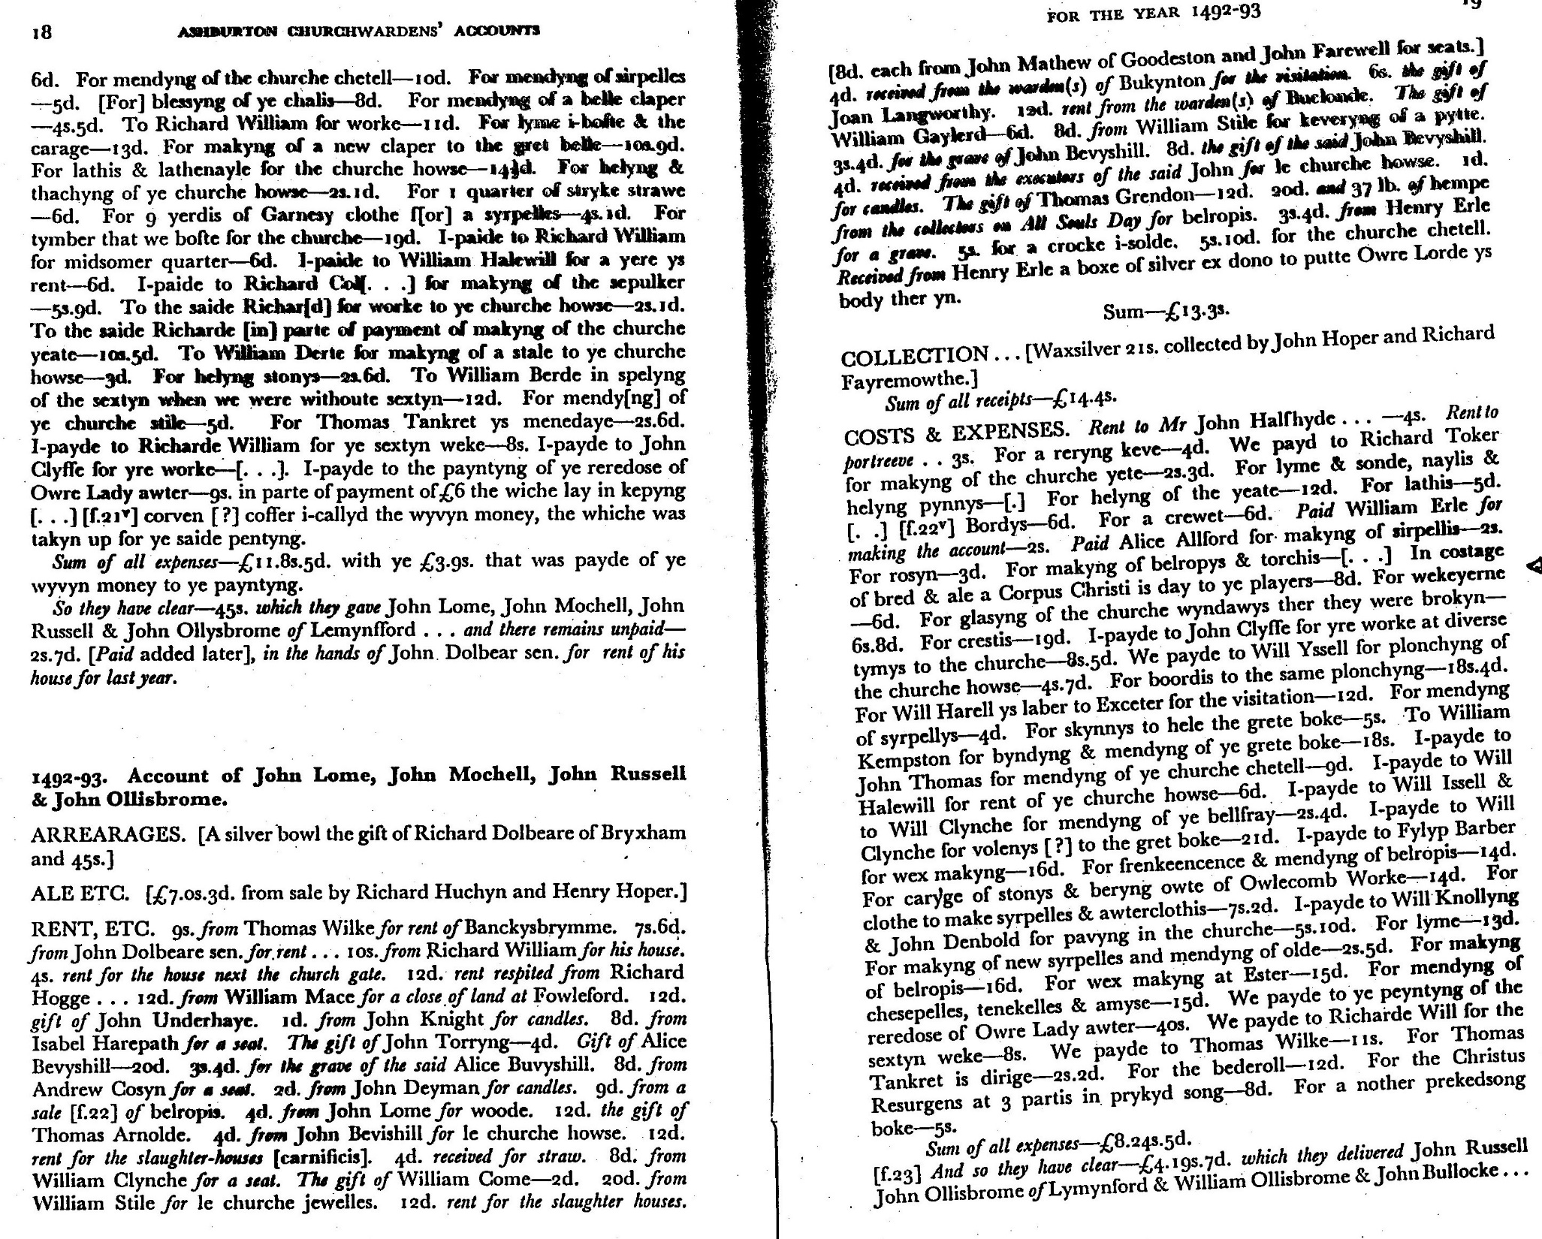
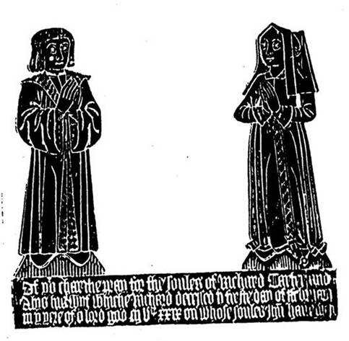
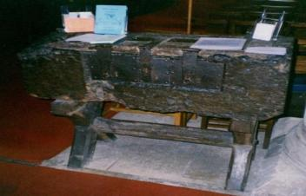
Administrative
Records
Left:
Churchwardens’ Accounts of St. Mary’s Church, Bletchingly, Surrey, 1546-1552 Folger Institute, Washington
Bottom & right:
Churchwardens’ Accounts of Ashburton, Devon, ed. A. Hanham (1970)
Richard Carter, churchwarden of Bramley (Hants, 1529)
People
CWA
Churchwardens’ accounts
of Bletchingly (Surrey, 1550)
Parish chest of Bishops Cleeve
(Glocs, 15thC)

Slide 7
1. Definitions and sources
‘Culture’, ‘popular culture’, ‘elite culture’
Mainly local, informal, oral, with wide appeal
Insights via (often indirect / mediated) legal, administrative, literary & visual sources – multimedia woodcuts, ballads

Slide 8
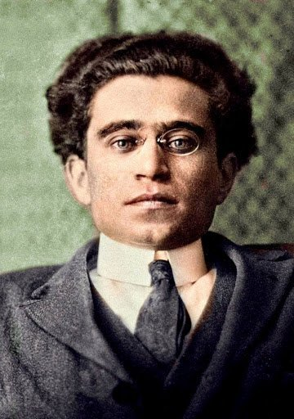

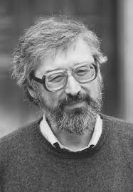
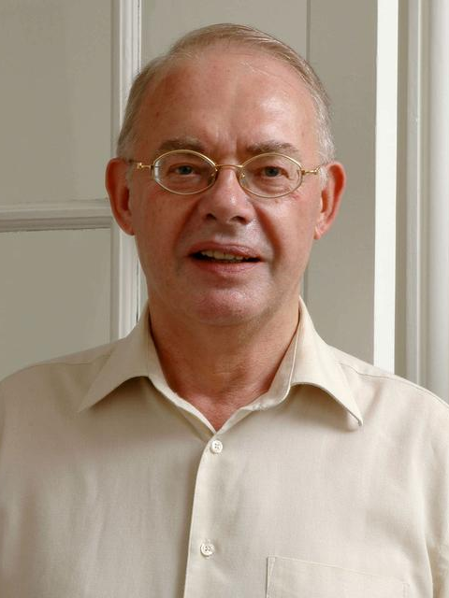
2. Scholarly Approaches
Struggle for ‘hegemony’ (Antonio Gramsci)
Anthropological perspectives (N. Z. Davis) – gender, rituals, mentalities
(Pre-)Reformation popular religion (R. W. Scribner) – sacramentals, shifts in visual communication, negotiation of reform process
Elite ‘acculturation’ attempts (Robert Muchembled)
Guidance in Capp & Scribner essays on seminar reading!

Slide 9
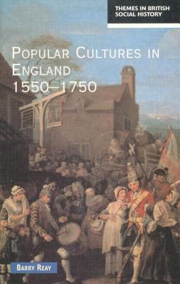
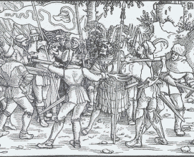
The state of play (Reay)
Peasants confront a nobleman (woodcut, 1519)

Slide 10
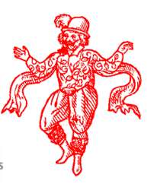
3. Features, meanings & shifts
Participants & occasions
Variables
Sites of exchange
Records of Early English Drama

Slide 11
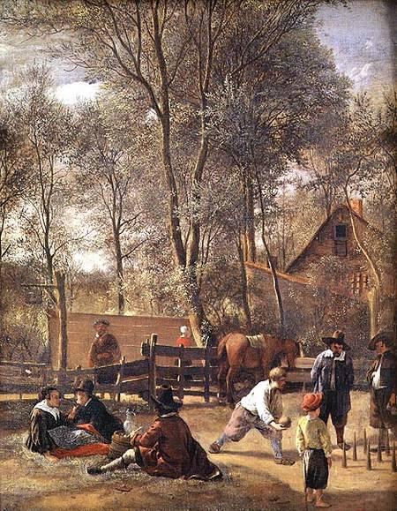
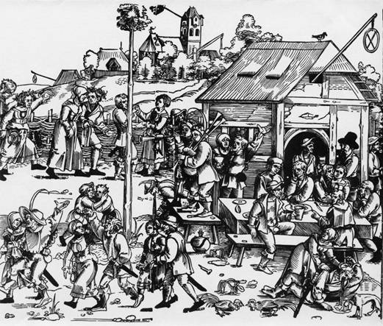
Public Houses
Barthel Beham, ‘Kermis’ (woodcut, c. 1530)
Jan Steen, ‘Skittle players outside an inn’
(oil painting, c. 1660)

Slide 12
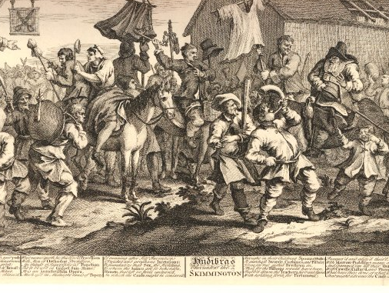
Ambivalent messages -
‘Conservative’ or ‘Progressive’ ?
Hudibras encounters the Skimmington (engraving, 1726). British Museum

Slide 13
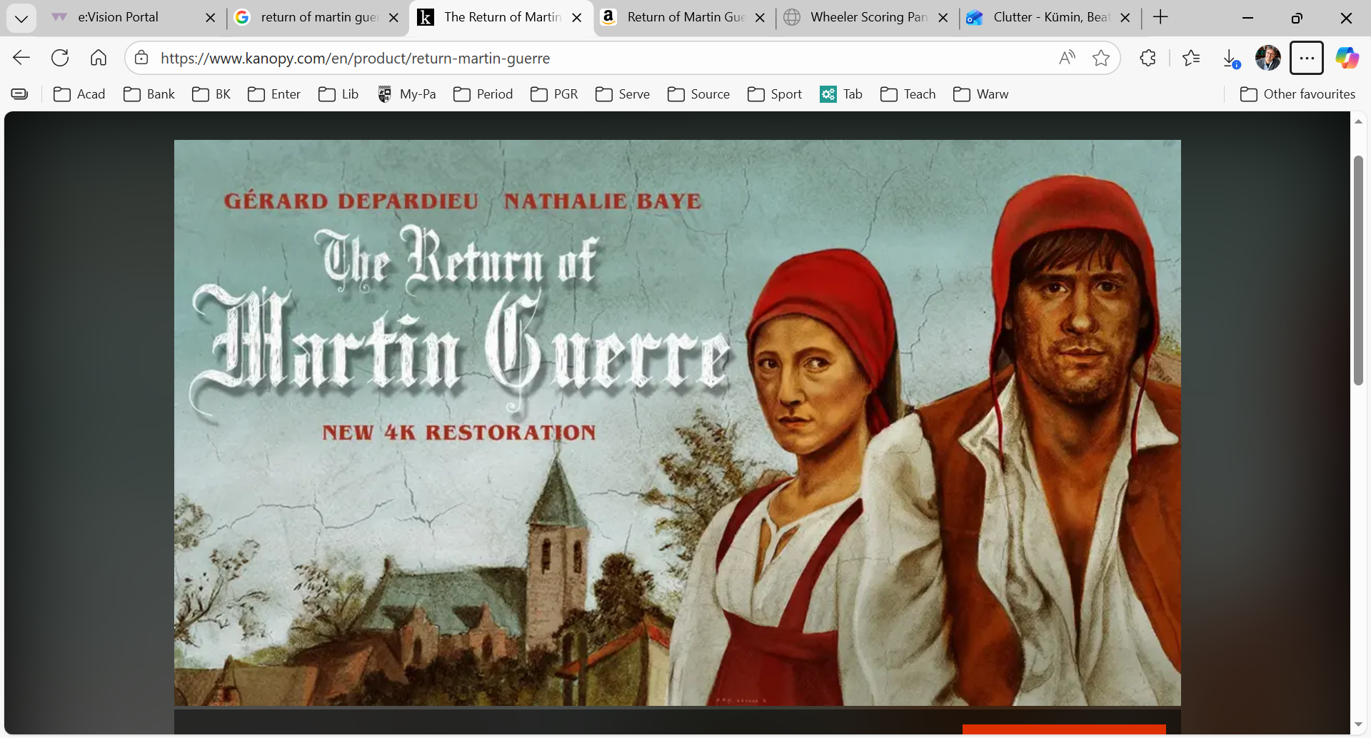
An artistic re-imagination of a shaming ritual known as ‘charivari‘ Clip from a film by Daniel Vigne (1982) based on research by Natalie Z. Davis

Slide 14
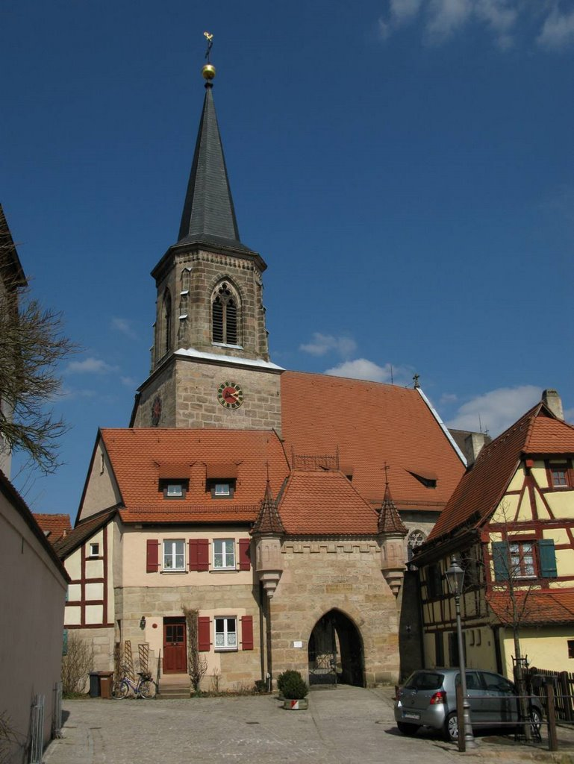
Popular religious assertion in the run-up to the German Peasants’ War
St George church,
Wendelstein
(Franconia)
In 1524 the parishioners of a village in central Germany drew up a manifesto projecting a notion of a communal Reformation. The source, known as the Wendelstein Church Ordinance, was read aloud to a new pastor the day he arrived to take up office. It specifies that: ‘we will not accept you as a lord, but merely a servant of the community’! They then – just like Luther - justify their claims and demands with Scripture, e.g. that his main duties will be to preach ‘the Gospel …. pure and clear, … untainted by human teachings; to lead a Christian life, to have the tithe, but no extra fees; and – crucially - should [you] neglect any of these duties, then we would dismiss you.’
‘German History in Documents and Images’
St George church, Wendelstein

Slide 15
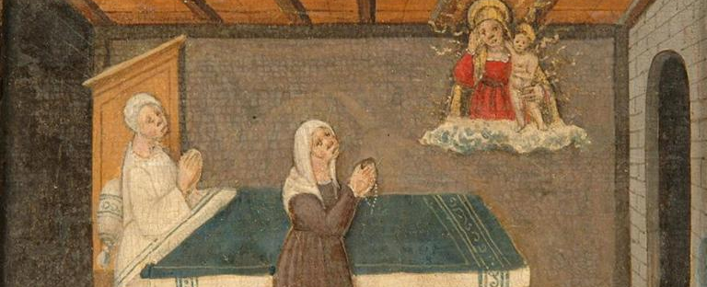
Spiritual influences: ‘Pagan’, ‘Christian’, idiosyncratic ?
Woman with a
rosary supplicates
the Madonna of
Lonigo on behalf
of a sick woman
(Italian votive painting, 1510)
Ronald Hutton, Merry England

Slide 16
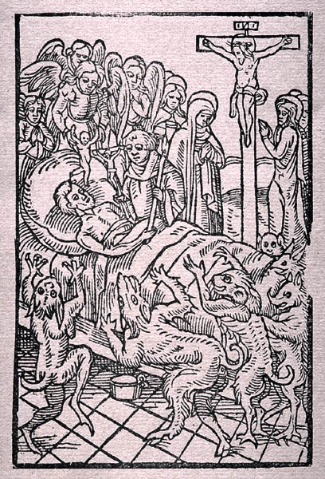
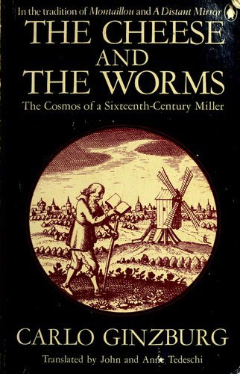
Ars Moriendi early 16thC woodcut

Slide 17
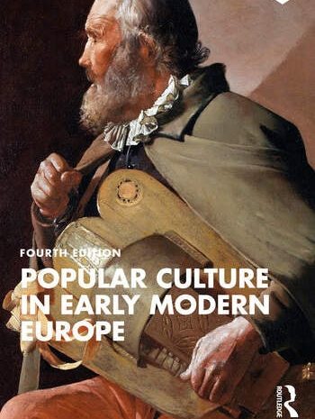
Post-Reformation Dynamics
Peter Burke for Europe: ‘great’ vs ‘little’ tradition, ‘Triumph of Lent’ over ‘Carnival’
Keith Wrightson for England: ‘Alehouses, order and Reformation in rural England’

Slide 18
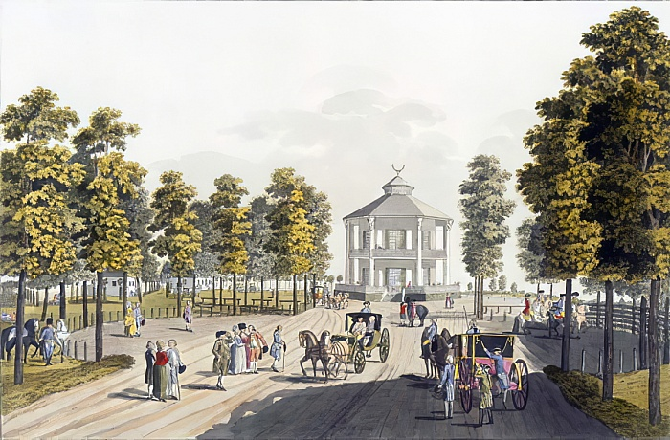
From every quartier of the city, and here and there soldiers
on Sundays and holy-days, there a procession and their fishwives
of decent folk from every trade, who, with no fear of the devil,
cobblers, tailors, wig-makers, turn their backs on the sermons
fish-wives and patching women, and gallop off to the pleasure-gardens
vegetable-peelers and laundry-maids, where the cheap wine is drunk …
serving-girls, lackeys and scrubbers,
dandies from the harbour or porters, Anonymous Parisian
poem (1773)
Longer-Term Shifts
The Lusthaus (pleasure pavilion, 1781)
in the Prater ‘leisure’ park of Vienna

Slide 19
Assessment
Problems of distance, sources, definitions
‘Conservative’ values with at times ‘revolutionary’ edge
Oral, musical, material & ritual media alongside print
Much evolution, oscillation and cross-fertilization, with top-down as well as bottom-up exchanges

