Slide 1
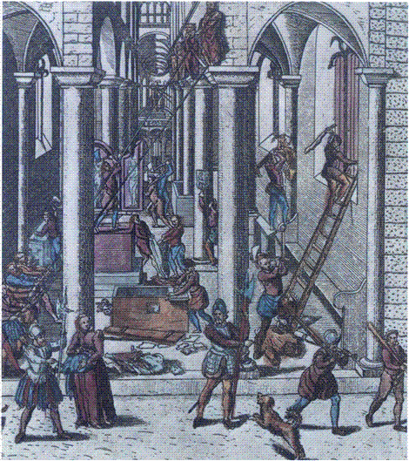
THE IMPACT
OF REFORMATION
Europe in the Making
Spring Term, Week 2
Prof. Beat Kümin
Iconoclasm at Ghent (1566)

Slide 2
Themes and questions
Why and how did Protestantism become divided?
What were the key features of the Swiss ‘Reformed’?
Why was Calvinism able to spread internationally?
Should the Reformation be judged a failure?
Lecture structure
Tensions among early Lutherans
The Swiss Reformation (in Zurich & later Geneva)
Wider long-term implications

Slide 3
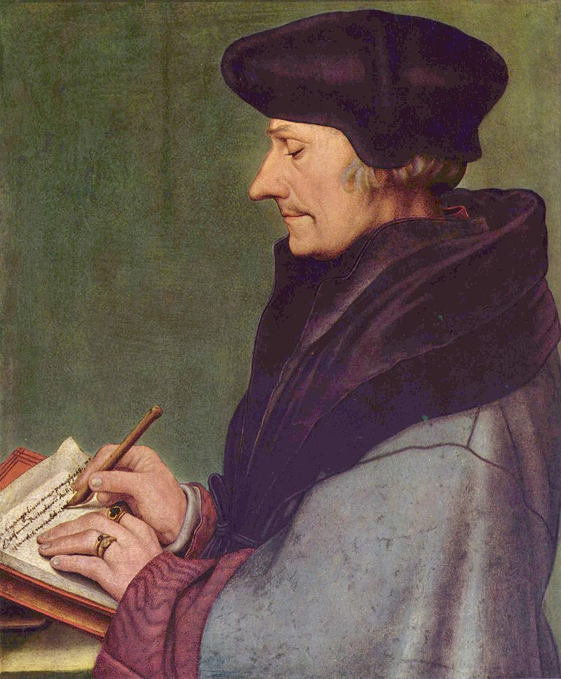
1. Tensions in the early
Reformation
Break with some Humanists
  Erasmus (over free will)
Wittenberg Disagreements
  Emergence of more radical theologians

Slide 4
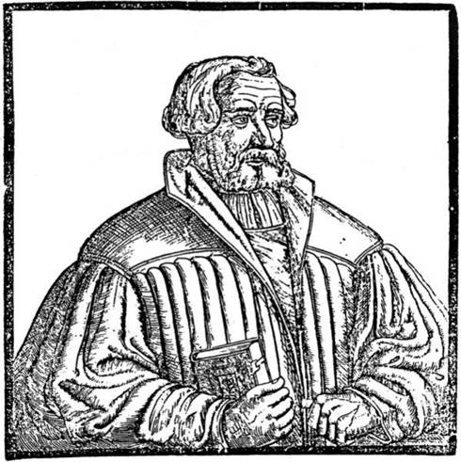
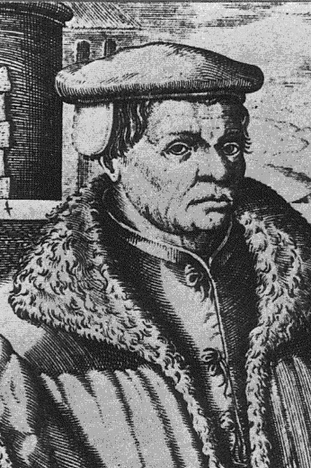
Andreas Karlstadt
(left, d. 1541)
Thomas
Müntzer
(d. 1525)
Posthumous engravings

Slide 5
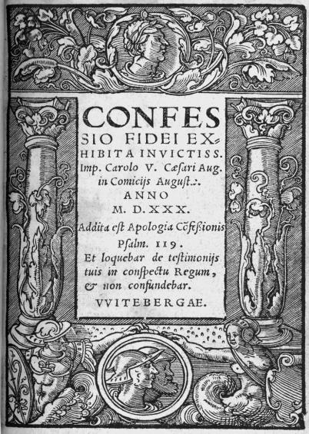
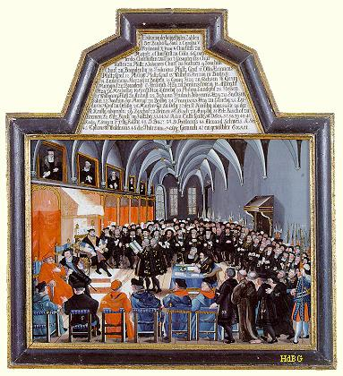
Confession of Augsburg (1530)
Title Page
Presentation to Emperor
at Diet of Augsburg (1530)

Slide 6
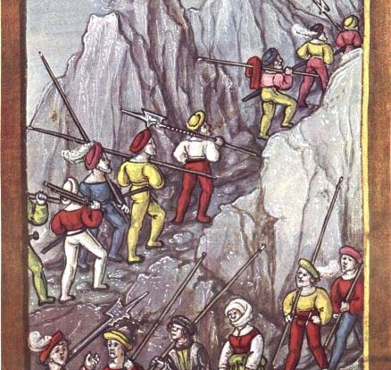
2. The Swiss
Reformation
Distinct socio-
political context
  Alliance of urban &
  rural republics
  Weak Church
  hierarchy
  Inner tensions
  (mercenary trade)
Pikemen
crossing
the Alps.
Illustrated
chronicle
(1513)

Slide 7
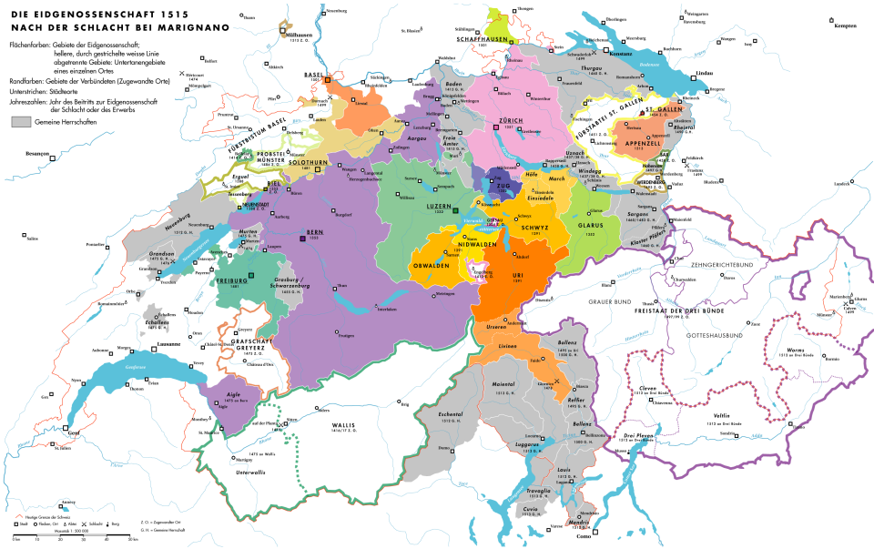
The Confederation
(c. 1515)
Full members (filled in)
Associates (boundaries)
Condominions (grey)
Catholic heartlands
Reformed cities

Slide 8
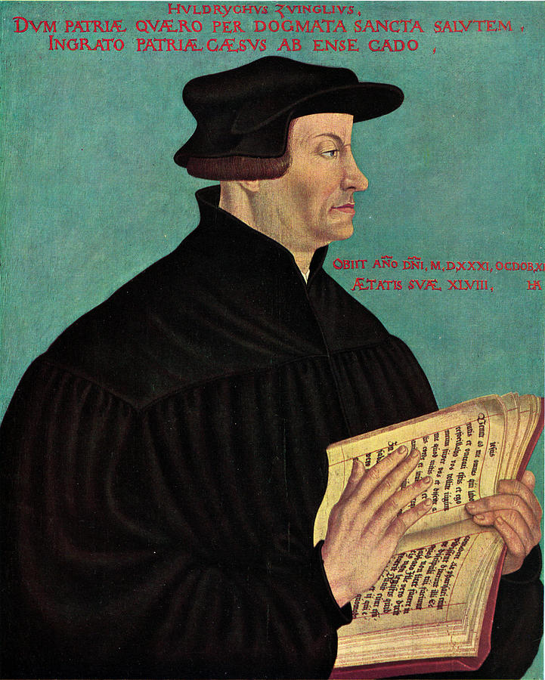
Huldrych Zwingli
(d. 1531)
Reformer of Zurich
Portrait by
Hans Asper (1549)

Slide 9
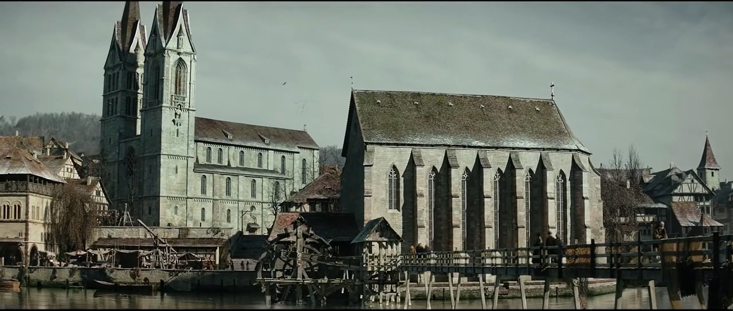
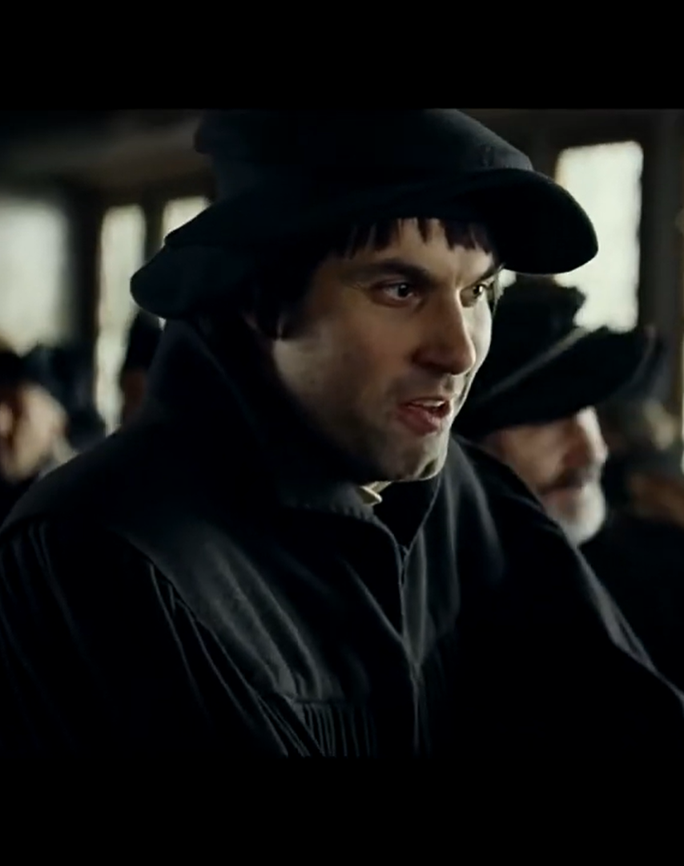
Trailer for ‘Zwingli’
feature film (2019)
Regeneration of Zurich
Bible as a code of conduct
Zwingli and Erasmus

Slide 10

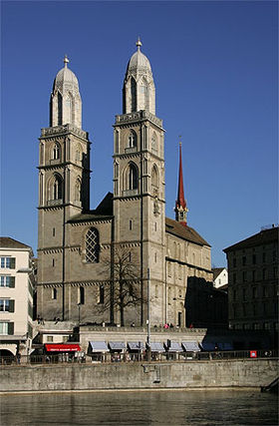
‘Affair of the Sausages’
(1522)
‘I began to preach the gospel of Christ ...
Before anyone in our region had ever
heard of Luther’
Lay council decides on right religion
Zurich’s Great Minster
(Preaching & 1523 disputation)

Slide 11
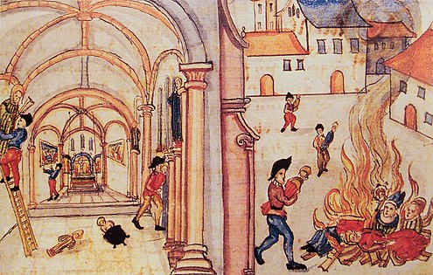
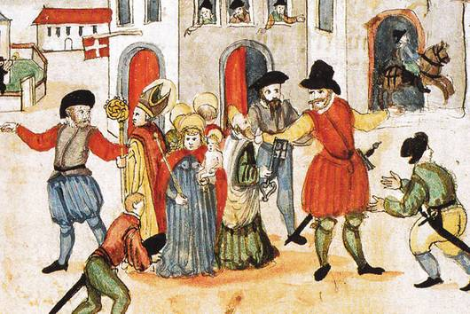
Religious Regeneration
of society as a whole
Key differences
from Lutheranism:
Even more biblicist (no tolerance
for things that could not be proved by Scripture)
Desire to purify church more thoroughly: hostility to images; no vestments for clergy;
stop church music
Greater emphasis on moral cleansing of community than subtleties of justification
Iconoclasm (1524) - Bullinger’s Reformation Chronicle
→ a degree of international influence: MacCulloch

Slide 12

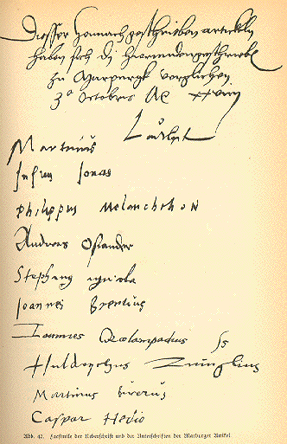
Marburg Articles
1529
Signed by the leading reformers
Some common ground but key inability to agree on meaning of Jesus’ words: ‘This is my body’
(Transubstantiation vs Consubstantiation vs spiritual presence)

Slide 13
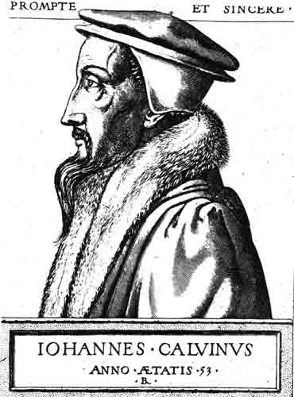
‘Second’
Reformation:
Jean Calvin
(d. 1564)
Transforms Geneva into a kind of
‘Protestant Rome’
17thC engraving

Slide 14
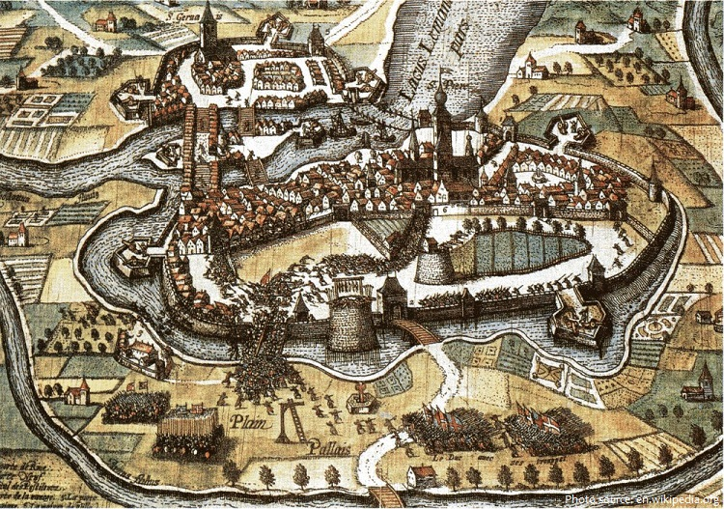
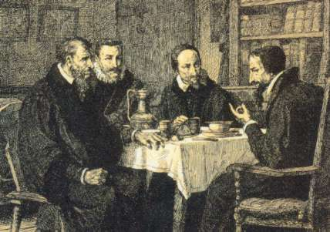
Farel, Beza, (Pierre)
Viret (d. 1571) and Calvin
19thC impression
Evolution of
a systematic
Theology
Institutes of the Christian Religion (1536)
Ecclesiastical Ordinances (1541)
Porspect of Geneva
Four-part ministry
Pastors (preach and give sacraments)
Teachers (teach doctrine/scriptures)
Elders (administer discipline)
Deacons (poor relief)
Double predestination
Total depravity, unconditional election,
limited atonement, irresistible grace,
perseverance of the elect

Slide 15
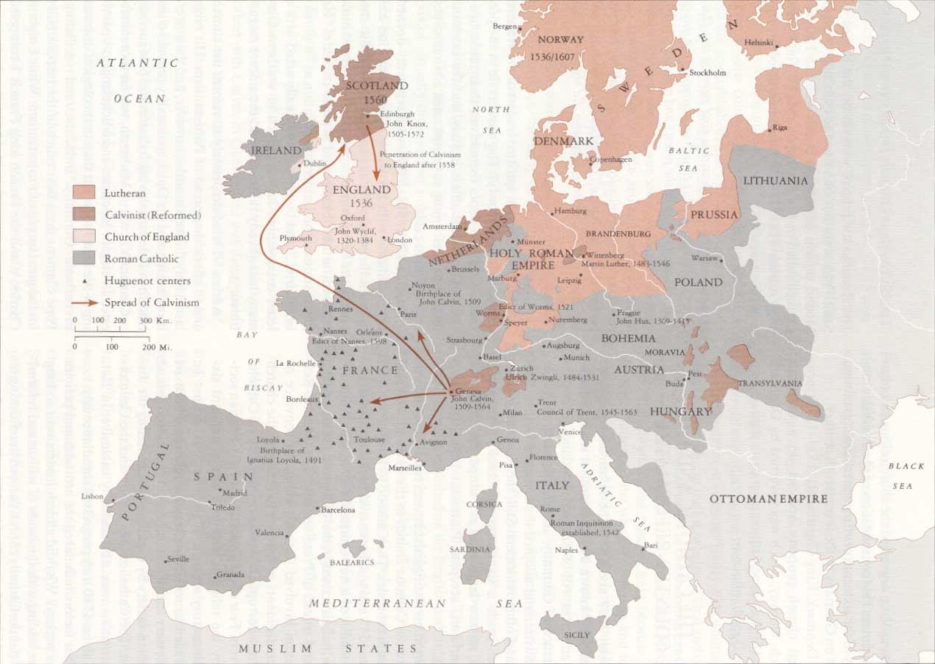
Calvinism’s spread in later 16th century
International Calvinism
Spread to France, Netherlands, British Isles, Holy Roman Empire (conversion of e.g. Brandenburg elector) & Eastern Europe (Lutheranism too ‘German’)
Flexibility: Elizabethan Church of England had Calvinist theology and Catholic-style bishops
A creed for rebels?
Association with political revolt in France, Netherlands & Scotland
Underground & stranger churches
Persecution a sign of election (Calvin rejects outward conformity ‘Nicodemism’)
On the other hand, big emphasis on asceticism, discipline, living a godly life

Slide 16
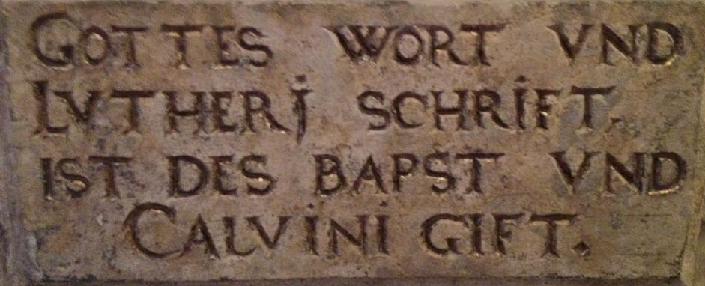
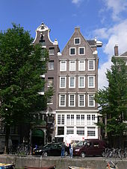
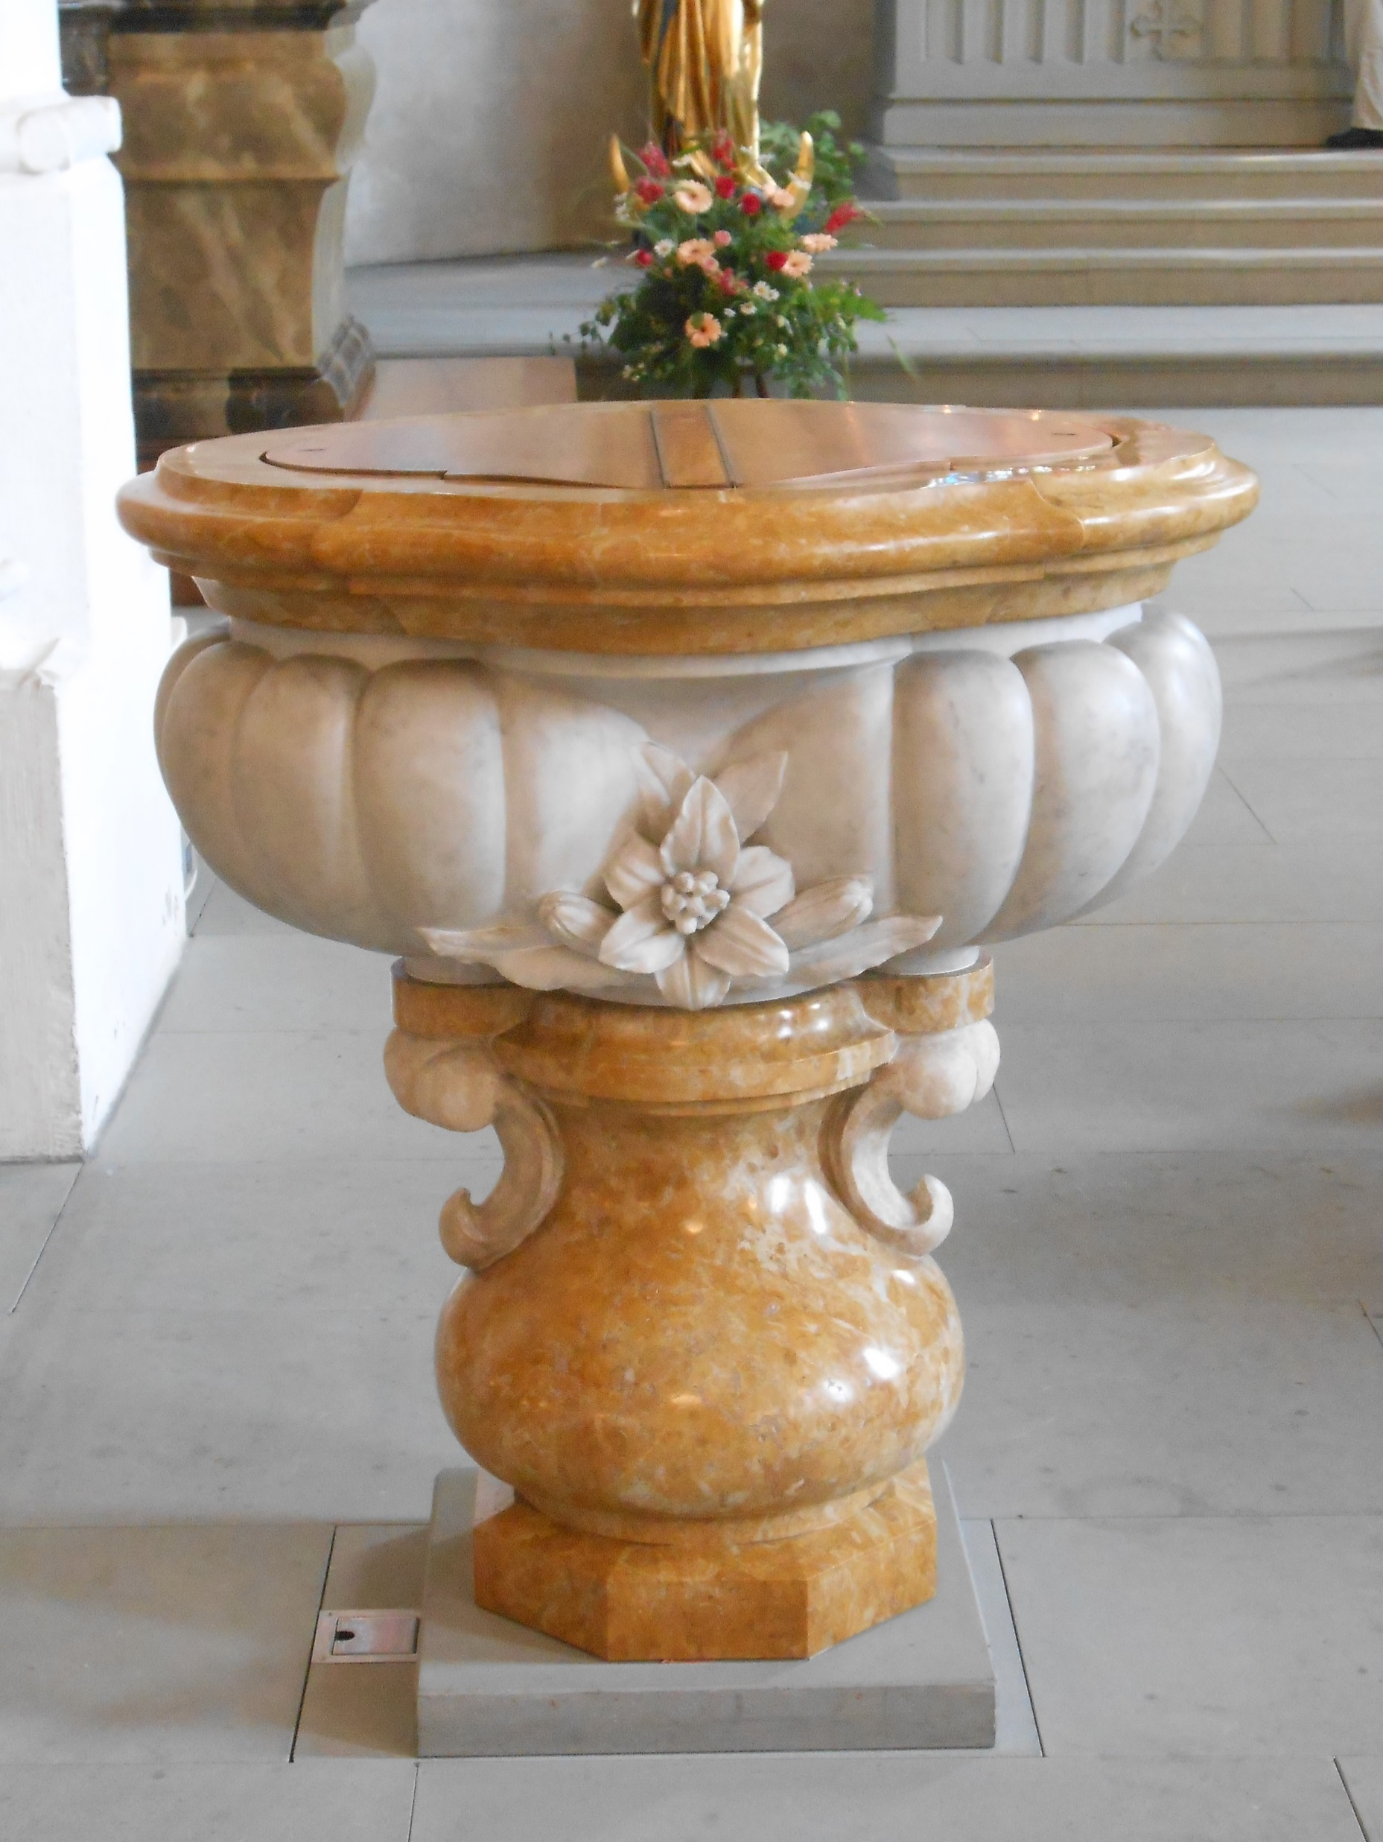
Living with Difference
Few confessionally ‘pure’ states (Lutheran Scandinavia; Catholic Spain) & growth of
pluralism (Lutherans, Calvinists, Catholics
mixed across Holy Roman Empire; Protestant Huguenots in Catholic France; Catholics in Netherlands, Protestant minority in Ireland) – much hostility and identity-formation through confessional demarcation: predestination more important to Calvinists because Lutherans attack it
→ In the Holy Roman Empire, you could cross borders to attend alternative services (‘Auslauf’); there were shared churches (‘Simultankirchen’);
over time, a gradual acceptance of diversity: trials & executions for heresy decrease after 1600, pragmatic co-existence on the ground; more active choice in highly diverse Poland-Lithuania.
→ emergence of informal, if often grudging co-
existence (Dutch Republic), but long
road to toleration
‘God’s Word and Luther’s writings are poison to the pope & Calvin’: inscription in early modern Wittenberg
‘Our Lord in the Attic’: A discrete
Catholic church in 17thC Amsterdam
At St Albin, Ermatingen
(Thurgovia),
church & font
are still shared
by Zwinglians (left) & Catholics (right)

Slide 17
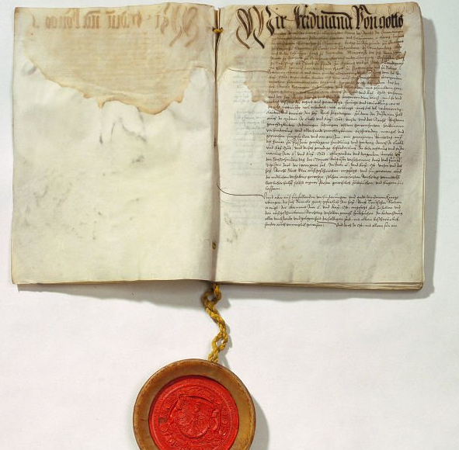
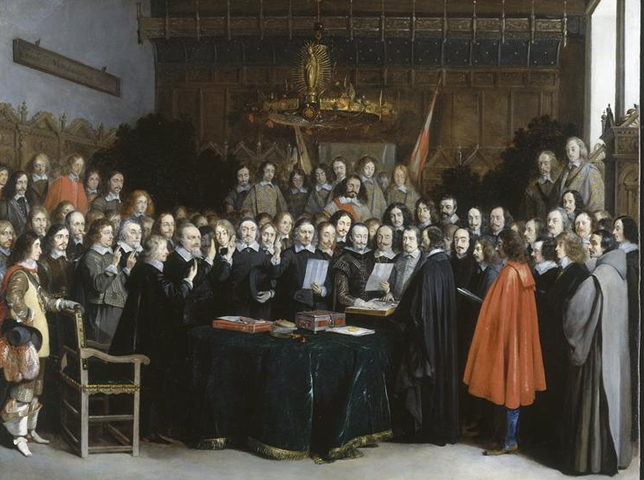
Towards Co-Existence
Peace of Kappel 1531, earliest example of a settlement accepting 2 confessions (among Swiss Confederates; shared lordships got to vote on their religion!)
Peace of Augsburg 1555, ended war between Catholic Charles V + Lutheran Princes with principle of cuius regio, eius religio (‘your prince, your religion’)
Edict of Nantes 1598 put (temporary) stop to religious conflicts in France & granted rights to worship for French Huguenots
Peace of Westphalia (Treaties of Münster and Osnabrück) 1648 marked end of Thirty Years War: reinstated Peace of Augsburg and extended legal recognition to Calvinism; brought independence to Dutch Republic / Swiss Confederation & limited rights for minorities to practice faith privately
(NB: late 17th and 18th century warfare in Europe became less obviously confessional: e.g. Protestant Britain allied with Catholic Austria vs Louis XIV’s France)
Peace of Augsburg
(1555)
Ratification of
Treaty of Münster
(1648)

Slide 18
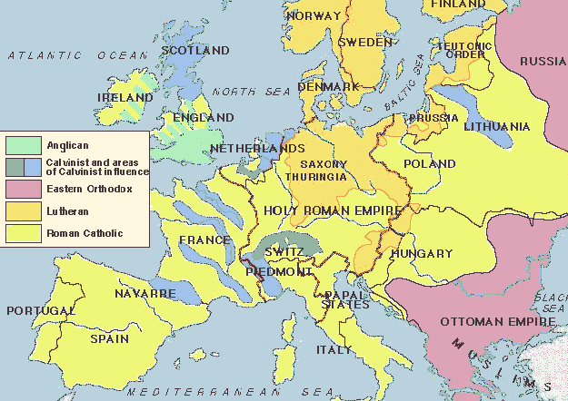
Europe c. 1600

Slide 19
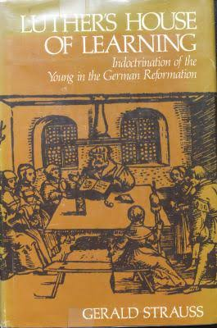
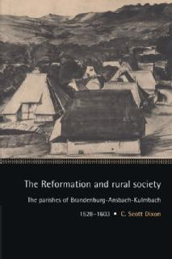
Was the Reformation a Failure?
Counter-/Catholic Reformation proved effective
Some reformers despaired about the chances to teach ordinary people complex doctrines: in 1566, Johann Aurifaber stated that Luther’s views ‘are now everywhere despised’
Gerald Strauss, Luther’s House of Learning (1978) highlights that Saxon church ‘visitors’ encountered ignorance, absence from church, work on Sundays; places where no single person even knew the Ten Commandments
Consistory records from across Europe show continuing ‘superstition’, belief in magic /ghosts
YET Catholicism could be overthrown in many places; commoners accepted changes selectively (e.g. better clergy education, greater access to Word
of God) but not attacks on local festive culture → good case for a negotiated (Scott Dixon), heterogeneous & partly successful
Reformation.

Slide 20
ASSESSMENT
Access to the ‘pure’ Gospel breeds disunity:
a case of unintended consequences
Europe faced with plurality of ‘Catholic’,
‘Lutheran’, ‘Reformed’ & radical identities
Gradual acceptance of co-existence
Reformation or Reformations?

