Slide 1

Europe in the Making HI113
Guidance on Assessment 3
Peter Marshall

Slide 2

The Research Project
40% of module mark – due Wednesday of week 5, term 3
3000 words
The following are included in the word count:
  Main text of the assignment, including quotations
  Subtitles or chapter titles in the text (these are optional)
The following are not included in the word count:
  Assignment Title
  Footnotes
  Bibliography
  Appendix
Builds on skills that you have already been developing in class and which you will need for the second-year modules (including a project) and final year dissertation

Slide 3
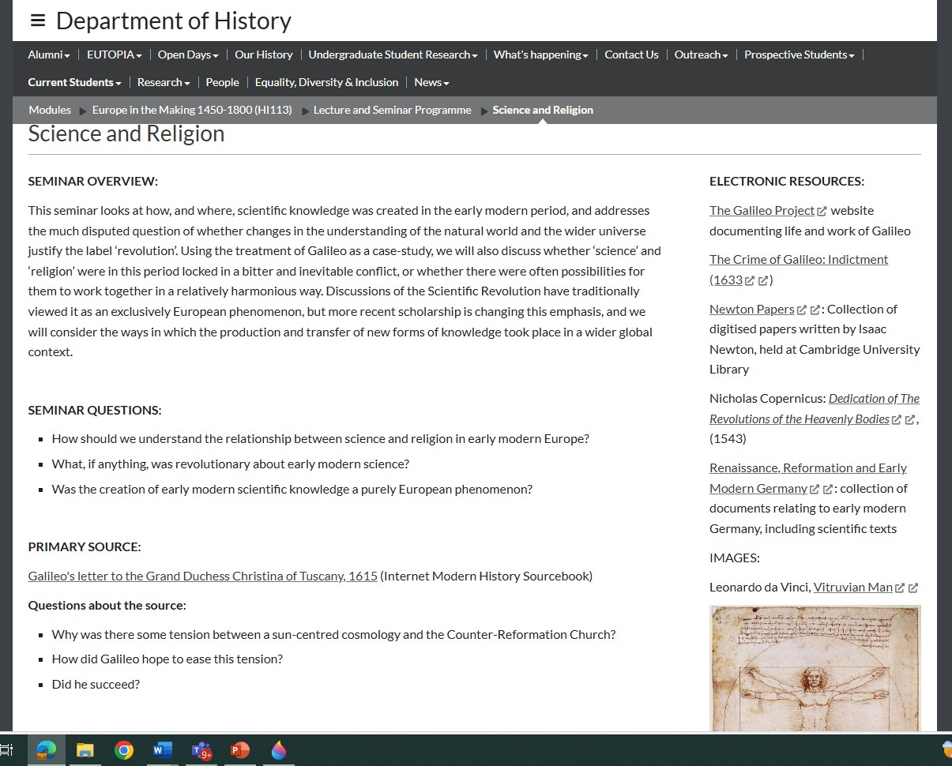
Focused on Primary Sources
The task is a critical engagement with, and analysis of, primary sources
Use up to three primary sources, to be found either in edited and printed editions/sourcebooks, or in an online set of resources or database.
These can be found on
  Seminar webpages

Slide 4
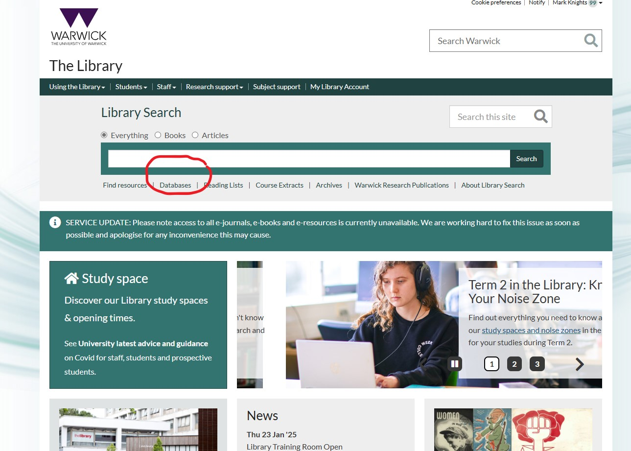
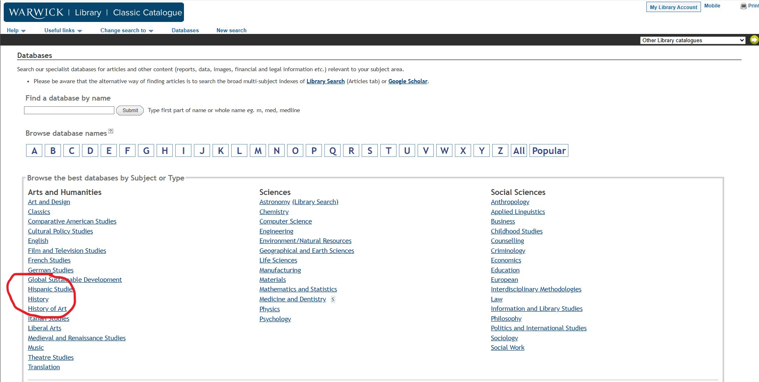
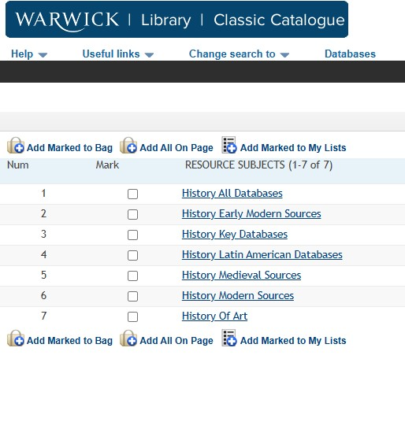
And digital databases provided by the library
  Early European Books; Electronic Enlightenment; French trade cards
  American colonial print; the Colonial Caribbean
  British history; the Cecil papers; Early English Books Online; Eighteenth Century Collections Online; English Historical Documents; State Papers
  Empire Online; The East India Company; Global Commodities; economic literature
  Defining Gender; Perdita project
  The Grand Tour
  And beyond: earlymodernweb.org Primary Sources;
  Early Modern History Collections | Institute of Historical Research

Slide 5
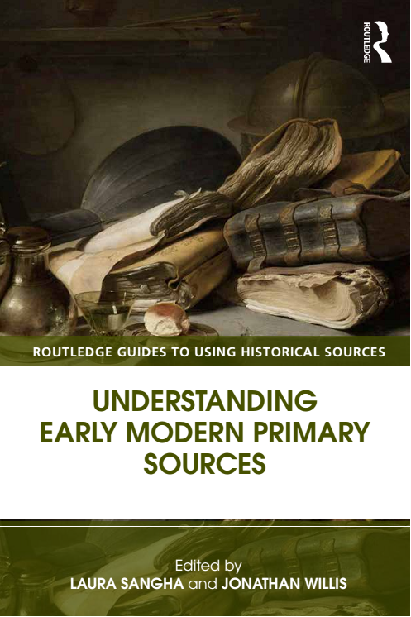
Wide variety of types (and you can use a mixture)
Print (ballads, periodicals, books etc)
Letters
Images – paintings, prints, maps
Diaries, journals, memoirs
Artefacts
Legal and state records

Slide 6
What to choose?
Identifying appropriate material for analysis may take a bit of time, and indeed is an integral part of the exercise itself.
You can choose a topic that interests you and find materials relating to it; or you can browse through material and see what interests you.
It is good to be ambitious but at the same time it is important to be realistic about what is feasible and manageable.
If you get stuck, and want advice, or confirmation that you are on the right track, DO ask your seminar tutor

Slide 7
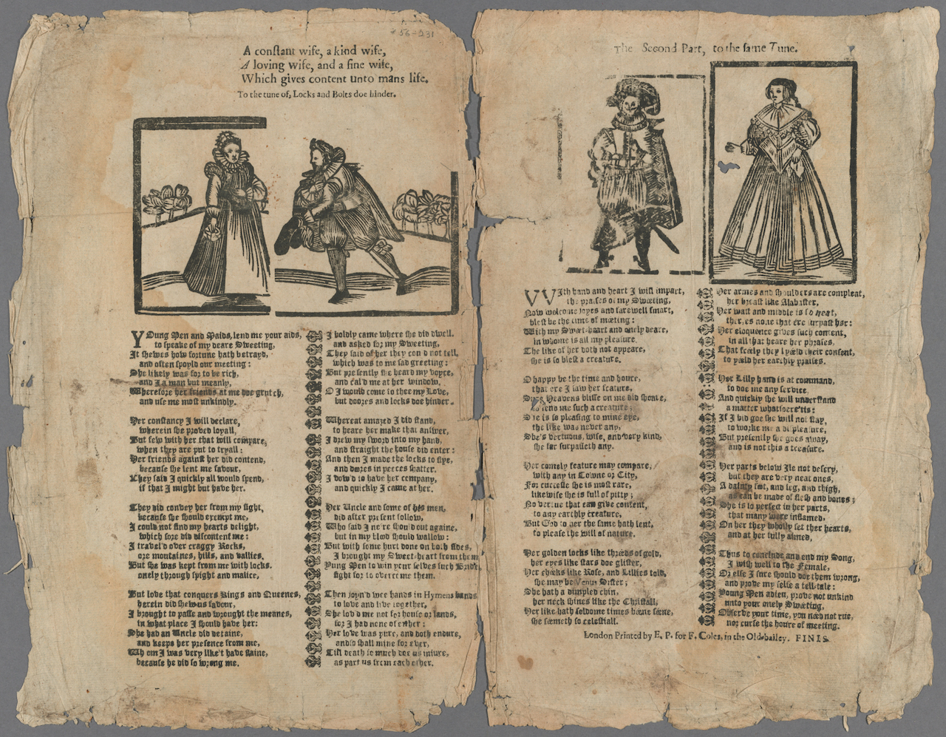
Your project might be
These are indicative examples only –
an evaluative discussion of the court documents relating to two or three witchcraft cases;
a close analysis of three visual propaganda prints from the era of the Reformation;
a cultural ‘reading’ of an early modern recipe book, almanac or political pamphlet;
a comparative analysis of selected parts of European and indigenous accounts of the conquest of the Americas.
The letters of a scientist
A close analysis of objects that reflect European trade/global interactions
There are very many possibilities! It’s up to you.

Slide 8
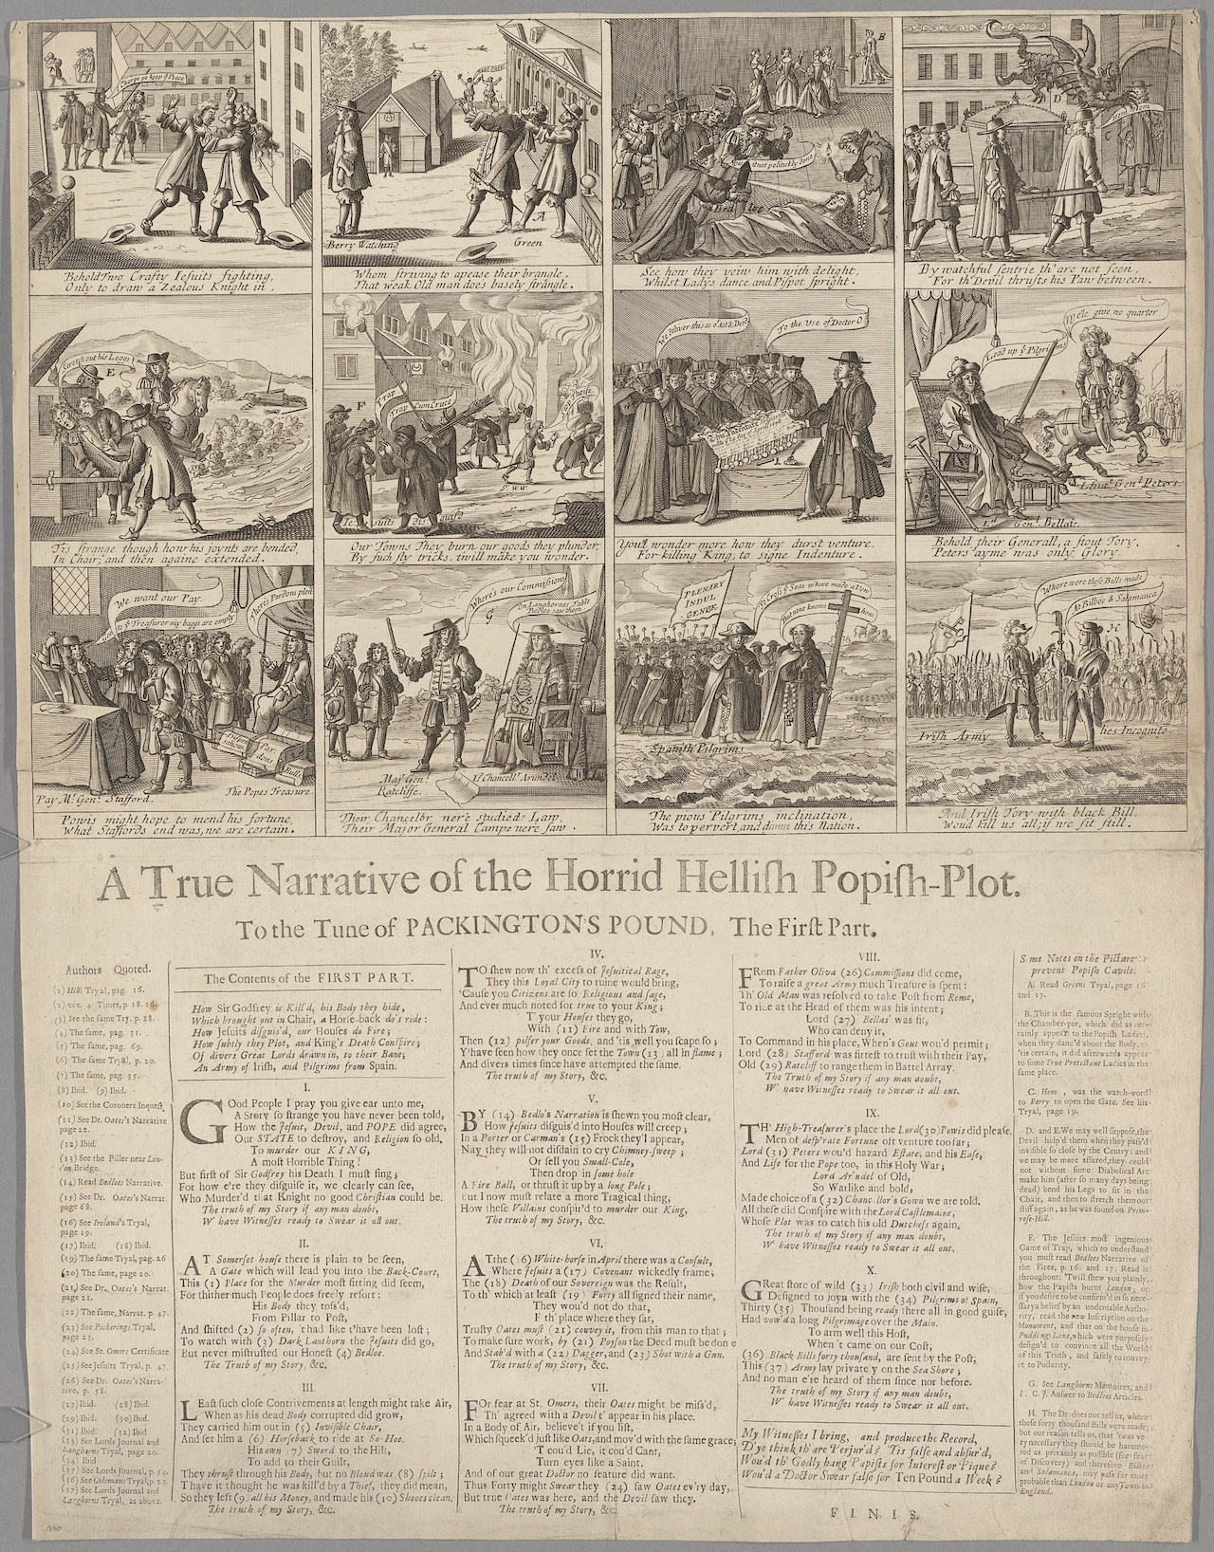
What can the source(s) tell us?
What key issues/points is the source raising?
Who wrote it and why? Does authorship and authorial intention shape the source in some way?
Is the language/style/iconography important for our understanding of it?
What context did it appear in and how might that have shaped it?
How do the sources relate to each other, if you are using two or three?
representative? innovative? aberrant? Influential?
Are the sources ambiguous or contradictory?
Are they sufficient to answer the questions you are interested in?

Slide 9
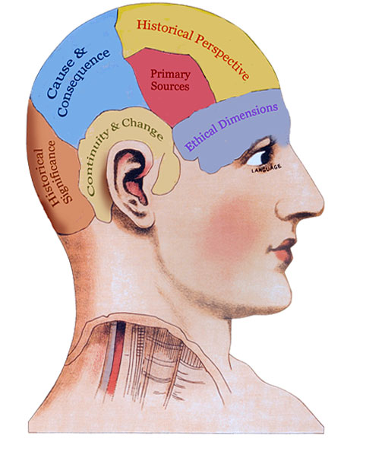
How does the source ‘open up’ larger issues of interpretation of the period?
So you will need to inform your analysis with reference to secondary literature – position your analysis in relation to historiographical debates.
Do your sources support/challenge arguments made by historians? Do they suggest gaps in what historians have considered and if so, what might the significance of that be?
So the expectation is that you should consult at least five items of secondary literature relevant to your sources and the interpretative approach of your project.

Slide 10
The research project should follow the following format:
a title – this can take the form of an essay-style question, though does not necessarily have to do so.
a project outline (c 500 words) that discusses the project’s intellectual aims, the historical and historiographical contexts, and the methodological issues involved (‘methodological’ refers to specific requirements or problems of interpretation and procedure that using this kind of source throws up).
the main body of the project, describing and analysing the source/s themselves, with specific examples and explanations, and contextualisation of the material with respect to existing scholarly literature and interpretations
a concluding section, underlining the key findings, and also reflecting critically on the various challenges you encountered undertaking the project.
(optional): an appendix or appendices, in which key parts of the sources are reproduced. This is often most appropriate in the case of visual or pictorial sources, though it is also permissible/desirable to insert visual reproductions into the main text itself.
bibliography, divided into sections for primary sources and secondary sources.

Slide 11
How to write your project/essay
Write this as an essay – you might consider the sources sequentially but they need to be stitched together and given a structure
Think what argument you want to make with them and what themes in them seem particularly important
use departmental guides and have another look at the marking criteria that we use - Marking
MMW skills Lectures
Essay Writing and Referencing in the student handbook – has sections on how to cite material and presentational tips

