Slide 1
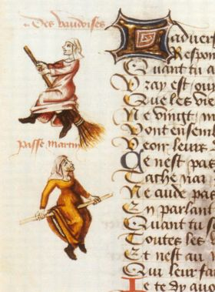
WITCHCRAFT
Recovering a mental world shared by elite & popular culture
‘Witchcraze’ many contributory factors
Patriarchy
Religious change
Socio-economic change
Climate change
Instability & uncertainty

Slide 2
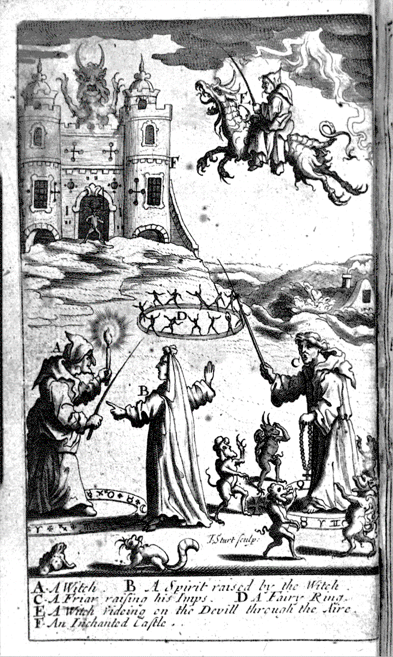
A world of spirits and magic
Anthropology
Role of good & evil
Presence of good & bad spirits
Supernatural forces & their agents – priest, wisewoman
Official & popular religion
Everyday use of magic

Slide 3
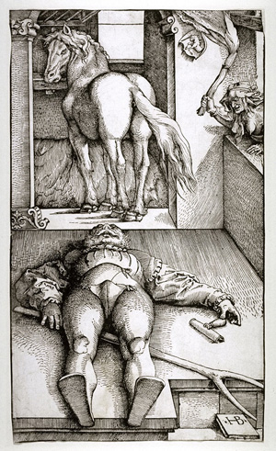
Rationalising popular belief
How to explain when misfortune struck
Falling out with neighbours & others, dealing with guilt
Problem solving – taking control, agency
E.g. impotence – supernatural powers at work, need to lift ‘spell’
Rational in own terms because successful
Cf good and bad luck

Slide 4
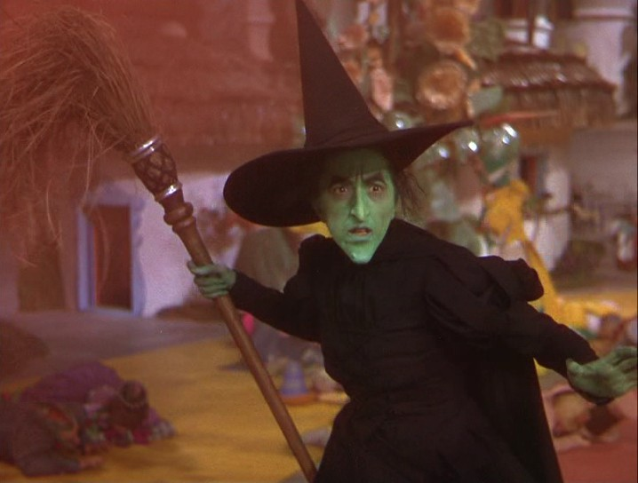
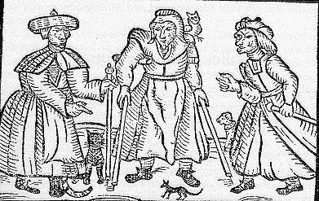
How to recognise a witch
Old? Ugly? Female?
Neighbour, stranger, opponent
The banality of evil vs
The power of supernatural agency
Some believed in own guilt!

Slide 5
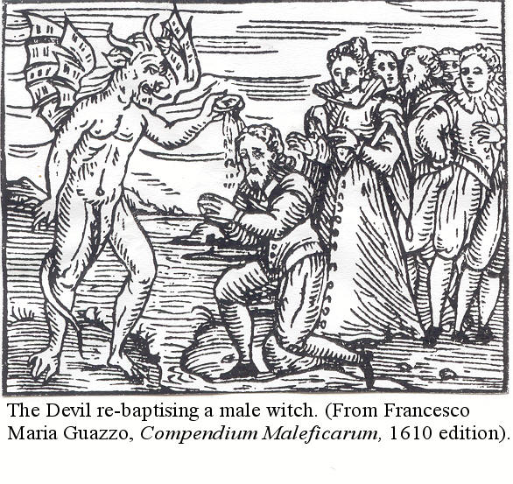
Male witches
20% of accused
Geographical variance e.g. Eastern Europe, Normandy
Related to female witches
If prosecuted more likely to be executed
Cf werewolves, possession

Slide 6
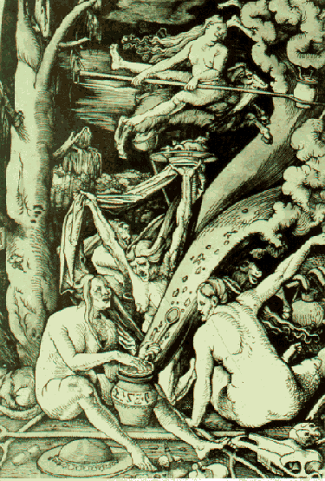
Witches as ‘perfect deviants’
Immoral and irreligious (sexual satanic pact)
Unnatural practices vs fertility & nurture (vs babies & crops), weather & ‘sympathetic’ magic
Destructive & secretive
Anti-social > threat to society (sabbats)
‘Terrorists’ of their age (Dillinger)? (vs usual legal process)

Slide 7
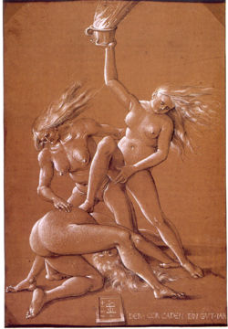
Fitted stereotype of deviant groups
Jews accused of ritual killing, poisoning wells & lust
Heretics of orgies & occult practices
Sexual deviants
Arsonists = vagrants
Atheists = libertines
All conspiring to corrupt & destroy Christian society > need to destroy

Slide 8
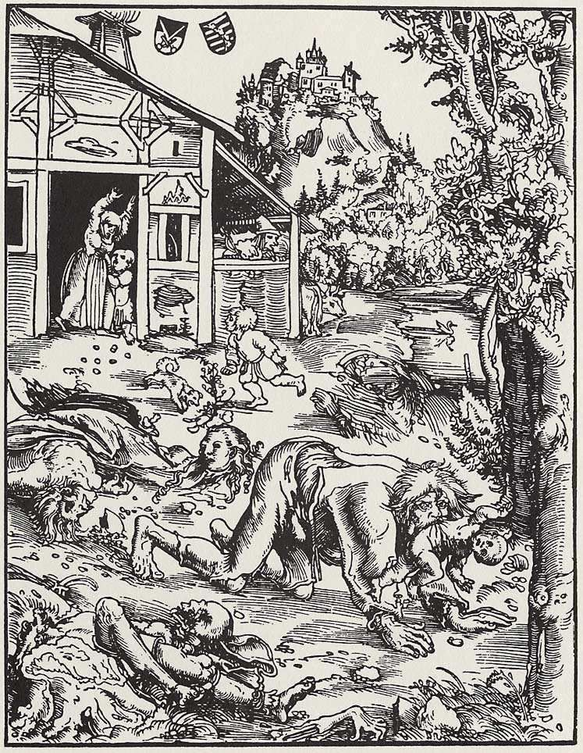
Shape-shifting, familiars and werewolves
Shape-shifting common
Rise in prosecution coincided with reports of werewolves
Diabolical or melancholic?
Jean Grenier condemned to death then confined in monastery 1603
Popular vs elite debates

Slide 9
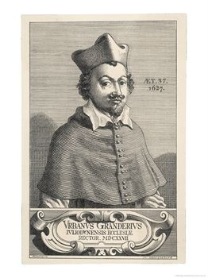
Possession
Possession, sorcery & exorcism
Fear of possession
The possessed as victims
The Reformation -Marthe Brossier & propaganda
Convents e.g. Loudun, 1630s - male confessor = perpetrator
Salem 1692 – mass hysteria & seizures
Urbain Grandier

Slide 10
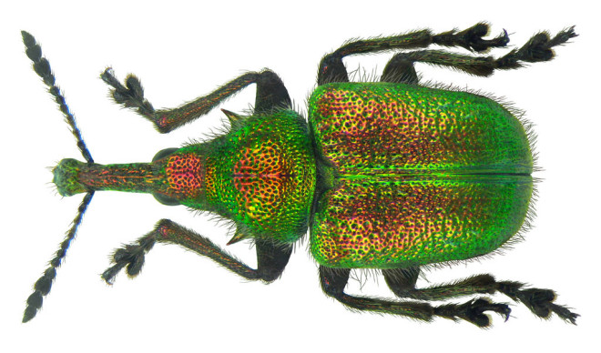
Other aspects of the ‘superstitious’ world view
The prosecution of animals
Posed threat to humans through violence or destruction of crops
Ecclesiastical and judicial process = divine will and exemplary, offered protection & blame as well as retribution
Restoration of order/hierarchy

Slide 11
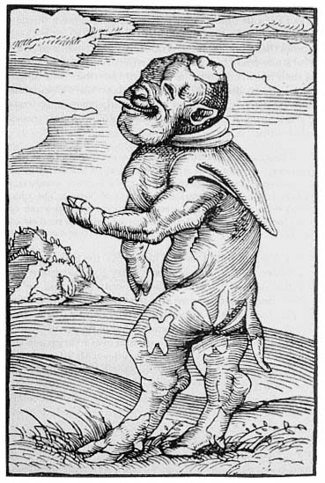
Signs and Monsters
Monk calf (Reformation)
Monstrous births
Portents in the sky e.g. comets & eclipses
Natural disasters – fire, flood, earthquake, crop failure
Extraordinary weather events
Sudden deaths

Slide 12
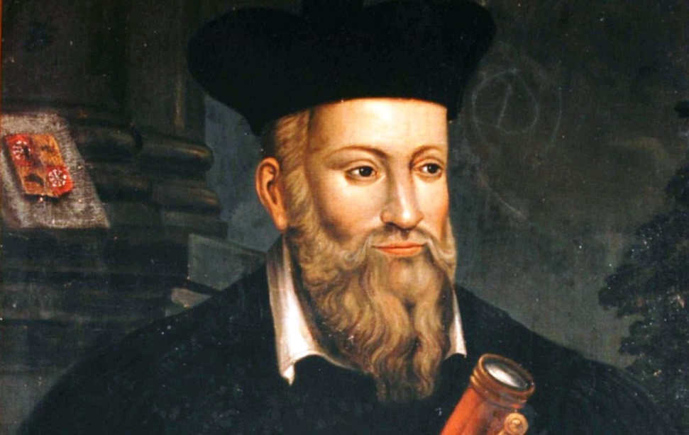
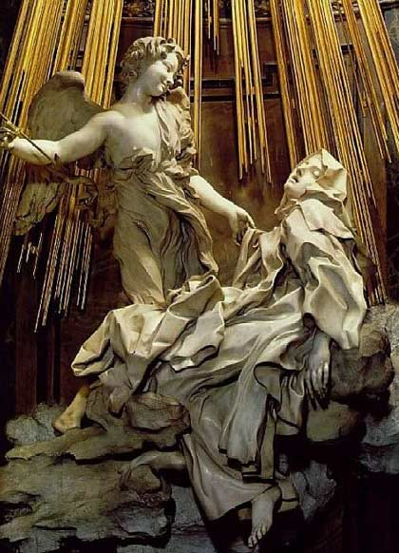
Prophets, astrologers & mystics
Nostradamus (1503-1566)
Court astrologer & prophet
Teresa of Avila
(1515-1582)
Catholic Reformation mystic

Slide 13
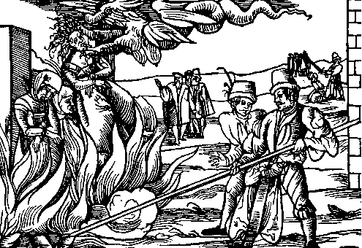
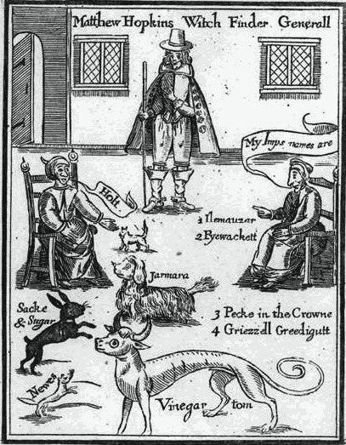
Witch hunts?
Exception not the norm
On average, 40-50% of those on trial for witchcraft executed
Leniency or caution of judges
Contrast with conviction rate for similar ‘moral’ crimes: x2 for plague-spreading in Geneva
Infanticide conviction rate high: 70 % by Paris parlement cf 20% for witchcraft (Soman)
Despite usually inadmissible testimony of women, children, felons & vested interest groups
Interrogation & torture to extract confessions > mass trials
Also role of witch-hunters and sensational cases – Salem, Pendle (1612)

Slide 14
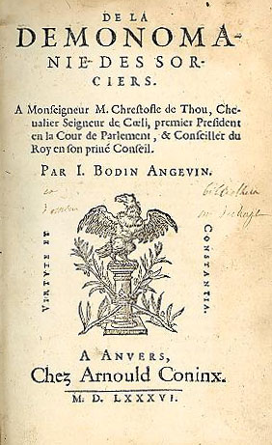
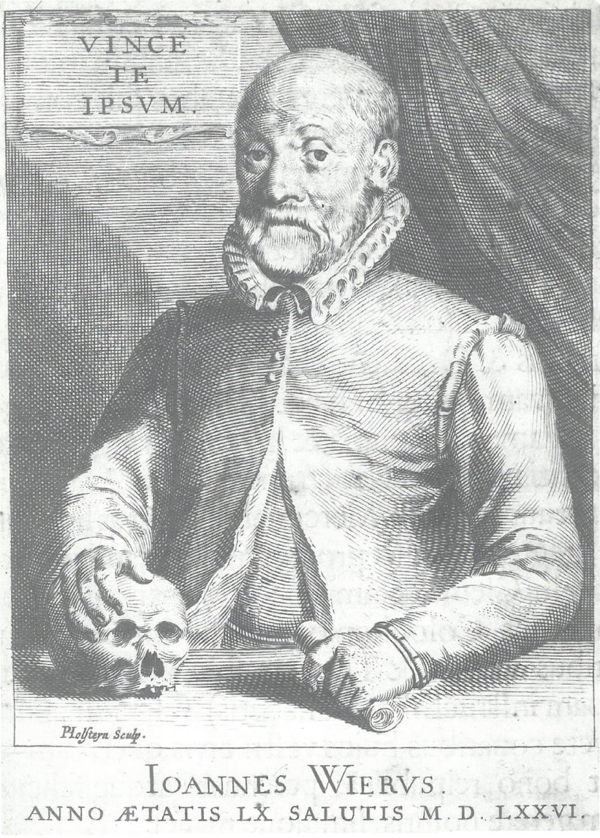
Elite views mixed: jean bodin vs johanN weyer

Slide 15
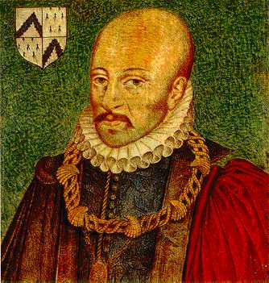
Michel de montaigne & judicial scepticism
‘After all, it is to put a very high value on your surmises to roast a man alive for them’ (Essays)
Paris parlement - 1600 banned ‘swimming test’, 1624 insisted on automatic appeal from lower courts, 1640 ceased prosecution
Not vs reality of witchcraft but injustice

Slide 16
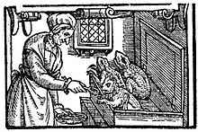
Embracing the complexities
Window into past society’s most deep-seated fears, shedding light on cultural attitudes & values; understanding these in their own terms allows us to find this world less strange
Witch feeding her familiars, 1579
Jim Sharpe: ‘The European witchcraze remains, in many ways, an elusive subject. The better informed we become, the more confused we get’

