Slide 1
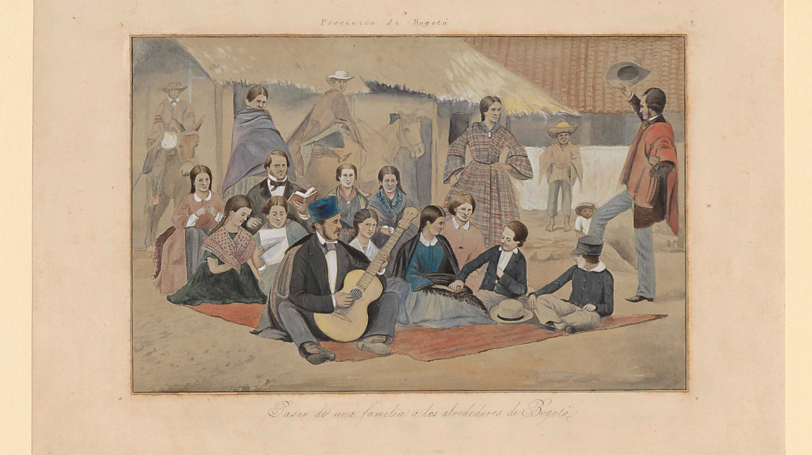
Nation-Building in 19th Century Latin America
Latin America Themes and Problems.
Dr. Camilo Uribe Botta

Slide 2
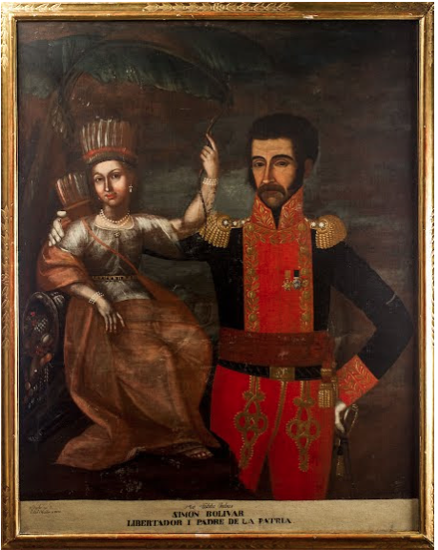
Simón Bolívar Libertador y Padre de la Patria Figueroa, Pedro José. 1819. Casa Museo Quinta de Bolívar. Bogotá, Colombia.

Slide 3
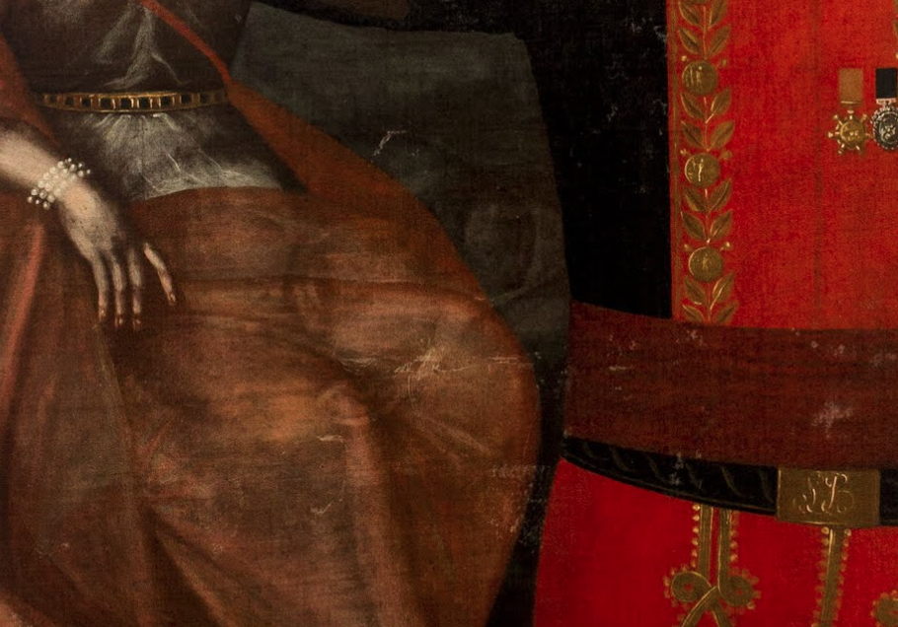

Slide 4
King Ferdinand VII of Spain?
Pablo Morillo?

Slide 5
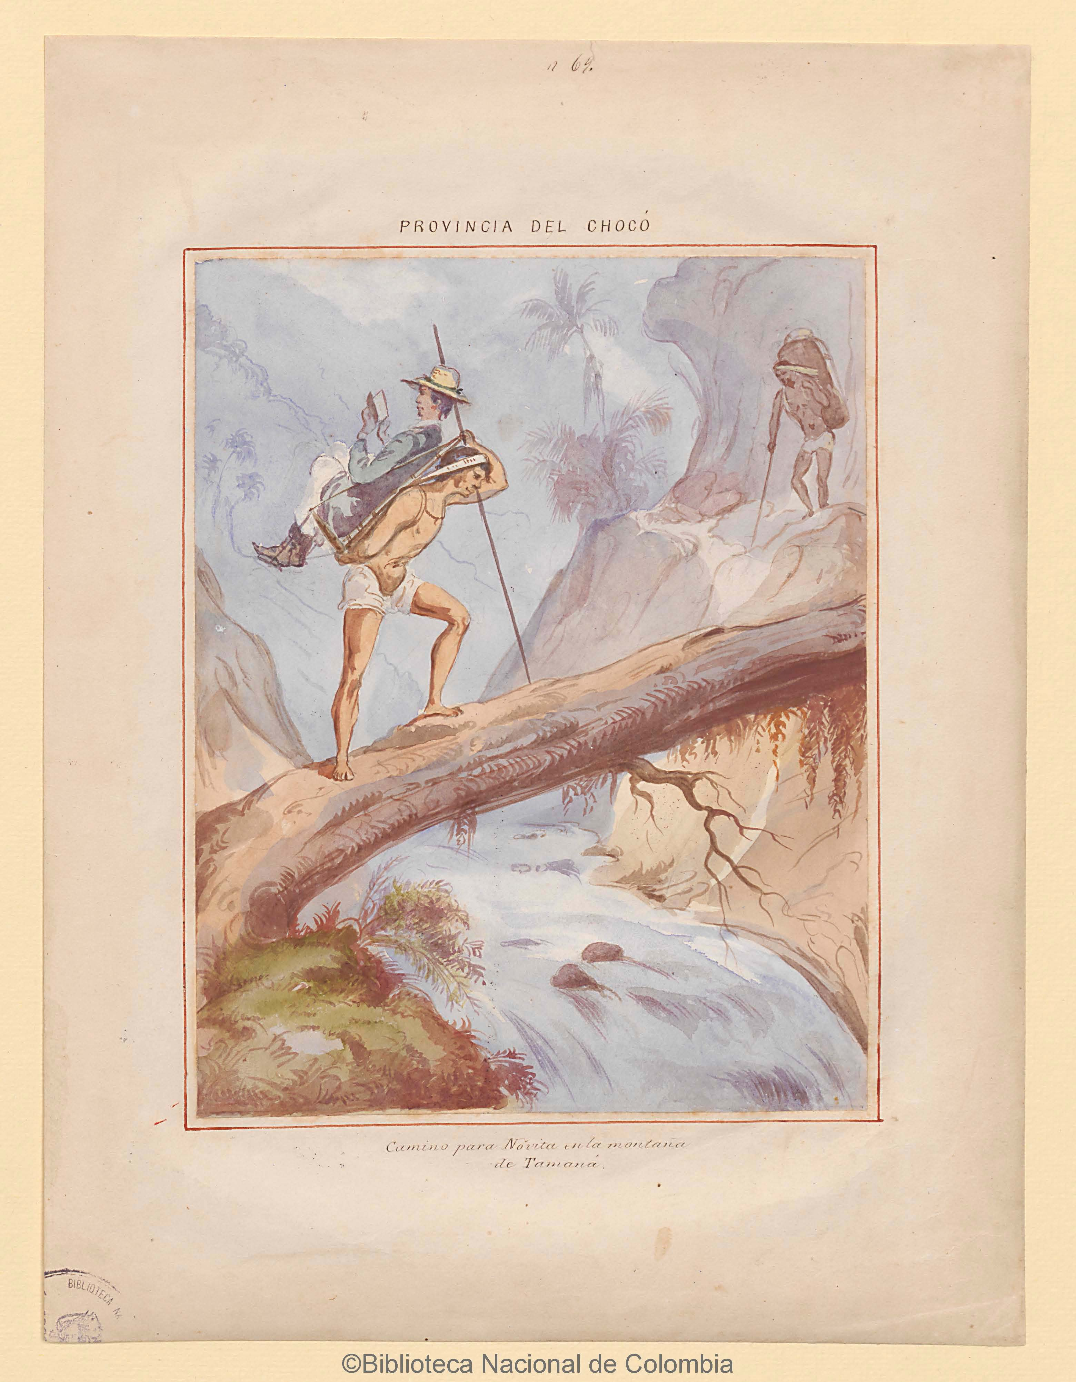
Lecture structure.
Symbols of the nation
Civilization vs. Barbarism. Homogeneity vs. Heterogeneity
Latin America at the Vanguard of Democracy
The material culture of civilization.

Slide 6
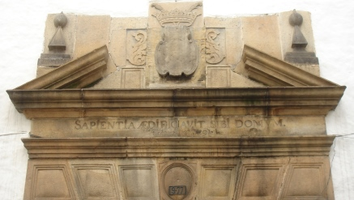
Symbols of the nation.

Slide 7
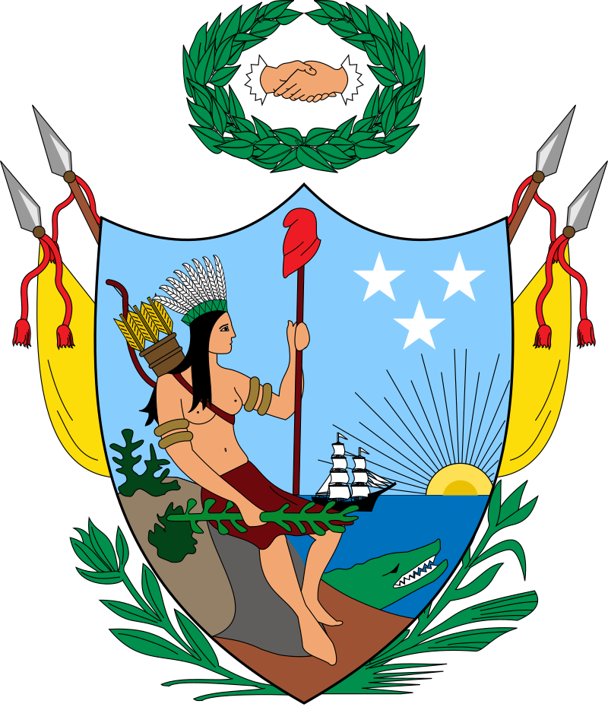

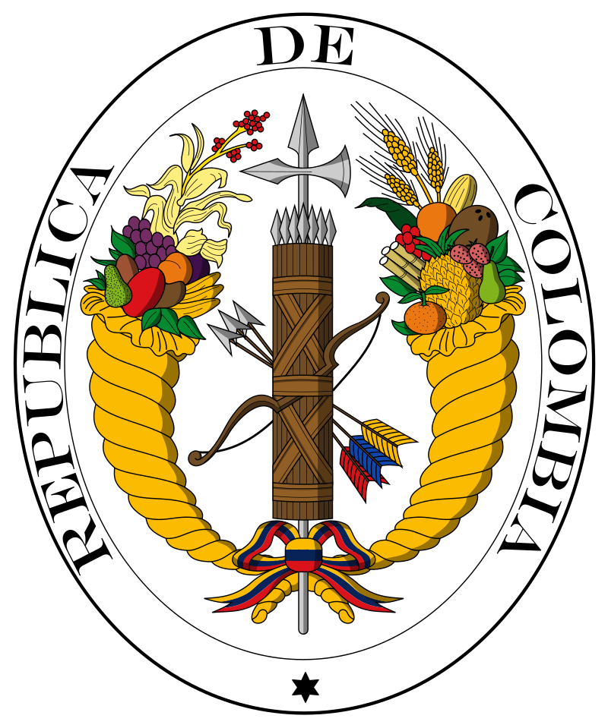
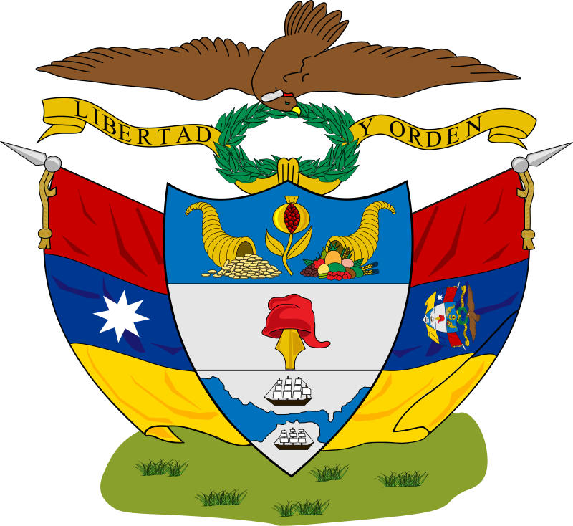
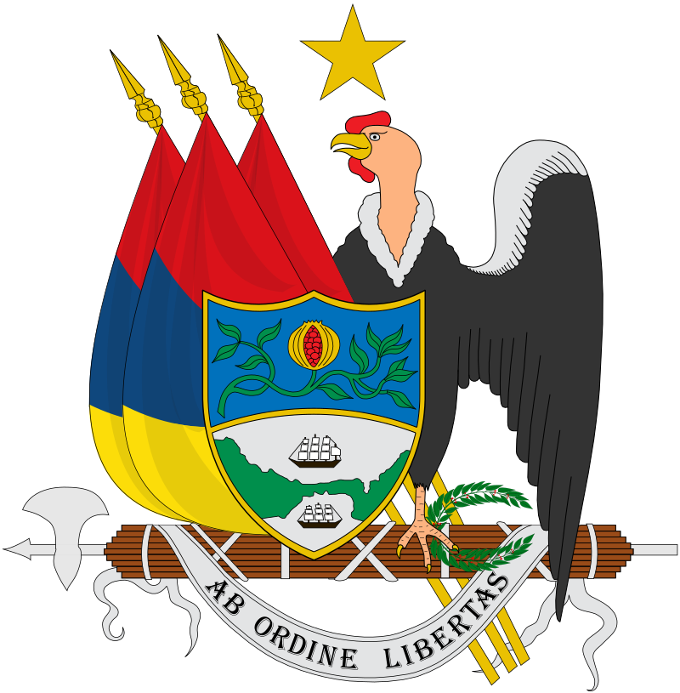
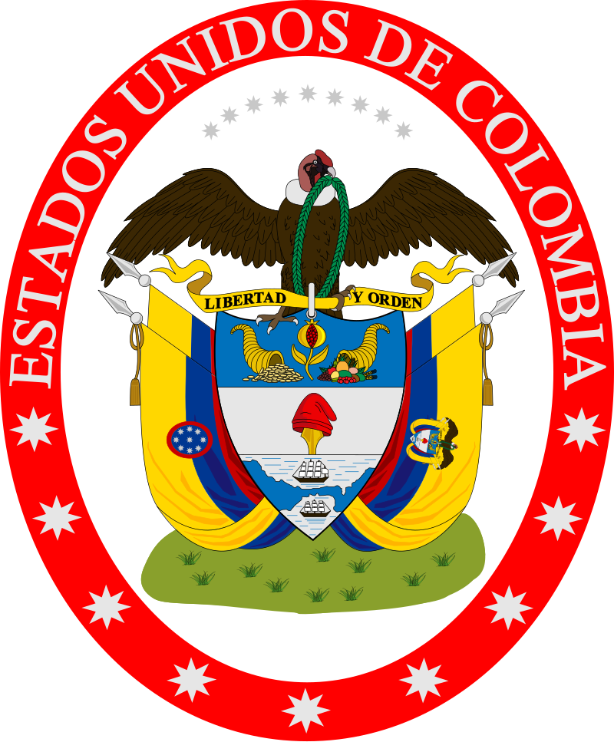
1819
1820
1821
1834
1854
1863

Slide 8
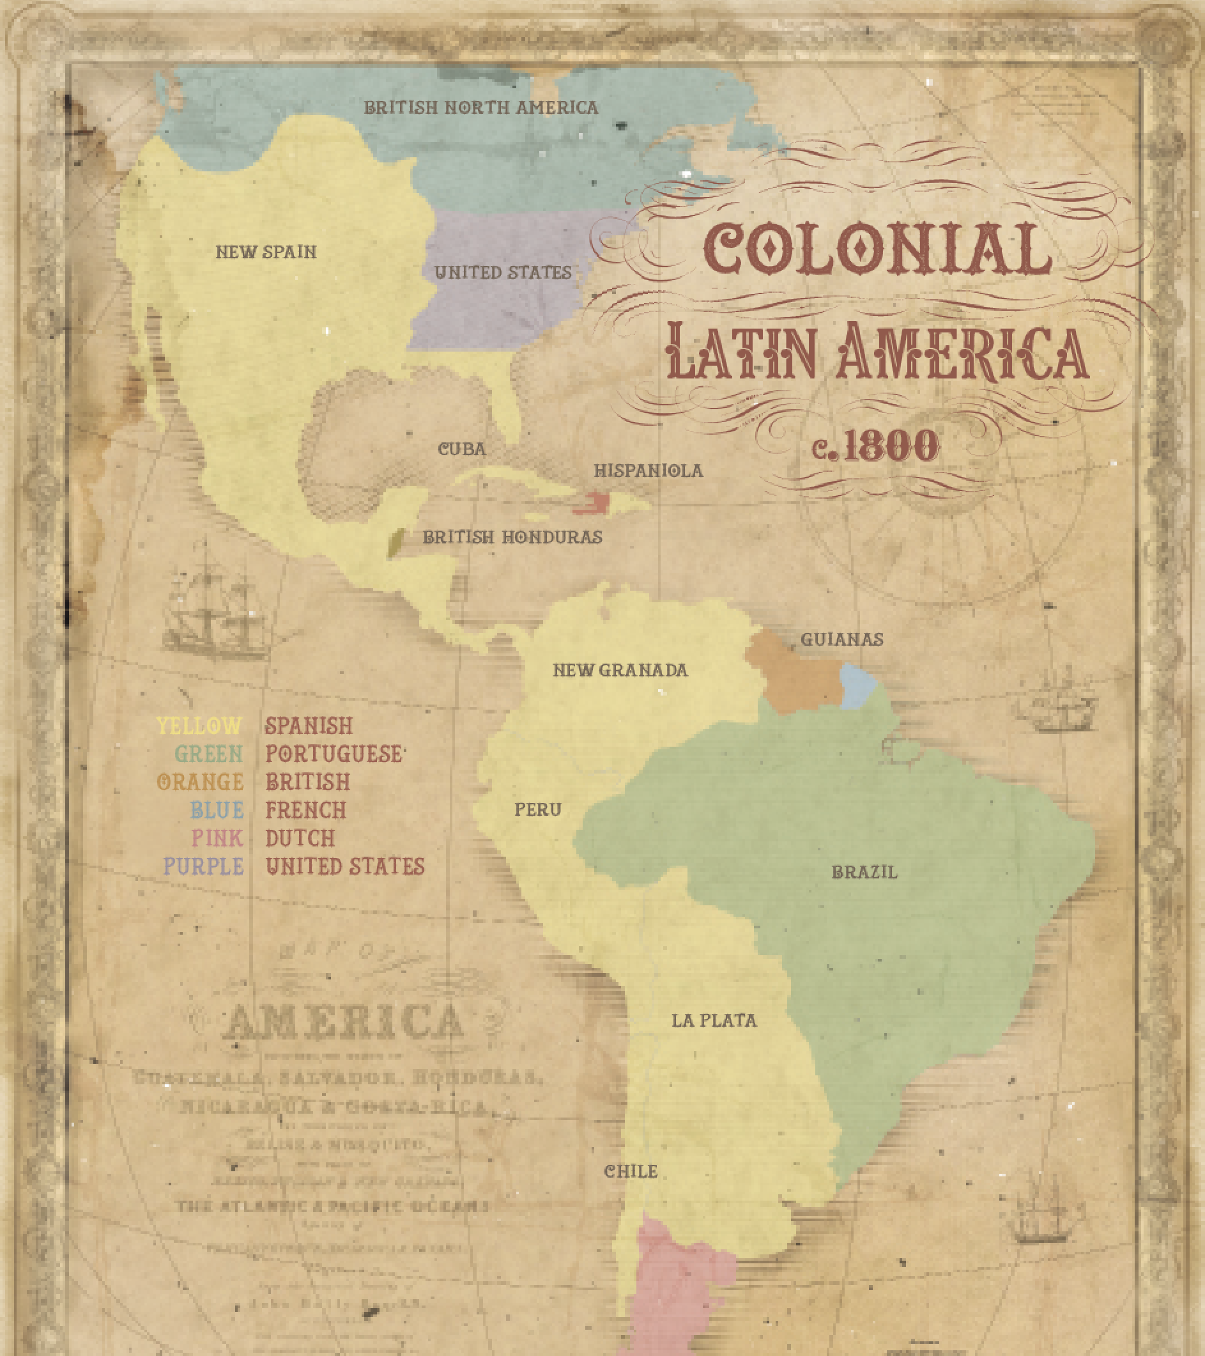
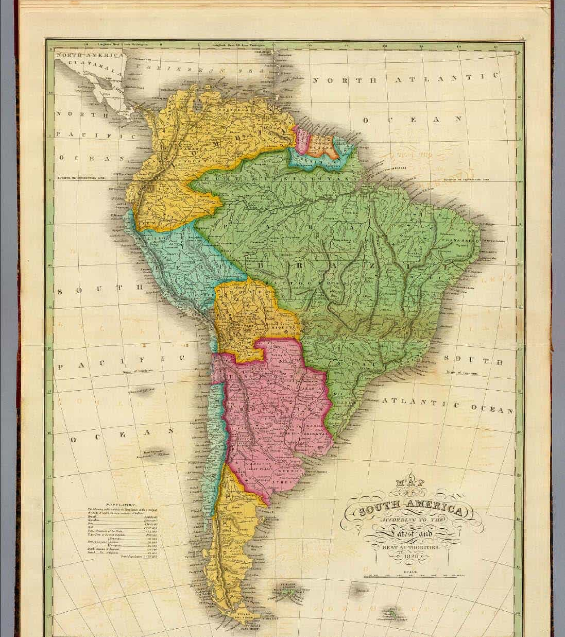

Slide 9
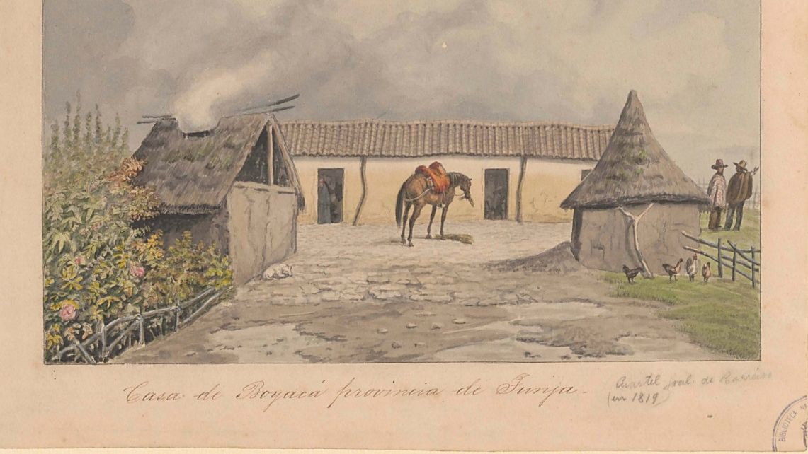
The Chorographic Commission of the Republic of New Granada. 1850-1863

Slide 10
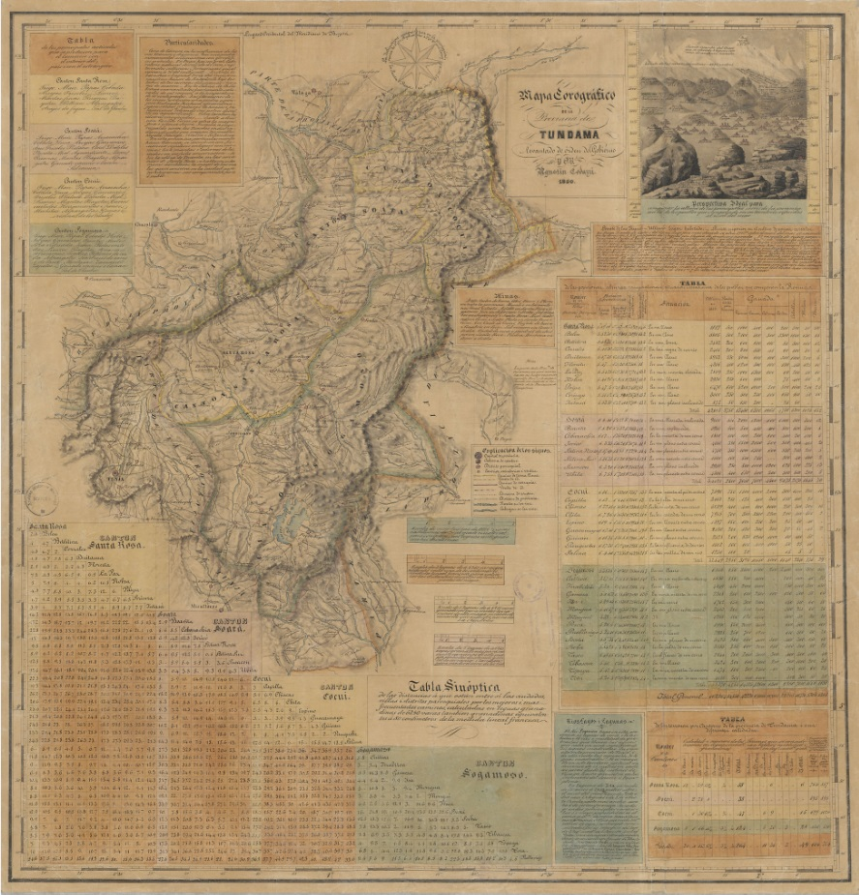
Maps
Provincia de Tundama 1850

Slide 11
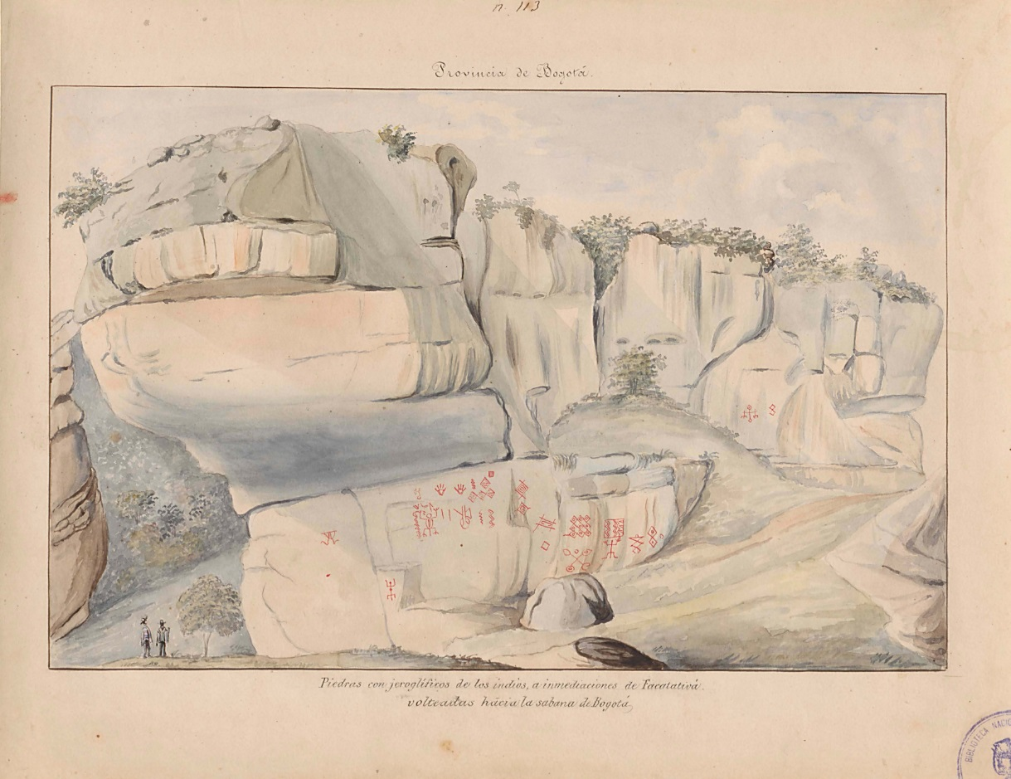
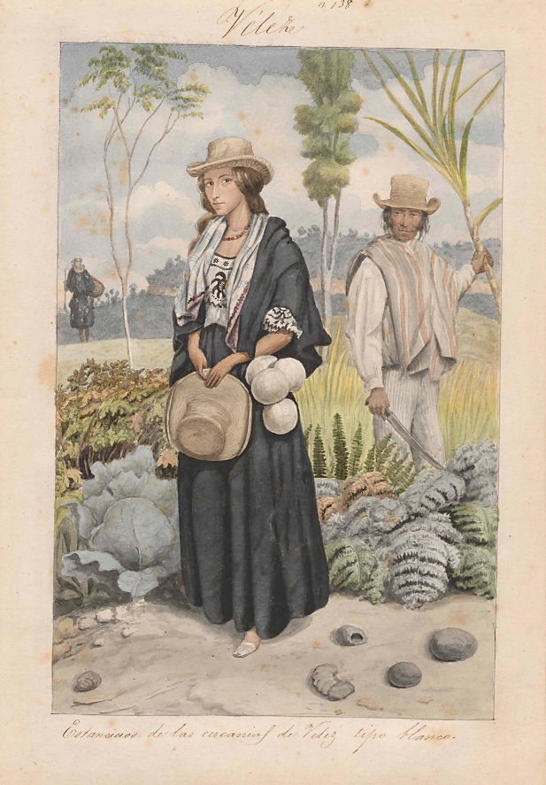
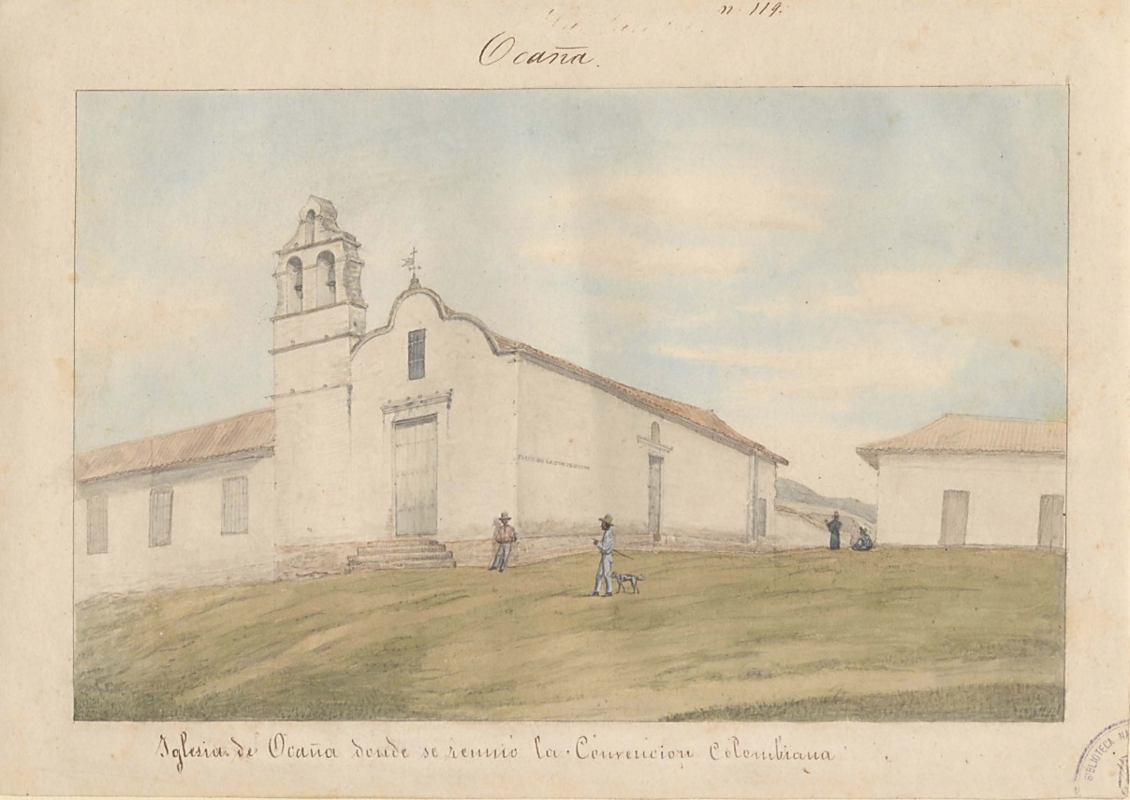

Slide 12
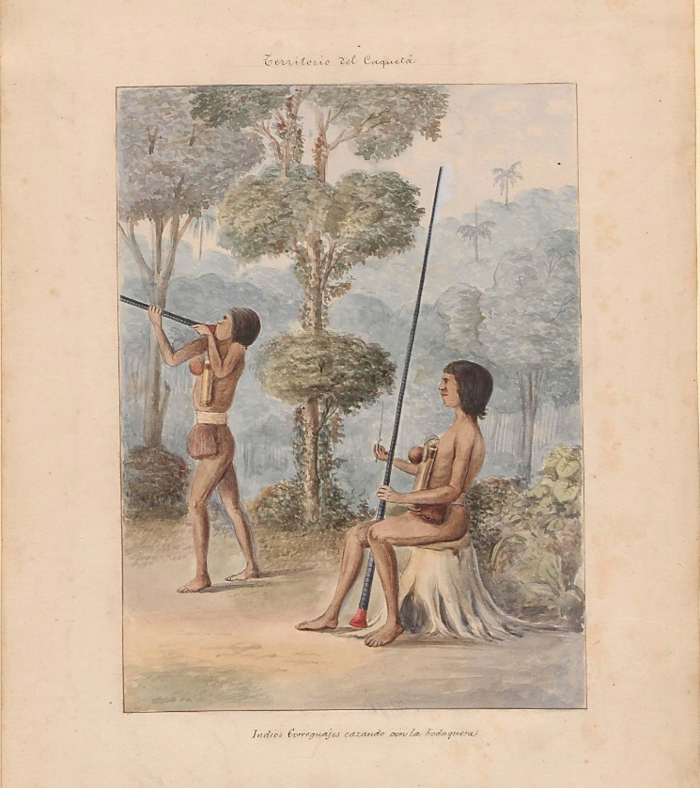
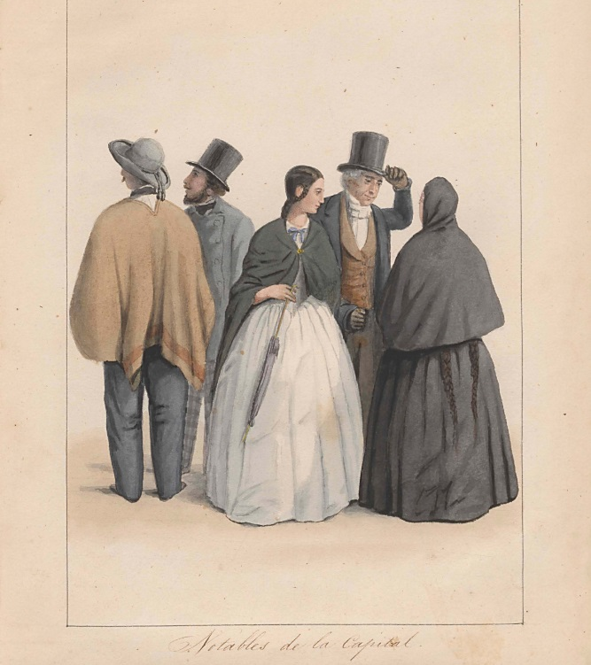
Civilization vs. Barbarism
“two distinct, rival and incompatible forms of society, two differing kinds of civilisation existed. . . : one being wholly Spanish, European and cultivated, the other barbarous, American and almost wholly of native growth’.
Sarmiento. Facundo. 54-5

Slide 13
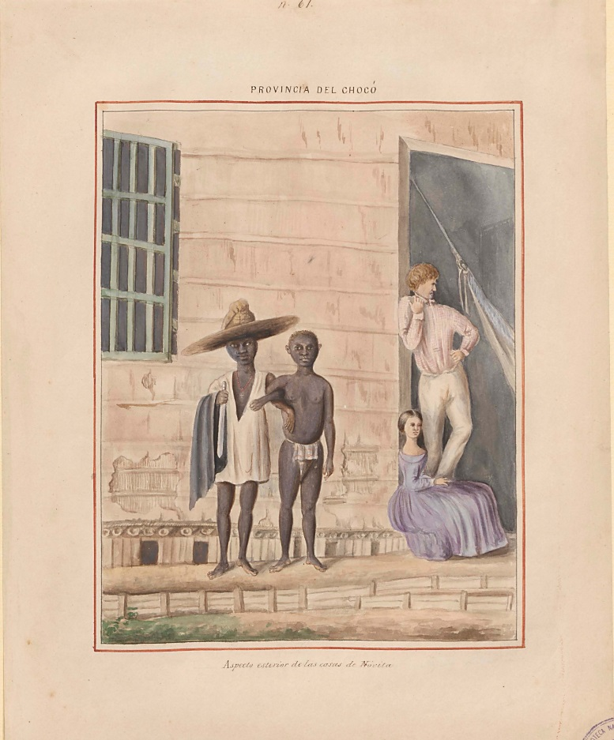
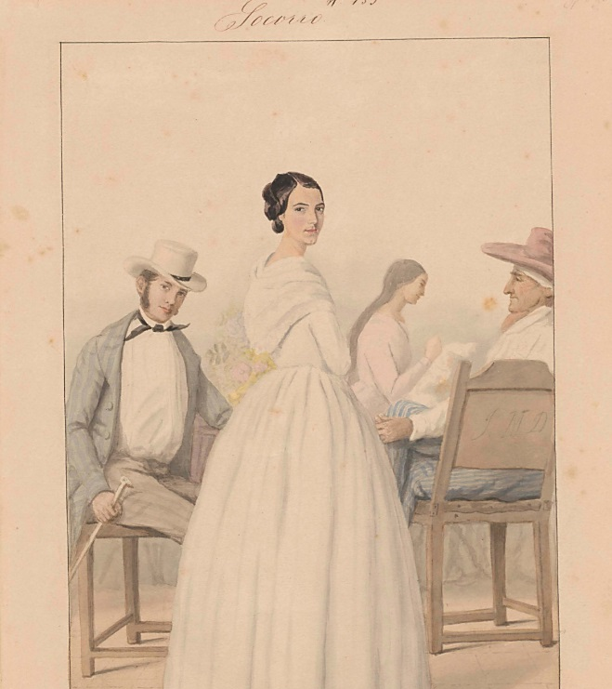
Homogeneity vs. Heterogeneity
“When the absorption of the indigenous race by the European has been completed, which will not take much longer, an homogenous, vigorous, and well-formed race will result, whose character will be halfway between the impetuousness of the Spaniard and the patience of the Chibcha Indian”
Manuel Ancízar. Peregrinación del Alpha. I. 120.

Slide 14
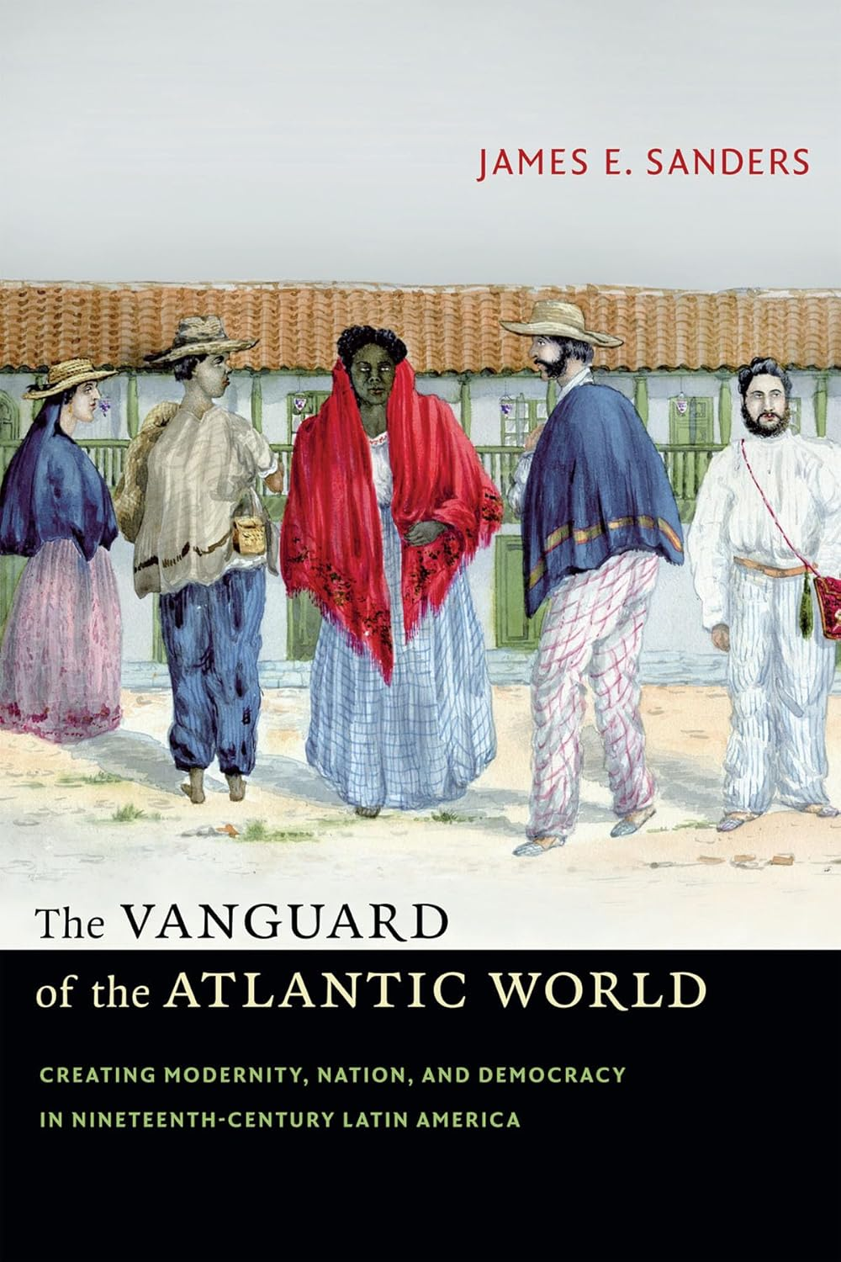
The vanguard of democracy
Democratic, republican project (Exception Brazil. More of that in the seminars)
Universal suffrage
Colombia 1853
Mexico 1857

Slide 15
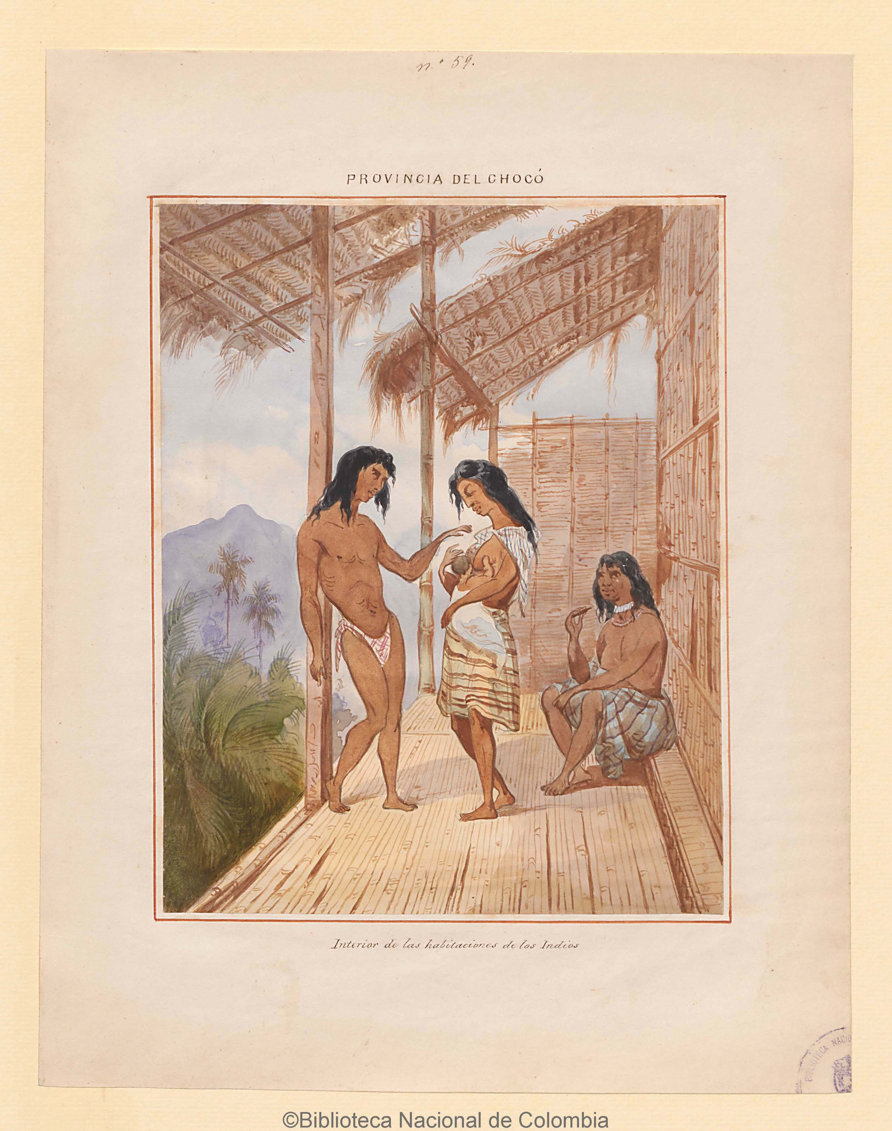
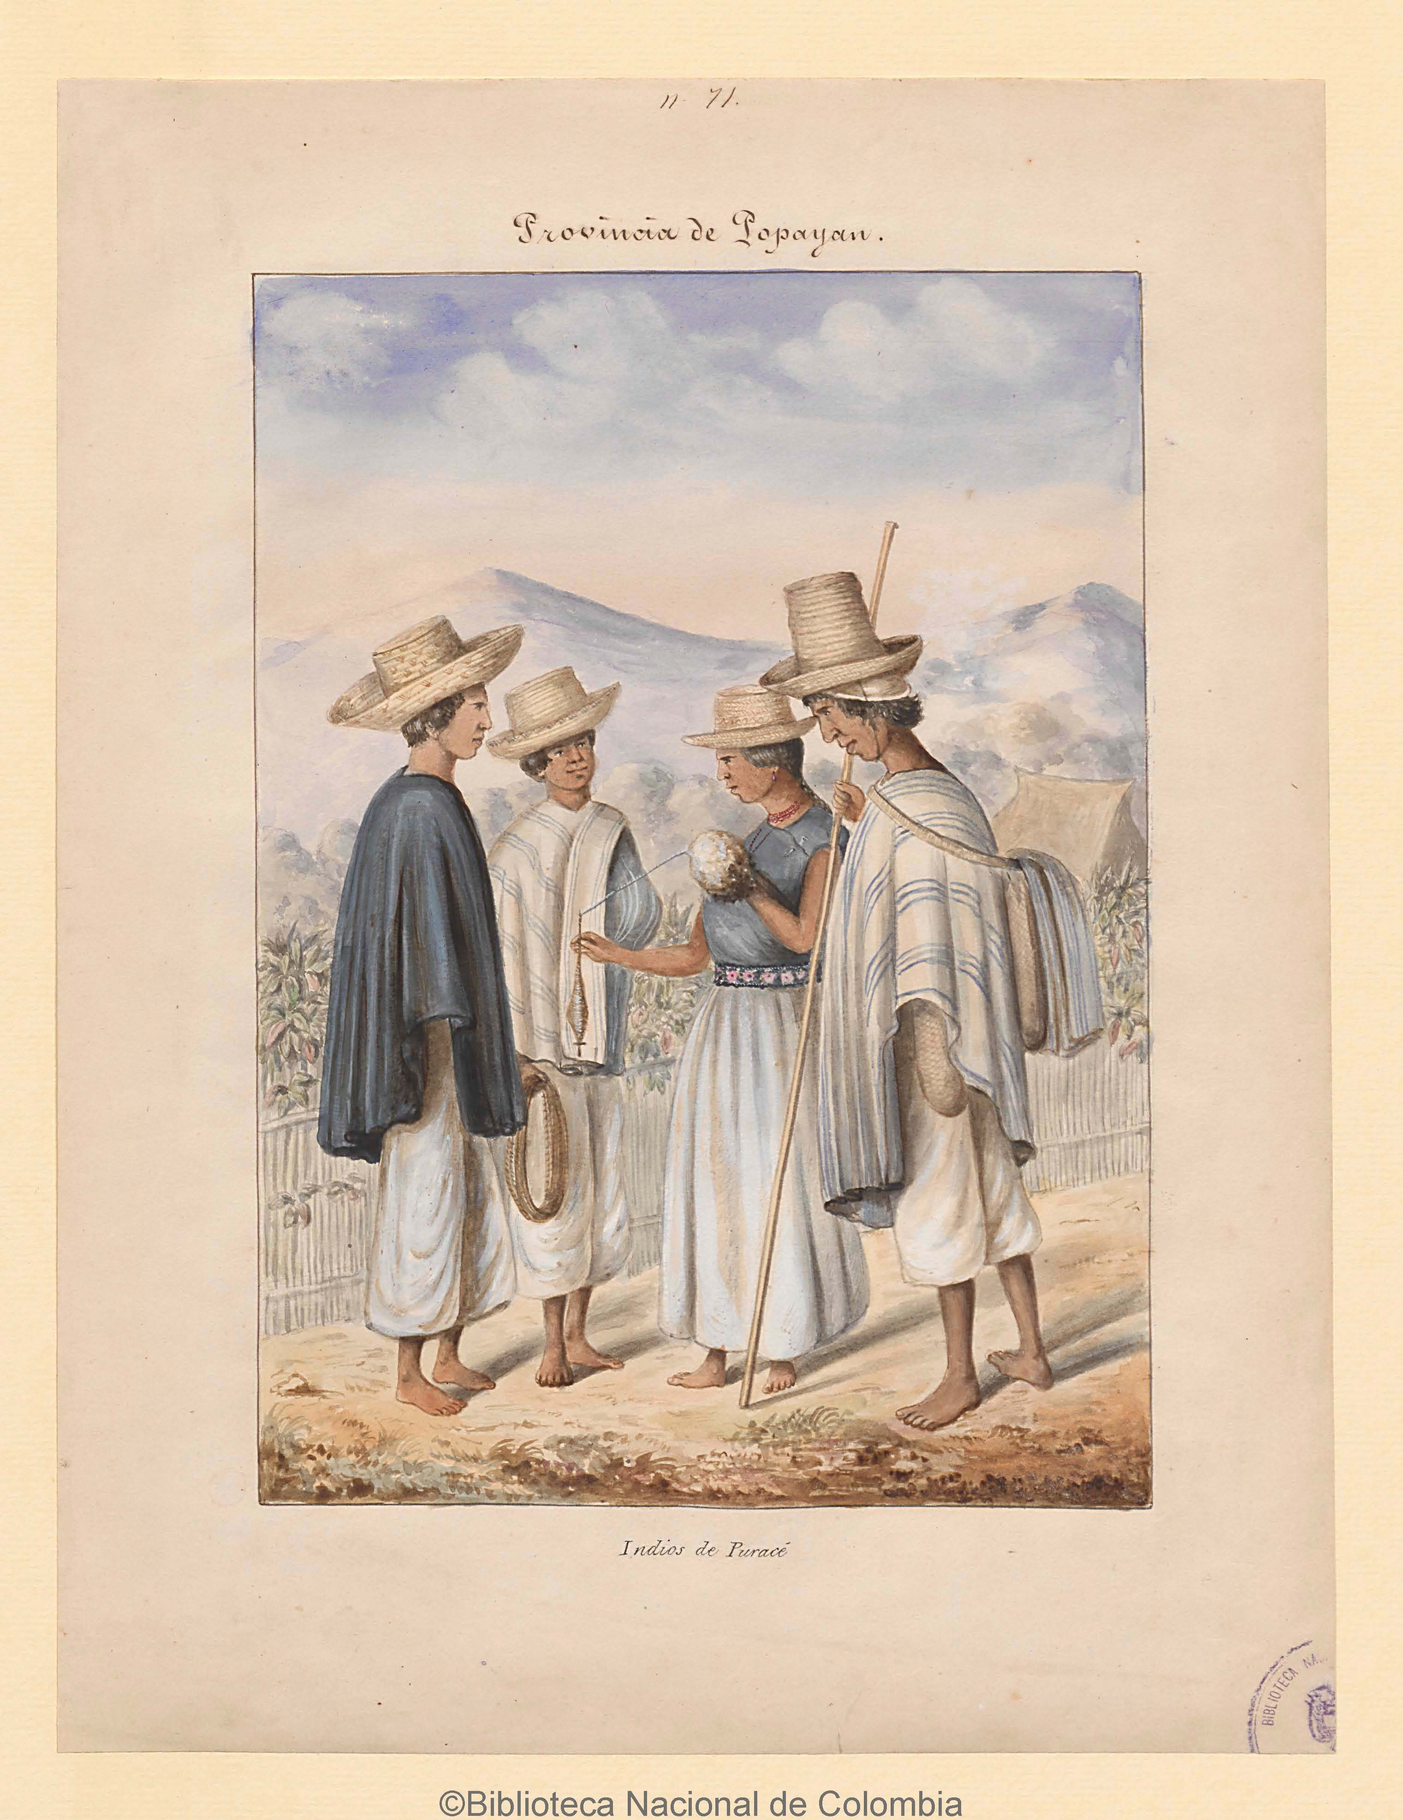
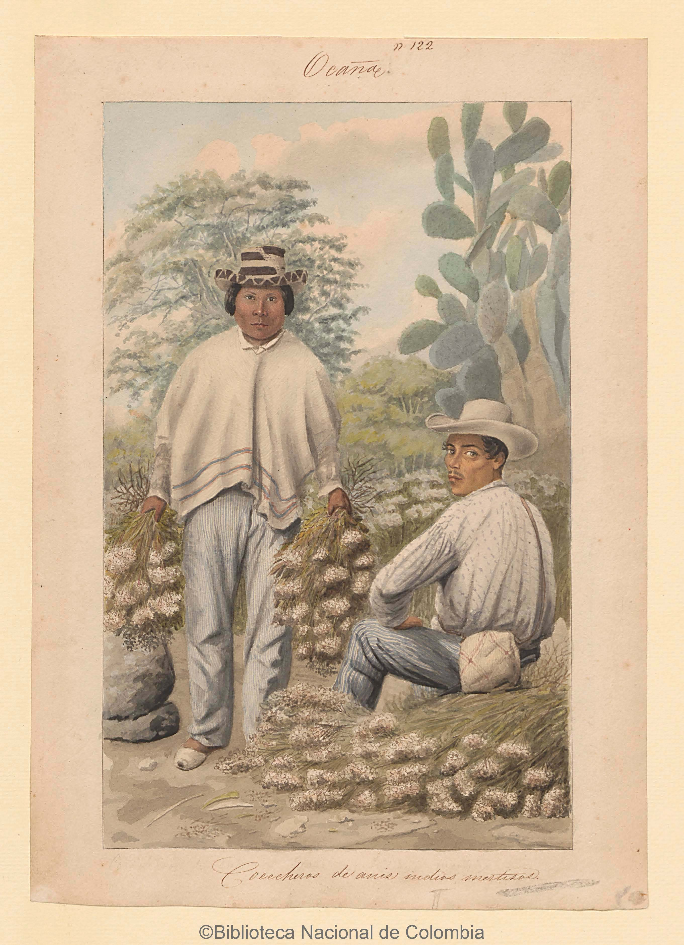
Petitions from subaltern groups.
“We are free citizens, like any other civilized Caucano.”
Indigenous group petition in 1874.

Slide 16
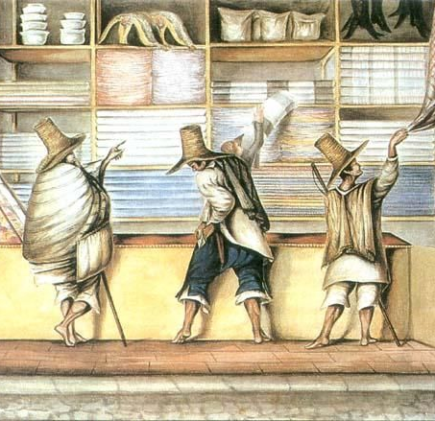
The material culture of civilization.
Civilizing goods:
National production.
Hats in Colombia, for example.
Imported goods. Elite AND popular consumption. Mostly British.
European goods are considered a powerful emblem of civilization.

Slide 17
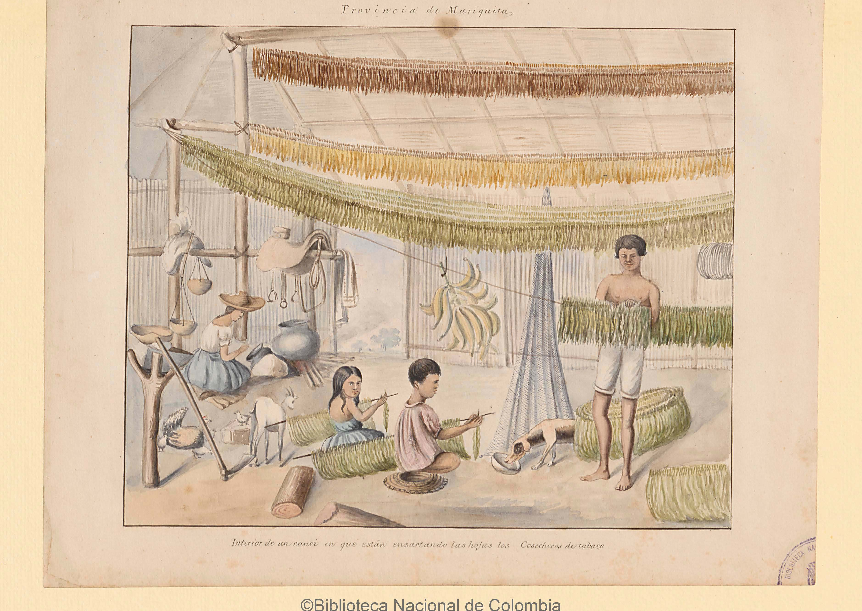
Conclusions
Nation-Building Challenges: Latin American nations faced immense difficulties in forging unity amidst regionalism, diversity, and colonial legacies, making the creation of shared symbols and national identities a fragmented process.
Democratic Vanguard: The region pioneered inclusive democratic reforms, with marginalized groups actively participating and reshaping the meanings of citizenship, challenging traditional hierarchies.
Legacies and Lessons: The nation-building experience reveal a region at the crossroads of tradition and modernity, grappling with its past while striving to articulate a vision for the future.

Slide 18
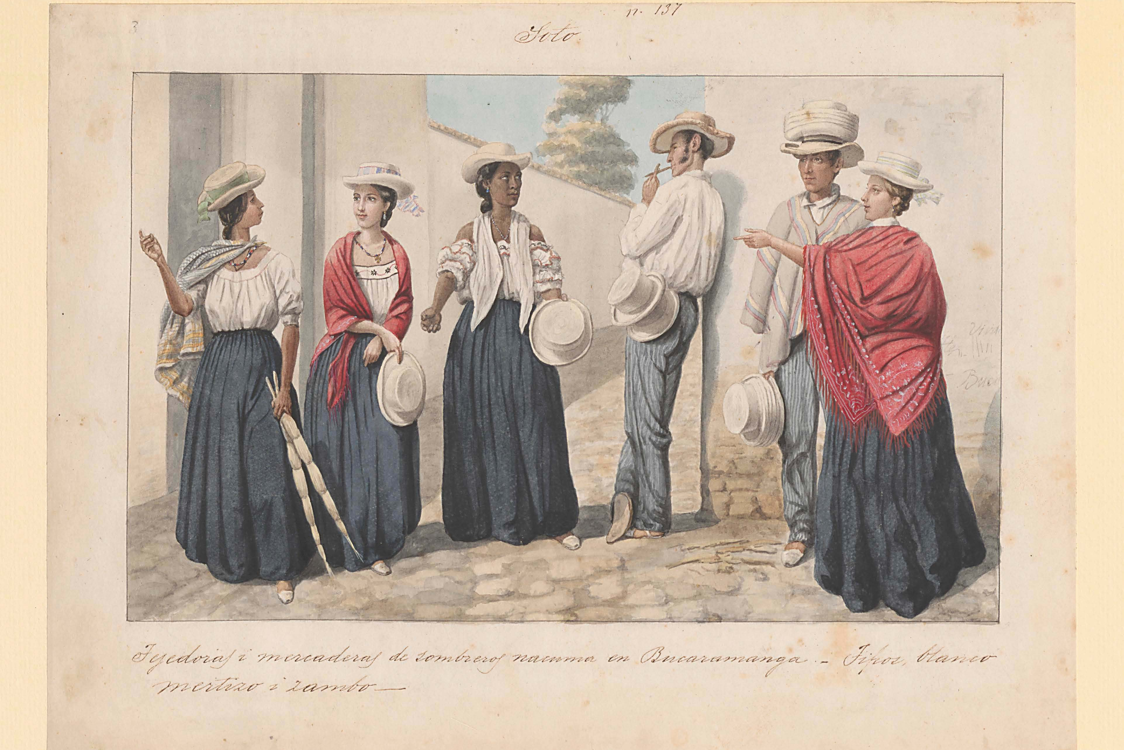
¡Gracias!

