Slide 1
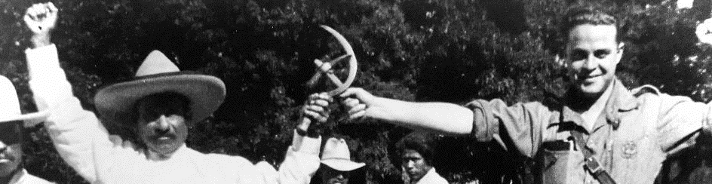
THE MEXICAN REVOLUTION and LATIN AMERICA (1910=1940)

Slide 2
The Mexican Revolution, 1910-1940
The world’s first twentieth century Revolution
Relatively bloody (1m dead)
Though influenced by communism, socialism and anarchism, Revolutionary Mexico developed a distinct political economy which balanced capitalism with
Massive land reform
Labour rights
Some democracy

Slide 3
MOTIVES
Discontent among rural poor who were thrown off their lands and forced to work on haciendas as peones
Discontent among the urban poor forced to work long hours for low wages, while living in dangerous slums
Discontent among the politically-excluded elites and middle classes

Slide 4
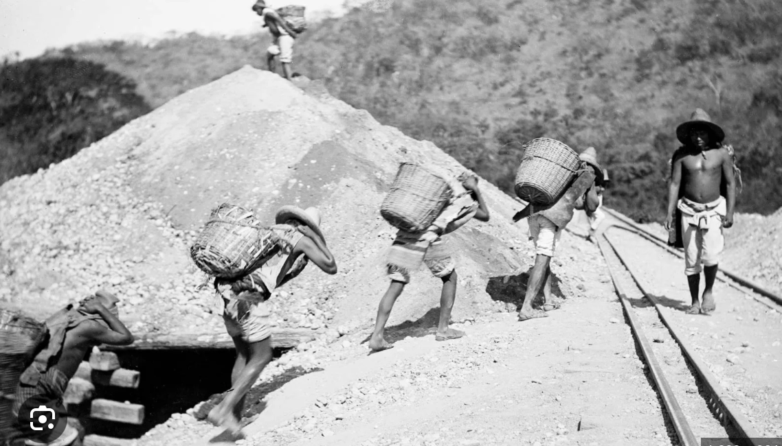
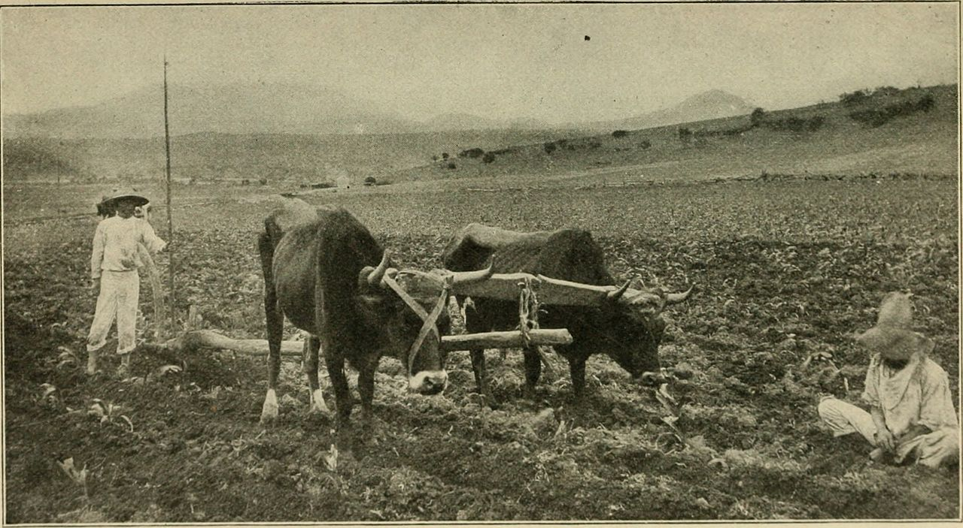
1. AGRARIAN DISCONTENT
How do you force Mexican peasants off their lands and get them to work for wages?
NEW LAWS which prohibit owning land communally. Everyone has to own land privately. This creates a market in land.
DEBT which forces peasants to sell their lands and then work for wages to pay off their debts.
Rich buy up lands, and form large “haciendas”; communal villages are swallowed up; Mexicans work as debt peons on haciendas.

Slide 5
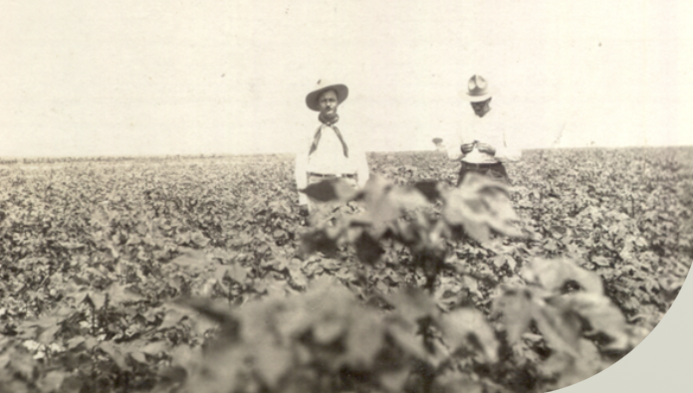
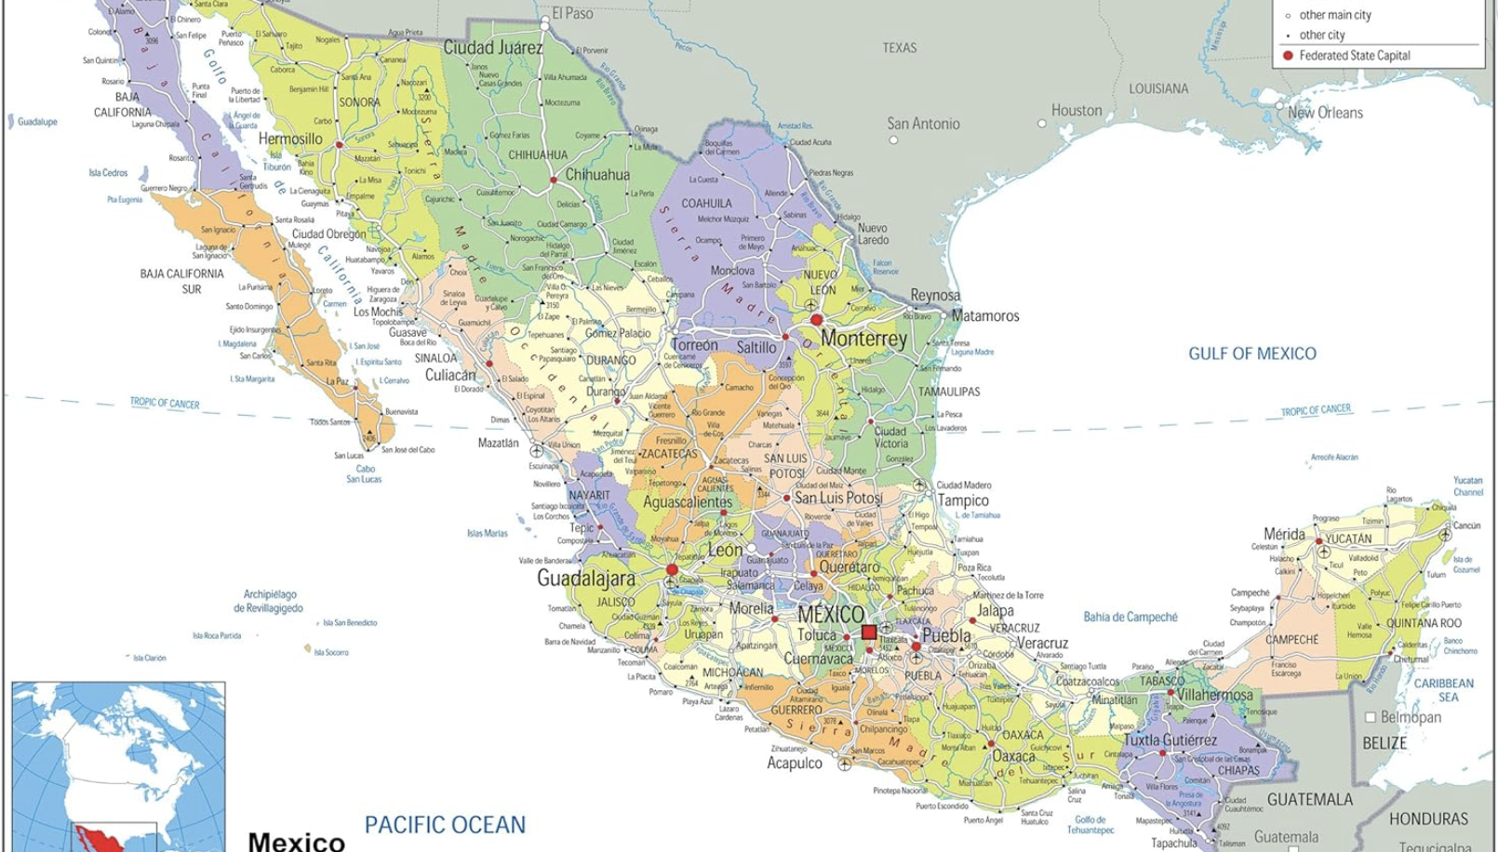
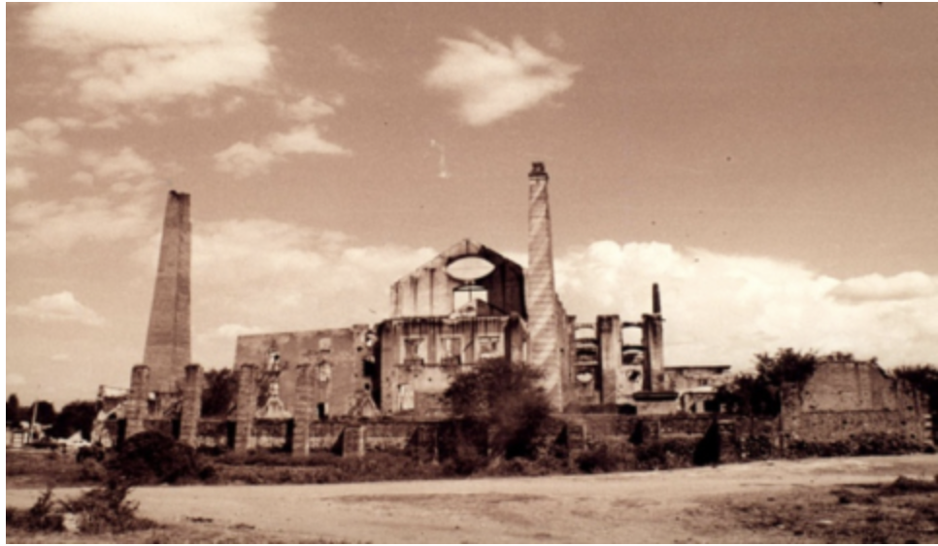
Particularly bad where you could cultivate sugar (Morelos) , cotton (Coahuila) or cattle (Chihuahua) for U.S. market

Slide 6
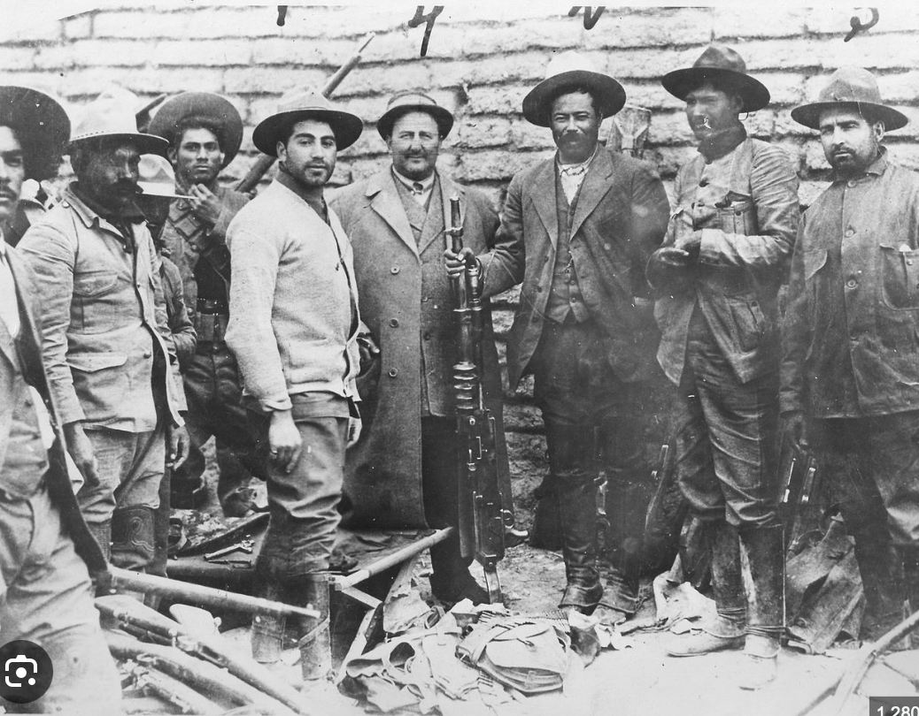
2. INCREASING WORKER DISCONTENT
Up to 1906, industrial and mine workers had broadly benefitted from the Porfiriato.
1906-1907 recession led to low wages, increasing political repression

Slide 7
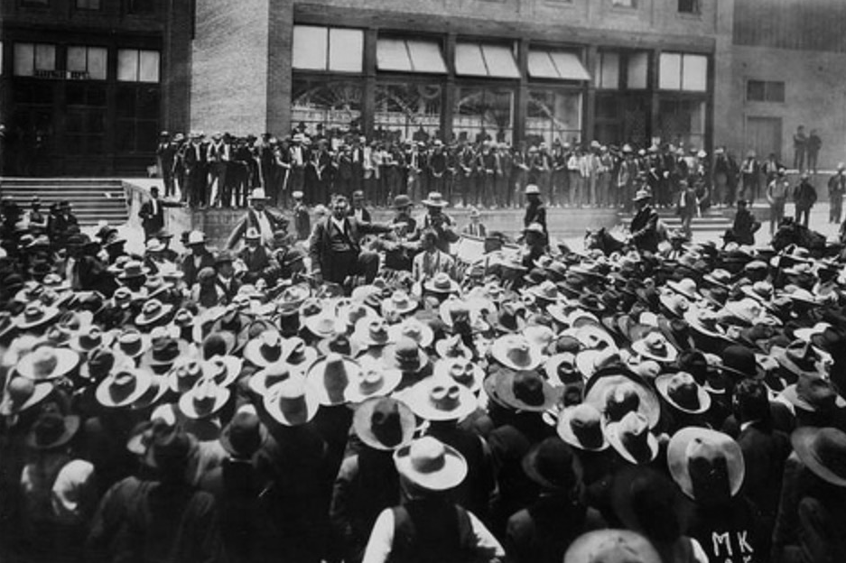
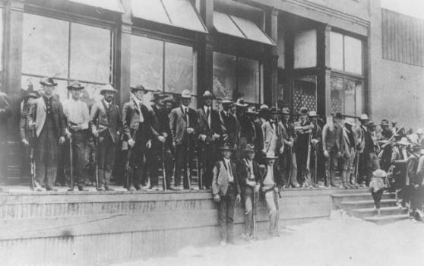
CANANEA (Sonora) Strike
1906

Slide 8
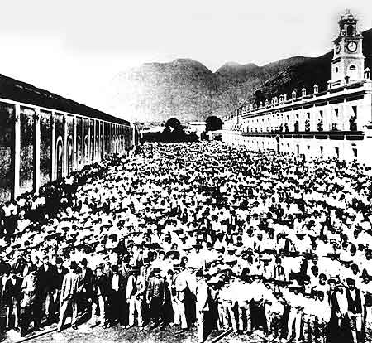
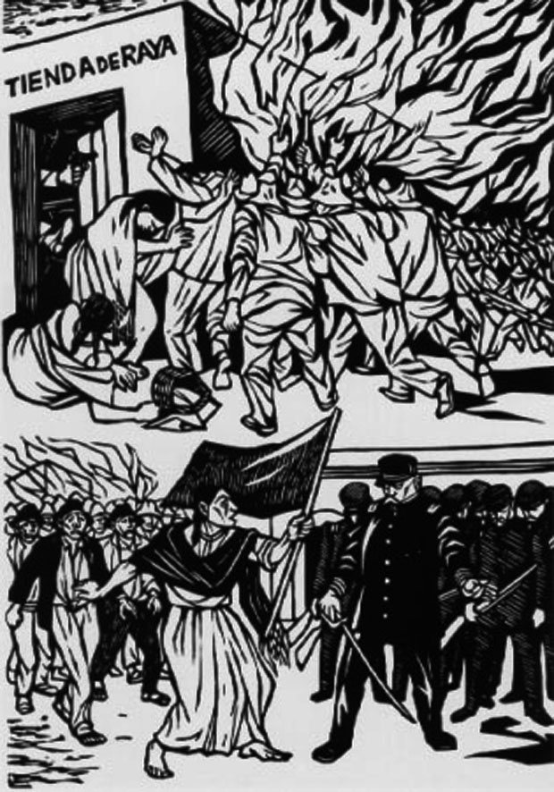
RIO BLANCO STRIKE
Orizaba, Veracruz, 1907
Workers, Rio Blanco, 1907
1930’s woodcut of strike

Slide 9
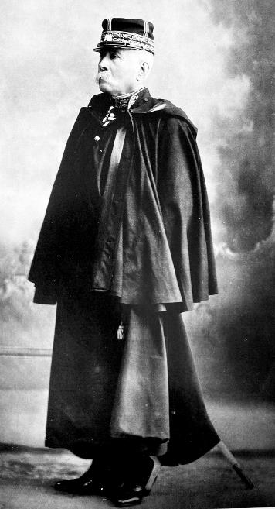
3. POLITICAL DISCONTENT

Slide 10
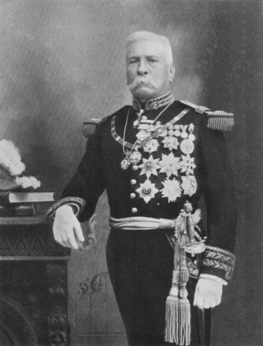
In 1908 Porfirio Diaz gives an interview with U.S. James Creelman, where he claims:
“if an opposition party were to arise in the Republic, I would regard it as a blessing and not an evil”
This encourages first General Bernardo Reyes and then Francisco Madero to attempt to run for office.

Slide 11
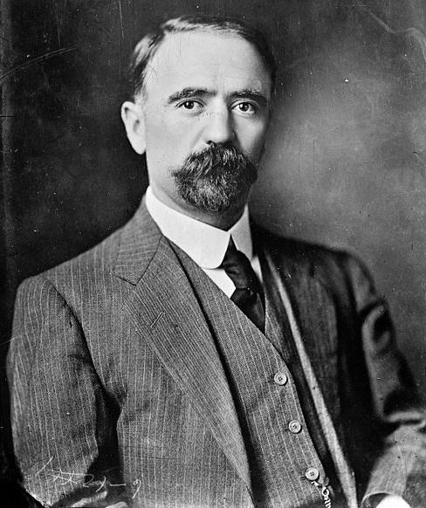
FRANCISCO MADERO
Son of a rich, politically-powerless family from northern state of Coahuila.
1909 Published “The Presidential Succession of 1910”, which called for greater democratic freedoms and the elected vice-president to become Diaz’s successor.
Started the Anti-Reelectionist party to promote himself as presidential candidate.

Slide 12
Francisco Madero’s campaign was well-received
A crowd of 10,000 welcomed Madero in Guadalajara, and throng of 25,000 in Puebla.
Diaz responds with heavy-handed repression – anti-reelection clubs are banned; state committees are jailed; and Madero arrested
Election results: Due to electoral fraud, Porfirio Diaz won by a landslide

Slide 13
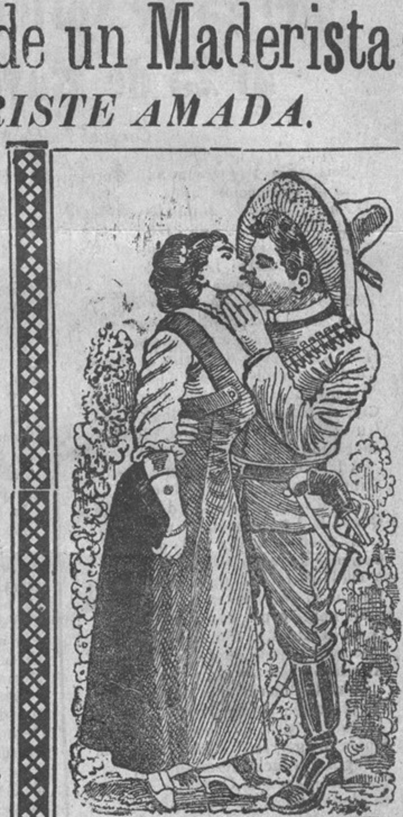
NOVEMBER 1910
Madero escapes house arrest and plans military revolt.
He writes the Plan de San Luis Potosi calling for the insurrection of those that had voted for him and wished greater political freedom.
18 November 1910: first shots fired in Puebla. Aquiles Serdan is the first martyr of the Revolution

Slide 14
20 November 1910 The Revolution begins
The middle-class revolution of Madero supporters in the cities fails.
However, to the surprise of many, including Madero, the insurrection succeeded in the northern mountains ranges of Chihuahua, Durango, and Coahuila.
Here miners unemployed; villagers dispossessed by cotton and cattle haciendas.
Led by men by Pascual Orozco in Chihuahua and Domingo and Mariano Arrieta in Durango.

Slide 15
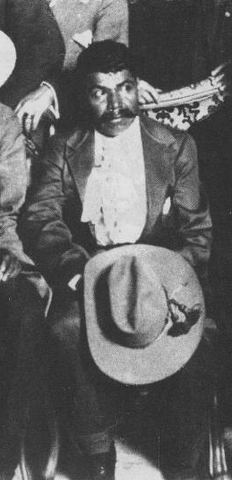
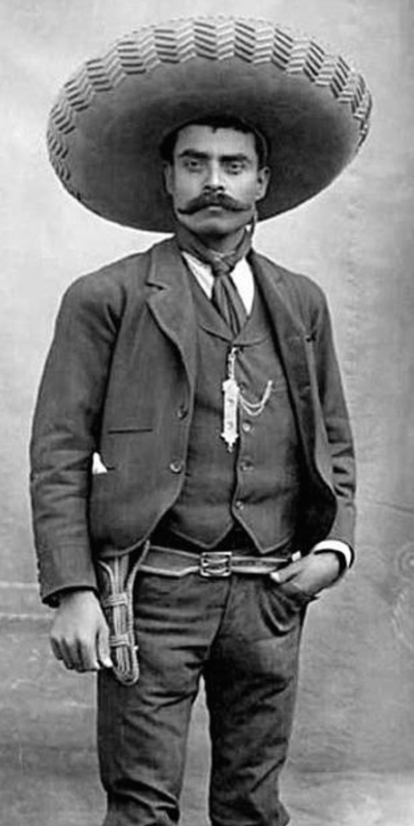
The revolution also succeeded in the sugar plantation region of Morelos
Here the Revolution was led by peasants like Emiliano Zapata and Genovevo de la O, who had seen their village communal lands stolen by hacendados.

Slide 16
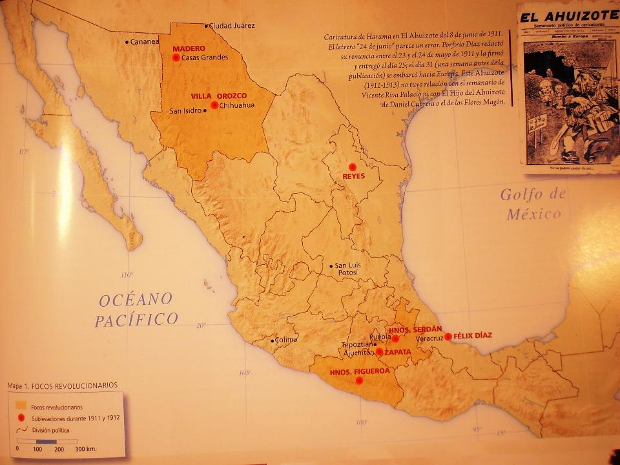
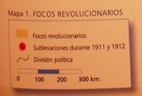

Slide 17
Diaz’s army crumbles, and with capture of Ciudad Juarez he resigns
New elections held in October 1911 and Madero comes to power with 98 per cent of the vote.
BUT, the middle class had come to power on the back of the fighting done by the miners and peasants. The miners and peasants now demanded their grievances were answered.

Slide 18
1911-1920 Revolutionary civil war
The tensions between the aims of the middle-class revolutionaries and their peasant fighters causes fragmentation of revolutionary forces.
Francisco Madero (d. 1913) – middle class revolutionaries.
Venustiano Carranza (d. 1920) – middle class revolutionaries.
Alvaro Obregon (d. 1928) – middle class revolutionaries and some peasant supporters
Vs
Emiliano Zapata (d. 1919) – peasants from southern state of Morelos
Pancho Villa (d. 1923) – peasants from northern states of Chihuahua and Durango

Slide 19
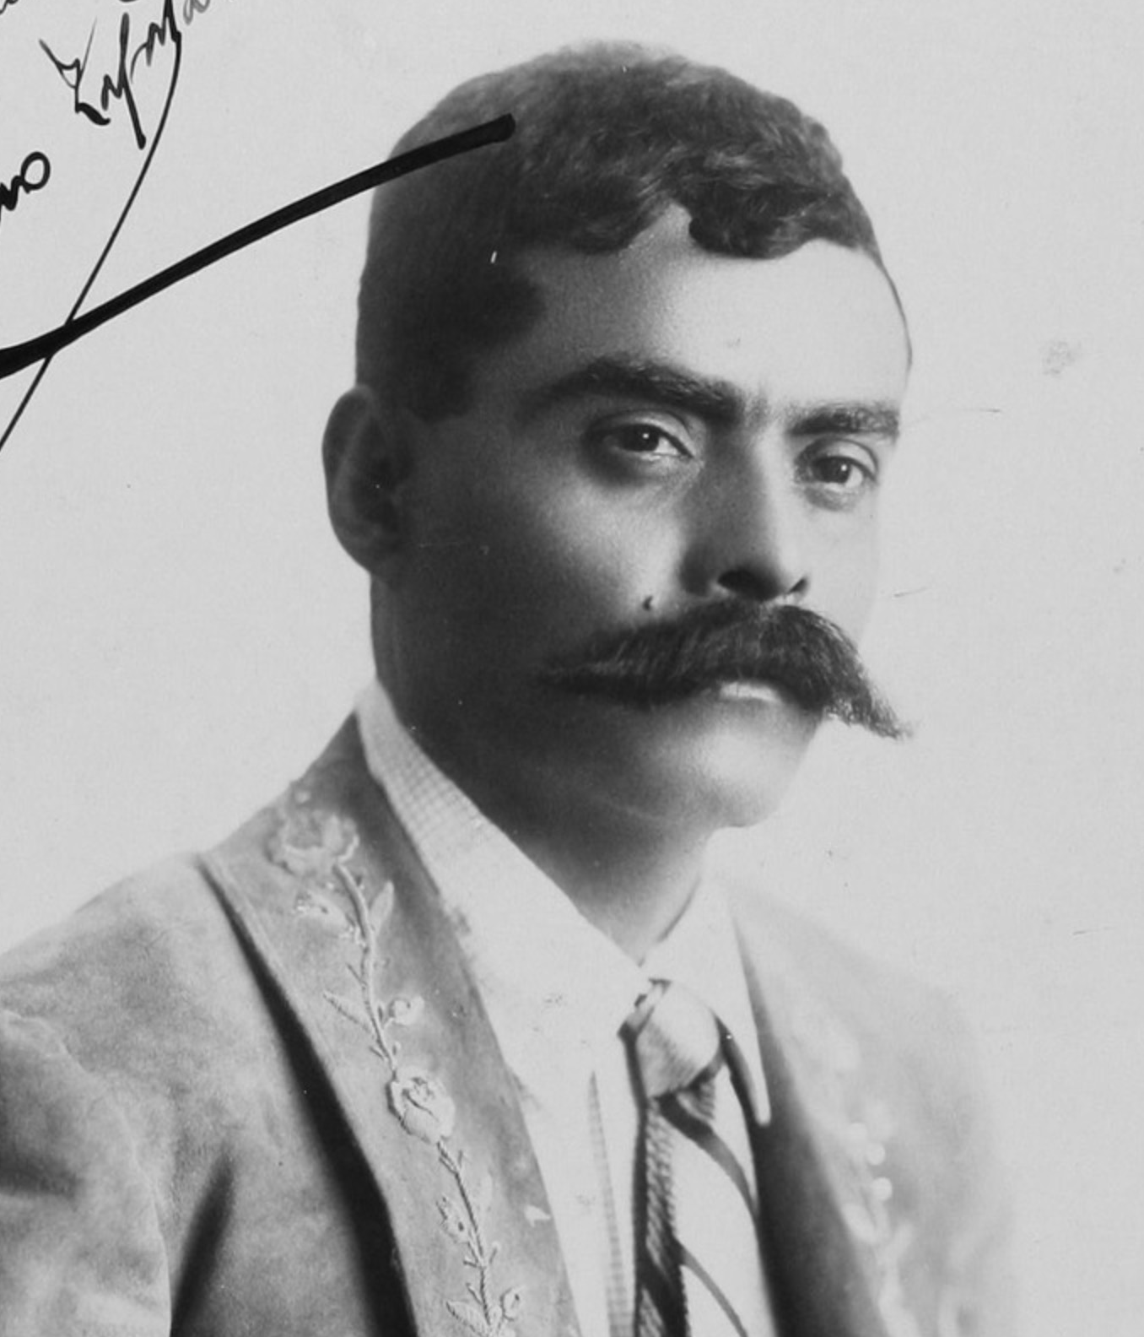
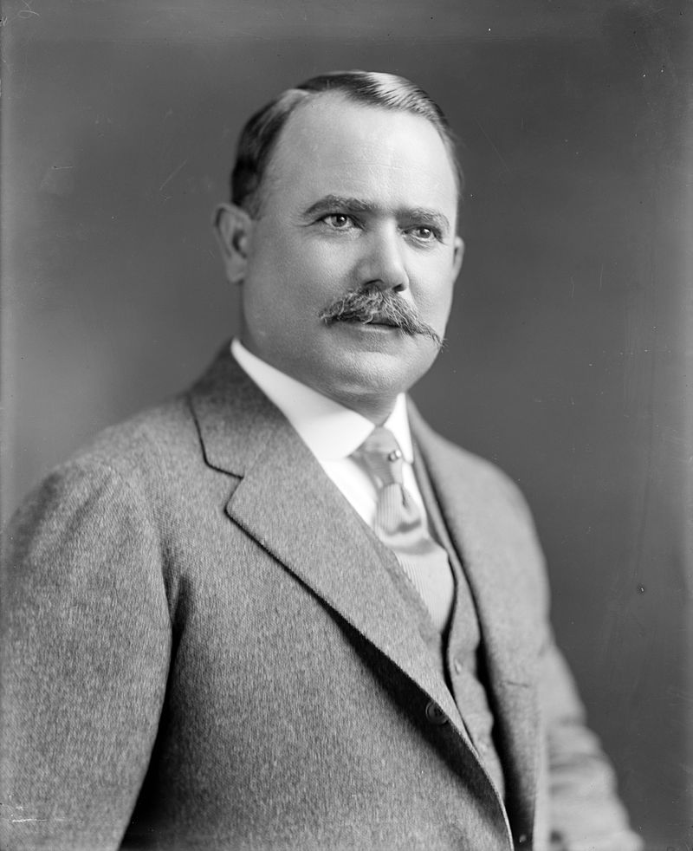
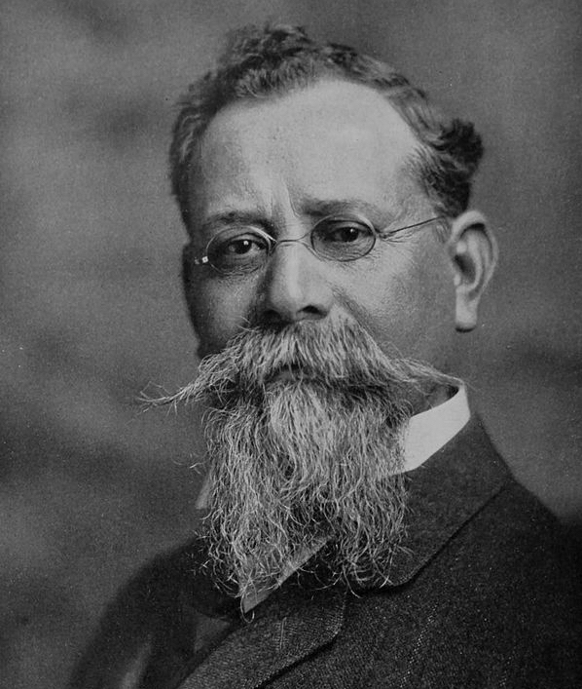
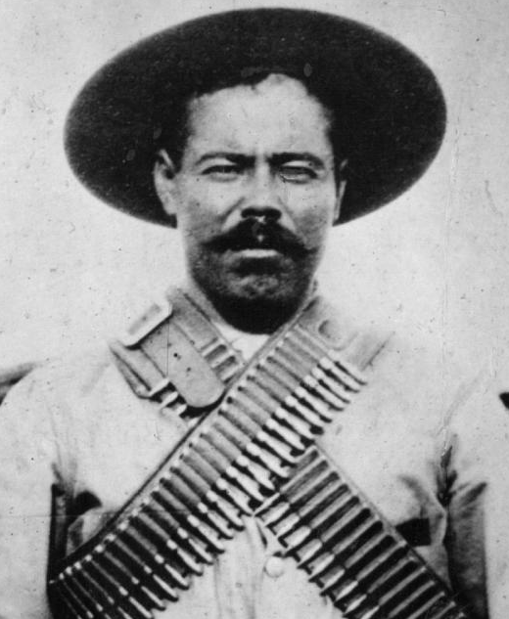
Francisco Madero
Emiliano Zapata
Alvaro Obregon
Venustiano Carranza
Pancho Villa

Slide 20
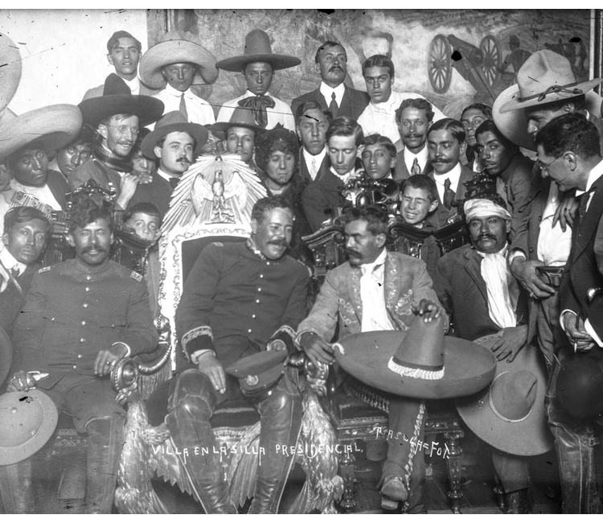
Villa & Zapata at the Presidential Palace

Slide 21
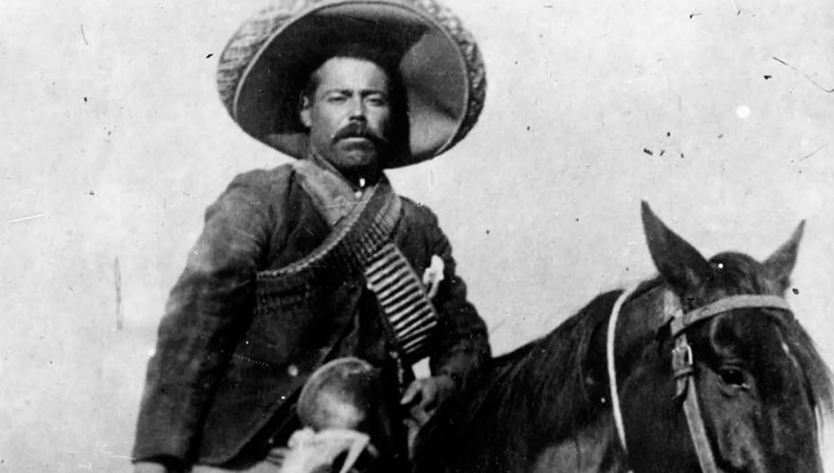
PANCHO VILLA: film star

Slide 22
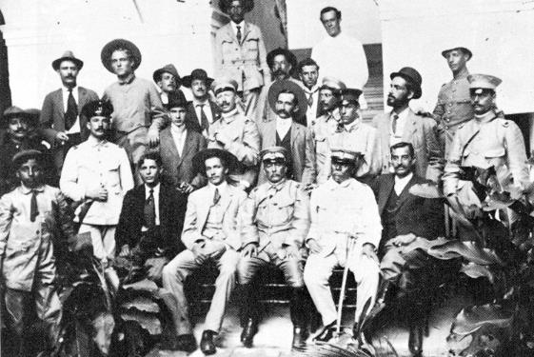
At times right wing supporters of Porfirio Díaz take advantage of these divisions to establish their own counter-revolutionary regime
e.g.
Victoriano Huerta (1913-1914)

Slide 23
HOW DOES IT END?

Slide 24
CARRANCISTAS manage to gain control through co-option and coercion
Co-option
The Carrancistas implement limited social reform.
The Constitution of 1917:
Article 3 calls for free, lay education
Article 27 promises agrarian reform and the return of communal lands
Article 123 was a charter of workers rights.

Slide 25
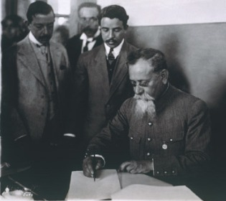
Carranza signs the Constitution

Slide 26
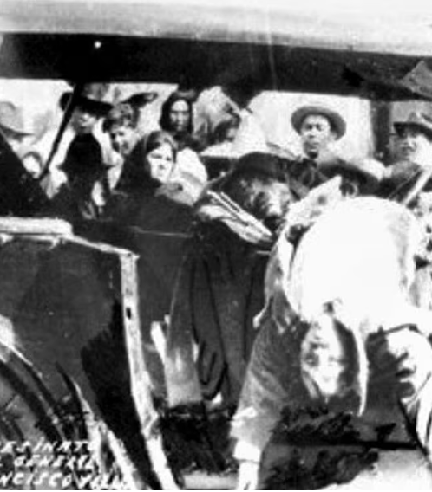
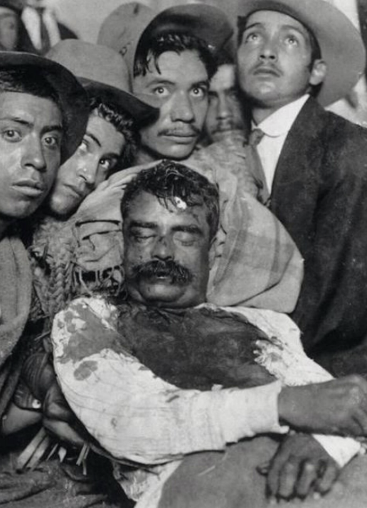
Coercion
Rebel leaders were tracked down and killed from 1917 onwards.
1919 Zapata is betrayed and murdered
1923 Villa is murdered by a hit squad in his ranch in Chihuahua

Slide 27
The Revolutionary Regime, 1920-1940
Land reform
The haciendas were to be divided up into ejidos.
The land could be split between the individual members of the ejido (the ejidatarios) or worked communally.
Prevaricated over, attacked, forgotten about, delayed until 1934-1940 when President Lázaro Cardenas gives out 18 million hectares to 1 million peasants

Slide 28
2. Labor Reform
Although industrial workers (except miners) did not play a key role in the Revolution, Article 123 of the 1917 Constitution made far-reaching labor reforms
These included the eight-hour day, the right to strike, the right to a day’s rest per week, and the right to indemnification following termination of work.
Again, these were predominantly introduced under President Cárdenas

Slide 29
3. Anticlerical reform
Revolutionaries were often highly anticlerical and wanted to shift people’s loyalty from the church to the state.
Prevented religious education, burned saints, closed churches.
This generates two major religious uprisings – the Cristiadas 1926-1929 and 1932-1936.

Slide 30
4. Other reforms
Nationalization of oil (1938) and railways (1936)
Education
Indigenismo
Women’s rights (?)
Healthcare

Slide 31
INTERNATIONAL EFFECTS 1. Political inspiration
“Mexico provided them a formula for how to create a modern nation – use the sovereignty over resources to raise revenue , (wither through taxation or nationalization) and use the money for two things – to distribute a “social wage” and to pay for public health care, public education and other kinds of welfare and to invest in local industry to modernize the economy.” Greg Grandin, America, América. e.g. Nicaragua, Cuba, Peru, Guatemala, Chile, Bolivia, United States

Slide 32
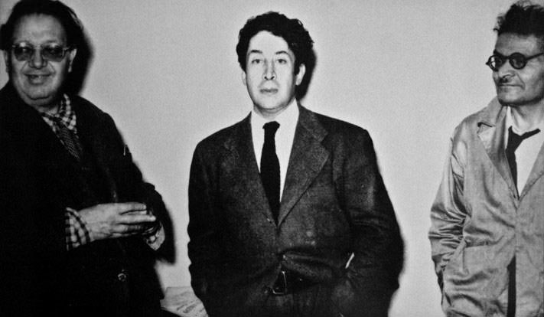
2. Art for the Masses
The pro-peasant, pro-worker and pro-indigenous aims of the revolution were popularised around the world by major revolutionary muralists, Diego Rivera, Jose Clemente Orozco and David Siqueiros.

Slide 33
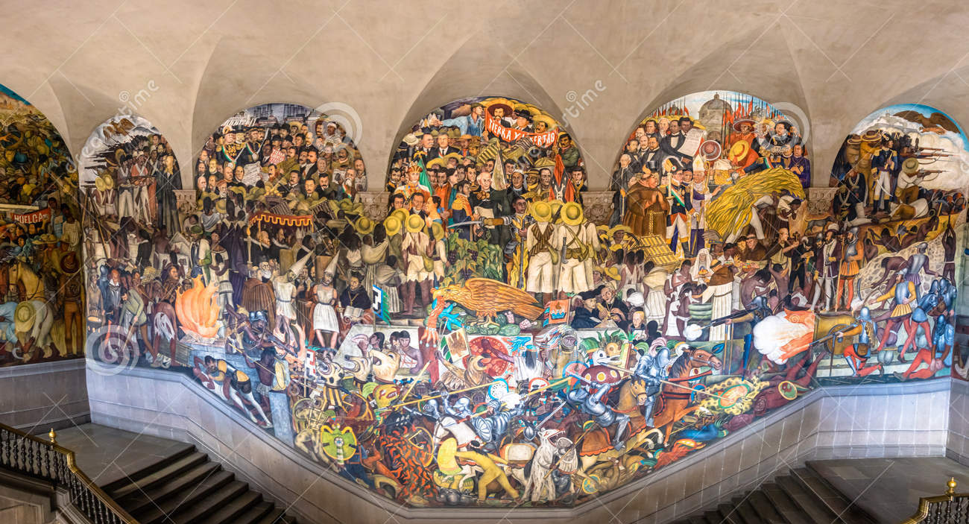
Diego Rivera, The History of Mexico, Mural, National Palace, 1928

Slide 34
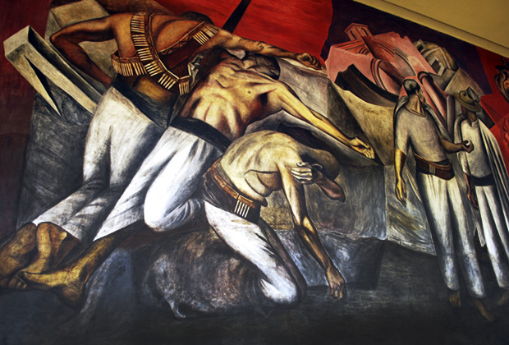
José Clemente OROZCO

Slide 35
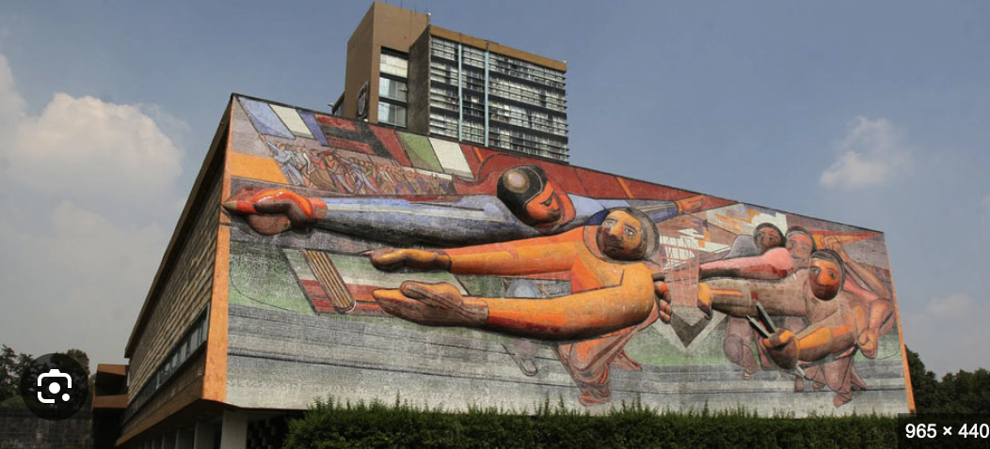

Slide 36
3. Mexico became a hub for political rebels and artists
Many future political leaders flocked to Mexico to experience the revolution first hand. E.g. M.N. Roy, leader of the Indian communist party, Augusto Cesar Sandino, liberator of Nicaragua.
At the same time, many European and US artists also flocked to Mexico. E.g. Tina Modotti, Edward Weston, Anita Brenner.

