Slide 1
Week 7: Modernity in Latin America

Slide 2
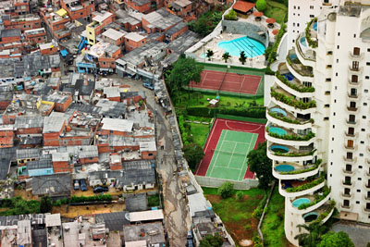
Morumbi neighbourhood, São Paulo, with Paraíso favela next door

Slide 3
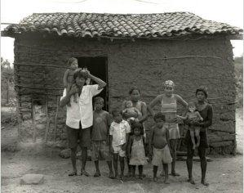
Garapa, dir. Jose Padilha, 2009
A documentary about people living with chronic hunger in Brazil’s arid north-eastern region
Garapa is a sugar solution given by parents to their children to assuage their hunger when they don’t have enough food to eat
Brazil is currently the world’s ninth richest country…
https://www.youtube.com/watch?v=efQcYZuq7G4

Slide 4
Readings
Aguilar-Rodríguez, Sandra. “Cooking Modernity: Nutrition Policies, Class, and Gender in 1940s and 1950s Mexico City.” The Americas, vol. 64, no. 2, 2007
Janice E. Perlman, “The Metamorphosis of Marginality: Four Generations in the Favelas of Rio de Janeiro,” Annals of the American Academy of Political and Social Science (July 2006)

Slide 5
Janice Perlman, president of the Megacities project…
https://www.youtube.com/watch?v=JTODK8nAaiY

Slide 6
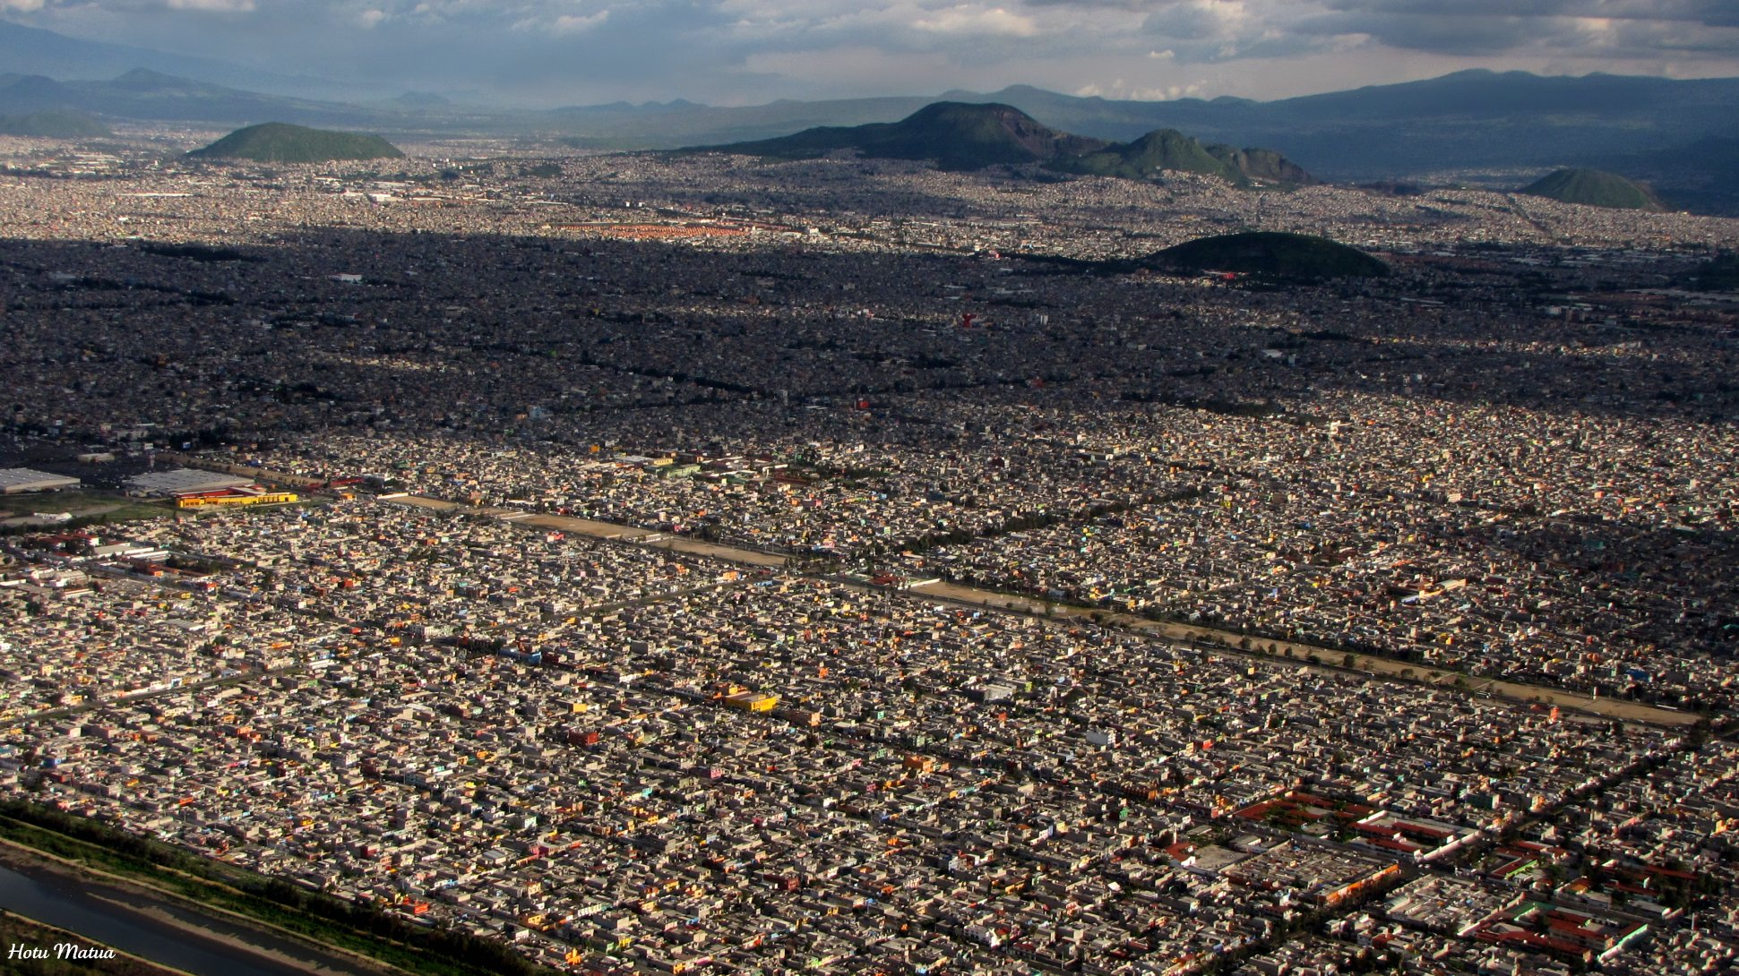
2020 Census CN1,077,208 CDMX 21,804,515

Slide 7
Questions
How did urbanization affect Latin America?
How did mass consumer culture affect Latin America?
Perlman: what techniques and methods does she use? What was the origin of the city's favela growth? How has "marginality" been perpetuated across the generations in Rio? How does consumption relate to marginality/ poverty?
Aguilar-Rodriguez: what can the history of food tell us about Latin American history more generally? How did the attempted 'modernisation' of eating affect gender roles in Mexico City?

