Slide 1
Latin America Today

Slide 2
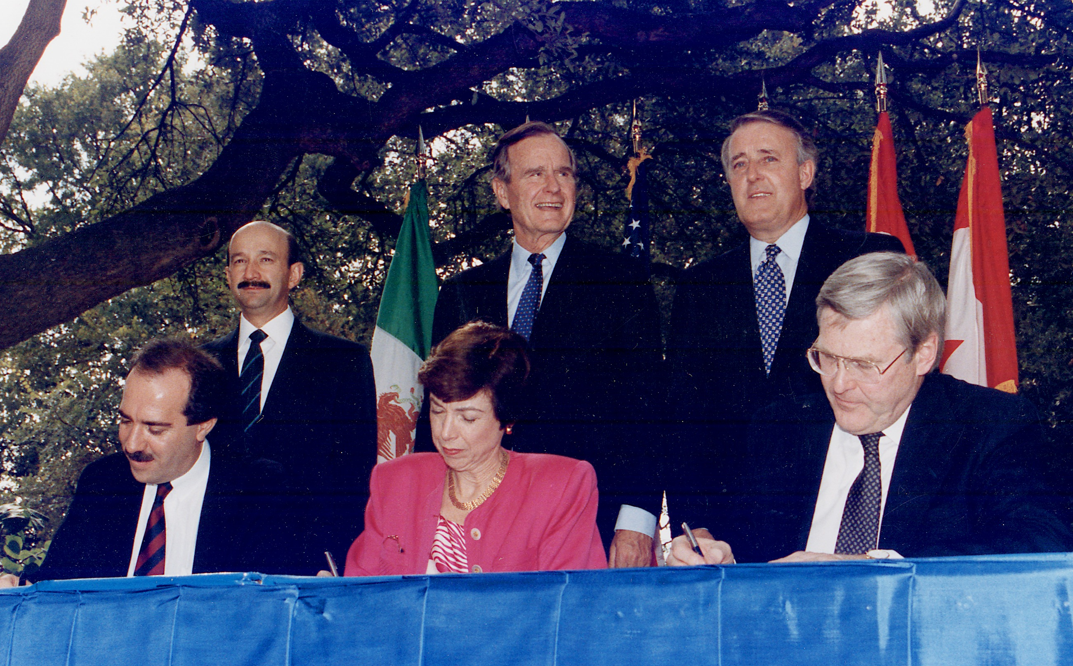
Mexico, January 1 1994
Victory of neoliberal capitalism over state-controlled economies
Mexico would re-write the 1917 Constitution allowing foreign ownership of Mexican resources
Mexico would be flooded with cheap GM crops produced in the US and Canada
Relocation of manufacturing plants to northern Mexico
Francis Fukuyama’s End of History

Slide 3
The EZLN Fight Back
The Ejercito Zapatistas Liberacion Nacional (EZLN), better known as the Zapatistas
01.01.1994 rose up in the primarily indigenous state of Chiapas, southern Mexico
Old and new – iconic Cuban guerrillismo with language of indigenous and women’s rights
Figure of subcomandante Marcos, more recently Capitan Marcos – internet celebrity

Slide 4
Social Movements and the 1990s
End of the Cold War and right-wing reaction against class-based movements
New movements emerge, tied to traditional left-wing movements but emphasising other characteristics – gender, environment, indigenous rights, Afro-Latino rights, social justice
MST and EZLN – both tied to the Left but put forward ideas of social justice, land rights, and for the EZLN indigenous rights
Water (1999-2000) and Gas (2003-2006) Wars in Bolivia – grassroots, often indigenous led, movements against water and gas privitisation

Slide 5
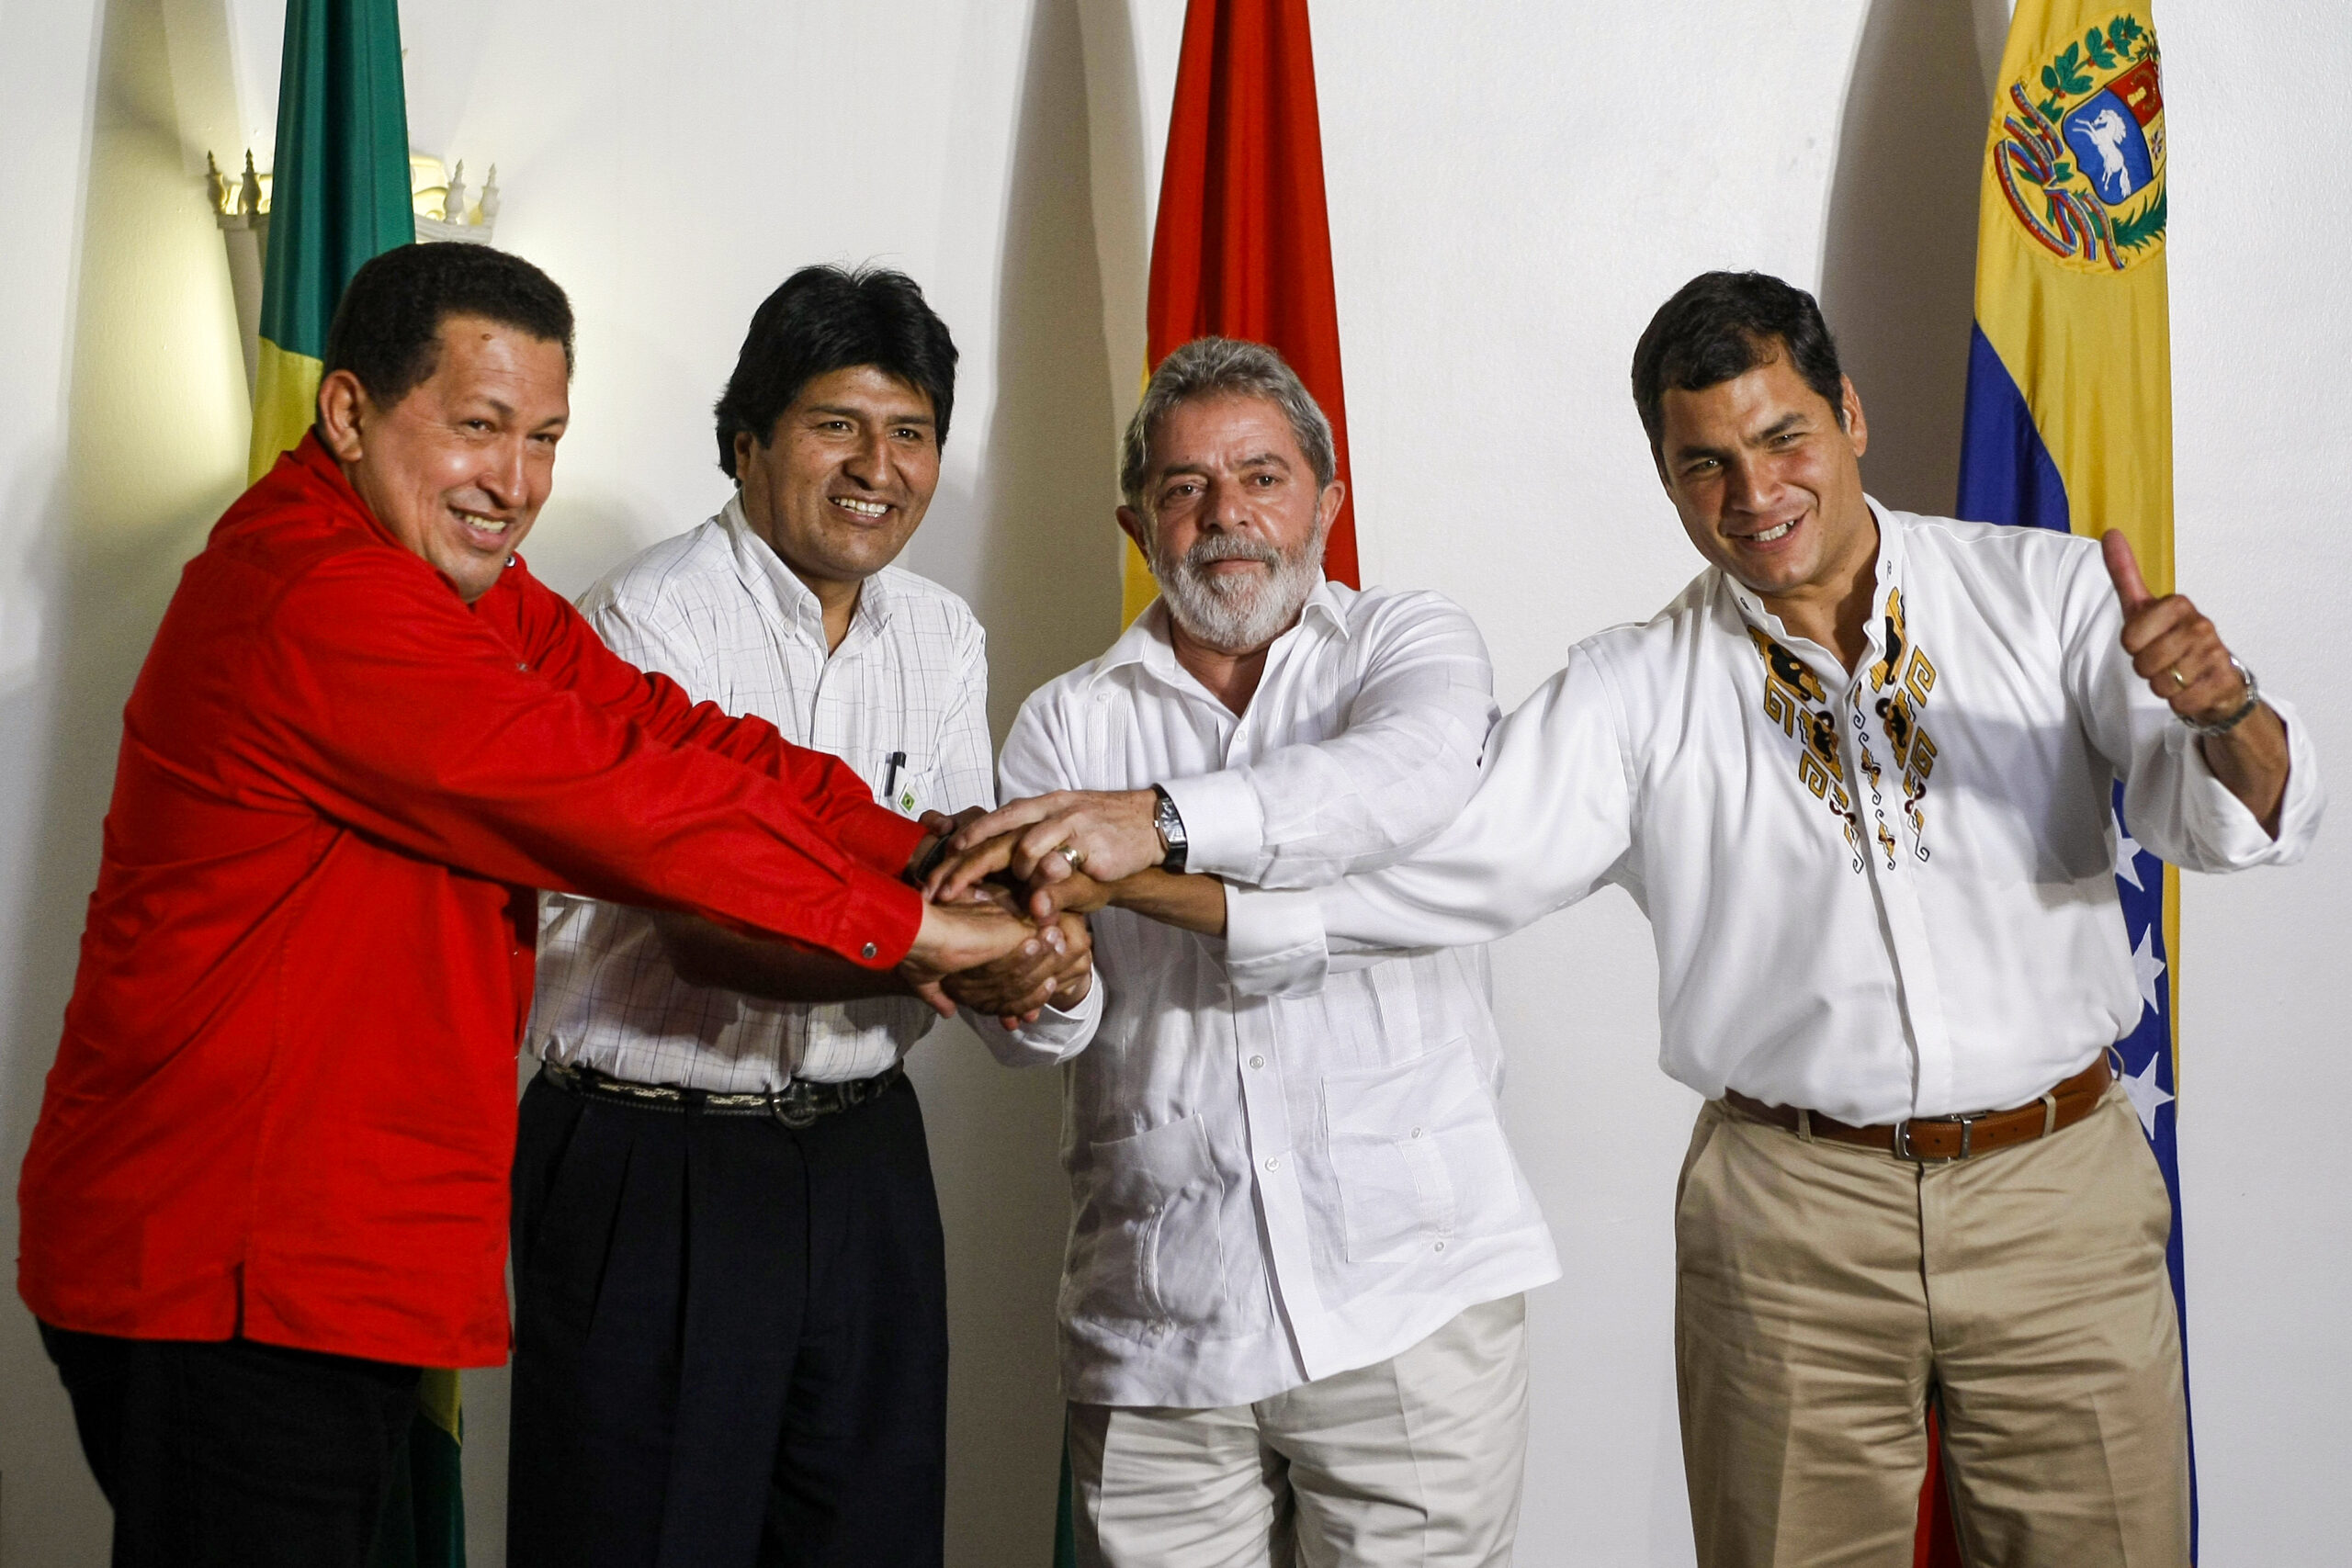
Pink Tide
Emerged in the decade following end of dictatorship
Some emerge from new social movements – Lula the trade unions, Morales through Gas and Water Wars
Centre-left to far-left populist movements, ‘Socialism of the 21st Century’
Hugo Chávez elected 1998 beginning ‘Pink Tide’
Left to Right: Hugo Chávez of Venezuela, Evo Morales of Bolivia, Lula da Silva of Brazil, and Rafael Correa of Ecuador

Slide 6
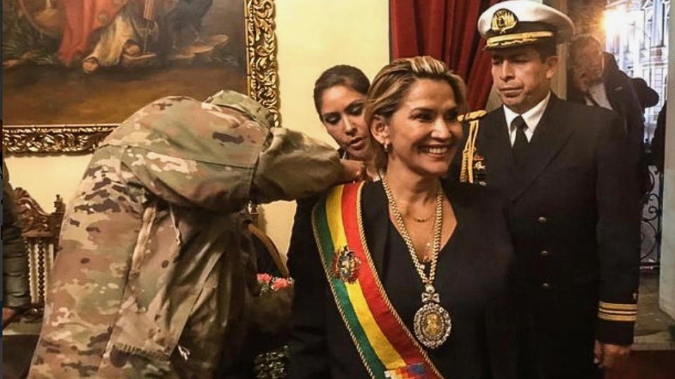
Pink Tide and Legacies
Populism and Cold War legacies led to intense political polarisation
Bolsonaro: ‘What debt? I never enslaved anyone in my life. Look, if you really look at history, the Portuguese didn’t even step foot in Africa. The blacks themselves turned over the slaves.’
Also Bolsonaro: ‘We're going to shoot all the PT supporters in Acre’
Second wave – late-2010s, early-2020s. Gustavo Petro in Colombia, AMLO and Claudia Sheinbaum in Mexico
Jeanine Áñez during the 2019 coup

Slide 7
Violence
No major inter-state wars since the Chaco War, only border conflicts, but several civil wars
Colombian Conflict – Colombian state, far-right militias, leftist paramilitaries, and drug cartels
2022 Truth Commission: 80% casualties civilians. 45% paramilitaries; 27% guerrillas; 12% state; 16% mixed or cartels
2025 Brazilian police massacre in Rio – estimated 117 killed

Slide 8
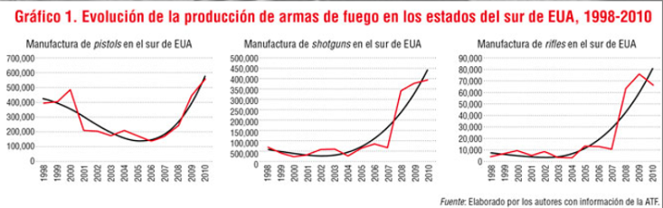
War on Drugs
Main reason for expansion of violence
43 of 50 cities in 2017 with highest homicide rates in Latin America
Why: large inequality with weak state institutions; US market demand; US weapon exportation
2004 US allows automatic rifles to be sold over-the-counter

Slide 9
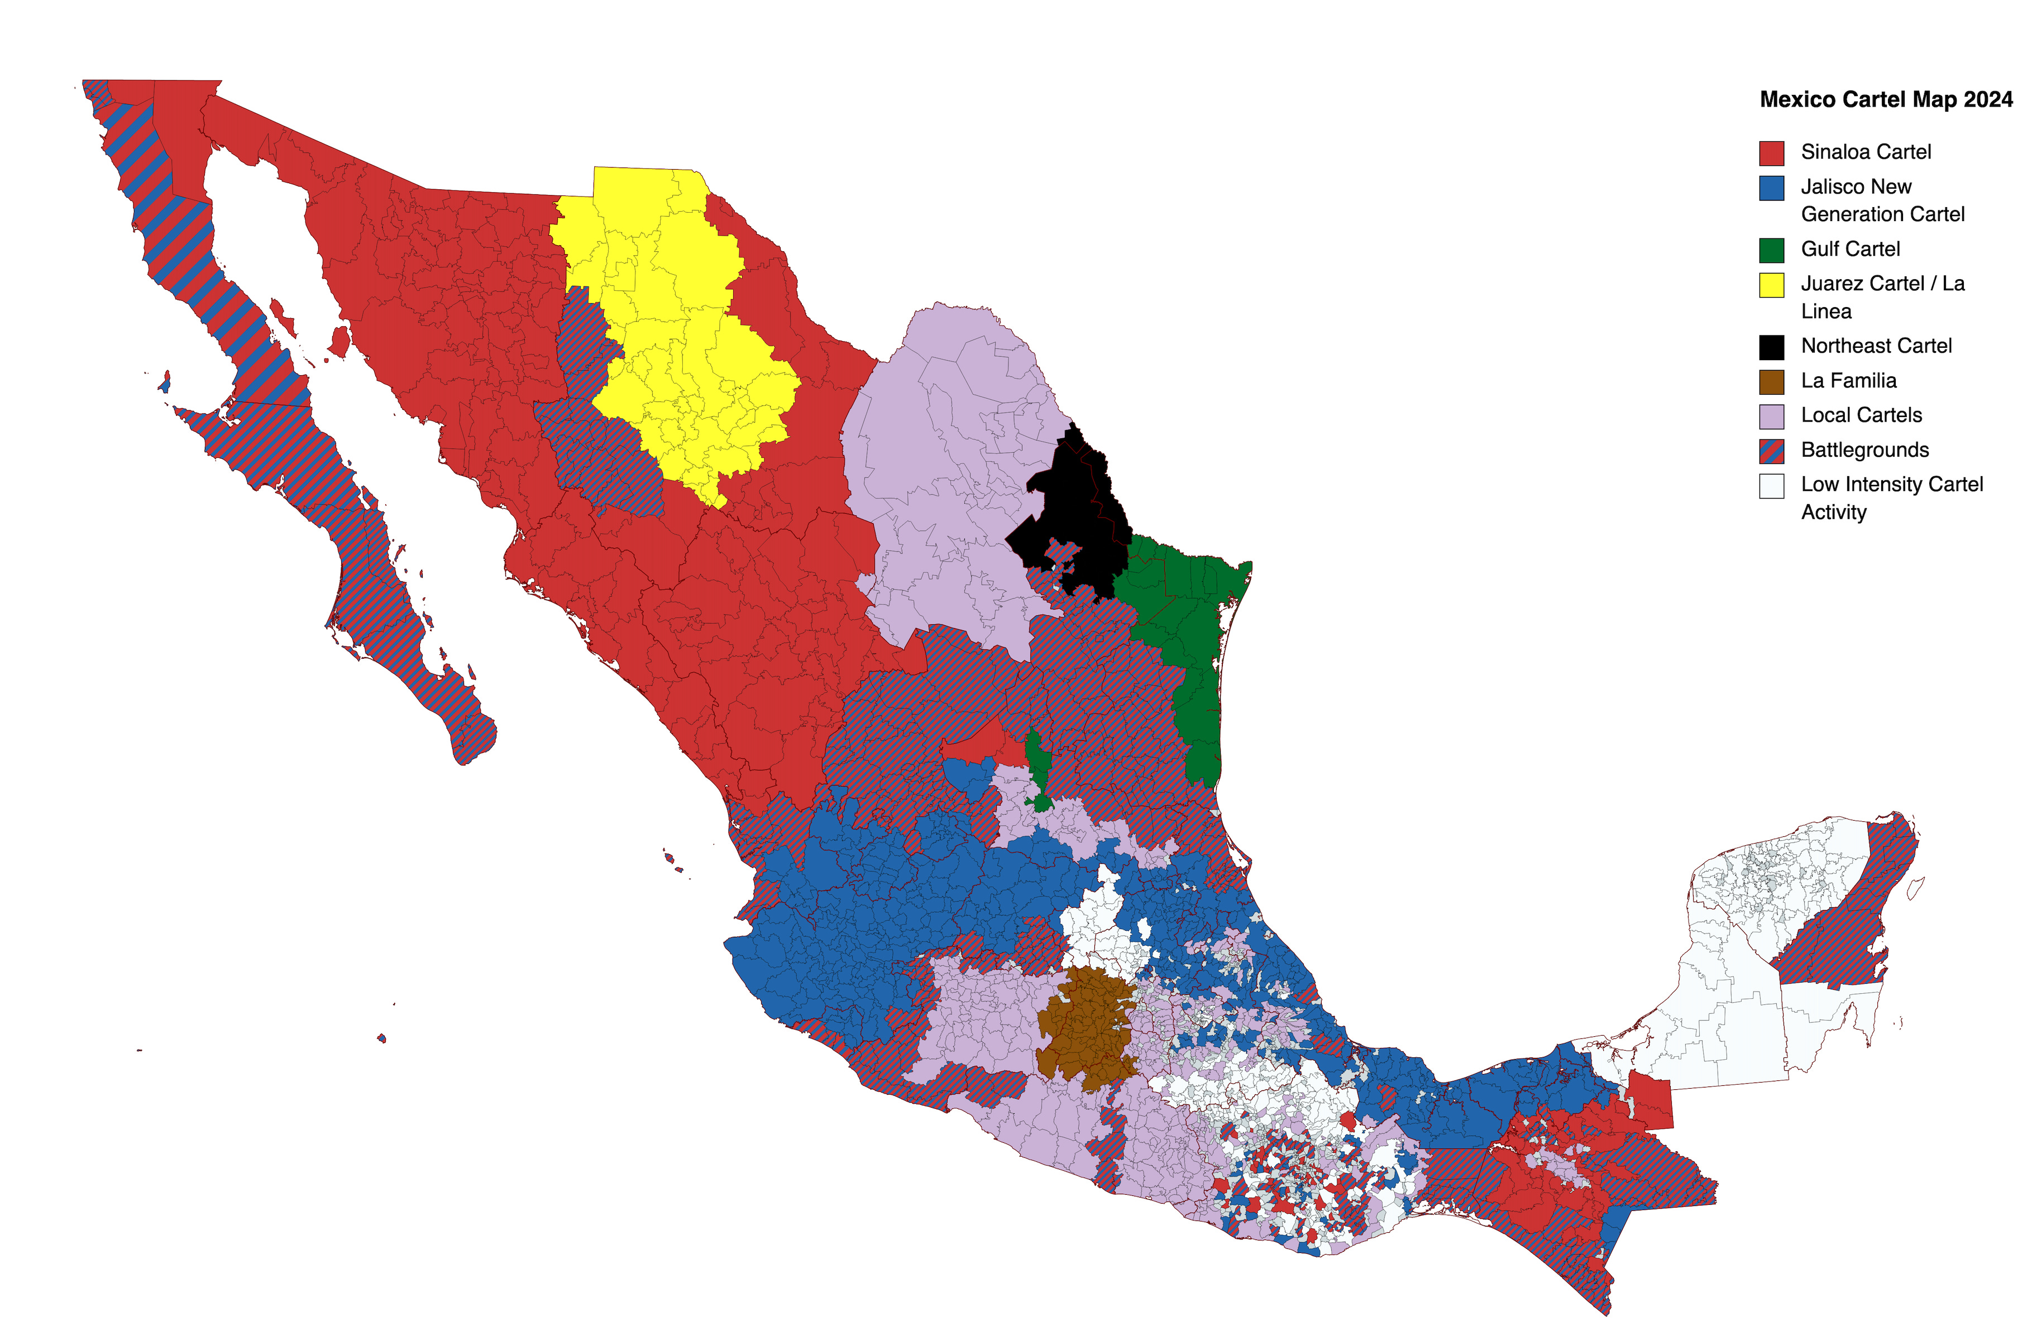
Mexican Cartels
Emerged from local drug gangs and networks since the 1970s
Collapse of Cali and Medellin Cartels in the 1990s let them control the trade
Kingpin and Democracy – new people to bribe and replacing leaders
Succession wars – rise of Sinaloa, La Familia Michoacana, CJNG

Slide 10
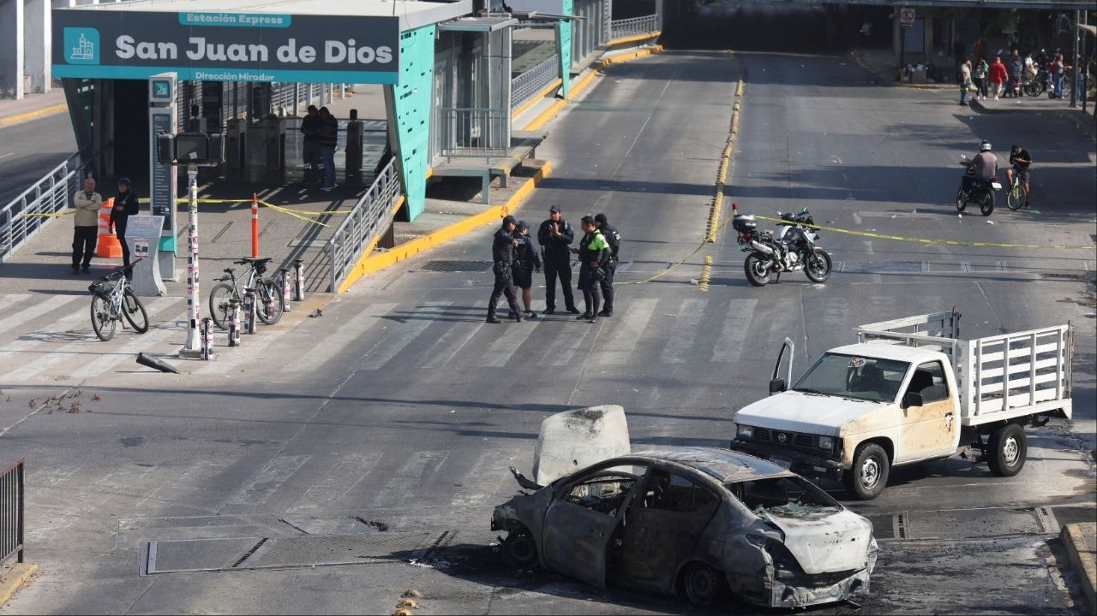
Violence, Cartels, Culture
Ciudad Juárez femicides
State violence – 2006 Michoacan campaign
2014 Disappearance of 43 students in Guerrero
Los Zetas – emerged from the army
Narcomensajes
Narcocorridos

Slide 11
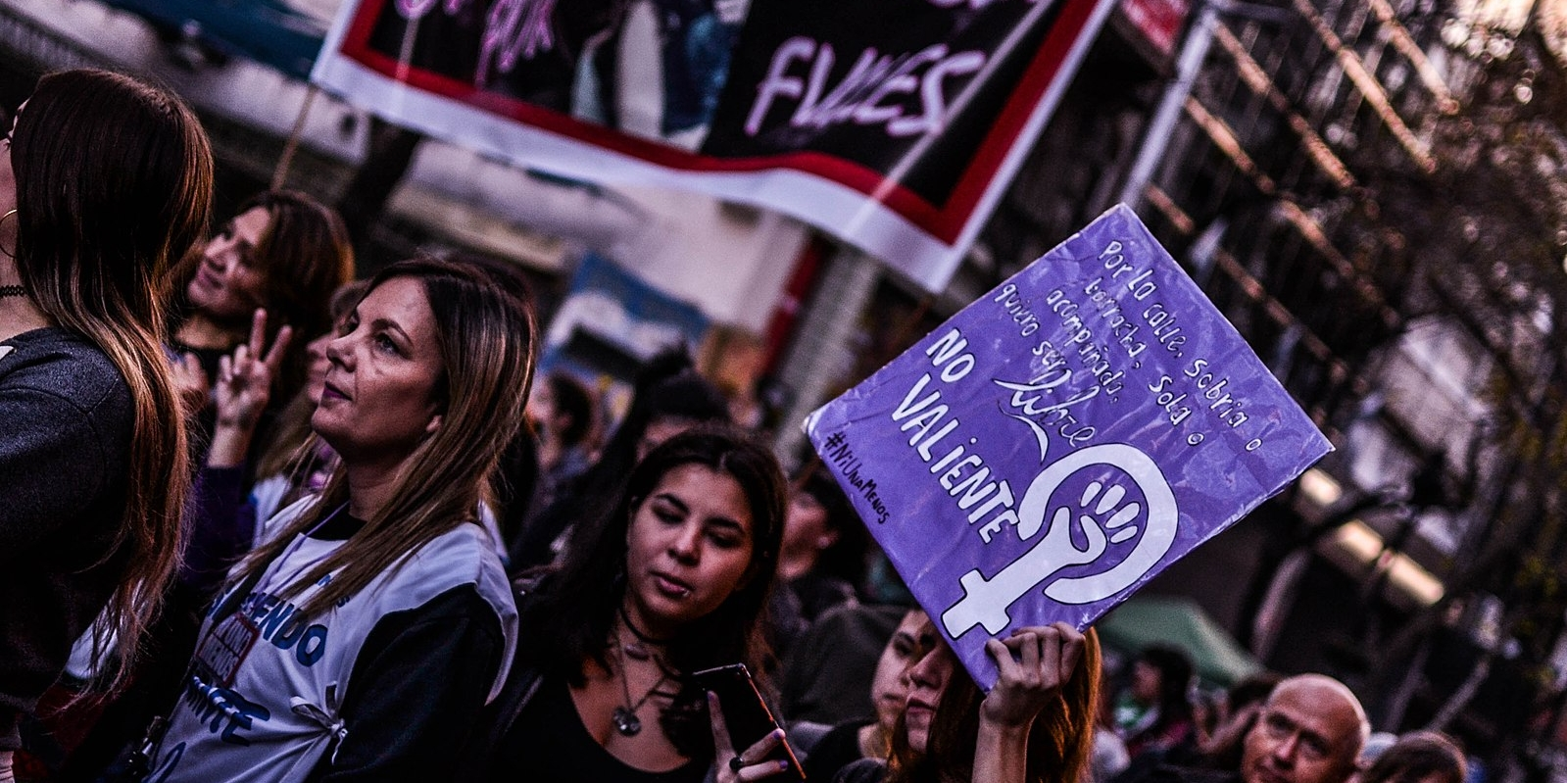
Responses
Social movements fill the void left by violence and state failure
Oaxaca 2006 – establishment of autonomous communities
Ni una menos (Not one woman less) – founded 2015 in Argentina against femicide, from a Mexican song
Cop30 and indigenous Brazilians

Slide 12
Adios y Buena Suerte

