Slide 1
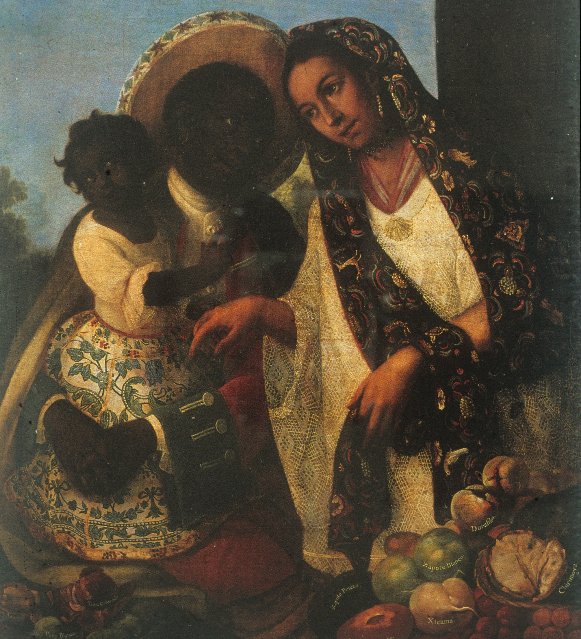
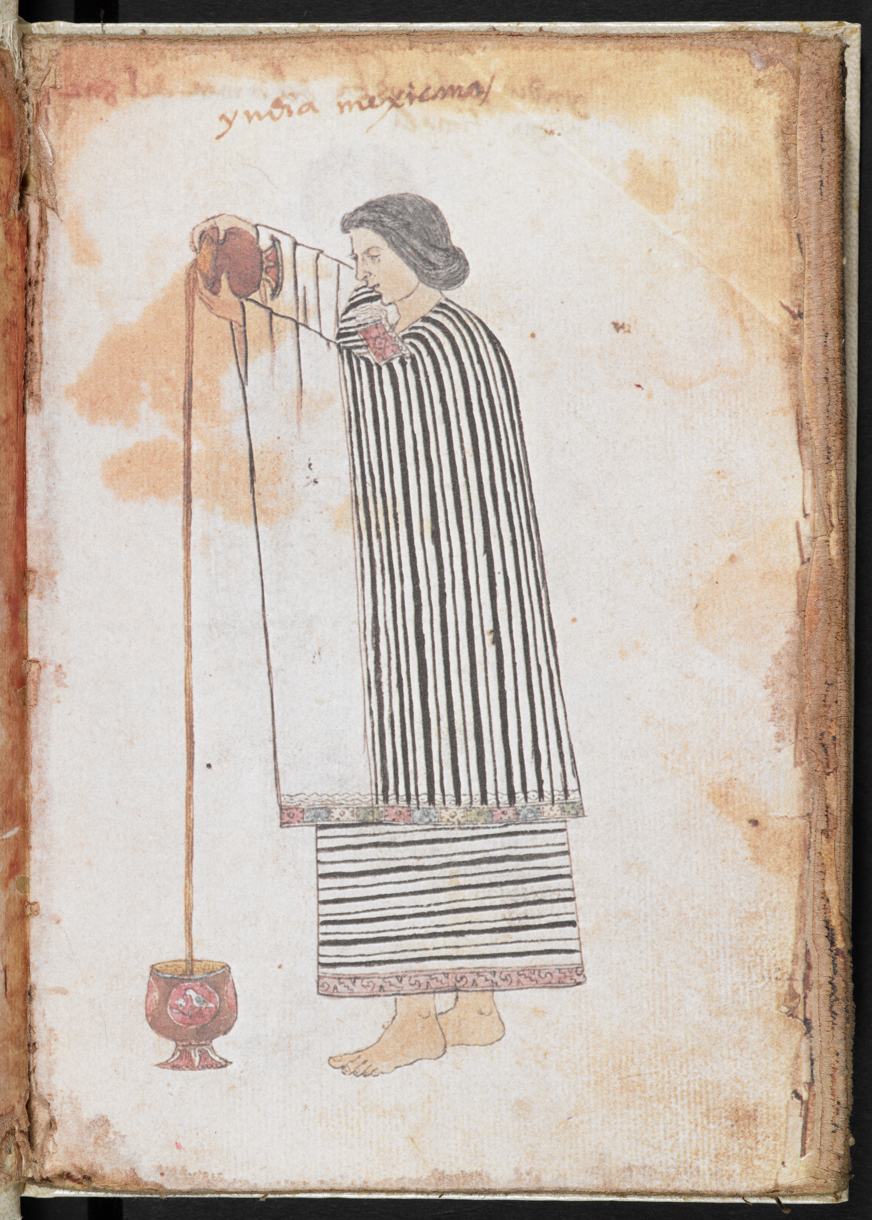
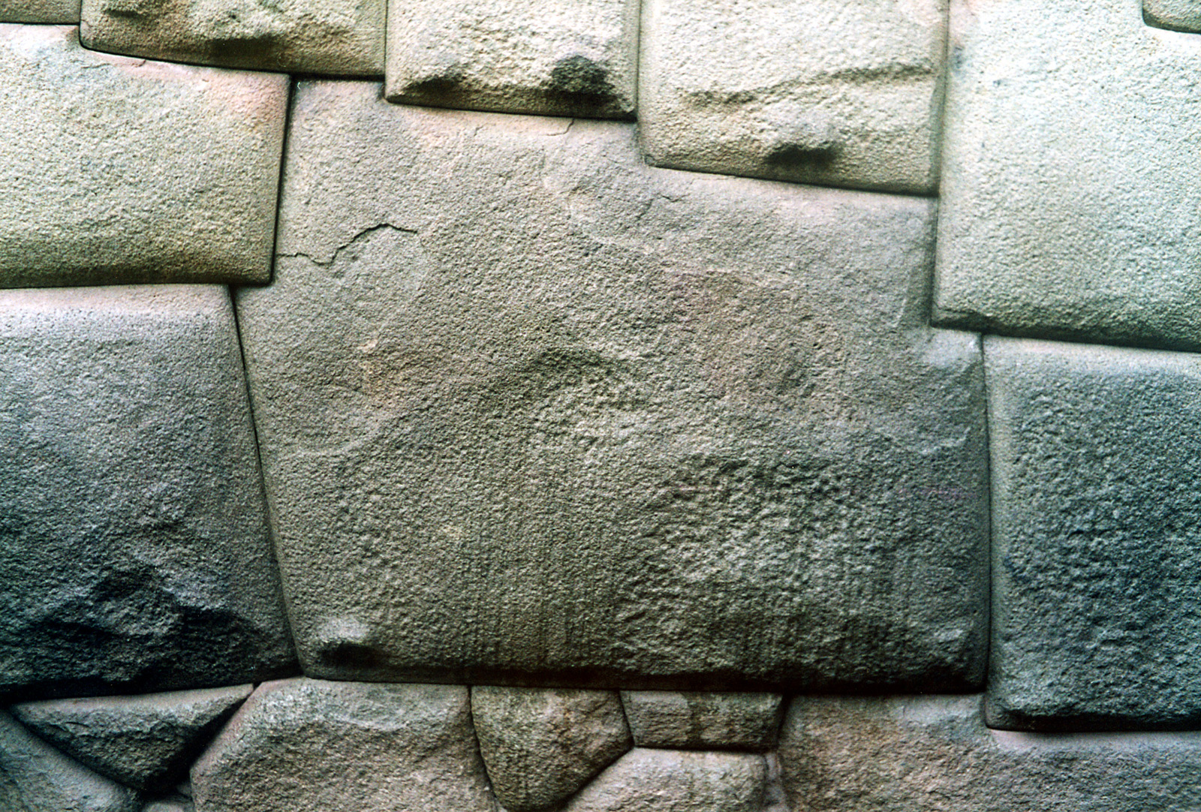
Colonial Society and Culture

Slide 2
A Reminder of Last Week’s Topics
Settlement through the founding of cities and establishment of an administrative structure
Demography: millions of indigenous people died. Population decreases from 60 million to 10 million during century after Conquest.
Coercive Labour regimes: encomienda (grants of indigenous labour) and slavery.

Slide 3
Colonial Society consisted of four/five key groups
Spanish born in Spain (Peninsulares)
Spanish born in Latin America (Creoles)
Indigenous Groups. Remnants of Inca and Aztec empires but also hundreds of other each with individual cultures and languages.
Africans
Descendents of all these groups

Slide 4
The Transatlantic Slave Trade in Colonial Latin America
Over 7,000,000 Africans were brought as enslaved persons to Latin America during the colonial era (1492-1886).
Nearly 1,000,000 Africans were taken to Latin America between 1500 and 1650 alone.
During the same period less than half that number (roughly 438,000) of Spaniards travelled to the Americas.
You can get much more detailed information from the Slave Voyages Database, https://www.slavevoyages.org/assessment/estimates

Slide 5
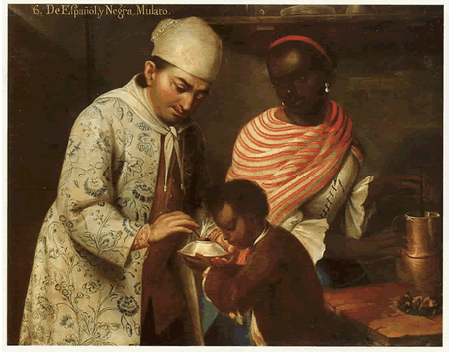
Colonial Latin America was a “racist” society.
One Key Point
‘race’ or ‘caste’ was central to structuring colonial society
José de Alcíbar (attrib.), From a Spanish Man and a Black Woman a Mulatto is Born (Denver Art Museum, c.1760-70)

Slide 6
Colonial Latin America was organized, at least in theory, on racial lines
The Spanish were meant to keep to certain towns and cities.
The indigenous were meant to keep to their rural pueblos (villages).
Slaves were meant to keep to slave plantations.
Miscegenation was occasionally legally prohibited.
There was no equality before the law. Different groups had access to different court systems.
Certain economic systems were predicated on racial difference (slavery of both Africans and indigenous people), encomienda (labour draft), taxation.

Slide 7
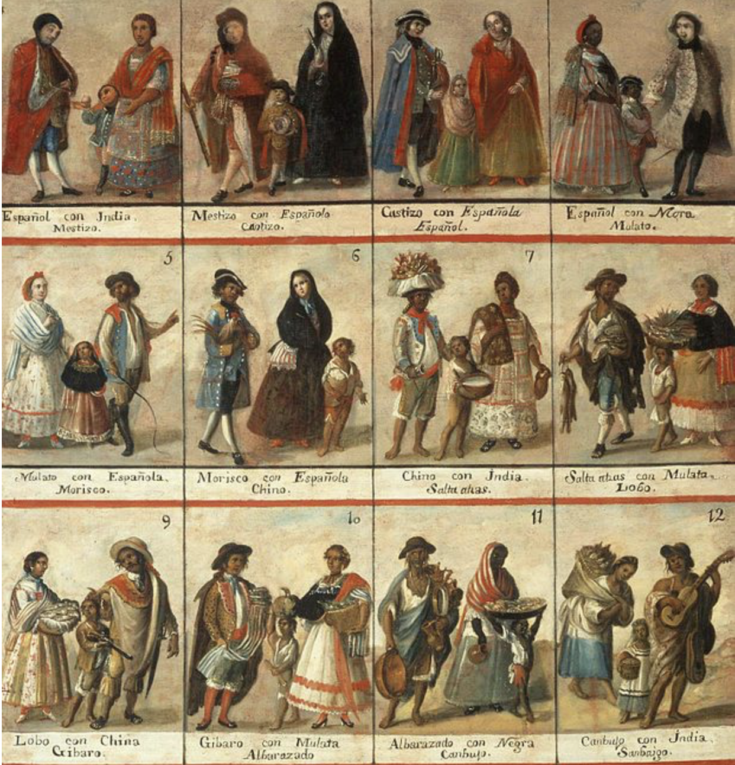
By the C18, this theory of racial dominance had solidified into a so called “casta system”

Slide 8
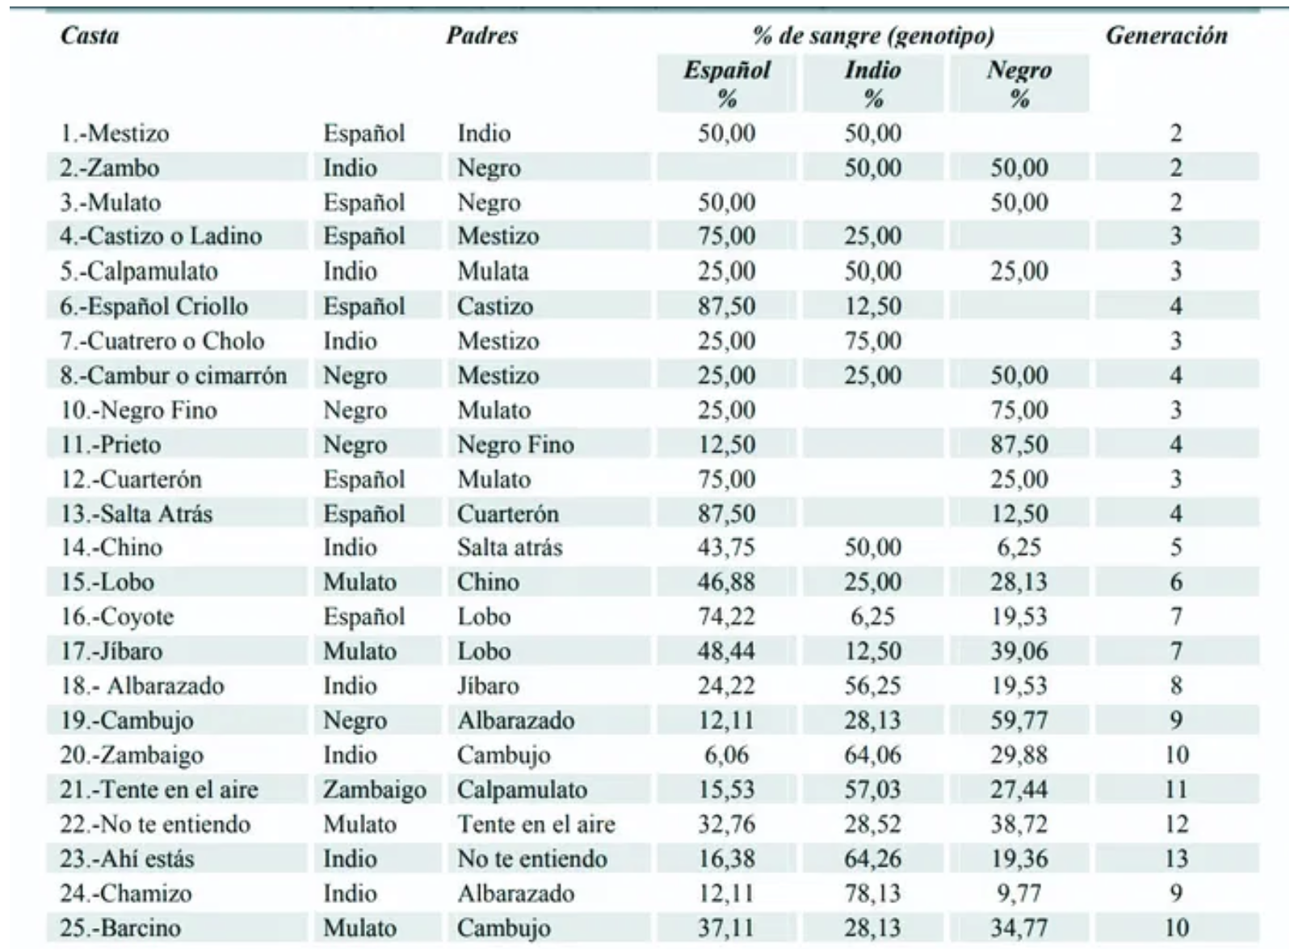
This theoretical hierarchy was based on purity of blood
Peninsulares:. Children of two Spanish-born parents
Criollos: Children of two Spanish parents born in the colonies
Mestizos: Children of a Spanish parent and an Indigenous parent,
Mulatos: Children of a Spanish parent and an African parent,
Zambos: Children of an Indigenous parent and an African parent,
Castizos: Children of a Mestizo parent and a Spanish parent,
Moriscos: Children of a Mulatto parent and a Spanish parent.
Tresalvos: Children born from a union of a Morisco parent and a Spanish parent,
Lobos (from a African and Indian parentage), and Coyotes (from Mestizo and Indigenous parents).

Slide 9
On the surface then, Latin America might seem like the British American colonies, a form of racial settler colonialism.
In reality, however, it was the first experiment in multiculturalism.

Slide 10
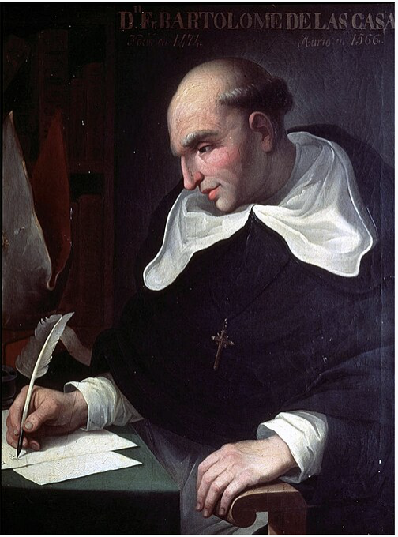
Why?
1) Universal rights
Spanish priest, Bartolomé de las Casas, (1484-1566) started as a believer in Spanish racial dominance. However, after years as an encomienda owner, he gave up his indigenous slaves, he joined the Dominican order.
From then on, together with other Spanish jurists and friars he published reams of criticisms of colonialism and fought for indigenous peoples (and Africans) to hold the same rights as Spanish colonists.
1550-1 Valladolid debate between De las Casas and Juan Ginés de Sepúlveda.
Though not entirely implemented, De las Casas’s vision shaped colonial Latin America, allowing indigenous groups access to rights, especially in court.

Slide 11
2) Everyday life.
Latin America had issues the British colonies didn’t have:
a demographic disaster and the need for labor,
impenetrable mountains and jungles,
no standing army,
limited Spanish colonisers
As a result, the Spanish monarchy was unable to enforce a racial hierarchy with any degree of success.
Mixing and fluidity ensued.

Slide 12
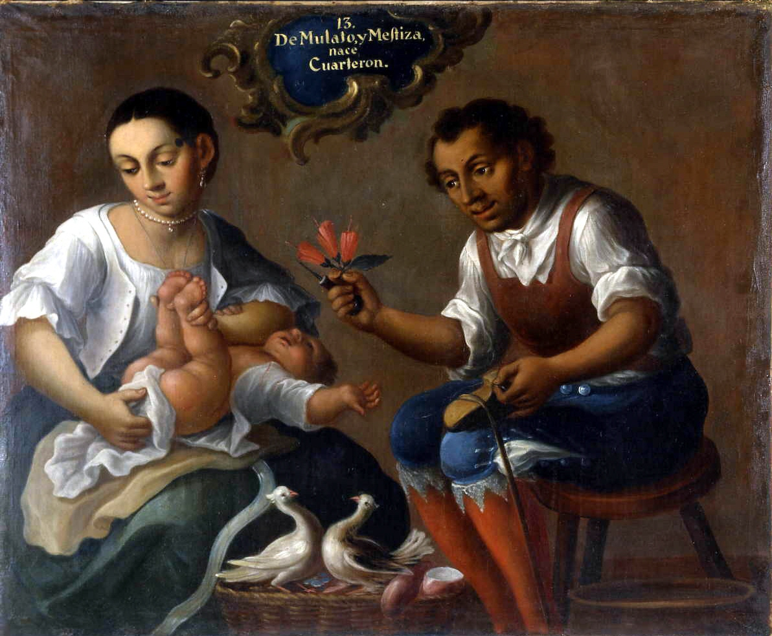
Everyday Life in the Indies
How can we study this?
Some sources:
Court records
Letters
Material culture
José Joaquín Magón, From a Mulato and a Mestiza is Born a Quadroon, c.1770, Museo de Antropología, Madrid.

Slide 13
Court records
Colonial society was very litigious
Domestic disputes between husbands and wives, petitions from enslaved men and women, conflicts between neighbours (violence, insults, lawsuits) . . .
Good source of information about gender norms
Reveal the central role of honour.

Slide 14
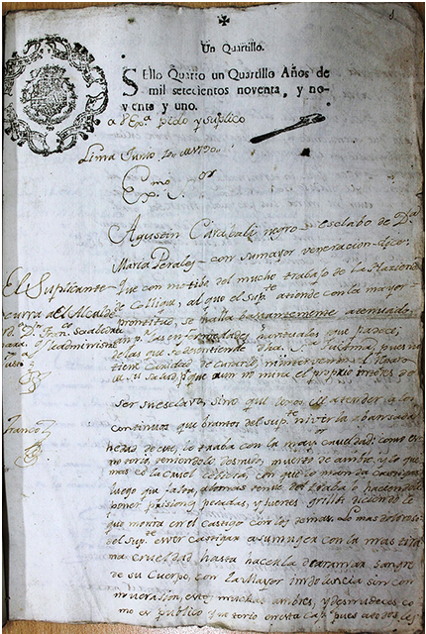
Many people went to court
The first page of a petition by the African-born, nonliterate enslaved man named Agustín Carabali.
It was submitted to the court in Lima in 1790.
Carabali accused his owner of abuse.
He won.
From Peru’s Archivo General de la Nación.
Notes:
The African-born slave Agustín Carabali, who charged his owner with abuse in civil court, wandered these back alleys. He first paid a popular legal writer—whose name he could not later remember—to pen an opening petition for him. Apparently, the rough language or legal faults of the petition caught the eye of the court receptor when Agustín attempted to submit it, so the receptor told the slave to have the petition rewritten. While the court receptor probably referred him to an official writer, Agustín ended up finding his next legal amanuensis in a tavern. A “negro criollo” named José, who rented a room in the house of one of the city’s licensed attorneys, was a frequent customer in the establishment. Presumably, José’s residence with the lawyer gave him access to legal knowledge. Putting this know-how to use, José rewrote the petition in the third person, signing at the end with squiggles and flourishes that were supposed to replicate the escudo, or coat of arms, a public notary might use to distinguish his signature, as shown in Figures 1 and 2. It appears that the receptor accepted this second, more elaborate but still rough, copy, making a few amendments and grammatical corrections.

Slide 15
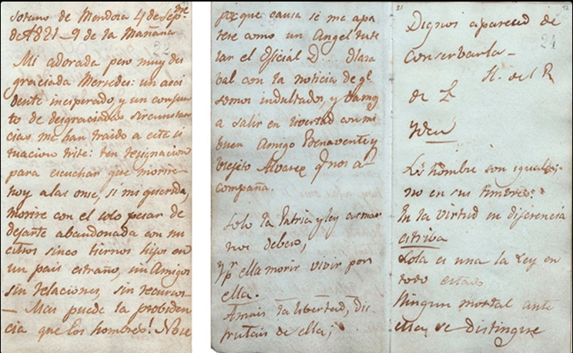
Letters
Farewell letter sent by José Miguel Carrera to his wife Mercedes Fontecilla, 4 Sept. 1821 .

Slide 16
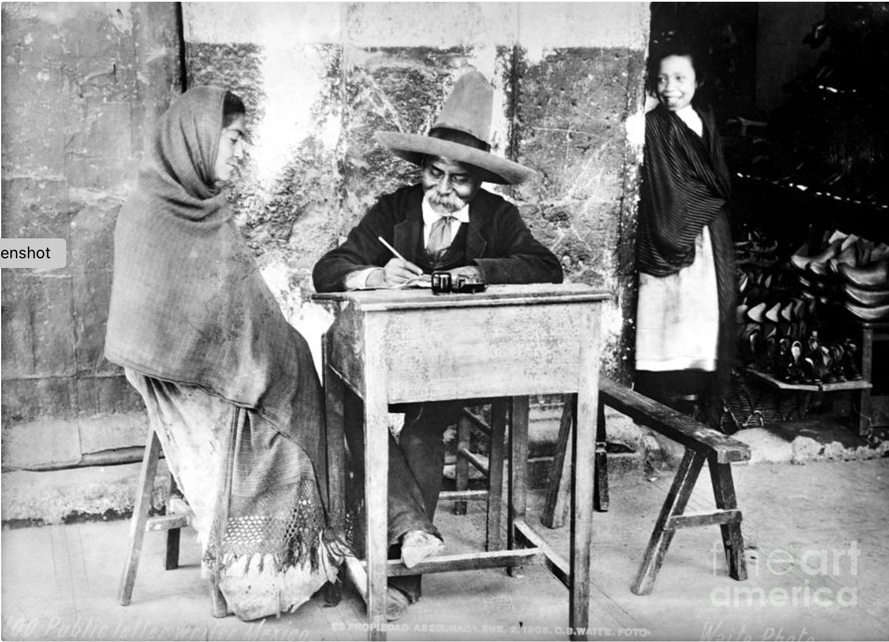
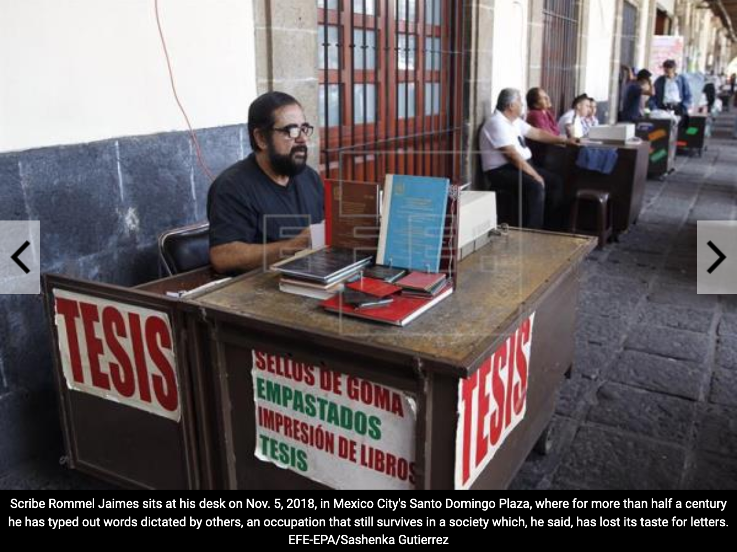
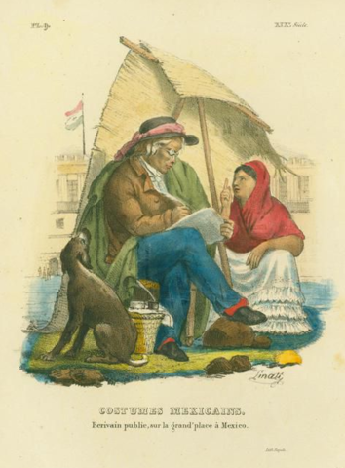
‘Escribanos’, ‘Tintorillos’ or Public Writers
Above is a rather staged photograph of a public writer in early 20th-century Mexico
Claudio Linati, ‘Public writer in the great square of Mexico’, 1828.

Slide 17
Hybrid Culture
This blend of universal rights and reality produced a fantastically hybrid culture in which elements of African, indigenous and Spanish culture intertwined.
In culture, we call this “mestizaje” or mixing. You could see it in food, material culture, clothing, and language.
In religion, it is often termed “syncretism”.

Slide 18
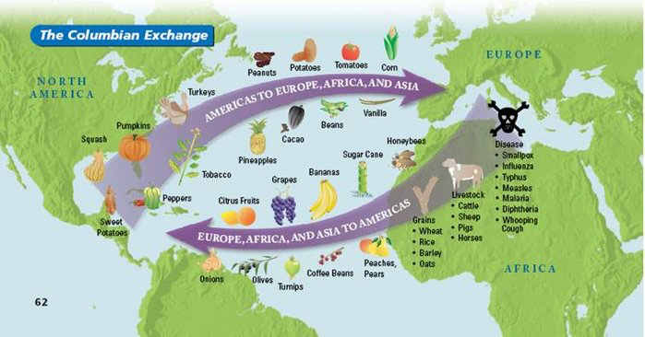
The ‘Columbian Exchange’ (Here is a rather Euro-centric map of what was a much more global process)

Slide 19
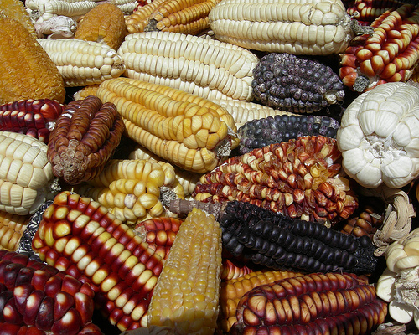
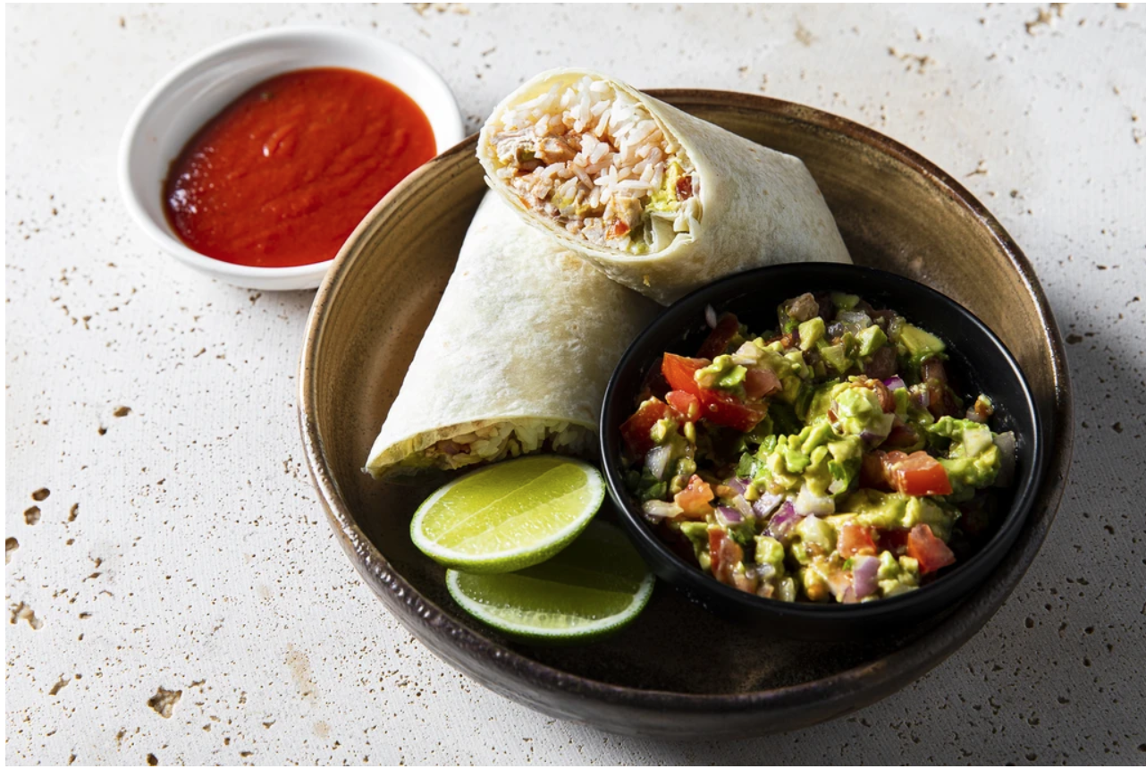
New food cultures

Slide 20
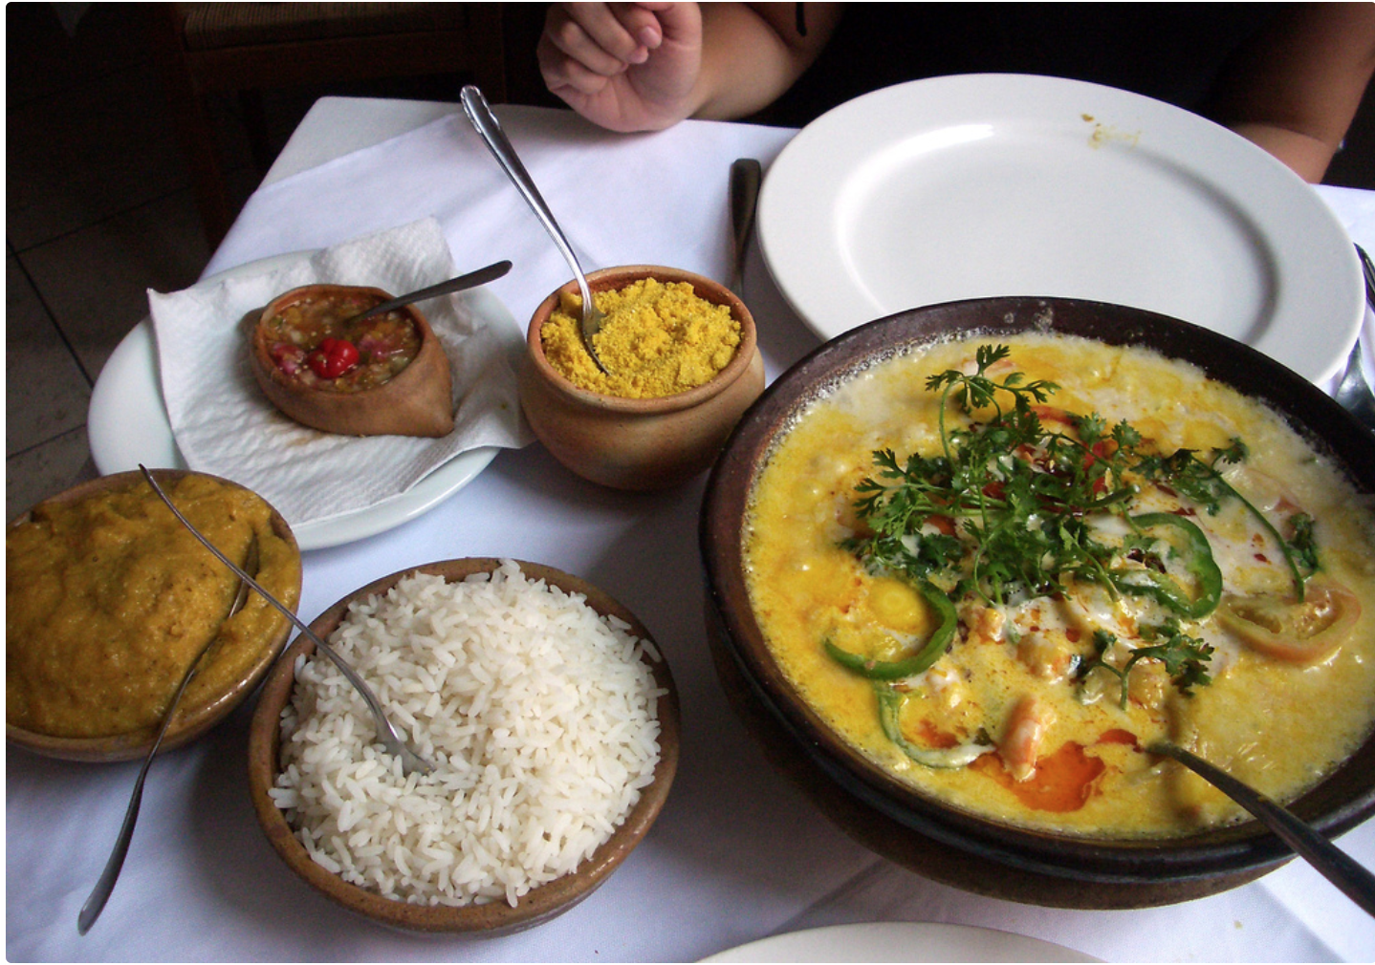
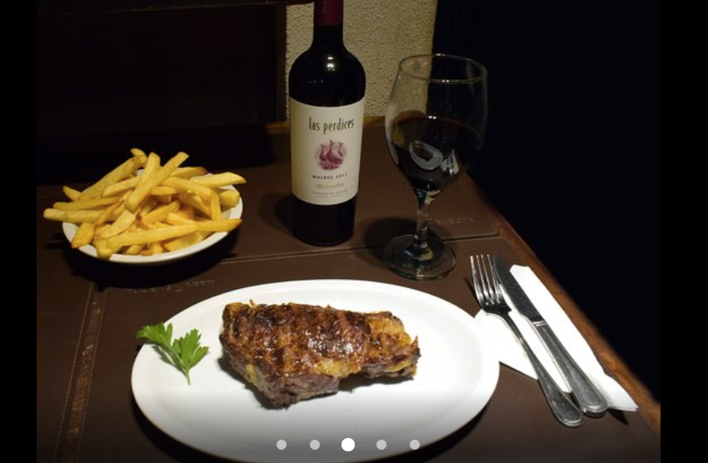
Moqueca a Brazilian stew made with coconut milk and palm oil, served with rice. The name comes from a word in the Kimbundu language of Angola.
An Argentine bifé de chorizo (steak) with chips and a nice malbec.
Many of Today’s Latin American Foods are Hybrid Blends of European, African and American Foodways

Slide 21
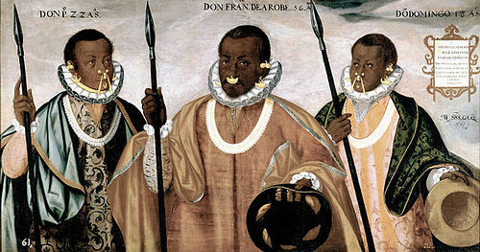
Hybrid Material Cultures
Andrés Sánchez Gallque, The Mulatto Gentlemen of Esmeraldas (1599), Prado Museum.

Slide 22
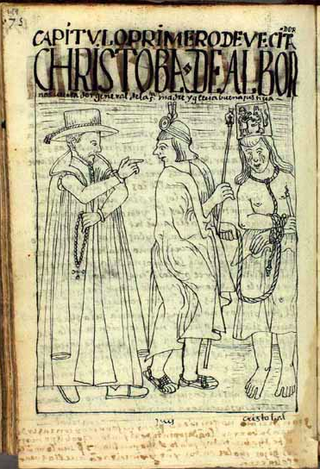
Religion: Concerns about ‘idolatry’
Jesuit José de Acosta (1588) on ‘our Indians’ way of life and religiosity’:
‘They give worship to Christ and they serve their gods; they revere the Lord and they do not revere Him; . . . They venerate Him only in word, . . . they venerate Him, in short, only with the appearance of Christianity. They do not venerate Him from deep inside, they do not give true worship nor hold the faith in their hearts as is truly required. But what use is there to carry on? [They] continue doing as their ancestors did.’
An Andean man punished for ‘idolatry’, from Guamon Poma, c. 1615

Slide 23
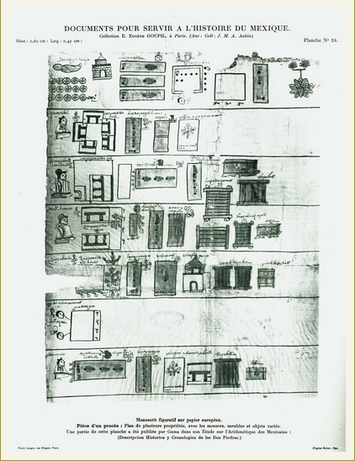
. . . Nonetheless, many indigenous (and West-African) people embraced Christianity
The Last Will and Testament of Don Miguel Damián Ink and watercolor on amatl paper, 1576
The indigenous Don Miguel Damián, deceased and wrapped in a shroud, is at the upper left in this list of his goods and heirs.
Circles with crosses represent money given to the church for masses and prayers to be said in his name.

Slide 24
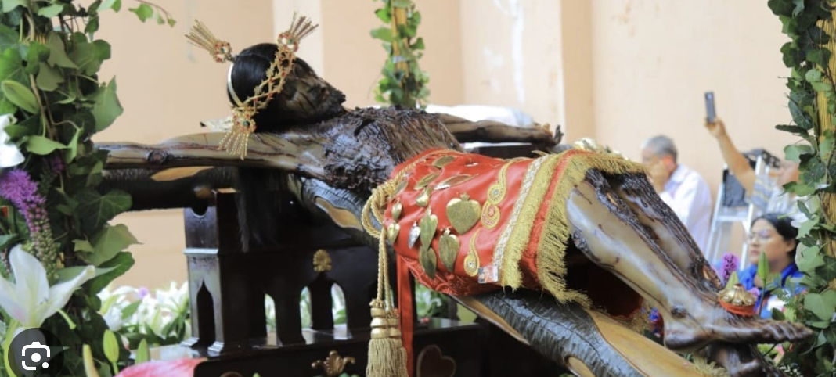
But indigenous and African people accepted Christianity by imbuing it with their own rituals, beliefs, images, symbols and stories. The village saint became the site for this process of “syncretism”. Every village had a saint and the villages were named after them.

Slide 25
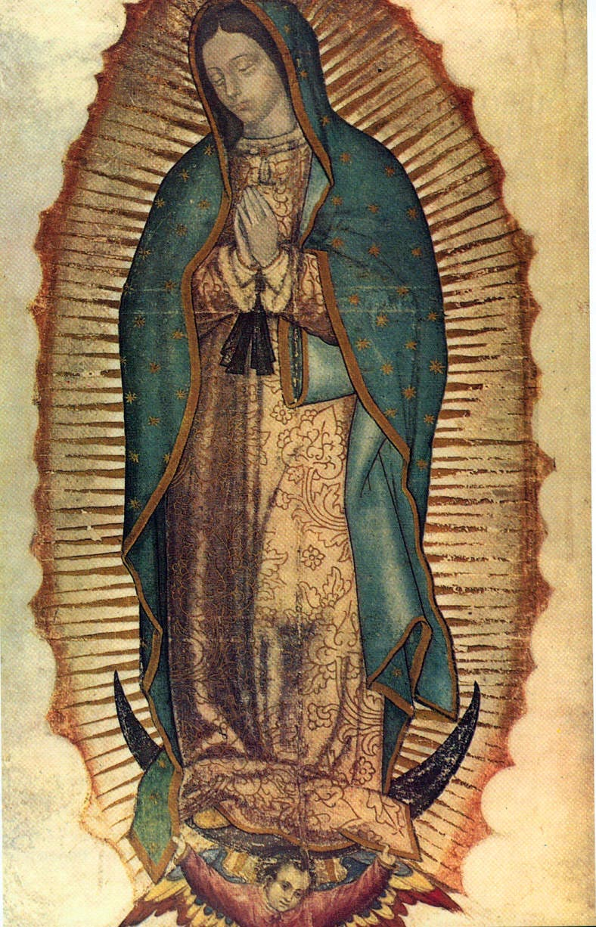
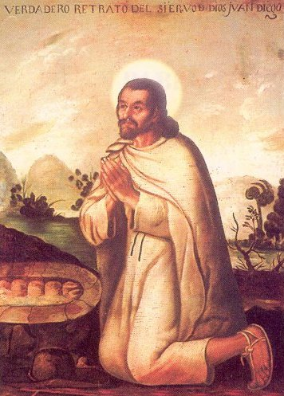
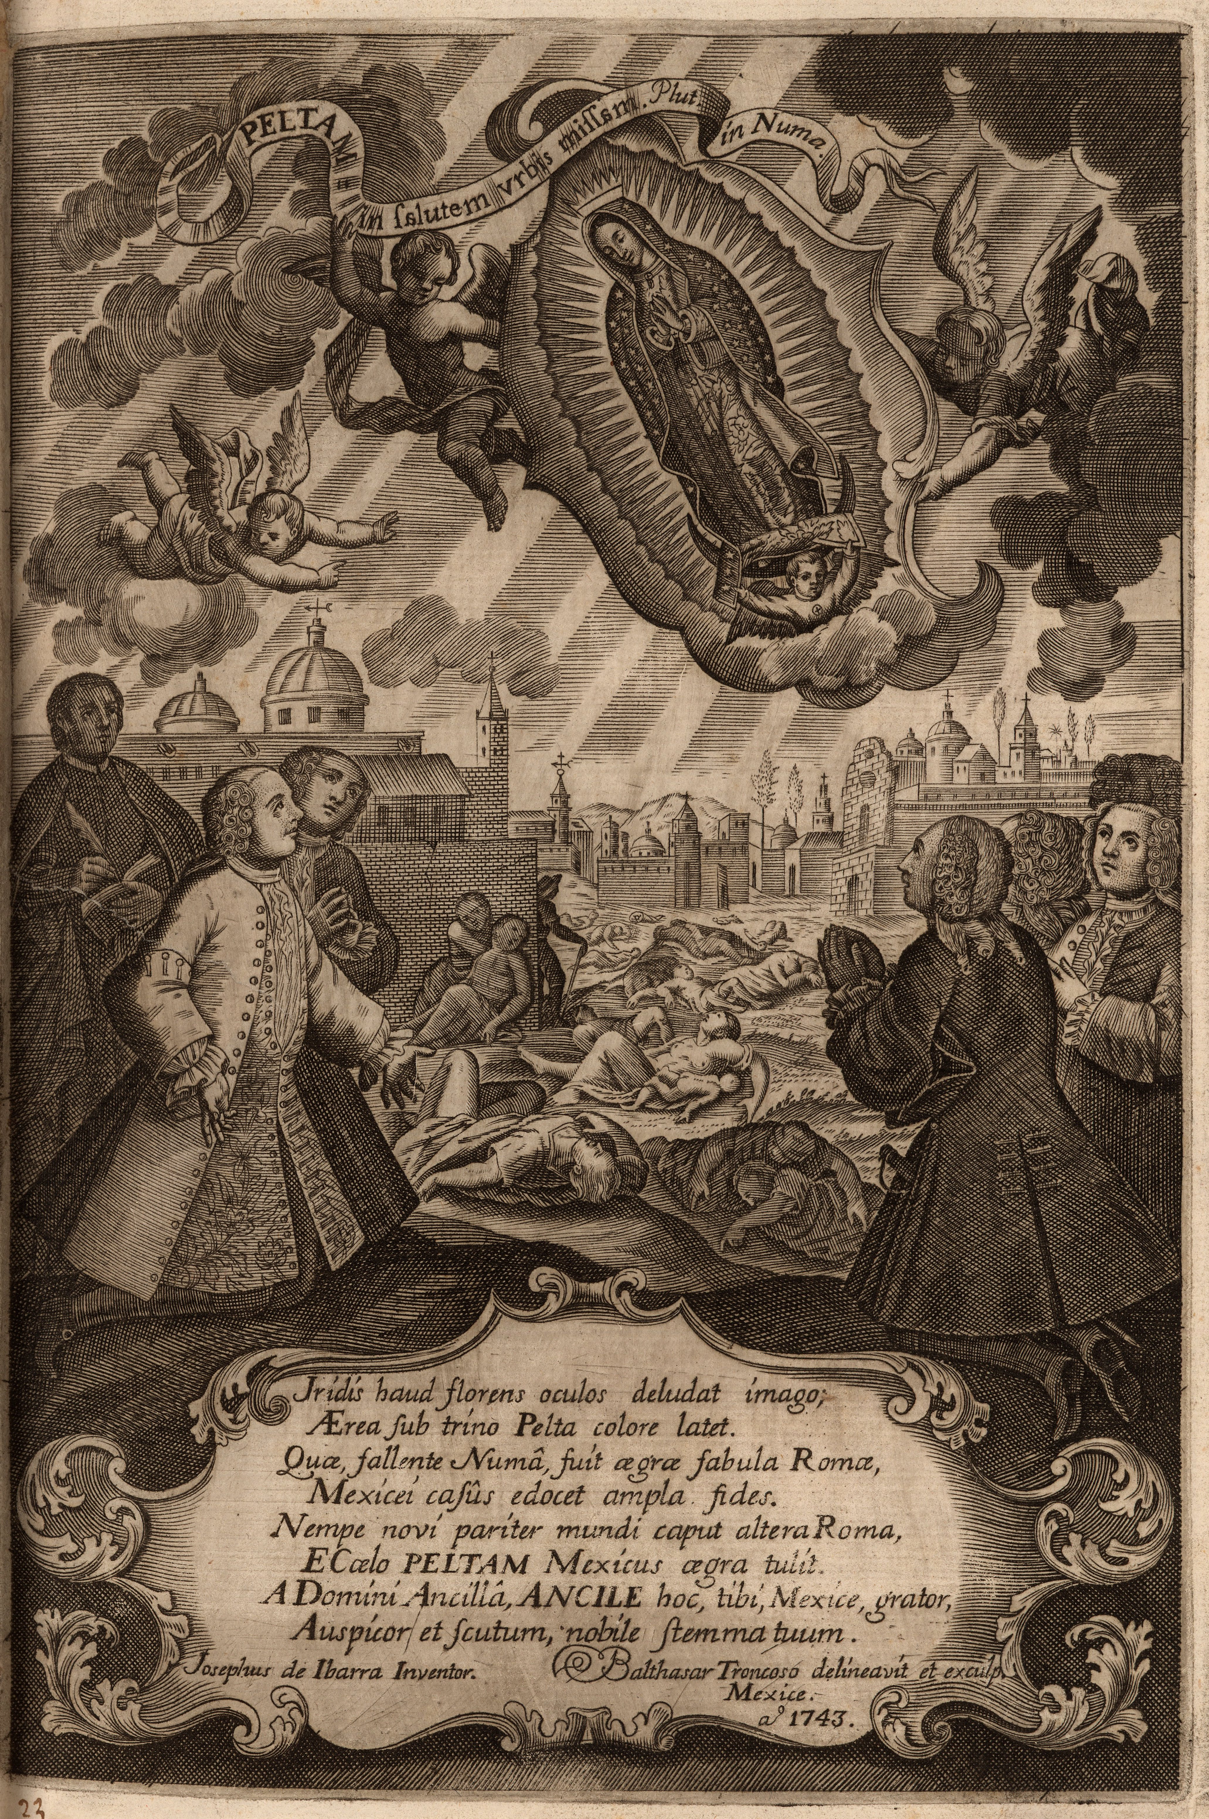
Virgin of Guadalupe
Tonantzin
Tepayac
Juan Diego
Miguel Cabrera, ‘Portrait of Juan Diego, Servant of God’, 18th century

Slide 26
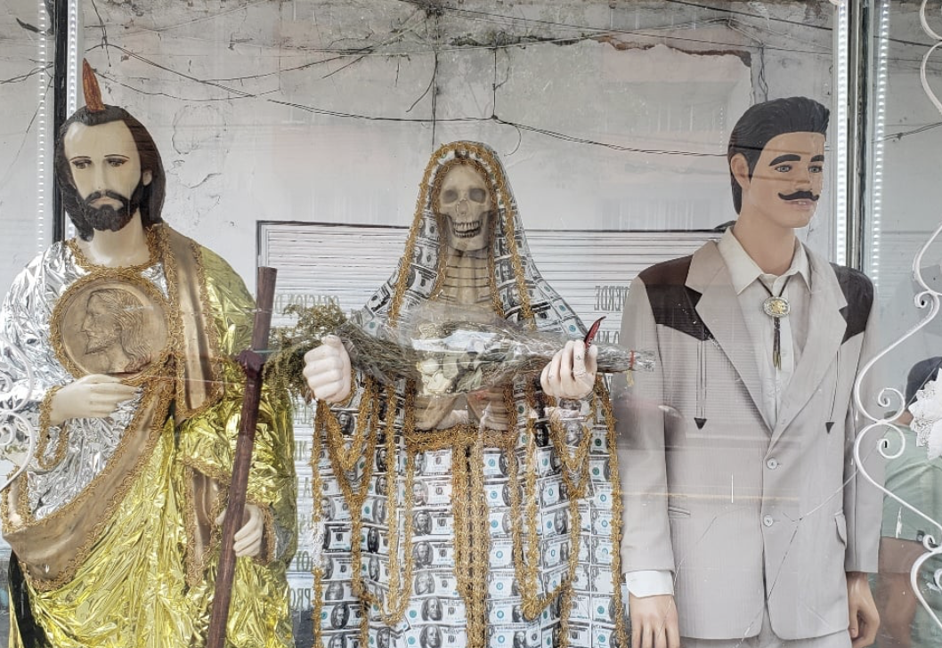
Contemporary Syncretism

Slide 27
Colonial Society
Hierarchical and unequal
Fluid and hybrid

