Slide 1
Empire and Aftermath
The British and French in the
Middle East, 1914-1948

Slide 2
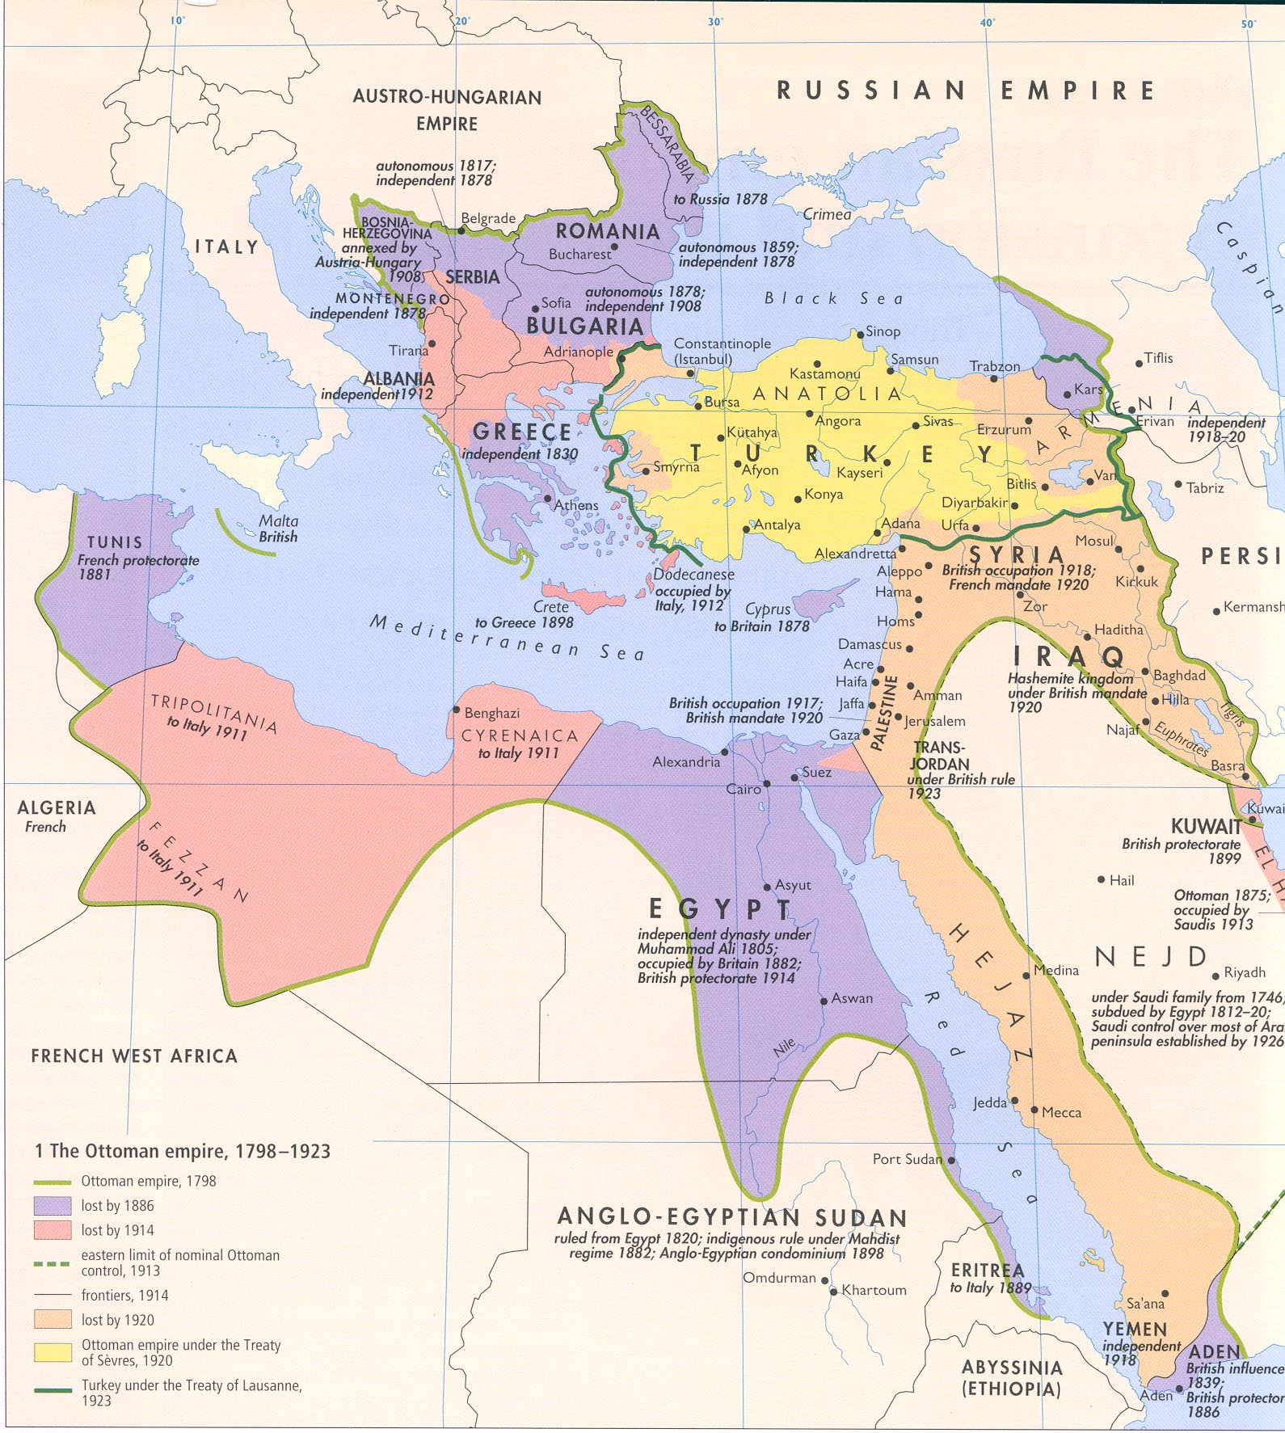
The Ottoman Empire

Slide 3
The Ottoman Empire
Until the First World War what became Palestine was ruled by the Ottoman Empire.
During the period of Ottoman rule the term Palestine denoted a geographic region, rather than a specific Ottoman province or administrative district.
The Ottoman Empire was a state founded by Turkish tribes under Osman Bey in 1299.
During the 16th and 17th centuries the Ottoman Empire was one of the most powerful states in the world – a multinational, multilingual empire including much of southeast Europe, Western Asia and North Africa.
The Ottomans were ethnically Turkish and religiously Muslim, but their empire was extremely diverse and included many ethnicities and large Jewish and Christian populations.
Christians and Jews did not have full equal rights, but were usually protected.

Slide 4
Arab nationalism
From the 16th through 20th centuries, most Arabs lived in the Ottoman Empire.
Nationalist ideas began to spread to Arabs in the late 19th century.
Arab interest in nationalism began as a literary and cultural movement to re-establish the prominence of Arab culture and to promote a positive ethnic identity. As time passed, Arabs increasingly expressed the desire for greater self-rule. I
Before World War I, few Arabs argued for a completely independent Arab state.
As time passed, Arabs increasingly felt that they should have greater self-rule.
During World War I, many Arabs felt greatly mistreated by the Ottoman government and Arab nationalists popularized the idea of independent Arab rule.

Slide 5
Zionism 1
In the late 19th and early 20th centuries, “pogroms” against Jews became common. These were organized government-tolerated or government-sponsored attacks on Jews in Russia and Eastern Europe.
In Western Europe, ghettoes were abolished and Jews were granted legal equality with Christians but anti-Semitism continued to flourish, they began to look for a new solution.
A watershed moment was in 1894 when a Jewish journalist named Theodor Herzl reported on the trial of Captain Alfred Dreyfus, a Jewish officer in the French army.
Herzl concluded that the only solution to antisemitism was to establish a Jewish state.
He organized modern political Zionism, which is a Jewish nationalism dedicated to self-determination for the Jewish people in their ancient homeland, the Land of Israel.

Slide 6
Zionism 2
While Jews had long dreamed of returning to their ancient homeland, most felt that this could not happen until God led them there.
Herzl popularized the idea that Jews could reestablish their homeland as an expression of nationalism rather than strictly on the basis of religious belief.
Jews around the world began donating money to purchase land from Arab and Ottoman landowners.
Eastern European Jews began immigrating to these properties and developing the infrastructure of a modern nation with schools, hospitals, and theaters, as well as agricultural communities.
On the eve of the first wave of Zionist-inspired immigration in 1882, the traditional, religious Jewish community in Palestine numbered about 24,000, or 5 per cent of the population of 500,000. By the conclusion of the second wave in 1914, the number had grown to 85,000.

Slide 7
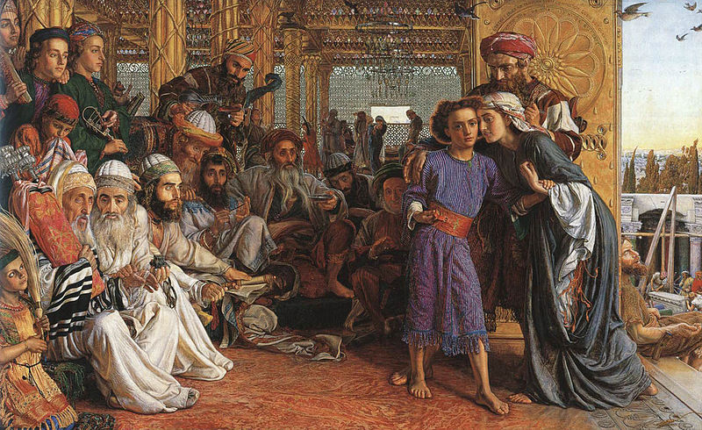
British and French influence pre-1914
Since the Crusades France had established extremely close cultural, economic, financial, and religious ties in the Middle East.
While the Middle East was never formally part of the British Empire, already by the late nineteenth century British statesmen regarded it as a region of vital interest.
And both Britain and France had major economic interests in the Arab provinces of the Ottoman empire in the late nineteenth and twentieth centuries.
The Finding of the Saviour in the Temple (1854–60) is a painting of a biblical scene by the British artist William Holman Hunt who travelled to the Middle East.

Slide 8
World War One
During 1915-1916, the British High Commissioner in Egypt, Sir Henry McMahon, convinced Husayn ibn `Ali, the patriarch of the Hashemite family and Ottoman governor of Mecca and Medina, to lead an Arab revolt against the Ottoman Empire, which was aligned with Germany.
McMahon promised that if the Arabs supported Britain in the war, the British government would support the establishment of an independent Arab state under Hashemite rule.
But Britain also tried to enlist Jewish support by promising to create a Jewish national home in Palestine. In 1917, the British Foreign Minister, Lord Arthur Balfour, issued a declaration announcing his government’s support for the establishment of “a Jewish national home in Palestine.”
A third promise, in the form of a secret agreement, was a deal that Britain and France struck between themselves to carve up the Arab provinces of the Ottoman Empire and divide control of the region.
Therefore at the conclusion of the war, both Jews and Arabs felt betrayed.

Slide 9
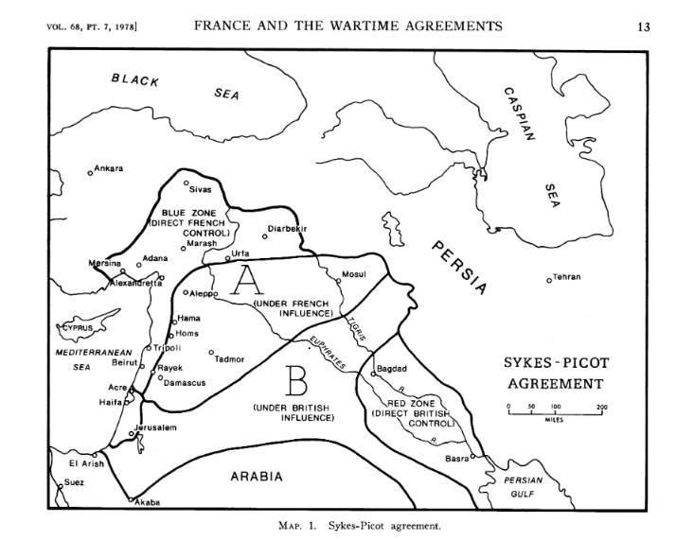
Sykes-Picot Agreement:

Slide 10
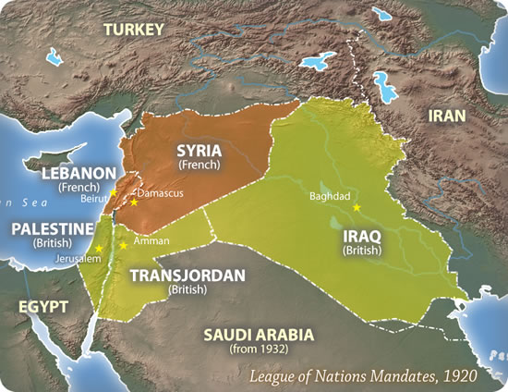
League of Nations Mandates

Slide 11
Article 22 of the charter of the League of Nations (1919):
To those colonies and territories which as a consequence of the late war have ceased to be under the sovereignty of the States which formerly governed them and which are inhabited by peoples not yet able to stand by themselves under the strenuous conditions of the modern world, there should be applied the principle that the well-being and development of such peoples form a sacred trust of civilisation and that securities for the performance of this trust should be embodied in this Covenant.
The best method of giving practical effect to this principle is that the tutelage of such peoples should be entrusted to advanced nations who ... can best undertake this responsibility, and who are willing to accept it, and that this tutelage should be exercised by them as Mandatories on behalf of the League.
Certain communities formerly belonging to the Turkish Empire have reached a stage of development where their existence as independent nations can be provisionally recognized subject to the rendering of administrative advice and assistance by a Mandatory until such time as they are able to stand alone.

Slide 12
What difference did the mandates system make?
For all the rhetoric of tutelage, the mandate system didn’t really help states climb the ladder to independence; to the contrary, it appeared to create pressures the other way.
Although often seen as a mechanism for reforming colonial administration or for preparing territories for self-rule, the mandatory administrations were neither uniform, nor particularly progressive, nor clearly distinguishable from colonial administrations.
The mandates system is better understood as a mechanism for generating publicity and norms than as a system of governance.
Susan Pedersen, ‘The meaning of the mandates system: an argument’, Geschichte und Gesellschaft 32 (2006), 560–82.

Slide 13
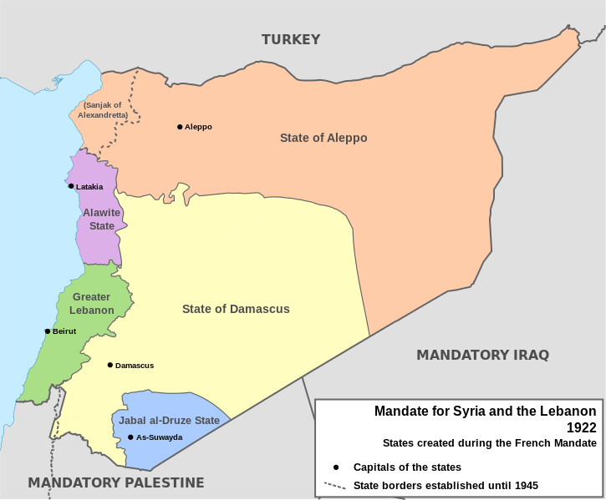
The French Mandate

Slide 14
The establishment of GreaterLebanon
Reflecting the sectarian divisions within Lebanon there are therefore two different interpretations of the establishment of Greater Lebanon by the French in 1920.
Either it is interpreted as correcting a historical injustice that had stripped Lebanon of its natural and historic territories which had been taken by Turkey.
Or it is interpreted as separating Lebanon from its Syrian or Arab environment and obstructed the historical process that should have led to the creation of Greater Syria or a united Arab state in Syria or even in the entire Arab East.
Kais Firro, Inventing Lebanon (2002).

Slide 15
Lebanese Independence
A Franco-Lebanese treaty of independence and friendship was signed in 1936 but was not ratified by the French government.
Lebanon was controlled by the Vichy authorities after the fall of France in 1940 but was occupied by British and Free French troops in 1941.
The Free French representative proclaimed the independence of Lebanon and Syria, which was underwritten by the British government.
In 1943 the Free French held elections which resulted in victory for the Nationalists under Bishara al-Khuri who was elected president.
On November 11, 1943, the president and almost the entire government were arrested by the French. This led to an insurrection, followed by British diplomatic intervention; the French restored the government and transferred powers to it.
Although independence had been proclaimed on November 22, 1943, it was not until 1945 that an agreement was reached on a simultaneous withdrawal of British and French troops which was completed in 1946.

Slide 16
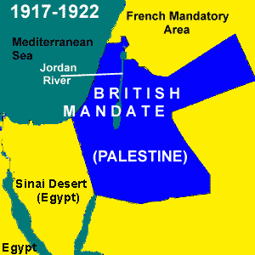
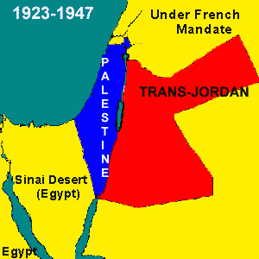
The British Mandate

Slide 17
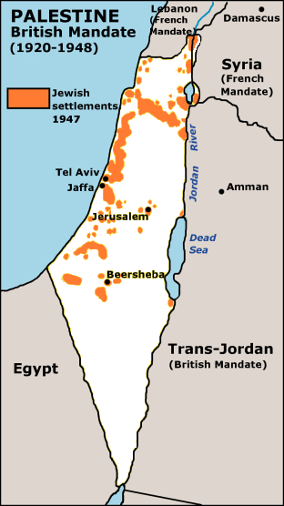
The population of Palestine
According to the 1921 British census a total of 752,048 people lived in Palestine. Of this group, 78.34% were Moslems, 9.5% Christians (making an Arab majority of 87.84%), and 11.4% were Jewish.

Slide 18
Jewish-British relations
After crushing the Arab revolt, the British reconsidered their governing policies in an effort to maintain order in an increasingly tense environment and issued a White Paper limiting future Jewish immigration and land purchases.
The Zionists regarded this as a betrayal of the Balfour Declaration and a particularly offensive act in light of the desperate situation of the Jews in Europe, who were facing extermination.
Relations worsened with the end of the war. Jewish anti-British violence – carried out by violent fringe groups – intensified.
On 15 February 1947 the British government announced that the problem of Palestine would be handed over to the United Nations. On 29 November, a two-thirds majority of the United Nations General Assembly voted for partition of Palestine; some days later the British Cabinet approved the policy for withdrawal, and set the date of 15 May 1948 for ending the Mandate and evacuating all British forces from the country.

Slide 19
The uniqueness of Palestine
Palestine was unique because of its specific ‘dual’ mandate.
The British had undertaken what became known as a "dual-obligation": to help bring about the establishment of the Jewish national home and to safeguard the rights of the Palestinian Arabs in the process.
A great deal of British policy and practice over the course of the Mandate was comprised of efforts to manage, however imperfectly, these conflicting obligations.
At the same time, it was only these conflicts (and the conflict on the ground which resulted from them) that seemed to justify the perpetuation of the Mandate at all.
British officials in Jerusalem were forced to steer a zigzag course between the Arabs and Zionists, incurring the wrath of both.

Slide 20
Conclusions
During the Mandate, Palestine was part of the larger British colonial empire, although mandates were a quite particular form of colonialism.
The mandate system, developed in the aftermath of World War I to manage German colonial holdings and the territories of the Ottoman Empire, was a colonial form that was intimately connected to the idea of the nation-state.
While in practice the mandate system may have felt very similar to other forms of colonialism to the populations subject to them, its distinct form did make a difference.
The language of legitimacy deployed by the mandatories (when it was deployed) was not that of a general ‘civilizing mission,’ but of a civilizing mission specifically connected to the idea of future independent states.

