Slide 1
Doctoring the Nation: The Rise and Fall of Eugenics
Mind, Body, and Society

Slide 2
Aims/Structure of Lecture
1. Introduce eugenics as a prime example of ‘doctoring the nation’ between the 1880s and 1940s
2. Demonstrate that this went beyond Nazi Germany
3. Examine the reasons for the rise of this mode of ‘doctoring the nation’
4.Consider reasons for its particular association with Nazi Germany
5. Postscript looking at whether the war saw the end of eugenics

Slide 3
1. Eugenics as a way of ‘doctoring the nation’

Slide 4
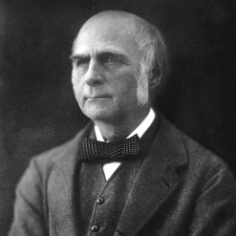
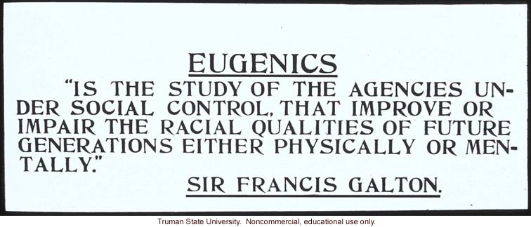
What was eugenics?
Term coined in 1883 by British scientist Francis Galton (1822-1911), cousin of Charles Darwin
Galton builds on work of Darwin to extend interest in variation, the role of heredity, and the question of (un)natural selection when it came to man

Slide 5
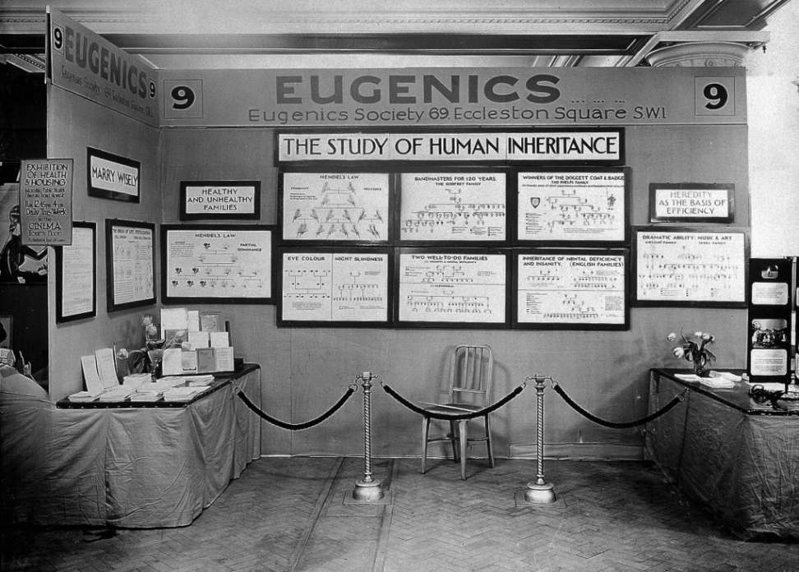
Eugenics becomes a science and a movement
1904: setting up of the Eugenics Record Office (later the Eugenics Laboratory) at UCL
1907: Eugenics Education Society founded (from 1926 The Eugenics Society)
1908 first edition of the Eugenics Review
Eugenics Society never more than 1000 members (high proportion of professionals) but influence of idea extends much further

Slide 6
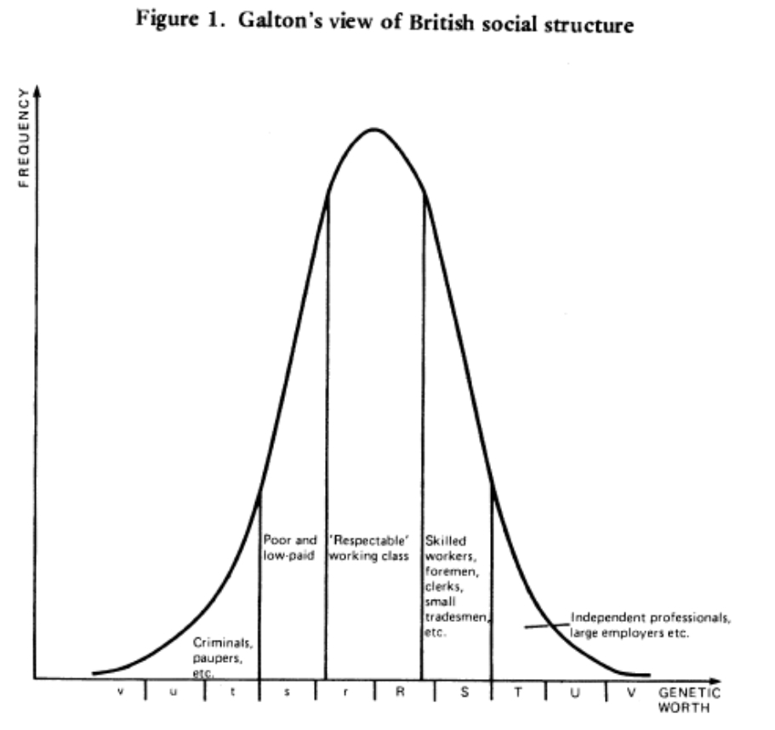
Eugenics as a prime example of ‘doctoring the nation’
Interested in the variation of qualities (eg intelligence) across a population
Draws attention to those at either extreme
Theory of heredity offers clue to how the society might adjust the mean to minimise social problems and maximise ability of population

Slide 7
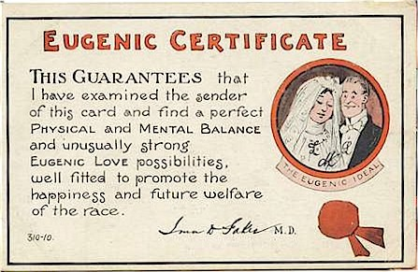
Positive eugenics
Encouragement of the fit to breed: education and propaganda
Leads to consideration of incentives
Consideration of marriage advice and certificates of fitness
Encourages use of mental testing to create a ladder of opportunity in education
Often meritocratic

Slide 8
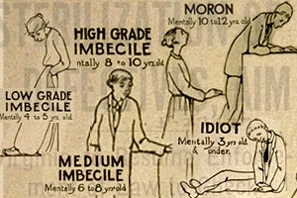
Negative eugenics
Birth control
Immigration control
Sterilisation
Segregation
‘Euthanasia’
Particular focus on ‘mental defectives’, ‘feeble-minded’, mentally ill, physically handicapped

Slide 9
2. Demonstrate that this went beyond Nazi Germany

Slide 10
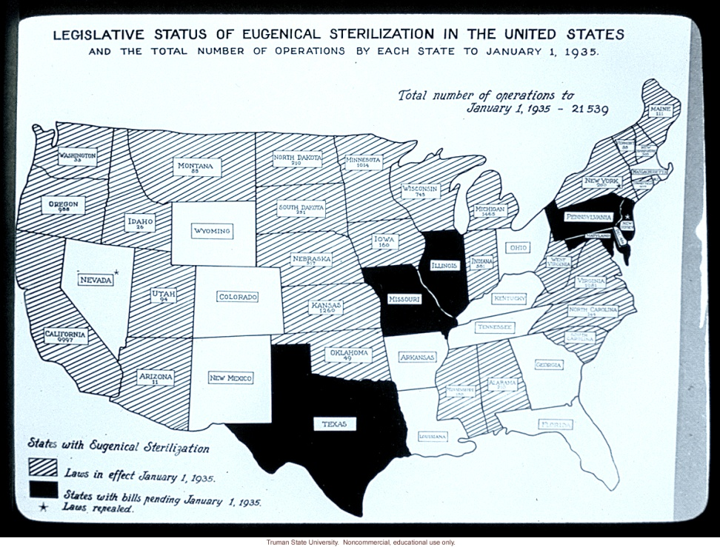
Compatibility with liberal regimes
British roots and continuing leading role
Support from leading writers and intellectuals including many on the left such as H.G. Wells and George Bernard Shaw
British Mental Deficiency Act 1913
USA, Canada, Australia: immigration control
USA: introduction of sterilisation in large number of states by 1930s

Slide 11
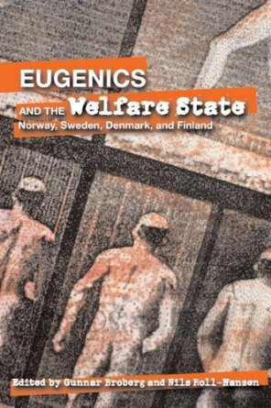
Compatibility with social democracy
Denmark, Finland, Norway and Sweden all introduce eugenic laws in 1930s
By 1970 estimated 170,000 sterilised

Slide 12
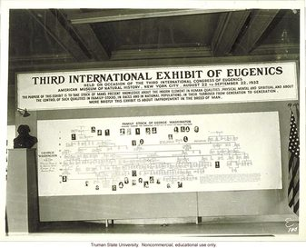
Becomes an international movement
International eugenics conferences beginning in London, 1912
Part of being a modern nation

Slide 13

Global Perspective
Britain, South Asia, Australia, New Zealand, China and Hong Kong, South Africa, Kenya, South East Asia, Germany, France, Holland and Dutch East Indies, Scandinavia, Southern Europe, Eastern Europe, Russia, Japan, Iran, Cuba, Puerto Rico, Mexico, Brazil, USA, Canada

Slide 14
3. Reasons for the rise of this mode of ‘doctoring the nation’

Slide 15
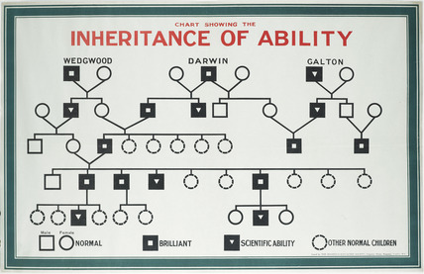
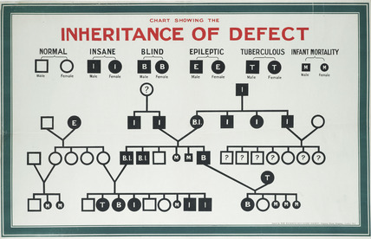
Science and pseudo-science
Victorian cult of measurement (Galton)
Longer-term cultures of breeding
Emerging science of heredity
Modernist attractions of science of eugenics
Science or pseudo-science?

Slide 16
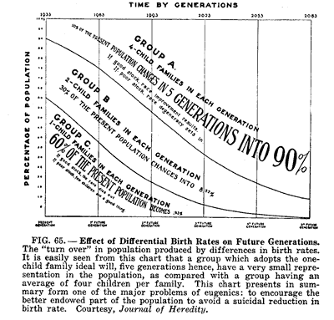
The demographic transition
From late 19th century a fall in fertility in western nations
Concern in Britain about decline being most marked in middle-classes and among professionals
In France, fear of overall population decline by early 20th century (encourages positive forms of eugenics)
Moral objections to birth control focus attention on segregation and ‘treatment’
Link to women’s groups, birth control advocates, and even sexual liberals

Slide 17
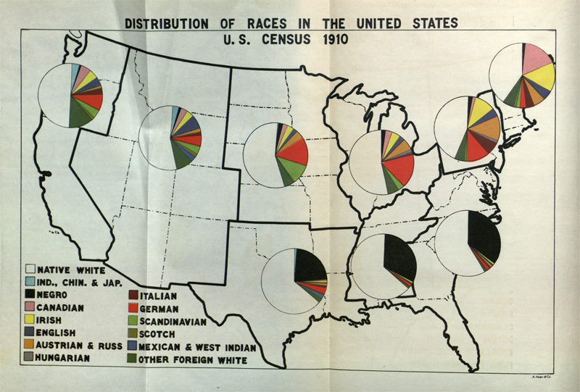
Nation building era
Heightened concern about international competition and ‘national efficiency’
Era of nation building & interest in defining the nation (eg post WWI)
Immigrant nations concerned about racial mix

Slide 18
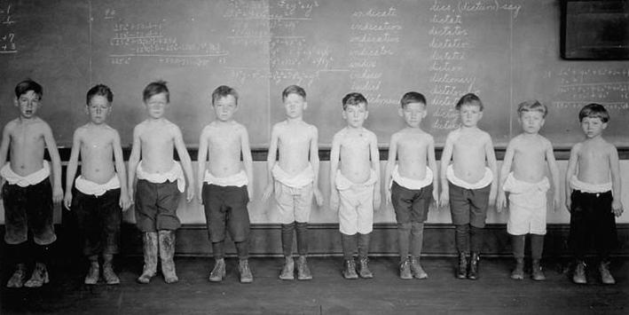
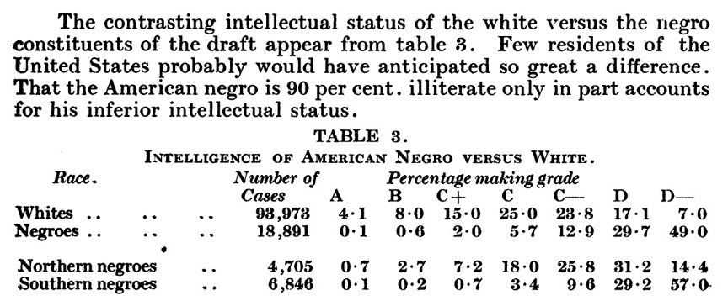
New ways of seeing /ranking population
Population problems and differences exposed by rise of mass education, and growing scale of asylums, prisons, workhouses
Emergence of new tools such as the social survey and the psychological test to rank individuals

Slide 19
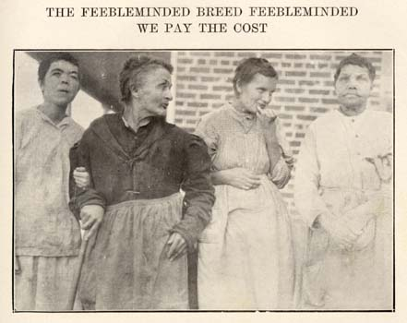
The challenges of a welfare state
Explaining failures: the ineducable; the recidivist, the unemployed
Opportunities for new experts to test, identify, segregate, and treat the unfit
Growing concern about the capacity and cost of solution of segregation (particularly as welfare state faces economic crises of war and depression, and as it becomes more ambitious)

Slide 20
4. Nazi Germany: an exceptional case?

Slide 21

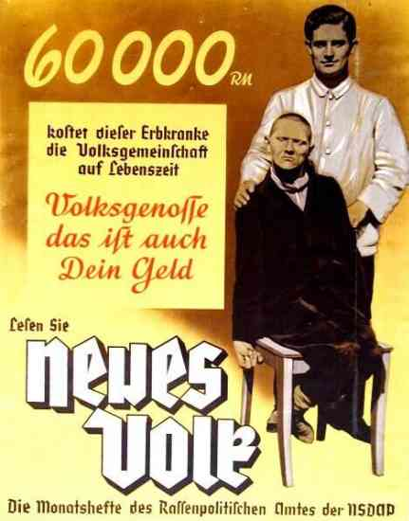
Why Nazi Germany stands out
Importance of ideology of national fitness and purity to politics and culture: ‘the ‘racial state’
Leader in psychiatric and genetic science
Opportunities from a sympathetic state
Degree of economic problems via depression and mobilisation of economy in WWII
Scale of sterilisation policy (375,000)
Use of ‘euthanasia’ for mentally handicapped (Action T4 – 70,000)

Slide 22

Yet German eugenics has roots before Nazi era
Sterilisation Law introduced before Nazis come to power
Follows example of USA
Eugenics and an interest in ‘race hygiene’ well established (1st society 1905)
Germany already a leader in eugenic sciences of psychiatry and genetics, eg via Kaiser Wilhelm Institute (and has financial support from Rockefeller Foundation into 1930s)
Deaths of mentally ill in German asylums in First World War (140,000)

Slide 23
Concluding thoughts
Strong position of science in German culture
Key importance of a regime able and willing to ignore rights of individual (compulsory rather than voluntary sterilisation); and of limited opportunities for organised opposition
Key importance of wartime situation in radicalising situation, though most extreme policy of euthanasia still remains secret and encounter opposition
But far from unique in seeing eugenics as a tool to ‘doctor the nation’
Broader structural factors: demography; nation-building; economics and welfare; medical science; new visibility

Slide 24
Postscript: the End of Eugenics?

Slide 25
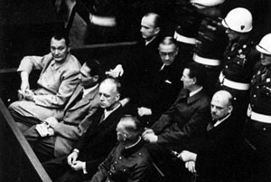
The post-war reckoning
At post-war Nazi trials the question of medical experiments is subject for prosecution, but eugenics itself in fact attracts little attention
Not until 1970s and 1980s and a new generation of historians does it come into focus

Slide 26
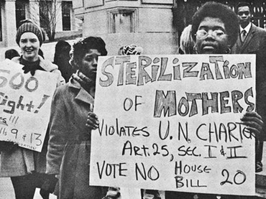
Persistence?
Policy of sterilisation for eg mentally handicapped continues in some countries well beyond WWII, eg in Sweden until 1970s
In Britain, abortion and sterilisation legalised in 1960s/70s as a form of voluntary birth control (along with contraception can target the ‘problem family’)
Subsequently, techniques of prenatal screening used to prevent birth of handicapped, though without the language of eugenics

Slide 27

In Britain, a eugenics society continues after WWII, though one that makes efforts to distinguish itself from acts of Nazis
In science, interest continues under the banner of ‘human genetics’
Far more potential now for eugenics than in first half of the century, but largely in hands of medical consumer rather than the state

