Slide 1
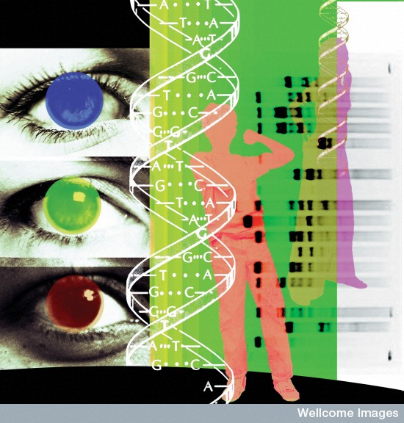
Medicine in the West: ‘The Rise of Science’
HI 176 Mind Body and Society
Roberta Bivins

Slide 2
From Germs to Genomes
I. Introduction: How did we get sick before the germ?
Systemic imbalance
Miasmatic taint
Contagions
II. The ‘Birth’ and impact of the ‘Clinic’
III. Microscopes and ‘Monster Soup’
IV. Selling ‘Clean’ – sanitary science and ‘the gospel of germs’
V. From Germs to Genes
Trailer: Germplasm and Eugenics --coming soon to a lecture hall near you…
The Power of Genetic Thinking

Slide 3
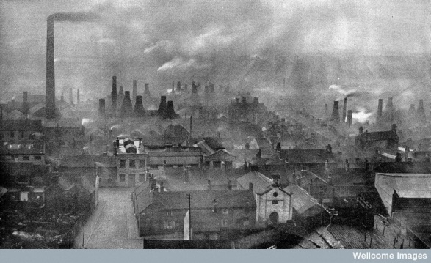
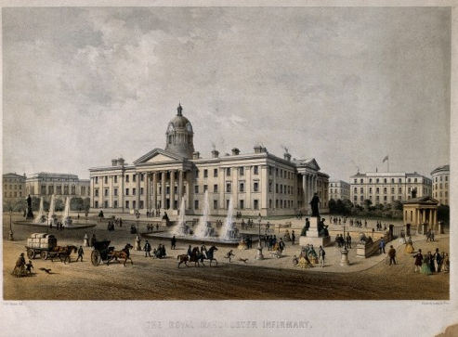
Why did illness matter? Medicine in the ‘Age of Revolutions’
Impacts of Industrial Revolution on Health
Enlightenment Responses to Urbanization and Industrialisation: the rise of the modern hospital
‘Every Able Industrious Worker … who so untimely dies, may be accounted Two Hundred Pound Loss to the Kingdom’
John Bellers, 1714.

Slide 4
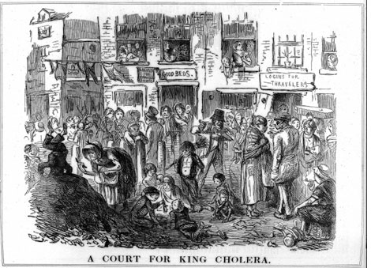
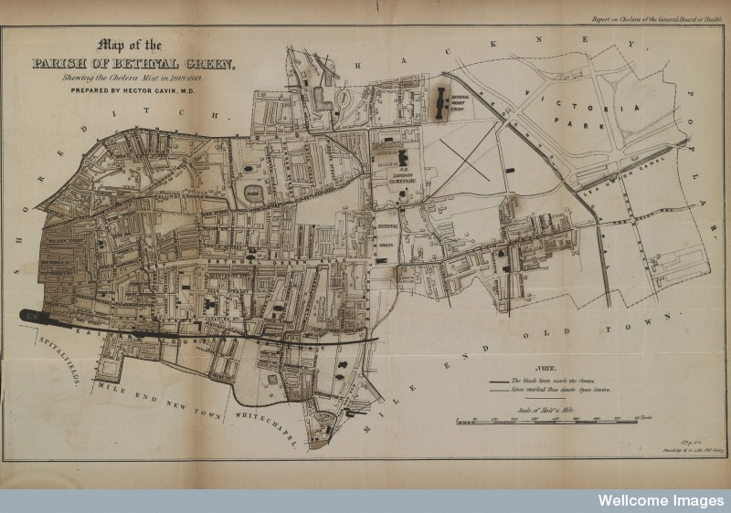
Miasma

Slide 5
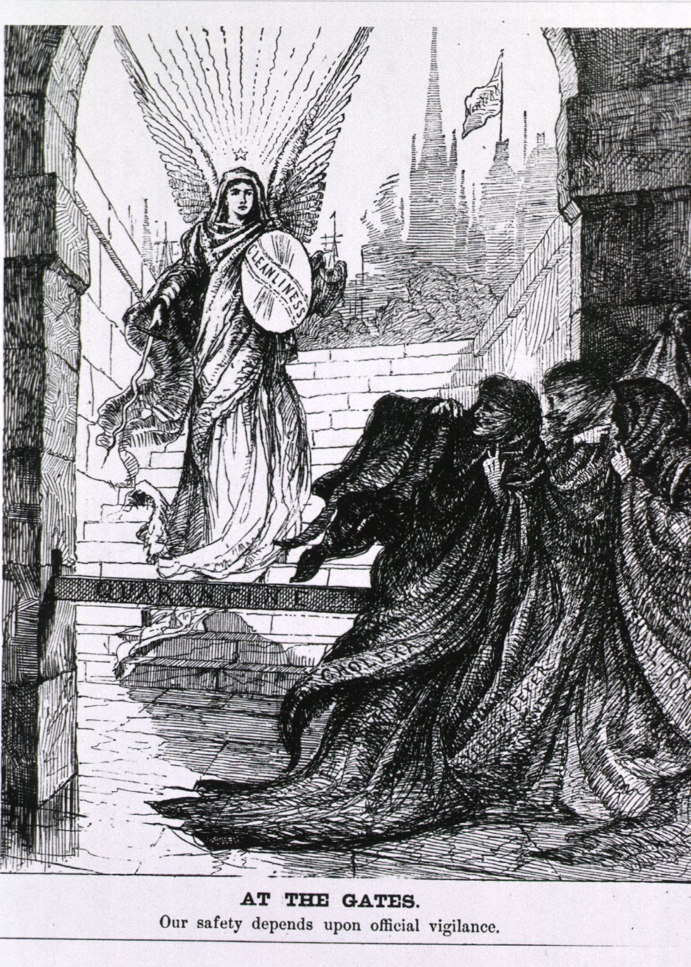
Contagion

Slide 6
Paris Anatomy & the Birth of the ‘Clinic’: from systemic to specific disease
Features:
Focus on linking symptoms of illness elicited through physical examination with pathological lesions uncovered through autopsy
Developing notion of ‘specific’ and ‘local’ disease
Decline of the vision of patients as (humoural) individuals → ‘disappearance of the sick man’
Requirements:
Vast amounts of ‘clinical material’ (thus, hospitals)
Meticulous record keeping
Close physical examination
Post-mortem dissection
Techniques and tools for ‘reading’ the body
Results:
Rise of ‘numerical method’ (medical statistics)
‘disappearance of the sick man’
Shift from ‘symptoms’ to ‘signs’
Expansion of medical technology

Slide 7
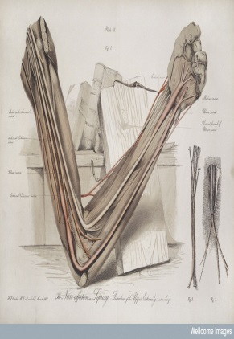
Morbid Anatomy: From ‘Symptoms’ to ‘Signs’
‘You may take notes for twenty years from morning to night at the bedside of the sick, and all will be to you only a confusion of symptoms… a train of incoherent phenomena… [but] Open a few bodies and this obscurity will soon disappear’.
Marie Francois Bichat, 1801

Slide 8
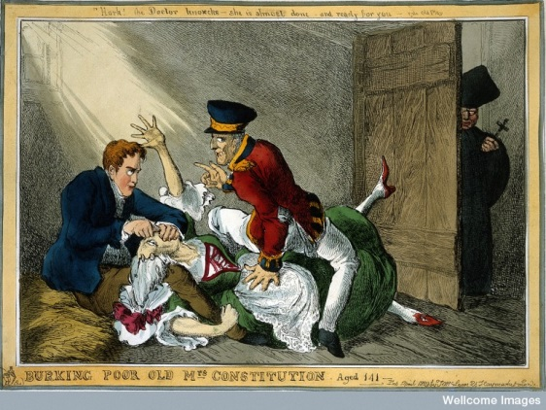
The Limits of Anatomical Observation?
‘Harvey’s discovery of the circulation of the blood was a beautiful addition to our knowledge … but on a review of the practice of medicine before and since that epoch, I do not see any great amelioration which has been derived from that discovery.’
Thomas Jefferson, 1806
Bodies to order: Burke and Hare, c. 1829

Slide 9
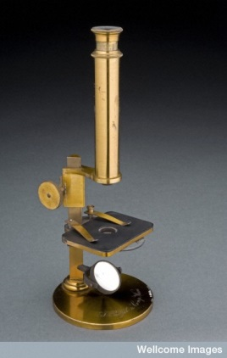
Learning from the Laboratory
The rising sciences of life:
Cell biology and pathology (→ bacteriology and parasitology)
Physiological chemistry (→ experimental physiology)
Pharmacology
Techniques:
Microscopy
Histology
Vivisection
Tools
Microscope
Sphygmograph
Spirometer
Thermometer
Scales, etc.
c. 1850s, esp germany

Slide 10
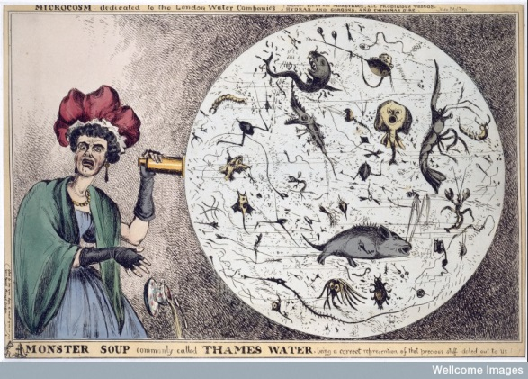
‘Monster Soup’ and Sanitarianism
Notes:
The caricature shows a woman looking into a microscope to observe the little monsters swimming about in a drop of London Thames water. In the 1820s much of the drinking water of Londoners came from the river Thames, and the sewers emptied into the Thames. A Commission on the London Water Supply was appointed to investigate this dangerous situation, and it reported in 1828. After that report, the five water companies which served the north bank of the river improved their supplies by building reservoirs etc., but the people of Southwark (on the south bank of the river) continued to receive infected water. The problems were not solved until the 1860s when London's present sewerage system was installed by the Metropolitan Board of Works (MBW) and its engineer Joseph Bazalgette. Between the date of this caricature (1828) and the completion of the MBW sewers, London suffered two cholera epidemics, one in 1832 (part of the world pandemic of cholera) and one in 1854. Looking at a drop of water though a microscope was a popular entertainment provided by travelling showmen who carried the microscopes around in cases on their backs (See: Wellcome Catalogue Description)

Slide 11
From Miasma… to Sanitation

Slide 12
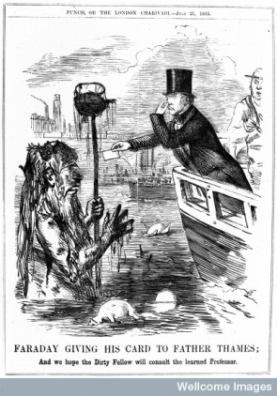
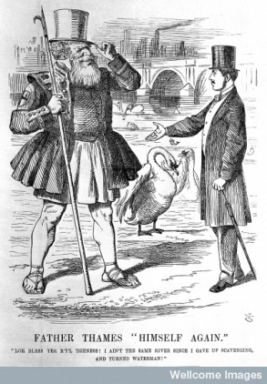
The (Sanitary) Science of Health?
Punch 1955
Punch 1865

Slide 13
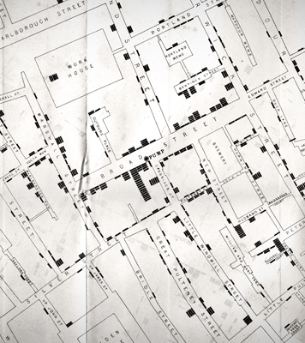
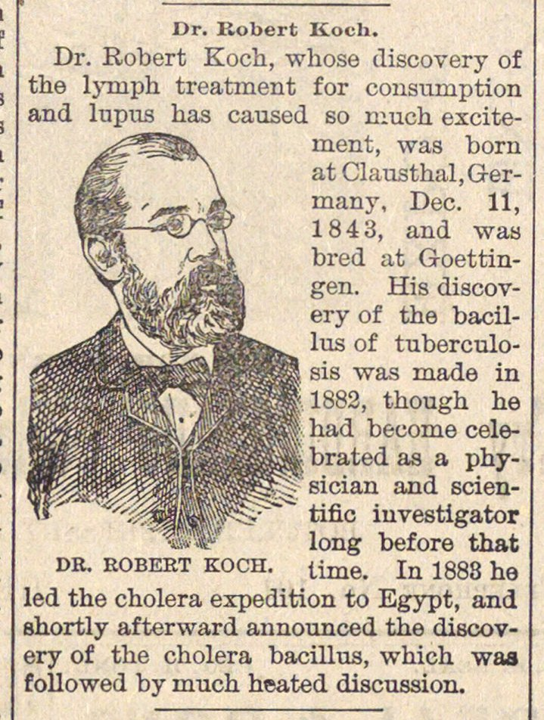
Old Water in New Bottles?
John Snow, Broad Street Pump, 1855
Ann Arbor Argus, 1891

Slide 14
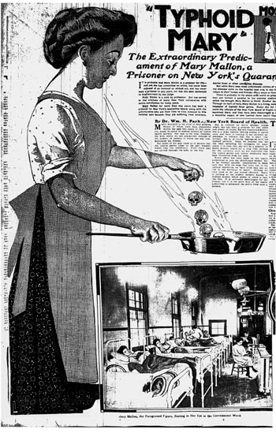
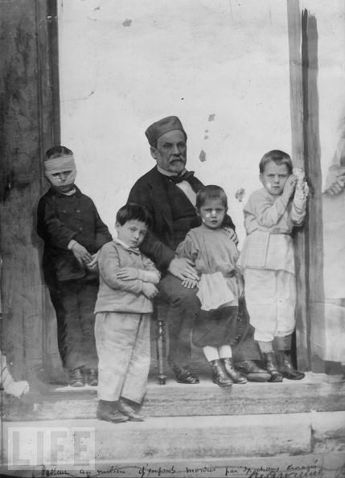
From the Gospel of Hygiene to the Gospel of Germs
Louis Pasteur and the rabies cure, 1885

Slide 15
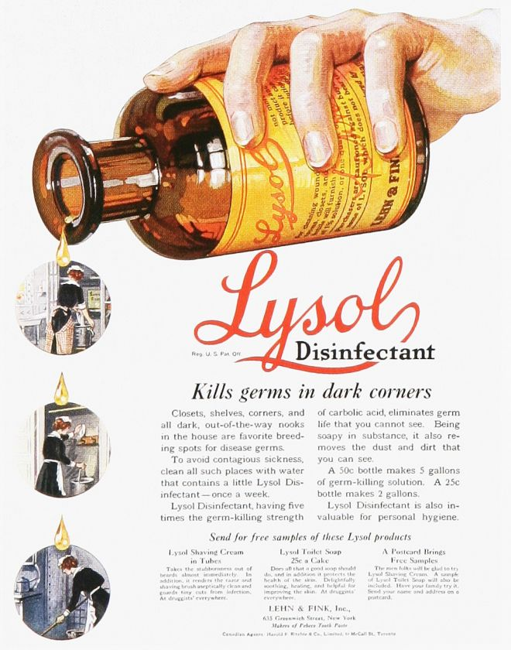
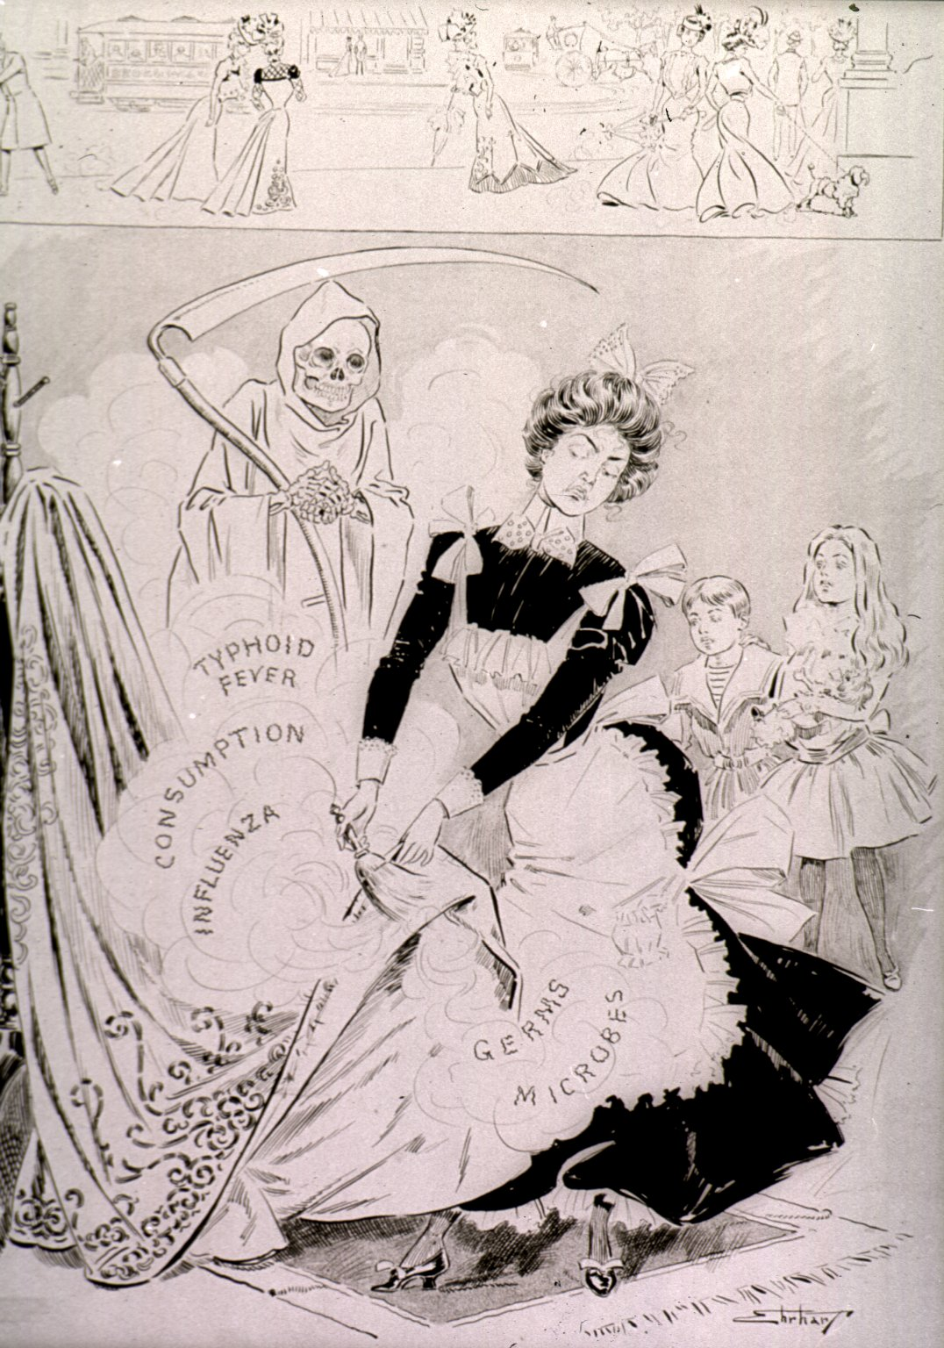
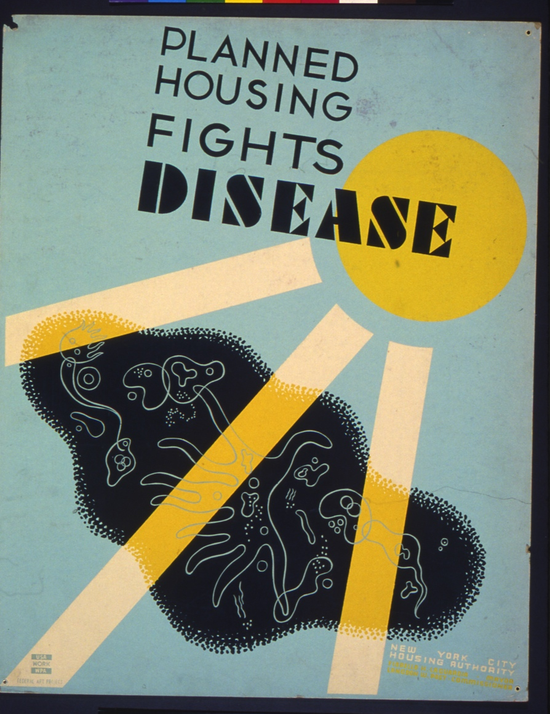
Selling ‘Cleanliness’: Individual and Political

Slide 16
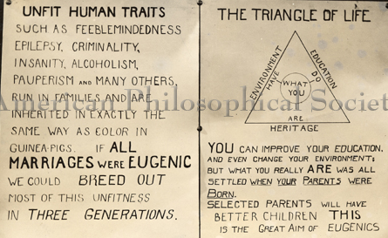
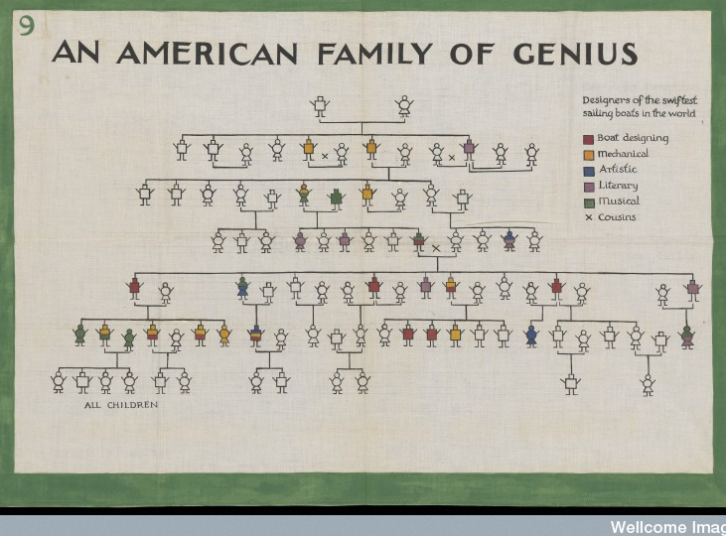
From Germs to Genes
Roots of medical genetics:
Darwinian Evolution
Mendelian genetics
Medical Statistics
Eugenics…
And MUCH LATER
Molecular Genetics

Slide 17

‘23andMe’: Google does Genomic Health
THE CLAIM:
“What your DNA says about you.
Find out things like if your body metabolizes caffeine quickly, or if you're at a higher risk for diabetes. The more you know about your DNA, the more you know about yourself.
Carrier status
Find out if your children are at risk for inherited conditions, so you can plan for the health of your family.
Health risks
Understand your genetic health risks. Change what you can, manage what you can't.
Drug response
Arm your doctor with information on how you might respond to certain medications.”
https://www.23andme.com/stories/
But see also: http://www.senseaboutscience.org/pages/genetic-ancestry-testing.html

Slide 18
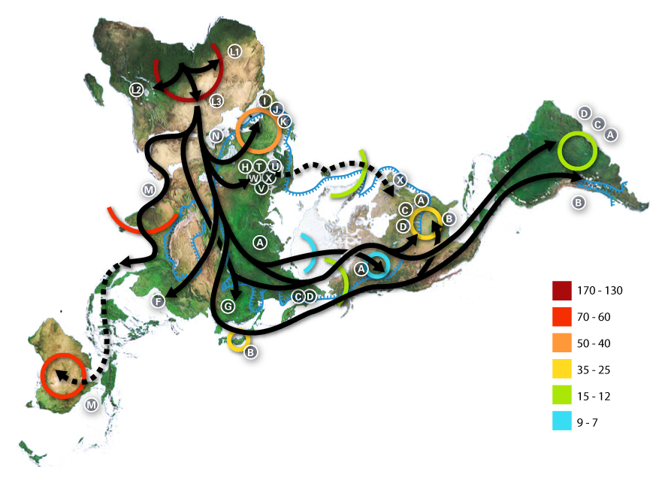
Who do you think you are? Genetics, history and identity
Letters are mitochondrial DNA ‘haplogroups’: that is, genetic indicators of maternal lineages
Thousand years before present
African: L, L1, L2, L3; Near Eastern: J, N Southern European: J, K General European: H, V Northern European: T, U, X Asian: A, B, C, D, E, F, G (note: M is composed of C, D, E, and G) Native American: A, B, C, D, and sometimes X
Notes:
World map of human migrations, with the North Pole at center. Africa, harboring the start of the migration, is at the top left and South America at the far right. Migration patterns are based on studies of mitochondrial (matrilinear) DNA. Dashed lines are hypothetical migrations.
Numbers represent thousand years before present.
The blue line represents area covered in ice or tundra during the last great ice age.
The letters are the mitochondrial DNA haplogroups (pure motherly lineages); Haplogroups can be used to define genetic populations and are often geographically oriented. For example, the following are common divisions for mtDNA haplogroups:
African: L, L1, L2, L3
Near Eastern: J, N
Southern European: J, K
General European: H, V
Northern European: T, U, X
Asian: A, B, C, D, E, F, G (note: M is composed of C, D, E, and G)
Native American: A, B, C, D, and sometimes X

