Slide 1
State Medicine and the National Health Service
Roberta Bivins
Mind, Body and Society

Slide 2

Questions
What factors encouraged a rise of state medicine in the 20th century?
Why has state medicine encountered difficulties since the 1970s?
What accounts for the longevity and popular appeal of Britain’s National Health Service?

Slide 3
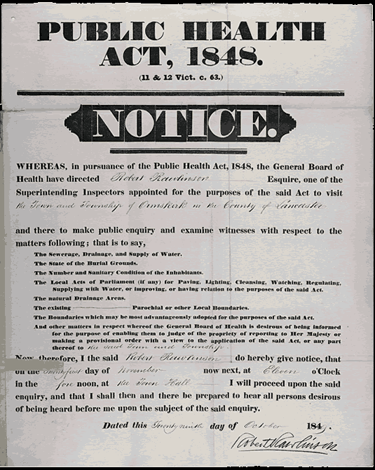
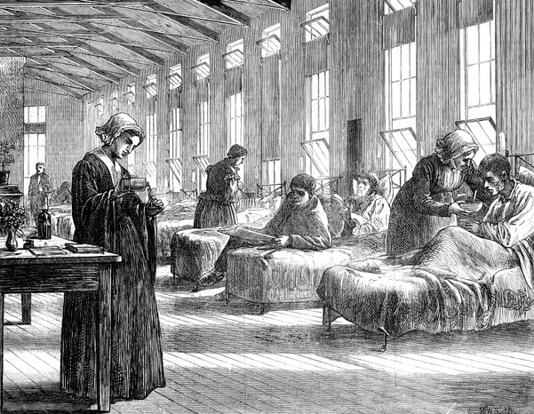
Was the state really absent from pre 20th century medicine?
Contagion, sanitary reform, local government medicine, and vital statistics
The Illustrated London News depicts a ward in the Hampstead Smallpox Hospital, c1871 →

Slide 4
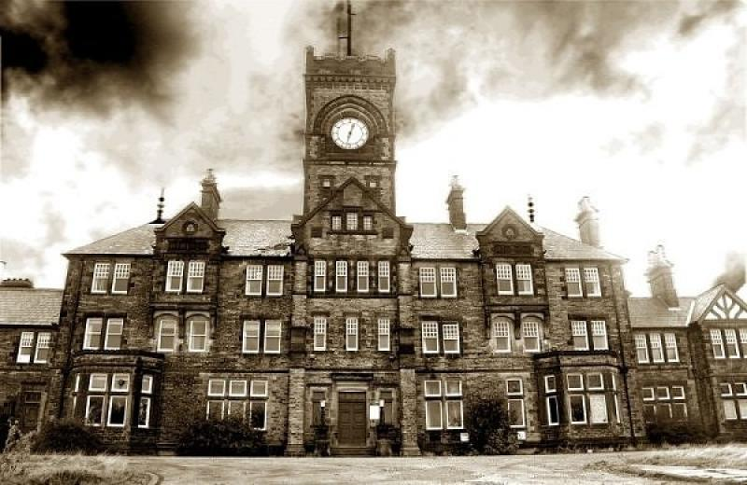
A national mental health service?
A partial timeline of UK Mental Health Legislation
1774 Madhouses Act
1808 County Asylums Act
1845 Lunacy Act and the County Asylums Act
1886 Idiots Act
1890 Lunacy and Mental Treatment Act
1913 Mental Deficiency Act
1930 Mental Treatment Act (‘Person of Unsound Mind’ and ‘Mental Hospitals’
1959 Mental Health Act
“Mrs. Smith […] had been carried to Turlington’s Madhouse by her Husband who left her there, with an assurance that he would return very soon […] it was now two years since she had been carried to this house […] during her confinement she had been attended by no physician or apothecary” – 22 February 1763, House of Commons Journal, Volume 29 Part 1, pg. 487
Read more here: https://archives.blog.parliament.uk/2024/03/14/mental-health-in-legislation/

Slide 5
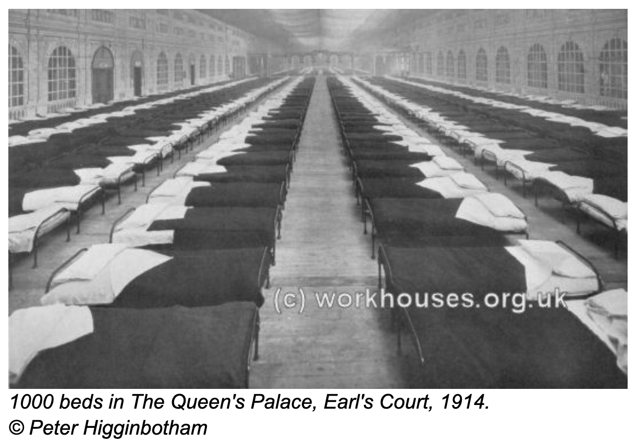
Poor law hospitals
New Poor Law 1834 establishes workhouses in place of ‘outdoor relief’ for the poor. Regime is deliberately harsh, and copes poorly with the sick and aged despite nominal hospital and dispensary provision
Metropolitan Poor Act of 1867 establishes separate hospitals for the poor, the first ‘state’ hospitals addressing the health needs of the sick poor.

Slide 6
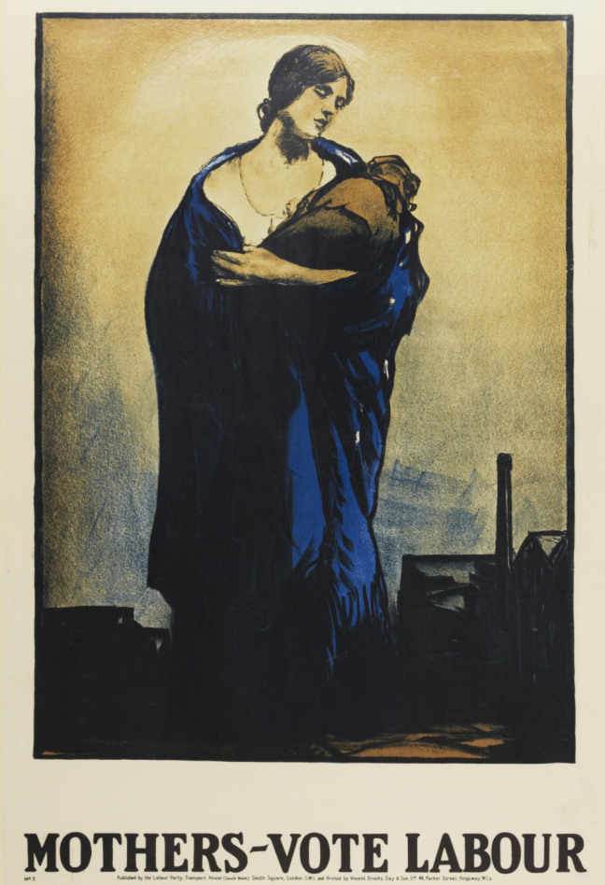
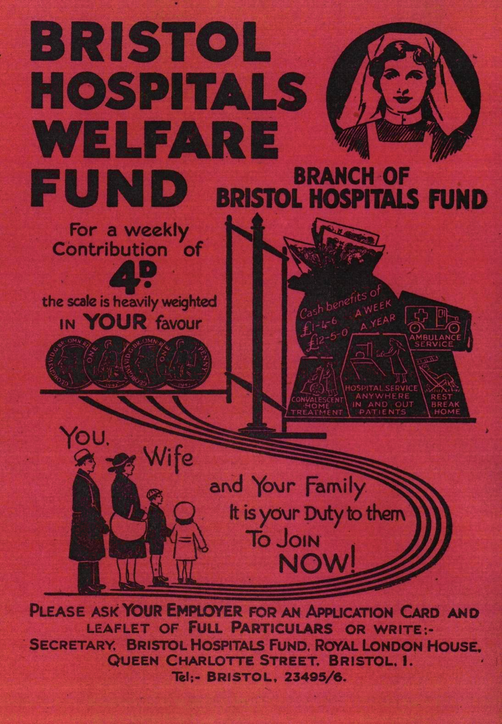
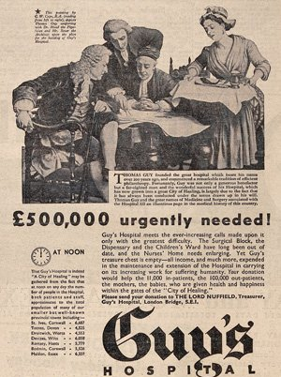
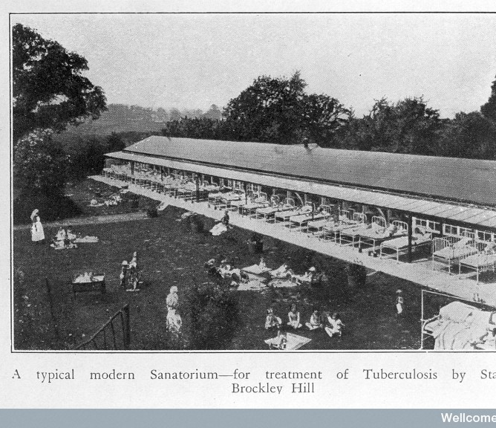
What factors encouraged the growth of state medicine in the 20th century?
‘In days gone by such conditions as appendicitis were treated with poultices and drugs in the patient’s home. Now they are treated by operation, which is more effective, but requires more equipment, a team of workers, and a larger expenditure. Such conditions as diseases of the lungs formerly received clinical examination and treatment by drugs. They may now require, in addition, the attention of the pathologist and the radiologist.
This means greater efficiency, but more organisation and higher cost.’
Viscount Bertrand Dawson
President, RCP
Royal Physician George V

Slide 7
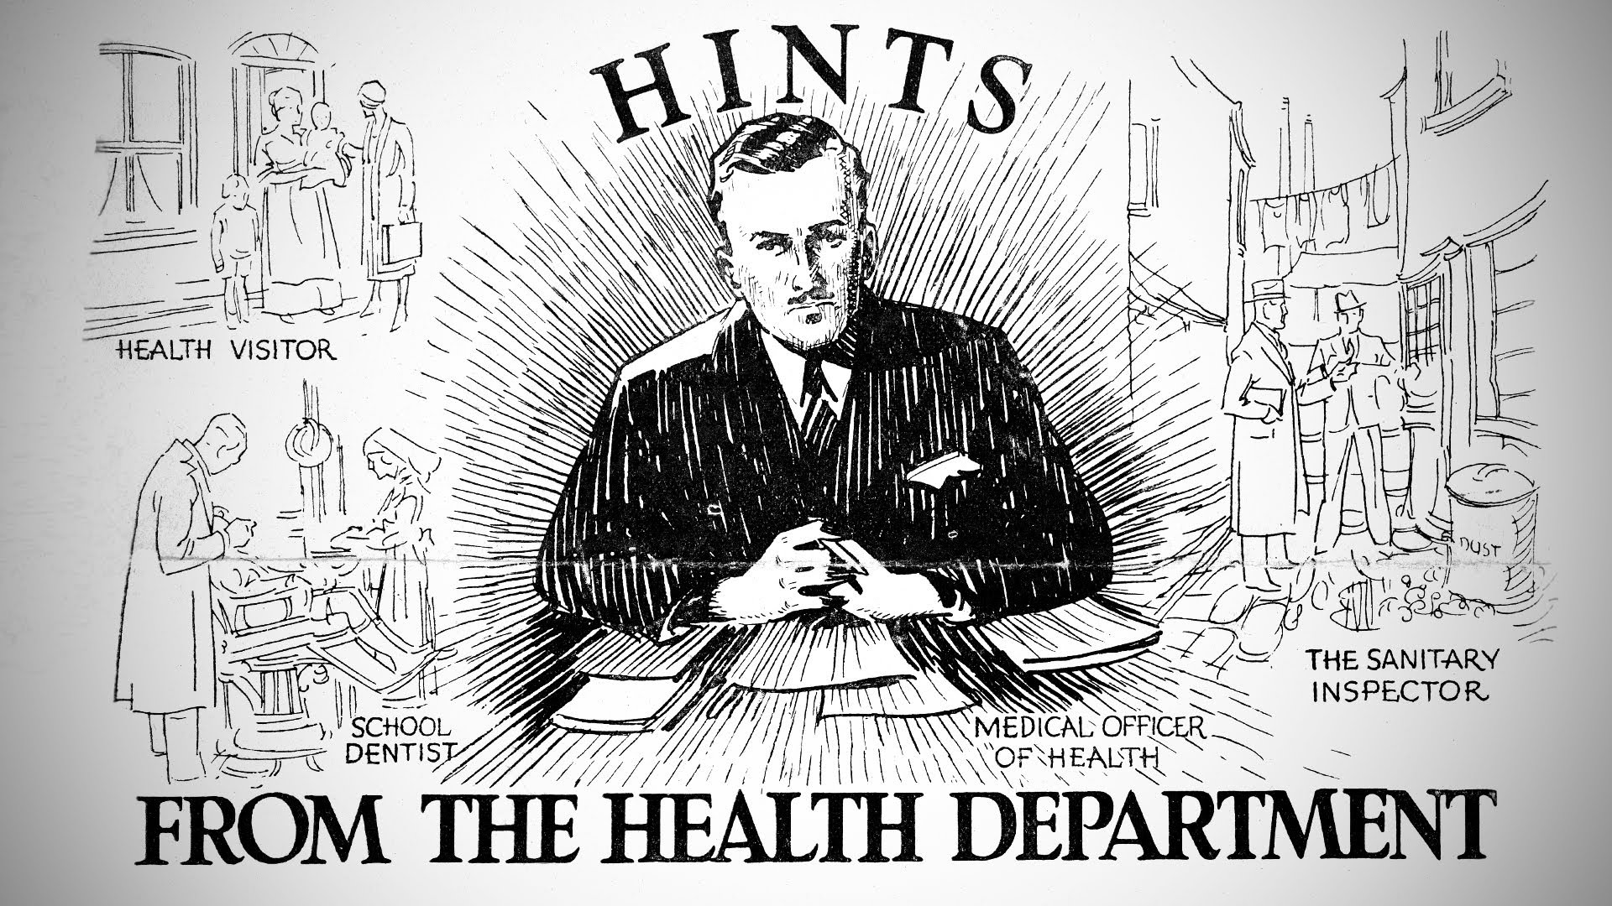
The local Medical Officer of Health

Slide 8
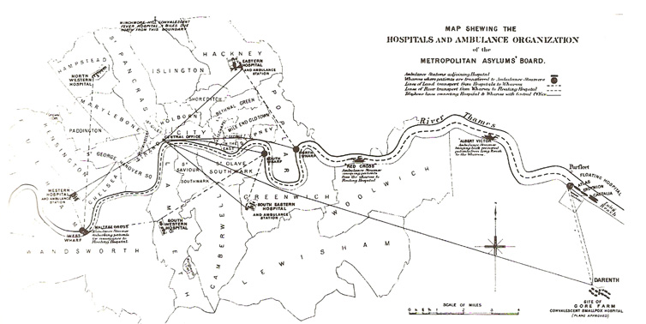
Making the LCC into the largest hospital authority in the world

Slide 9
Keeping the state at arms length
For those who could afford medical care, avoiding ‘public’ or ‘state’ medicine was a priority, even as the hospital became ever more central to acute care.

Slide 10
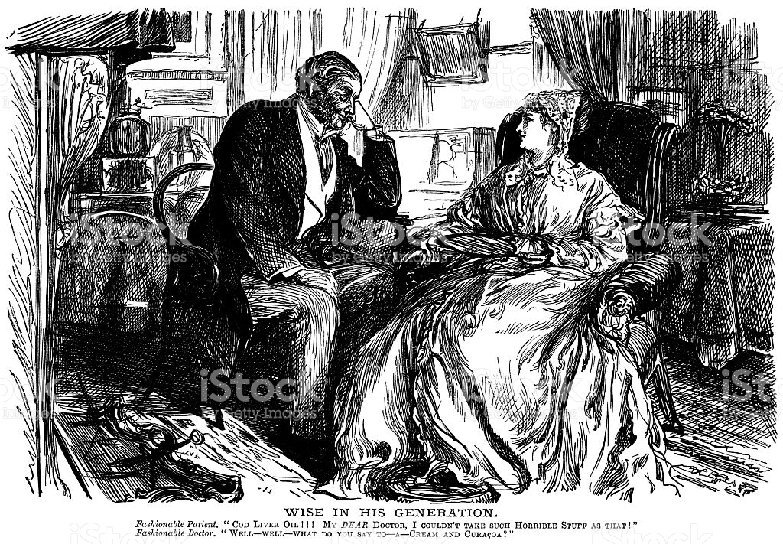
Privacy, privilege and doctor-patient relationship

Slide 11
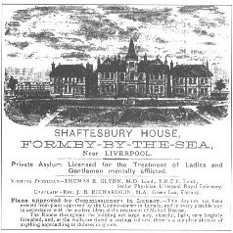
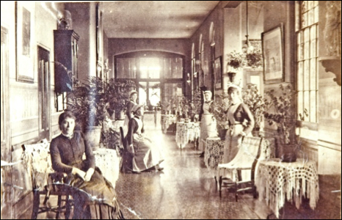
Private asylums and convalescent homes

Slide 12
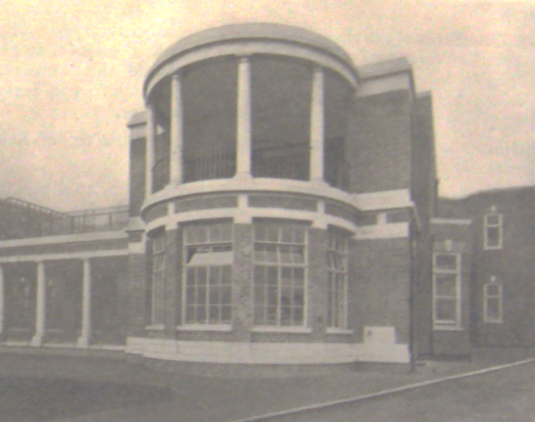
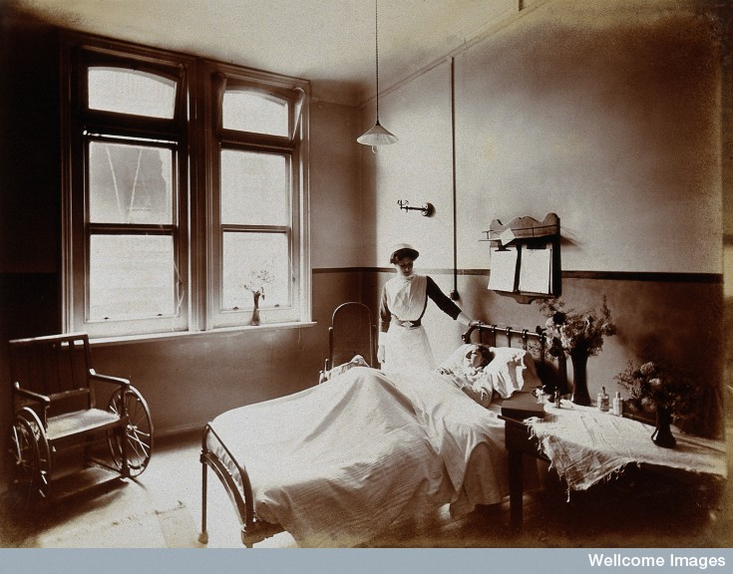
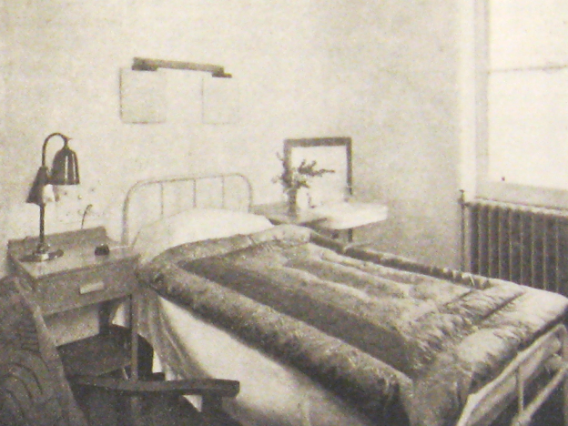
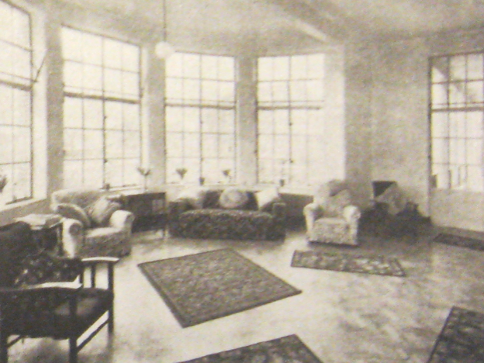
Private Hospital Medicine
Above: ‘A Ward for Paying Patients’ at the Great Northern Central Hospital, Holloway Road in London, 1912
Left: The Baker Memorial Wing for Private Patients at St George’s Hospital in London, c.1937
Notes:
Picture credit (left):

Slide 13
Why does the state step in, and the alternatives fade?

Slide 14
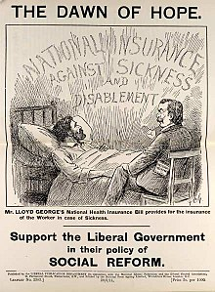
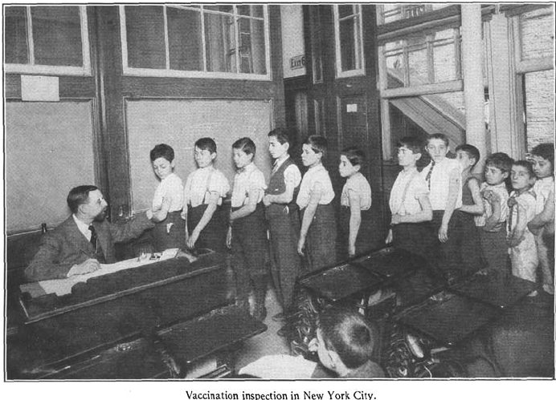
National efficiency (productionism)

Slide 15
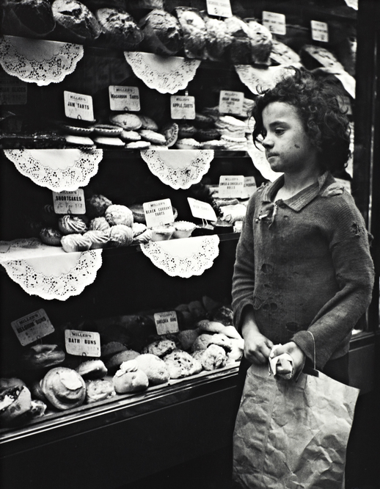
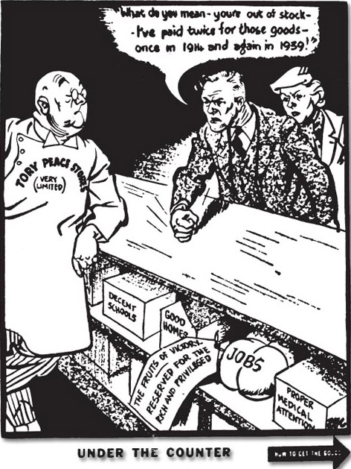
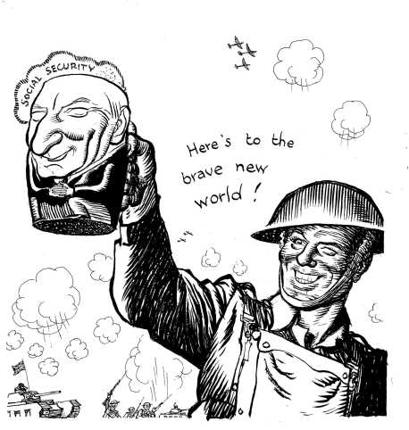
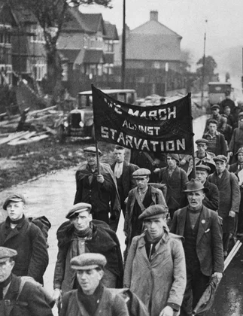

Communitarianism?
Impacts of two world wars, rise of USSR, Great Depression, ‘Hungry Thirties’, Evacuation (Operation Pied Piper), and Beveridge Report

Slide 16
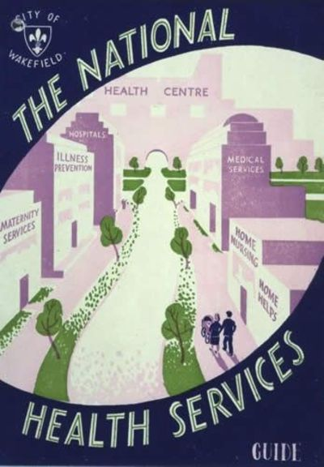
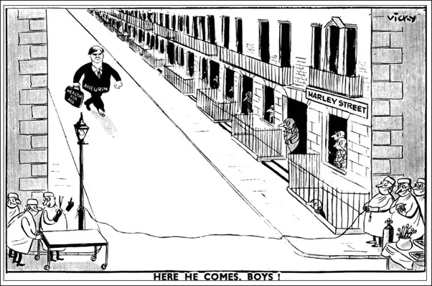
Self-interest?

Slide 17
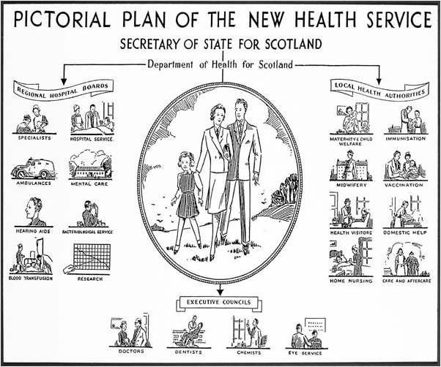
The first compromise: the illness service

Slide 18
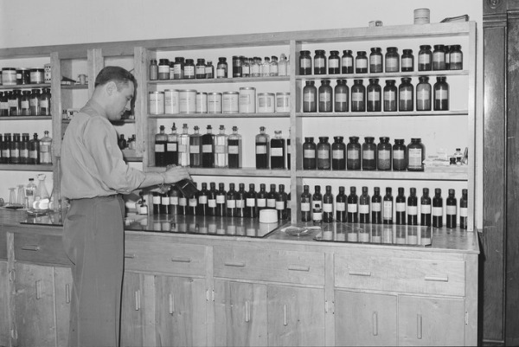
The second compromise: a mixed economy of healthcare?

Slide 19
Q2: Why has state medicine encountered difficulties since the 1970s?

Slide 20
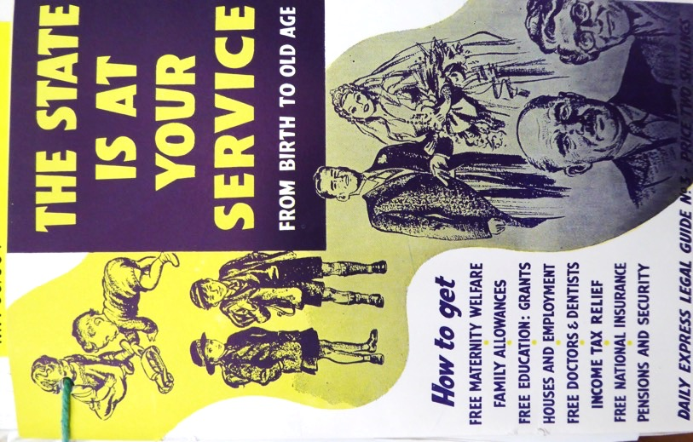
Entitlement?
‘The last half century has seen the building up in this country of the Welfare State… The object of this book is not to discuss the justification for this – ... the duty of the State to give help to its citizens ... – but to provide a brief, clear, accurate and up to date account of ...what are the practical steps to be taken by the individual citizen to secure the benefits to which he is entitled.’
‘Foreword’, Viscount Simon, House of Lords
‘The citizens are the State ... It is YOUR money which keeps this machinery working... Remember all the Services, Benefits, Grants, and other amenities which are discussed in this book are yours by RIGHT ... You are ENTITLED to them, but more often than not you may have to prove your entitlement...’
Derek Hene, 1952
Daily Express Legal Guide Series, 1952

Slide 21
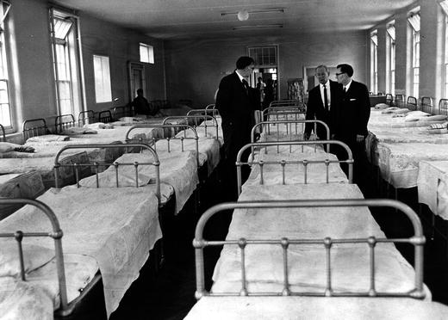
The shadow of the poor law

Slide 22
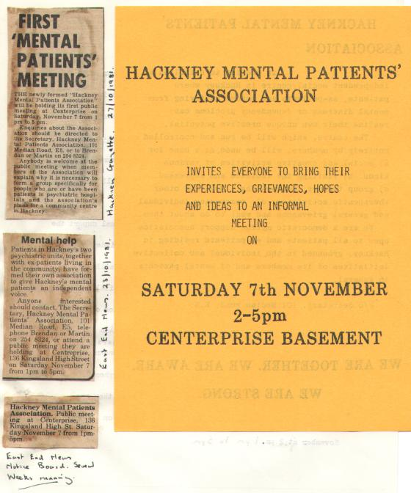
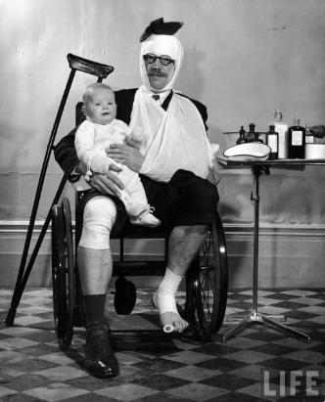
Consumerism and Rights

Slide 23
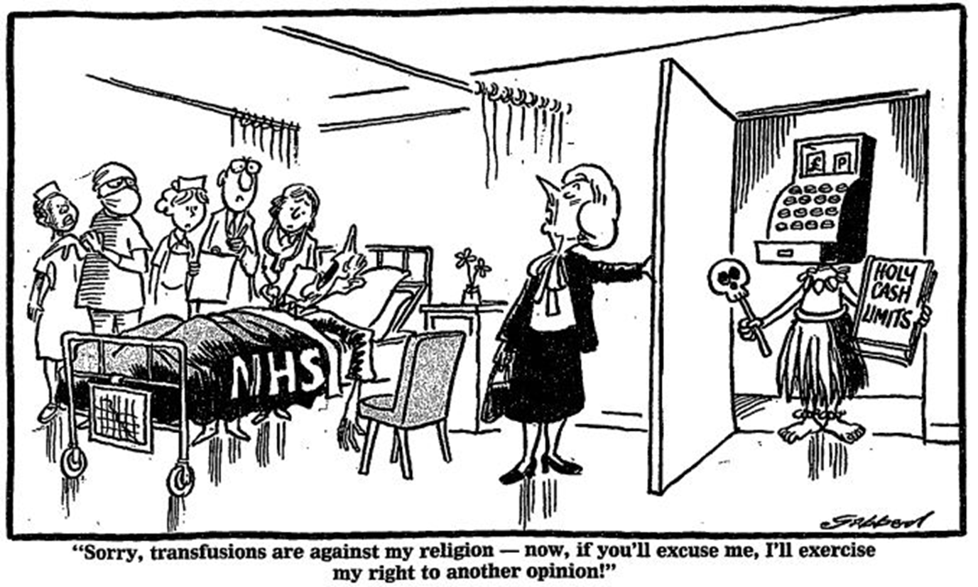
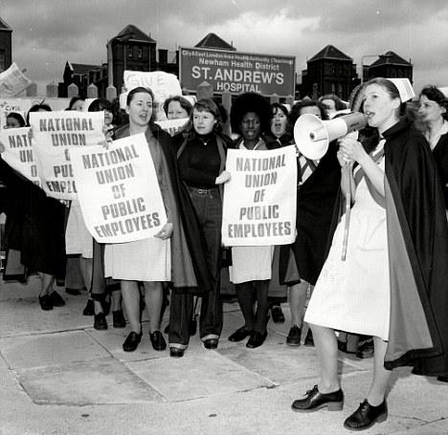
Collapse of post-war socio-economic settlement

Slide 24
40 years in: The (re)view from abroad is love-ly…
Original: Charles Griffin Daily Mirror 4 Feb 1988
Original: Kal (Kevin Kallaugher), Today, 7 October 1986
‘The British Love their NHS’, Washington Post, 1988
But at home: ‘At 40 the NHS is in danger of losing the attractive-ness of its youth and idealism, and developing the world weary, slightly cynical standard of middle age…’ Robin Cook, Labour Social Services spokesman
Notes:
Kal (Kevin Kallaugher), ‘Look what you’ve done’ Today, 7 October 1986 Maggie Thatcher and Norman Fowler Norman Fowler Sec State DHSS 1986
Charles Griffin ‘Griffin’s Eye’ Daily Mirror 4Feb 1988

Slide 25
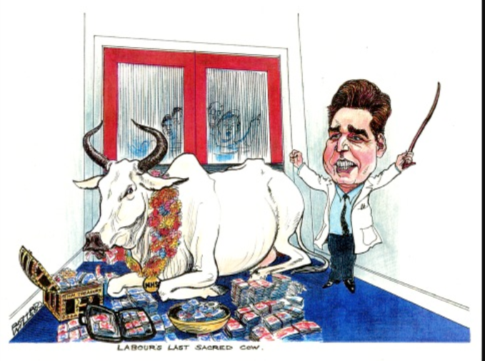
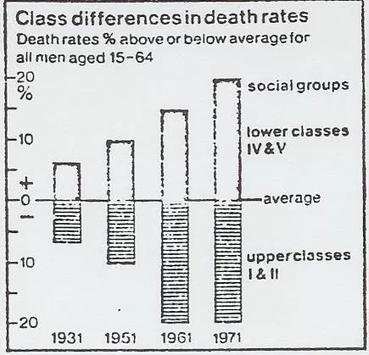
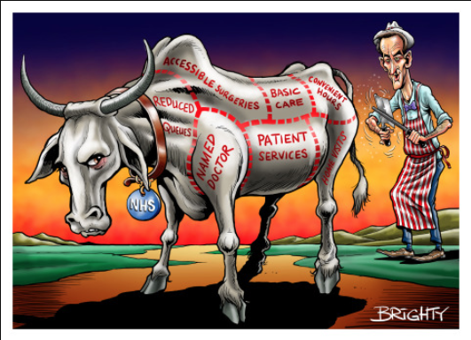
Critiques of the mid-century compromises and ‘Sacred Cows’
Richard Wilson, Times, 7 Aug 2002 Context: Budget announces record breaking NHS funding
Steven Bright, Sun on Sunday, 5 Jan 2014
Context: Increasing involvement of commercial companies in providing NHS services for profit. →

Slide 26
Q3: What accounts for the longevity and popular appeal of Britain’s National Health Service?
Consumerism
Communitarianism
Productionism

Slide 27


consumerism

Slide 28
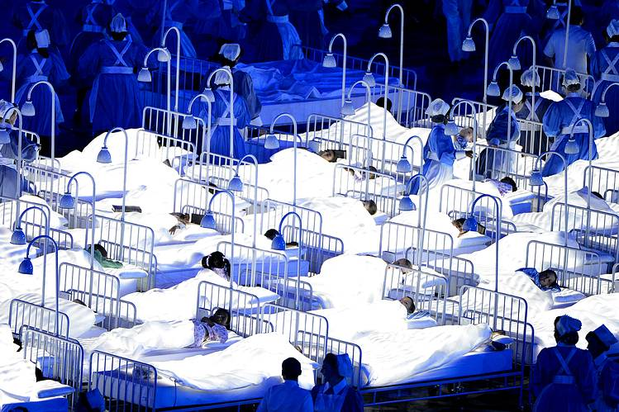
communitarianism

Slide 29
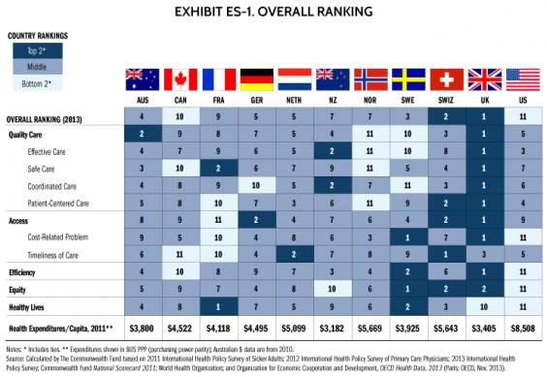
productionism

