Slide 1
The invention of blood transfusion, autotransfusion, and the role of the man midwife

Slide 2
Per 100,000 births
https://www.cdc.gov/reproductivehealth/maternalinfanthealth/pregnancy-mortality-surveillance-system.htm

Slide 3
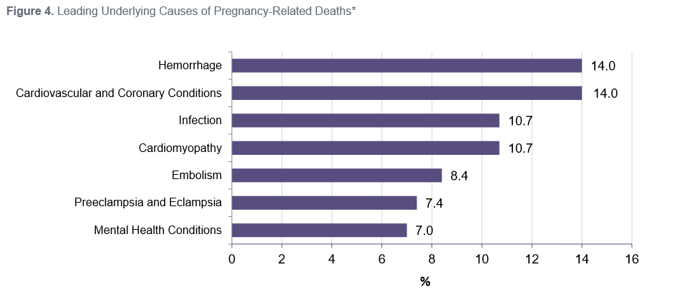
REPORT FROM NINE MATERNAL MORTALITY REVIEW COMMITTEES
Colorado, Delaware, Georgia, Hawaii, Illinois, North Carolina, Ohio, South Carolina, Utah, Virginia.
The leading underlying causes of death varied among states. Only two states had the same three leading causes of pregnancy-related deaths (cardiovascular and coronary conditions, hemorrhage, and infection); however, states with small numbers of pregnancy-related deaths made it difficult to draw comparisons across all states.

Slide 4
Causes of Postpartum hemorrhage:
Uterine atony (90% of postpartum hemorrhage)
Genital trauma
Retained placenta
Uterine inversion (1 in 5000 deliveries)
Placenta accreta/increta/percreta

Slide 5
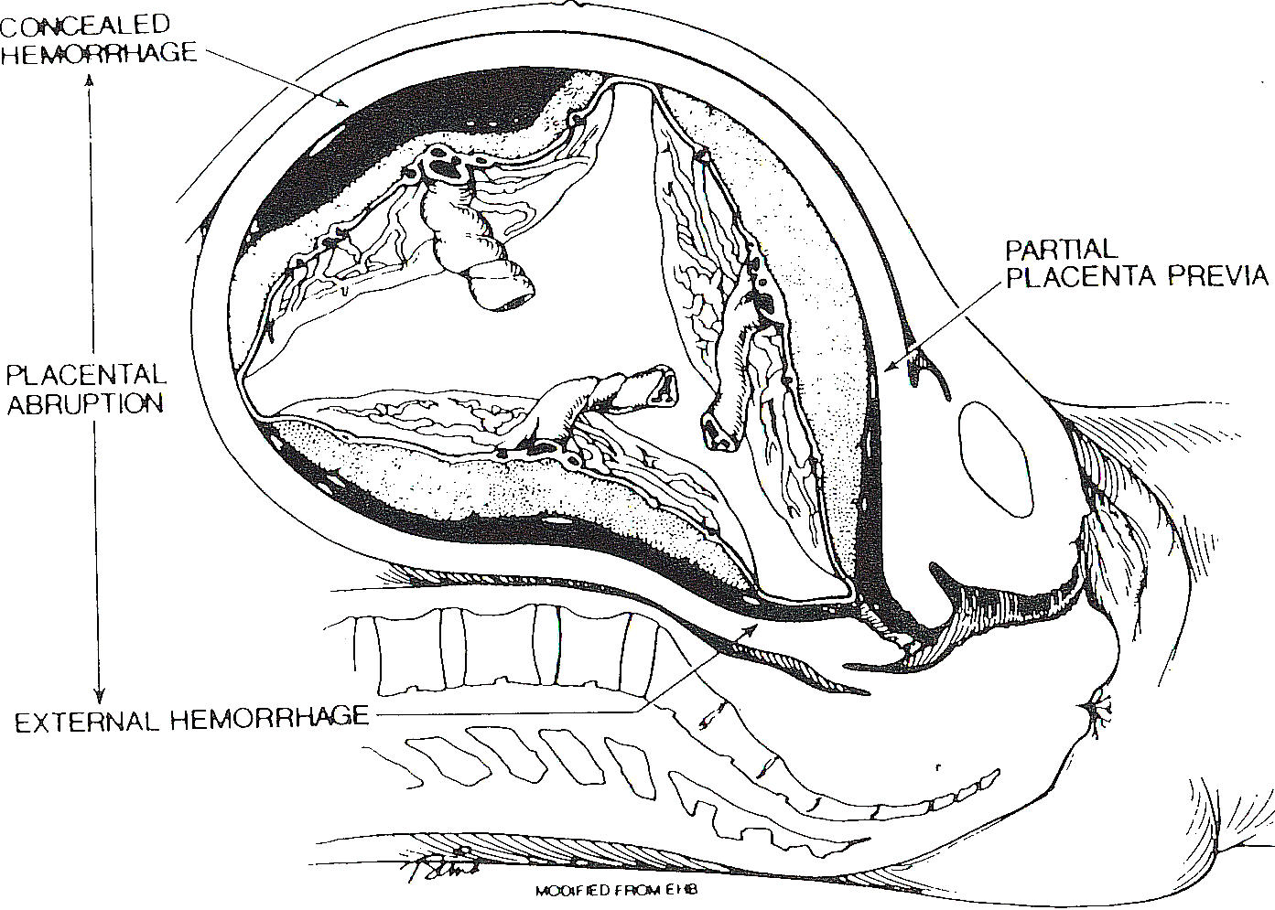

Slide 6
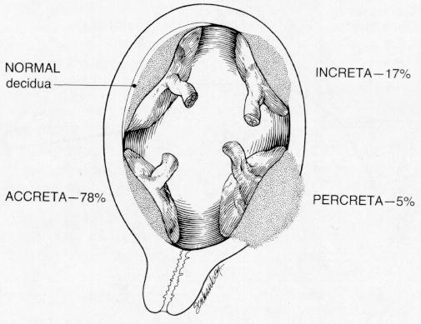

Slide 7

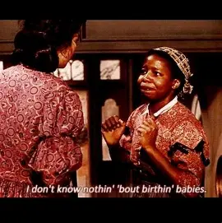
-Scarlett to Prissy upon the birth of Melanie’s baby.
Gone With the Wind

Slide 8
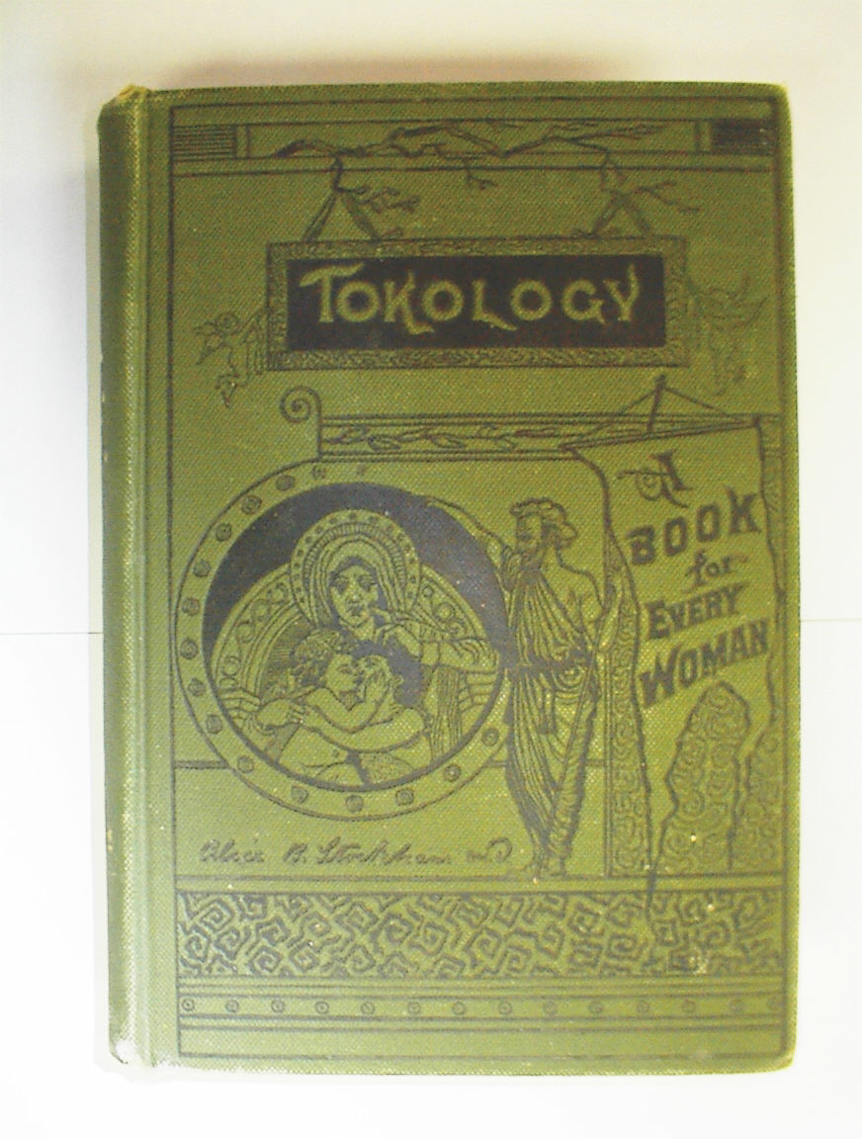
“Recently the medical profession recognize(s) that heat is better than cold, to arrest hemorrhage. In surgery, hot water is applied to exposed bleeding vessels. Cases are known where hot vaginal injections have instantly arrested bleeding that had resisted applications of ice, styptics and the tampon.”
Alice B. Stockham, M.D., 1883

Slide 9
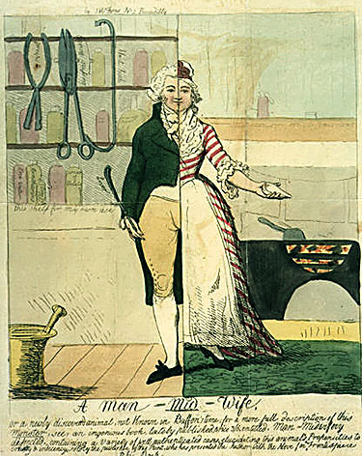
The origin of the man midwife
The term first appeared around 1631, with pioneers like Percival Willughby (1630–1670)
The secret use of obstetric forceps, popularized by the Chamberlen family and later perfected by Scottish surgeon William Smellie in the 1740s-50s
Man-midwives slowly evolved into today’s gynecologists and obstetricians, creating a "revolution in obstetrics" that replaced traditional, female-only care with male-dominated medicine.

Slide 10
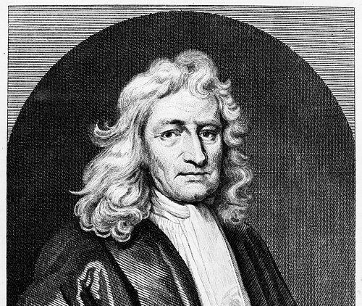
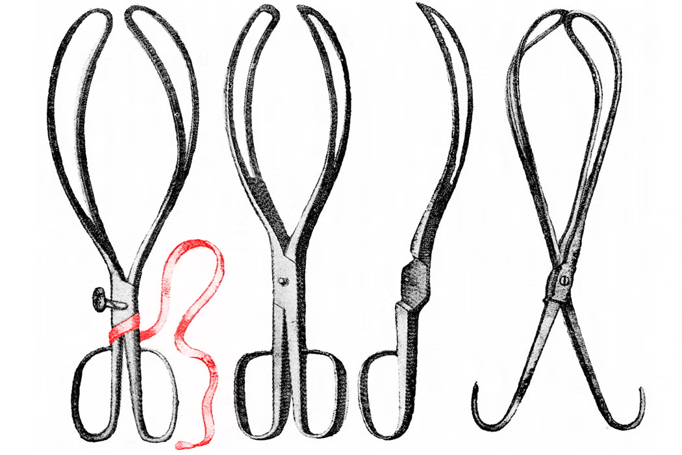
Chamberlen Forceps

Slide 11
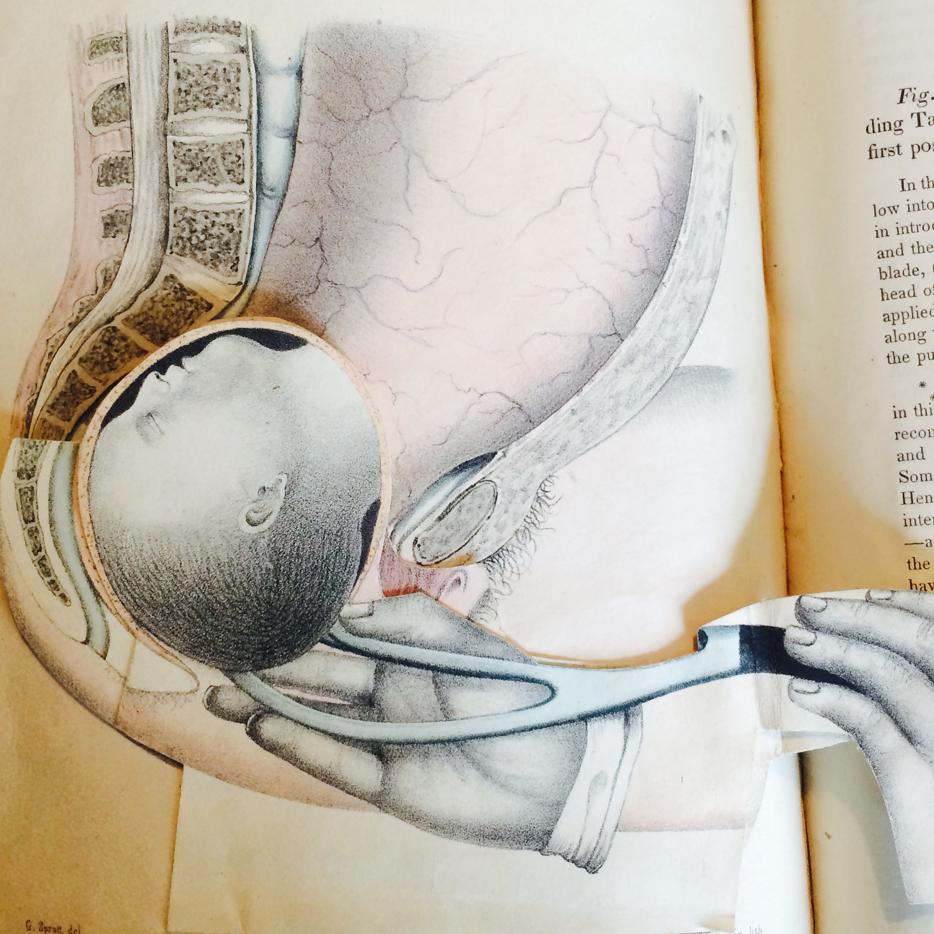
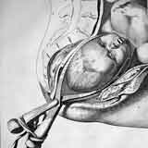
Forcepts Use

Slide 12
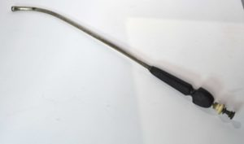
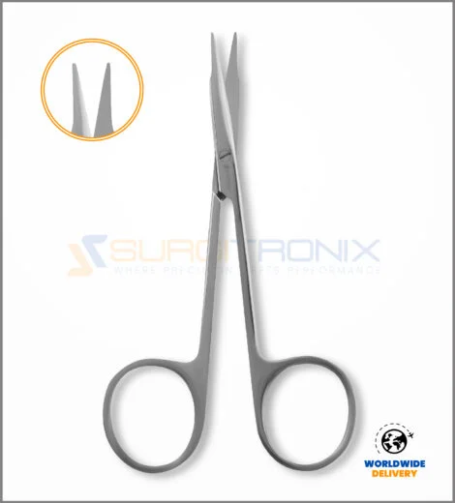
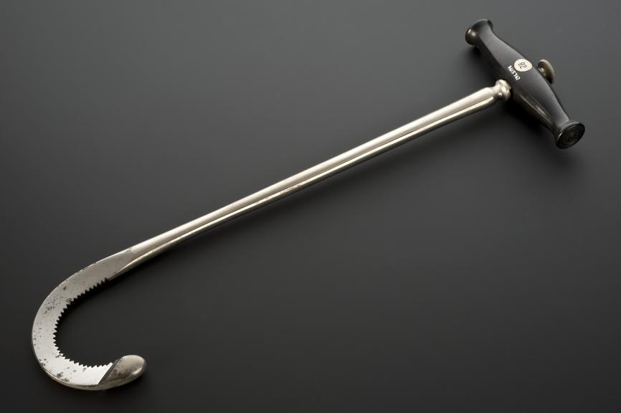
Membrane perforator
Cleidotomy scissors
Decapitating hook

Slide 13
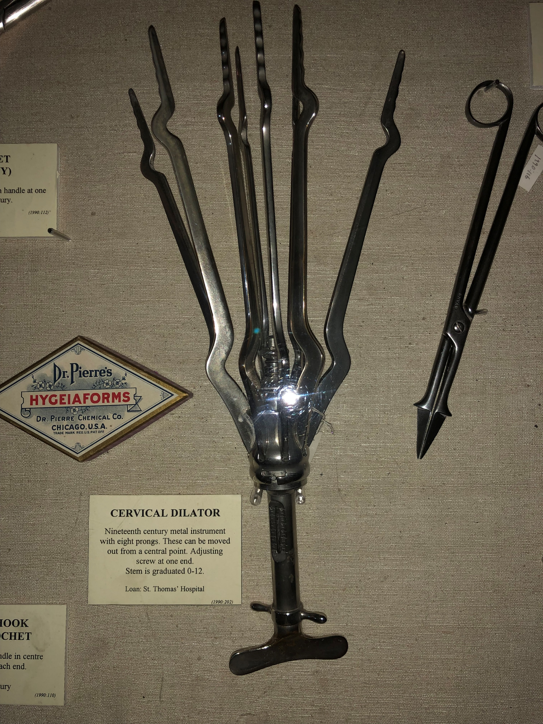

Slide 14
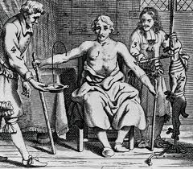

History of Transfusion Medicine

Slide 15
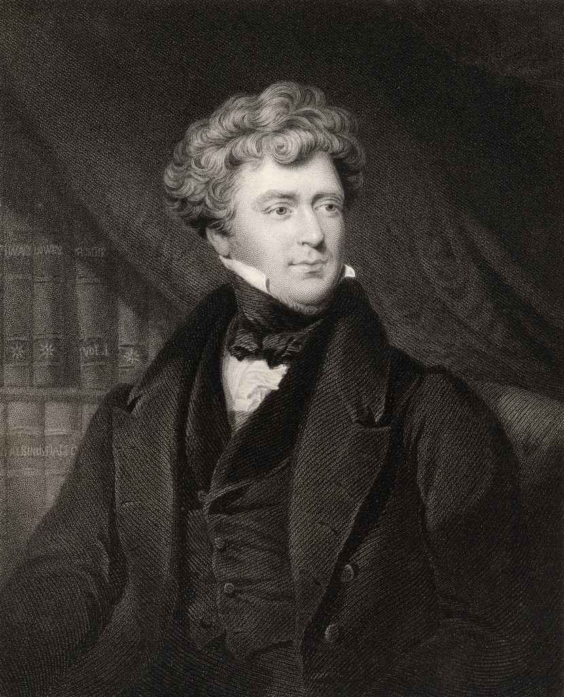
James Blundell (1790-1878)
James Blundell was a London‑born English obstetrician and physiologist best known for performing the first successful human‑to‑human blood transfusion in 1818, a procedure he developed in response to the high maternal mortality he witnessed from postpartum hemorrhage. Over the 1820s he conducted pioneering transfusion experiments, devised early transfusion instruments, and published widely—including Researches, Physiological and Pathological (1825) and later works on obstetrics and women’s diseases—establishing himself as a foundational figure in both experimental physiology and modern obstetric practice. was a London‑born English obstetrician and physiologist best known for performing the first successful human‑to‑human blood transfusion in 1818, a procedure he developed in response to the high maternal mortality he witnessed from postpartum hemorrhage.

Slide 16
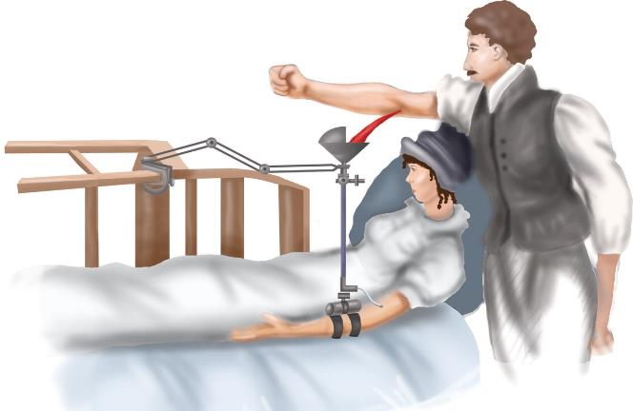
Blundell’s Blood Gravitator
Direct donor to recipient transfusion
No understanding of ABO blood type compatibility
No knowledge of anticoagulation
No understanding of blood volumes and blood pressure.
Blood transfusion was thought to be replacing the vital force lost during childbirth
http://bloodjournal.hematologylibrary.org/content/112/7/2617/F5.large.jpg

Slide 17
