Slide 1
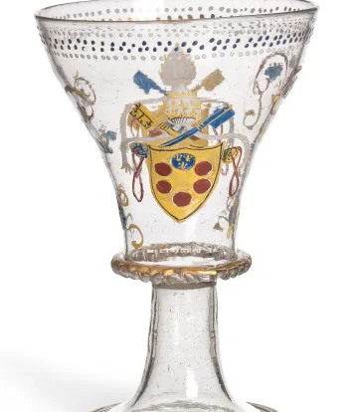
“Jest was Like a Venice Glass”: the Rise and Fall of 17th-century Jests, in Love and Hatred
Stemmed bowl, Venice, 1st third of the 16th century
Enameled and gilt blown glass
H: 0.175 cm
Purchased with the support of the Kovacek Gallery in Vienna
Inv. 998.115
© Les Arts Décoratifs
Humour, Censorship, and Print Culture in Early Modern England

Slide 2
Historical background
Religious tolerance – James I/Charles I/Civil War/Charles II/post1689?
Print industry of early modern England: the Stationer’s Royal Charter 1557/boost of publications during the Interregnum/surveyor of press after 1660s(bond of stationers)/ Acts of Copyrights 1710
Print regulation of early modern England, before the Act of Copyrights: 1630s Bishop William Laud/1637 Star Chamber/Civil War searching without warrants/Roger L’Estrange as the Surveyor of the press(1663)(the second person appointed to the office)/
Illicit printing of the 17th century – 1630s specific Puritan printers/1640/1650/after 1660

Slide 3
Aims of the dissertation
By comparing the press regulation/religious tolerance with the publication of jokes, this research aims to discuss how the content of jests can be influenced by the contemporary discussion environment.
By comparing the themes of republished jestbooks, it wants to explore if there are any changes in the themes under strict press regulation environments
  1)Can jokes become aggressive and offensive for certain groups, censoring other opinions? And;
  2)Can jokes be a text under regulation, acting as an unwelcomed opinion, under regulation and censorship
It intends to discuss the possibility of a text that can both exert a censorship effect and be censored.
  Maybe resonant to Habermas’s public sphere and Foucault’s discussion on power and resistance(History of sexuality); but better fits with Elisabeth Noelle-Neumann’s self-censorship. Not sure if theories should be included.

Slide 4
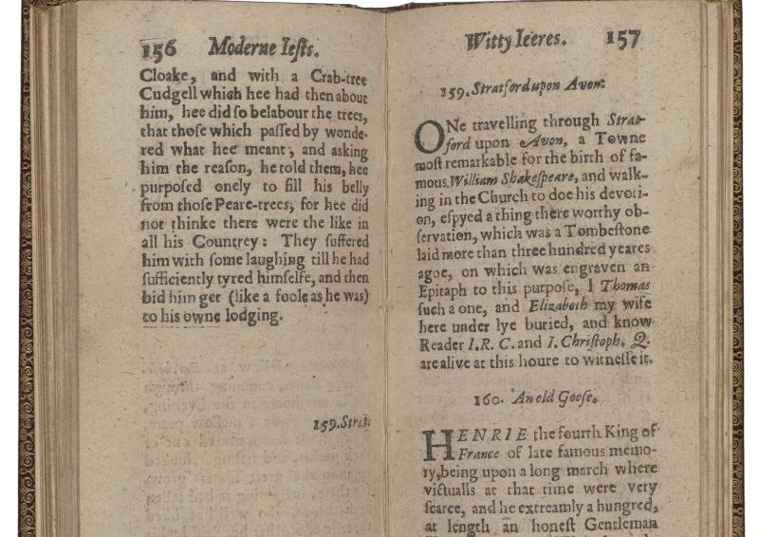
Jest, jestbooks and Jokes in the 17th century
Genre of humorous texts in the 17th century.
  Wit/Witty epigrams/Witty apophthegms
  Merry tales
  Jestbooks
  Collection of epigrams, merry tales and jests
  Comedies
  Strange news
  Biography of humorous figures(E.g. “The history of that incomparable thief Richard Hainam)
  Ballad(sometimes overlapped with jests?)
  Satire (of Quakers and Courts)
A banquet of ieasts. ca. 1632
Contributed by Folger Shakespeare Library

Slide 5
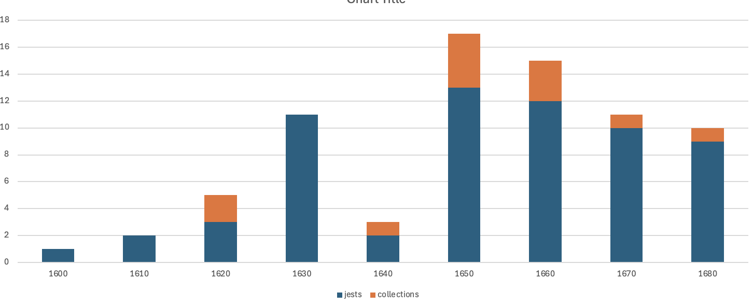
Changes of jest books
Emergence of this genre: a hundred merry tales/ Pasqvils Iestes
During 1640s, there’s a trend of resisting jokes, saying it will have no help for the contemporary disputes but to provoke chaos.
After 1660, jests start to be more prevalent, and gradually reduce its copies of print since then.

Slide 6
Republished jestbooks
Earlier jestbooks:
  Pasqvils Iestes
  Scoggins Iestes
  Tarltons
1630s:
  A help to discourse.
  A banquet of jests
Since 1650s Author’s Reputations seems to become more important:
  Laurence Price in 1650s
  Poor Robin & Hugh Peters in 1660s
  William Hickes: "Coffee house jests”(Also Oxford Jests) 1670s
1660s also see some ballads overlaps with jests. (still not sure about ballad’s history)

Slide 7
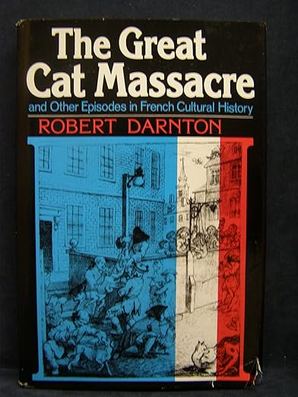
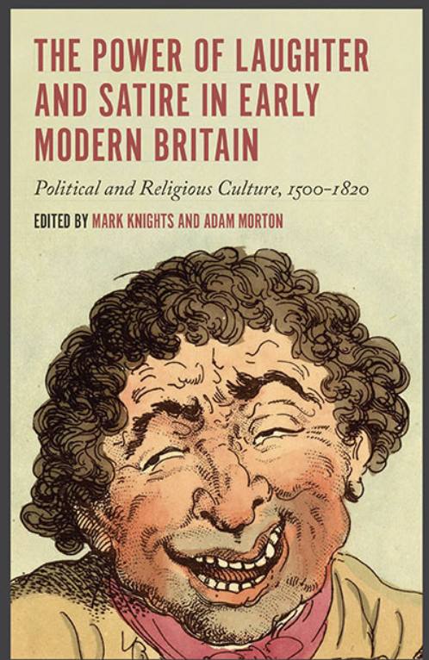
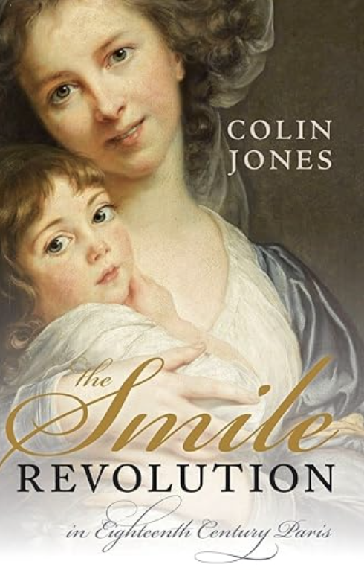
Relevant research

Slide 8
Of a Justice of Peace, and a Horse-stealer.
A Horse-stealer was brought to be examined before a Justice, who, finding the felony to be most apparent.
“Well friend,” said he, “if you are not hanged for this fact, I will be hanged for you.”
“I humbly thank your Worship,” replied the thief, “and when the time comes, I desire you that you will not be out of the way.”

