Slide 1
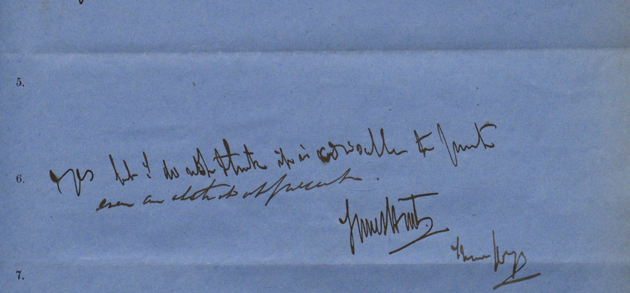
James Hunt and The London Anthropological Schism of 1863: Institutional and Epistemic Underpinnings of Anthropology, Ethnology, and Scientific Culture from 1860-1875.

Slide 2
Historical Background
James Hunt: Speech Pathologist and Racial Anthropologist
Gentlemen’s Clubs
The schism: “the great science of mankind”
Huxley vs Hunt

Slide 3
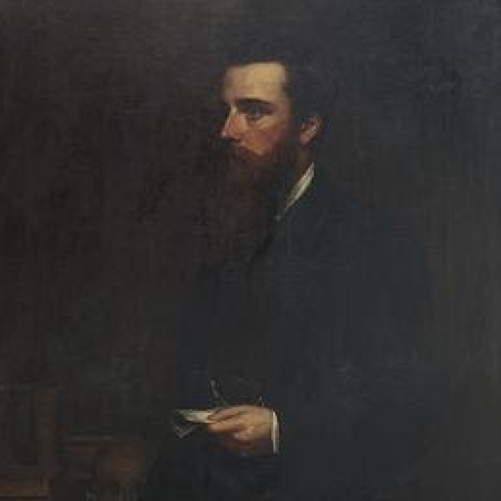
Research Questions
How do changes in anthropology’s British institutions reflect anthropological discourses of race?
How does James Hunt’s life and work illuminate the ideological structures and their nuances present in these institutions?
And, how did factors outside of British Anthropology, such as the British Association for the Advancement of Science, Victorian gentlemen’s clubs, politics, personal motivations, and French anthropology shape British anthropology?

Slide 4
Tentative Thesis
The antagonistic role that James Hunt played for the Darwinians, the broader liberal scientific culture, and any of his enemies, had an undue influence on the history of science relative to his scientific output. In general, James Hunt is not just a roadblock in science’s progress as he is often represented.

Slide 5
Historiography and Theory
Theory:
Sociology of Science
Foucauldian Discourse analysis
Historiography
Stocking, “What’s in a Name?”
Sera-Shriar, Efram. The Making of British Anthropology, 1813-1871
Beasley, The Victorian Reinvention of Race
Burrow, “Evolution and Anthropology in the 1860’s”
History of Victorian science, gender, and race.
Biographies of prominent scientists.
Currently a gap in detailed work on James Hunt.

Slide 6
Sources/Archives
Locations
Royal Anthropological Institute (RAI)
British Library
University of Bristol
Digital
Document Types
Correspondence by, to, and about James Hunt and the Cannibal Club (Darwin, Huxley, Beddoe, Lubbock. etc.)
Meeting Minutes and other documents from the RAI
Published scientific works
Documentation of scientific events in periodicals and journals

