Slide 1
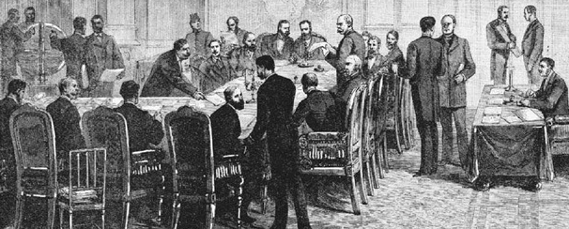
From Berlin to Berlin: the division of Africa, the division of the world

Slide 2
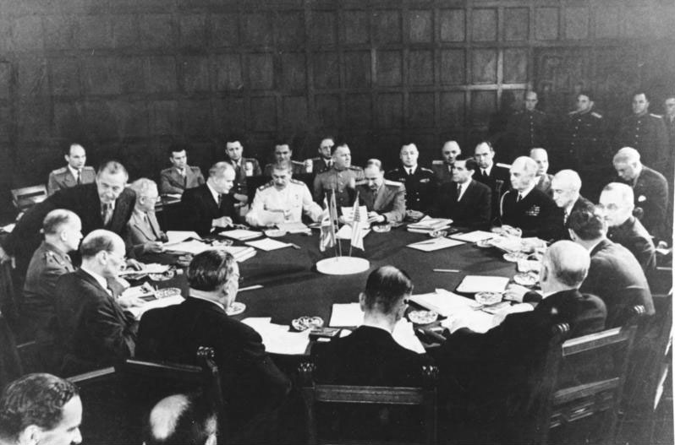
Potsdam Conference, 1945

Slide 3
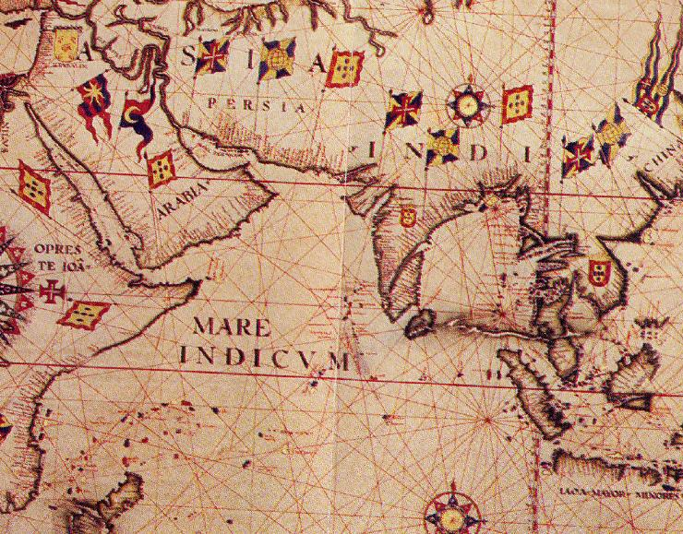
Global connections

Slide 4
Why colonialism?
Imperial rivalry between European nation-states, especially after German unification in 1871
Search for opportunities for investment
No longer possible for an ‘empire of free trade
Long-term development of racial ideas about civilisational hierarchies – idea of ‘civilising mission’
Enforcing ‘legitimate trade’ after abolition of slavery

Slide 5
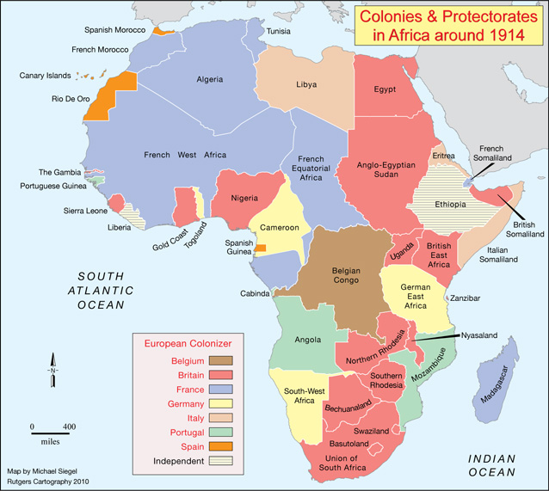
Lines in the sand: the colonial invasion
nypl.com

Slide 6
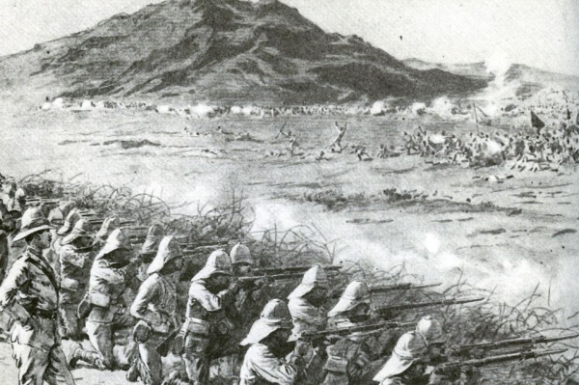
Omdurman,
Sudan, 1898

Slide 7
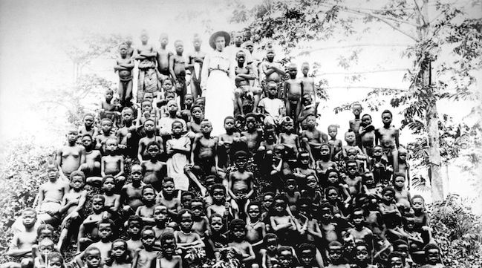
Missionary Alice Seeley Harris with children Congo Independent State, c. 1904
Autograph ABP

Slide 8
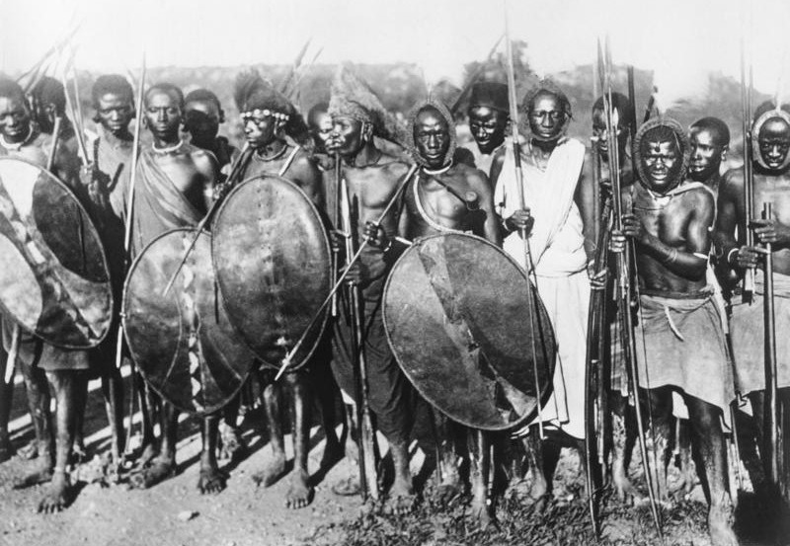
Maji Maji War, Tanganyika, 1905-07
Black Star Atlantic

Slide 9
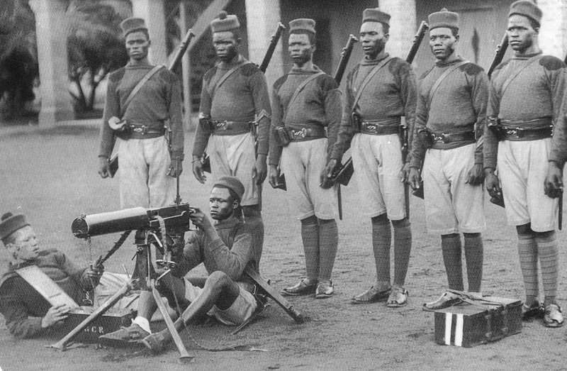
Troops from the Gold Coast (Ghana), serving in the East African Campaign during the First World War
black-history.org.uk
Black Star Atlantic

Slide 10
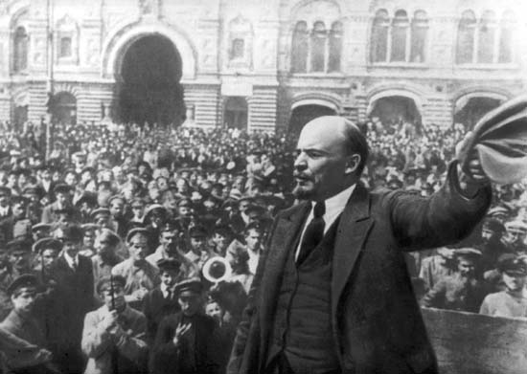
The Bolshevik Revolution, 1917
Lenin & Imperialism: The Highest Stage of Capitalism
Britannica

Slide 11
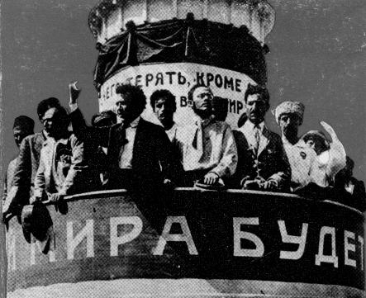
Congress of the Peoples of the East, Baku, 1920
marxists.org
black-history.org.uk

Slide 12
The rise of a superpower
Chrysler factory, Detroit, during the Second World War
wikipedia

Slide 13
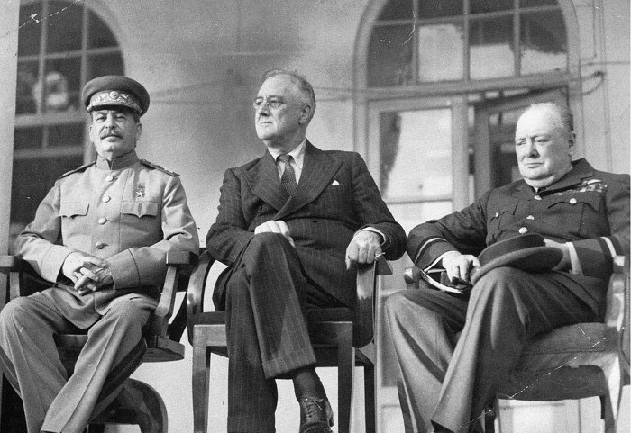
The apogee of the Grand Alliance:
The ‘Big Three’, Tehran, 1943
wikipedia

Slide 14
From World War to Cold War I
: ‘Percentages Agreement’ between Stalin and Churchill
1945: Yalta Conference
Defeat of Germany
Potsdam Conference
Hiroshima, Nagasaki, and the defeat of Japan
1946: Churchill’s ‘Iron Curtain’ speech
1947: Truman Doctrine
Marshall Plan
Creation of Cominform

Slide 15
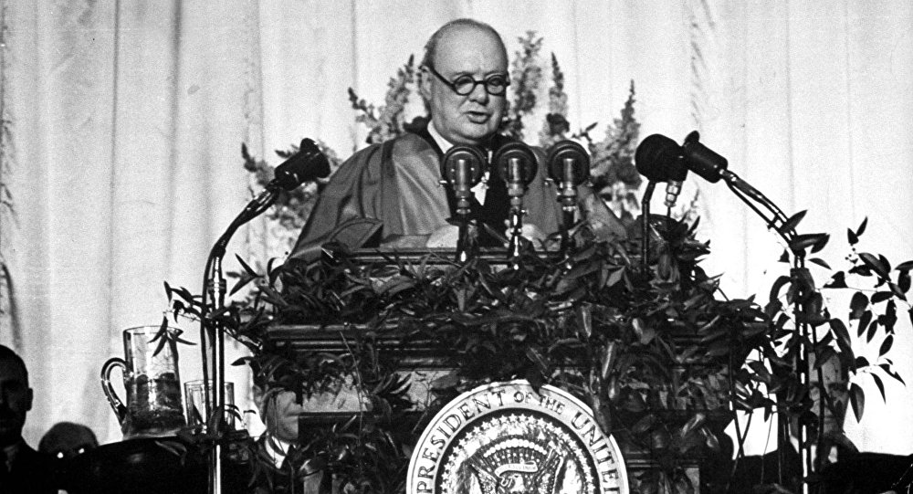
The breakdown of the Grand Alliance:
Churchill’s ‘Sinews of Power’, Fulton, MO, 1946

Slide 16
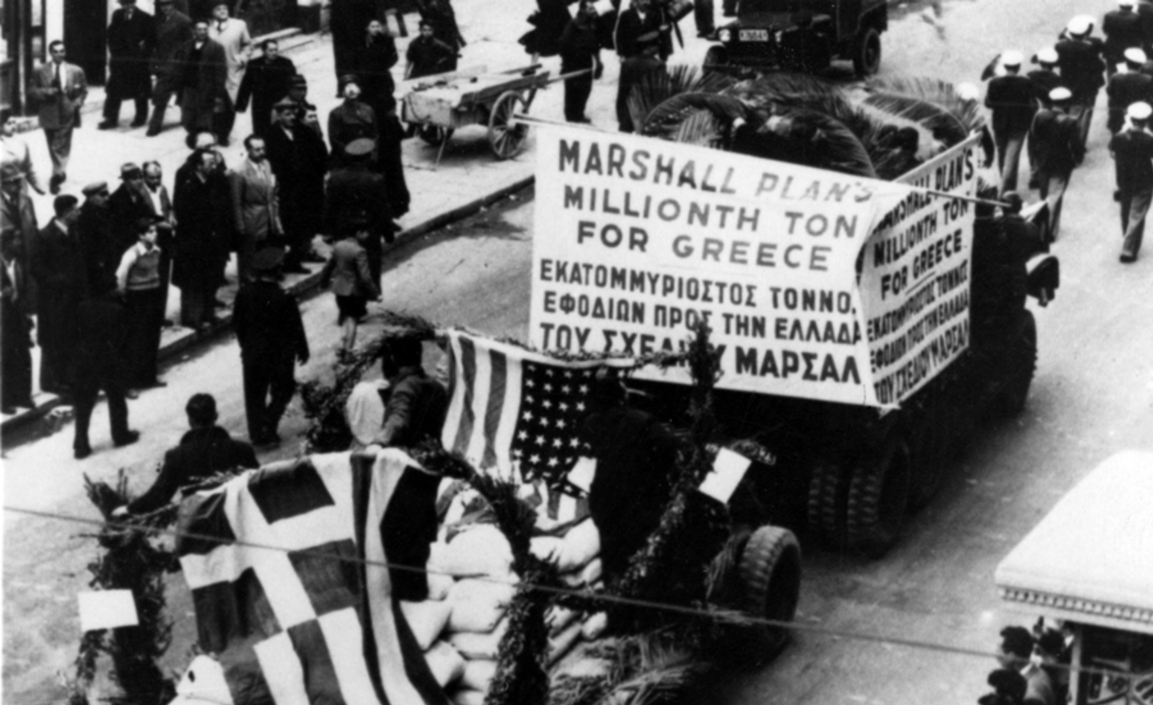
The United States confronts communism:
The Truman Doctrine and the Marshall Plan

Slide 17
From World War to Cold War II
1948: Communist seizure of power in Czechoslovakia
Soviet forces blockade West Berlin
1949: North Atlantic Treaty signed
First Soviet atomic test
Creation of Federal Republic of Germany
Creation of German Democratic Republic
1950: NSC 68
North Korea invades South Korea

Slide 18
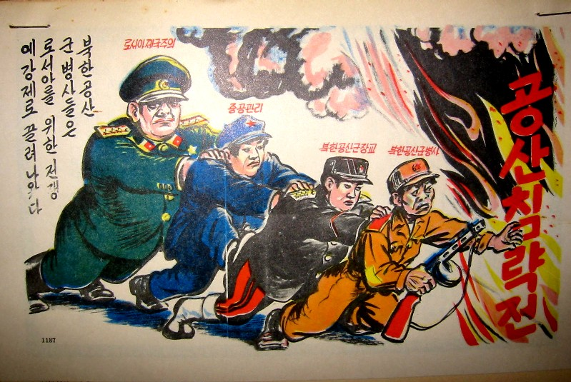
mtholyoke.edu
Comrades together: North Korean war propaganda

Slide 19
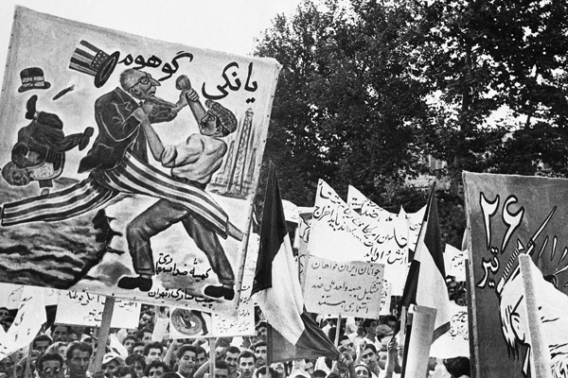
Before the coup: pro-Mossadegh demonstration
Tehran, 1953

