Slide 1
Crisis in Congo, 1959-65

Slide 2
‘Africa is a revolver, Congo its trigger’
Frantz Fanon

Slide 3
Decolonisation in the Belgian Congo
Mass nationalist protests in 1959 push Belgium into hurried withdrawal
Patrice Lumumba (1925-61) and the Congolese National Movement (MNC)
Independence day, 30 June 1960: Lumumba’s assault on Belgian colonialism, in presence of King Baudouin.
Mutiny in Congolese army > mass European exodus
Belgian army intervenes, supposedly to protect Belgian lives and property

Slide 4

Katanga
60% of Congo’s natural resources, especially minerals
Mining interests controlled by Union Miniere du Haut-Katanga
Animosity towards immigrants from Kasai Province
Creation of CONAKAT (1958)
Elections in April 1960
  CONAKAT won slender majority
  Opposition alliance (affiliated to Lumumba) walked out
  CONAKAT had no two-third quorum
  Belgian parliament hastily amended legislation to reduce quorum to a simple majority – a ’legal coup d'état’
Secession on 11 July

Slide 6
Moïse Tshombe on the streets of Elisabethville, 1960
Magnum

Slide 7
Katangese troops and white mercenaries, 1962

Slide 8
The UN intervention
Lumumba requested UN intervention to restore order and prevent a ‘recolonisation’ of Congo
Consensus on UN Security Council – Soviet Union believed it would prevent the escalation of a Cold War conflict
By the end of 1960, there were 19,000 UN troops in Congo
Lumumba’s appeal to Washington for aid rejected, so he turned to the Soviet Union…

Slide 10
Mobutu’s coup and the death of Lumumba
US-backed coup brought to power General Joseph Désiré Mobutu in 15 September 1960
Lumumba placed under house arrest, but escapes
CIA and Belgians collaborated to have Lumumba extradited to Katanga
Murdered by Katangese enemies in January 1961

Slide 11
UN stepped-up operations against Katanga after the death of Lumumba
Resolution taken to eliminate mercenaries in Katanga
September 1961: UN Secretary-General Dag Hammarskjold killed in a plane crash in Ndola, Northern Rhodesia
White interests in central and southern Africa involved a conspiracy? Demonstrates the transnational aspect of the crisis

Slide 12
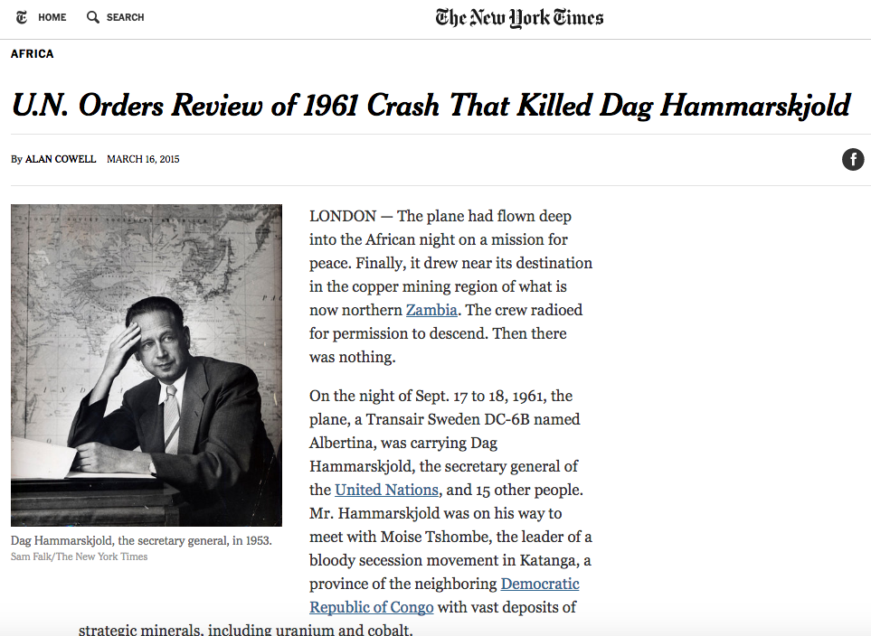

Slide 13
Mobutu bolsters his position
Antoine Gizenga and proclamation of Lumumbist government in December 1960 – recognised by Moscow
Kennedy administration supported Mobutu in Leopoldville
Installation of Cyrielle Adouala as Prime Minister, August 1961; Gizenga within government
Washington broke with European powers in ending an end to the Katangese secession – held out until January 1963
Adouala forced to resign in June 1964 – Mobutu strengthens position
Tshombe appointed Prime Minister

Slide 14
Rebellions in eastern Congo
‘Simbas’ parade in Stanleyville, 1963

Slide 16
Operation Dragon Rouge – Stanleyville, November 1964

Slide 17
Cuban interest in Africa following the revolution in 1959
December 1964: Guevara begins a two-month tour of Africa
April-June 1965: expedition of 120 Cubans into eastern Congo
Led to a rethinking of Cuban policy in sub-Saharan Africa…
Cuba, Che Guevara, and Congo

Slide 18
Conclusions
Fears of secession and insecurity of borders > foundation of the Organisation of African Unity, 1963
Rising fears of Cold War intervention, increased anti-Americanism
Importance of Western business interests in decolonisation
Was this a Cold War conflict? Was Lumumba a genuine threat to the West?
Stabilising and destabilising Congo:
  Mobutu and the creation of a US-backed dictatorship
  Katangese gendarmes – fled into Angola
  Continued calls for separatism
  Rwandan genocide and the Congo war

