Slide 1
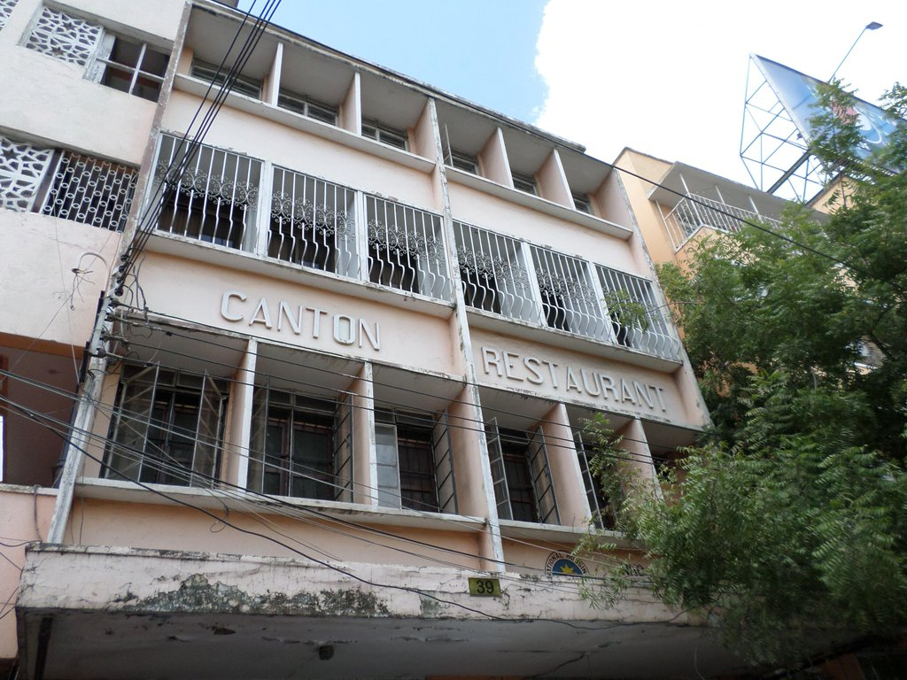
The Other Cold War: Sino-Soviet Rivalry
Term 1 | Week 9

Slide 2
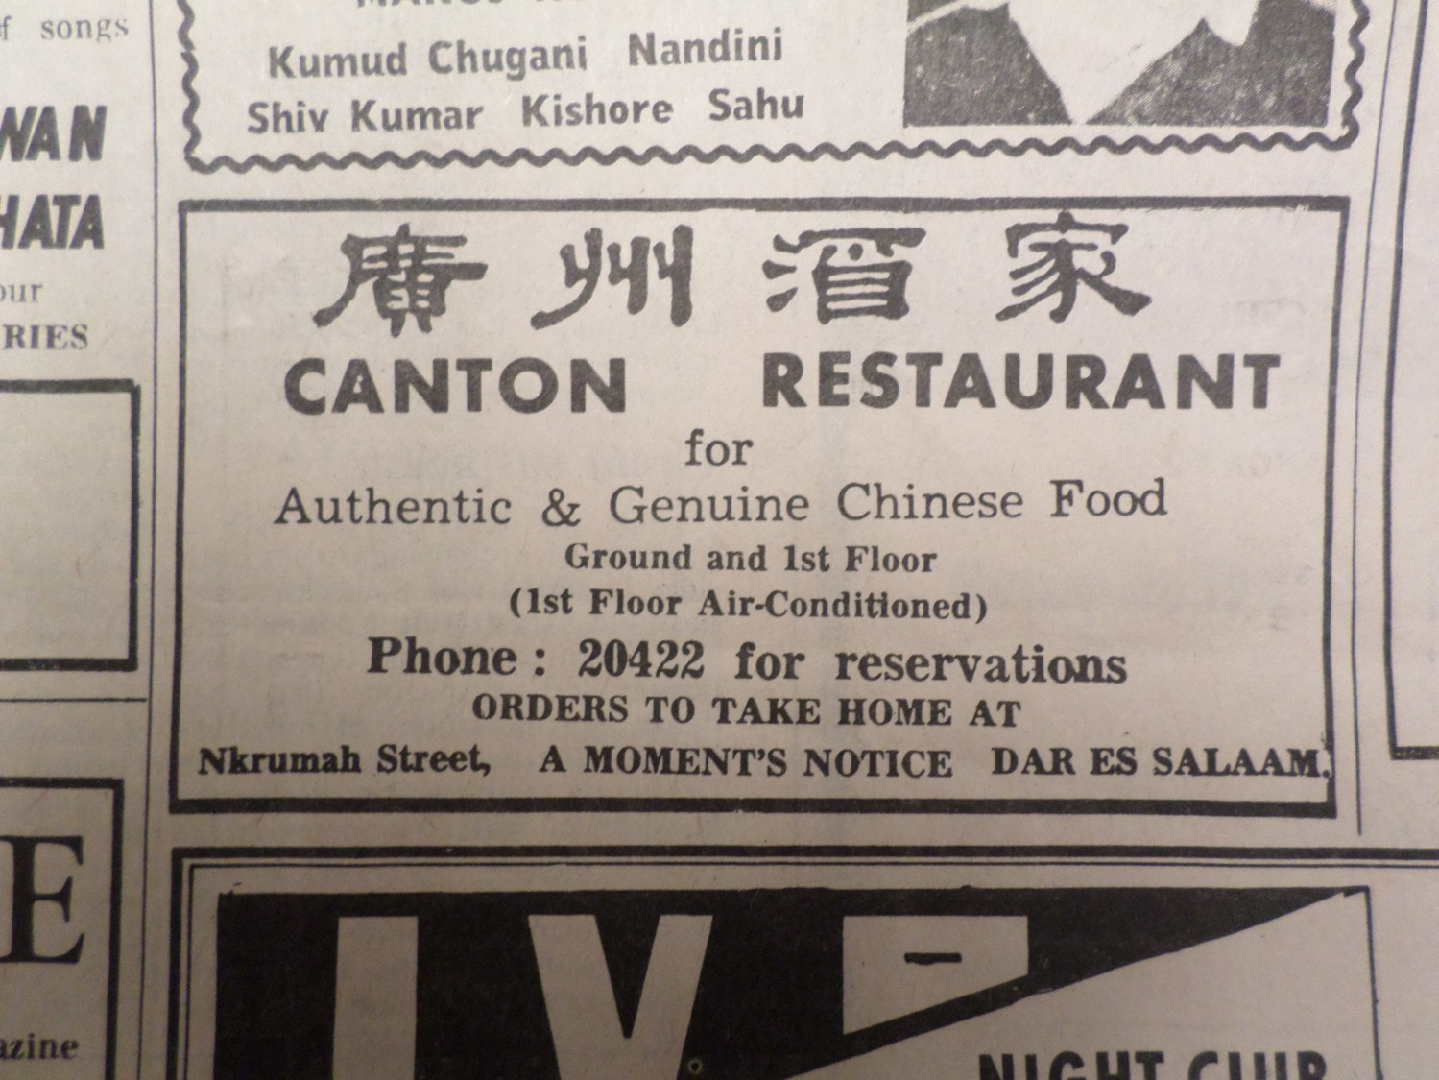

Slide 3
A tale of two revolutions
Soviet Union
Rapid industrialisation in late 19thC
Collapse of Tsarist state during First World War
Bolshevik Revolution, 1917
Stunning economic growth in 1920s and 1930s
People’s Republic of China
Imperialism and 19thC Opium wars with Britain
Communist Party of China founded in 1921
Civil war between CPC and nationalist Kuomintang (1927-36, 1946-49)
Proclamation of People’s Republic, by Mao Tse Tung
’Great Leap Forward’ (1958-61)

Slide 4
The Sino-Soviet split
Khrushchev and ‘peaceful coexistence’ with the West led to gradual deterioration in relations between Moscow and Beijing
Happier days: Khrushchev and Mao, 1959
1959 – tacit Soviet support for India in Sino-Indian war
1960 – withdrawal of Soviet experts from China
1962 – Chinese discontent with Cuban Missile Crisis
1963 – failure of Moscow talks
1964 – Mao’s ‘three worlds’ theory
Why the split? Ideology… or Realpolitik?

Slide 5
Visions of modernity
Marxist theory and the challenge of decolonisation: revolution before industrialisation?
The capitalist alternative: US modernisation theory
The appeal of socialism to post-colonial elites
Competing models of Marxist revolution:
Soviet Union and state-led industrialisation
China and collective agriculture
Friedman: ‘anti-capitalist revolution versus anti-imperialist revolution’

Slide 6
The Soviet Union in Africa: From Stalin to Khrushchev
Soviet aim: weakening connection between newly independent states and former colonial masters
Involvement in Arab countries
Construction of Aswan Dam
Czechoslovakian arms to Egypt
Formation of African sector at International Department of Communist Party of Soviet Union, 1960
Peoples’ Friendship University, 1960

Slide 7
Soviet development policy ‘national democracies’
Resurrection of the ‘non-capitalist path to development under Khrushchev
Problem of adapting Marxist theory to an ‘underdeveloped society’
‘National democracy’ – broad front comprising workers, peasants, intelligentsia, and ‘national bourgeoisie’
Sekou Touré’s Guinea
Modibo Keita’s Mali
Purely ideological or more pragmatic?
Case of Nigeria – Biafran secession and civil war
[https://vimeo.com/88701475]

Slide 8
The failure of Soviet development policy
Too pushy?
e.g. expulsion of Soviet ambassador from Guinea in 1961
Economic aid inadequate in Cold War flashpoints
The coup fever
1964 – Ben Bella in Algeria
1966 – Nkrumah in Ghana
1968 – Keita in Mali
African societies unwilling to risk Western investment
Shift away from ‘national democracy’ to ‘revolutionary democracy’ in mid-1960s

Slide 9
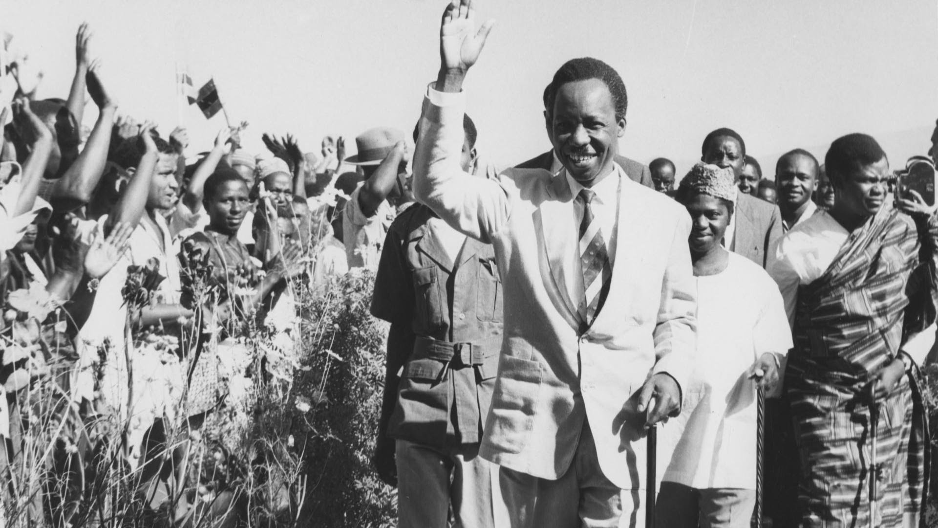
African socialism
Nyerere, ujamaa, and the Arusha Declaration (1967)

Slide 10
China in Africa: Anti-imperialism and Afro-Asian solidarity
Chinese Third World activity peaked 1960-66
Attacked Soviet Union for ‘peaceful coexistence’
Zhou Enlai in Africa, 1963-64
‘Eight Principles’ of foreign aid
Both Third World country and Cold War power
Emphasis on rural development, frugality, discipline

Slide 11
The TAZARA Railway A Chinese megaproject in Africa
Rhodesia’s Unilateral Declaration of Independence (UDI), November 1965
September 1967 – China, Tanzania, Zambia sign agreement for construction of TAZARA railway
2,000km long between Dar es Salaam and Kapiri Mposhi
$415 million interest-free loan, plus technical assistance

Slide 12
The Cultural Revolution

Slide 13
Mao’s Little Red Book
‘Chairman Mao is the great liberator of the world's revolutionary people’ (1968)

Slide 14
Propaganda wars
Soviet poster (1957)
Chinese poster (1971)

Slide 15
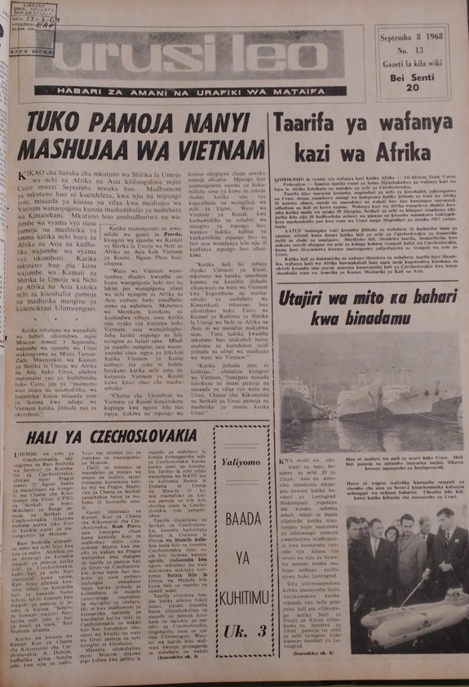
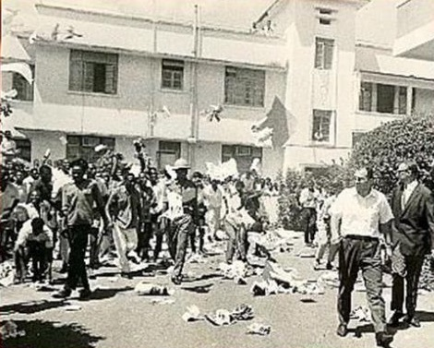
A Soviet own goal?
The invasion of Czechoslovakia, 1968
Tanzanian students protest at the Soviet embassy
Urusi Leo (’Russia Today’)
Tanzania (1968)

Slide 16
Beyond the superpowers
German Democratic Republic (East Germany)
West German ‘Hallstein Doctrine’ sought to freeze GDR out of international arena
‘Cold War subplot’ between the two German states
Yugoslavia
Broke with the Soviet Bloc in 1948
African policy driven by Tito’s non-alignment
Cuba
Spreading and defending revolution in Africa
Major interventions in Angola and Ethiopia

Slide 17
Into the 1970s…
Border skirmishes between China and the Soviet Union, 1969
Soviet shift towards supporting communist parties and Marxist-Leninist orthodoxy
Carnation Revolution in Portugal (1974) and Ethiopian Revolution (1975) new opportunities for the Soviet Union in Africa
Death of Mao in 1976 and Chinese economic reform under Deng Xiaoping

Slide 18
Conclusions: the ‘other’ Cold War
Damaging effects of the Sino-Soviet split on communist influence in the Third World
What role did Africans play in the rivalry?
Ideology or Realpolitik?
Moving away from a bipolar world…
... and towards a post-Cold War world – renewed Chinese interest in Africa in the new millenium

