Slide 1
Calvert Journal
Educating Africa: students in the Soviet Bloc
Term 2 | Week 11
https://www.youtube.com/watch?v=Cjjv0FB1F2g

Slide 2
The development of Soviet student programmes
1921 – Comintern established Communist University of the Toilers of the East
1930 – some Africans attended short courses
1950s – Soviet Union targeted trade unions
1956 – beginning of formal exchange programmes
1957 – Moscow hosted World Youth Festival
1960 – Peoples’ Friendship University established – became Patrice Lumumba University in 1961

Slide 3

Patrice Lumumba University, Moscow
1960 – 43,000 students applied for fewer than 597 places
1970 – 5,000 African students in the Soviet Union
1990 – 30,000 African students in the Soviet Union

Slide 4
Student experiences in the Eastern Bloc
Surveillance and subversion
disrupting the Soviet order
Racial tensions
‘Everyday racism’
Protest in Moscow after death of Ghanaian student, 1963
Gender
Problem of interracial relationships
African strike in Kiev after expulsion of Czechoslovakian woman, 1967
Mobility
Students travelling in Western Europe
https://www.youtube.com/watch?v=9YsMpS-HzJs

Slide 5
The American experience
Kennedy’s initiative backed by the Fulbright Foundation and the Mellon Foundation
Most students attended southern ‘cow colleges’
Tom Mboya and the Kenyan ‘airlift’
More than 1,000 Kenyan students in US by 1965
JFK Library

Slide 6
African students in Croatia, Yugoslavia
1977

Slide 7
Assessing Soviet education policy
How did Africans reflect on their Soviet Bloc experiences?
Students returned to an Africa in which the possibilities of independence were fading
Did exposure to Marxism-Leninism lead to ideological convergence, or throw into relief differences between socialisms?
Into the 1970s
  structural adjustment
  perestroika
  racism in the Soviet Bloc

Slide 8
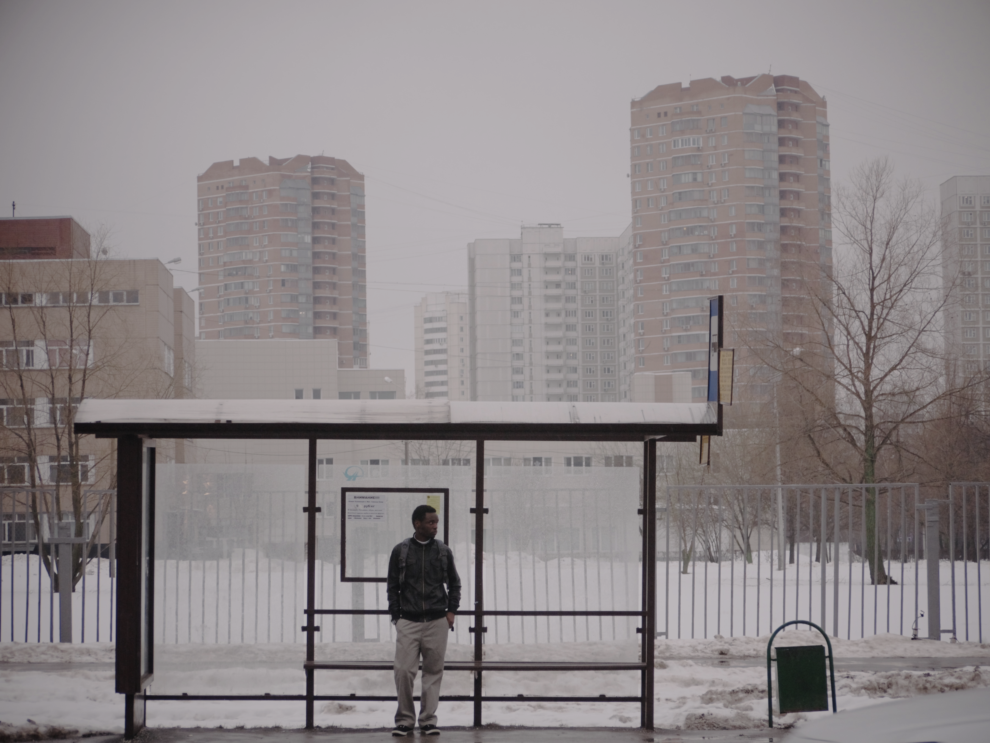
Conclusions
Beyond high politics? African lived experiences of the Cold War
Cosmopolitanism or culture clash?
Cold War propaganda function of education
Youth Mobility – transnational traffic between North and South
Afropean Odyssey

