Slide 1
Proxy war? The Ethiopia-Somalia conflict, 1977-78
HI277 | Africa and the Cold War
Term 2 | Week 4
Somali refugee camps during the Ogaden War

Slide 2
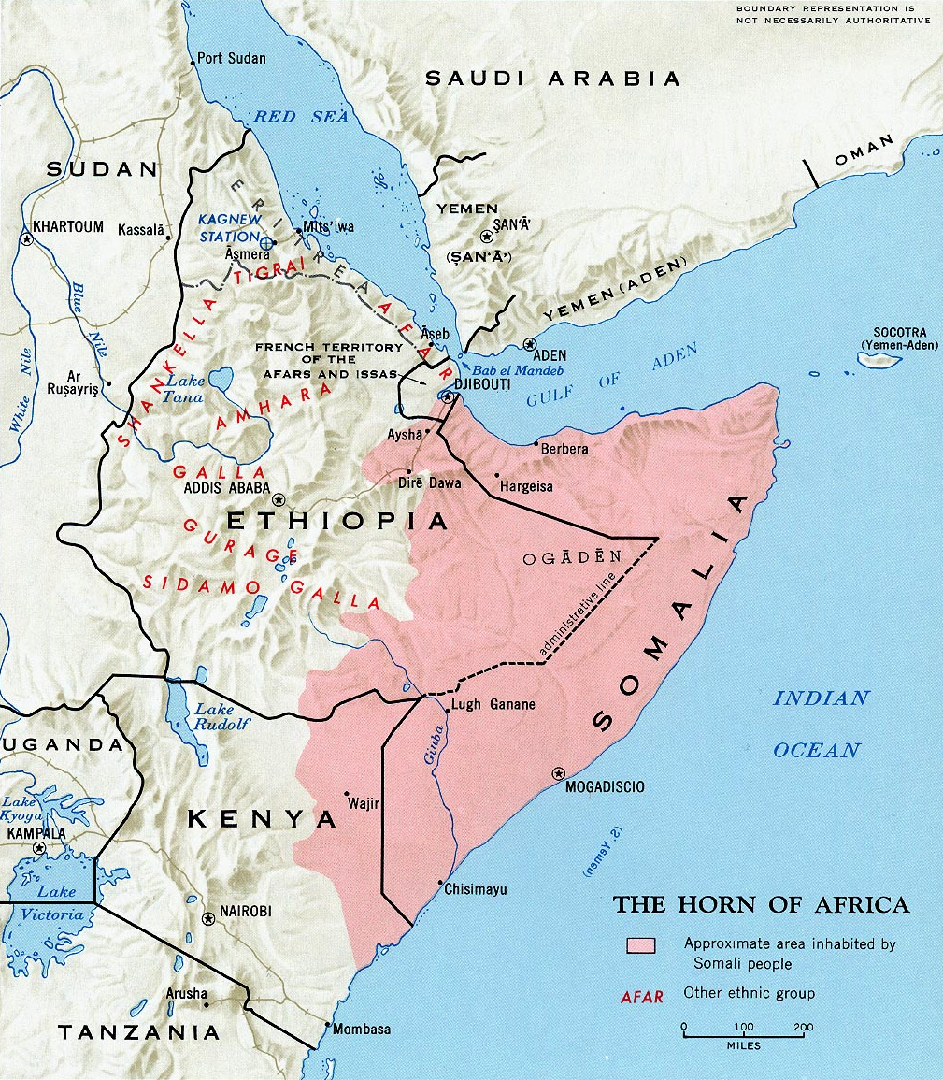
Somali irredentism
Barre continued to support irredentism in Ethiopia and Kenya, despite Soviet opposition and despite a peace treaty with Kenya
Formation of Western Somali Liberation Front (WSLF) in Ogaden in 1975 to fight for secession of the region
Ethiopia responded by funding insurgency in Somalia from 1971
Somalia received support from the Arab world, especially as Ethiopia was supporting South Sudanese separatist movements

Slide 3
Ethiopia and the Derg: the threat of invasion
Somali army well equipped with Soviet weapons; had three times as many tanks as Ethiopia
Somalia sought to exploit political turmoil in Ethiopia: early 1976, rumours of an imminent invasion
Derg inherited imperial Ethiopia’s wars against Eritrean and Tigrayan separatists – spread Ethiopian army thin
Failure of talks with Barre in Addis Ababa in January 1976

Slide 4
The Somali invasion of Ethiopia
February 1977: 1,500 Somali troops invade Ogaden
By July 1977, there were 40,000 Somali soldiers in Ethiopia

Slide 5
Ethiopia and the Soviet Union
February 1977
  United States cuts military aid to Ethiopia
  Podgorny and Castro in Addis Ababa
May 1977
  Mengistu in Moscow: $350-450m arms deal
  (48 MiG aircraft, 200 tanks, anti-tank/-aircraft missiles)
October 1977
  Mengistu complained that Soviet Union still aiding Somalia
  Moscow ceased arms supply to Somalia
  Barre evicted Eastern Bloc and Cuban advisers
November 1977
  Soviet Union begins airlift of arms and aid to Ethiopia

Slide 6
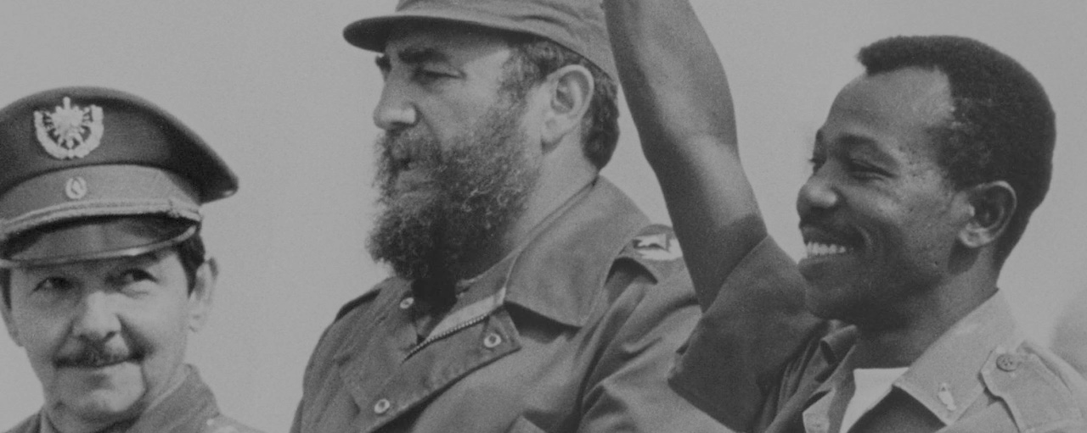

Ethiopia and Cuba
Castro initially tried to act as a peacemaker – sought to create socialist confederation in region
Castro impressed by the revolutionary character of the Derg and Mengistu’s bold leadership
Cubans initially turned down repeated Ethiopian requests for aid… until they joined Soviet airlift operation in November 1977
Problematic implications of Cuba’s aid for Derg; refuses to support war against Eritrea and Tigray; Gleijeses largely silent here

Slide 7
The defeat of Somalia
November 1977
  Soviet Union began six-week airlift and sealift
  Total $1-2bn arms and equipment
  12,000 Cuban troops plus 6,000 advisors
  Rapid Somali retreat…
March 1978
  Somalia withdrew from the Ogaden
  30,000 Somalis taken prisoner
April 1978
  Attempted coup against Barre regime

Slide 8
A failure of American foreign policy?
President Jimmy Carter
Zbigniew Brzezinski
National Security Adviser
Cyrus Vance
Secretary of State
…towards the ‘second Cold War’

Slide 9
An embarrassment for Africa
Breakdown of OAU peace talks held in Gabon in August 1977: Ethiopia would not accept participation of WSLF
Weakness of OAU shown by impotence in Uganda-Tanzania war in 1978-79
Soviet image in Africa boosted…
... but mid-1978 OAU summit in Khartoum condemned foreign intervention in African affairs

Slide 10
The fate of Ethiopian socialism
Continued war within Ethiopia, against the Eritrean People’s Liberation Front (EPLF) and Tigrayan People’s Liberation Front (TPLF)
1983-4 ‘Live Aid’ famine
By 1986, 4.6m people were resettled in villagisation programme
Moscow distanced itself from Addis Ababa after Gorbachev came to power in 1985

Slide 11
The end of the Cold War
End of the Derg and flight of Mengistu, 1991
  Independence of Eritrea in 1993
  1998-2000 - Eritrea-Ethiopia war
  Rapid economic growth… but authoritarian government, current ethnic unrest
Fall of Barre and collapse of the regime in Somalia
  American intervention and withdrawal – ‘Black Hawk Down’
  Islamic Courts regime and the rise of Al Shabaab
  Ethiopian and Kenyan invasions of Somalia; AU AMISOM force

Slide 13
Conclusions
Why did Moscow intervene in the Horn? Was it successful?
What were the consequences of the war for the United States?
Was the Ogaden War a watershed moment in the Cold War?
Did Ethiopia ‘win’ the conflict?
Domestic + regional + international politics

