Slide 1
Revolution in Zanzibar, 1964
Term 1 | Week 8

Slide 2
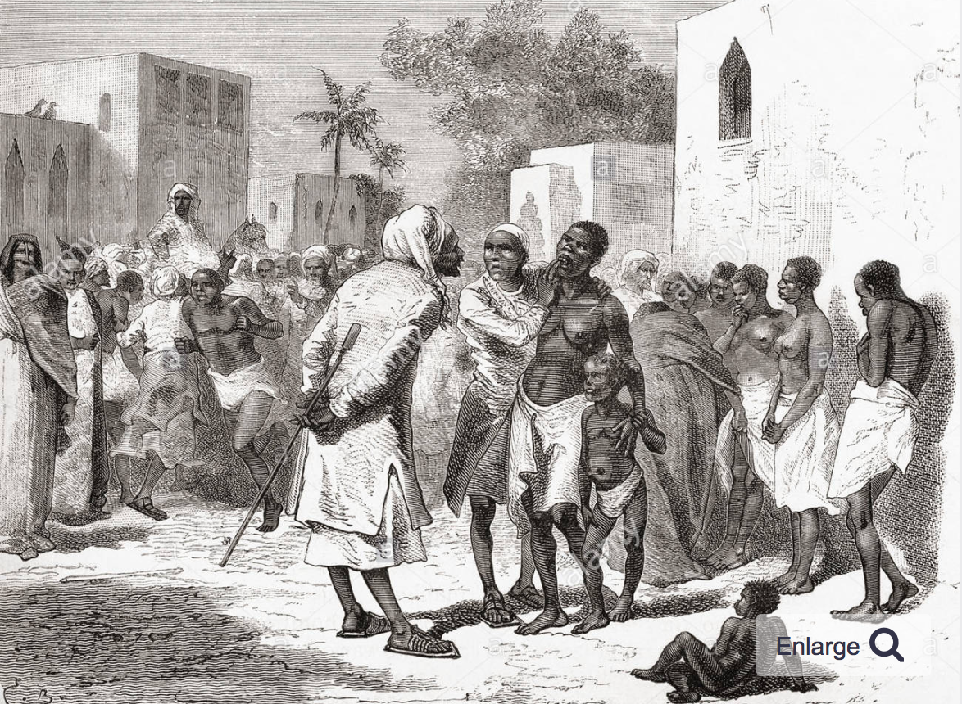
Trade and Slavery
Slave Market in Zanzibar, 1878
Zanzibar: Unguja and Pemba
1840: Omani sultan Sayyid Said moved capital to Zanzibar. 19th century: economic boom due to trade in ivory and slaves. Introduction of cloves. Slave-based economy

Slide 3
British Rule and Identity Politics
1890: British protectorate
Abolition of slavery
Establishment of racially-based ‘associations’
Power and land in the hands of the Arabs
Still, ethnic identities fluid
By 1963: approx. 230,000 ‘Africans’ and ‘Shirazi’; 50,000 Arabs and 20,000 Asians in Zanzibar
Zanzibar: 1900-1920

Slide 4
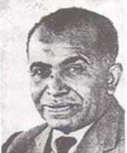
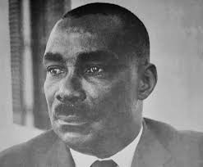
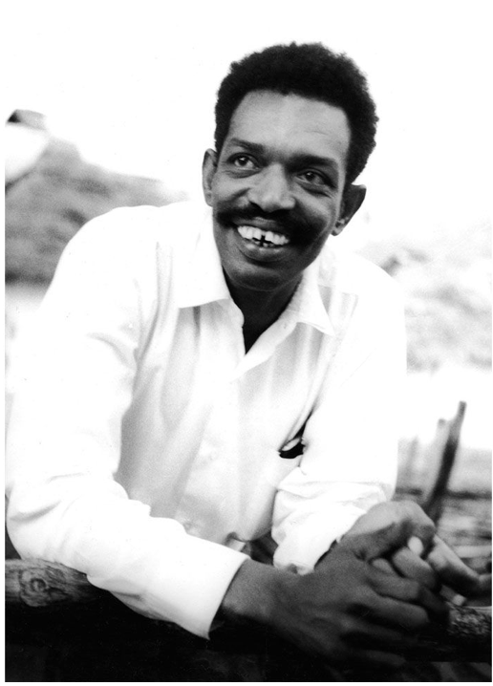
Nationalist Politics: Politicization of Ethnicity
Zanzibar National Party (ZNP) 1955 Ali Muhsin | Afro-Shirazi Party (ASP) 1957 Abeid Karume | Umma Party 1963 Abdulrahman Babu
Mostly Arab support Nationalism celebrated islands’ cosmopolitanism Connections with Nasser’s Egypt | Mostly African and Shirazi support Racially-defined African nationalism Included some Marxists, e.g. Kassim Hanga | Split with ZNP just before July 1963 election Connections with China and Soviet Union Rejected racial politics in favour of Marxism

Slide 5
Zanzibar at decolonization
Democratisation led to emergence of identity politics.
Key role of the press →aligned to major political parties and contributed to politicisation of ethnicity
Ethnic disputes infused with Cold War rhetoric. Afro-Shirazi engaged in attacks against communists
British fears about communists led to marginalisation of the left-wing in the ZNP →Umma and Babu would join revolution in 1964

Slide 6
Zanzibar General Election, July 1963
 | Votes | % Votes | Seats | % Seats
ZNP | 47,950 | } 46% | 12 | } 58%
ZPPP* | 25,609 |  | 6
ASP | 87,085 | 54% | 13 | 42%
*Zanzibar and Pemba Peoples’ Party – splinter from ASP, mostly in Pemba
NB: Umma Party did not field any candidates

Slide 7
ZNP/ZPPP in Power
10 December 1963. Zanzibar became independent
New authoritarian measures:
ban on opposition parties;
arbitrary search and seizure;
restrictions on travel;
posts in civil service staffed by ZNP supporters
removed African members of the police force
Jan 1964:
Umma party banned.
Babu flees to Tanganyika

Slide 8
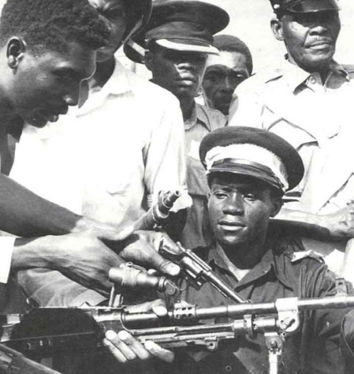
Coup: 12 January 1964
Coup led by John Okello and ASP Youth League
Abeid Karume made president
Marxist revolution?

Slide 9
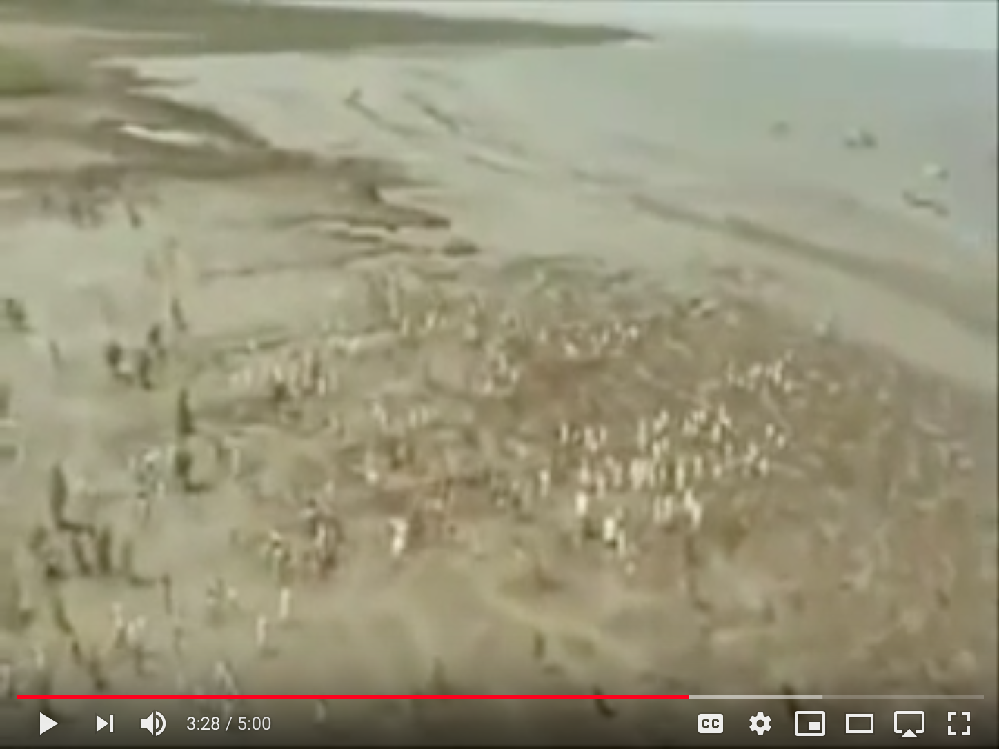
Racial Pogroms, 1964
January 1964: attacks against Arab and Asians
12,000 Arabs killed
Thousands fled from island
Footage of people fleeing towards the sea, Zanzibar, early 1964
https://www.youtube.com/watch?v=bUytKlrVS0M

Slide 10
Reactions to Revolution in Zanzibar
US: Fears of a ‘communist bridge’ to the mainland
New York Times: Zanzibar was ‘a Cuba in Africa’
US pressure on Britain to intervene. London resists
Communist powers established strong presence:
Soviet Union agreed to purchase $318,000 in stockpiled cloves, Zanzibar’s staple export.
China provided a $518,000 grant
→ Influence of men like Babu and others on the left in the revolutionary government. Babu elected foreign minister

Slide 11
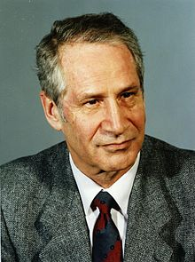
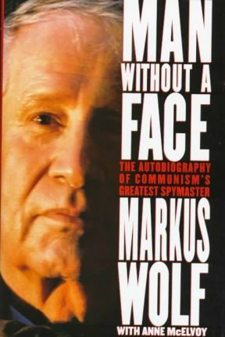
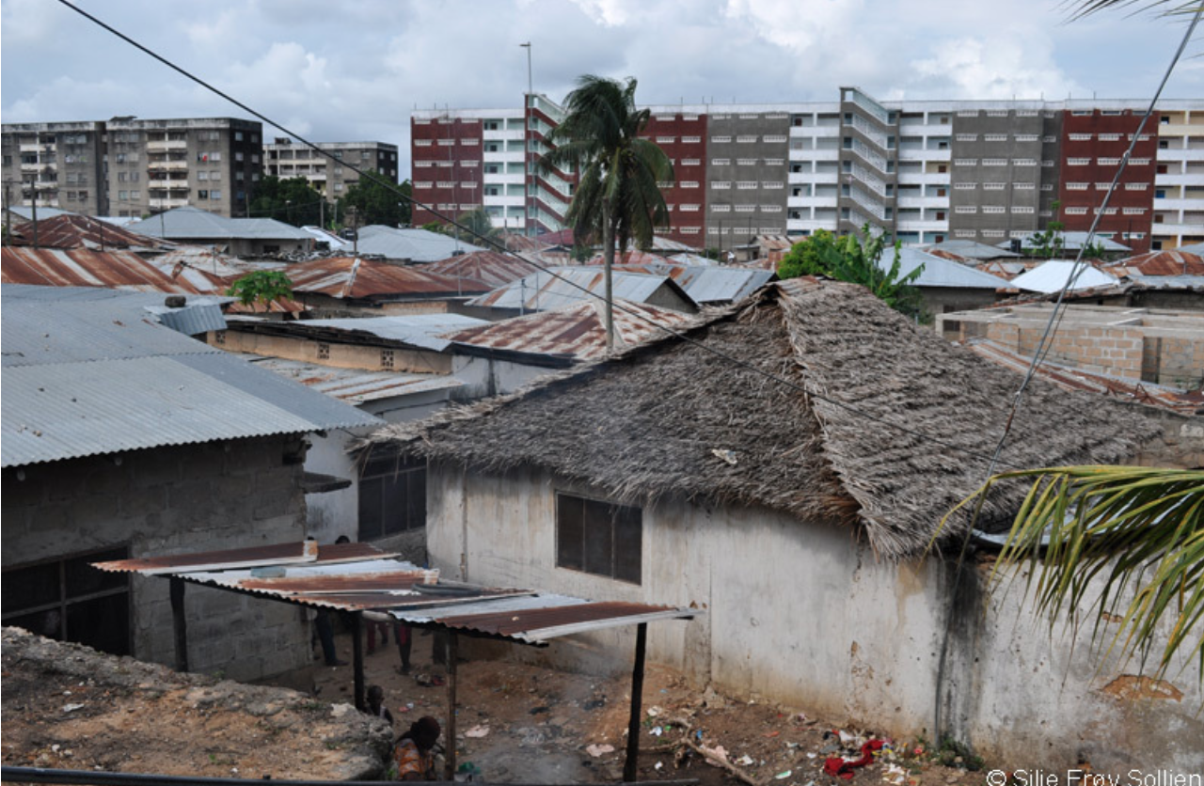
East Germany (GDR) – West Germany (FRG) Competition in Zanzibar
Left: Markus Wolf, head of GDR’s secret intelligence (visit to Zanzibar in 1964). He would tell the story in his memoir “Man without a Face”
Right: GDR-built apartment blocks in Zanzibar’s Stone Town

Slide 12
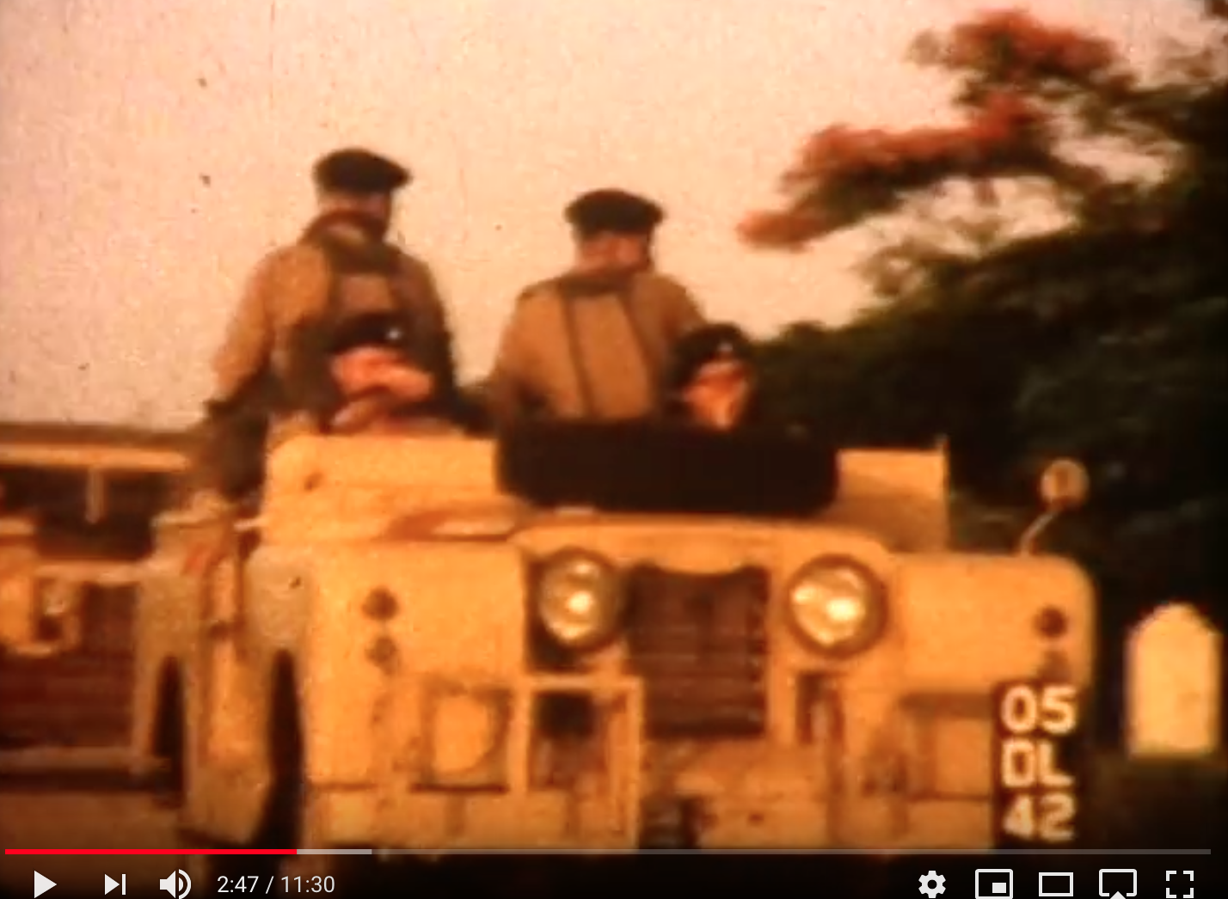
East African Mutinies, January 1964
19 January 1964: Tanganyika Rifles in Dar es Salaam rebelled
→quickly spread to Kenya and Uganda
24 January: Nyerere fled into hiding, then called in British military aid
Nyerere: ‘grievous shame for our nation’
British army on the streets of Dar es Salaam, January 1964
https://www.youtube.com/watch?v=tZuEmvFToCs

Slide 13
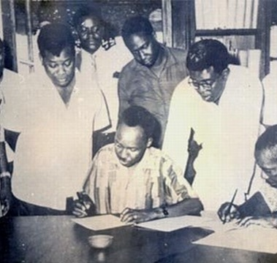
Karume and Nyerere sign the Act of Union, 23 April 1964

Slide 14
Understanding revolution
Revolution was: motivated by ethnic concerns, OR stoked fears of racial violence ?
US and the Soviet misinterpreted events
Revolution and East African mutinies encouraged Nyerere to increase party control over the country
Tanganyika-Zanzibar Union - best seen as an expression of Pan-Africanism; OR CIA Plot; OR Elite Interests?

Slide 15
Zanzibar after the Union: “Dark Days"
Karume‘s regime became increasingly authoritarian:
persecution of Arab and Comorian minorities
Extrajudicial killings of Kassim Hanga and others
Economic chaos – shortages of consumer goods
1972: Karume assassinated
Propaganda under Abeid Karume

Slide 16
Conclusions
Another mismanaged decolonisation?
... or a Cold War conflict?
Elections and the politicisation of identities
Did the United States overreact?
… or did it have genuine cause for concern here?
Impact on Tanganyika/Nyerere
shift towards authoritarian forms of control
socialist ideas of transformation + forge links with China
Soviet Union: failure of revolution was another a disappointment

