Slide 1
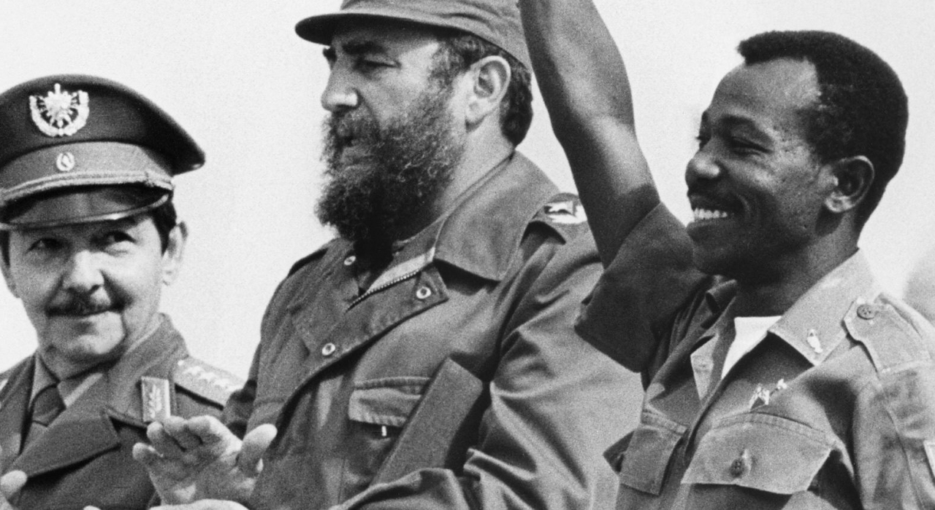
Superpower rivalry and revolution in the Horn of Africa
HI277 | Africa and the Cold War
Term 2 | Week 13
Fidel Castro and Haile Mengistu Mariam, Cuba, 1975

Slide 2
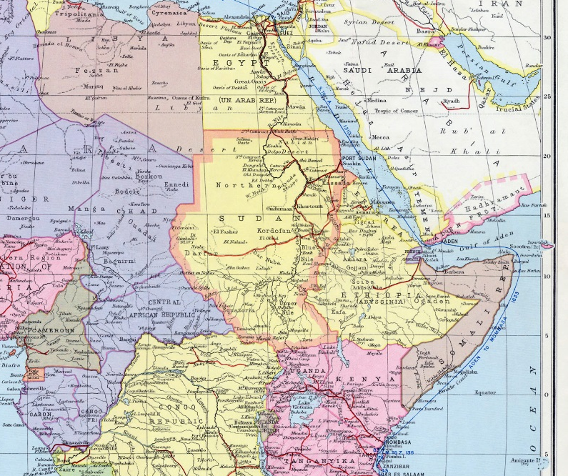

Slide 3
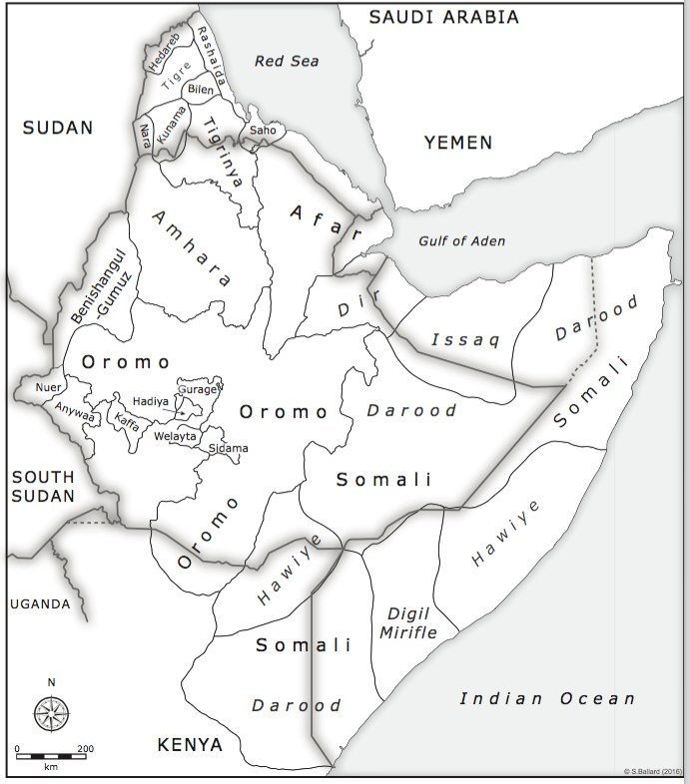
From Christopher Clapham, State Formation and Decay (London, 2017).

Slide 4
Imperial Ethiopia
Long history as a strong, independent Coptic Christian state
Imperial expansion by Amhara people in late nineteenth century
Resisted first Italian invasion in 1890s – defeated Italian forces at Adwa in 1896
Briefly colonised by fascist Italy, 1936-41
Federation with Eritrea in 1952; fully annexed 1962
Close relationship with the United States under Emperor Haile Selassie

Slide 5
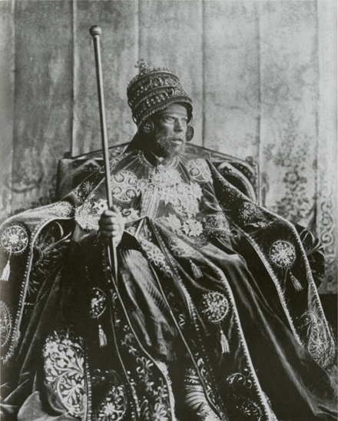
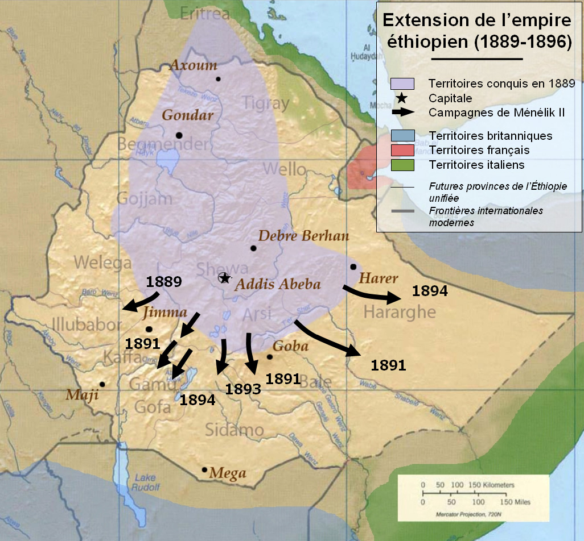
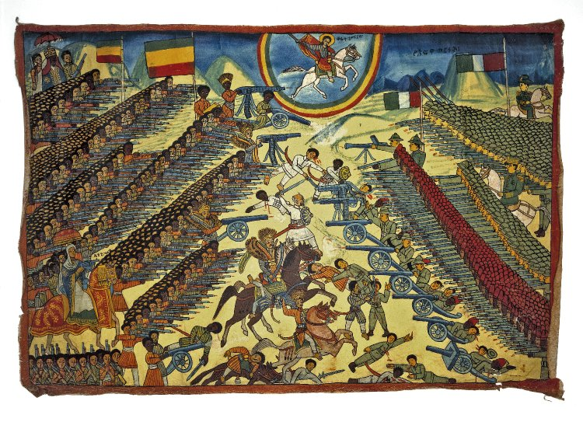
Emperor Menelik, 1889-1913
Menelik II, 1889 -1913.
Bottom right: Ethiopian representation of the Battle of Adwa (1896). British Museum
Expansion of the Ethiopian Empire under Menelik II
Notes:
The lands that are currently Ethiopia saw some of the earliest human settlement and development of a centralised polity centred on Aksum. In the 13th century, rule over Ethiopia was assumed by the Christian Solomonic dynasty who claimed their descent from King Solomon and the Queen of Sheba.
Italy; Battle of Adwa 1896
Menelik II aspired to a Modern Ethiopia. He oversaw the building of a railway, a modern capital city in Addis Ababa, a banking and a communications infrastructure.

Slide 6
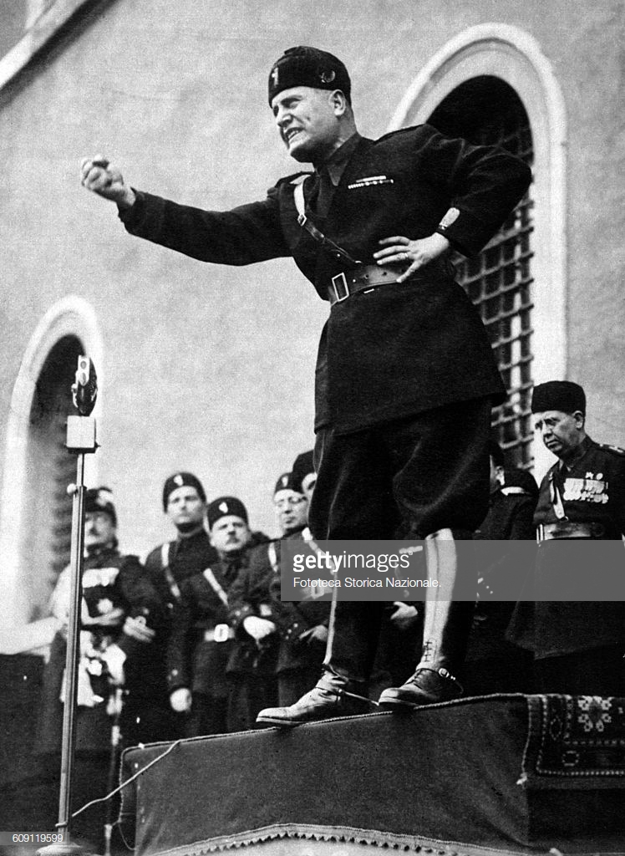
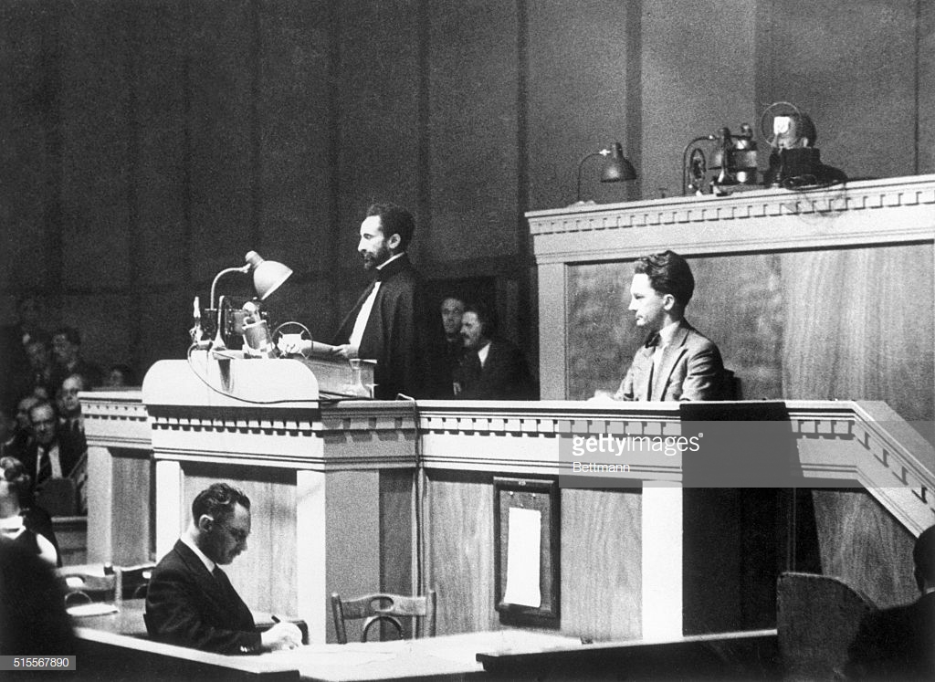
The Italian Invasion, 1935
Mussolini announces Italy’s Emperor Haile Selassie argues for protection
invasion of Ethiopia at the League of Nations, 1936
3 October 1935
Notes:
October 1935: Italy under Mussolini invade Ethiopia under a pretext; this time a much more mechanized army
Haile Selassie leaves the country; goes and presents his case at the UN
Importance of ‘hands off Ethiopia’ movement; sparks anti-colonial activism across the world, incl. George Padmore in London

Slide 7
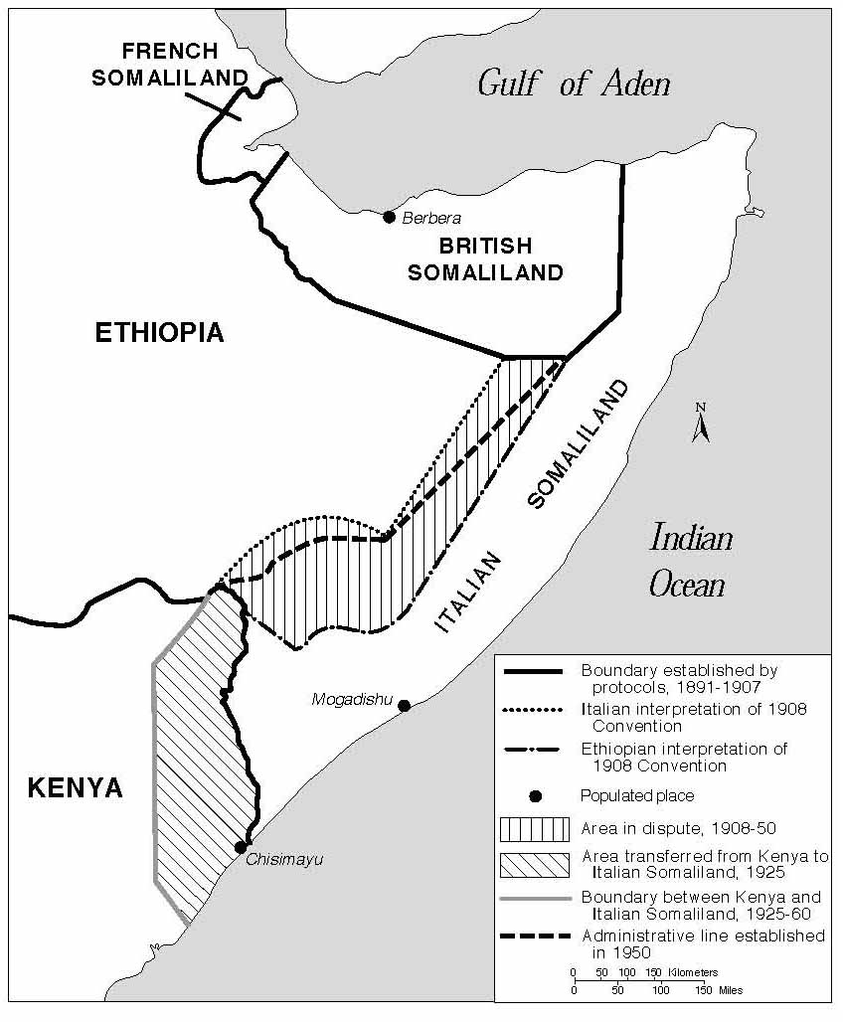
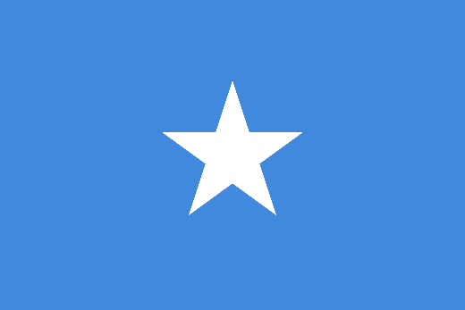
Somalia: in search of a nation
1960s onwards: support for liberation movements in Ogaden and northeastern Kenya
1961: British/Kenyan u-turn over plebiscite in Northern Frontier District
1963: formation of OAU and commitment to preservation of colonial borders
1969: assassination of President Abdirashid Ali Shermarke; Siad Barre assumed power

Slide 8
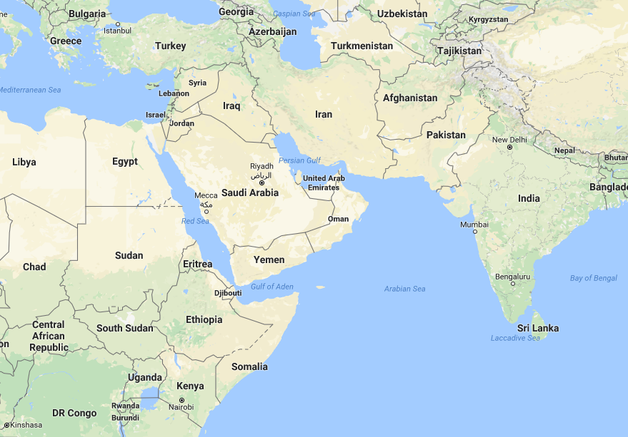
Superpower interest in the Horn of Africa
  Kagnew communications post in Eritrea
  Access to deep-sea port at Mogadishu – access to the Red Sea > Suez
  Competing against Arab influence, especially after OPEC boycott
  Global Cold War in the Middle East – Marxist government in Yemen

Slide 9

The arms race in the Horn of Africa
  1959: US endorsed union of British Somaliland and Somalia > Haile Selassie signed $100m credit arrangement with Moscow
  1963: Somali-Soviet arms arrangement
  1964: short war over Ogaden ends with Ethiopian victory
  1970-77: Somali army more than doubled in size
  1977: 4,000 Soviet military personnel in Somalia
  United States continued to provide military support for Ethiopia

Slide 10
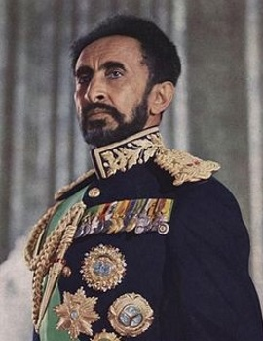
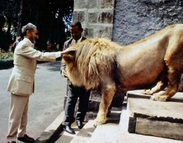
Ethiopia under Emperor Haile Selassie
Feudal system – land owned by aristocracy
29m out of 32m population were tenant farmers
Internal war against Eritrean People’s Liberation Front (EPLF), which received Soviet and Cuban support
Famine in Sahel Belt, 1972-73 – killed c. 200,000 Ethiopians
1973 oil crisis aggravated deteriorating economic situation
Growth of student radicalism, beginning with Crocodile Society

Slide 11
The Ethiopian Revolution, 1974
January
  army mutinies
  street protests in Addis Ababa, involving students and taxi drivers
February
  Haile Selassie announces concessions to student demands
  establishment of army committee, dominated by young, radical junior officers
March-May
  waves of general strikes in Addis Ababa
June
  formal establishment of the Derg – committee of junior officers
September
  documentary film The Unknown Famine broadcast on Ethiopian television
  formation of Provisional Military Administrative Council (PMAC)
  Derg decides to arrest Haile Selassie – killed in 1975

Slide 12
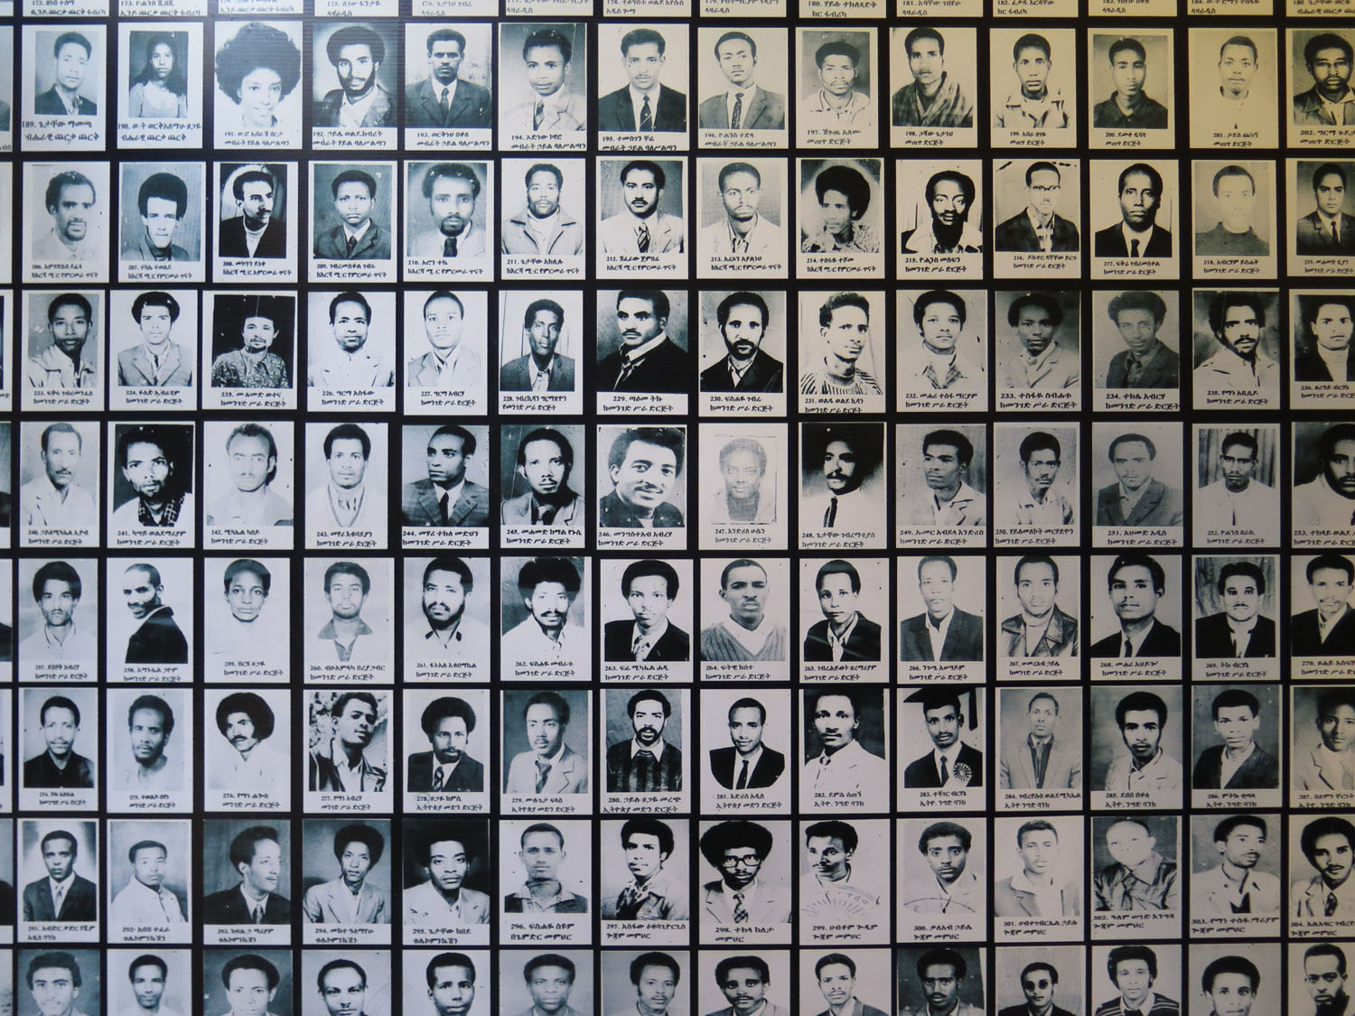
The Red Terror
Red Terror Museum, Addis Ababa

Slide 13
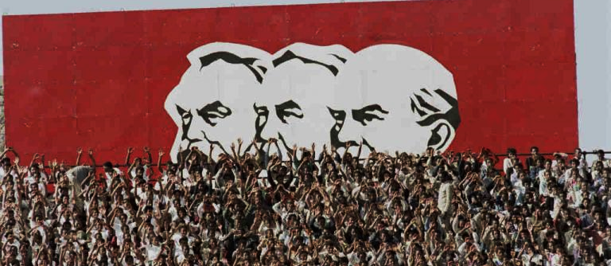
The Derg in power: a Marxist regime?
Early 1975: Mengistu announces ‘National Democratic Revolution’: nationalisation of banks, industry, businesses
March 1975: Derg nationalised all land
‘Live Aid’ famine of early 1980s > mass villagisation scheme

Slide 14
Superpower responses
Soviet Union slowly warmed to the Derg, but concerned to not jeopardise its relationship with Somalia
Moscow emboldened by ‘successes’ in Angola, Mozambique, and Vietnam – more assertive Third World policy
Soviet embassy in Addis Ababa increasingly convinced of Marxist credentials of Mengistu’s regime
United States initially supported the new regime, but disturbed by Red Terror, especially given Jimmy Carter’s new commitment to human rights

Slide 15
Conclusions
Colonial – and precolonial – origins of conflict
Borders, sovereignty, and their problems
Geopolitical salience of the Horn of Africa
Political and ideological dimensions of the Ethiopian Revolution
What role do the Cold War powers play here?
Where does power lie – with superpowers, or Africans?
Regional arms race...
…towards the Ogaden War

