Slide 1
Wrap up: Term 1, 2024-25

Slide 2
Four central claims of the module:
Human nature is a concept, i.e. an abstract idea that serves as a foundation for more concrete principles, thoughts, and beliefs at a particular moment in time.
Human nature is not universal, i.e. the same throughout time, but relative to time and space. It is an ever-changing ‘concept’.
All knowledge produced by humans about what it means to be human is relative to the society/culture that produces such knowledge. This includes all scientific knowledge. (Scientific knowledge is NOT objective or neutral and on a higher epistemological level as knowledge produced by the human and social sciences.)
The history of human nature is therefore NOT a history of ‘discovering’ human nature (in the brain through advance neuroscience technology, for example) but a history of understanding the thoughts, principles, beliefs, and practices that ‘made up’ the concept at a given time.

Slide 3
Famous Stories we tell ourselves (I): The ‘Discovery’ or the ‘self-fashioning’ of Renaissance Man? Jacob Burckhardt and Stephen Greenblatt
Term 1, Lecture I

Slide 4
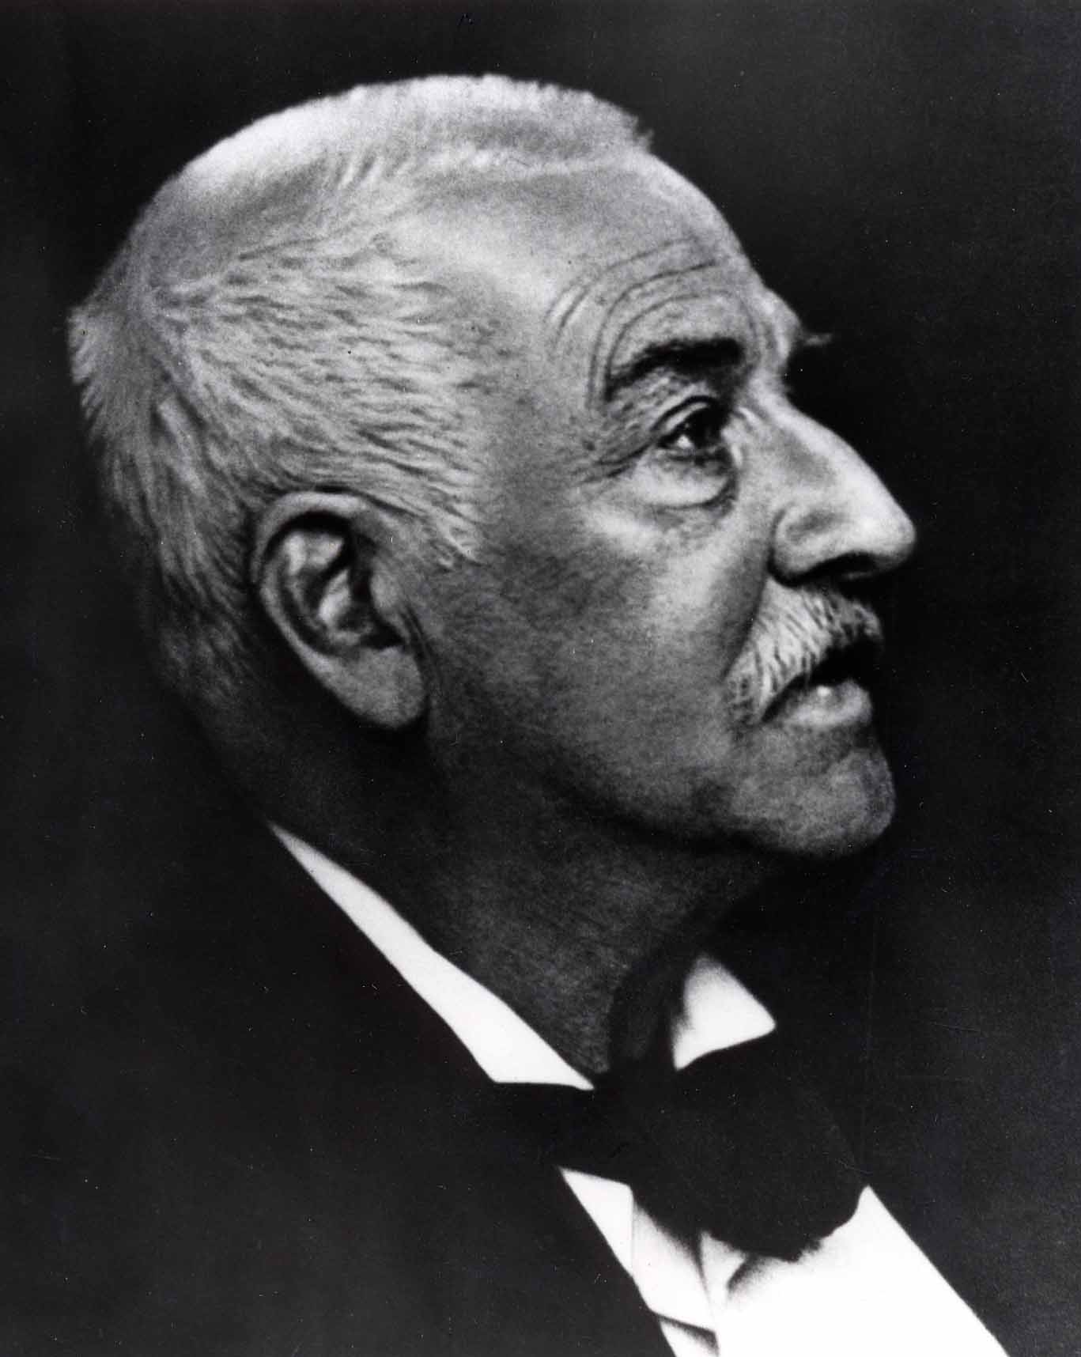
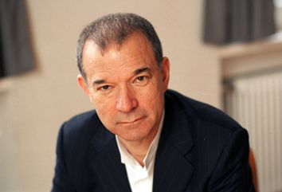
What is Renaissance ‘Man’
2 famous historians who understood human nature radically different – due to the different context of the time they wrote their famous works
Stephen Greenblatt, 1943-
Claim: Their view on the nature of renaissance ‘man’
depends on their own socio-cultural context
Jacob Burckhardt, 1818-1897

Slide 5
Burckardt’s famous interpretation of Spirit of the Renaissance:
‘In the Middle Ages both sides of human consciousness – that which turned within as that which was turned without – lay dreaming or half- awake beneath a common veil. The veil was woven of faith, illusion, and childish prepossessions, through which the world and history were seen clad in strange hues. Man was conscious of himself only as a member of a race, people, party, family, or corporation – only through some general category.
In Italy this veil first melted to air; an objective treatment and consideration of the State and of all the things of this world became possible. The subjective side at the same time asserted itself with corresponding emphasis; man became a spiritual individual, and recognised himself as such.’
(Burckhardt, The Civilisation of the Renaissance in Italy, part 2, p. 87)

Slide 6
Characteristics of Renaissance Human Nature According to Burckhardt:
Renaissance Man
Male
European
Rational and reasonable
Willful and autonomous (free of social constraints of MA)
Creative and ingenious
Dominate the social and natural world
Many of the characteristics of human nature, he deemed under threat at this own time. He is aware that he romantisises the Renaissance.
Note: Women or non-European cultures did not play a role in his account. A general characteristic of all 19^{th-}century history writing.

Slide 7
Greenblatt’s understand Renaissance Man differently
‘When I first conceived this book … it seemed to me the very hallmark of the Renaissance that middle-class and aristocratic males began to feel that they possessed … a shaping power over their lives, and I saw this power and the freedom it implied as an important element in my own sense of myself. But as my work progressed, I perceived that fashioning oneself and being fashioned by cultural institutions – family, religion, state – were inseparably intertwined. In all my texts and documents, there were, so far as I could tell, no moments of pure, unfettered subjectivity; indeed, the human subject itself began to seem remarkably unfree, the ideological product of the relations of power in a particular society. Whenever I focused sharply upon a moment of apparently autonomous self-fashioning, I found not an epiphany of identity freely chosen but a cultural artefact.’
(Greenblatt, Renaissance Self-Fashioning, pp. 256-7)

Slide 8
He suggests that another process of human individualization:
Self-fashioning, def.:
The process of constructing one’s identity and public persona according to a set of socially acceptable standards. The process is never-ending, nothing will be discovered. Identity is socio-culturally constructed.
Self-fashioning individuals are not free or autonomous; they struggle to adapt to ever-changing situations. They can only survive this way. Their identity is ever changing and has no core.

Slide 9
Warning: History does not ‘discover’ human nature because….
“… every generation (of historians, CS) has to rewrite history, not because the past has changed …but essentially because the present is changing, and with it the assumptions and needs of readers of history. In other words, ... the historian is a kind of interpreter, a “cultural translator” we might say, who attempts to make the language of the past intelligible to the present.”
(see, Peter Burke, ‘Decentring the Italian Renaissance’, in S. Milner, At the Margins, 2005, p. 36)
Historians have been interpreting ‘human nature’ differently because – they too – are
shaped by their own time and culture.
They go to the archive with an ‘assumption’ of what it means to be human (e.g. Burckhardt and Greenblatt)

Slide 10
Term I, Lecture 3, 2022/23
Famous Stories We Tell Ourselves (part II):
The Concept of the Scientific Revolution

Slide 11
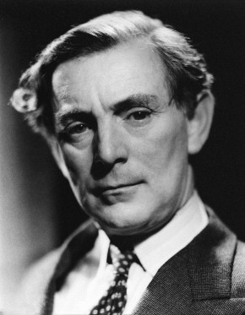
The Inventor of the Concept of Scientific Revolution
The Whig Interpretation of History ( 1931)
The Origins of Modern Science, 1300-1800 (1948)
Butterfields lecture (later turned into a book) have to be understood within the famous
‘Two Culture Debate’, waging in Postwar Britain. It was driven by the widespread fear that the UK would miss out on scientific/technological developments due to the lack of scientific education in schools/universities.
E.P. Snow ‘Two Cultures and the Scientific Revolution (1959)
Sir Herbert Butterfield, 1900-1979
English historians and philosopher of
History, Regius professor of Modern History,
Vice-chancellor of the University of Cambridge

Slide 12
The concept of ‘the Scientific Revolution’ construct a glorifying picture of pre-modern science in
Britain
‘Since that revolution, overturned the authority in science not only of the middle
ages but of the ancient world – since it ended not only in the eclipse of scholastic
philosophy but in the destruction of Aristotelian physics – it outshines everything
since the rise of Christianity and reduces the Renaissance and the Reformation to
the rank of mere episodes, mere internal replacements, within the system of
Christendom.
Since it changed the character of men’s habitual mental operation
even in the conduct of the non-material sciences, while transforming the whole
diagram of the physical universe and the very texture of human life itself, it looms
so large as the real origin of the modern world and of modern mentality that our
customary periodization of European history has become an anachronism and an
encumbrance. There can hardly be a field in which it is of greater moment to us
to see at somewhat closer range the precise operations that underlay a particularly
historical transition, a particular chapter of intellectual development.’
(Henry Butterfield, The Origins of Modern Science, p. 7-8)
The Scientific Revolution is the ‘real’ reason why ‘the West came to rule the rest of
the world through science and technological advances (not as Burckhardt had argues
via genius in art and culture)

Slide 13
Central Characteristics of the ‘Scientific Revolution’ according to Butterfield:
1. Butterfield’s revolution refers to an abrupt and immediate change, after which nothing was the same – (from around the mid 16th century to the ) – a ‘big bang’
2. It was an abrupt change in ‘thinking’ about the natural world (it does not ‘practices’ which contribute to the development of natural sciences)
3. It is a triumphant story of progress and breakthroughs in natural science, presented as a series of great thinkers (all male whose scientific ‘genius’ progressively changed the world through ‘empirical’ investigation of the natural world (e.g. Bacon, Newton)
4. The ‘Scientific Revolution’ was the triumph of a rational and objective mind and thinking over superstition and irrational reasoning of the Middle Ages (e.g. very similar to Burckhardt’s ‘veil’ of superstition in Italy)
5. The Scientific Revolution took place in Europe (particularly Protestant norther Europe such as Britain or Holland)

Slide 14
Part II:
How did people understand the natural world around 1500?

Slide 15
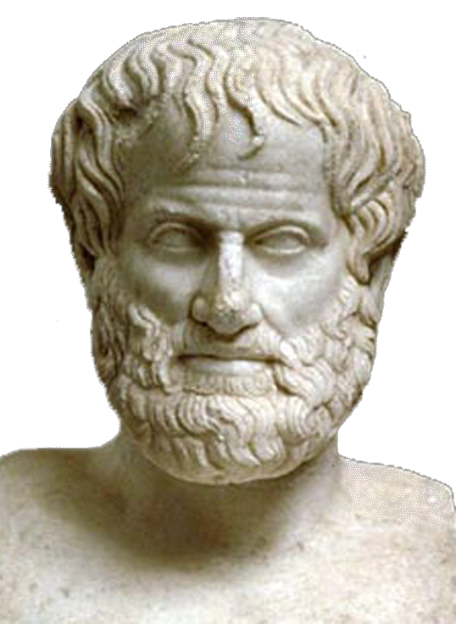
A philosopher who dominates the understanding of the natural world for a thousands of years....
Some of his writings:
On the heavens
On sleep and sleeplessness
On animals
On the soul
Virtues and vices
Meteorology
Metaphysics
On Longlivity and Shortness of Life
Poetics
Generation and Corruption
And many, many more …
Note: Aristotle’s writings were ‘christianised’ throughout the centuries and came to represent the world of the Christian God
Aristotle, 384 BC – 322 BC

Slide 16
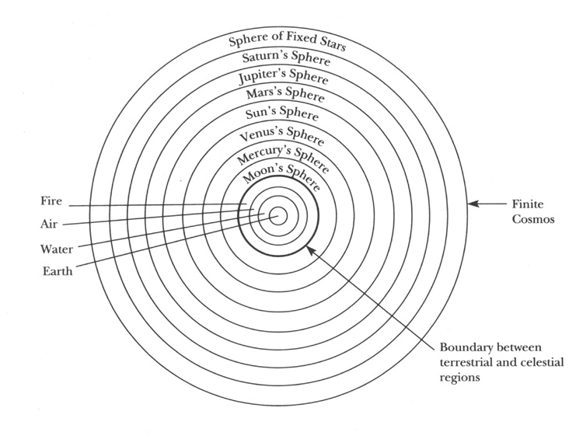
Some of Aristotle’s influential ideas that guided the understanding of nature & human nature
Aristotelian cosmos
Earth is a place of constant change; the celestial/superlunar regions above the moon are never changing

Slide 17
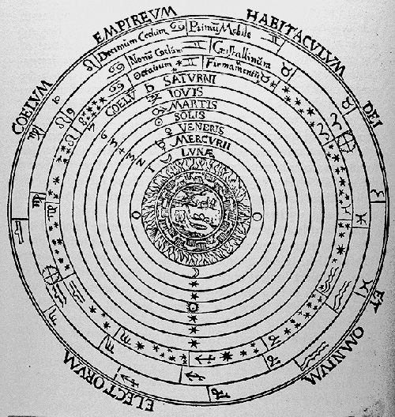
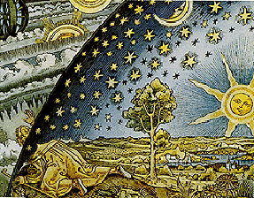
The Christian version of Aristotle’s cosmos
God controlled the terrestrial region through his servants, the stars and planets. He influenced human life through them.
Aristotle’s cosmos centers on earth (geocentric view) --- heliocentric view (around the sun)

Slide 18
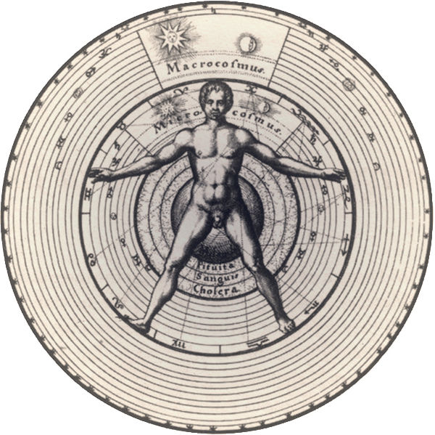
Micro-Macrocosm – Man as the mirror of the wider cosmos
Human life on earth is the ‘little world’ (microcosm)
Above the moon – the superlunary world -- starts the ‘big world’ (macrocosm)
God has created and controls both worlds and. Man was His creation.

Slide 19
What do university-trained ‘natural philosophers’ do? (note: they are not ‘scientists’!
Collecting and cataloguing the wonders of God’s Creation (all the knowledge humans lost due to ‘the Fall’).
As God has created everything to perfection, they saw their duty in explaining why things are the way they are (e.g. why does the sun rises and sets every day)
Natural philosophers did not aim ‘to discover’ something new or unheard of (as we want to do!) because in a world created and run by God, there is nothing new to discover by humans. The only thing humans can do it so worship God for His creation.
Their natural philosophical enterprise is thus intrinsically linked to God and questions; it is a spiritual exercise. (Many of the natural philosophers were theologians by training)

Slide 20
The Great Chain of Being
Represents a combination of Aristotelian
knowledge about the natural world and the cosmos and Christian knowledge from the Bible about the creation of the world and humankind by God.
This order is fixed; everything has its God-given place.

Slide 21
Term I:
Lecture 5
Discovering Human Nature? The Case of Sixteenth–Century Anatomy
Reform or Revolution?

Slide 22
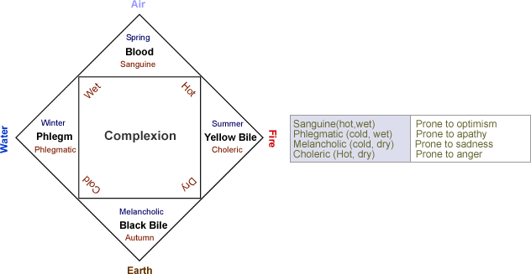
Medical Knowledge and the Functioning of the Human Body: interplay between Micro-and
Macrocosm
Every human is born with a unique mixture of the humors: temperament or completion
The six-non naturals: air, food and drink, sleeping and waking, motion and rest,
excretions and retentions, and the passions of the soul (emotions). Need to be balanced at all times!

Slide 23
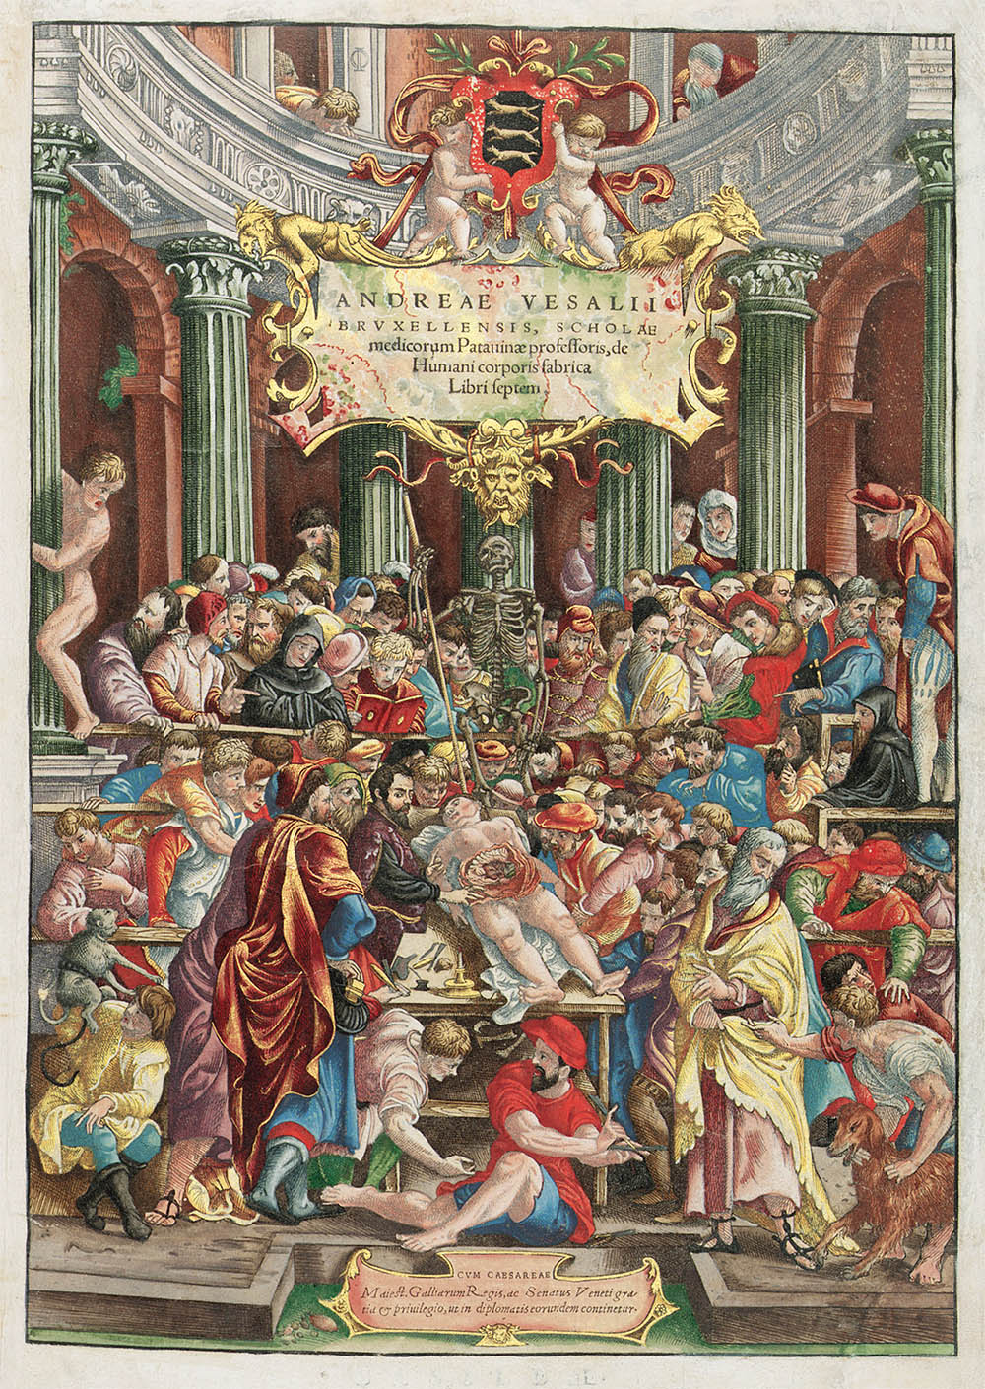
Anatomy was not yet central to medicine…humours explained disease
Vesalius is a humanist, natural philosopher, and anatomist.
He is a humanist and member of a European humanist Galen translation project
Aim: rescue anatomy from decline
‘I decided that this branch of natural philosophy ought to be recalled from the region of the dead. If it does not attain a fuller development among us then ever before or elsewhere among the early professors of dissection, at least it may reach such a point that one can assert without shame that the present science of anatomy is comparable to that of the ancients, and that in our age noting has been so degraded and then wholly restored as anatomy.’
(quote from Preface, in Dear, p. 38)

Slide 24
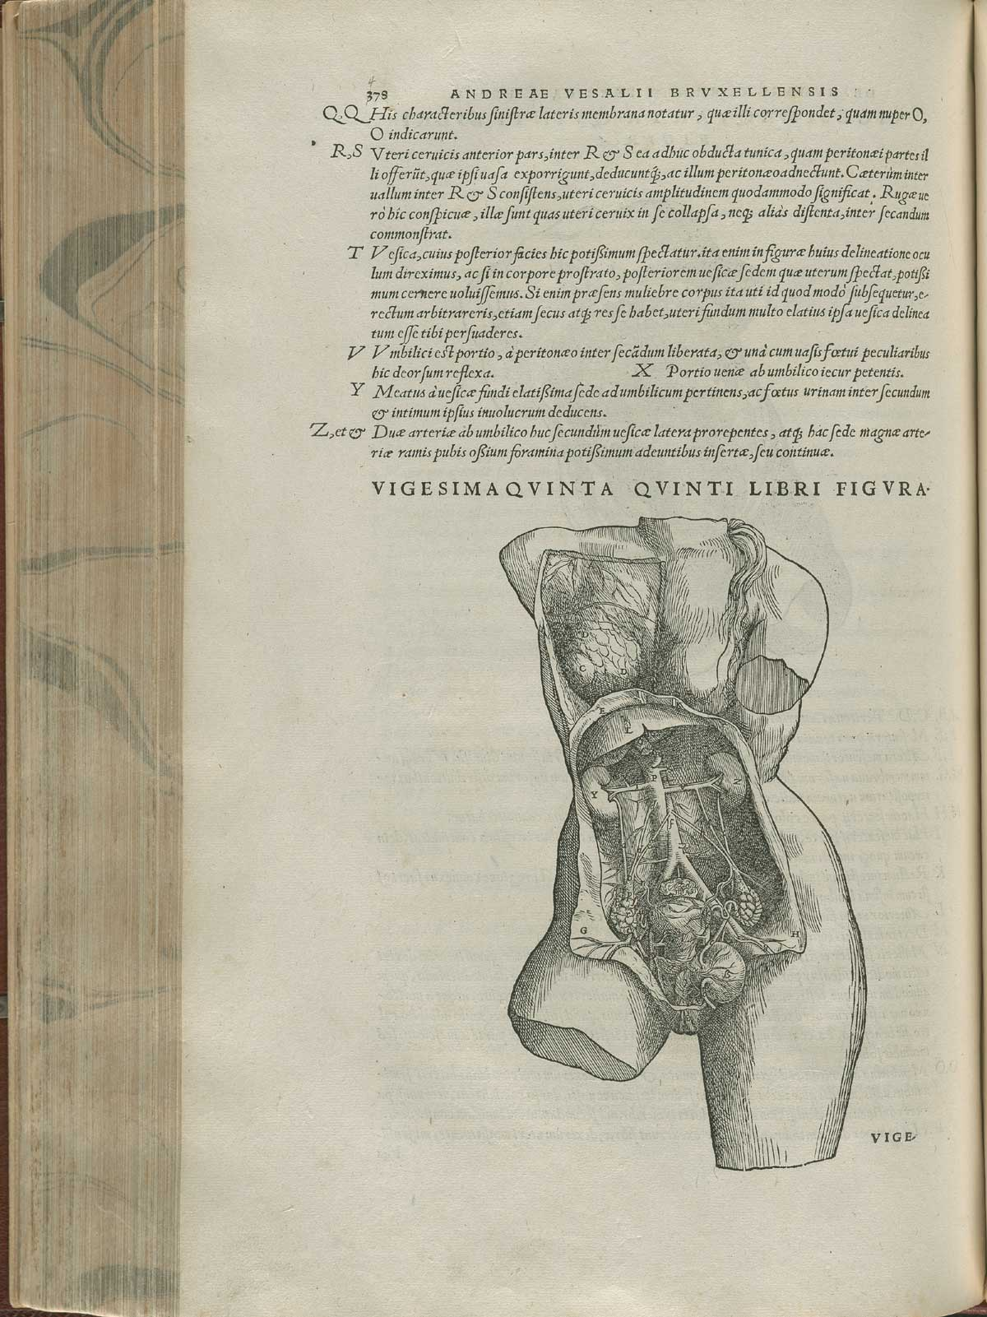
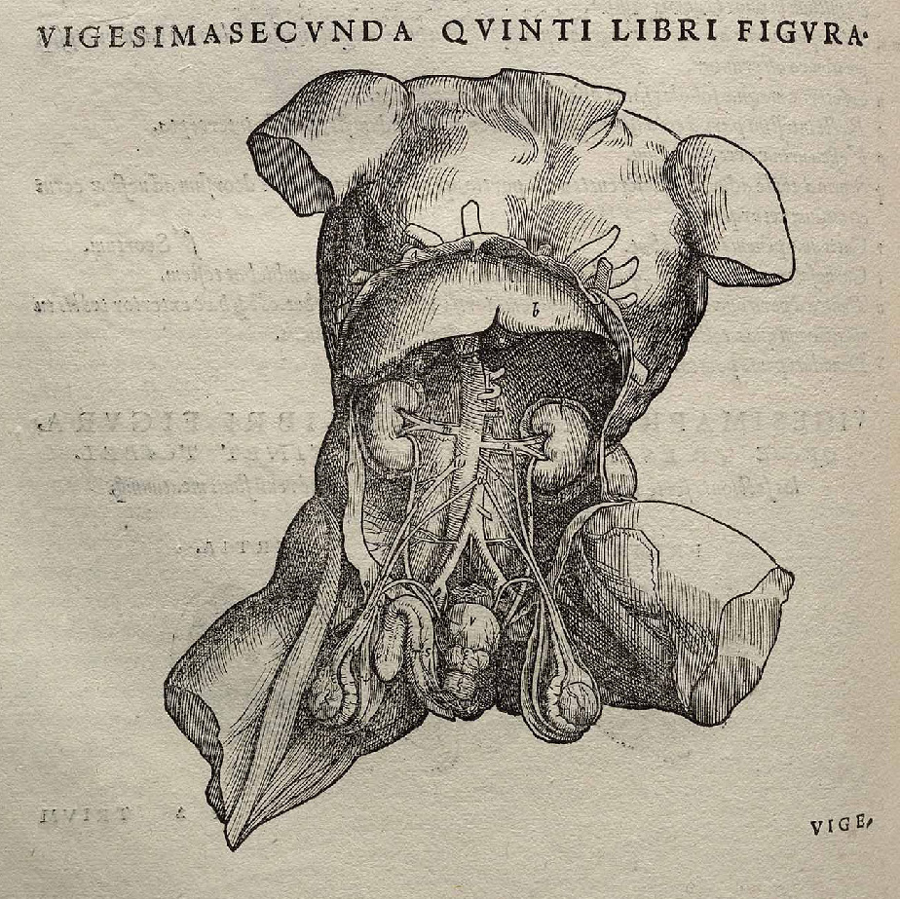
Humanistic influences: The body images are presented in classical sculpture pose and are often inspired by famous statues
Torso of Belvedere

Slide 25
Term 1, Week 7, 2024
Human Nature Possessed:
How to become a Divine and Demoniac Being ?

Slide 26
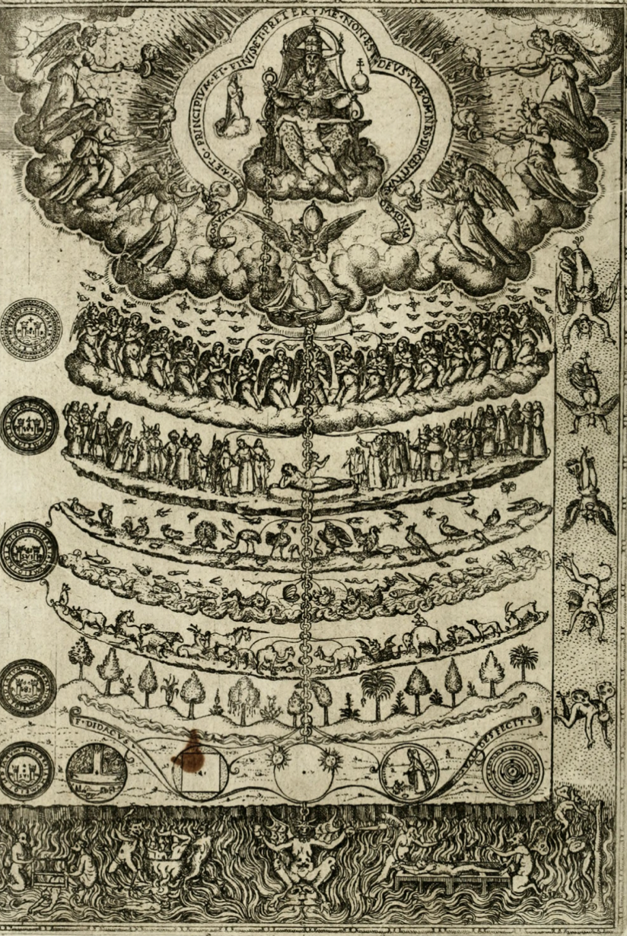
The question of the soul
In the Great Chain of Being
natural and Christian spiritual worlds
were intertwined
We today see them as separate but
for contemporaries they were one.
The soul and its spirits are key concepts
that mediated these two worlds

Slide 27
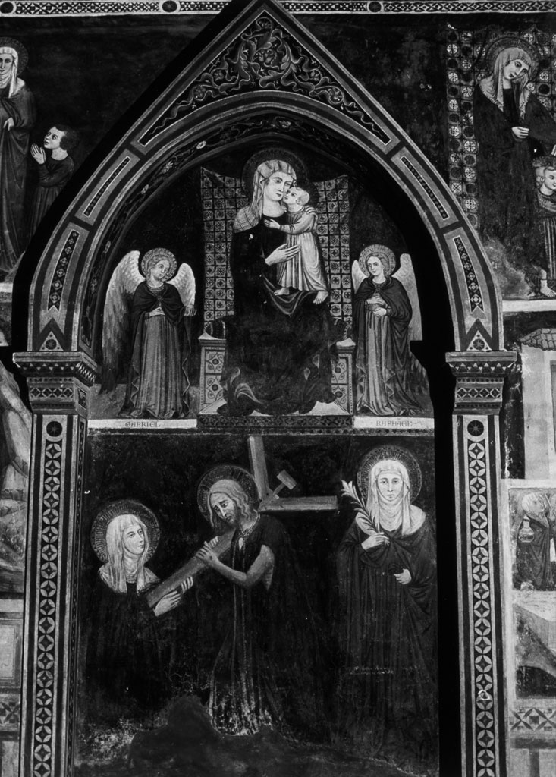
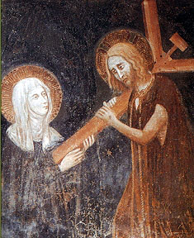
S. Clare of Montefalco receiving the cross with Christ literally implanting his cross into her heart.
(church of Santa Chiara, Italy)

Slide 28
What is the soul?
1. The soul in Aristotelian understanding of nature in natural beings
Aristotelian psychology:
the study of the ‘soul’ or ‘psyche’ (in his text, De Anima); the study of the
nature of the soul (or psyche), which he considered the basis of all life. The soul, according to Aristotle, is the essence of all living things that makes them behave in the ways distinctive of living things.
note: today the term ‘psychology’ refers only to the study of the mind; Aristotle understood it in a much broader way
Central question for Aristotle was:
How does the soul relate to the physical human body?
Answer: He regards the body as the matter (parts and material that make up the body) and the soul as the form of a living thing. The two are correlative to one another. What humans do involves always the soul (form) and the body (matter) together (differs from Plato’s ideas of the soul).

Slide 29
The souls are not thought to be material but Artistotle related them to specific organs in human body:
Vegetative powers of ‘vegetative’/’nutritive soul’: located in liver, served by the
veins and auxiliary members such as the bladder and genitals.
2. Emotive powers of ‘sensitive soul’: located in the heart, served by the arteries
Power of cognition and voluntary motion of ‘intellective’/’rational soul’: located in the brain, served by the nerves, the sense organs, and the muscles

Slide 30
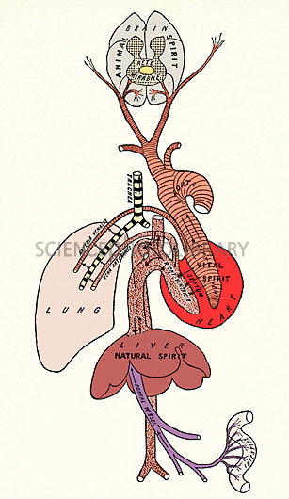
Soul(s) relied for their operation on the system of spirits
Galen developed these ideas on the basis of Aristotle’s ideas of the soul
spirit/pneuma: means ‘air’ or ‘breath’, and is imagined
as a sort of hot vapor fused in blood
1. natural spirit: resided in the liver, the centre of
nutrition and metabolism.
2. vital spirit was located in the heart, the centre of
blood flow regulation, heart beat, respiration, and body temperature.
3. animal spirit was created in the brain, the centre of sensory perceptions and movement.
The spirit operates between the flesh, the materiality of the body and its invisible souls.
Galen’s idea of body and spirits

Slide 31
2. Theological Meanings: the spirits and the soul within Christian belief
From 12th-14th century the ‘spirit’ slowly took on theological meanings
Natural philosophers (mainly theologians) whished to create a language embracing both the phenomena of physical life AND the experience of salvation within a unified conceptual frame work.
Appropriation of natural function and organs related to the spiritual and soul systems of Galen and Aristotle. These physiological concepts were linked to Christian beliefs, narrated in the Bible and writings of Church fathers

Slide 32
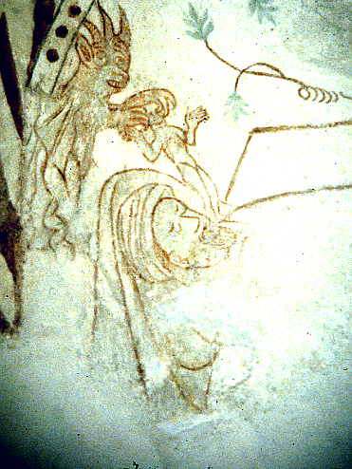
The spiritual meaning of the spirit
During 12-14th century the ‘spirit’ took on theological meanings
Appropriation of natural function and organs related to the spiritual and soul systems of Galen and Aristotle and the linking of these physiological ideas to Christian ideas, expressed in the Bible and writings of Church fathers
Devil snatches the spirit leaving the body of dying man through the mouth
(Danish mural, 12th century)

Slide 33
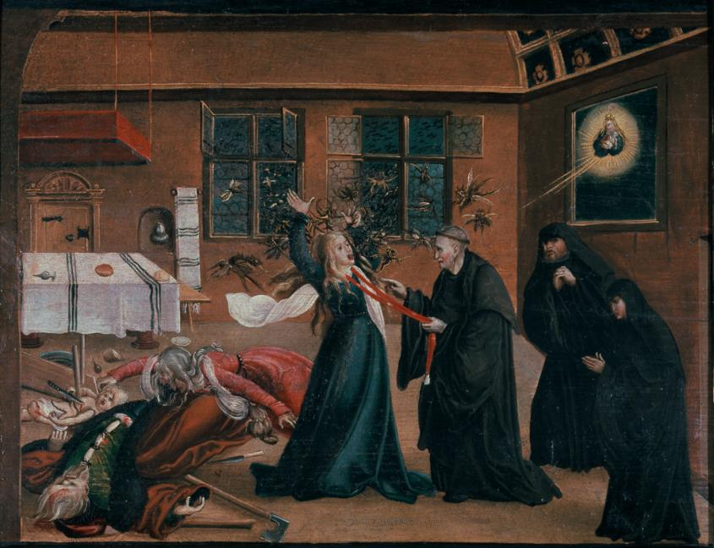
The Mechanisms of Demonical Possession
Def. exorcism: The practice of evicting demons or other spiritual entities from a
person believed to be possessed.

Slide 34
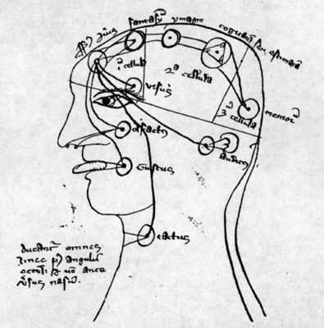
How did vision function and how was it connected to cognition
species: object’s forms/images
radiated out by each sensible thing
There were 5 internal senses: common sense, imagination, estimation, and cognition, located in the two anterior cerebrial ventricles, or stored in the hinder ventricle of memory or further use.
Demons could alter species which would then disrupt the cognition process’ particularly prone to such muddling was the sense of ‘imagination’.
mid- 14th century illustration, showing the five internal senses located in the three cells of the brain and connected to each other
(Bayerische Staatsbibliothek München (Clm., 527, fol. 64v)

Slide 35
How do demons meddle with vision and cognition?
Demons could meddle with the outside species which would then, in turn, ‘fool’ the sense of imagination
2. When present in the body, demons were able to influence the sense of imagination directly and make people imagine things that were false
Spiritual possession is not irrational or a sign of a backwards thinking (not yet scientific). It is
rational and scientific within the logic of the Chain of Being.

Slide 36
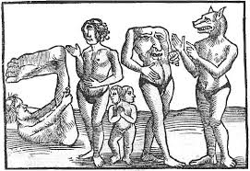
Term I, week 8
Of Monsters and Cannibals: Europeans and their Encounter with the New World ‘Other’

Slide 37
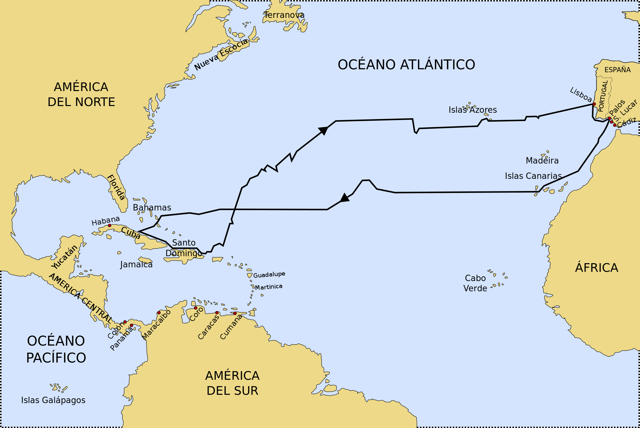
How to understand the New World (a world that did not exist according to Aristotle and the Bible)?
First voyage of Christopher Columbus 1492/93

Slide 38
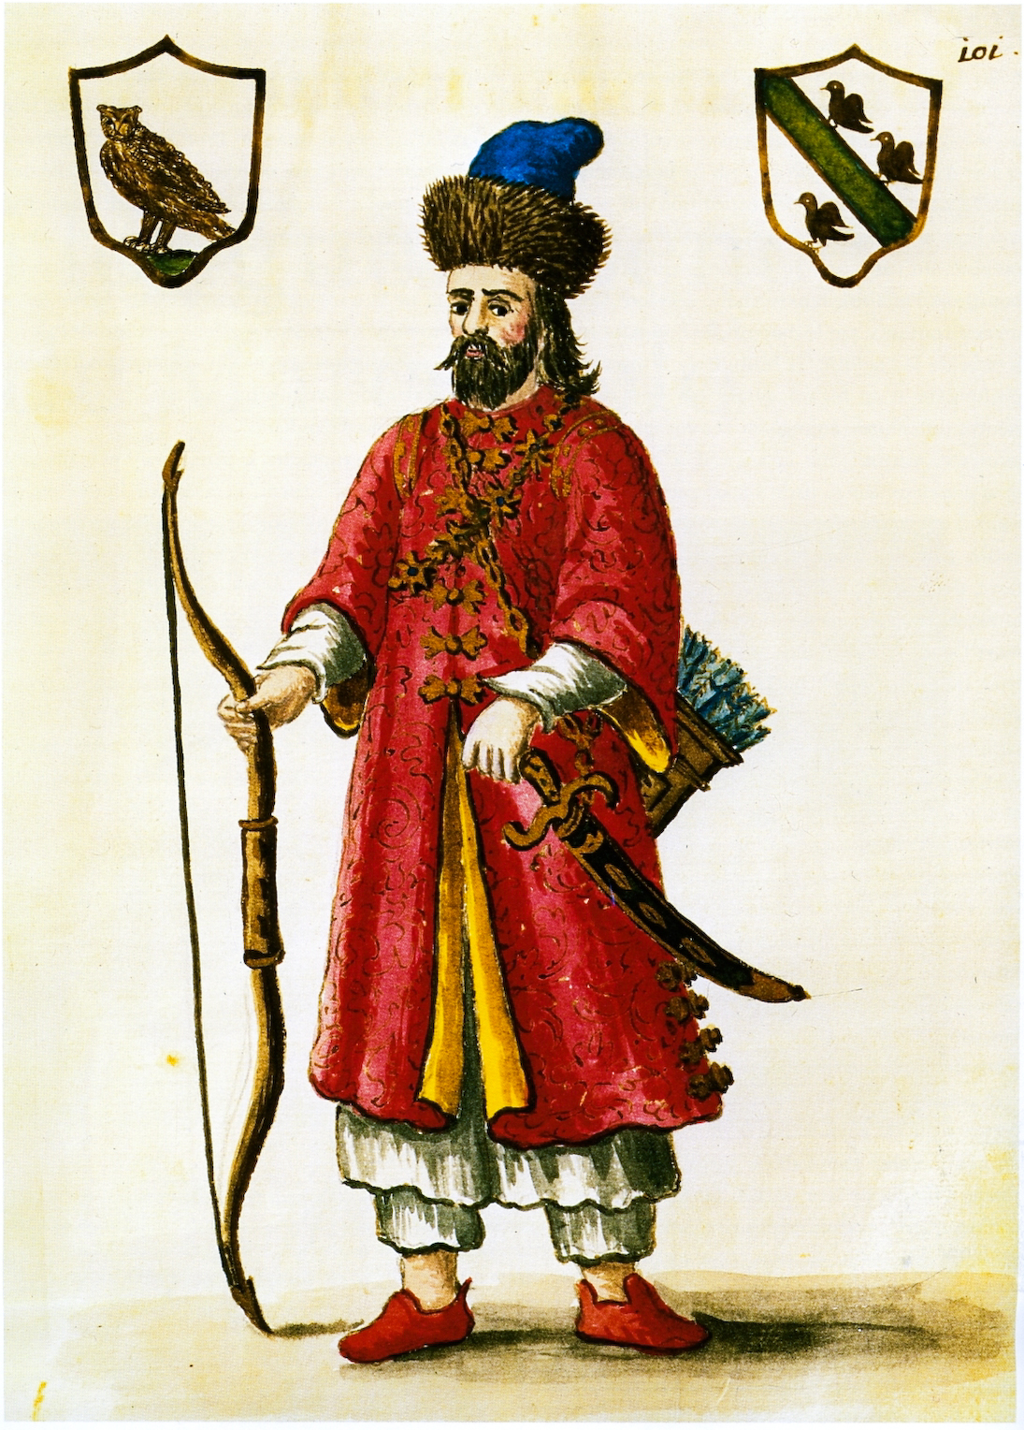
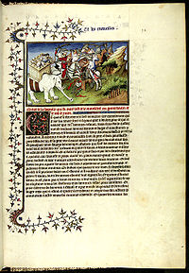
What did Columbus know about the world? Reconstruction of his knowledge
Marco Polo’s travel account was a key source of information for Columbus
Polo at the court of Kublai Khan
A page from ‘The Travels of Marco Polo’, c. 1300
At the time of Columbus everything in Polo’s
account was considered to be genuine
including his description of monsters --
It had become an ‘authoritative texts’,
a guide for travellers to these areas of the known world

Slide 39
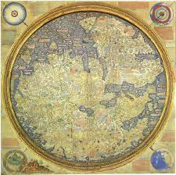
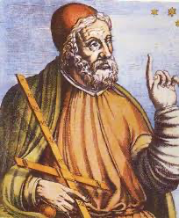
Mapmaking: Polo and Ancient geographers
The Greek Ptolemy
World map by the Italian monk Fra Mauro, c. 1450
Also relies partly on Polo’
Note: according to conventions of the time, the south is on the top!
Garden of Eden is outside in the lefthand corner – usually inside a map to the very East
The map first depicts Cipangu (Japan), mentioned by Polo. He described it as a land of extraordinary riches.
.
Ptolemy, c. 100 – c. 170 AD
’Geography’ summarises the geographic knowledge of the Greco-Roman world
Another ancient authority (like Aristotle or Galen to be believed without questioning it

Slide 40
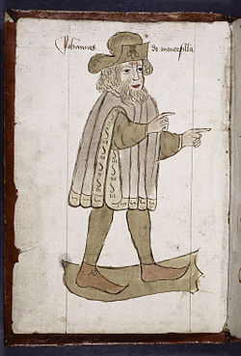
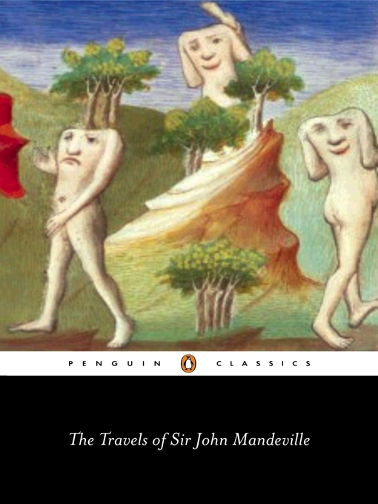
More travel accounts…
The Travels of Sir John Mandeville, c. 1370
‘Portrait’ of ‘Sir John Manderville’ who, according to historians, is most probably just a fictional character.
But at times of Columbus his account was widely believed to be real. The information – mostly fiction according today’s literary critics -- was taken for real and true.

Slide 41
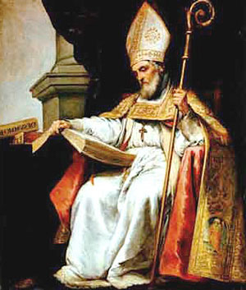
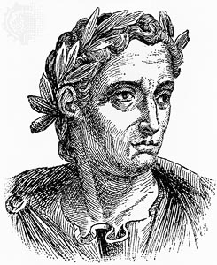
Manderville account is based on classical accounts
on monster races. They derive from classical sources
Isiodore of Seville, 560 AD-636 AD
Pliny, the Elder, AD 23 – August 25, AD 79)
Roman author, naturalist, and natural philosopher.
Pliny became one of the most important ancient authorities in the Renaissance on natural history
The Etymologies: sums up all knowledge available at Isidore’s time in alphabetical order, including all sorts of monster races

Slide 42
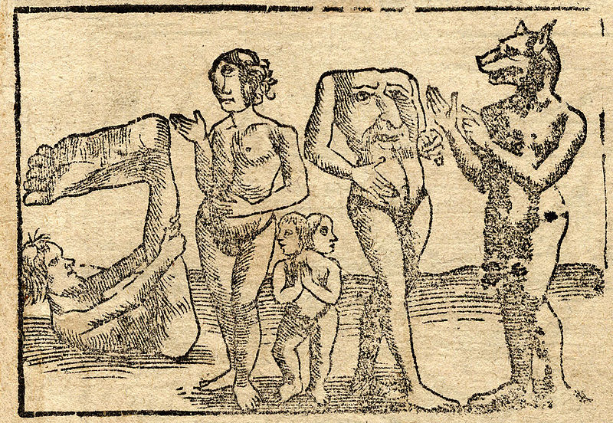
Monster races mentioned in Manderville
cyclopes: giants, each with a single eye in the middle of his forehead.
sciapodes/monopodes: mythological human creatures with a single, large foot extending
from a leg centered in the middle of their bodies.
blemmyes: species of headless men
Cynocephalus/i: dog-headed species of men
Anthropophagus/i: man-eater(s), a mythical race of cannibals, described
first by Greek historian Herodotus (84–425 BC) in his Histories

Slide 43
A linguistic misunderstanding that stands at the core of the name ‘Cannibal’
Arawaks: The term Arawak originally applied specifically to the South American group who self-identified as Arawak. Columbus encounters them in the Caribbean
Caribs: The Island Caribs, also known as the Kalinago, are an indigenous people of the Antilles in the Caribbean. The were know as ‘maneaters’.
Columbus refers to them as ‘Caniba’ ---- due to a linguistic misunderstanding between him and some Arawaks (remember: they don’t share a single language).
Letter:
‘I therefore repeat what I have said several times already: That the Caniba are none other than the people of the Great Khan, who must be neighbours to these. They have ships, they come and capture these people, and as those who are taken never return, the others believe that they have been eaten.’

Slide 44
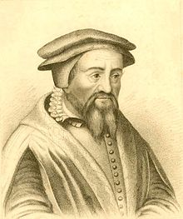
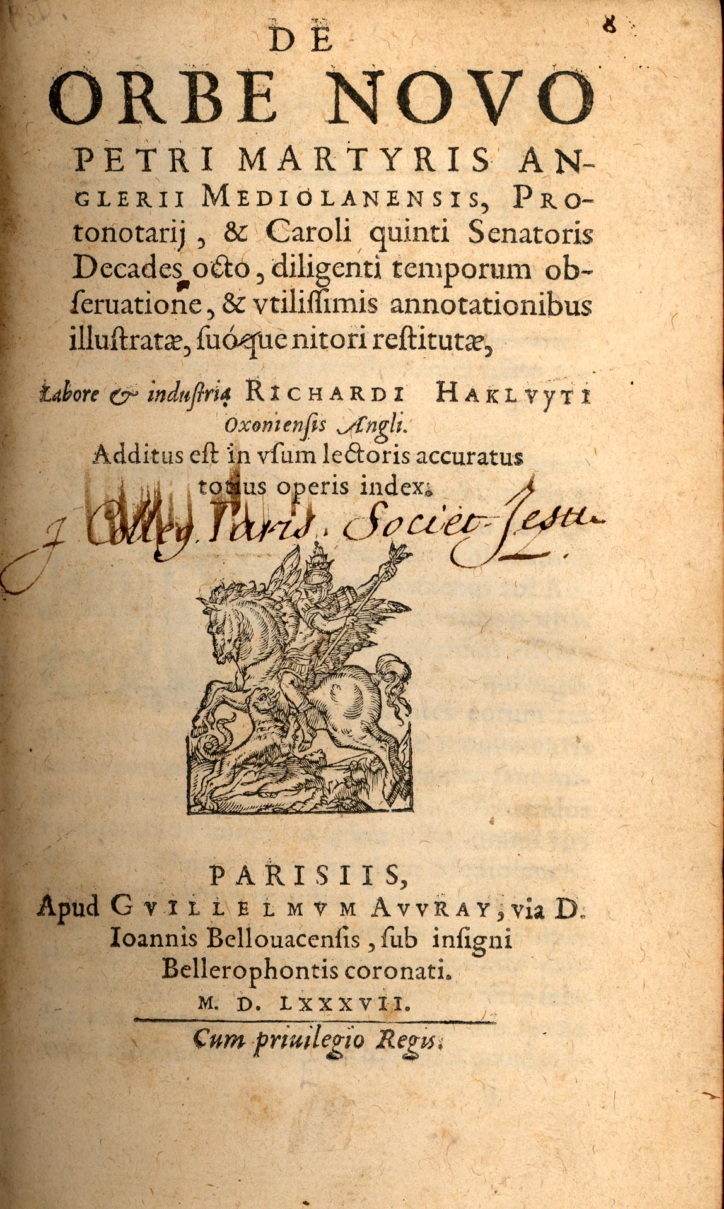
Although the term cannibal relies on a misunderstanding, the term spreads like wildfire
And the story gets ‘spiced up’
Columbus letters were reprinted.
‘Decades’, a series of letters and reports,. grouped in 10 chapters, of the early explorations of Central and South America that was published beginning 1511 and later anthologized. It includes Columbus letter in which he mentions the ‘caniba’
‘De Orbe Novo (On the New World, 1530)
Martyr adds more ‘spicy’
materials on cannibal
story
There are no plagiarism laws at the time. one just added what one wanted.
Peter Martyr of Angleria, 1457-1526

Slide 45
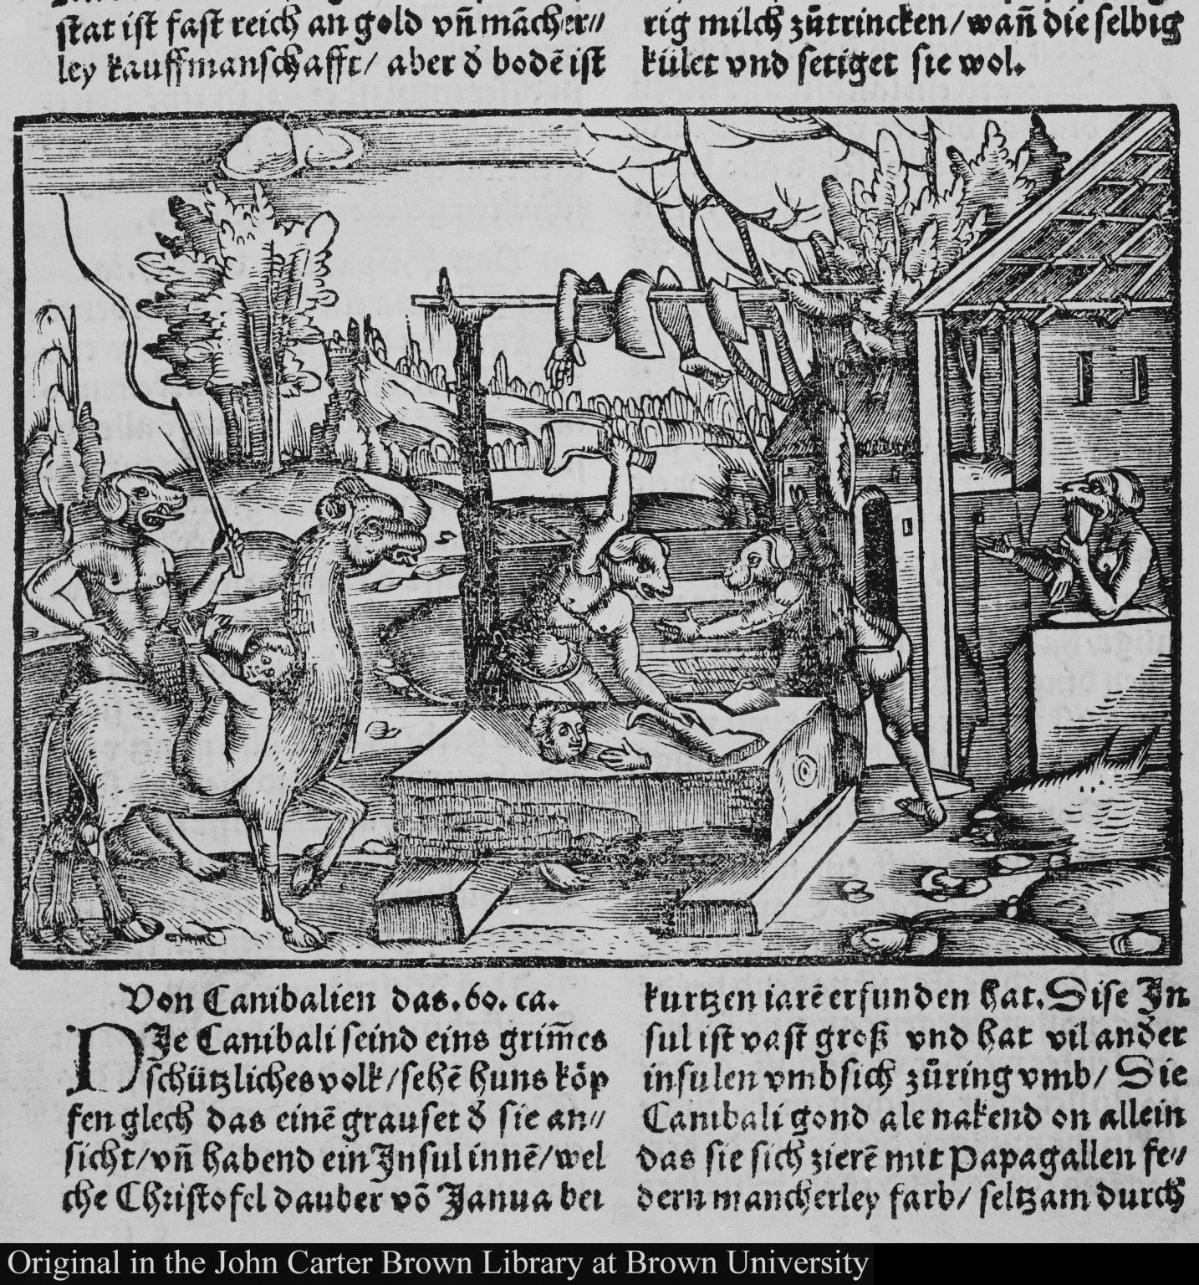
Images were added! The new medium of print allowed for visual representations of the alleged terrible dog-headed race in the New World
Lorenz Fries, c.1490- 1550
Auslegung der Mercarthen oder Cartha Mariana, 1525
Note: The image illustrates the chapter ‘On cannibals’ (Von Canibalien) who are depicted as dog-headed humans, chopping up humans (very much like in a European butcher shop!)
The Cannibals become Europeans!

Slide 46
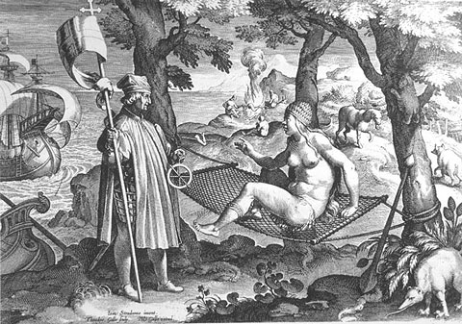
The closer the European’s got to these new people, the more they wondered who they
where?
1. Is the New World and its inhabitants Paradise, found on earth?
Amerigo Vespucci 1454-1512
America is named after him
‘America’, ca. 1580. Engraving by Theodor Galle after a drawing by Jan van der Straet (ca. 1575)

Slide 47
2. Or are these New World people savages, the radical opposite of the Christian Europeans?
‘They have as many women as they wish. Son couples with mother, and sister with brother, any man with any woman; any and every time they wish, they divorce from their marriages, and in nor thing do they keep order.’
Amerigo Vespucci, Mundus Novum 1505

Slide 48
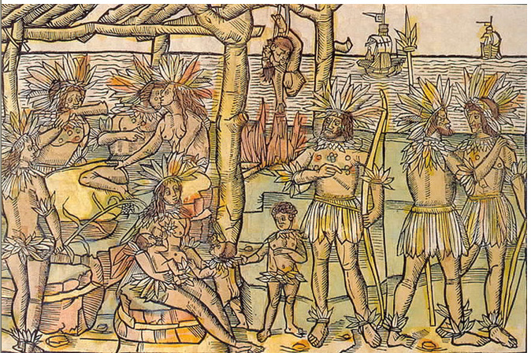
3. Could they be both? The cannibal as both the ‘First Man’ and the incestuous ‘Other’
‘This figure represents to us the people and island which have been discovered by the Christian King of Portugal or by his subjects. The people are thus naked, handsome, brown, well shaped in body, their heads, necks, arms, private parts, feet of men and women are a little covered in feathers. The men also have many precious stones in their faces and breasts. No one also has anything, but all things are in common. And the men have as wives those who please them, be they mothers, sisters, or friends, therein they make no distinction. They also fight with each other. They also eat each other, even those who are slain, and hang the flesh of them in the smoke. They become one hundred and thirty years old. And have no government.’
Amerigo Vespucci, Mundus Novus, published by Johann Froschauer in Augsburg in 1505.
This is the first ‘realistic’ depiction of cannibals

Slide 49
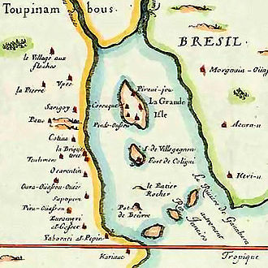
5. Are they good or bad?
André Thevet, 1516-1590
Accompanied Nicolas Durand de Villegaignon (1510–1575) and a group of Hugenots to find a refuge against persecution in France. He writes about experiences in:
‘Singularities of France Antarctique’ (first published in 1557)
’Antarctique’ refers to the French colony south of the Equator, on an island in front of today’s Rio de Janeiro. The colony existed between 1555 and 1567 and was ultimately destroyed by the Portuguese in 1567.

Slide 50
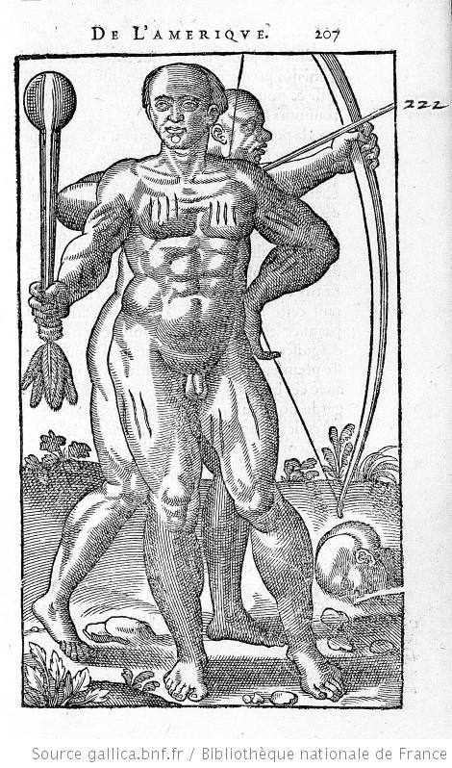
New: the Encounter with ‘the Other’ made some European reflect about themselves
Jean de Léry (1536–1613), History of a Voyage to the Land
of Brazil, Also Called America (1578)
It is published long after he returned from Brazil and after
he experienced a terrible siege in France during the Wars
of Religion
History of the City of Sancerre (1574)
‘To those who will read these horrible things, exercised ritually between the barbarous nations of the land of Brazil, can come somewhat closer to understanding such dangers among us ourselves.’ (Léry, 228).

Slide 51
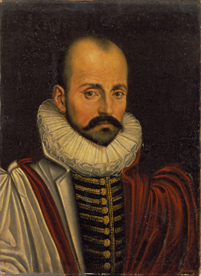
Self-reflection as a new way to understand
human nature
Montaigne popularises ‘the essay’ as a literary genre
As Essai is French for ‘trial’ or ‘attempt’. Montaigne attempted to explore his inner thoughts, his life and learning in written form.
His own Essays were first published in 1580 in 3 volumes. They contain 107 chapters of varying length.
In two essays he explores cannibalism:
‘On Cannibals’
‘Of Coaches’
(you might want to read them online; they are
Classics – as all his Essays are); the demonstrate the curious mix of observation and reliance on ancient authorities (including the bible we have already encountered)
Michel de Montaigne, 1533-1592

Slide 52
But Montaigne argues that the Europeans are surpassing anyone else in their
Barbarism (note: French Wars of Religion)
‘We can, then rightly, call them barbarians with respect to the rules of reason, but not with respect to ourselves, who surpass them in every sort of barbarism.’
(Montaigne, On Cannibals, 1580)

Slide 53
Term I, week 9, 2024
Challenging God’s Creation:
The Invention of a ‘Curious’ Human Nature

Slide 54
Yet another concept…….
Reminder: A concept is an abstract idea that serves as a foundation for more concrete principles, thoughts, and beliefs. (‘human nature’ is such a concept!)
So, if curiosity is a concept, it is relative to time and place. While the concept of human curiosity exists a long time in Western culture, it has been filled with very different principles, thoughts and beliefs.
We are going to explore the history of this concept….

Slide 55

Nothing is more valued than human curiosity in today’s culture
Is it a universal human character trait? Something to be found in our DNA?
‘I suspect I might be one of the most curious entrepreneurs alive today….
I love learning, and I just find that my general motto in life - "Screw it, just do it" - is great fun. Sometimes we fall flat on our face. Sometimes we succeed. But I'm learning all the time because I'm a curious person.’
(Sir Richard Branson)

Slide 56
Claim: Curiosity has a history and only became a celebrated virtue in Western capitalistic societies
The Story of Curiosity: From Vice to Virtue
‘Christians have special knowledge of the extent to which curiosity is a natural and evil in man. The desire to increase in wisdom and in knowledge: that was the first ruin of mankind. That is the path by which it hurled itself into eternal damnation.’
Montaigne, in, Apology for Raymond Sebond

Slide 57
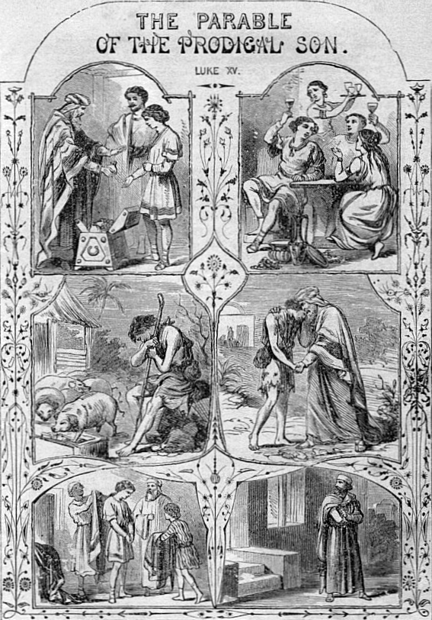
Curiosity and Early Christianity
Curiosity as a vice was linked to original sin:
Curiosity drove Adam and Even to taste from tree of the Knowledge.
‘. . . the eyes of both of them were opened and they discovered that they were naked.’
Consequently the Bible warns against curiosity:
Parable of the prodigal son, Luke 15
Curiosity let the younger son to sin
against his father
Leads to the advice for all Christians:
‘Put then a limit to your thought’ and avoid curiosity in investigating the incomprehensible’.
(advice by Church father St. Basil the Great)
Church father, def.: any of the great bishops and other
eminent Christian teachers of the early centuries of Christianity

Slide 58
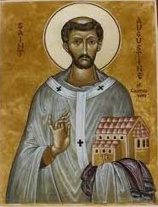
Saint Augustine’s Confessions shapes Christian thinking about curiosity for centuries
Confessions
Considered the first autobiographical work in the West and became a model for many other autobiographical writers during the Middle Ages until roughly the 17th century, including Montaigne.
The autobiography outlines his ‘sinful’ youth and eventual conversion to Christianity.
Sin: "a word, deed, or desire in opposition to the eternal law of God” (in Confessions)
Vice: while sin refers to the act itself; vice, on the other hand, refers to the tendency to act wrongly.
Augustinus of Hippo (354 – 430 BC)

Slide 59
What does Saint Augustine says about ‘curiosity’ in his Confessions?
Intellectual curiosity as a variant of the sin of lust
‘Besides this there is yet another form of temptation still more complex in its peril. For in addition to the fleshly appetite which strives for the gratification of all senses and pleasures … there is also a certain vain and curious longing in the soul, rooted in the same bodily senses, which is cloaked under the name of
knowledge and learning; not having pleasure in the flesh, but striving for new experiences through the flesh.
This longing--since its origin is our appetite for learning, and since the sight is the chief of our senses in the acquisition of knowledge--is called in the divine language ‘the lust of the eyes.’
(Augustine, Confessions)

Slide 60
2. Curiosity is also related to the sin of pride
The learned in particular are in danger of being too curious:
‘…to investigate the works of nature, which do not concern us and which it is useless to know, but which people desire to know only for the sake of knowing’.
This makes the proud of their own mental capacities and achievements and blinds them to the love of God
‘The proud cannot find you (God), even though with curious skills they number the stars and grains of sand, and measure the starry heavens, and track the courses of the planets…People that do not know these things marvel and are amazed, and those that know them exult and are puffed up.
Note: ‘Marvel, ‘wonder’ and ‘amazement’ is the appropriate way to approach the God’s world, according to Augustine – NOT curiosity (to know more)

Slide 61
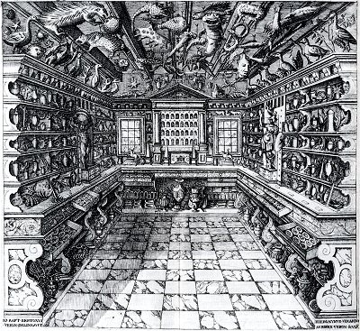
But curiosity was hard to tame….
‘Save spaces’ for curiosity: Cabinets of curiosity and wonder from the late 14th century
Contained precious material,
exotica and antiques, specimens
of exquisite workmanship
(artificalia), and natural objects
(naturalia).
The cabinets aimed at imitating
the interplay of the God-created
micro-macrocosm in order to
provoke wonder and marvel at
God’s creation in the dazzled on-
looker’s soul.

Slide 62
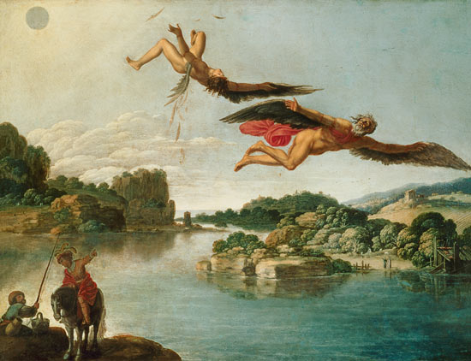
Despite these spaces of curiosity for the wealthy and powerful the question remained:
How to avoid Icarus’s fate? How to gain knowledge without sinning against God and being punished?

Slide 63
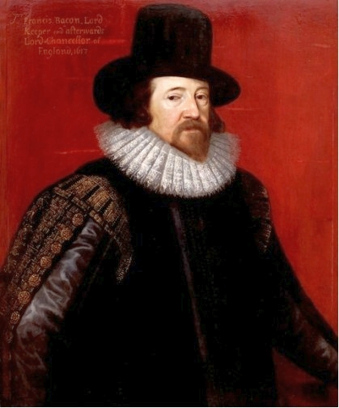
‘So as what so ever is not God but parcel of the world, he hath fitted it for the comprehension of man's mind, if man will open and dilate the powers of understanding as he may.
But yet evermore it must be remembered that the least part of the knowledge passed to man by this so large a charter from God must be subject to that use for which God hath granted it; which is the benefit and relief of the state and society of man;
for otherwise all manner of knowledge becometh malign and serpentine, and therefore as carrying the quality of the serpent's sting and malice it maketh the mind of man to swell; as the Scripture saith excellently: knowledge bloweth up, but charity buildeth up.’
Bacon’s strategic move to turn curiosity from a vice to a virtue
God offered the world to people and it was their duty to explore it; they do not for
themselves but for society; they do it for charity (not for their own advancement)

Slide 64
Charity is the driving force of human curiosity
"that they consider what are the true ends of knowledge, and that they seek it not either for pleasure of the mind, or for contention or for superiority to others, or for profit, or fame, or power, or any of these inferior things; but for the benefit and use of life; and that they perfect and govern it in charity’
Useful knowledge, for the state and society is an expression of human religious duty, Bacon argues, it aims at repairing the losses of knowledge that ensued upon the Fall.

Slide 65
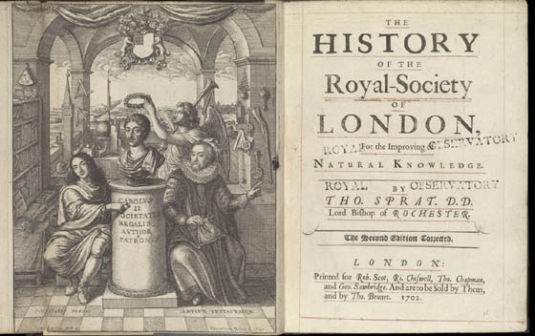
The philosophical method of this new production of knowledge Bacon called ‘empiricism’:
Royal Society, founded in 1660. Francis Bacon is on the right; Charles II
in the middle

Slide 66
Week 10
Body and Soul Re-Thought:
Man as Machine and the Changing Animal/Human Relationship in the 17th Century

Slide 67
“We do not think that it is any more relevant to the present subject whether the discovery to come were once known to the ancients…than it should matter to men whether the New World is the famous island Atlantis which the ancient world knew… For the discovery of things is to be taken from the light of nature, not recovered from the shadow of antiquity’.
(Bacon, Novum Organum)

Slide 68
Bacon turns scholastic thinking on its head and attacks its inner logic.
Demonstrative syllogism (deductive method)
All men are mortal (Major or general premises)
Socrates is a man (Minor premises)
Therefore, Socrates is mortal (specific conclusion)
Deductive reasoning involves using general premises to form a specific conclusion
Bacon introduces a new method called ‘inductive reasoning. Inductive reasoning involves starting from specific premises and forming a general conclusion.
Experimentation becomes the central practice mirroring inductive reasoning.
Experiment, def.: the making of specific trials of phenomena typically with contrived circumstances or apparatus.

Slide 69
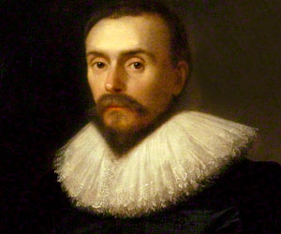
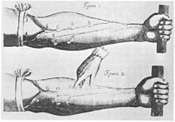
The Rise of Experimentation
‘Anatomical Exercise on the Motion of the Heart and Blood in Animals’(1628) (Exercitatio Anatomica de Motu Cordis et Sanguinis in Animalibus)
Problem: how to convince scholastics natural philosophers that your conclusion based on the new method of experimentation (and the new philosophy of Empiricism) is universally ‘true’?
William Harvey, 1578 – 1657

Slide 70
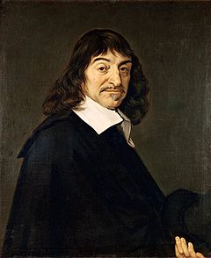
Cartesianism
1637. Discours de la méthode (Discourse on the Method)
1641. Meditationes de prima philosophia (Meditations on First Philosophy), also known as Metaphysical Meditations
1648. La description du corps humaine (The Description of the Human Body)
1649. Les passions de l'âme (Passions of the Soul). Dedicated to Princess Elisabeth of the Palatinate.
René Descartes, 1596-1650
He aims to radically ‘replace’ the Aristotelian world view, one that provided a mechanical explanation of the world and the human in it.

Slide 71
Descartes’s ‘New World’ based on absolute certainty:
‘The only principles which I accept, or require, in physics are those of geometry and pure mathematics; these principles explain all natural phenomena, and enable us to provide quite certain demonstrations regarding them.’
Ergo, everything in the natural world can be explained by mathematics and mechanics.
For Descartes the totality of all possible existence in the world was being composed of two kinds of substances:
matter/extension of dead matter
‘res cogitans’, the ‘thinking stuff’, he also refers to it as ‘mind’ or as ‘soul’
  This ‘split’ applies to the human body – we are dead matter (body) and thinking mind’; the famous Cartesian split of body/mind

Slide 72
As the body is dead matter, Descartes suggests to understand the body as a machine
“I suppose the body to be nothing but a statue or machine made of earth, which God forms with the explicit intention of making it as much as possible like us.”
Everything can be mechanistically explained in a body:
…the digestion of food, the beating of the heart and arteries, the nourishment and growth of the limbs, respiration, waking and sleeping, the reception by the external sense organs of light, sounds, smells, tastes, heat and other such qualities, the imprinting of the ideas of these qualities in the organ of the ‘common’ sense and the imagination, the retention or stamping of these ideas in the memory, the internal movements of the appetites and passions, and finally the external movements of all the limbs”

Slide 73
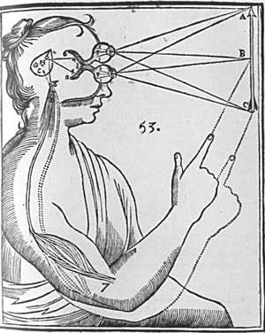
Descartes accepts only one soul: the rational soul
Rational soul’ resides in the pineal gland’ (today we know it produces the hormone melatonin but Descartes didn’t know that of course.)
He ascribes all kind of function to this pineal gland and its ‘rational soul’ and sees it involved in sensation, imagination, memory and the causation of bodily movements.
(anatomically we know know it was all wrong but he and his followers were convinced he was correct)

Slide 74
Descartes radically changes relationship between humans and animals:
Central claim: Animals are machines (automata), they lack the rational soul and are therefore fundamentally different from humans
‘…it is nature which acts in them according to the disposition of their
organs, just as a clock, which is only composed of wheels and weights
is able to tell the hours and measure the time more correctly than we
can do with all our wisdom.‘
How do we know that they have no rational soul, he asks? Because they cannot speak and communicate their thoughts and feelings.

Slide 75
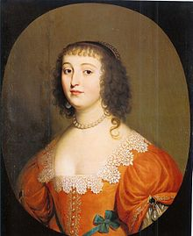
Descartes and Human Passion
Passions of the Soul (1649)
Human reason and free will can and should control human passions
Passion arose in the body – not the rational soul
Ergo, the rational soul can control the body through
will and reason -- through self-discipline
Elisabeth of Bohemia, Princess Elisabeth of the Palatinate, 1618-1680Daughter of Frederick V, Elector Palatine (who was briefly King of Bohemia) and Elizabeth Stuart; lives in exile in the Netherlands

Slide 76
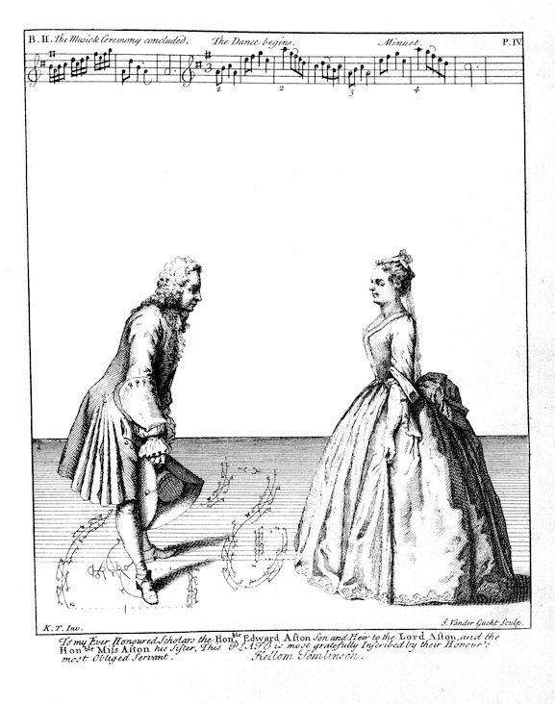

Descartes lived in a world of patronage in which
The body was increasingly ‘disciplined’ in his movement and expression

Slide 77
End term 1

