Slide 1
Week 9
The ‘Linguistic Turn’
Dr Claudia Stein

Slide 2
Linguistic Turn
The term was first used by the American philosopher Richard Rorty in an edited volume, entitled The Linguistic Turn (1967).
At its core stands a new focus on the relationship between language, language users, and the world – perceived through human ‘experience’ and expressed through language.
This ‘linguistic turn’ begins in philosophy and literature studies/criticism and then spreads to the humanities as a whole.
The linguistic turn in history writing
It has become ‘a catch-all phrase for divergent critiques of established historical paradigms, narratives and chronologies, encompassing not only poststructuralist linguistic criticism, linguistic theory, and philosophy but also cultural and symbolic anthropology new historicism and gender history.’ (Kathleen Canning, Feminist history after the Linguistic turn: Discourse and experience, Sign, 19,2 (1994), p. 147.

Slide 3
Central issue: What is human ‘experience’? Is human ‘experience’ prior to the use of language?
Central issue in Anglo-American history writing from the late 1980s/early 90s:
‘The seemingly simple recognition that the category of experience (out of which historians such as E.P. Thompson argue comes class consciousness) is in fact not prior to and constitutive of language but it is actively constituted by language, has been increasingly been recognized as having far-reaching implications.’
(Patrick Joyce, Visions of the People: Industrial England and the Question of Class, 1884-1914),p. 9.
Claim: language constitutes ALL human experiences. Language ‘makes’ our experience – that includes what we now call our ‘lived experience’! There is nothing ‘authentic’ about your very own experience.
Ergo, human experience is not universal or transhistorical (as new social historians claimed). As humans use language to express their ‘experience’, experience is not suitable to link the past and the present. Our experience is not shared by those in the past. It is constituted in entirely different ways.
What stands behind this view?

Slide 4
Lecture outline
Two central theories that constitute the ‘linguistic turn’:
French views: structuralism and poststructuralism: Roland Barthes
American views: history is literature: Hayden White

Slide 5
The linguistic turn as an intellectual response to the conditions of postmodernity
Def. Postmodernity:
This term refers to a set of perceived (sociological, cultural, political, economic,
technologicaletc.) conditions of everyday life, which are perceived as distinctly
different from the conditions of ‘modernity’. The discussion of postmodernity is
the discussion of these conditions. The debates intensify during the 1960s and they coincides with the rise of post-industrial societies in the West, which was marked by a transition from a manufacturing-based economy to a service-based economy.
Def. Postmodernism:
Postmodernism is the intellectual response to the conditions of postmodernity. The linguistic turn is one of these many responses.
By questioning human experience, it also questions all human knowledge production (scientific, economic, political, sociological, historical, anthropological and so on) which is based on language.

Slide 6
So, once again, what is at stake in postmodernism and the linguistic turn?
The question of how to understand human experience.
Central claim:
Can humans represent ‘the reality’ of human experience when they have to use language to express and communicate these experiences?
Note: history writing from the 1960s claims to ‘resurrect’ the experience of the ‘forgotten people’ of the past or to ‘make-meaning’ of past experiences (anthropological turn)

Slide 7
The ‘linguistic turn’ as an expression of a postwar intellectual crisis in all disciplines of the human and social science
The ‘linguistic turn’ is an expression of a fundamental breakdown of European
intellectual traditions going back to the Enlightenment. All disciplines in the human and social sciences, including history writing, find themselves in crisis mode.
Why: The intellectual and moral basis of their modern existence – the Enlightenment – seems to be bankrupt!
‘Enlightenment, understood in the widest sense as the advance of thought, has always aimed at liberating human beings from fear and installing them as masters. Yet the wholly enlightened earth is radiant with triumphant calamity.” (Theodor W. Adorno and Max Horkheimer, Dialectic of the Enlightenment, 1947)
‘Enlightenment is totalitarianism’
(Theodor W. Adorno/Max Horkheimer, Dialectic of the Enlightenment, 1947)
Claim: The celebration of reason by thinkers of the 18th-century Enlightenment had led to the development of technologically sophisticated but oppressive and inhumane modes of governance, exemplified in the 20th century by fascism and totalitarianism.

Slide 8
The Enlightenment produced ‘myths’ --it is ‘a grand narrative (or meta-narrative)
The linguistic turn is one of the many attempts undertaken in postwar human and social sciences in Europe and America to question the Enlightenment ideals and reveal them as ‘mythical’.
The task becomes to lay bare the hidden the ‘grande narrative’ (or (meta-narrative) of the Enlightenment

Slide 9
Part I:
Linguistic Turn
France
Vichy regime, 1941-1944; collaboration with the occupier Nazi-Germany
Postwar conservative governments; communism widespread, especially among intellectuals
Decolonisation (e.g. Algerian War of Independence 1954-1962)
Economic crisis of the 1970s
Civic rights movements, feminism, student revolts,

Slide 10
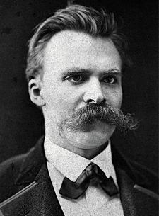
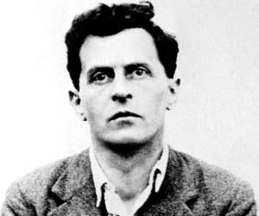
Intellectual responses: take up late 19th and early 20th critiques of modernism
Focus on language
Ludwig Wittgenstein (1889-1951)
Friedrich Nietzsche (1844-1900)

Slide 11
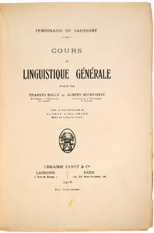
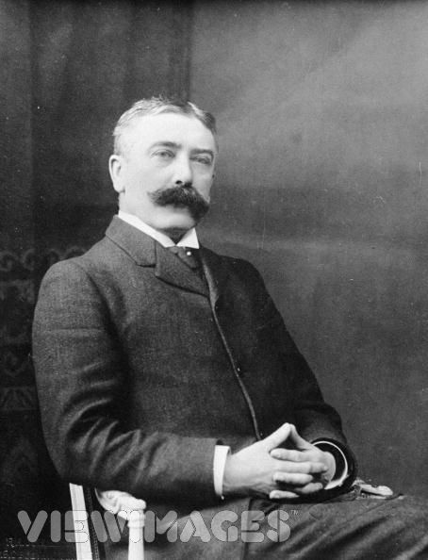
Another ‘hero’ whose work is rediscovered in the 1950s
Cours de linguistique générale (1916)
Linguistics: scientific study of language in broadly three aspects: language form, language meaning, and language in context
Ferdinand de Saussure, 1857-1913

Slide 12
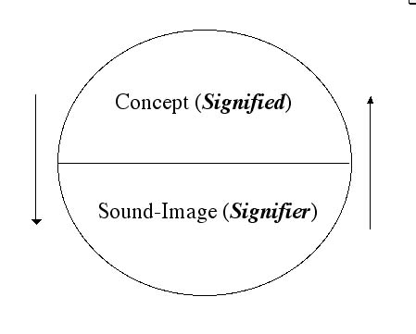
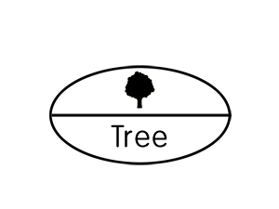
Saussure replaces the term ‘word’ with ‘signs...
Sign, signifier, signified: The sign is constituted by the relationship of a ‘signifier’ (a medium, such as a word, a road sign, a gesture etc) to a ‘signified’ (also known as the referent, the ‘thing’ being signed.)
Note: The ‘signified’ is not the thing itself, only a mental concept of it which the ‘speaker’ and ‘listener’ share.

Slide 13
Saussure’s central structuralist claims:
Languages are not confined to words but include any system of communication that uses ’signs’.
A sign is composed of a ‘signifier’ (vocal sound, image, gesture) and a‘signified’ (the mental concept that speaker and listener share).
The mental concept/structure precedes the ‘signifier’ in existence (according to Saussure, and that is what ‘structuralists’ follow (and what later poststructuralists reject)
A ‘signifier’is established quite and bears no resemblance to the’ signified’. (different language use different ‘signifiers’ for the same mental images)
Every sign acquires meaning only by belonging to a network of other signs. There is in every sign a suggestion of another, oppositional sign (binary relations: women/man; child/adult; animal/human etc.)

Slide 14
Significance of these claims:
Relationship to knowledge becomes uncertain by undermining the connection between a ‘word’ (signifier) and a ‘thing’ (signified) with no relation to the real thing. ‘Meaning’ and ‘sign’ are separated.
The notion of arbitrariness of the sign deeply challenged the correspondence theory of truth: if words relate only to each other within an own structure, how could language be deemed to refer to the world out there? And how would historians argue that their discourse about the past matched up with ‘what really happened’ as Ranke, for example, had famously argued?
During the ‘linguistic turn’ Saussure’s ideas were applied to wider human culture; central claims became :
Reality is not representable in any form of human culture (whether written, spoken, visual or dramatic)
No authoritative account can exists of anything. Nobody can know everything, and there is never one authority on a given subject. There is no authority!

Slide 15
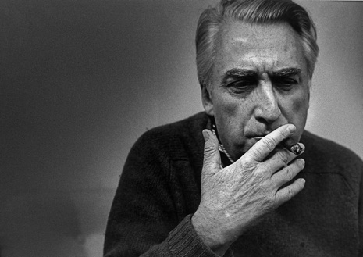
Barthes develop Saussure’s theory further – and politicises it – by moving it from the narrow study of language to the study of cultural and every-day objects.
note: for Saussure ‘signs’ were not political but neutral as he was only talking about their meaning within language and not in culture at large)
Unlike Saussure, Barthes was politically on the left (in an ultra conservative France of the 1950s).
He observed that all sign systems are highly motivated and deeply structured by political power. Understanding each sign, he argued, meant placing it in its political context
How are these ideas applied and re-worked in Roland Barthes’ work
Roland Barthes, 1915-1980,
literary theorist, essayist, philosopher and semiotician

Slide 16
Signs in Everyday Culture
Mythologies, 1957: essay collection, using structural linguistic analysis of cultural icons such as ‘Soap-Power and Detergent” or in ‘Novels and Children (an acid attack on the women’s magazine Elle );’Steak and Chips’; ‘Striptease’ (the commodification of female nakedness and sex industry); ‘Plastic’; ‘The New Citroen’; ‘The Brain of Einstein’, ‘Wrestler’)
Aims to expose how bourgois French society 1950/60 asserted its values

Slide 17
Barthes as a Structuralist
‘The goal of all structuralist activities is to reconstruct an ‘object’ in such a way as to make evident the rules of its functioning .’
Reminder Structuralism:
Barthes does not invent ‘structuralism’ which posits that elements of human individual and collective identities in society/culture must be understood in terms of their relationship to a larger, underlying – invisible -- system or structure (e.g. the anthropologist Clifford Geertz and his method of‘thick description’in, Interpretation of Culture (1973) is structuralist. Karl Marx’s theories were structuralist, too. So, is Saussure.
‘The starting point of these reflections was usually a feeling of impatience at the sights of the ‘naturalness’ with which newspaper, art and common sense constantly dress up a reality which, even though it is the one we live in, is undoubtedly determined by history. In short, in the account given of our contemporary circumstances, I resented seeing Nature and History confused at every turn, and I wanted to track down the decorative display of what-goes-without-saying, the ideological abuse which, in my view, is hidden there.’
(Barthes, Mythologies, p. 11)

Slide 18
The study of hidden meanings -- semiology
Barthes argued that an oppressive ideology was normalised in society by silent sign systems in everyday popular culture that goes beyond Saussure’s original ideas of the signifier-signified.
Barthes calls this larger system ‘myth’.
Everybody in a culture understands nor just the sign but also the myth to which it belongs. Barthes showed that signs and sign systems were embedded codes with normative meanings.
Barthes called all of this 'the semiological system', and the study of the hidden meanings he called 'semiology'.

Slide 19

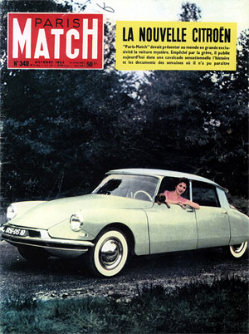
Exercises in semiology for the seminar:
what is the ‘hidden myth’ in these images?
‘The Rhetoric of an Image’
‘

Slide 20
Barthes Poststructural Phase
Death of the Author (1967)
Main claim: the meaning of a text is not determined by the author's intention (or some other sort of structure) but rather by the reader’s own interpretation
Def. Poststructuralism: a philosophical direction within the wider movement of postmodernism. Postmodernists argue that all knowledge is constructed by humans (and language) within a given culture and time. They admit that no ‘facts’ exist independent of ‘structure’.
But they tend to not understand these structures as ‘real’ or ‘fixed’. They are interventions of the observer/reader and they are historical (e.g. ‘class’ or ‘experience’)
Poststructuralists tend to argue that while we need to be aware of structures ``(using them as devices for to aid our inquiry), we need to de-centre them and problematise them for study (e.g. Joan Scott’s famous article on ‘experience’ is a perfect example of this approach).

Slide 21
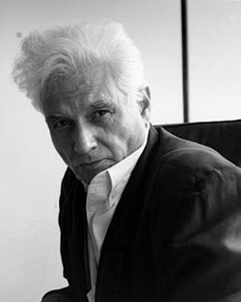
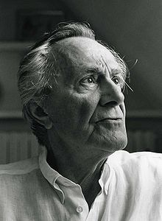
Central question of poststructuralists: What is a text?
A text is the material manifestation of a multiplicity of signs, discourse and structures.
Deconstruction: a form of criticism which asserts that there is not one single intrinsic meaning to be found in a work, but rather many, and often these can be conflicting. A deconstructive approach to criticism involves discovering, recognising and understanding the underlying and unspoken and implicit assumptions, ideas and frameworks of cultural forms such as literary or historical texts.
Jacques Derrida, 1930-2004
Grammatology (1976):
Language is made made by exclusion of the real; nature disappears from the text
“Il n’y a pas de hors-text” (“there
Is no nothing outside text”)
The Postmodern Condition, 1977:
Postmodern manifesto, arguing for the
end of the Enlightenment project; coins the term ‘the postmodern condition’
Jean-François Lyotard (1924-1998)

Slide 22
Is history truly nothing but ‘a text’ in need to be ’endlessly deconstructed’?

Slide 23
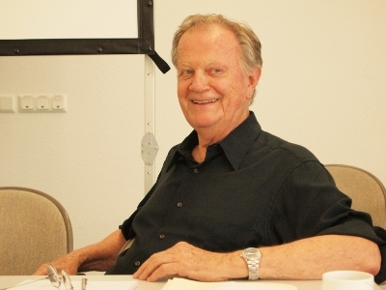
Part 2: American Literary Criticism and ‘the Linguistic Turn’
Is history writing simply literature?
Metahistory: The Historical Imagination in
Nineteenth-Century Europe (1973).
‘My own analysis of the deep structure of the historical imagination of nineteenth century Europe is intended to provide a new perspective on the current debate over the nature and function of historical knowledge.’
(Metahistory, p. 2).
White contradicts the view that "historiography can be objective or truly scientific in itself, unaffected by anything."
Hayden White, 1928-2018
Note: His work reflects the widespread Anglo-American ‘misunderstanding’ of Ranke’s critical method (i.e. empirical, objective).

Slide 24
Metahistory considers eight major figures of 19^{th -}century history writing among them Leopold von Ranke. The histories of these men, White argues, are characterized by four modes of linguistic prefiguration (Metaphor, Metonymy, Synecdoche, and Irony), four theories of truth (Formism, Mechanism, Organicism, Contextualism), four archetypal plot structures (Romance, Tragedy, Comedy, Satire), and finally four ideologies (Anarchism, Radicalism, Conservatism, and Liberalism).
Main point:
“to deconstruct a mythology, the so-called positivistic science of history.”
History is not neutral, rather it entails “entails ontological and epistemic choices with distinct ideological and even specifically political implications.”
Narrative is thus “inextricably bound to issues of authority.”
In sum: Metahistory tossed the entire concept of historical ‘science’ out the window, claiming that historians are fundamentally ‘artists’ who imbue historical action – empirically collected in the archives -- with aesthetic and ethical purpose. The book urged historians to grapple with whether and how their writing creates rather than reflects reality.

Slide 25
The Linguistic Turn as the Narrative Turn
White distances himself from French poststructuralists (besides Barthes) and does not embrace their methods of deconstruction
White believes in a historical ‘reality’ but claims that historians have mistaken the product of their tropological encoding of the past for the past itself.
Difference between reality itself and what is intellectual construction
White compels us to think about how narrative works and how it tends to conceal the contradictions within a given society by framing a unifying story that emphasizes continuity

Slide 26
The End

