Slide 1
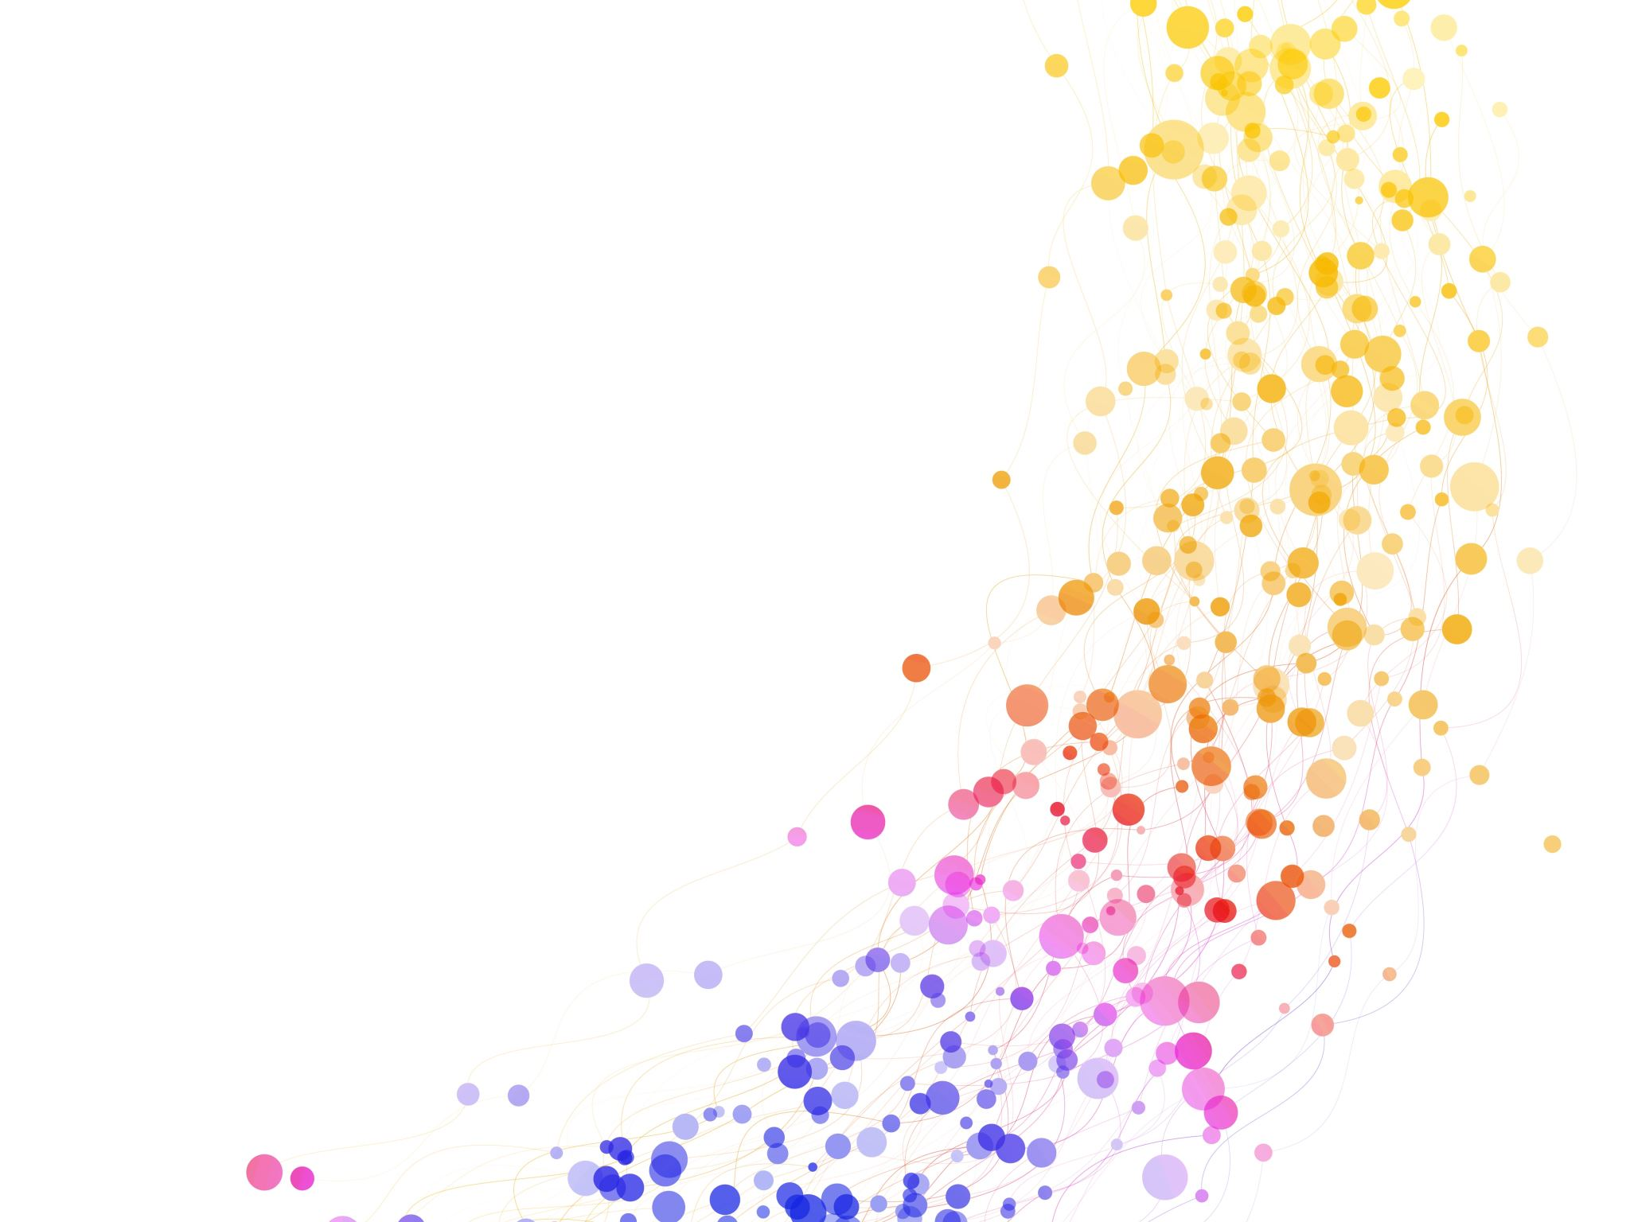
Benjamin Constant
MP 31/01/2023

Slide 2
1767-1830
b. Lausanne, Switzerland – French Protestant marginally noble family – educated at home and in Germany and Edinburgh. Acquired French citizenship in 1798.
Caught up in the French revolution – committed republican in 1795, supported Napoleon’s coups of 1797 and 1799. Became leader of a liberal, constitutional opposition from c 1800. Recalled from exile during the 100 days. Deputy from 1818 til his death – known as an independent and a proponent of parliamentary rule. Seen as a major founding liberal - and one of the first to embrace that term as a self-identification. Key works include:
The Spirit of Conquest and Usurpation and their relation to European Civilisation (1814)
Principles of Politics (1815)
The Liberty of the Ancients compared with that of the Moderns (1816)
But see also his diary, Le Cahier Rouge and his novel Adolphe

Slide 3
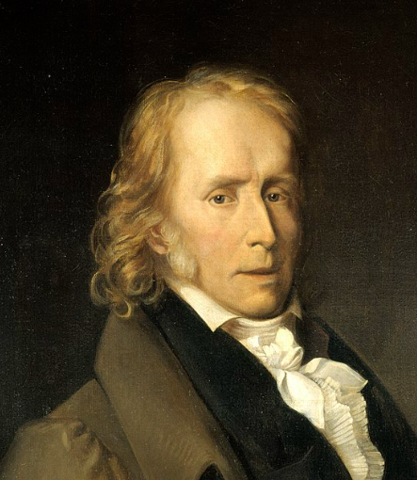
‘position’
Long-standing relationship with/affair with Mme Germaine de Stael – the ‘intellectual-power-couple’ of post revolutionary France (met in 1794 – affair til 1811 – but relationship lasts longer (G’s diary 1813) – She died in 1817).
The problem of boredom and dislocation – an Aristocrat in a post-aristocratic world, and with a commitment to making that world work. Not unlike Tocqueville. Gambling debts; several marriages; more liaisons.
Committed to a view that the modern world was a break with the past – and demanded new institutions, not merely reanimation of the old.
Influences – Montesquieu, Smith, Godwin, Burke – and negatively, Rousseau.
Attracted to Montesquieu for the sociology, and the ideal types; to Smith for analysis of new commercial order; to Godwin for belief in progress; and Burke for the importance of custom and habit/prejudice.

Slide 4
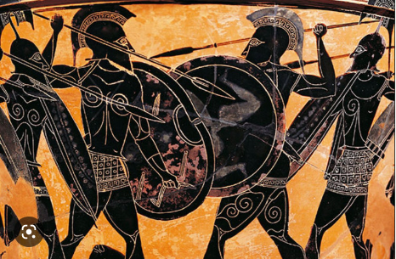
War
Not always an evil
Develops some of men’s finest and grandest faculties – heroic devotion, sublime friendship
Not same as self-defence – interested in war as a fact of life for ancient societies in competitive pursuit of glory
Civilized societies find war a burden – commerce is more important than glory – and people seek comfort, repose and are industrious in their pursuit.
War is a game of hazard – refined morality needs time and a stable order

Slide 5
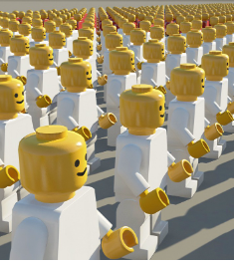
uniformity and locality
Ancient wars might destroy entire nations but when they didn’t they left untouched people’s traditions and practices.
‘The vanity of civilisation is more tormenting than the pride of barbarism’ The later is satisfied with general obedience – the modern world demands uniformity ‘the same code of law, the same measures, the same regulations, and if they could contrive it, the same language…’ (73)
Modern political systems look for uniformity - but man essentially adapts to established institutions and experiences the world through them – his patriotism is local – and his happiness is local – and different localities cannot be subordinated to a single set of rules. Patriotism springs from local differences – and touches on all the disinterested, noble and pious feelings. (76)
‘Variety is life; Uniformity, death.’ (77) Modern states of extensive territory and empires treat their people en masse – not as individuals.

Slide 6
Ancient liberty
Active participation in collective power
Each citizen has great importance
Exercise of rights of citizen were the occupation of all – whole people made laws, decided on war and peace, and pronounced judgment
The will of each individual had a real influence
But to ensure the system worked:
Equality had to be preserved, distinctions proscribed and wealth constrained
Territory had to be limited – in a small state the importance of each member is accentuated
War was a constant feature
And all ancient states had slaves (part of a process of servicing the polity whose ends were higher – war, liberty, the common good – and not private)

Slide 7
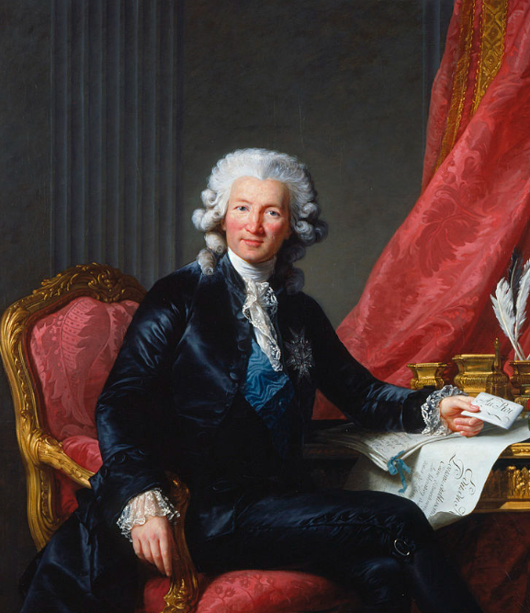
French Revolution
Attacks Rousseau (Social Contract) and Gabriel Bonnot de Mably (Author of De la legislation ou principles des lois) (on the left!)
For failing to recognize that the ancient world is no longer relevant
Montesquieu sees the difference as lying in the distinction between monarchies and republics – but not to the different spirit of ancient and modern times (although…)

Slide 8
Modern liberty
It would be easier today to make Spartans out of an enslaved people, than to turn free men into Spartans. In the past, where there was liberty, people could endure hardship; now, wherever there is hardship, they need slavery so as to be resigned to it.
The mistake of the French Revolution was to model itself on the ancient republic – but ignored the fact that its people were modern private individuals rather than ancients. ‘They attempted to subject the French to a multitude of despotic laws which grievously offended all that they held most dear.’ (108)

Slide 9
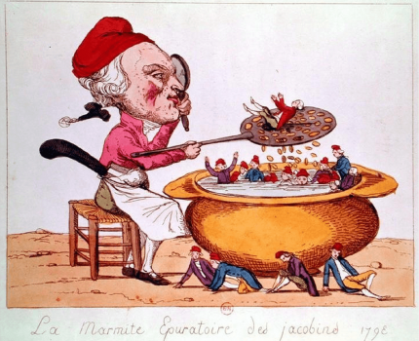
The terror
‘Liberty had to be postponed until factions died down; but factions only die down when liberty is no longer postponed. Violent measures, adopted dictatorially in advance of a public spirit, prevent that spirit from coming into being. It is a vicious circle…Force increasingly necessitates more force. Anger is fed by anger; Laws are forged like weapons, codes become declarations of war, and the blind partisans of liberty, who thought they could impose it all through despotism, stir up all the spirits against themselves, and are left only with the support of the vile flatterers of power.’ (111-2)

Slide 10
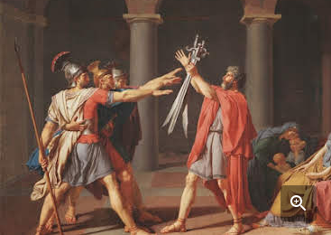
French revolution II
Combination of falling under the spell of the ancient world , and
Failing to see the fundamentally different dynamics of a commercial society
Failing to recognise that all power seeks to extend itself
Failure to acknowledge fundamentally private character of modern man

Slide 11
Modern Liberty
Modern world is different.
States larger and contribution of each individual miniscule
Abolition of slavery means that most of the free population has to work
Commercial world is constantly active and dominates men’s attention
And commerce cultivates individual independence and satisfies their needs – the state becomes less important.
we can no longer support demands of civic virtue – although that does not mean we are not nostalgic for it

Slide 12
Modern Liberty 2 calls for:
Governing less – despite a capacity for governing more.
Not just a matter of rule of law – but the limits of law: How and how much we are governed
People essentially trade, look after themselves and pursue their private pleasures – but for that we need:
Security, property rights, and a civil order in which people can exchange and pursue their pleasures, greater respect for custom and affection (Burke) – i.e. individual liberty
Plus Godwin and PJ corruption by tutelage – self development is what we are called to by destiny
But if all power seeks to extend itself – what about political rights?
Appropriate political order for a modern commercial society:
Representative government
Rights of participation (general will)
Religious freedom – higher morality
Freedom of association, press and speech – but also need to educate people
Multiplication of bodies that need to cooperate in order to exercise power (int. powers)
Pouvoir neutre - UK

Slide 13
Squaring the circle
Need political participation – and vigilance about those entrusted with power – but doesn’t the endorsement of commercial activity threaten our motives for this participation?
Engagement called for is less intense, danger of descent into pleasures (anti Bentham)
Not fully articulated but a desire for self-development under conditions of liberty – importance of religion to provide a morality that extends us beyond ourselves – moderation of interests – but never an eradication or a unification of them; an emphasis on sentiment and emotional embeddedness of judgment.
Plural political world matches a plural subjective world?

Slide 14
the emptiness of enlightenment
‘Man, emerging a victor from the combats he fought, casts a glance upon the world, now emptied of all protecting forces, and is stunned by his own victory…He finds himself alone upon the earth which is bound to swallow him. On this earth generations follow one another, transient, fortuitous, isolated; they appear, they suffer, they die…No voice is raised from the races which have ceased to exist to the living ones, and the voice of the living is doomed to sink into the same eternal silence. What will man do without memory, without hope, between a past which deserts him and a future which is close in front of him. No one listens any longer to his invocations, no one answers his prayers. He has rejected all the supports of which his predecessors had surrounded him, and has reduced himself to his own forces.’
(quoted in Fontana, 1991, 104)

Slide 15
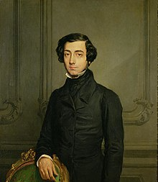
Links to Tocqueville
Modern individualism
Rise of commercial society
Need for religion
Value of intermediary orders and local commitments
Demise of aristocratic order and moeurs
Liberty and virtue

