Slide 1

Individual, Polis and Society Autobiography 1.ii
Mark Philp

Slide 2
IPS Web-page resources
Samuel Pepys late 17th C
Dudley Ryder early 18th C
Laurence Sterne 1760s
James Boswell - 1760s
David Hume - 1770s
Jean Jacques Rousseau – 1712-1778
Benjamin Franklin c 1780s
Sharon Turner 1790s
William Upcott 1800s

Slide 3
Comparative self-examination
Does Pepys think like us?
Does he think like others in this period?
How do we tell?
Varieties of self as other: detachment, control, fascination; disgust; shame; guilt
Varieties of self expression: I am what I am
What they admit to, and what not?
What don’t they seem to see in their own behaviour?
What is idiosyncratic to the writer – what is symptomatic of wider trends

Slide 4

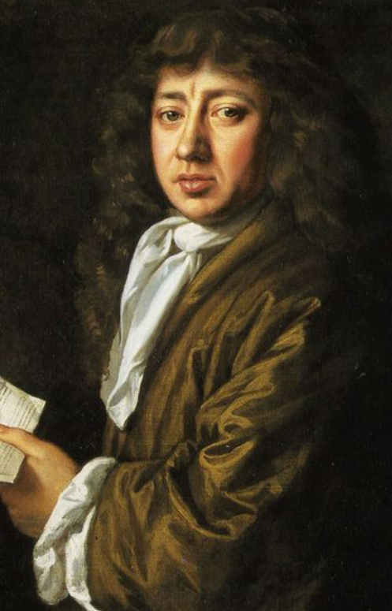
Samuel Pepys 1633-1703
Son of a tailor, rose to become a leading civil servant; unexampled witness to events of the mid-late 17th C; secret short-hand; and perplexing honesty.

Slide 5
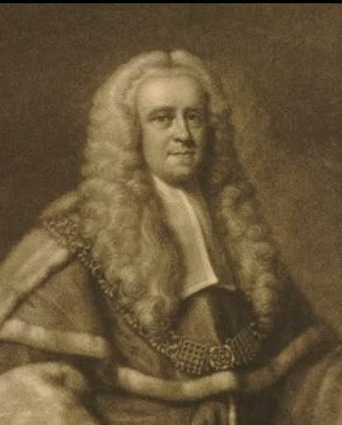
Dudley Ryder 1691-1756 Diary 1715-16
Non-conformist; trained at Dissenting academy (Hackney) and at Edinburgh and Leiden; Middle Temple; married 1733 (aged 42)

Slide 6
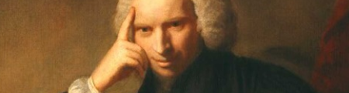
Laurence Sterne 1713-1768
Anglican clergyman, novelist: Tristram Shandy; Sentimental Journal

Slide 7
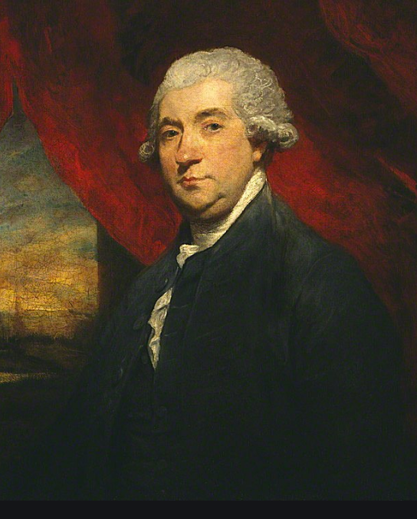
James Boswell 1740-1795
Scottish, visited London in 1762-3, became an intimate frind of Dr Samuel Johnson’ accompanied Johnson on Tour of Scotland, wrote major biography of Johnson.

Slide 8
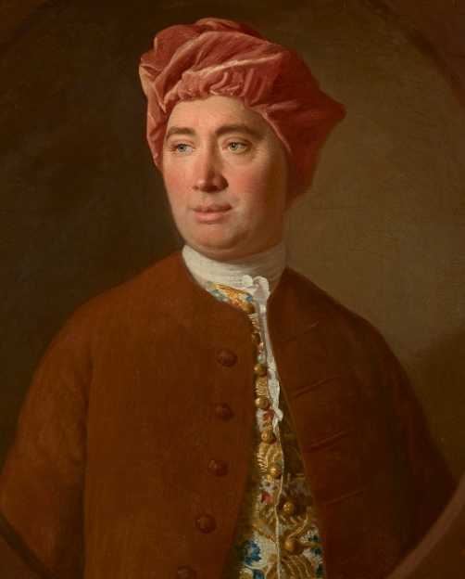
David Hume 1711-76
Scottish Philosopher: Treatise of Human Nature; Enquiry Concerning Human Understanding; Essays, Moral, Political and Literary; History of England. And a very short autobiography ‘My own Life’ (which prefaces modern editions of the Essays).

Slide 9
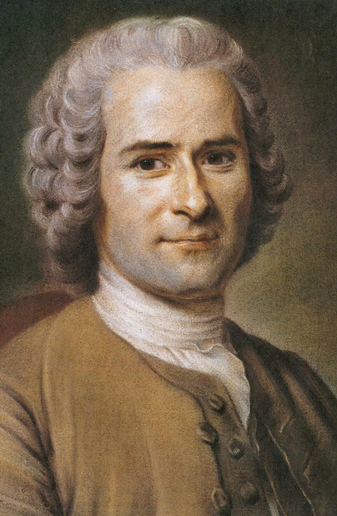
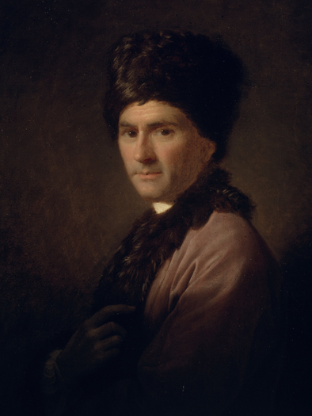
Jean Jacques Rousseau 1712-1778

Slide 10
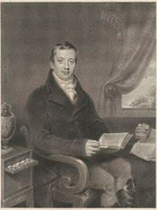
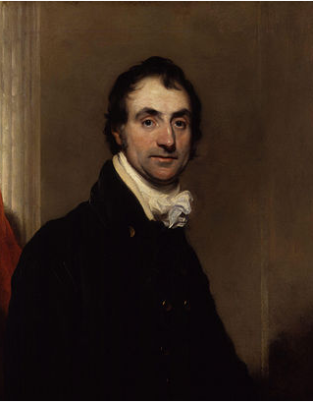
Sharon Turner 1768-1847 William Upcott 1779-1845

Slide 11
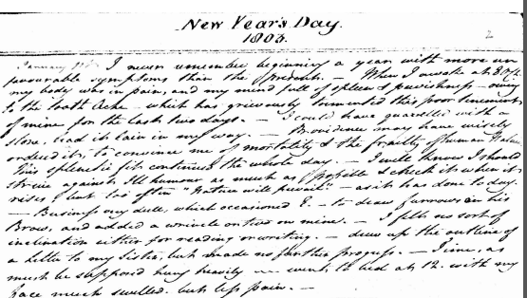
Self and not self

Slide 12
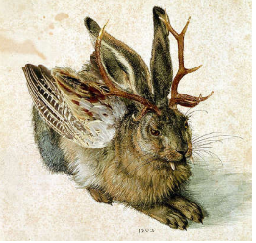
William Upcott
New Year’s Day 1803
I never remember beginning a year with more unfavourable symptoms than the present. When I awoke at 8 o’c my body was in pain, and my minds full of spleen and peevishness– owing to the tooth ache- which has grievously tormented this poor tenement of mine for the past two days. – I could have quarrelled with a stone – had it lain in my way. Providence may have wisely ordered it, to convince me of the mortality and the frailty of human nature. This splenetic fit continued the whole day – I well know I should strain against the humour as much as possible + will check it when it rises - but too often “nature will prevail” as it has done today.
Business very dull, which occasioned E to draw furrows on his brow, and added a wrinkle or two on mine. I felt no sort of inclination either for reading or writing – drew up the outline of a letter to my sister, but made no further progress. – Time, as must be supposed hung heavily – went to bed at 12 with my face much swelled, but less pain.

Slide 13
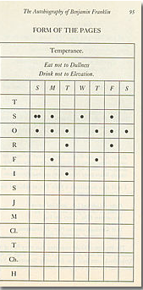
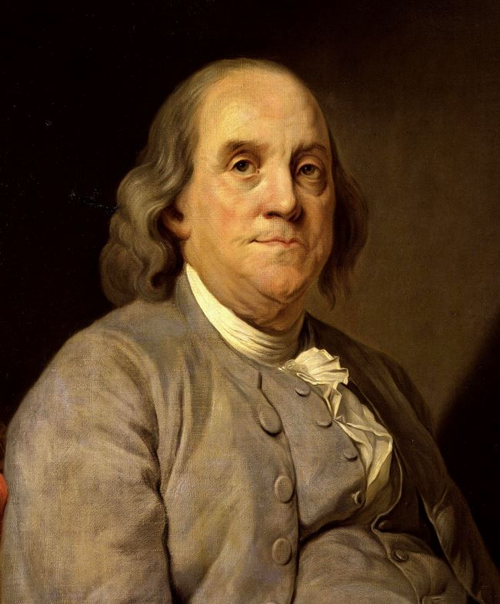
Benjamin Franklin’s Virtues

Slide 14
Franklin’s 13 Virtues
Temperance. Eat not to dullness; drink not to elevation.
Silence. Speak not but what may benefit others or yourself; avoid trifling conversation.
Order. Let all your things have their places; let each part of your business have its time.
Resolution. Resolve to perform what you ought; perform without fail what you resolve.
Frugality. Make no expense but to do good to others or yourself; i.e., waste nothing.
Industry. Lose no time; be always employ'd in something useful; cut off all unnecessary actions.
Sincerity. Use no hurtful deceit; think innocently and justly, and, if you speak, speak accordingly.
Justice. Wrong none by doing injuries, or omitting the benefits that are your duty.
Moderation. Avoid extremes; forbear resenting injuries so much as you think they deserve.
Cleanliness. Tolerate no uncleanliness in body, cloaths, or habitation.
Tranquillity. Be not disturbed at trifles, or at accidents common or unavoidable.
Chastity. Rarely use venery but for health or offspring, never to dullness, weakness, or the injury of your own or another's peace or reputation.
Humility. Imitate Jesus and Socrates.

Slide 15
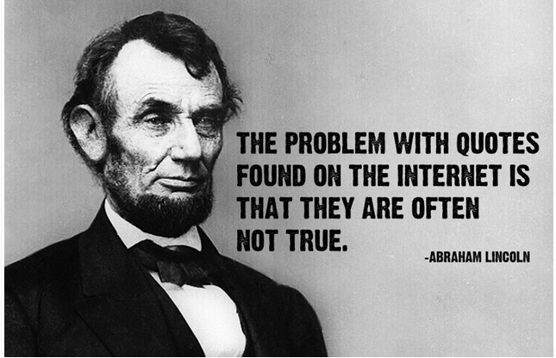

Slide 16
Franklin
‘Beer is living proof that God loves us and wants us to be happy.’
"Behold the rain which descends from heaven upon our vineyards, and which incorporates itself with the grapes to be changed into wine; a constant proof that God loves us, and loves to see us happy.“ or
Letter to Morellet On parle de la conversion de l’eau en vin, à la nôce de Cana, comme d’un miracle. Mais cette conversion est faite tous les jours par la bonté de Dieu, sous nos yeux. Voilà l’eau qui tombe des cieux sur nos vignobles, et alors elle entre dans les racines des vignes pour-être changée en vin. Preuve constante que Dieu nous aime, et qu’il aime à nous voir heureux.

Slide 17
Want to turn in the next section to reflect briefly on other sources that one might use in Thinking about the ‘Presentation of self on everyday life’
Viz – the title of a Erving Goffman’s extremely influential 1956 text, which introduced ‘dramaturgical’ analysis in sociology’ and remains well worth reading, alongside his ‘Stigma’ and T Berger and D Luckman’s Social Construction of Reality.

