Slide 1

Individual, Polis and Society i.iii
Mark Philp

Slide 2
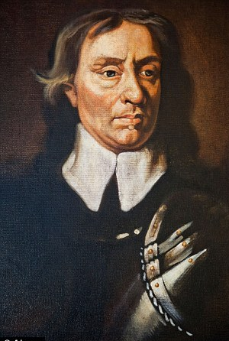
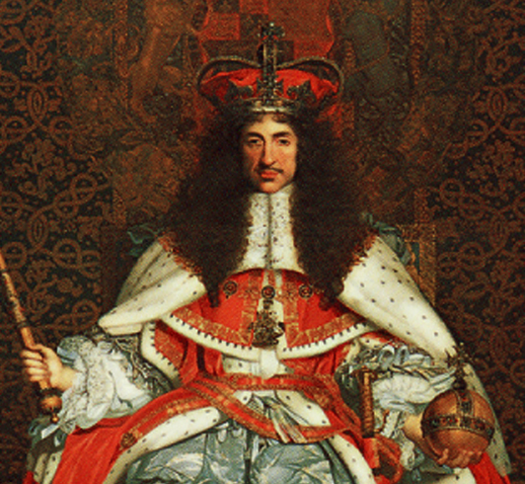
Changing imaginaries, changing self-fashioning

Slide 3
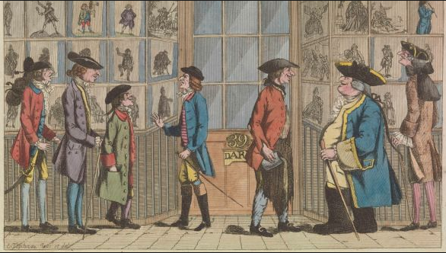
Masculinity

Slide 4
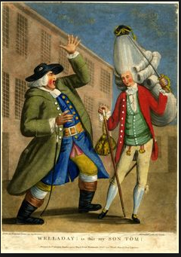
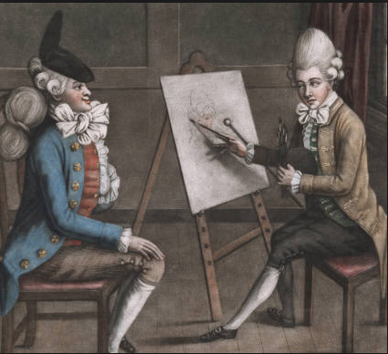
Macaroni

Slide 5
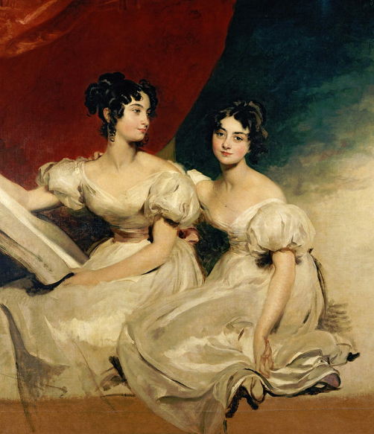
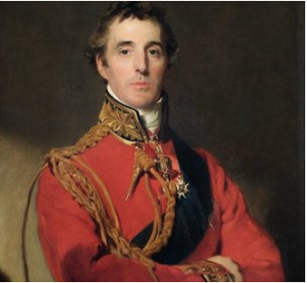
Thomas Laurence, Arthur Wellesley; and the Fullerton Sisters

Slide 6
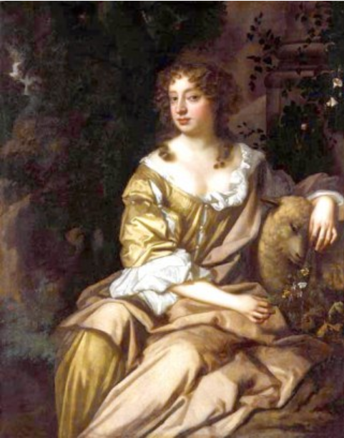
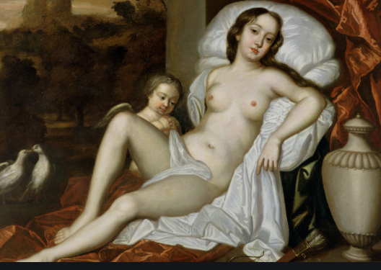
Nell Gwynn

Slide 7
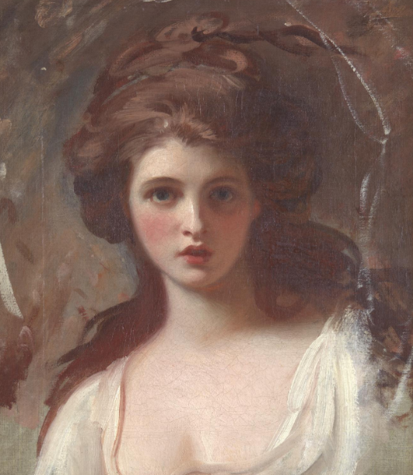
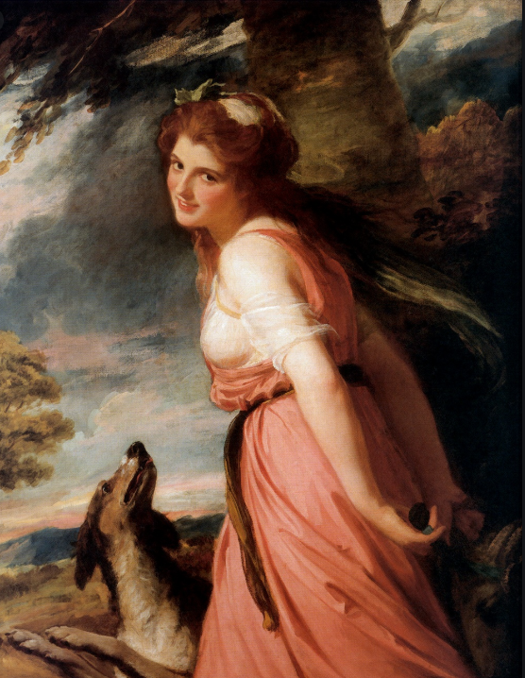
Emma Hart/Hamilton as Circe and as a Bacchante

Slide 8
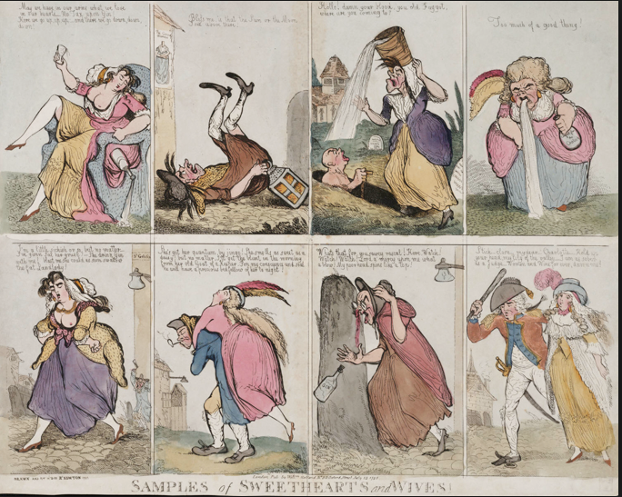
Femininity 1795

Slide 9
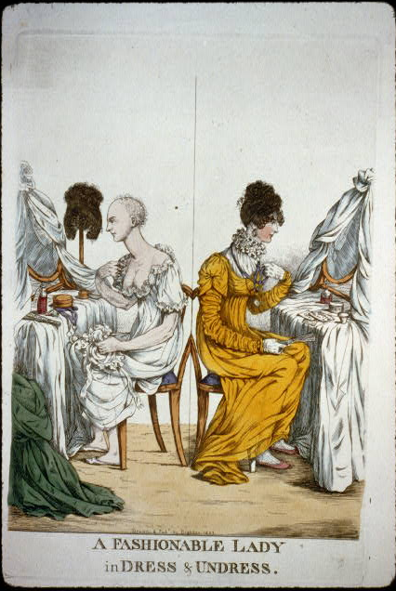
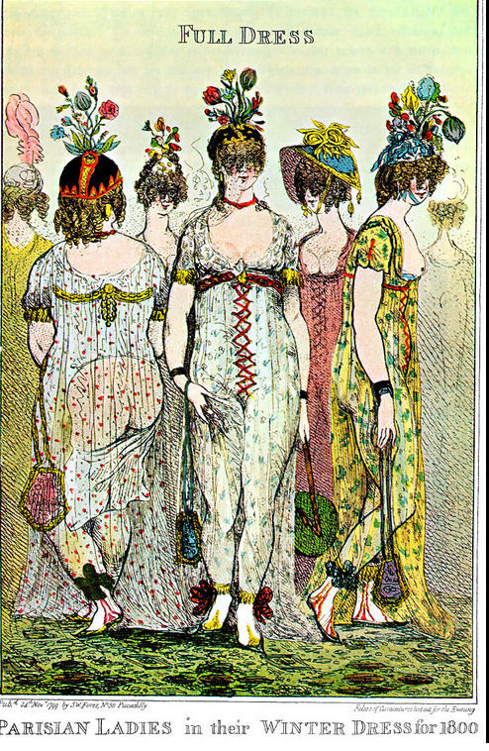
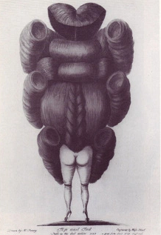
Female fashions

Slide 10
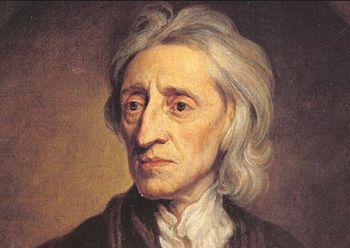
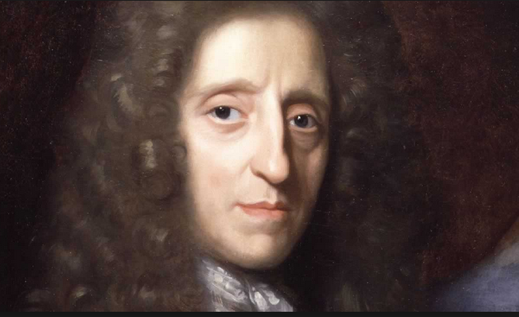
Wigs

Slide 11
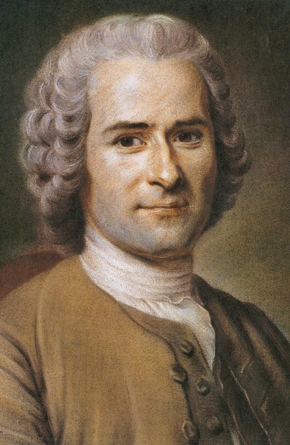
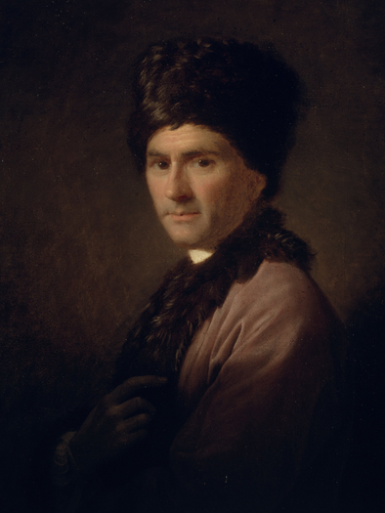
amour de soi/amour propre the social construction of identity

Slide 12
Types of diary
1812

Slide 13
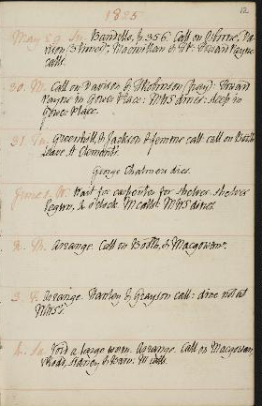
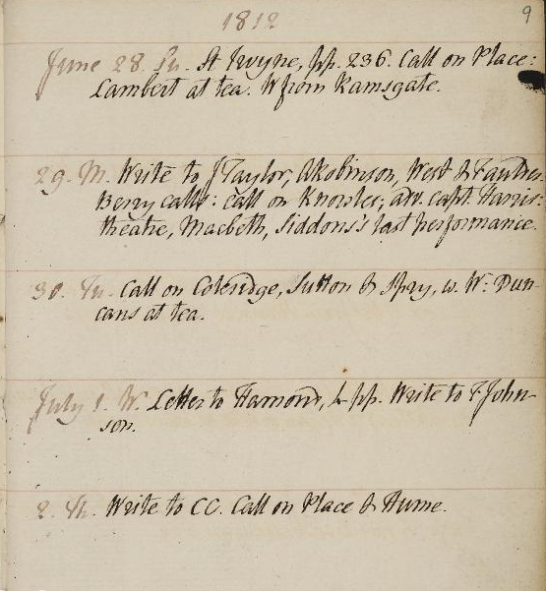
William Godwin Diary:1756-1836
June 29 1812

Slide 14
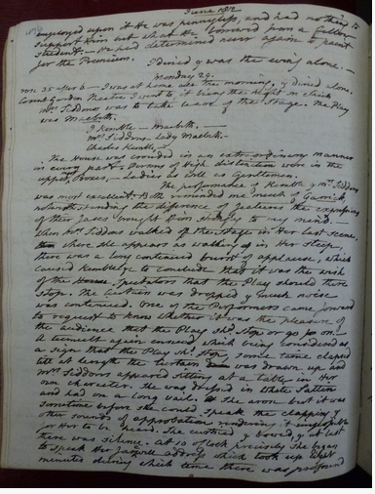
Joseph Farington 1747-1821
29 June 1812

Slide 15
Henry Crabbe Robinson
20 June 1812
29. This day I shall long remember. It was the day of the interment of M^{rs} Becker – I attended as one of the Mourners And I had never been present at a funeral before. I went in a Mourning Coach with Allingham & Haydon. At the house I found a larger number collected than I had any expectation of seeing Or than I think proper on such an occasion; but funerals are more numerously attended in Germany than in England. I went in the first Coach with M^{r} G. B., Alfred, Dalgas, Barker & Aders – Three other coaches followed. There were about 20 persons in all. The burial was in Hackney Church Yard. The church Service was impressively delivered And I felt the general beauty & force of the form. Every one seemed to feel strongly the merits & excellence of the deceased. I returned to the House Where I found Miss Lewis & M^{rs} Barlow in deep sorrow. I walked to the City with Aders. Calling on M^{r} Sam: Robinson I was induced to dine there, though in no mood for society. Indeed my dinner with him was not festive. Returned home to tea; After which I called with Thomas on Anthony Robinson. Thomas was pleased with A. R. Afterwards the Lambs and Gooden came & supped with us. I never enjoyed Lamb’s company less. A dull rubber at Whist was followed after Supper by forced runs & fun on his part. An old lady, it seems, has promised to give him a freehold. He joked unceasingly on his importance as a freeholder And we had not a change of the subject, till I stole away to bed, after it was late.
Mem: M^{rs} Siddons left the Stage this Evening.

Slide 16
Eliza Soane
1812
April 1 Wed Mr S out of town, had a little dance
4 Gave M a shawl and Ann a piece of cloth
9 James Cutler and Thomas Young came to live
August 9 Sunday Mr Soane fetched me back from Chertsey after staying there 3 weeks and 5 days
Aug 13 Thurs Walked in the Bedford
14 Frid - sent Cofee, sugar etc

Slide 17
Seminar
Assignment for August/September
This week will examine some of the diary writing of Samuel Pepys, Dudley Ryder, James Boswell, and Fanny Burney, and consider also more public facing reports of the self, such as Rousseau's Confessions and Benjamin Franklin's Autobiography, or the more novelistic Sterne's Sentimental Journey, or Mackenzie's Man of Feeling. Each of the former group kept an extensive diary, recording events and their reactions, but also exploring their internal and their social life, their bodily states and desires, their social status and intellectual anxieties, and so on. Who were these diaries written for, and for what purpose? And what were Rousseau and Franklin doing in setting out their lives for a public readership? How far are we witnessing a form of largely non-religious internal reflection in which the body and society are accepted and indulged as having their own imperatives and pleasures; how far is this an exploration of the changing character of masculinity in the enlightenment world; and how far is it an attempt to gain some sense of self in a world experienced as other and in which place and standing cannot be assumed? It is also worth getting a sense of the contrast between such writing and that of, for example, John Bunyan in Grace Abounding or Pilgrim' Progress.
Assignment for September
Before the start of term all students should read a year of at least two or three of these diaries (Pepys, Rider, Bosewell, Burney) Pepys's is available online (see below). And dip into either Pilgrim's progress or Grace abounding to compare the style and concerns
James Boswell, London Journal 1762-3 (3 copies in the Library PR3325) see extract including brief sections from Montaigne, Montesquieu, Hume and Rousseau here
Rousseau's Confessions: http://www.gutenberg.org/files/3913/3913-h/3913-h.htm see short extract in Boswell extract
Sharon Turner - transcription of diary of a ms in the BL 1794-5 see here
The following are items that, if you are interested in autobiography and self-analysis, might form the basis for essay work.
Franklin Autobiography: http://www.gutenberg.org/files/20203/20203-h/20203-h.htm see short extract here
Laurence Sterne, Sentimental Journey - http://www.gutenberg.org/ebooks/804
Henry Mackenzie, The Man of Feeling - http://www.gutenberg.org/files/5083/5083-h/5083-h.htm

Slide 18
Week 2 Seminars
Women’s self analysis – Wollstonecraft’s Vindication; Memoirs of Emma Courtney
Secondary literature:
Faramerz Daboiwala, The Origins of Sex (2012)
Vivien Jones (ed) Women in the Eighteenth Century (1990)
Ruth Perry, Novel Relations (2004)

