Slide 1


Adam Ferguson: Society and its defence
Mark Philp

Slide 2
Last week
Federalists on design as a solution to the failure to cultivate virtue – and the tension between virtu and individual liberty
This week – different solutions to that tension – and different takes on it – in particular from the Scottish enlightenment and stadial theory.
Can commerce replace virtue as an alternative glue for society and in a way that does not merely succumb to the exercise of force and power (as in R’s DoI)?

Slide 3


Stadial theory and the place of armed force
Set of concerns in Scottish Enlightenment
Rise of analysis of the economy (especially Smith)
Engagement with ancient history and concerns about stability and decline (Ferguson)
And development of an understanding of the distinctive features of modern commercial society (Millar – and Smith and Ferguson)

Slide 4
economy
Reading of Smith in history of economics
Development of political economy as self-regulating system e.g. Malthus and as the motor of historical change – eg Marx
Is that what the Scottish enlightenment is about?
Multi-causality, with a sharp eye to the ancient world, and a concern about the distinctive character of the modern
Starts by thinking about sociability and conflict - and in that respect not a million miles from social contract theory

Slide 5
David Hume Of Parties in General in Essays (1753 – final ed 1777)
Factions subvert government, render laws impotent, and beget the fiercest animosities among men of the same nation, who ought to give mutual assistance and protection to each other…. Factions may be divided into PERSONAL and REAL: that is, into factions based on personal friendship or animosity….and into those founded on some real difference of sentiment or interest. …Real factions may be divided into those from interest, from principle, and from affection. …the first are the most reasonable, and the most excusable. …Parties from principle, especially abstract speculative principle, are known only to modern times, and are, perhaps, the most extraordinary and unaccountable phenomenon, that has yet appeared in human affairs.

Slide 6

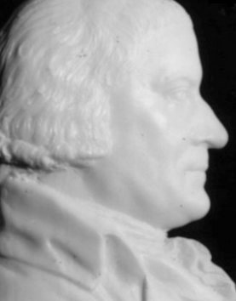
John Millar 1735-1801
The Origin and Distinction of Ranks (1771)
In both hunting – and then under herding societies – every person is a warrior. When they acquire extensive land through military conquest, they develop retainers and followers and tend to become monarchical – but the monarch has little authority and there are many inter-group conflicts and wars – generating a culture of high military honour, chivalry and gallantry – and increasingly military conflict became intra-societal. Little reliance on central institutions of justice. Has a major impact on courtship, literary activity etc

Slide 7

Transition to commercial society
Rise of arts, commerce, manufactures, and the rise of the power of the Church and science – unwarlike – leading to a decay in dueling (and rise in poisoning!)
Increase in govt authority to protect society
Increase in industry and lucrative employment
Military service becomes burdensome
Standing mercenary army increases power of crown
Independence of law and judgement

Slide 8
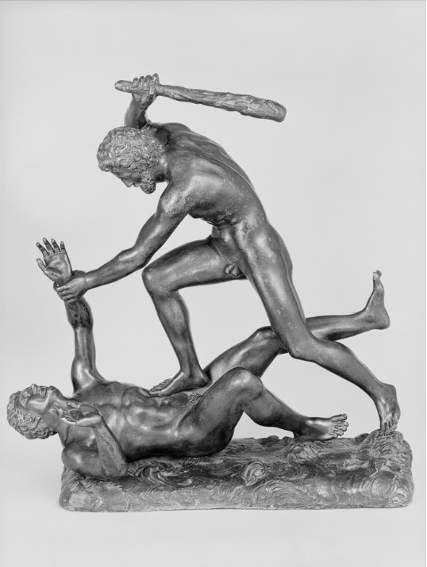
Wealth of Nations Book V I a
Army of hunters – at most 2-300 men
Army of shepherds 2-3,000 (Tartar invasions)
Native American Indians
Cultivating age – every man has abilities, but less leisure – so limits campaign season
In the first three cases the individual carries the cost of provision and time – and his revenue remains constant – as technology changes – and as manufacture and commerce increases – there is less time for war – and higher cost of provision – so devolves on to a professional army.

Slide 9
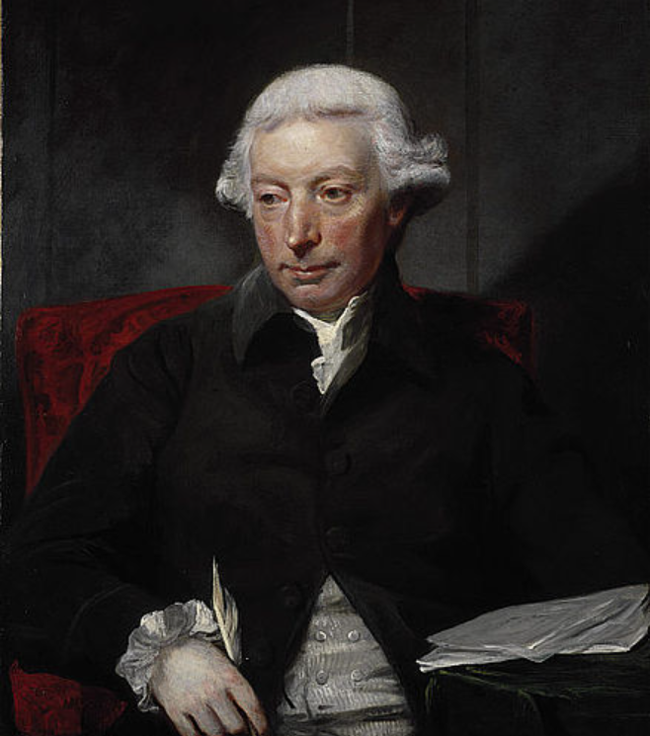
Adam Ferguson 1723-1816
An Essay on Civil Society 1767
‘…we find that some cases may be supposed, and actually happen, where oppositions take place, and are lawful, prior to any provocation, or act of injustice; that where the safety and preservation of numbers are mutually inconsistent, one party may employ his right of defence, before the other has begun an attack. And when we join with such examples, the instances of mistake, and misunderstanding, to which mankind are exposed, we may be satisfied that war does not always proceed from an intention to injure’
‘Mankind not only find in their condition the sources of variance and dissension; they appear to have in their minds the seeds of animosity, and to embrace the occasions of mutual opposition, with alacrity and pleasure. …Even where no particular claim to superiority is formed, the repugnance to union, the frequent wars, or rather perpetual hostilities, which take place among rude nations and separate clans, discover how much our species is disposed to opposition as well as concert.’ 24-5
‘They are sentiments of generosity and self-denial that animate the warrior in defence of his country; and they are dispositions most favourable to mankind, that become the principles of apparent hostility to men….Without the rivalship of nations, and the practice of war, civil society itself could scarcely have found an object or a form.’ 28

Slide 10
Ferguson’s stadial account
Rude Nations:
savage
barbarous
Civilised Nations
agricultural
commercial
polite
Savage = egalitarian and ‘sociable’ based on mutual trust
Barbarian despotisms –
Civilized states – increasing complexity, division of labour, separation of arts and professions, and dangers of competition, and the dereliction of the civic realm.

Slide 11
war and politics
Ferguson – defence and society are co-implied (Plato’s Republic and Laws)
‘We have had occasion to observe, that in every rude state, the great business is war; and in barbarous times, mankind, being generally divided into small parties, are engaged in almost perpetual hostilities. This circumstance gives the military leader a continued ascendant in his country, and inclines every people, during war-like years, to monarchical government.’ 142
But also need a society in which men are inured to equality and where the meanest citizen may consider himself, on occasion, as destined to command as well as obey. (thereby weakening the tendency of savage monarchies to become despotic) 144
In free and uncorrupted states soldiers are driven by a zeal for the public not simply by a professional calling, and that has an impact on their military leaders.
As states progress and there is separation of warriors and non-warriors you have a recipe for masters and slaves. And society evolves into different orders, eg nobility, the court, the people, the priesthood, and the army in the latter case – ‘A discipline is invented to inure the soldier to perform, from habit, and from fear of punishment, those hazardous duties , which the love of the public, or a national spirit, can no longer support.’ 146

Slide 12
Smith and Ferguson
Smith (and Hume) generally represent commercial society as a well regulated, self-equilibriating order – and in large part as a story of progress – but both have concerns about what might disrupt it – Hume and factions – Smith, the de-moralizing effect of repetitive labour
Ferguson follows suit – but has more (and more classical) concerns about the medium to long run consequences of a specialization of function and the development of a standing army
Professionalism – de-skills some while making a business of war for others – who may turn their skills on their own society
Standing armies and policing strengthen the state and the law – but also remove the commercial sphere from the practices of military virtue – and detach commercial men from the institutions of power
Luxury threatens to turn people’s attention from what they share in common to what they hold themselves – ironically, lose their sense of mutual dependence – and pursue entertainment and pleasure
Manufacturing and its narrowing of perspective; specialisation removes attention from the common good See Pt 5 sect 4
Adversity sharpens virtues; ease blunts them and switches attention to pleasures and manners

Slide 13
Polished ages
‘The boasted refinements of the polished age, are not divested of danger. They open the door, perhaps, to disaster, as wide and accessible as any they have shut. If they build walls and ramparts, they enervate the minds of those who are placed to defend them; if they form disciplined armies, they reduce the military spirit of entire nations; and by placing the sword where they have given a distaste to civil establishments, they prepare for mankind the government of force’ V (iv) 219)
‘…nations under a high state of the commercial arts are exposed to corruption, by their admitting wealth, unsupported by personal elevation and virtue, as the great foundation of distinction, and by having their attention turned on the side of interest, as the road to consideration and honour.’ (VI (iv) 241)

Slide 14
Commerce and war
The moment that an artificer, a smith, a carpenter, or a weaver, quits his workhouse, the sole source of his revenue dries up – so he needs paying.
Smaller proportion can fight (because of cost)
Training, exercises, development of mechanical arts,
And artificers and manufacturers have no leisure
Either inc police and social control to enforce exercises (militia) or. Render soldiery a trade (standing army)
Changes in military technology – increase cost, also decrease skill – but inc need for order and prompt obedience (less likely in militia).
Changes conquest: A standing army establishes, with an irresistible force, the law of the sovereign through the remotest provinces of the empire.
‘Real or imaginary dangers of a standing army’ Wealth of Nations V.i.a. sect: 41

Slide 15
Scottish enlightenment: History and sociology
Stepping back from contractarian tradition – up to a point (there remain links)
Natural sociability – but limited – both war and sociability are elements of society (Montesquieu)
Conjectural history
Progressive vs cyclical history Montesquieu’s 3 historical arcs; Smith vs Ferguson
Place of the economy – drivers of change – stable vs shifting components
Place of the state/government
Place of civic virtue
Passions and the interests

