Slide 1

Self-narration and the voice of the ‘othered’ Section iv
Mark Philp

Slide 2
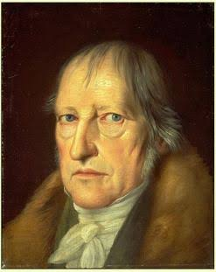
G. W. F. Hegel 1770-1831 Phenomenology Section B iv A

Slide 3
Master and slave dialectic: 1
Desire – Hobbesian self preservation
Desire for recognition ‘Each wills to be valid for the other; it is the end of each to look upon itself in the other.’
A recognises B when A has an image of B as a self-conscious being like A; but for recognising B to work, B also has to recognise A. But..
Recognising B threatens A (and vice versa). The other’s independence threatens my self-certainty. Struggle to the death, as an existential struggle for self, life and certainty. Hobbesian ‘nasty, poor, brutish and short’
Emergence of patterns of domination: facing death, we accept life under subordination, thereby surrendering self-recognition – master and servant

Slide 4
Master and slave dialectic: II
Master (A) dominates B, B recognises A, A does not have to recognise B.
B has no recognition – ‘its essence is life or being for another’ - Hobbes’s ‘despotical dominion.’ Put into bondage, by his own consent.
Hobbes vs Hegel: In Hobbes the slave is just a tool; in Hegel, he contributes to self-recognition of the master; In Hobbes the slave’s drive is self-preservation – in Hegel, he cannot achieve, but also cannot give up, self-recognition.
But the Master’s self-recognition through the other is an illusion – the master and his sense of self-recognition are dependent on the slave i.e. – for material things; and becomes dependent on slave’s recognition, which he needs but does not value.
For the slave: his self-consciousness supersedes ‘the inner immediacy of desire’ ‘and in this alienation from the master lies the beginning of wisdom – it makes possible the transition to universal self-consciousness – the beginning of true human freedom.

Slide 5
Master and Slave III - summary
1. Selfhood involves the desire for self-certainty – self-positing and self-interpretation
2. Self-certainty requires recognition – need an object reflecting back to me my sense of my self as a free self – but that requires recognition by others
3. self-certainty through domination does not work
4. mutual recognition requires universal self-consciousness – seeing myself as a rational being, independent of particular desires, capable of acting on principles that are universally valid for all selves (Kant’s Idea of Freedom)
5. recognition through universal self-consciousness requires a community of free and equal persons. The desire for self-certainty cannot be met if it is entirely egoistic and particular – it has to express my universal rationality.
Which underlines both the repression and the corruptness of the master

Slide 6
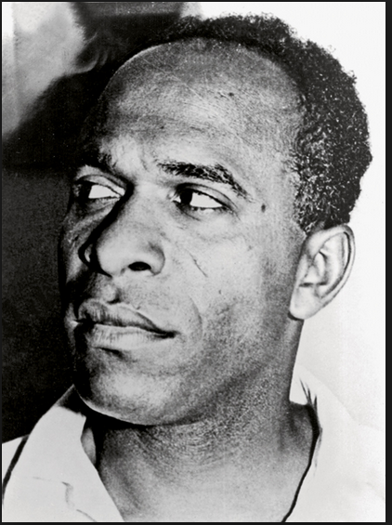
Franz Fanon 1925-1961 Black Skins/White Masks 1952 Wretched of the Earth 1961 ‘…violence is a cleansing force. It frees the native from his inferiority complex and from his despair and in action; it makes him fearless and restores his self respect.’

Slide 7
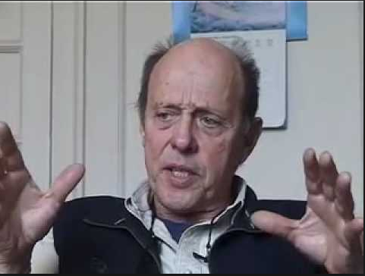
James Scott, Domination and the Arts of Resistance (1990)

Slide 8
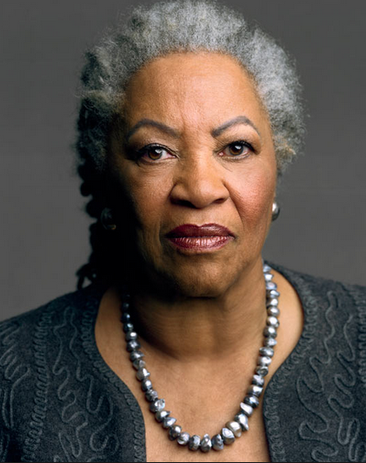
Toni Morrison, Beloved (1987)

Slide 9
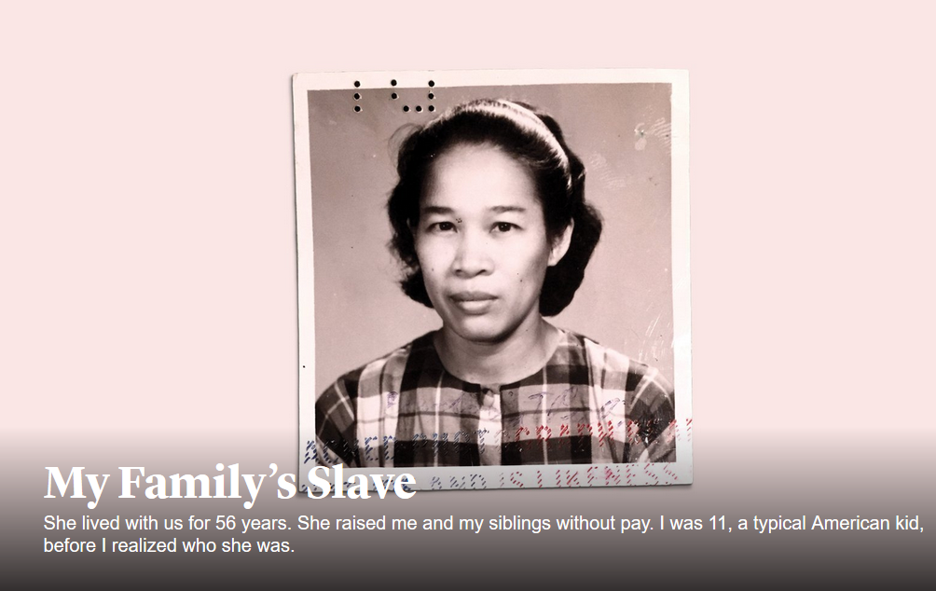

Slide 10
https://www.theatlantic.com/magazine/archive/2017/06/lolas-story/524490/

Slide 11
Formative assignment
Using the lectures and the primary texts you have been reading write 500 words answering one of the following two questions.
What is right or wrong about punishing people to exact retribution?
What do the descendants of the dominant class owe to the descendants of those whom their forebears oppressed and exploited?

