Slide 1



Black Narratives
Preface and Reading

Slide 2
The History of Mary Prince: -A West Indian Slave (1831)
Quobana Ottobah Cugoano: Thoughts and Sentiments on the Evils of Slavery (1787)
The Interesting Narrative of the life of Olaudah Equiano, or Gustavus Vassa, the African (1789)
Letters of the Late Ignatius Sancho, an Arican (1782)

Slide 3
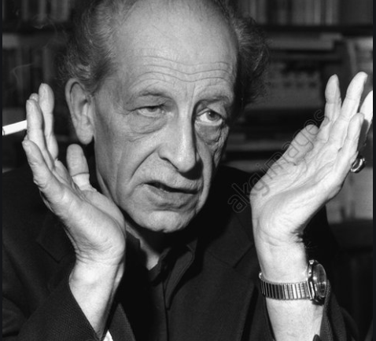
Jean Amery
At the Minds Limits: contemplations by a survivor on Auschwitz and its realities (reissue 1977)
Ch 4 Resentments
See also
J. Stauffer, Ethical Loneliness (ch 4 Revision)
Nietzsche, Beyond Good and Evil

Slide 4
Resentment - and History
Against the perpetrator
Should we want revenge?
Against those who want to move on
What is the responsibility of the present in relation to the past?

Slide 5
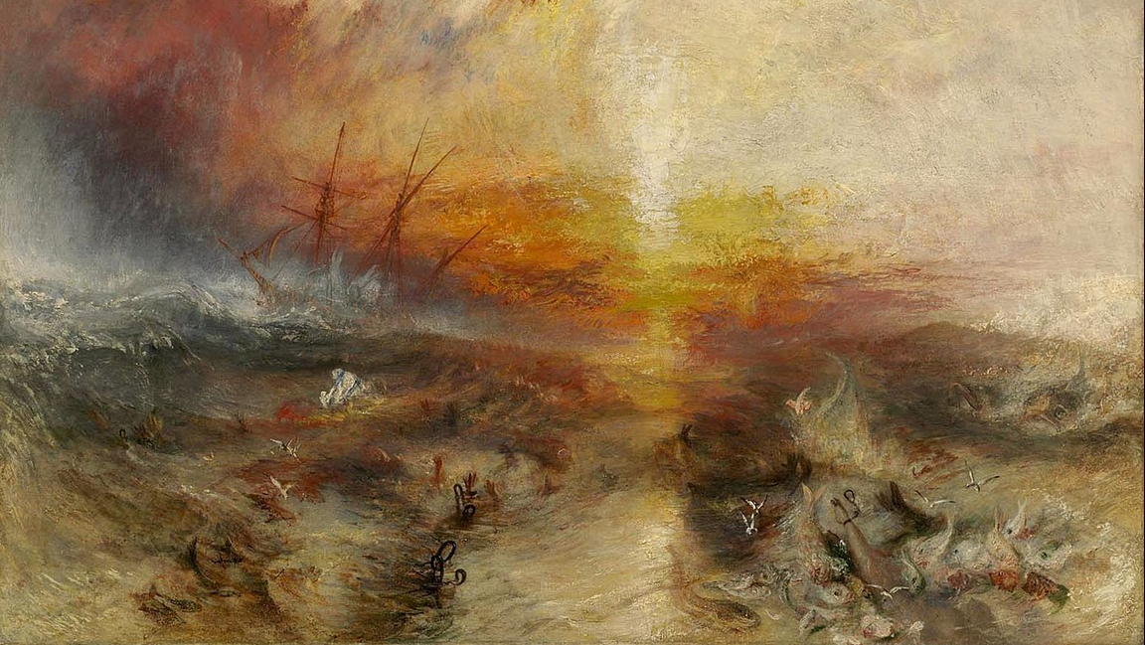
responsibility to and ownership of the past

Slide 6
Saidiya Hartman
Venus in Two Acts
On what we can and cannot know/say about the slaves’ experience.
Captain Kimber
See Nicholas Rogers, Murder on the Middle Passage: The Trial of Captain Kimber (2020) (177—186 on the Hartman’s account).

