Slide 1


History Research Project
Footnotes, bibliographies and professional polish
Susan carruthers

Slide 2
Why are historians so hung up on footnotes?
Footnotes serve several important functions:
1) They let you acknowledge your indebtedness to earlier scholars/writers whose work has influenced your own knowledge and understanding of the topic
2) Likewise, they enable you to provide full information about primary sources you’ve consulted and where you found them
3) ”Proper” footnotes ensure that anyone reading your work who wants to consult a source you looked at for themselves can do so readily– which is why it’s so important that you provide as much specific information as possible, including precise page number(s)
4) Footnotes show your readers how you researched the topic and who/what shaped your thinking. The absence of notes, or inadequate references, indicates poor academic practice, and possibly plagiarism.

Slide 3
When/what do you need to footnote?
If you directly quote, no matter how briefly, from a source, you (obviously!) need a footnote, providing full information about where this quotation comes from.
BUT: footnotes aren’t required ONLY when you import language verbatim– i.e. in quotation marks-- from another author or primary source
If you’re summarizing or paraphrasing another author’s argument, you need to cite their work in a footnote
You should also provide references to authors/sources that have shaped your thinking about the topic more broadly

Slide 4
Are there times when NO footnote is required?
The basic rule of thumb is that if you refer to a well-documented historical event-- simply reiterating the fact that X happened rather than offering any interpretation of it-- you do NOT need a footnote.
Eg. ”In March 1933, Franklin Delano Roosevelt was inaugurated as President of the United States.”
This is a matter of historical record. FDR’s inauguration indisputably occurred on this date. No one claims otherwise. So, you don’t need to cite a source for straightforward information that could be found in any reference work.
But if you were to make some additional interpretive claim about FDR– say, that he was the “most popular US president to date”– you would need a footnote to provide corroborative evidence. (“Popular” as gauged how? By whom? Who says so??)

Slide 5
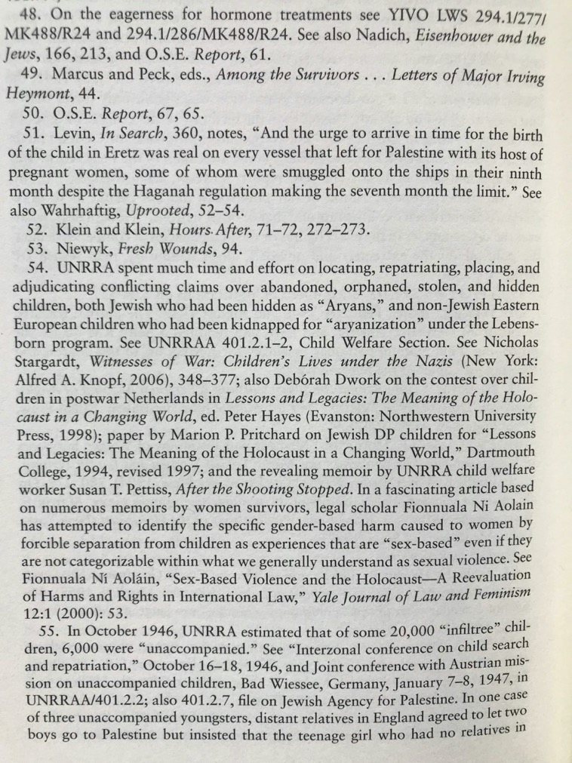
Avoid discursive footnotes
Atina Grossmann, Jews, Germans and Allies: Close Encounters in Occupied Germany (Princeton University Press, 2007), 336.

Slide 6
Don’t use footnotes to circumvent the word limit!

Slide 7
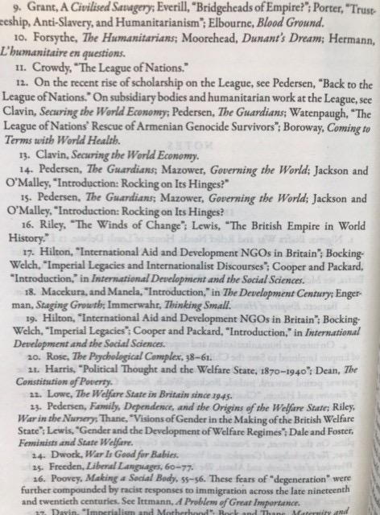
Footnote style fundamentals
Insert a superscript numeral at the END of a sentence-- after the full stop– even if a quoted phrase concludes earlier in the sentence.
A single footnote can contain citations to more than one source– just be sure that the note clarifies which citation refers to what part of your sentence/paragraph. (Look at n.12 here.)
Notes that reference more than one source make the text more user-friendly and less cluttered than a text in which almost every sentence ends with a note.
You should never put two superscript numerals next to one another at the end of the same sentence. This just isn’t done– except in Wikipedia entries!!

Slide 8
MHRA style http://www.mhra.org.uk/pdf/MHRA-Style-Guide-3rd-Edn.pdf
BOOKS
Tom McArthur, Worlds of Reference: Lexicography, Learning and Language from the Clay Tablet to the Computer (Cambridge: Cambridge University Press, 1986), p. 59.
Jean Starobinski, Montaigne in Motion, trans. by Arthur Goldhammer (Chicago: University of Chicago Press, 1986), p. 174.
CHAPTERS OR ARTICLES IN BOOKS
Martin Elsky, ‘Words, Things, and Names: Jonson’s Poetry and Philosophical Grammar’, in Classic and Cavalier: Essays on Jonson and the Sons of Ben, ed. by Claude J. Summers and Ted-Larry Pebworth (Pittsburgh: University of Pittsburgh Press, 1982), pp. 31–55 (p. 41).

Slide 9
Articles in journals and online publications
Richard Hillyer, ‘In More than Name Only: Jonson’s “To Sir Horace Vere”’, MLR, 85 (1990), 1-11.
Robert F. Cook, ‘Baudouin de Sebourc: un poème édifiant?’, Olifant, 14 (1989), 115–35 (pp. 118–19).
NB: the abbreviation p. denotes a single page; pp. denotes a run of pages.
It’s important to identify the specific page– or pages– from which a quotation comes (or a longer passage referenced by the note) unless you wish to indicate that the whole essay has been influential in shaping your approach.
ONLINE PUBLICATIONS
11.2.12 Els Jongeneel, ‘Art and Divine Order in the Divina Commedia’, Literature and Theology, 21 (2007), 131–45 <http://dx.doi.org/10.1093/ litthe/frm008>
NB: simply pasting a link to a webpage into a footnote is not a proper citation!!

Slide 10
Second and subsequent references
In all references to a book or article after the first, the shortest intelligible form should be used. This will normally be the author’s name, or a short-title reference if appropriate, followed by the volume (if applicable) and page reference:
McArthur, p. 62; Elsky, pp. 42–46 (p. 43); Dictionary of the Middle Ages, vi (1985), 26.
It may be necessary, for example when more than one work by an author has been cited, to repeat a title, in a shortened form:
McArthur, Worlds of Reference, p. 9.

Slide 11
Bibliographies

Slide 12
Basic principles
Use sub-headings to organize
Begin by grouping primary sources together
List secondary sources after primary sources
Alphabetize by author’s surname
Note that MHRA style has a different format for bibliographic entries than for footnotes

Slide 13
Formatting bibliographic entries
An author’s surname precedes their first name– unlike in a footnote.
Do not reverse the normal order for collaborating authors or editors other than the first quoted.
Chadwick, H. Munro, and N. Kershaw Chadwick, The Growth of Literature, 3 vols (Cambridge: Cambridge University Press, 1932–40; repr. 1986)
Cook, Robert F., ‘Baudouin de Sebourc: un poème édifiant?’, Olifant, 14 (1989), 115–35
NB: unlike footnotes, bibliographic entries have no period at the end.

Slide 14
Professional polish
Allow
Allow yourself plenty of time to go back and re-read your essay
Aim
Ideally, aim to finish writing your research project a few days before the deadline
Give
Give yourself a break from the essay so that you approach again with fresher eyes when you review it
Think about
Think about arranging with a friend on the module to proof-read their work and vice versa
Look out
Look out not only for typos and mistakes but also awkwardly phrased sentences
Check
Check that you’ve footnoted everything that needs a citation and that your notes are properly formatted

Slide 15
Final reminders
Submitting a polished piece of work indicates both that you take your own work seriously but also that you respect your readers– and don’t want to present them with something that looks hasty and typo-littered
Double-space your work. This is not only the “industry standard” in academia, but it’s much kinder on your readers– and markers!
If in any doubt about good academic practice, do be sure to consult your seminar instructor (and/or me). We’re here to help.
Have fun with writing your project. We look forward to seeing the end results of your research process!

