Slide 1
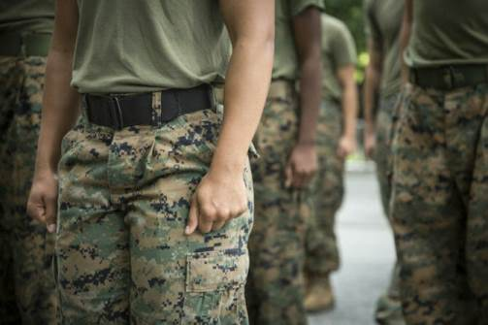
Sex and the US Military:
From Cold War to the ‘War on Terror’
Prof. Susan Carruthers (FAB 3.76)

Slide 2
Foundational claims
Being at war and/or projecting ‘peacetime’ military strength have been key preoccupations of the US in the c20th and 21st
How the military functions institutionally tells a lot about US society– its values, its self-image, its inequities and tensions-- though the armed forces don’t precisely mirror civil society
The ‘right to serve’ as a litmus test of citizenship status/civil rights
How US armed forces operate overseas reveals a good deal about the character of US power– and the (often asymmetric) nature of interactions between Americans and other nationals
Issues around gender/sex/sexuality have been especially challenging and controversial for the US military– a site of ongoing contestation within the armed forces and between the military and civil society
The ‘culture wars’ have been waged with particular intensity within– and around– the US military
Progressive ‘victories’ not irreversible

Slide 3
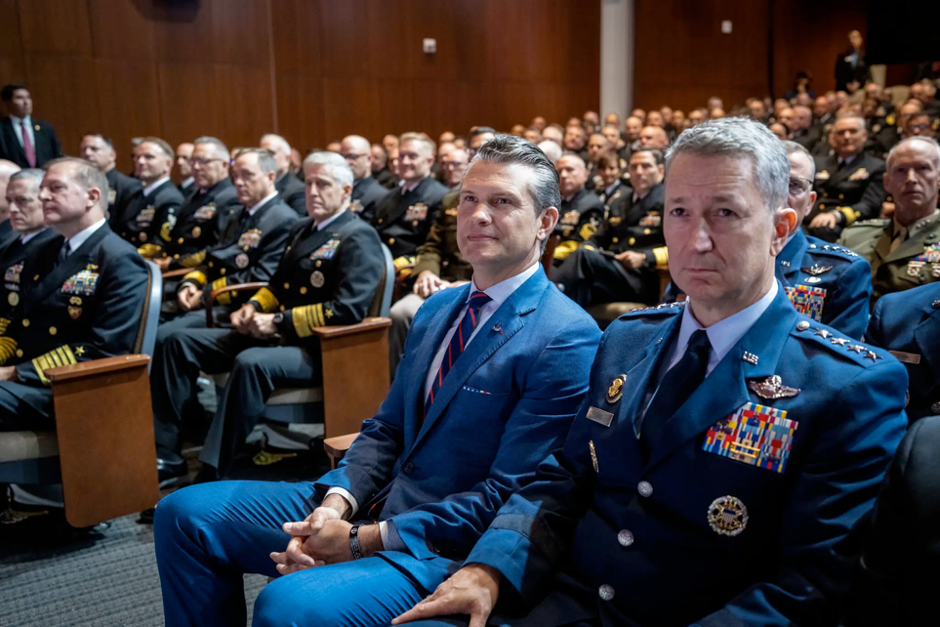
‘A Novice Defense Secretary Lectures the Brass on What It Takes to Win’
‘In his 2024 book, “The War on Warriors,” Mr. Hegseth maintained that women were not mentally suited to combat roles. “Women bring life into the world,” he wrote. “Their role in war is to make it a less deathly experience.”
In his speech to the generals, Mr. Hegseth struck a slightly different tone, arguing that the military had improperly loosened standards to accommodate women who may not be as able to carry a rucksack or lift a casualty on the battlefield.
“War does not care if you’re a man or a woman,” Mr. Hegseth said. “Neither does the enemy.”
But he insisted that he did not want to prevent women from serving in combat roles. Rather, Mr. Hegseth said, he wanted to hold them to the “highest male standard.”
“If that means no women qualify for some combat jobs, so be it,” he added.’
Greg Jaffe,
New York Times, 30 Sept. 2025
‘Defense Secretary Pete Hegseth’s vision of the military and what it should be was almost entirely defined by his 12 months of service in Iraq and his experience as a major in the Army National Guard’. Credit...Doug Mills/The New York Times
https://www.nytimes.com/2025/09/30/us/politics/hegseth-military-officers.html

Slide 4
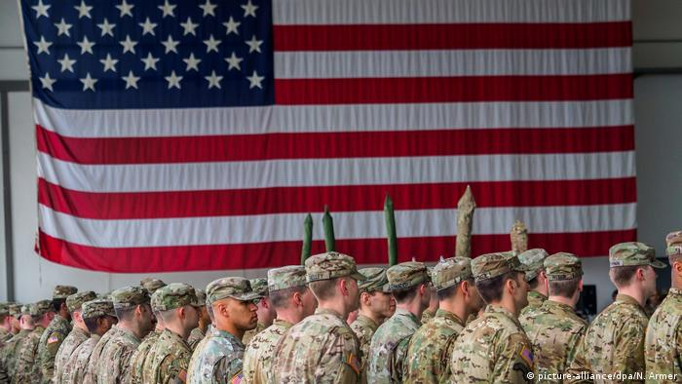
About the US military

Slide 5
US war-making since 1945
Sept. 1945: World War II officially concluded with Japan’s surrender (approx. 16m American men and around 400,000 women served in uniform)
US forces continued to occupy parts of Germany, Austria, Italy, Japan & Korea for varying periods into the early 1950s
US bases remained (and still remain) in many locations– including the UK
1948-89: ‘Cold war’ under way with USSR (and PRC after 1949)
1950-53: Korean war
1955(?)-75: Vietnam war (approx. 2.7m Americans serve)
1990-91: Persian Gulf war
Oct. 2001 - 2021: ‘Operation Enduring Freedom’ (Afghanistan)
March 2003 - 2011 : ‘Operation Iraqi Freedom’ (aka the ‘forever wars’)
NB: This list doesn’t include numerous overseas actions; ‘humanitarian interventions’ and deployments in national and regional conflicts

Slide 6
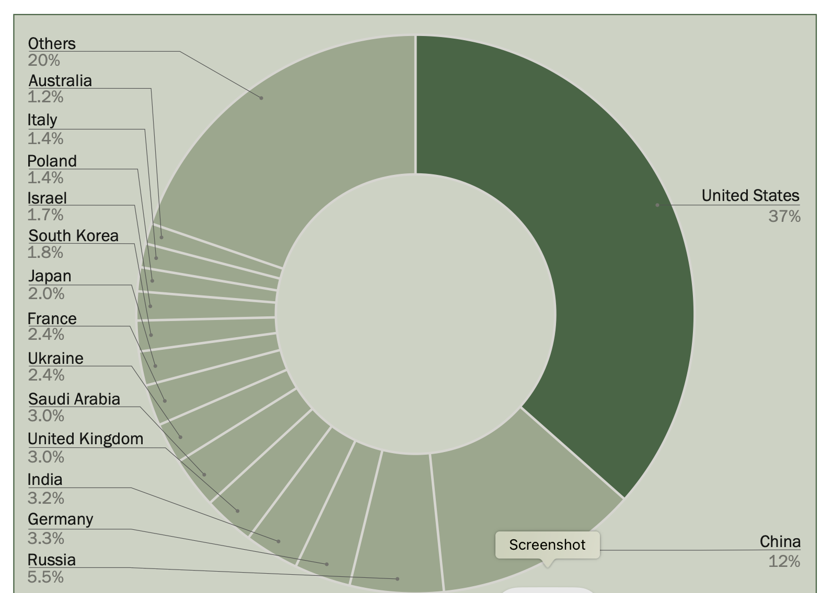
The share of world military expenditure of the 15 countries with the highest spending in 2024
Source: SIPRI Military Expenditure Database, Apr. 2025.
Stockholm International
Peace Research Institute
https://www.sipri.org/sites/default/files/2025-04/2504_fs_milex_2024.pdf

Slide 7
‘From October 2001 through September 2020, U.S. taxpayers paid $6.4 trillion to the federal government that went to wars in Afghanistan, Iraq, Syria, and Pakistan. In the post-9/11 years through 2022, the Department of Defense also received an $884 billion increase to its baseline budget.
In 2022, the U.S. spent $877 billion on its military – the most of any country, and more than China, Russia, India, Saudi Arabia, the U.K., Germany, France, South Korea, Japan, and Ukraine combined. This figure includes $19.9 billion in military aid to Ukraine, according to the report.
The U.S. spends $2,169 on the military per person, according to NATO data. In total, the U.S. spends about 12% of all its spending on the military, compared to China’s 4.79%.’
From the Chicago Council on Global Affairs: https://globalaffairs.org/commentary/blogs/us-sending-more-troops-middle-east-where-world-are-us-military-deployed#:~:text=Where%20are%20US%20Military%20Stationed,military%20expansion%20–%20to%20contain%20communism.

Slide 8
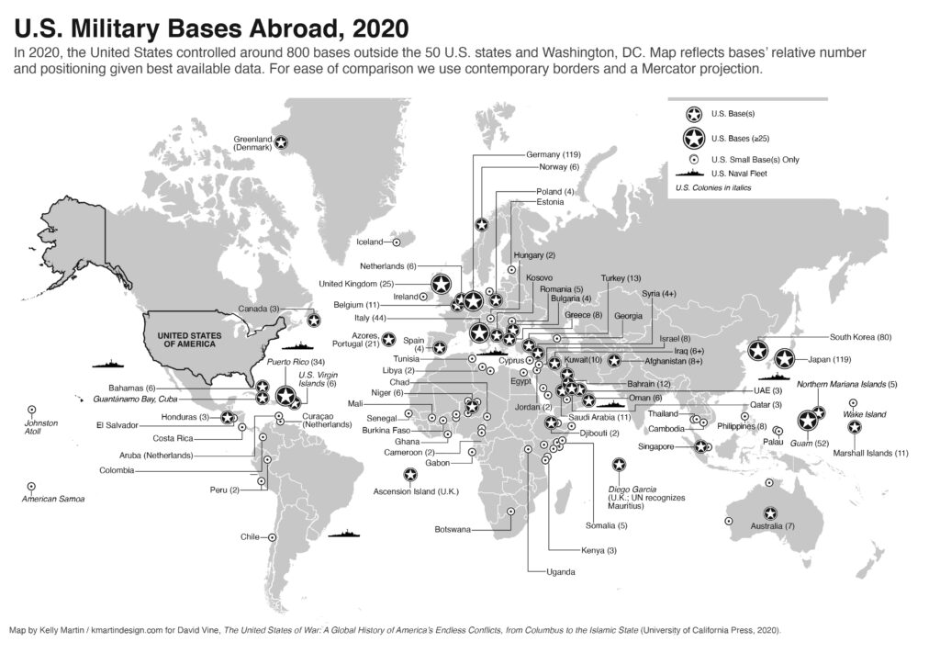
There are around 750 U.S. military bases in at least 80 countries,
according to
publicly
accessible sources
https://quincyinst.org/report/drawdown-improving-u-s-and-global-security-through-military-base-closures-abroad/

Slide 9
Key changes in the US military since 1945
NB: ‘the Military’ = the US Army, the US Marine Corps, the US Air Force (founded 1947), the US Navy, the US Coast Guard, and the reserve services
1948: Truman ordered racial desegregation of the armed forces.
Women’s forces integrated into permanent structures of the US military– but capped at 2%.
1973: All-Volunteer Forces introduced– a signal shift away from reliance on the draft. But who was eligible to serve hinged on various criteria including IQ scores, physical fitness, criminal background, gender identity and sexuality
American men– not women-- aged 18+ still must register for ‘Selective Service’
The share of the U.S. population with military experience is declining. In 2018, about 7% of U.S. adults were veterans, down from 18% in 1980.
Over the past half-century, the number of people on active duty has dropped significantly, from 3.5 million in 1968, during the military draft era, to about 1.4 million (or less than 1% of all U.S. adults) in today’s all-volunteer force.
https://www.pewresearch.org/short-reads/2021/04/05/the-changing-face-of-americas-veteran-population/

Slide 10
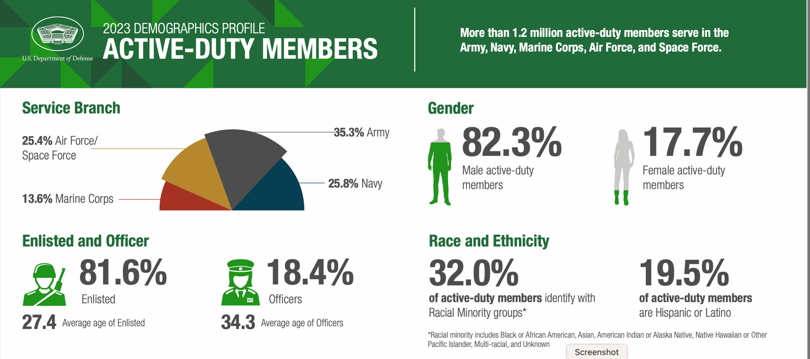
Military demographics

Slide 11
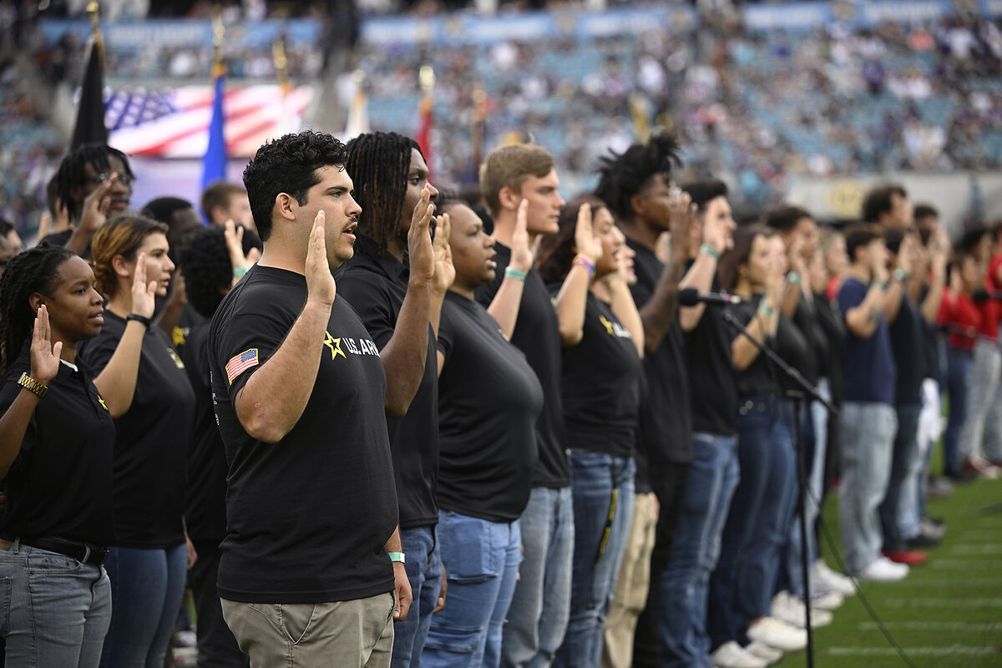
A recent
“Trump Bump”
in military
recruitment?
New recruits take the oath of office at a swearing in ceremony during an NFL football game, Jacksonville, Florida, 10 Nov. 2024
https://www.csmonitor.com/USA/Military/2025/0811/military-recruiting-trump-defense

Slide 12
How and why does sex matter so much in, and to, the US military?
And what variety of things does “sex” denote?

Slide 13
Sex and gender
Biological determinism– or essentialism-- a fixed point in much military thinking: ie the proposition men and women possess distinct physical attributes and corresponding psychological traits– hinging around a binary distinct between male strength and female weakness
Military service– combat in particular– was long regarded as a MALE endeavour, or even THE preeminent test of masculinity
When military/civil leaders invoke sex, they tap into a reservoir of gendered assumptions often presented as incontrovertible biological fact
‘Gender’ as a social construction– a script for performing ‘maleness’ and ‘femaleness’ widely (though not exclusively) shared by members of a society; an invisible ‘commonsense’ that changes over time and norms contested at any given moment

Slide 14
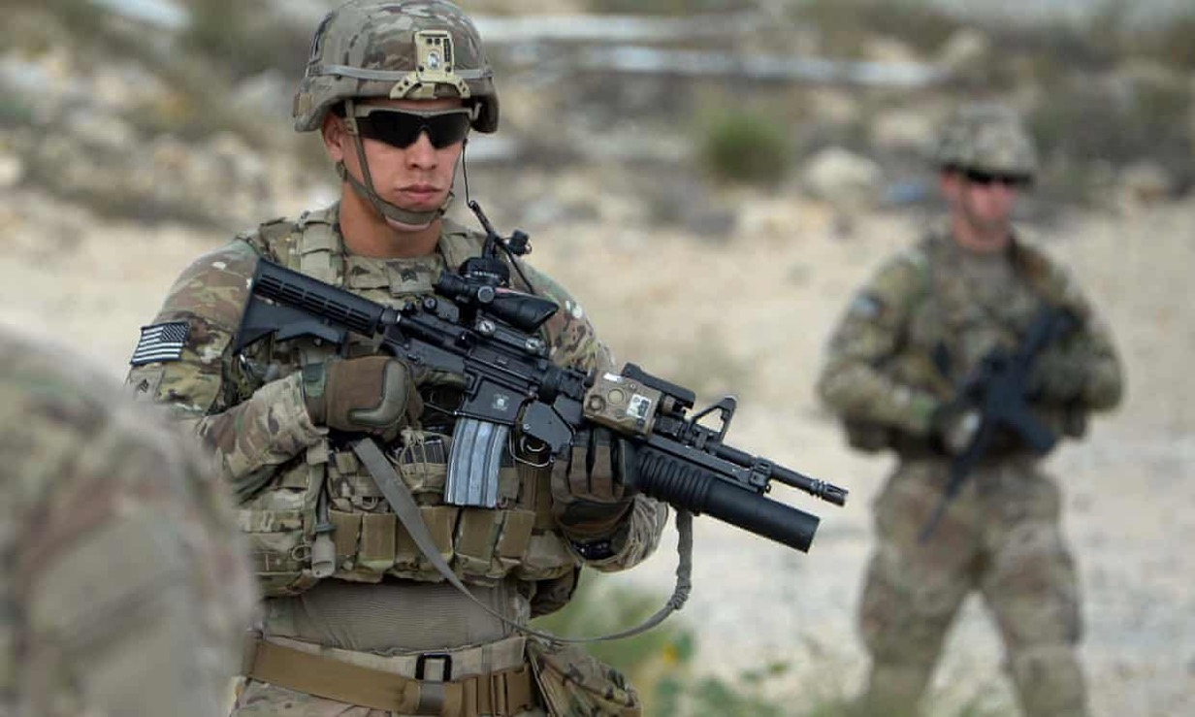
Envisioning ‘the soldier’: martial masculinity
Core attributes?
Physical strength
Toughness
Aggression
“Killer instinct”
Courage
Level-headedness
Technical prowess
Resilience
Photograph: Noorullah Shirzada/AFP/Getty Image (2016)

Slide 15
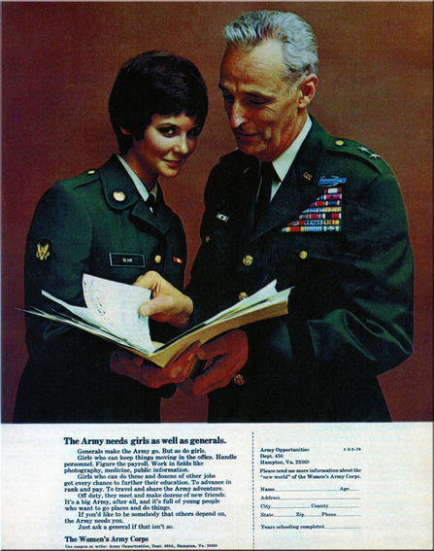

Enlisting gender: 1944; 1970; 2019
WAC recruitment ad, 1944

Slide 16
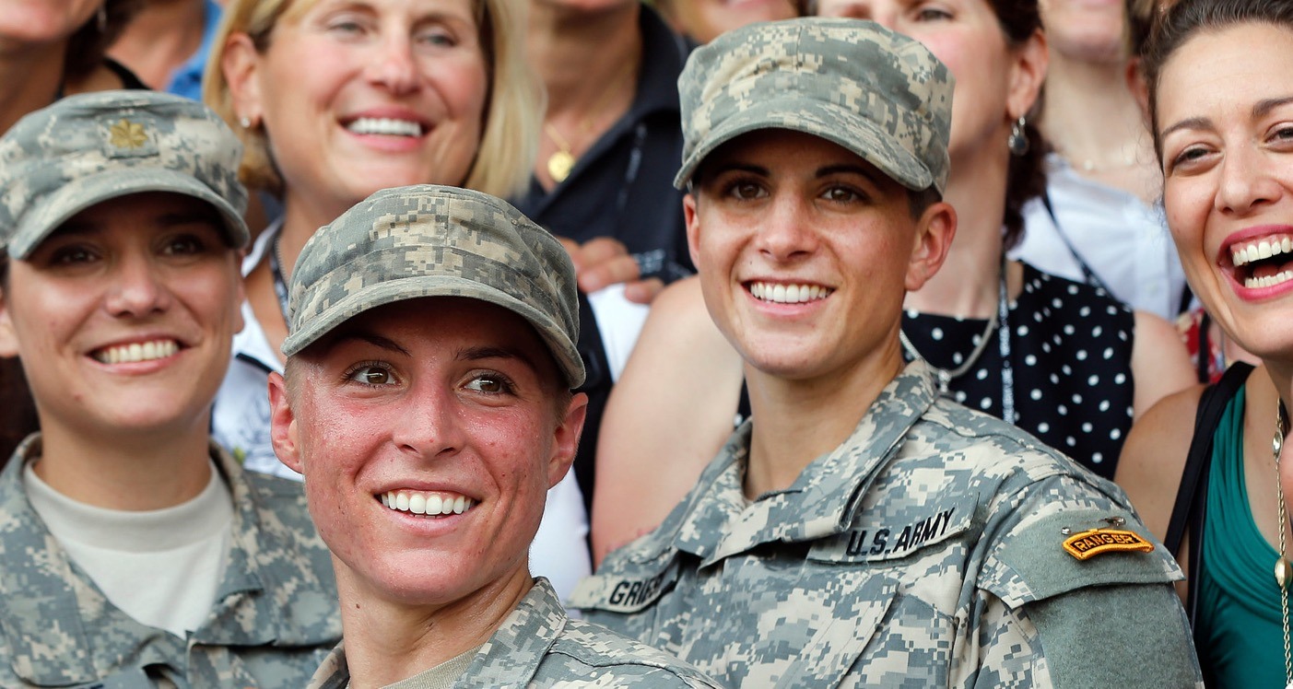
Women in combat
‘All Combat Roles Now Open to Women, Defense Secretary Says’
New York Times
Dec. 3, 2015
https://www.nytimes.com/2015/12/04/us/politics/combat-military-women-ash-carter.html
United States Army First Lt. Shaye Haver, center, and Capt. Kristen Griest, right, in August after becoming the first female graduates of the Army's demanding Ranger School.
Credit: John Bazemore/Associated Press

Slide 17
Transgender troops
Under Obama, from 2016 to 2017, transgender Americans were allowed to serve openly in the armed forces.
From 2018 to 2019, and again from 2021 to 2025 (the Biden era), they were allowed to serve and enlist openly.
From 2019 to 2021 (Trump’s 1st presidency), transgender individuals were banned from enlisting in and serving in the U.S. military, except under narrow exceptions.
Trump returned to the White House in January 2025 and swiftly announced a more far-reaching reimposition of his prior ban on trans military personnel.

Slide 18
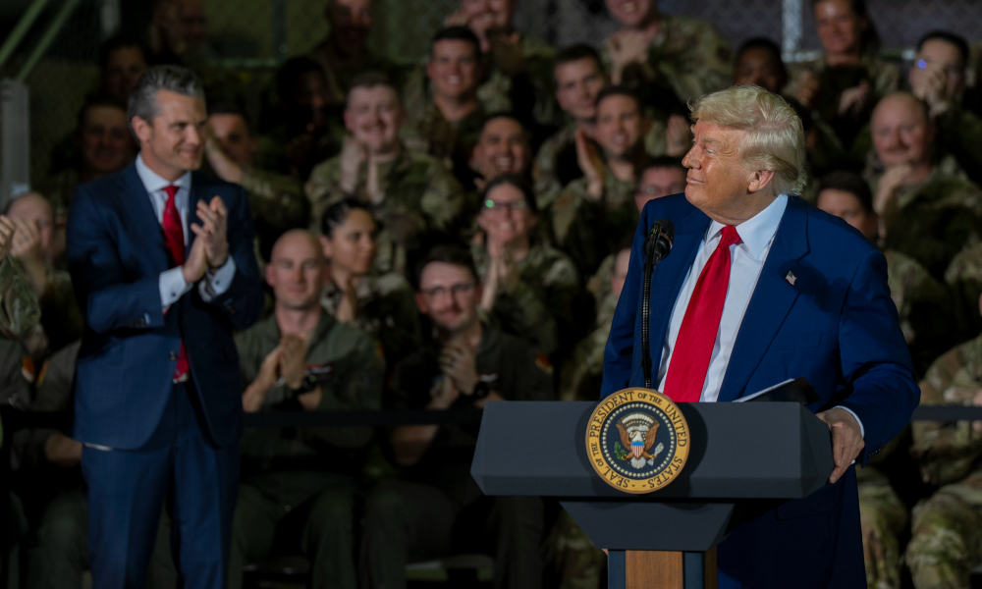
One week after his inauguration, President Trump issued an executive order misleadingly titled “Prioritizing Military Excellence and Readiness.” The order—which was initially blocked by two federal judges but reinstated in early May by the Supreme Court—asserts that “expressing a false ‘gender identity’ divergent from an individual’s sex cannot satisfy the rigorous standards necessary for military service.” Under the new policy, transgender soldiers with any diagnosis, history, or symptoms of gender dysphoria will be discharged.
Trump’s order offers three reasons why transgender people should be excluded from military service. It posits, first, that transgender soldiers undermine unit cohesion, which is argued to be an essential ingredient of military effectiveness; second, that transgender people are incapable of meeting the military’s rigorous standards and adversely affect readiness; and third, that transgender soldiers lack the honor and truthfulness needed to serve because they are living a lie.’
https://www.lawfaremedia.org/article/trump-s-misguided-war-on-transgender-troops

Slide 19
Sexuality & military service
For much of the c20th and into the c21st, the US military debarred openly LGBT Americans from serving, with shifting justifications for exclusion/discrimination (from ‘perversion’ to combat unit cohesion)
‘Homosexual personnel, irrespective of sex, should not be permitted to serve in any branch of the Armed Forces in any capacity, and prompt separation of known homosexuals from the Armed Forces is mandatory.’ Department of Defense (DOD aka the Pentagon), 1949
‘Homosexuality is incompatible with military service. The presence in the military environment of persons who engage in homosexual conduct or who, by their statements, demonstrate a propensity to engage in homosexual conduct, seriously impairs the accomplishment of the military mission.’ DOD, 1981

Slide 20
“Don’t ask, don’t tell, don’t pursue” [DADT]
Feb 1994: DADT introduced by the Clinton administration
2010: DADT repealed by Obama
Sept. 2011: DADT no longer in operation
Read more:
https://www.hrc.org/resources/the-repeal-of-dont-ask-dont-tell
Image from DIGNITY & RESPECT (2001), a U.S. Army training guide on the “homosexual conduct policy”.

Slide 21
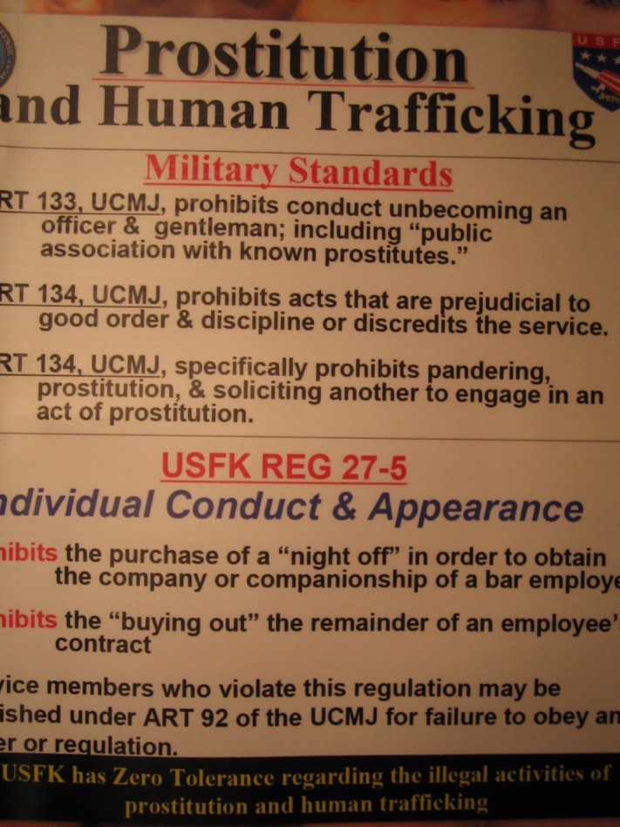
The military’s sex problems
Heterosexual intercourse as a male
prerogative– a reward or entitlement?
But sex with whom?
Spouses?
Partners of the same sex?
Commercial sex-workers?
Sex as a public health problem
Sex as a public relations problem
Sex as a command problem

Slide 22
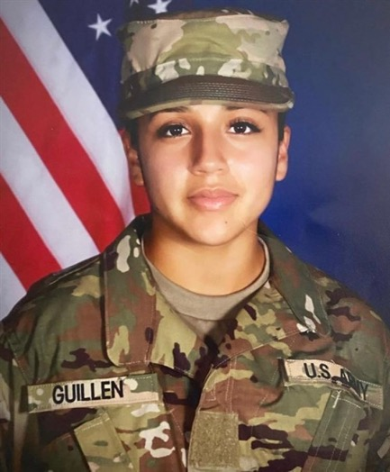
Sex/crime: the Uniform Code of
Military Justice (UCMJ)
same-sex intercourse (until repeal of DADT)
‘sodomy’
adultery (shifting definitions)
bigamy
‘pandering’
‘consorting with notorious prostitutes’
voyeurism
sexual assault/rape
Gen. David Petraeus with Paula Broadwell in July 2011
Army spc Vanessa Guillen,
murdered by a colleague
near Fort Hood, 2020
https://www.nytimes.com/2020/07/31/podcasts/the-daily/vanessa-guillen-military-metoo.html

Slide 23
Part 1: Hetero-normativity and the US military
Seminars
1) Defining the terms of engagement
2) Prostitution, rape and resistance to US militarism in Asia
3) Married in and to the military: 'war brides' and 'army wives'
Lectures
1) Why sex matters in the US military
2) The US military and commercial sex
3) Domestication: a 'family friendly' army?

Slide 24
Part 2: Gender, sex and soldiering
Lectures
4) Gender at war in Vietnam
5) Recruitment in the All-Volunteer era
6) Reading Week [no lecture]
7) Women in combat
Seminars
4) Women's work in Vietnam
5) Assignment writing workshop
6) Reading Week [no seminar]
7) The fight over fighting women in Iraq and Afghanistan

Slide 25
Part 3: Managing sexuality & gender identity in the US military
Lectures
8) The queerness of the military
9) Sexual violence:
an invisible war?
10) Transgender service
Seminars
8) DADT and its repeal
9) Rape and sexual violence within the US military
10) Conclusions?

