Slide 1
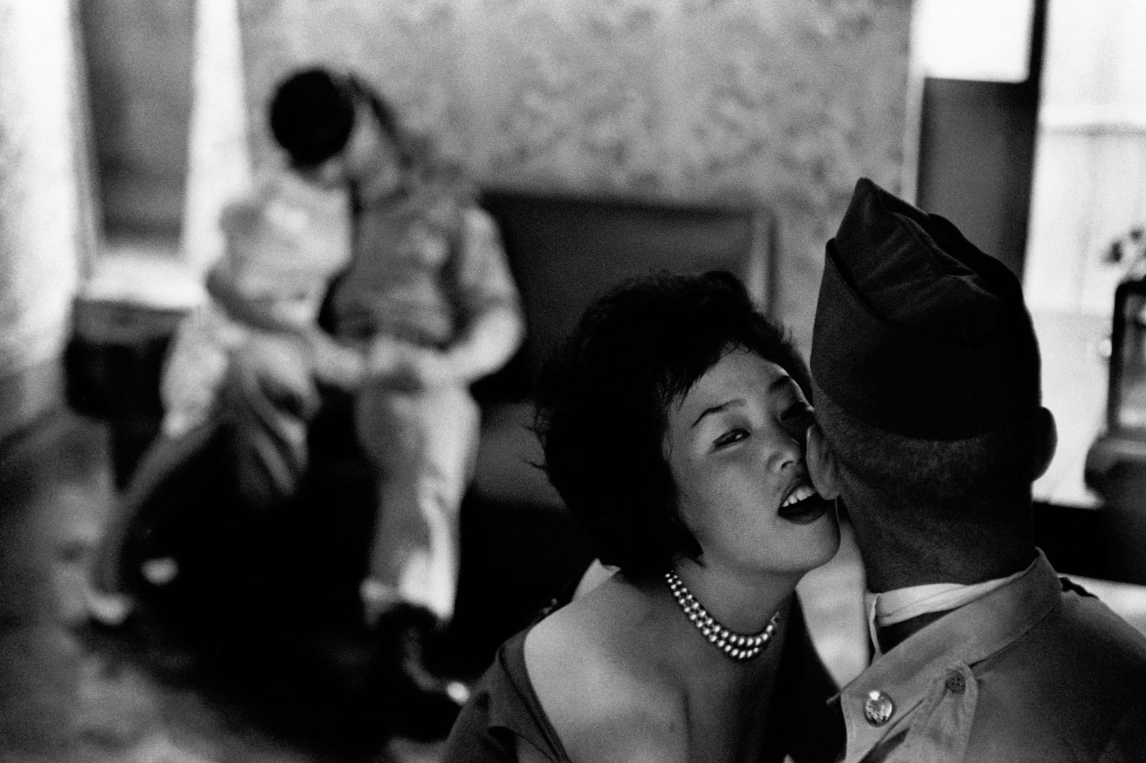
An entangled history
The US military and the commercial sex industry
HI2C6 Term 2, week 2
NB: This lecture deals with disturbing content, including discussion of rape & sexual violence
https://newrepublic.com/article/155707/united-states-military-prostitution-south-korea-monkey-house

Slide 2
Q: With whom should American servicemen have sex?
With women (until after the repeal of DADT in 2011
But which women?
Marriage often discouraged for young enlisted men– romantic intimacy as a costly distraction
So, then…. with whom??
NB: the question of with whom servicewomen should have sex was infrequently posed– other than that (before 2011) they should not be sleeping with other women
The ‘right to sex’ as a male prerogative (Amia Srinivasan)

Slide 3
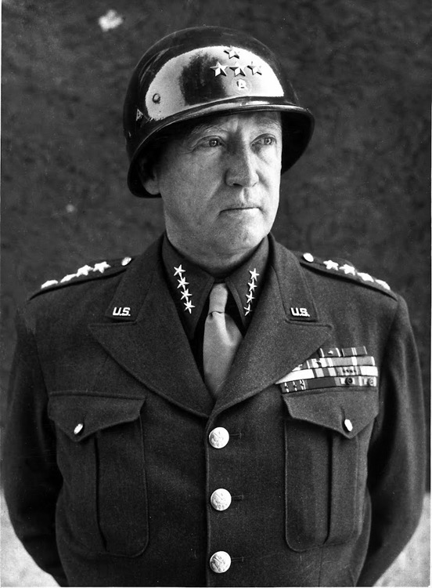
Male heterosexual prerogative— or imperative?
‘A soldier who won't f**k won't fight.’
Quote attributed to Gen. George S Patton(WWII)
The perceived nexus between esprit and libido
Red-blooded ‘virility’ and combat motivation
Sex not just a male expectation—but construed as a reward for soldiering
Patton in 1944

Slide 4
The Uniform Code of Military Justice (UCMJ, codified 1951, periodically updated) prohibits personnel from paying for, selling or arranging for the sale of, sex under Article 134, Pandering and Prostitution
Service personnel who are court-martialed and found guilty of Article 134 offences face steep penalties:
‘Service members convicted of prostitution and patronizing a prostitute face the maximum possible punishment of a dishonorable discharge, forfeiture of all pay and allowances, and confinement for one year.’
‘Service members convicted of pandering face the maximum possible punishment of a dishonorable discharge, forfeiture of all pay and allowances, and confinement for five years.’
Read more: https://www.mymilitarylawyers.com/ucmj-article-134-pandering-and-prostitution/

Slide 5
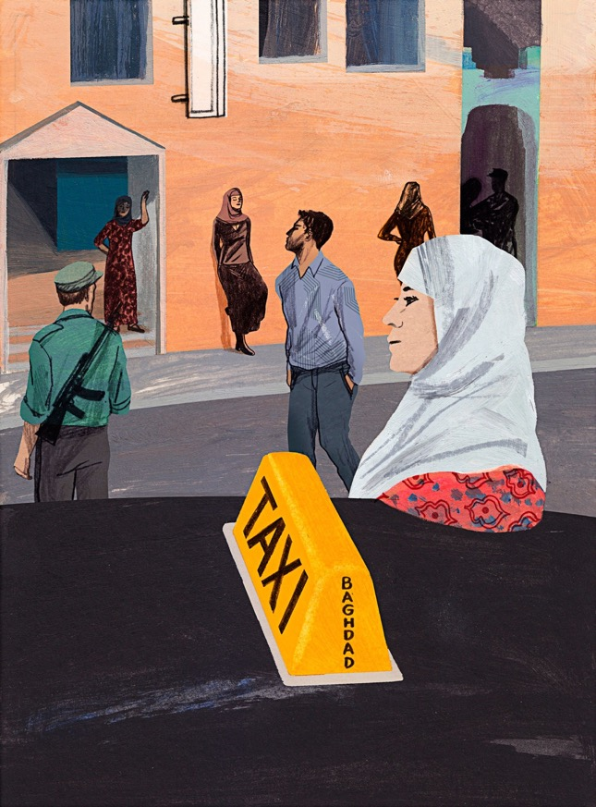
From 2004, the military attempted to crack down on ‘human trafficking’ and ‘sex trafficking’
“Military Fraud: Alcohol, Hookers Sent
to Iraq War Base Via U.S. Contractor,
Report Claims”
By Greg Price On 5/3/17 at 1:53 PM EDT Newsweek
‘U.S.-based security firm Sallyport Global has been accused by two former internal investigators of smuggling alcohol, stealing, keeping two different account ledgers and even human trafficking of prostitutes while executing an almost $700 million contract to protect Balad Air Base in Iraq, the Associated Press reported Wednesday.’
For an investigation of the sex trade and sex trafficking in Iraq in the New Yorker, https://www.newyorker.com/magazine/2015/10/05/out-of-sight-letter-from-baghdad-rania-abouzeid?verso=true

Slide 6
The pre-history of the US military’s postwar entanglement with commercial sex

Slide 7
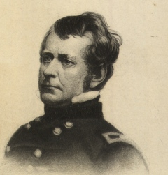
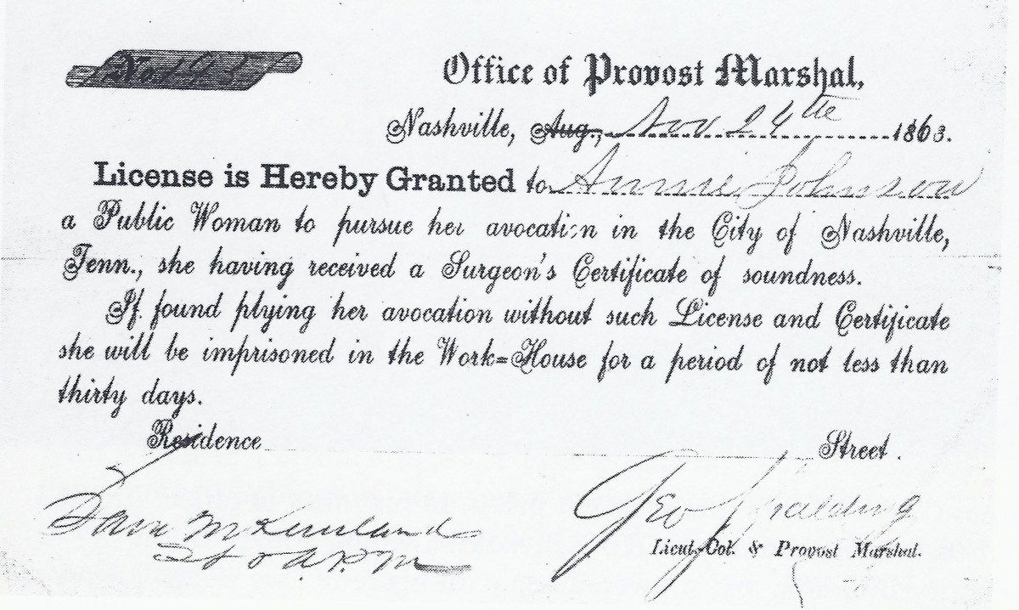
The US Civil War (1861-65)
Maj. Gen. Joseph ‘Fighting Joe’ Hooker– whose name became a widely used synonym for ‘sex worker’ or ‘prostitute’
COURTESY OF THE ARMY HERITAGE AND EDUCATION CENTER
https://www.stripes.com/blogs-archive/the-rumor-doctor/the-rumor-doctor-1.104348/do-hookers-owe-their-moniker-to-a-civil-war-general-1.142179#.Xhrp_-tb9E4
A license to protect a ‘public woman’ signed by George Spalding circa 1863. Courtesy of the US National Archives.
https://www.history.com/news/civil-war-prostitution-nashville
Watch a short PBS video about prostitution during the US Civil War:
https://www.pbs.org/video/the-dig-civil-war-prostitution-9y8b5c/

Slide 8
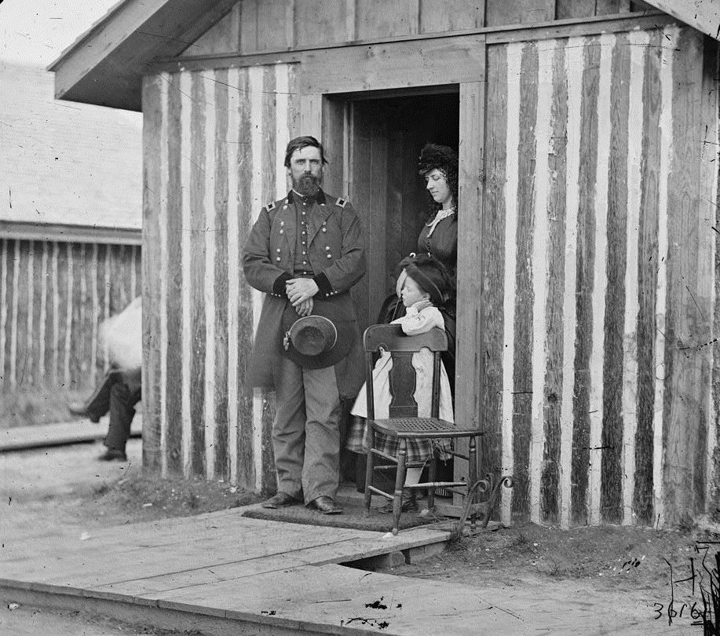
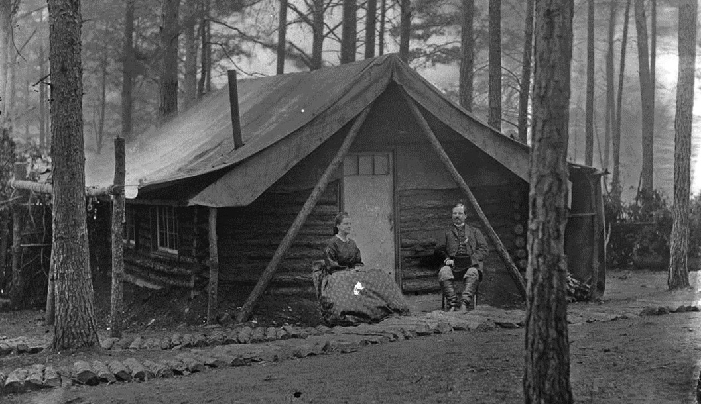
‘Camp followers’
Col. Cox and wife, Brandy Station
General and Mrs Rawlins with their daughter, City Point
https://civilwartalk.com/threads/the-real-camp-followers-officers-wives.121716/

Slide 9

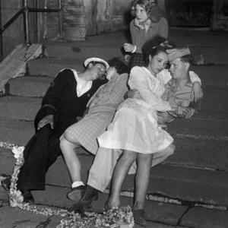
World War II and its aftermath
’Liberated’
women?
‘Newly released documents show that French complained in droves about American servicemen having sex in the streets.’
Charbonnier/Gamma-Rapho/Getty Images
‘one Army report… estimated 80 percent of single men and 50 percent of married [American] men would have sex during their stay in Europe.’
Mary Louise Roberts
https://www.npr.org/2013/05/31/187350487/sex-overseas-what-soldiers-do-complicates-wwii-history
https://nypost.com/2013/06/16/the-dark-side-of-d-day/

Slide 10
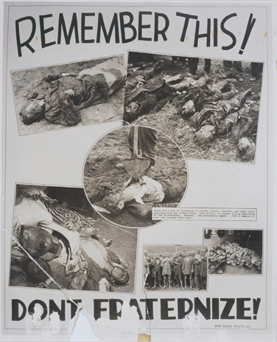
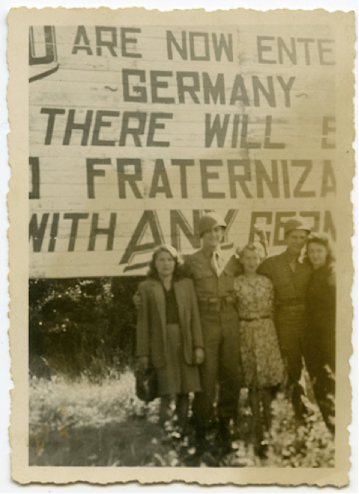
‘Non-fraternization’
Left: A 1945 US army
poster warns GIs not
to “fraternize,” using
images from newly
liberated Nazi camps
to underscore the point.
Credit: US Holocaust
Memorial Museum
Right: photo from an
GI’s scrapbook.
caption reads:
“Two buddies. Three girls.
Not bad.”
Credit: unknown

Slide 11
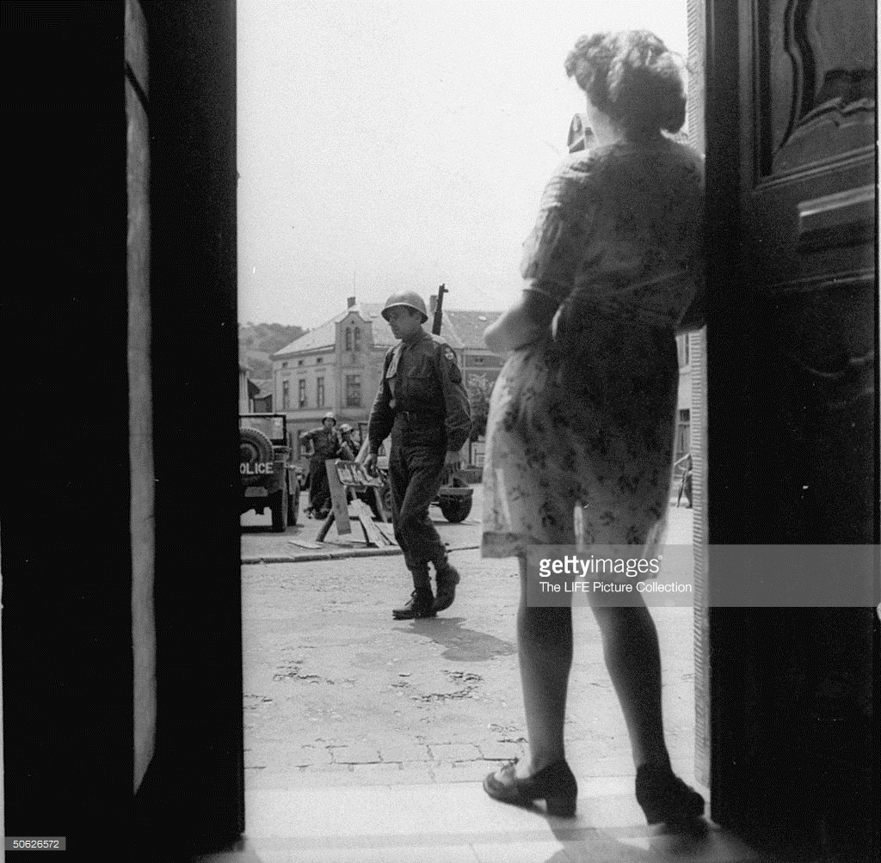
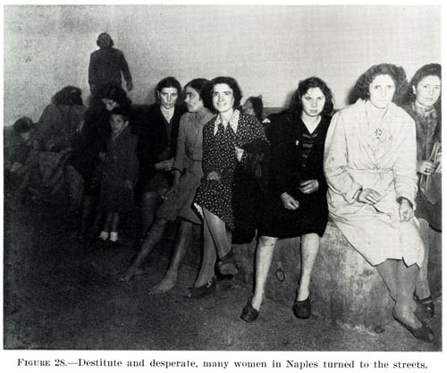
Italy and Germany
“Fraternization”– any social interaction with
German civilians-- which the military attempted
to ban in Germany in the spring/summer of
1945 became a major story in the US press.
The “F-” word became a euphemism.
Italy 1944 – Office of Medical History, U.S. Army Medical Department
https://bethelatwar.org/2014/08/14/letters-to-and-from-bethel-the-crash-of-ruin/

Slide 12
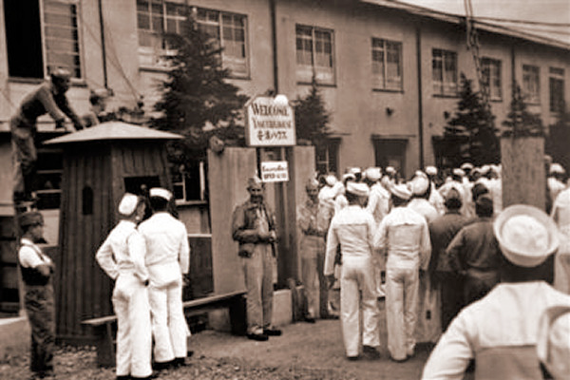
Postwar Japan
With Japanese government
backing, ‘Recreation and
Amusement Associations’ (RAA)
provided brothels for US
occupation troops in the early
months of Japan’s postwar
occupation.
The US Eighth Army initially
gave tacit consent to this
arrangement.
‘In this undated image released by the Yokosuka City Council in Japan, U.S. sailors gather in front of a
Yasu-ura House "comfort station" in Yokosuka, south
of Tokyo.’(AP Photo/Yokosuka City Council, HO)
http://navy.memorieshop.com/World-Ports/Japan/Comfort-Women.html

Slide 13
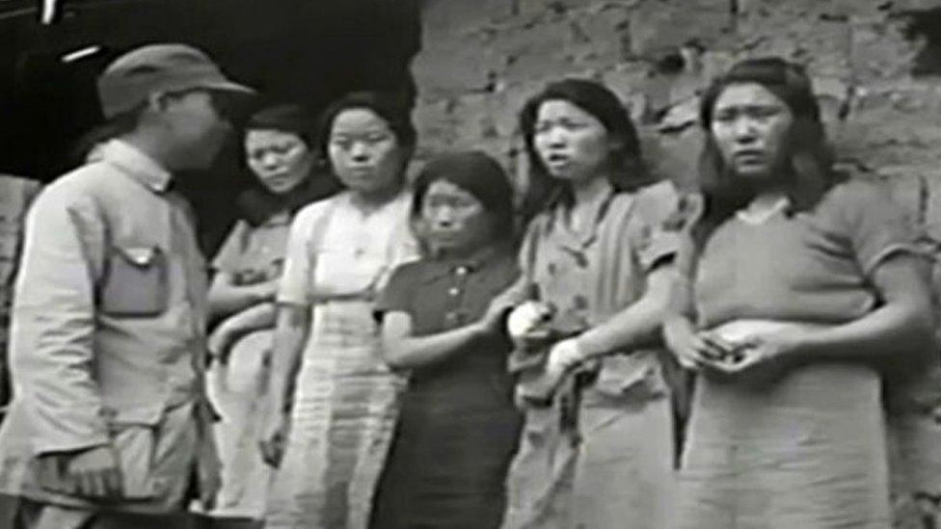
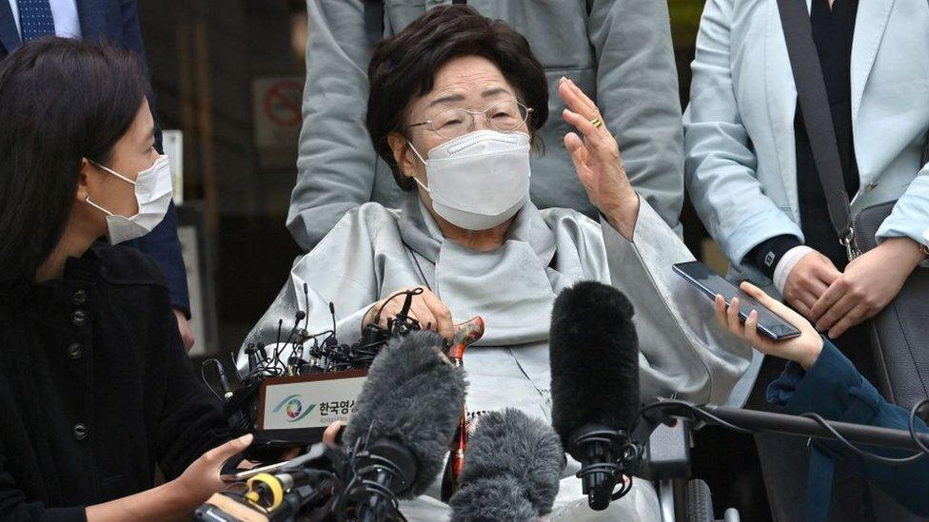
‘Comfort women’
It's estimated that more than 200,000 Asian women and girls were forced into prostitution to serve Japanese soldiers in WWII.
Many of those kept in military brothels were Korean, others were from mainland China, the Philippines, Indonesia and Taiwan.
Over many subsequent decades, survivors have fought for redress, winning significant legal victories.
Korean women and girls lined up against a wall with a Japanese soldier looking at them
Read the story:
https://www.bbc.co.uk/news/world-asia-67512578
Lee Yong-soo leaves the Seoul Central District Court in Seoul on April 21, 2021

Slide 14
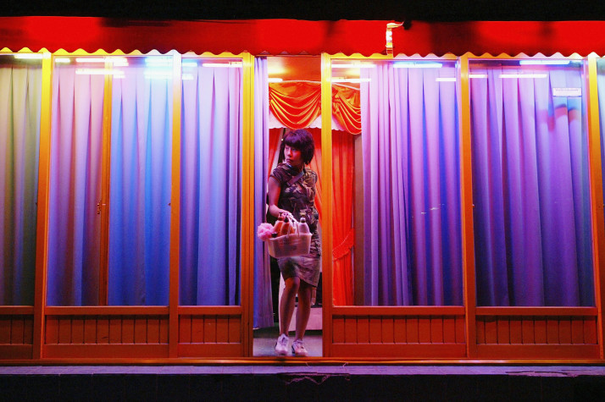
South Korea: 1945 -
A South Korean sex worker leaves her shop in Seoul. [Getty]
https://www.politico.eu/article/my-body-was-not-mine-but-the-u-s-militarys/
Right: Soldier posing with two women at a Korean brothel (1952)
https://cdm15730.contentdm.oclc.org/digital/collection/p15730coll5/id/1550

Slide 15
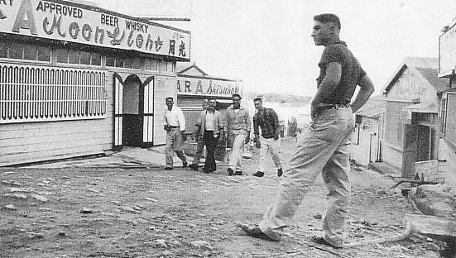
Okinawa: an intensely militarized/ sexualized island
Watch a British Granada TV report on growing local opposition to the US presence in Okinawa during the Vietnam war:
https://www.youtube.com/watch?v=5Sg_lNxePXU
Koza Yaejima Street(Red-light district) circa 1955. “Maps of new home: Vol.3,” Okinawa Times.(Licensed under Public Domain via Commons.)
https://notchesblog.com/2015/11/17/rape-and-the-sexual-politics-of-homosociality-the-us-military-occupation-of-okinawa-1955-56/

Slide 16
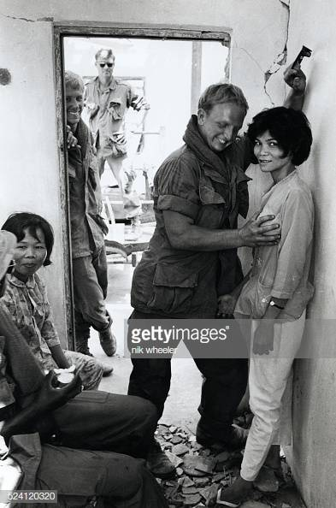
The Vietnam War:
R&R
“Troops in Vietnam got to take a few days off from the war during their one-year tour of duty. They were allowed a week of R&R, rest and recuperation, outside of Vietnam. They could choose from a list of approved destinations that included Hawaii, Australia, Japan, Taiwan, the Philippines, Malaysia, Hong Kong, Singapore and Thailand. They were also eligible for shorter breaks, usually three days, inside Vietnam.”
https://www.historynet.com/rr-on-the-beaches-of-south-vietnam-2.htm
“American soldiers play with Vietnamese prostitutes in ruins of bombed village during an operation outside Saigon during the Vietnam War in South Vietnam in the late 1960s.”

Slide 17




Why has the military tacitly (or more actively) condoned servicemen’s purchase of sex?

Slide 18
The alternative: abstinence campaigns
The US military has made periodic attempts to promote sexual abstinence/chastity
Sometimes the impetus came from civilian society to ‘clean up’ military bases and the areas around them in the domestic US; e.g. the May Act of 1941
Character Guidance programs in the armed forces have also promoted messages stressing the importance of abstinence; e.g. the Duty, Honor, Country pamphlets first issued in 1952 by the Army and Air Force
Preserving the military’s ‘moral character’
Shifting social attitudes towards sex
Role of religious precepts– particularly Christianity– in shaping military conceptions of morality

Slide 19
‘Masturbation is
unhealthy because it
can train a person to “fly solo”…‘
New York Times
Oct. 30, 2005,
p. C14

Slide 20

Military sex ed as infection-prevention
Brothels as more easily regulated sites of sexual encounter
than ‘informal’ interactions
In WWII, the US military pioneered the use of penicillin in treating STIs, as well as establishing ‘Pro-Stations’ [Pro for Prophylaxis].
The emphasis was primarily on preserving men’s health and hence their operational efficiency.
The military was not so concerned with the health & wellbeing of the women GIs slept with; nor with preventing unplanned pregnancies.
https://www.theatlantic.com/magazine/archive/2015/04/very-short-book-excerpt-prophylaxis-vs-the-axis/386258/

Slide 21
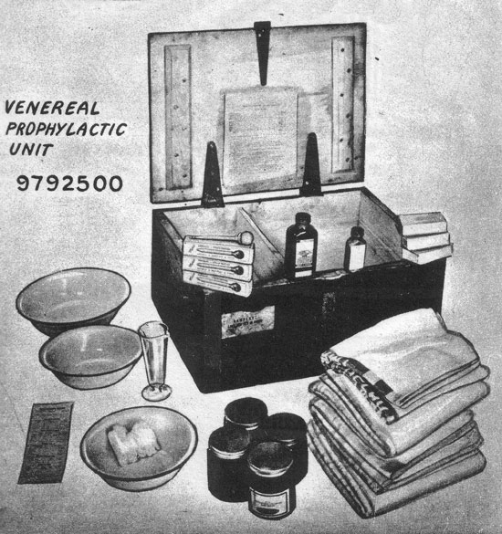
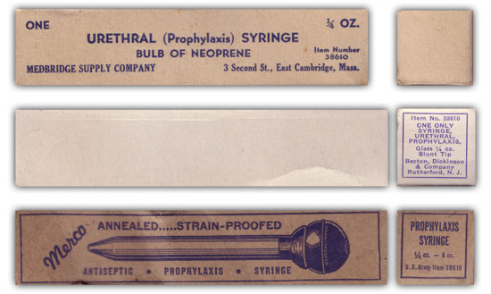
Illustration showing three variations of Prophylaxis (or Urethral) Syringes in use by the US Army during WW2.
Read more on WWII military sex education:
https://www.med-dept.com/articles/venereal-disease-and-treatment-during-ww2/

Slide 22
‘Containment’
Prostitution perceived by the military as an outlet for male sexual desire likely to reduce (if not eliminate altogether) rape and sexual violence perpetrated by US personnel– the ‘floodwall’ or ‘buffer’ thesis
Regulated commercial sex work would (military authorities imagined) clarify the distinction between ‘good girls’ and ‘bad’, turning the latter into an expendable underclass
Restricting sex to licensed and controlled ‘entertainment districts’ would supposedly help insulate ‘respectable’ local communities from the problems associated with GI ‘misbehaviour’– including male retaliatory violence directed by local men towards US soldiers
The US military could police individual establishments and neighbourhoods, and in so doing MPs [Military Police] could also reinforce racialized boundaries between where Black and white soldiers ‘socialized’ off-duty
The significance of race more generally to arrangements for overseas troops’ entertainment.

Slide 23
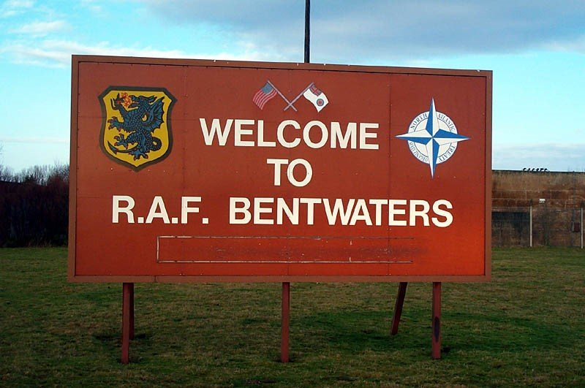

Terms of engagement
What’s ‘thinkable’ and ‘do-able’ in Asia wasn’t/isn’t identical to the terms of operation in Europe
Former USAF base in Woodbridge, Suffolk,
closed in 1993.

Slide 24
Complications

Slide 25
The fallacy of the ‘buffer’ thesis
Rape has been a persistent occurrence in areas with high concentrations of military personnel
The availability of easily purchased sexual services has not eliminated rape
Arguably, the pervasive eroticization of women, particularly in Asia, has encouraged sexual violence (the ‘anti-prostitution’ feminist argument)
Rape better understood as a crime of violence than of frustrated erotic desire
The ‘buffer theory’ also posits some women (sex workers) as essentially ‘unrapeable’
Military willingness to take violent crime seriously has wavered

Slide 26
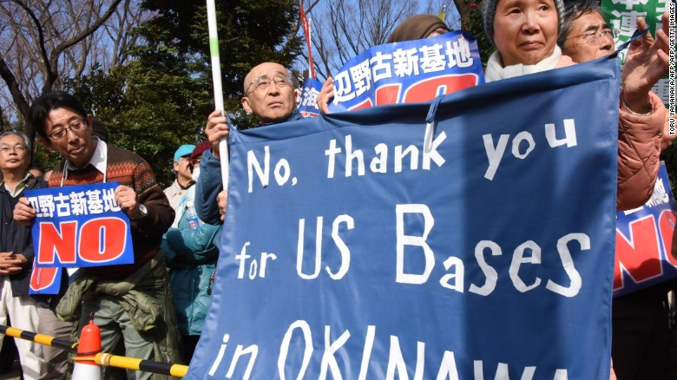
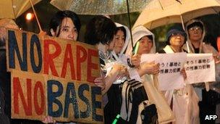
US-host nation tensions
Note also anger often directed by local
populations towards their own governments
for authorizing the US military presence
Demonstrators protest the construction of a U.S. Marine air base in the remote Henoko part of Okinawa island, to replace the existing Futenma facility, in front of the National Diet in Tokyo on February 21, 2016. https://edition.cnn.com/2016/03/17/asia/okinawa-us-serviceman-rape-restrictions/index.html
Protestors register their anger in Okinawa
after a rape perpetrated by 2 US servicemen
in 2012. An earlier gang-rape in 1995 (the
subject of one of this week’s readings)
galvanized protests across Japan.
https://www.bbc.co.uk/news/world-asia-21583785

