Slide 1
Domestication
A ‘family friendly’ military?
HI2C6 Week 3

Slide 2

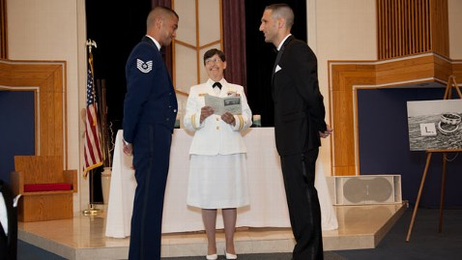
Married in the military
On 14 August 2013, the Department of Defense (DoD) announced that it would provide spousal and family benefits to servicemembers in same-sex marriages on the same terms as it offers to heterosexual married couples.
47.6% of 1,267,738 active-duty service members were married as of 2024
Two men became the first same-sex couple to marry on a military base when they held their wedding ceremony in [June 2012] at Joint Base McGuire-Dix-Lakehurst in New Jersey.
https://abcnews.go.com/blogs/headlines/2012/07/first-military-base-same-sex-wedding-held

Slide 3
The martial and the marital: a tangled relationship
‘If the army wanted you to have a wife, it would have issued you with one.’ [popular adage, n/d]
‘We recruit individuals but retain families.’ [Army Chief of Staff John A. Wickham, 1983]
‘War is bad for marriage.’ [recurrent finding of scholars in the aftermath of every war from WWI onwards]

Slide 4
Why the disinclination toward married soldiers?
An ideological contradiction—
if ‘family’ and ‘home’ are presented as the institutions being fought for
US World War I poster (1918)

Slide 5
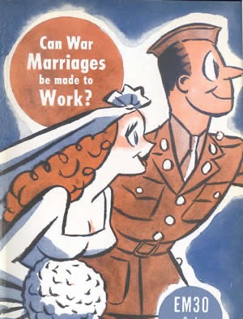
Marriage for the ‘wrong reasons’?
By Clifford Kirkpatrick
Professor of Sociology, University of Minnesota
(Published November 1944)
https://www.historians.org/about-aha-and-membership/aha-history-and-archives/gi-roundtable-series/pamphlets/em-30-can-war-marriages-be-made-to-work-(1944)

Slide 6
Marriage as a financial burden
Providing financial support to soldiers’ wives a costly obligation for the US state
Likewise, provision of life insurance and payments to soldiers’ widows
‘Allotments’ (payments to soldiers’ dependents) risk making vulnerable young men prey to predatory ‘bounty-hunters’/’gold diggers
‘Allotment Annie’

Slide 7
Wives as a source of anxiety to soldiers: the spectre of female infidelity
Army Air Force engineers in New Guinea tracked
romantic defections on this "operations board."
Source: Stars and Stripes. © 1944
Screenshot from Jarhead (dir. Sam Mendes, 2005) based on USMC veteran Anthony Swofford’s memoir of the 1990-91 Gulf War

Slide 8
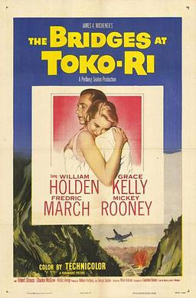
The dangers of excessive
spousal devotion
‘All through history, men have had to fight the wrong war in the wrong place, but that's the one they're stuck with.’
Paramount Pictures
1954

Slide 9
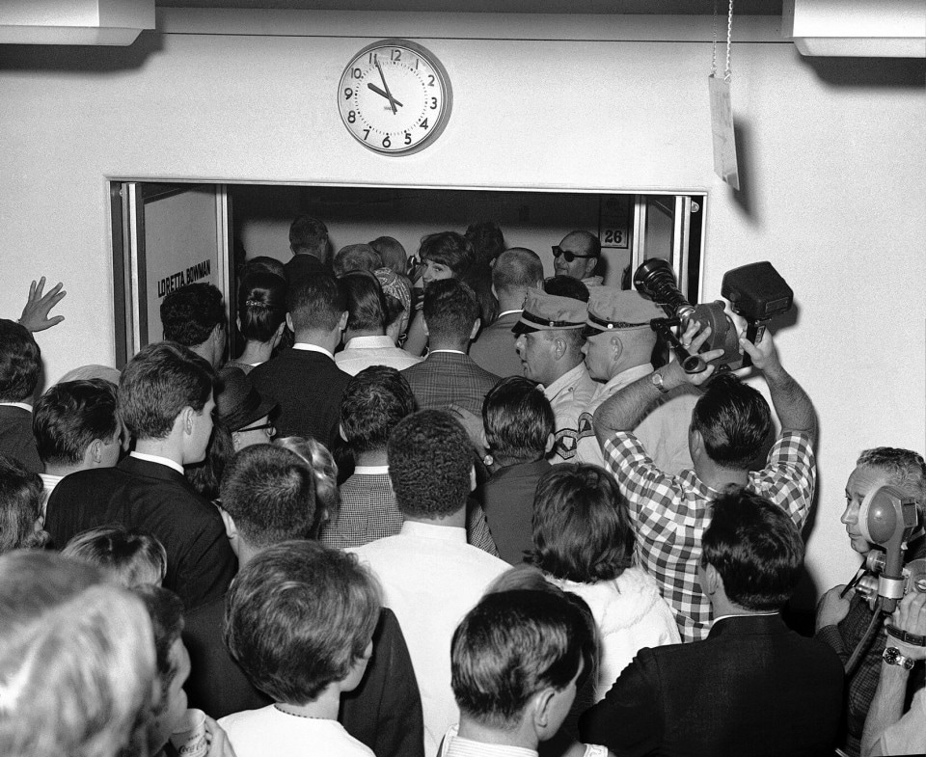
But if husbands are exempt from conscription, how to prevent ‘draft dodger’ marriages?
‘President Lyndon B. Johnson signed an executive order on Aug. 26, 1965, changing the military conscription rules for the expanding war in Vietnam.
One second after midnight, married men would no longer be exempt from the draft. Those married before midnight would be.’
Couples rush to secure a marriage license and get married ahead of a military draft deadline Aug. 25, 1965. (Milt Palmer/Las Vegas News Bureau)
Read the Washington Post story: https://www.washingtonpost.com/news/retropolis/wp/2017/09/23/a-rush-to-the-altar-to-avoid-the-vietnam-draft-the-day-lbj-eliminated-the-marriage-exemption/

Slide 10
The marital turn
Military manpower
And spousal support

Slide 11
‘Dependents’ as unofficial disciplinarians of male sexuality
Five Army wives meet for tea in Heidelberg,
1946
https://www.uglyhedgehog.com/t-318512-1.html
Unidentified African American GI and his wife in Japan (1945-49) Schomburg Center for Research in Black Culture, Photographs and Prints Division

Slide 12
Dependents as
‘unofficial ambassadors’
Advertising the ‘American way of life’
Showing ‘democracy’ in action
Winning over locals’ allegiance
Spearheading civic initiatives– especially
for women and children
Naturalizing the US military presence
Q: But does US military family diplomacy
actually work??
NYU Press, 2007

Slide 13
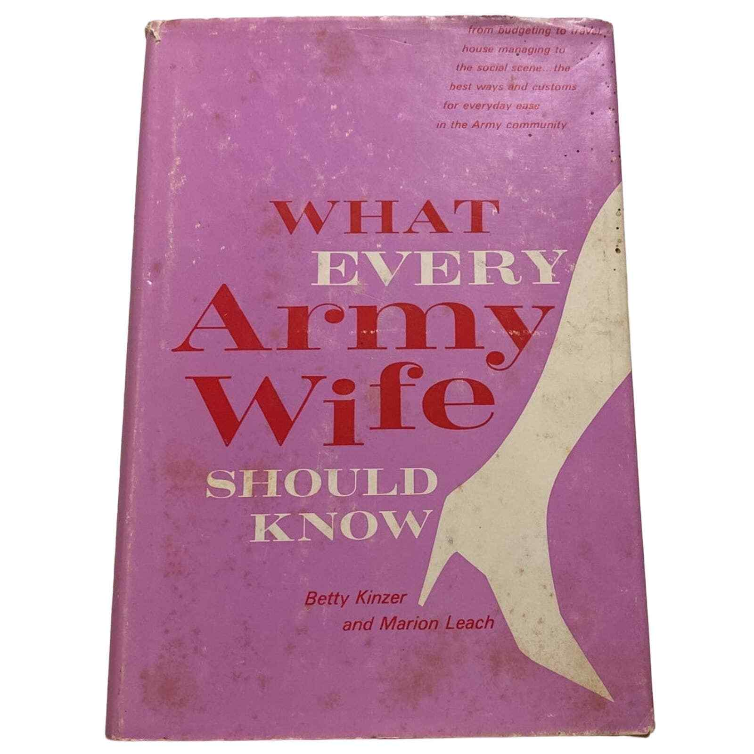
The ‘army wife’ as individual and institutional asset
1966

Slide 14
‘War Brides’
Shifting attitudes towards
foreign female spouses

Slide 15
From banning foreign marriages to
(grudging) tolerance
1942: War Dept. directives required all overseas servicemen to obtain permission of commanding officers in order to marry
During and for some months after WWII, US servicemen overseas were not permitted to marry women from former Axis enemy countries (see Zeiger)– a ban later lifted
Soldiers who intended to marry had to submit lengthy applications, including birth certificates, medical certificates (showing the woman was free from STDs and TB), a criminal background check, copies of previous marriage/divorce papers; notarized parental consent; character references, etc.
Mandatory pre-marital counseling by military chaplains
WWII-era regulations requiring commanders’ permission to marry remained in place for decades– applying to GIs who hoped to marry Vietnamese women in the ‘60s and ‘70s
Why so much hostility to bi-national marriages?
Issues of race/racism clearly influenced military marriage policy, as have prejudicial ideas about predatory foreign women and immature US men
Immigration restrictions (esp. with regard to Asian women)
1967: Loving v State of Virginia– ended ‘anti-miscegenation’ statutes

Slide 16
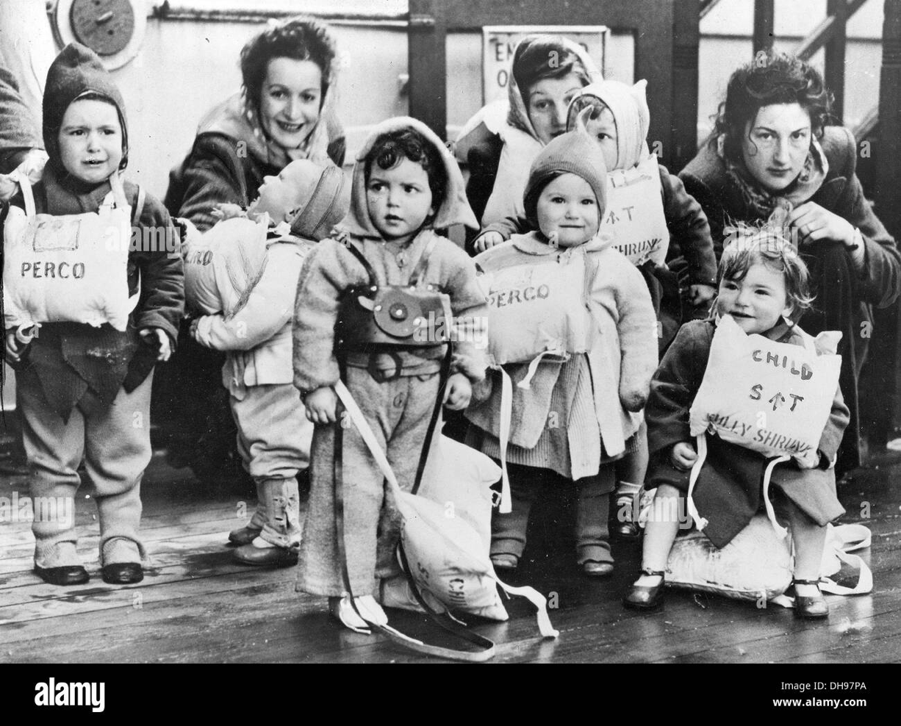
‘War brides’
Left: British GI War brides and their GI children during lifeboat drill head for America on the Queen Mary at the end of WWII

Slide 17
The All-Volunteer
Era (1973 - )
The fitful turn to ‘family
Friendliness’

Slide 18
Incentivizing marriage and family after Vietnam
The ‘Army Family’ as metaphor and reality
Within a year of the military’s turn to an All Volunteer force, 50% of service members were married
NB: while, by the 1970s, more than half of civilian women (aged 18-64) engaged in paid work, this figure was lower for army wives (approx. 30.5%)
WHY? Mobility– frequent postings– expectation that wives should (or must) perform unpaid welfare work on behalf of the military
Army spouses fought for: better pay & housing
Child-care: by the late ‘70s, nearly 60% men in uniform were fathers
Health care
Harvard University
Press, 2015

Slide 19
The USMC’s proposed ban on married recruits
In August 1993, the US Marine Corps announced an intention to bar married people from enlisting.
Within hours, the USMC back-tracked. The Corps had neglected to okay this proposed policy change with the White House.
“The problems associated with a failing marriage, a marriage whose fabric is being torn apart by our operational deployment tempo--or the difficulty of making ends meet on a junior military salary, in locations where the cost of living is especially high--can be overwhelming to a young Marine and his family.”
The new policy would have limited the number of married recruits to 4% by Oct. 1 of this year [1993] and 2% by Oct. 1, 1994, and would have prohibited married people from enlisting at all after Oct. 1, 1995.
https://www.latimes.com/archives/la-xpm-1993-08-12-mn-23077-story.html

Slide 20
What about married servicewomen?
During WWII, married women, including those with children 14+, could enlist in the WAC
But if women became pregnant, they were discharged on the grounds that they were ‘no longer physically fit for duty.’
Servicewomen who terminated pregnancies were often discharged on the grounds that they had committed ‘conduct unbecoming’, damaging the reputation of the service
after WWII, many women left military service
1950s/60s: the military continued to discharge servicewomen who gave birth or became adoptive parents
Many women terminated pregnancies in order to continue their military careers
Abortion in military medical facilities was legalized in July 1970, if the woman’s mental health was at stake
1971: the DOD announced that it would extend the same spousal benefits to the husbands of married servicewomen as it did to the wives of servicemen
A court case in 1976 deemed the military’s practice of discharging pregnant women unlawful

Slide 21
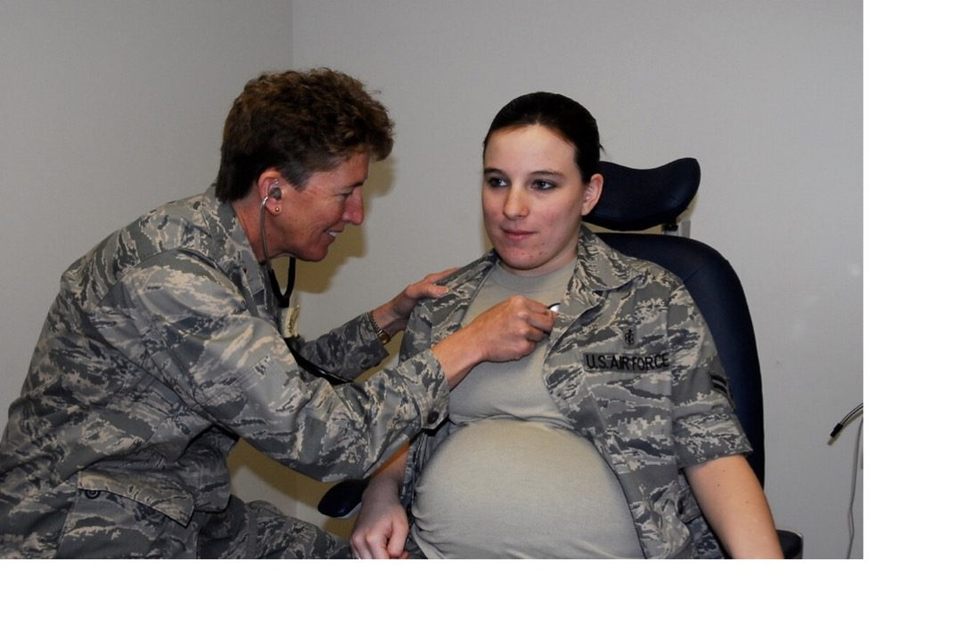
Can mothers be soldiers?
Today nearly half of active-
duty servicewomen are married.
Nearly 40% are mothers.
“Airman First Class Brandy Fraher, who is in the final stages of her pregnancy, receives an examination from Major Noreen Burke during a unit training assembly.” Since 2017, Air Force personnel have a 12 month window after giving birth to decide whether to stay on or leave the USAF.
https://www.airforcetimes.com/news/your-air-force/2017/04/29/new-air-force-policy-gives-new-mothers-12-months-to-decide-if-they-want-to-stay-in-uniform/
https://coyotelegal.com/2013/11/27/good-news-for-military-families/

Slide 22
ONGOING TENSIONS
THE AGE OF “FOREVER WAR”
https://www.militaryfamily.org/about-us/

Slide 23
Technology and virtual proximity
“It was through video calling that Sgt. Emmett Mailman was able to witness the birth of his son in Lincoln all the way from Kabul.”
https://www.supertintin.com/blog/skype-recorder/the-soldiers-story-a-skype-video-call-testimony

Slide 24
Suicide and relationship breakdown: correlation or cause?
26 Sep 2019
Military.com | By Patricia Kime
‘The suicide rate for active-duty U.S. military members in 2018 was the highest on record since the Defense Department began tracking self-inflicted deaths in 2001.
Officials said Thursday that 2018's rate of 24.8 deaths per 100,000 service members is comparable to age and gender-adjusted civilian rates, but added that fact is "hardly comforting," given that "the numbers aren't moving in the right direction.”
A new DoD publication, the 2018 Annual Suicide Report, released Thursday confirms that 325 active-duty personnel took their own lives last year, up from 285 in 2017 and 280 the previous year.
The Pentagon has long struggled to address the problem of suicides in the ranks, attacking the issue with renewed fervor in 2012, when the number of deaths, 319, and the rate, 22.7 per 100,000, were the highest since the DoD began tracking the data following the 9/11 attacks.’
https://www.military.com/daily-news/2019/09/26/military-suicide-rates-hit-record-high-2018.html

Slide 25
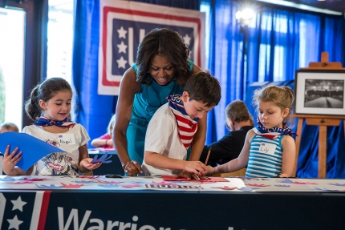
Michelle Obama’s ‘Joining Forces’ Initiative
‘In 2011, First Lady Michelle Obama and Dr. Jill Biden came together to launch Joining Forces, a nationwide initiative calling all Americans to rally around service members, veterans, and their families and support them through wellness, education, and employment opportunities. Joining Forces works hand in hand with the public and private sector to ensure that service members, veterans, and their families have the tools they need to succeed throughout their lives.’
https://obamawhitehouse.archives.gov/joiningforces/about

Slide 26
‘Resilience’ training
Left: Original U.S. Army "Comprehensive Soldier Fitness" logo (2009-2012)
Middle: New U.S. Army "Comprehensive Soldier and Family Fitness" logo (August 2012-present)
Right: U.S. Air Force Comprehensive Airman Fitness logo (2011-present)
https://thewinnower.com/papers/49-a-critical-examination-of-the-u-s-army-s-comprehensive-soldier-fitness-program
https://www.army.mil/article/113208/comprehensive_soldier_and_family_fitness_expands_resilience_training_to_army_leaders

