Slide 1
Gender, sex and service in Vietnam
HI2C6 Sex and the US Military, Week 4
NB: Some slides contain disturbing content

Slide 2
The American war in Vietnam
Some historical
context

Slide 3
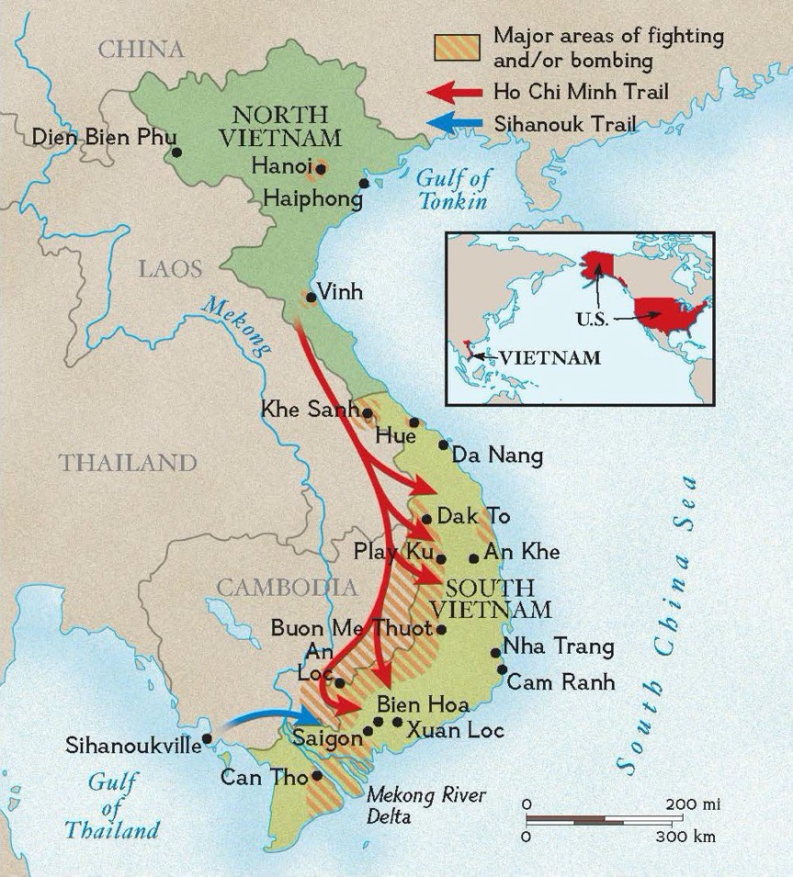
“War without fronts”
A war for Vietnamese independence and reunification under the leadership of Hanoi (capital of North Vietnam aka the Democratic Republic of Vietnam)
an internationalized civil war, in which the US committed itself to propping up South Vietnam (aka the Republic of Vietnam) as an independent state after France failed to reimpose imperial control after WWII– leading to the partition of Indochina in 1954, pending elections that were intended to reunify the country
an air war– with intense US bombing of North Vietnam, and later Laos and Cambodia
a ground war fought by the US/ARVN against South Vietnamese guerrilla fighters who opposed the US presence (the “Viet Cong”) and their North Vietnamese Army allies
https://www.nationalgeographic.org/photo/vietnam-war/
For an hour-long lecture on the history of the Vietnam Wars:
https://web.microsoftstream.com/video/1b4105d5-eb31-4b08-a251-8f2fab645ceb

Slide 4
How to combat a popular nationalist movement?
“We had to destroy the village
to save it”
South Vietnamese forces follow after terrified children, including 9-year-old Phan Thi Kim Phùc, center, as they run down Route 1 near Trang Bang after an aerial napalm attack on suspected Viet Cong hiding places on June 8, 1972. Credit:Nick Ut/The Associated Press
https://www.pri.org/stories/2018-02-21/how-vietnam-wars-napalm-girl-found-hope-after-tragedy
CBS Journalist Morley Safer reporting on the destruction
of Cam Ne, August 5, 1965
https://www.cbsnews.com/news/controversial-report-changed-war-coverage-in-america/

Slide 5
Demonstrators at the Harlem Peace March to End Racial Oppression, 1967.
The sign on the placard was taken from boxer Muhammad Ali's original statement about his refusal to participate in the Vietnam War
Source: Courtesy of Builder Levy.
https://www.amistadresource.org/civil_rights_era/black_opposition_to_vietnam.html
Support Demonstration for draft resister Mike Leavy, at Seattle's Federal Building, September 13, 1968. Copyright (c) Fred Lonidier.
https://depts.washington.edu/antiwar/pnwhistory_vietnam.shtml

Slide 6
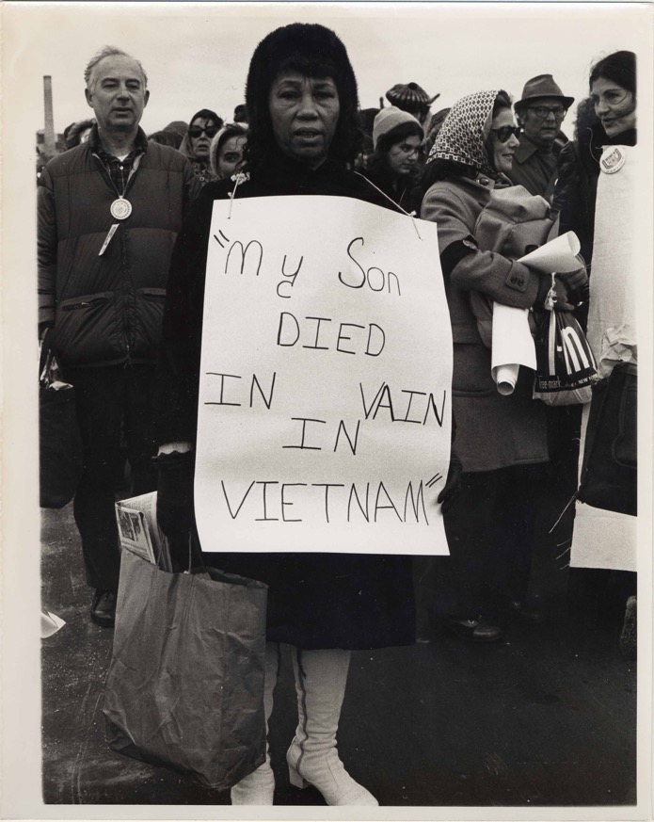
Women’s anti-war resistance
Helen Boston, “My Son Died in Vain in Vietnam” Women Strike for Peace, Washington, D.C. January 4, 1973
https://www.swarthmore.edu/library/peace/Exhibits/Dorothy%20Marder/MarderExhibit1A_files/MarderExhibit1A.html
Two women in silent vigil holding protest signs against the War in Vietnam standing on Second Street, San Jose.
http://digitalcollections.sjlibrary.org/cdm/ref/collection/sjsuUA/id/1267

Slide 7
American military service in Vietnam
Who served in what capacities?

Slide 8

Facts and Figures from the US Veterans Administration
About 2.7 million US personnel deployed to Vietnam
265,000 women served during the Vietnam War era
11,000 women were stationed in Vietnam
90% of women who served were nurses
Army Nurse Corps arrived in Vietnam as early as 1956
8 American military women were killed the Vietnam War
(7 nurses)
59 civilian women were killed the Vietnam War
https://blogs.va.gov/VAntage/86001/women-veterans-bravely-served-vietnam-war/

Slide 9
The Women’s Army Corps (WAC) in Vietnam
WAC officer training Vietnamese women soldiers, 1965
MAJ. KATHLEEN 1. WILKES AND SGT. 1ST CL. BETTY L. ADAMS, the first WAC military advisors in Vietnam, observe the issue of uniforms to members of the Women's Armed Forces Corps, Republic of Vietnam, 9 March 1965.
http://webdoc.sub.gwdg.de/ebook/p/2005/CMH_2/www.army.mil/cmh-pg/books/wac/chapter9.htm
https://www.army.mil/women/history/
Read more about the WAC in Vietnam:
http://www.vietnamwomensmemorial.org/pdf/bmorden.pdf

Slide 10
The Army Nurse Corps

Slide 11
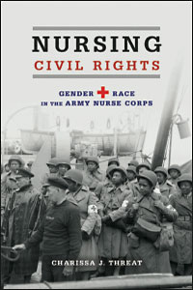
A brief history of military nursing
1901: Army Nurse Corps (ANC) founded, an all-female force of unmarried white women
WWII: ANC rules relaxed, permitting married women to join “for the duration”
1941: Black women nurses first allowed to serve– nursing Black men
1947: Army-Navy Nurse Act granted nurses permanent military rank/integration into the Regular Army. But applicants to the RA could not be married or have children
1955: ANC open to male nurses– who could be married. By 1966, 20.2% of ANC personnel were men.
1964: Army permitted married women to join the Regular Army
1967: 24% women in ANC married
NB: Vietnam the first war in which pregnancy was not automatic grounds for discharge
BUT the ANC faced a recruitment crisis in the 1960s
2015 (e-book in
Warwick library)

Slide 12
The Army Nurse: Soldier of Mercy (1965)
“Operation
Nightingale”—
a recruitment
drive—
launched
1963
Watch the half-hour
film:
https://www.c-span.org/video/?459918-2/the-army-nurse-soldier-mercy

Slide 13
Women’s motivations for enlistment
Patriotism– desire to serve their country/aid male soldiers
Familial reasons– fathers had served in WWII
Brother(s) drafted– “unfairness” of gendered civic obligations
Material incentives– army pays for nursing education
A “ticket out” of small-town life/rural communities
Desire to lead a non-traditional life, not defined by marriage
Some women recruits actively sought assignment to VN
Others hoped for “travel and adventure” but not in a war zone
The Army nurses who served in Vietnam averaged 23.6 years of age and were relatively new to nursing, only 35% had more than two years nursing experience.
https://vietnamwomensmemorial.org/wp-content/uploads/2020/03/iwest.pdf
https://www.westvirginiastatecouncil.com/woman-vets-page.html

Slide 14
ANC Basic Training, Fort Sam Houston
During basic training women nurses were introduced to field
medicine; military rank and insignia; marching and drill;
map reading and orienteering—
BUT women received only 3 hours of weapons training,
which didn’t always involve actually firing a weapon.
Male recruits received 22 hours of weapons training,
learned to fire rifles, and practiced combat maneuvers.
http://www.usmilitariaforum.com/forums/index.php?/topic/20252-womens-uniforms-in-vietnam-photos/

Slide 15
A gendered division of labour in the ANC
Between 20-30% of ANC nurses who served in
Vietnam were men (1000-1500).
Male nurses were assigned as advisors to the all- male Nursing Division of the Republic of Vietnam Armed Forces.
Captain John Alexander explained why female nurses were not given these assignments:
“The living conditions and the travel and the field were not conducive to putting females into these positions. Oftentimes, we would not shower for days on end. This would have been difficult for women.”
But the idea that female ANC nurses would be kept away from the ‘front line’ was purely notional in a war where the ‘front line’ was everywhere.
http://e-anca.org/History/Topics-in-ANC-History/Male-Nurses-Vietnam
2nd LT Terry Kuntz, ANC, caring for patient 93rd Evac Hospital, Long Binh, Vietnam, 1968
https://history.amedd.army.mil/ancwebsite/articles/malenurses.html

Slide 16
American nurses, Vietnamese casualties
Male ANC nurses were used to staff hospitals with Prisoner of War (POW) wings. But US female nurses also worked with Vietnamese patients– often children.
“Up to 40 percent of our patients were kids—we saw about a thousand people a year—because the kids are the ones who take the ducks out and take the water buffalo down to the river. And some yo-yo leaves a landmine in the path and—pop! That’s it. No, I wasn’t prepared for how many kids were so badly damaged. A lot of them came in with no arms and legs. And we saw kids with neck injuries from shrapnel, so that they were entirely paralyzed. At times we took over the hospital’s burn unit, where we saw the kids who’d been napalmed…”
ANC nurse, Julie Forsythe
https://vietnamtodayandalways.wordpress.com/2015/04/29/during-the-vietnam-war/

Slide 17
The symbolic/morale function of female nurses
“When my soldiers come
into the hospital I want them
to see a woman in a white
uniform, with lipstick and hair
done up.”
General William Westmoreland
Nurse talking to a wounded
patient in Vietnam
VA053676, Claire Brisebois Starnes Collection, The Vietnam Center and Sam Johnson Archive, Texas Tech University
https://www.vietnam.ttu.edu/exhibits/nurses/

Slide 18
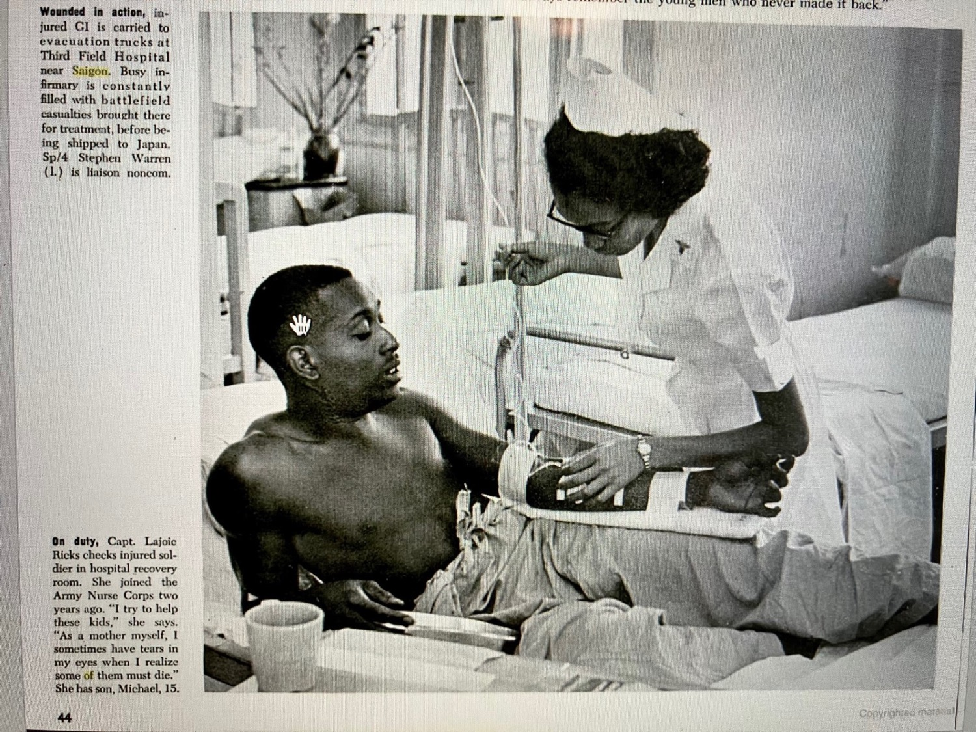
“Angels of Saigon”
Ebony,
August 1966, p.44
Nursing as “service to
one’s race”
https://books.google.co.uk/books?id=ys2MeNoI4NIC&lpg=PA44&dq=angels%20of%20saigon&pg=PA43#v=onepage&q=angels%20of%20saigon&f=true

Slide 19
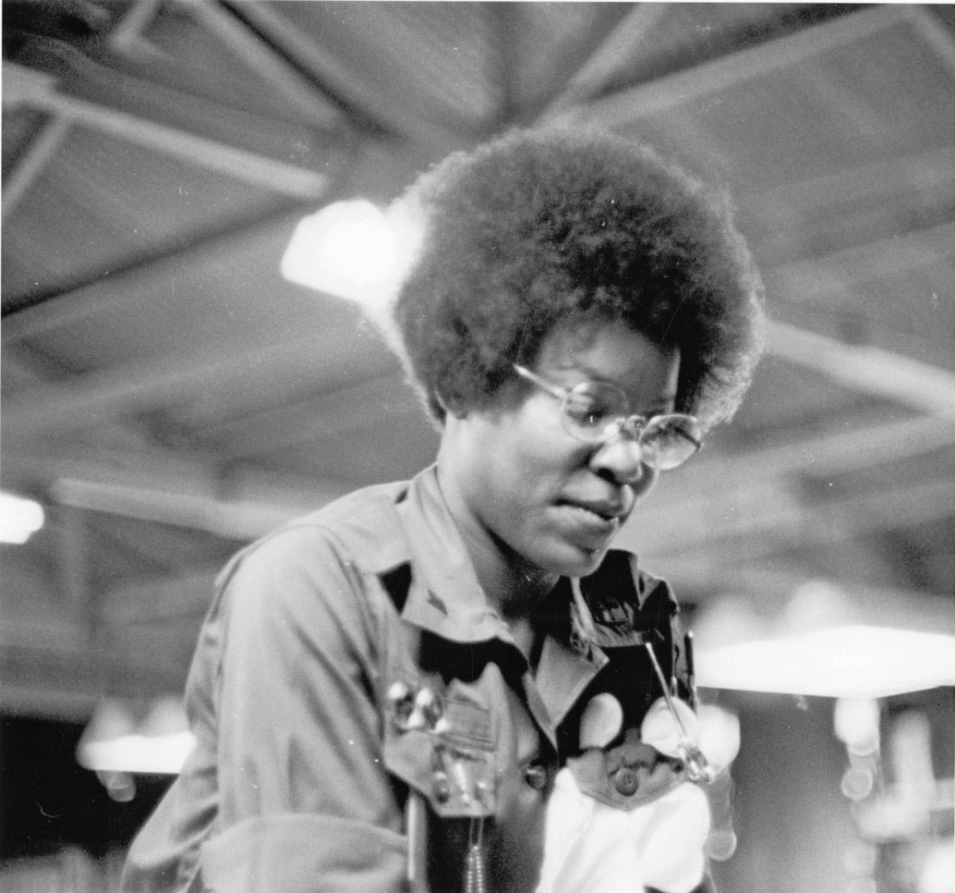
The racialized politics of appearance and authorized hairstyles
Some Black American nurses noted that beauty parlours on US bases in Vietnam catered for white women’s hair and cosmetic needs, not theirs.
Lieutenant Lily [unknown last name], Army Nurse Corps, in Emergency Room, 91st Evacuation Hospital, Chu Lai, South Vietnam. She was promoted to captain late in 1970.
VA062594, James Evans Collection, The Vietnam Center and Sam Johnson Archive, Texas Tech University

Slide 20
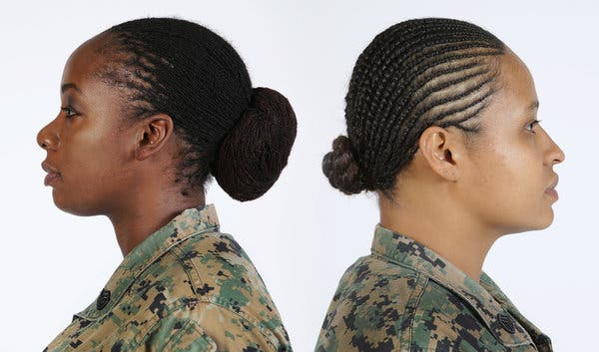
Army Lifts Ban on Dreadlocks, and Black Servicewomen Rejoice
“In 2014, Defense Secretary Chuck Hagel ordered the military to review its policies about hairstyles popular with black women after complaints that new Army regulations banning large cornrows, twists and dreadlocks unfairly targeted black women. A few months later, some of the rules were relaxed. The Marine Corps approved lock and twist hairstyles in late 2015.”
New York Times, Feb. 10, 2017
“The United States Army last month revised its regulations to allow women to wear their hair in twisted locks. The Marine Corps, above, approved lock and twist hairstyles in late 2015.” Credit...Marine Corps
Watch a video on this topic: https://www.youtube.com/watch?v=XjM4ShZFd4g&t=40s

Slide 21
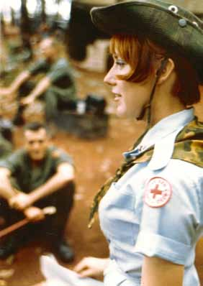
Emotional caretaking as women’s work
A ‘Donut Dolly’ in Vietnam.
American Red Cross ads sought “qualified young women who were willing to serve one year overseas.” They had to be at least 21, have a college education, and have that “girl next door” look.
https://armyhistory.org/the-donut-dollies-of-vietnam/
An American soldier reads a "Dear John" letter from home, while taking a break from repairing a tank tread. Lang Vei, March 1971. Photo by David Burnett.
https://libarchive.slcc.edu/islandora/object/vietnam%3A108

Slide 22
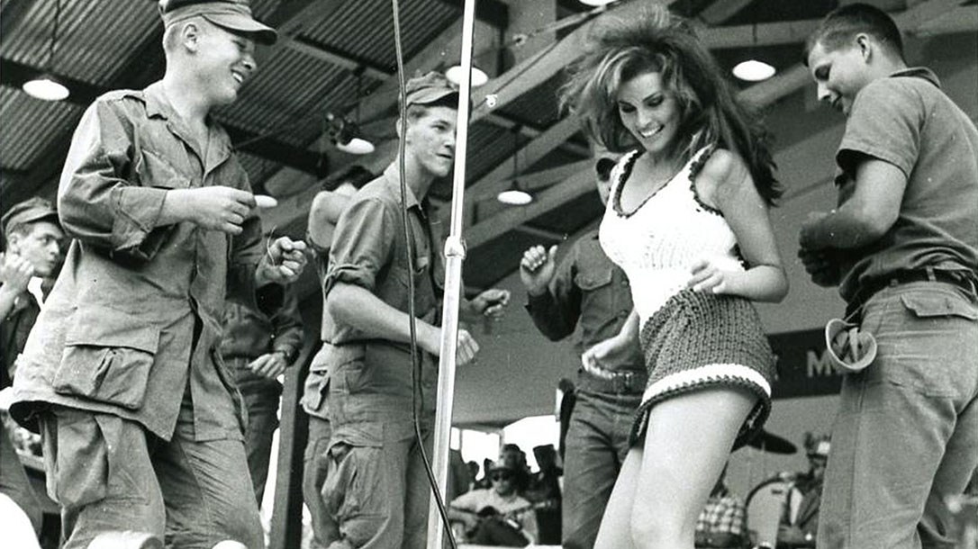
USO Shows and female entertainers
Raquel Welch performs ‘Different Drum’ at a USO Show in Vietnam (1967)
https://www.youtube.com/watch?v=s7Cic_N8iTc&t=78s

Slide 23
Sexual violence and rape
“During the Vietnam War Era, if you reported a sexual assault there was no hope that it would be taken seriously. There were rarely repercussions for acts against women. The good-ole-boy military did not discipline a man for behaving like a ‘normal male.’ The stigma about getting raped was so great that victims kept it to themselves. Often women kept quiet so as not to frighten the other women in their units.
Many women were awakened in the night by a man breaking into the hooch, or they woke as they were about to be raped. Guards posted around women’s areas often were paid to look the other way. It was a hazard for a woman to go to the latrine at night alone.”
Kate O’Hare-Palmer, chair, VVA’s Women Veterans Committee
https://vva.org/programs/women-veterans/military-sexual-trauma-women-veterans/

Slide 24
Postwar recuperation
The nurse as veteran

Slide 25
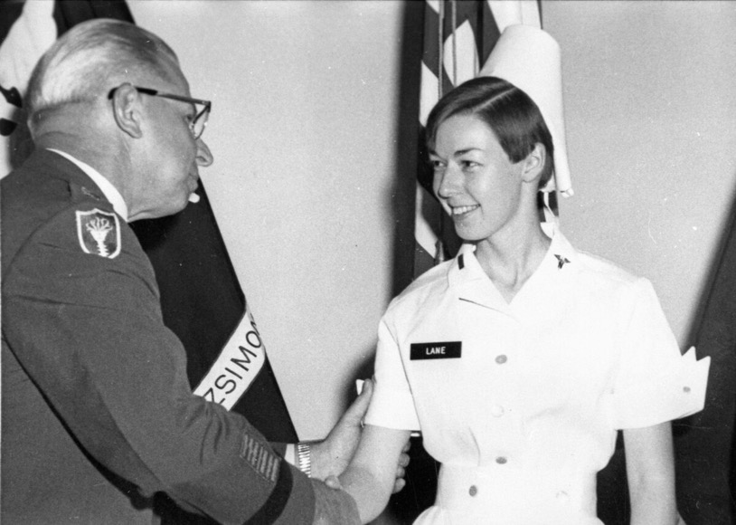
Casualties of war
Sharon Lane was the only American nurse to be killed by enemy fire in Vietnam, June 8, 1969.
https://www.armytimes.com/news/your-army/2017/05/28/friends-recall-only-nurse-killed-by-hostile-fire-in-vietnam/
A woman, who was a nurse during the Vietnam war, cries for the memory of her friends on Memorial Day on May 29, 2000 at the Vietnam Veterans Memorial in Washington, D.C.
ALEX WONG/NEWSMAKERS
https://www.usnews.com/news/articles/2015/12/05/vietnam-veterans-still-have-ptsd-40-years-after-war

Slide 26
Vietnam Women’s
Memorial,
Washington, DC
1993

Slide 27
Women’s struggle for recognition as veterans and for access to VA healthcare for PTSD
Tommy and Barbara Chiminello in Nha Trang, South Vietnam
Barbara Chiminello: “That was a big problem with us returning, the veterans returning. Because it was such an unpopular war, no one wanted to talk about it. It’s true that lot of Vietnam veterans now came home to no support. No one really reached out to us. I did not have an adjustment. I would have loved to have talked to people about it. For years, no one knew I was a Vietnam veteran.”
In 1993, Barbara attended the opening of the Vietnam Women’s Memorial in Washington, DC with other veterans of the 71st Evacuation Hospital where she served during the war
https://vietnamwar.nyhistory.org/oral-histories/barbara-chiminello/

