Slide 1
Gendered appeals
Military recruitment in the all-volunteer era (1973 to today)
HI2C6 Week 5

Slide 2
Key questions
How to persuade US citizens (and others who aspire to citizenship) that a job which may require them to take, or lose, life is personally advantageous?
What combination of appeals to idealism– patriotism, duty, self-sacrifice– and/or self-interest– material rewards, elevated status, enhanced masculinity (or femininity?)– was/is best placed to encourage enlistment?
Recruitment campaigns are pivotal in projecting ideas about military identity towards both uniformed personnel and civilians– in idealized/aspirational form
Military ads are instrumental in shaping and redefining gender roles and identities in the armed forces; likewise, how the services hope to appeal to Americans of different ethnic and class backgrounds
Shifting recruitment strategies– as well as the physical or virtual venues, and technologies, employed to deliver them-- illuminate key changes in the US since Vietnam, helping chart an evolving relationship between the armed forces and civil society over the past half century.

Slide 3
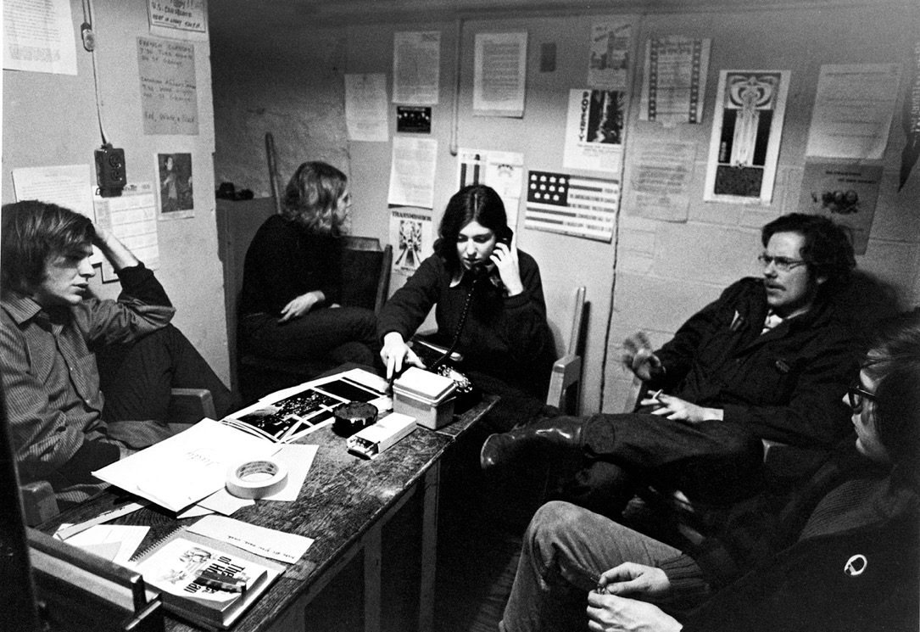
The 1970s: armed forces in crisis
Vietnam War draft evasion
approx. 570,000 young men were classified as draft offenders, and approximately 210,000 were formally accused of draft violations
8,750 were convicted
3,250 were jailed
Inequitable service
More than half of the 27 million men eligible for the draft during the Vietnam War were deferred, exempted, or disqualified
Draft-age Americans being counseled by Mark Satin (far left) at the Anti-Draft Programme office on Spadina Avenue in Toronto, August 1967. The Toronto Anti-Draft Programme was Canada's largest organization providing pre-emigration counseling and post-emigration services to American Vietnam War resisters.
https://en.wikipedia.org/wiki/Draft_evasion_in_the_Vietnam_War#/media/File:Draft_dodgers_being_counseled_1967.jpg

Slide 4


Demoralization, drugs and indiscipline:
Or civil rights activism and resistance to an unjust war
In this photo taken from video, soldiers in fire-support base Aries, a small clearing in the jungles 50 miles from Saigon, smoke marijuana using the barrel of a shotgun. (Credit: Jim Wells/AP Photo, 1970)
2005 documentary
https://www.history.com/news/drug-use-in-vietnam
Watch the trailer:
https://www.youtube.com/watch?v=64VULejzNhc

Slide 5
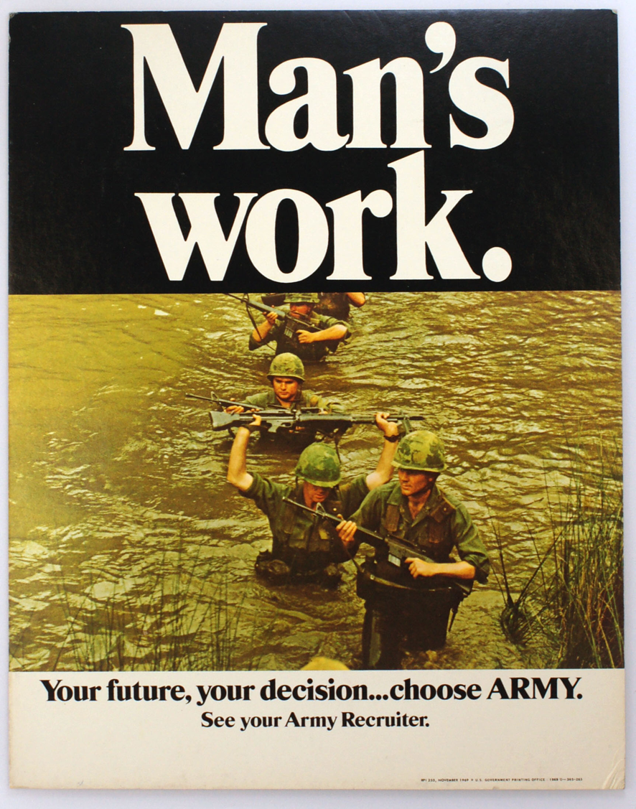
A New Look Army
In March 1971, N.W. Ayer & Son were assigned to a new, $10 million campaign, for a 3 month period.
“Today’s Army Wants to Join You,” was launched in the fall of 1971.
Ayer’s assignment was explained in the May/June 1971 issue of Ayer News, the agency’s monthly news publication, as follows:
“We have been given an improved and improving product to work with. A ‘changing’ United States Army. An Army still totally committed to professionalism and preparedness—but with new concern for individual expression and changing life-styles”
https://digitalcommons.lasalle.edu/military_advertisements_visual_history/#

Slide 6
The Army joins YOU! (1971)
Individuality encouraged—
not disciplinarian authority

Slide 7
The “Grand Tour”
Reinvented:
Leisure,
Pleasure,
Sight-seeing,
Romance
N. W. Ayer Advertising Agency Records, Smithsonian Institution

Slide 8
The Army as a more egalitarian and progressive employer?
“The Army
Needs Girls
As well as
Generals”
(1969)
N. W. Ayer Advertising Agency Records, Archives Center, National Museum of American History, Smithsonian Institution
(1971)

Slide 9
“This is the Army” (1979)
https://www.youtube.com/watch?v=0uO6K2_sNIY&list=PL2443E24C4672D3FA&index=23&t=0s
In the late 1970s, the Army was struggling– and failing-- to meet its recruitment quotas.
In 1979, the services were short of 20,000 recruits, and worried about the calibre of men in uniform.
The Army’s recruiting budget for fiscal year 1979 was $237.8 million, including $42.6 million for advertising.
https://history.army.mil/books/DAHSUM/1979/ch05.htm
Army recruitment centres are a common
fixture of US strip malls

Slide 10
“Be All You Can Be” (1980-2001)
https://www.youtube.com/watch?v=ms9pxvEbILs
The era of “self-realization”
and personal reinvention:
from the political to the
personal

Slide 11

2001:
A shift in advertising strategy—
away from ads predominantly aired during
football games towards ads during popular TV dramas
The army also introduces its first Spanish-language TV
ads with the slogan, “Yo Soy El Army” (I Am the Army)

Slide 12
“An Army of One” (2001-6)
“An Army of One” commercial (2005)
https://www.youtube.com/watch?v=APxLwA7vx0w

Slide 13
America’s Army (2001- )
Note the “Teen: Blood, Violence” rating
The army launches an
online first-person
shooter video game.
The website links
players directly to the
army recruitment site.
https://www.americasarmy.com

Slide 14
Recruiting young Americans– from high school classrooms to college campuses
“Since the draft ended in 1973, the military has relied on an all-volunteer service and has targeted young people, using strategies that include placing recruiters in schools. This is allowed because the No Child Left Behind Act, signed by President George W. Bush in 2002, requires military recruiters be granted the same access in schools as college recruiters.”
https://www.teenvogue.com/story/the-military-targets-youth-for-recruitment
About 1,100 high schools have prohibited army recruiters from their premises.
https://www.washingtonexaminer.com/policy/defense-national-security/pentagon-complains-about-the-1-100-us-high-schools-that-ban-military-recruiters
https://www.themainewire.com/2013/07/maine-dems-stand-military-recruiters/

Slide 15
Recruiters in high schools
FOR: “The presence of military recruiters in high schools does not force students to join the military; it simply alerts them to an option.
We want to make sure every high school student is aware of the career and training opportunities the military has to offer—everything from being in the infantry to learning how to work high-tech equipment or be a medical technician.”
S. Douglas Smith, Spokesman U.S. Army Recruiting Command
AGAINST: “Right now, recruiters desperate for warm bodies to be shipped to Iraq are prowling selected high schools and neighborhoods across the country with sales pitches that touch on everything but the possibility of being maimed or killed in combat.
The teenagers who are the prime targets for recruitment are being told just about anything to ward off whatever misgivings they may have. Need money for college? No problem. You want to go to a nice place? Certainly. Maybe even Hawaii.”
Bob Herbert New York Times columnist

Slide 16
“Uncle Sam wants you — to play video games for the US Army”
By CHAD GARLAND | STARS AND STRIPES
November 9, 2018
“The Army is putting together a team of video gamers from within its ranks to try to reach young Americans in the digital worlds where they spend much of their time.
The move follows the Army’s failure this year, for the first time in more than a decade, to meet the fiscal year target for bringing in new soldiers as it seeks to expand its ranks to more than 500,000 in the next four years.”
Sgt. Kalyntae Williams, top, and Sgt. Deveon Landfair, soldiers with the Army's Second Cavalry Regiment, play the final round of Street Fighter V, at the E-game tournament at Grafenwoehr, Germany, Saturday, July 28, 2018. Williams beat Landfair, and will now be traveling to Seattle to compete in the PAX West Gaming Convention.
MARTIN EGNASH/STARS AND STRIPES
https://www.stripes.com/news/uncle-sam-wants-you-to-play-video-games-for-the-us-army-1.555885

Slide 17
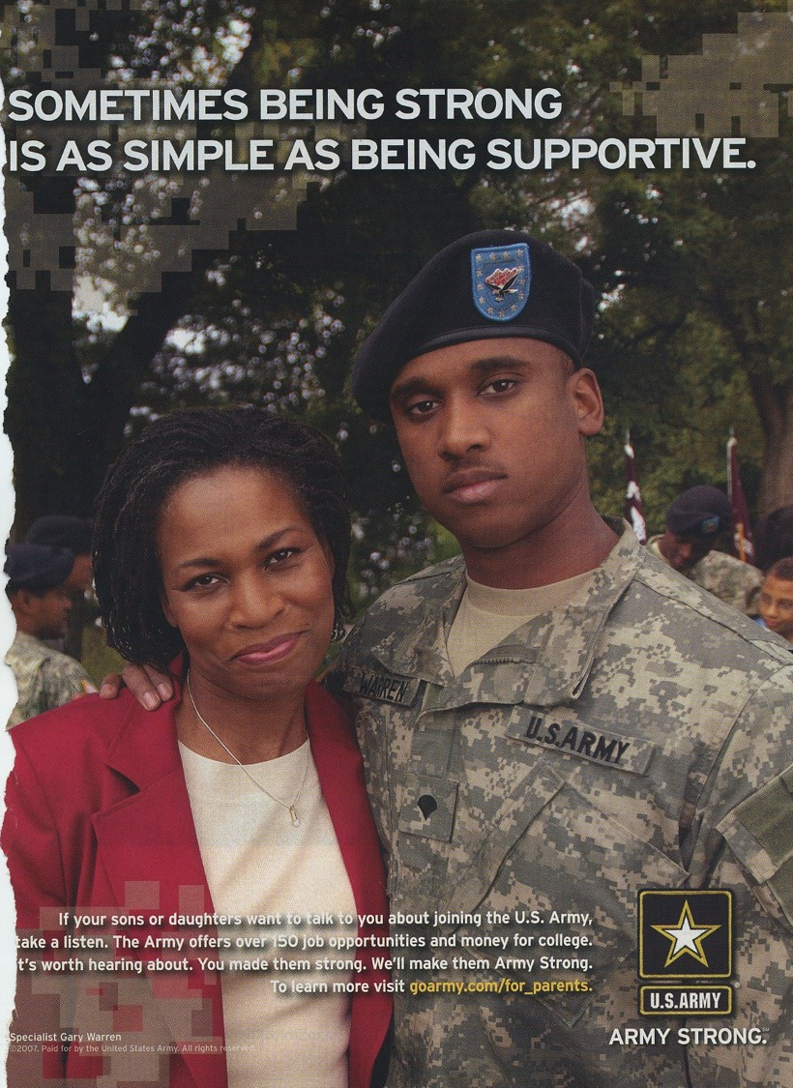
“Army Strong” (2006-18)
Backdrop: an increasingly unpopular war in Iraq
The Army missed its recruiting target in 2005 by the widest margin in more than two decades
“Army Strong” was developed by McCann Worldgroup, the
communications firm the Army hired last December [2005] after
struggling through a disappointing recruiting year.
The overall five-year contract with McCann Worldgroup
is valued at $1 billion, with the first two years guaranteed
at $200 million annually.
“The new slogan, developed in numerous tests with focus groups and interviews with soldiers, is meant to convey the idea that if you join the Army you will gain physical and emotional strength, as well as strength of character and purpose.”
“What will happen if you come into the Army is what soldiers
know happens: you become better,” [Lt Gen Robert] Van Antwerp said in an interview. It also is aimed at selling the merits of Army service to parents, teachers and other “influencers” — adults who directly influence a young person’s direction in life, Van Antwerp said.
https://www.nbcnews.com/id/wbna15197720

Slide 18
“The Army is cool, man!”
“Giving All I Got” Army rap video (2019)
https://www.youtube.com/watch?v=SDggg8G9B7o&list=RDSDggg8G9B7o&start_radio=1
Life magazine, 1971
https://www.motherjones.com/media/2017/05/army-ads-recruitment-advertisements-draft-seventies/

Slide 19
“Army's new recruiting ads focus less on combat roles”
ABC News, Nov. 2019
Captain Erika Alvarado, who serves on an Army Reserve Cyber Protection Team is seen in the Army's new recruiting campaign "What's Your Warrior” U.S. Army
https://abcnews.go.com/Politics/armys-recruiting-ads-focus-combat-roles/story?id=66893818

Slide 20

“The Calling” (2021)
“Comment section removed from Army recruiting ad
featuring soldier with two moms”
Sen. Ted Cruz, R-Texas, responded to a tweet about the ad campaign:
“Holy crap. Perhaps a woke, emasculated military is not the best idea....”
https://youtu.be/MIYGFSONKbk
https://www.armytimes.com/news/your-army/2021/05/20/comment-section-removed-from-army-recruiting-ad-featuring-soldier-with-two-moms/

Slide 21

“Peace Through Strength”, US Department of War (2025)
https://www.war.gov/Multimedia/Experience/365-Days-of-Peace-Through-Strength/
https://www.youtube.com/watch?v=nM-wp4oJ2LY

Slide 22

“Who Signs Up to Fight?
Makeup of U.S. Recruits
Shows Glaring Disparity”
“More and more, new recruits come from the same small number of counties and are the children of old recruits.”
January 10, 2020
The Powers Recruiting Station in Colorado Springs. In 2019, 79 percent of new Army recruits reported having a family member
who served. Credit...Theo Stroomer for The New York Times https://www.nytimes.com/2020/01/10/us/military-enlistment.html

Slide 23
A “Trump bump”?
‘Defense Secretary Pete Hegseth has credited President Trump’s election with what he and other administration officials have called the “Trump bump” for military recruitment.
“They see leadership ... that says, ‘We want you to be warriors. We’re not doing this politically correct garbage anymore. We’re doing war fighting,” Secretary Hegseth said on a visit to Normandy, France, in June to honor the 81st anniversary of D-Day.
In fact, Pentagon figures show that military enlistments began bouncing back between October 2023 and September 2024 – before Mr. Trump was elected – rising by about 12.5%.
Starting in 2023, Congress passed three straight basic pay raises for troops, amounting to between 4.5% and 5.2% annually. Another 10% pay increase for junior enlistees – those in the lowest service ranks – went into effect this past April, adding an additional $3,000 to $6,000 per year to the pockets of each of those new soldiers.
These hikes marked the largest increases in troops’ basic pay in two decades. The annual base salaries for new troops have increased from about $22,000 in 2022 to nearly $28,000 in 2025.
Air Force officials have noted the success of a 2023 program that offers foreign-born recruits an accelerated path to citizenship. Recruits can complete paperwork and take citizenship tests immediately upon entering basic training. By the time they graduate 7 1/2 weeks later, they can be sworn in as citizens.’
Read the full story from the Christian Science Monitor (11 Aug. 2025):
https://www.csmonitor.com/USA/Military/2025/0811/military-recruiting-trump-defense

