Slide 1
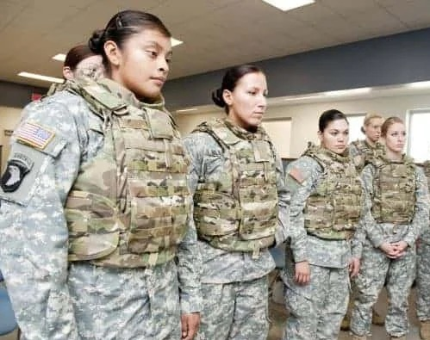
American Women in Uniform: Patriots or Problem?
Offer Holders’ Open Day,
3 December 2025
Prof. Susan Carruthers

Slide 2

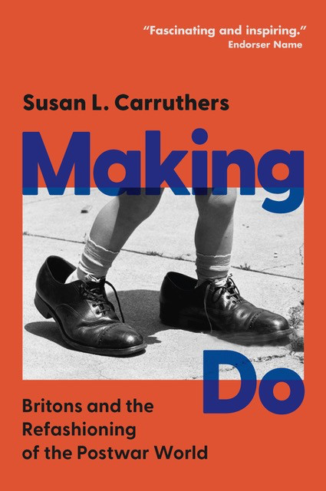
Research-led teaching/teaching-led research
Cambridge
University
Press, 2022
Cambridge
University
Press, 2025

Slide 3
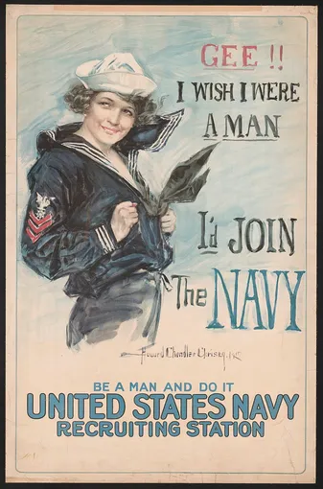
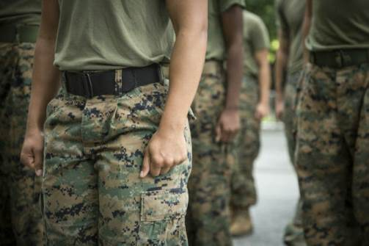
Teaching delivery:
1 lecture + 1 seminar weekly
War, Sex & Gender
In the United States:
From the Civil War
To World War II
(Year 2, term 1)
Sex & the US Military:
From Truman to Trump
(Year 2, term 2)

Slide 4

Some foundational claims
War has been a dominant force in US history– from the colonial era to the present
The military has been a key social (not just martial) institution in American life
War brings gender norms and identities into sharp focus– often intensifying shared (but not necessarily consensual) notions of what it means to be male or female
That issues of sex and sexuality likewise often assume greater significance in wartime, particularly in the armed forces.
War often generates both progressive social change and a conservative backlash/entrenchment

Slide 5
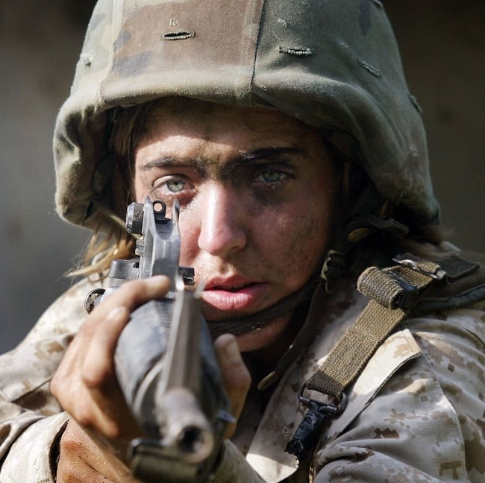
The ‘female soldier’: an oxymoronic conceit?
Why do you think the United States historically hesitated to recruit women into the armed forces and, even after women were permitted to enlist, debarred them from frontline combat roles until 2015?
With your neighbour(s), list as many different reasons as you can think of to explain this.
How many of your points are specific to the US?

Slide 6
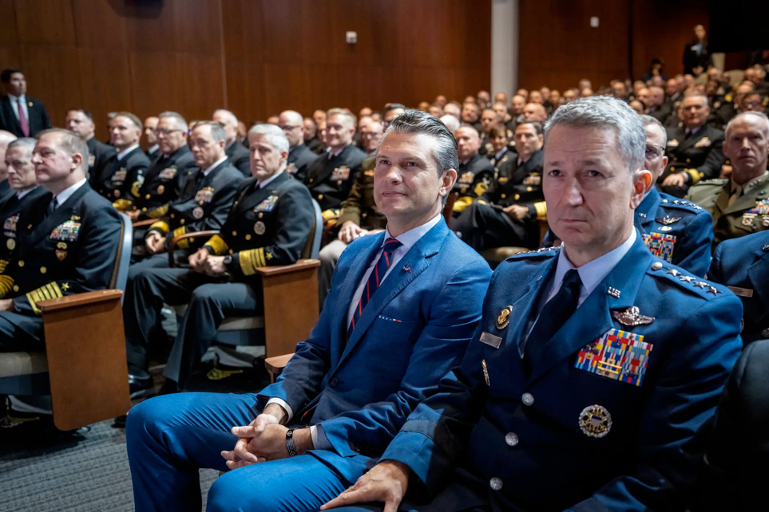
‘A Novice Defense Secretary Lectures the Brass on What It Takes to Win’
‘In his 2024 book, “The War on Warriors,” Mr. Hegseth maintained that women were not mentally suited to combat roles. “Women bring life into the world,” he wrote. “Their role in war is to make it a less deathly experience.”
In his speech to the generals, Mr. Hegseth struck a slightly different tone, arguing that the military had improperly loosened standards to accommodate women who may not be as able to carry a rucksack or lift a casualty on the battlefield.
“War does not care if you’re a man or a woman,” Mr. Hegseth said. “Neither does the enemy.”
But he insisted that he did not want to prevent women from serving in combat roles. Rather, Mr. Hegseth said, he wanted to hold them to the “highest male standard.”
“If that means no women qualify for some combat jobs, so be it,” he added.’
Greg Jaffe,
New York Times, 30 Sept. 2025
‘Defense Secretary Pete Hegseth’s vision of the military and what it should be was almost entirely defined by his 12 months of service in Iraq and his experience as a major in the Army National Guard’.
Credit: Doug Mills/The New York Times
https://www.nytimes.com/2025/09/30/us/politics/hegseth-military-officers.html

Slide 7
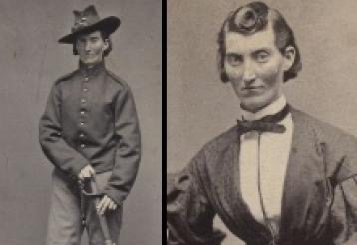
Frances Clayton presented herself as Frances Clalin
to fight in the Civil War. (Library of Congress)

Slide 8
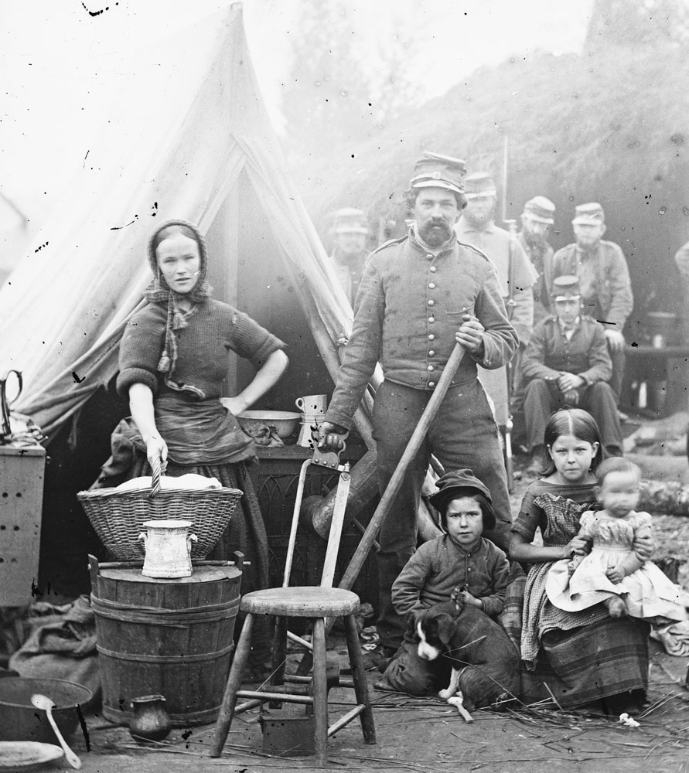
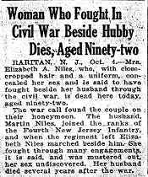
“Camp Followers”
Tent life of the 31st Pennsylvania Infantry at Queen's farm, vicinity of Fort Slocum, Washington, DC (1861) . A "camp follower" military family.

Slide 9

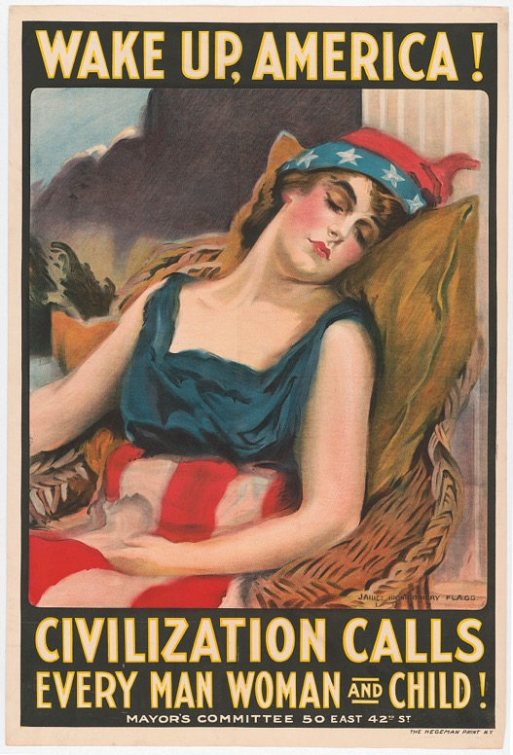
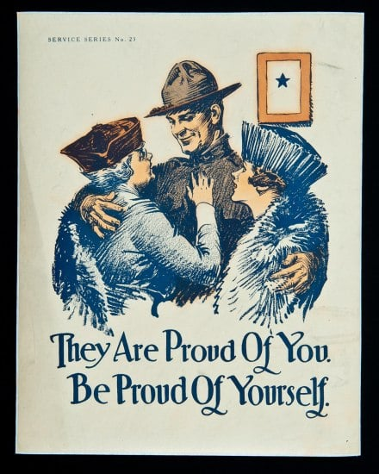
Recruitment posters from World War I: how are gendered tropes mobilized to
encourage American men to enlist?

Slide 10
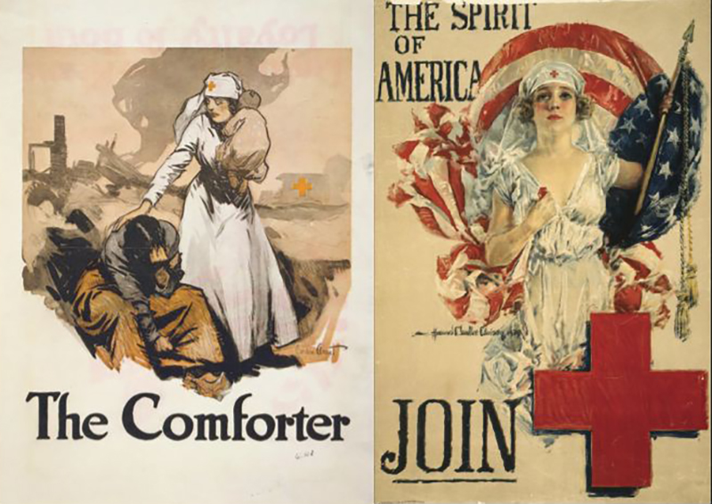

Slide 11
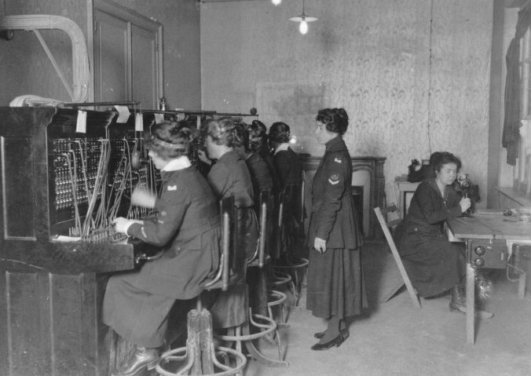
America’s first female soldiers? The “Hello Girls”
The US army felt women would make the best telephone switchboard operators to connect calls at the front. They would need to be fluent in both English and French.
The government issued a contract to Western Electric. About 7,600 women applied & the company selected and trained the recruits.
The first group of 100 arrived in March 1918 and eventually 223 ‘Hello Girls’ served in France.
They did not receive veteran status until 1977– despite belonging to the Army
Signal Corps.

Slide 12
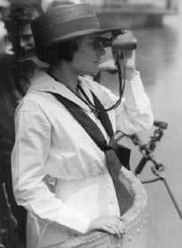
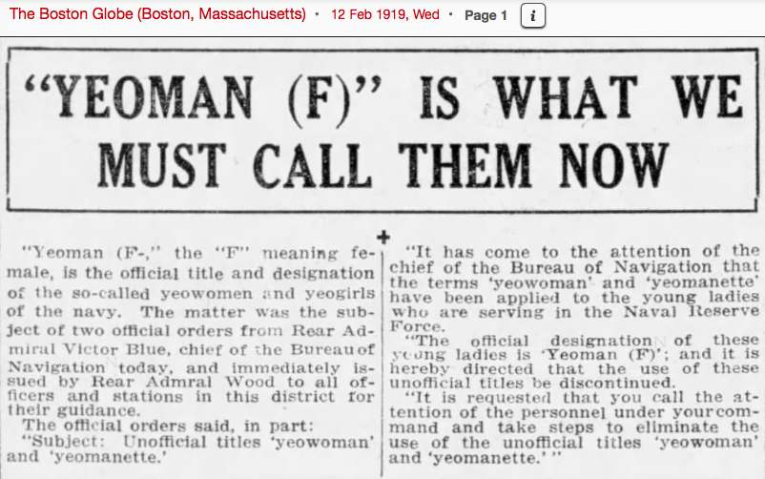
The Navy’s “Yeomanettes” (1917-21)
Around 12,000 women enlisted in the Navy under the title, “Yeoman (F).” Most served stateside on naval bases, replacing men who had deployed to Europe. While many female recruits performed clerical duties, some worked as truck drivers, mechanics, radio operators, telephone operators, translators, camouflage artists and munition workers.
They received the same pay as male recruits of $28.75 per month.
A yeoman (F) on Submarine K-5 gazes through her binoculars. (80-G-1025873)
https://www.archives.gov/publications/prologue/2006/fall/yeoman-f.html

Slide 13
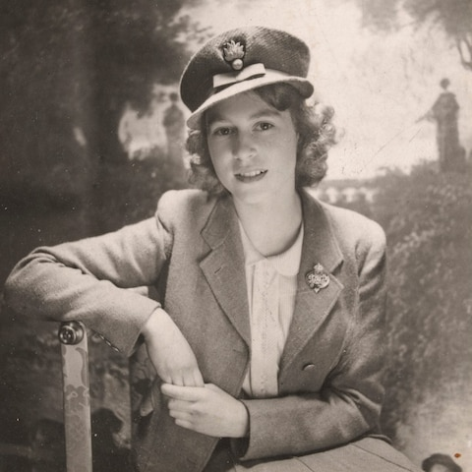
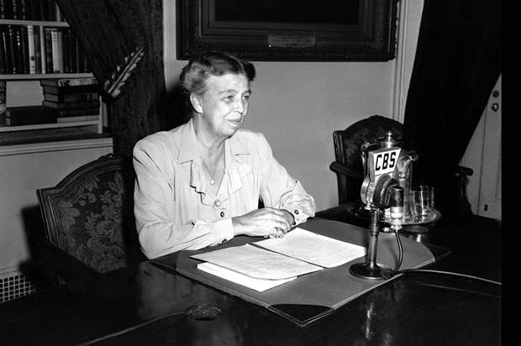
World War II: The Women’s Army Auxiliary Corps (1942)
Bi-partisan pressure from prominent female political leaders, arguing that women should be allowed to play substantial roles in the war effort
Support from First Lady Eleanor Roosevelt
A shortage– and anticipated crisis—of “manpower”
The British Auxiliary Territorial Service (ATS) impressed Chief of Staff George Marshall
The most famous member of Britain’s ATS, Princess Elizabeth.
Eleanor Roosevelt delivering
her Sunday night broadcast,
Dec. 7, 1941.

Slide 14
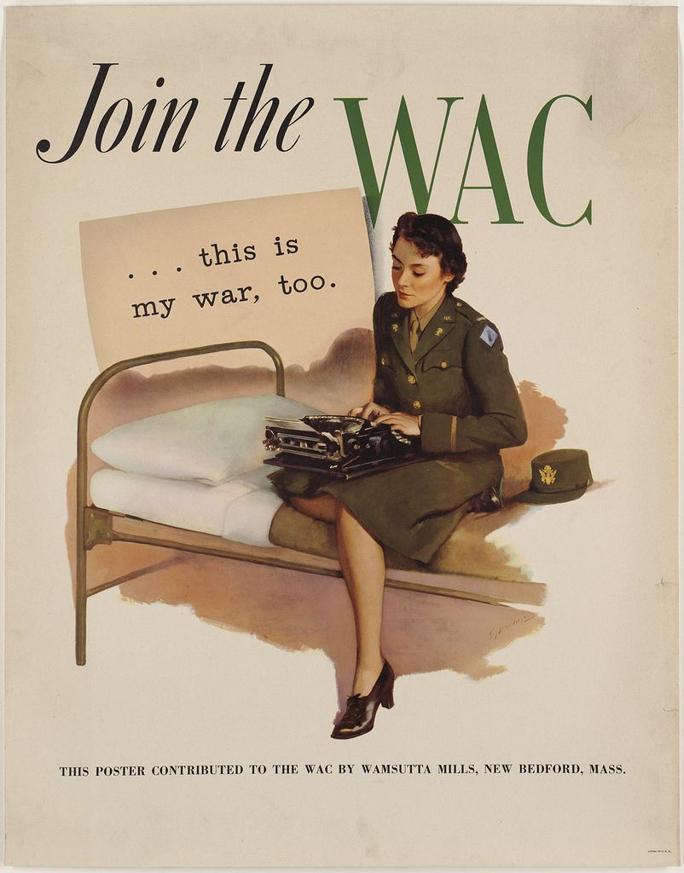
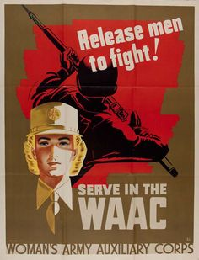
What messages are communicated by these posters?
http://libcdm1.uncg.edu/cdm/singleitem/collection/WVHP/id/6777/rec/1

Slide 15
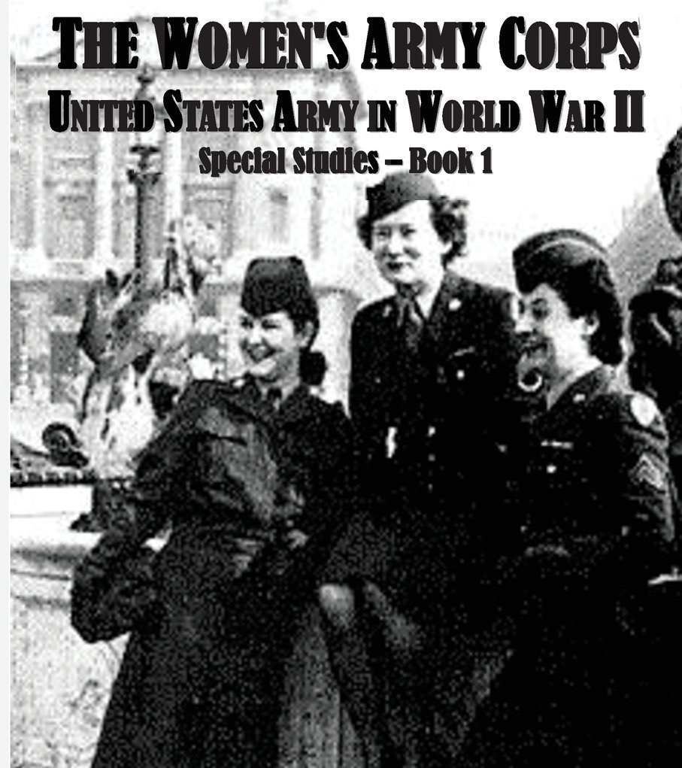
The slander campaign
The official history of the Women’s Army Corps
was written by WAC veteran Mattie Treadwell,
published in 1954.

Slide 16
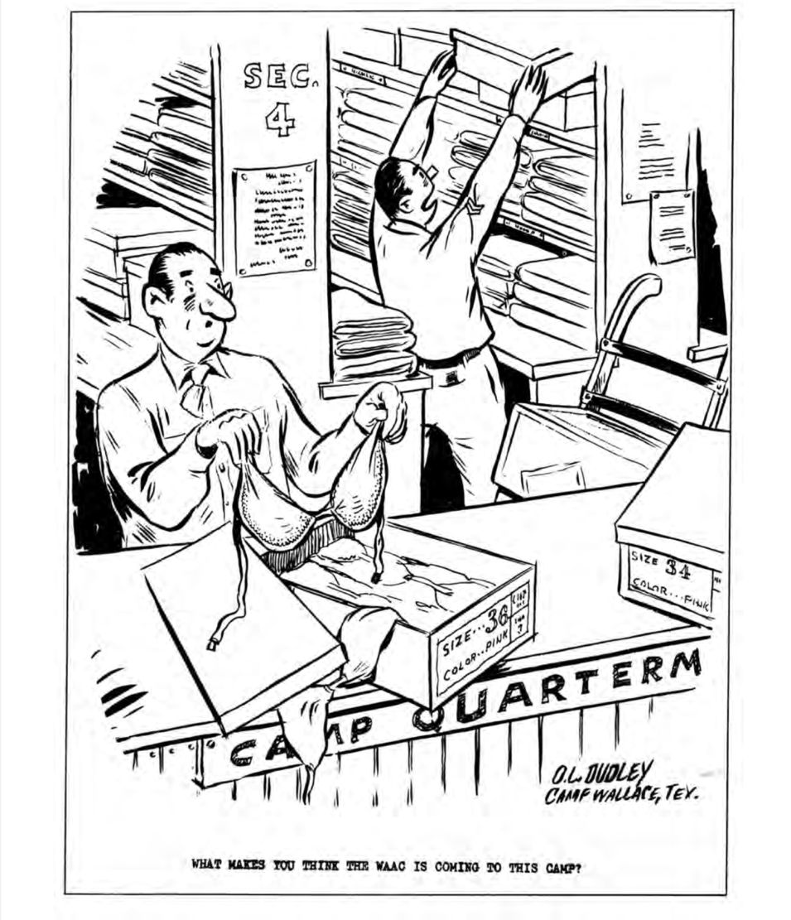
The slander campaign
Mattie E. Treadwell:
‘Male columnists were the worst offenders, in spite of Damon Runyon’s remark, “A lady in the uniform of her country will scarcely be an object of jesting on the part of a gentleman not in the same garb.” Some of the attacks contained savage comparisons to “the naked Amazons… and the queer damozels of the Isle of Lesbos.” Others, as expected, had a field day with the idea that woman’s place is in the maternity ward.’ (p. 49)

Slide 17
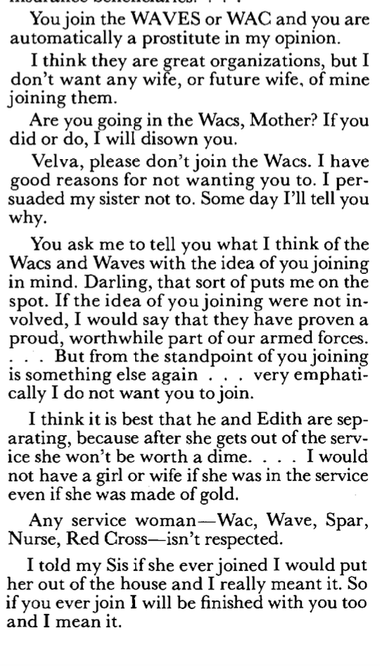
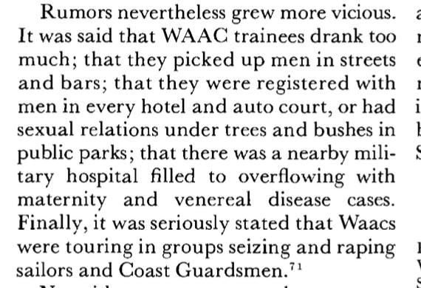
From Treadwell’s Official History of the WAC.
Q: What do these extracts reveal about Americans’
feelings about female service personnel?
Q: Who do you think was responsible for the ‘slander campaign’?

Slide 18
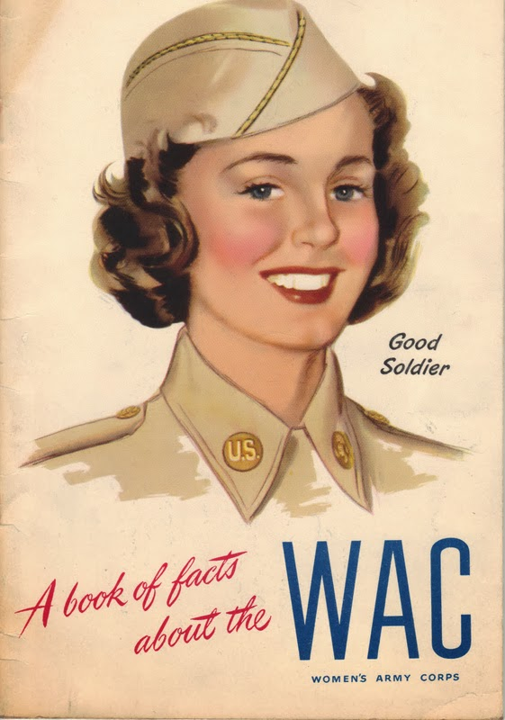
Recruiting for, and selling, the WAC
We’re In The Army Now (US Army Signal Corps, 1943)
https://www.youtube.com/watch?v=kxNnG7aPAfg
5.50
Q: How does this film attempt to reassure American viewers
about the wisdom of creating a women’s auxiliary corps, and
about the kinds of women who volunteered?

Slide 19
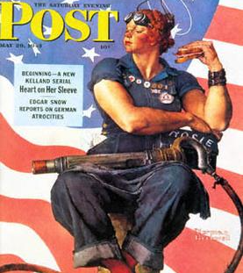
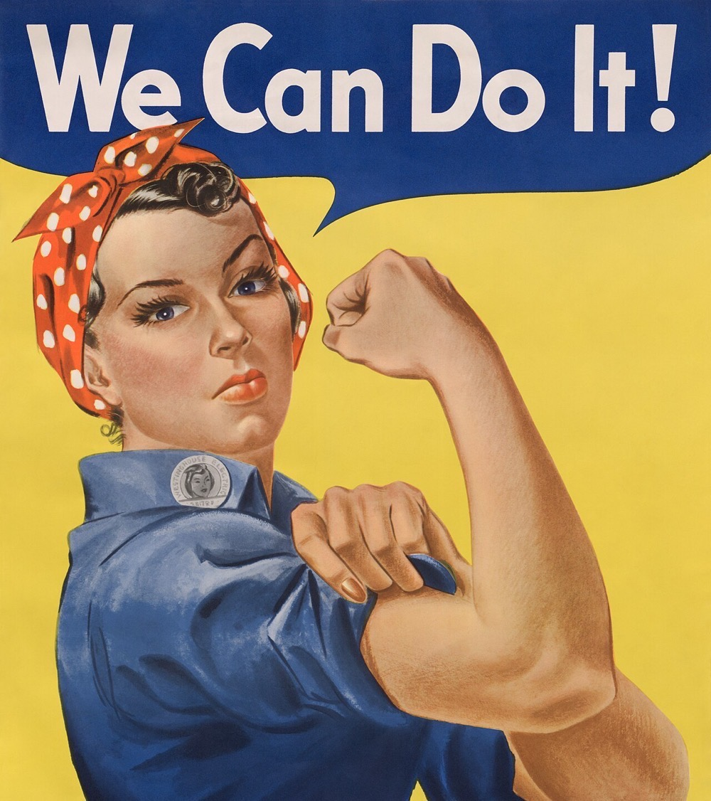
Remembering Rosie, but forgetting the WACs

Slide 20
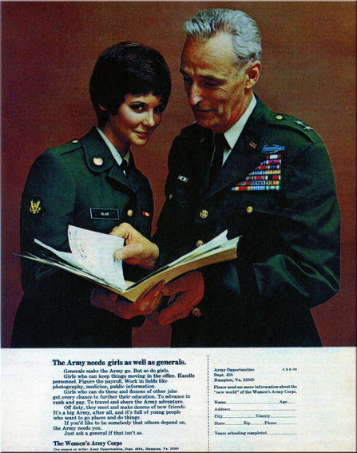
“The Army needs girls
as well as generals.”
Seventeen magazine
Feb. 1970

Slide 21
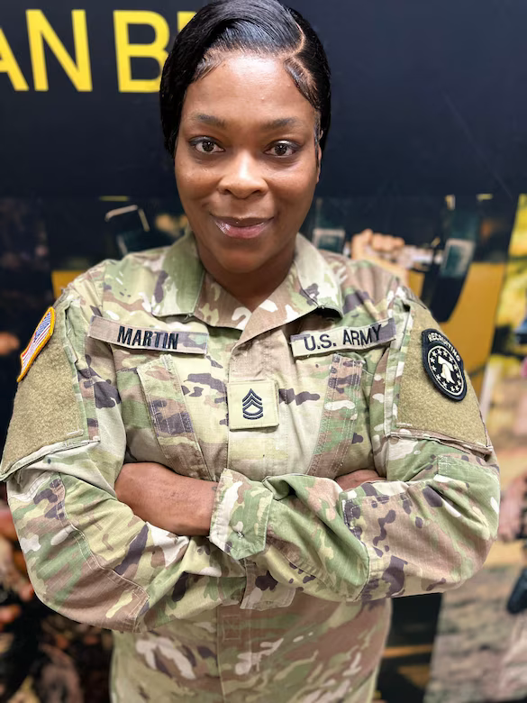
NEWS | Dec. 23, 2024
Meet your recruiter-Sgt.1st Class Chashella Martin
https://recruiting.army.mil/News/Article/3974807/meet-your-recruiter-sgt1st-class-chashella-martin/

Slide 22
It’s Your War, Too (1944)
https://www.youtube.com/watch?v=TnjKPy0-vEY

