Slide 1
War, demobilization and social change
Restoring the status quo ante?
HI2C9 week 10

Slide 2

What’s at stake?
Can we, and Should we, characterize war
as an agent of
progressive social change?

Slide 3
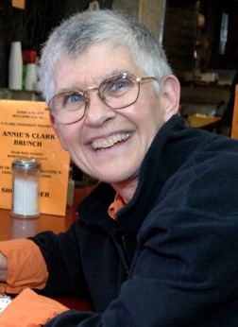
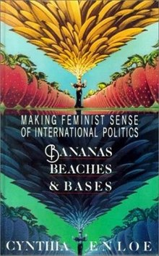
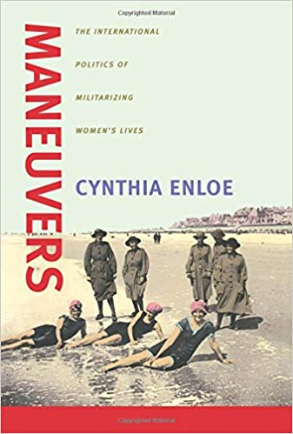
A feminist critique of US “militarization”
What demobilization??!
Cynthia Enloe
http://news.bbc.co.uk/1/hi/business/1800954.stm

Slide 4
The rise of US global
military power
Maps from David Vine,
Base Nation
https://www.basenation.us/maps.html

Slide 5
The racialization
of commercial
sex work.
A more pervasive
sense of US
male entitlement
to Asian women’s
bodies?
Philippine women
stand in the
doorway
of a “juicy bar” in
The Ville, outside
Camp Casey in
South Korea.
JON RABIROFF/
STRIPES
https://www.stripes.com/news/juicy-bars-said-to-be-havens-for-prostitution-aimed-at-u-s-military-1.8019#gallery

Slide 6
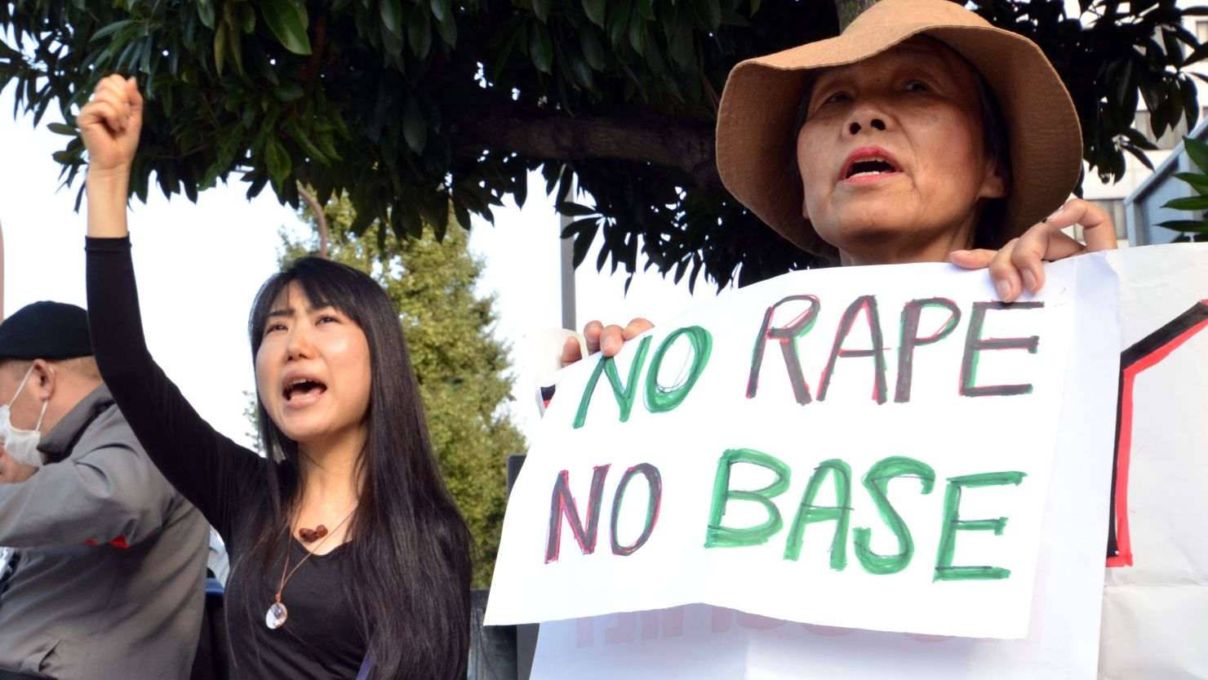
‘US soldier charged in Japan for rape of minor’
26 June 2024
A US soldier has been charged with the kidnapping and rape of a teenage girl in Okinawa, a Japanese island chain that hosts the region's largest American military base.
The case is likely to stoke the long-standing local opposition to US military presence - the islands are home to more than half of the 54,000 US soldiers serving in Japan.
The anger has also been fuelled by sexual assault cases - one of the most high-profile was in 1995, when a 12-year-old girl was raped by three US service personnel, sparking months-long protests.
The latest allegation also involves a minor, who is younger than 16, the age of consent in Japan.
https://www.bbc.co.uk/news/articles/cpwwdyye4vgo
https://edition.cnn.com/2012/11/06/world/asia/japan-us-rape-allegations

Slide 7
WAR AND CIVIL RIGHTS

Slide 8
The Civil War and Radical Reconstruction
When it took effect in January 1863, the Emancipation Proclamation freed 3.1 million of 4 million enslaved people in the US.
By December 18, 1865, three-quarters of US states had ratified the Thirteenth Amendment, which ensured that “neither slavery nor involuntary servitude … shall exist within the United States.”
In 1867, Congress approved the Fourteenth Amendment, prohibiting "states from abridging equality before the law."
The second part provided for a reduction of a state's representatives if suffrage was denied. Republicans gave the South a choice — accept Black enfranchisement or lose congressional representation.
https://www.ushistory.org/us/35b.asp
Hiram Revels of Mississippi was elected Senator and six other African Americans were elected as Congressmen from other southern states during the Reconstruction era.

Slide 9
Suffragettes hold a jubilee
celebrating the passage
of the Nineteenth
Amendment.
Ratified
August 18, 1920
https://www.theatlantic.com/
photo/2019/06/the-battle-for-
womens-suffrage-in-photos/591103/

Slide 10
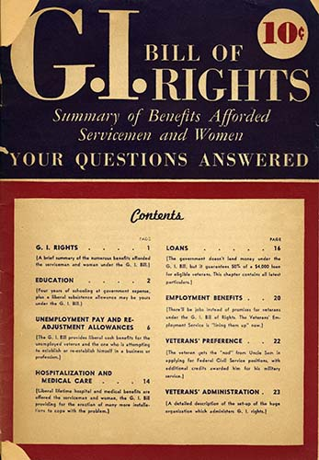
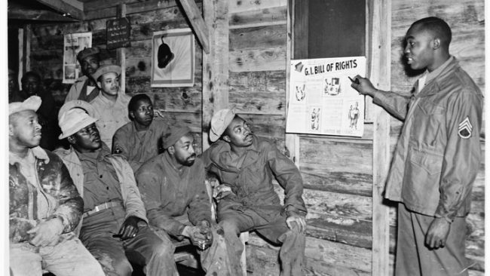
Veterans’ rights: the GI Bill (1944)
A staff sergeant explains the G.I. Bill to a group of military truck drivers.
Library of Congress
https://www.cah.utexas.edu/db/dmr/image_lg.php?variable=e_rap_1191_001

Slide 11
Executive Order 9981
July 26, 1948
Harry S. Truman bans
segregation in the
Armed Forces

Slide 12
But… postwar reactionary backlash
Post-Civil War: Formation of the Ku Klux Klan, Dec. 24, 1865, Pulaski, TN, by 6 former Confederate officers—a white supremacist terrorist organization
First Red Scare (Jan. 1919-April 1920): workers’ strikes; the October Revolution; demobilized veterans; race riots in US cities; anarchist bombings; government repression
Palmer Raids. Federal agents arrest suspected radicals. Deportation.
Cold war anti-communism: the House Committee on Un-American Activities
HUAC begins hearings on alleged communist subversion in Hollywood, 1947
McCarthyism (1950-54)
Senator Joe McCarthy
The first Red Scare
Members of an anti-suffrage mob tear a suffragette banner to bits during protests outside the White House. World War I.
Topical Press Agency / Getty

Slide 13
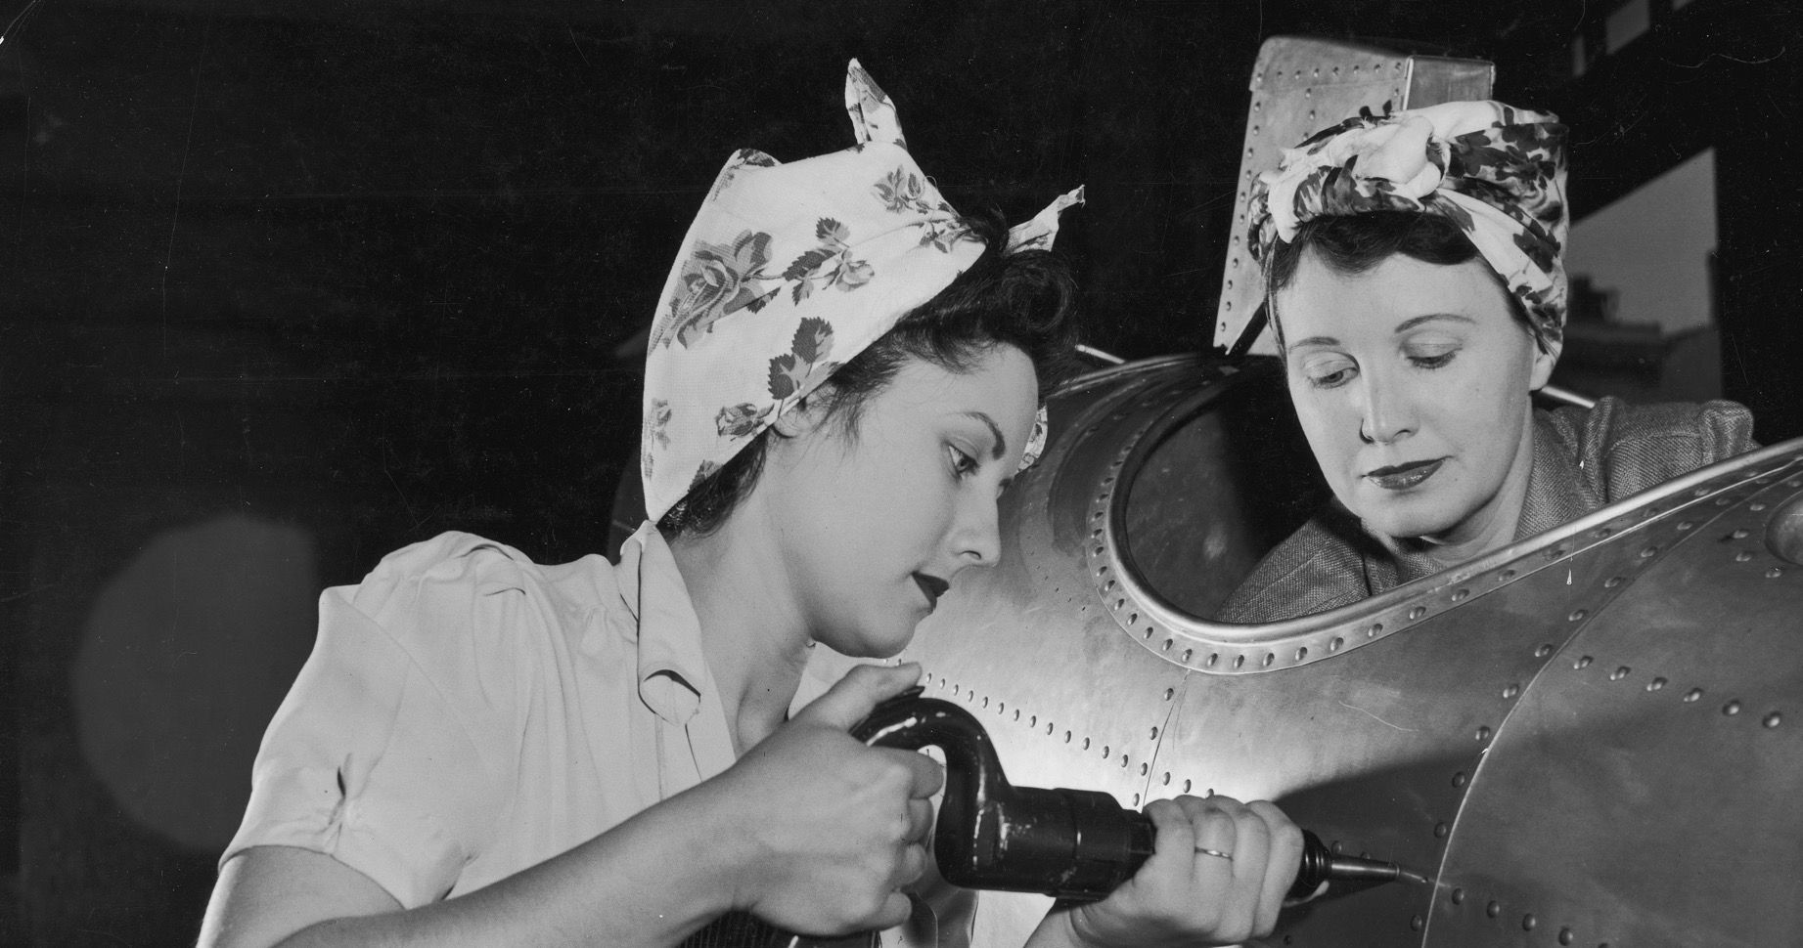
War and women’s work
For the duration only?

Slide 14
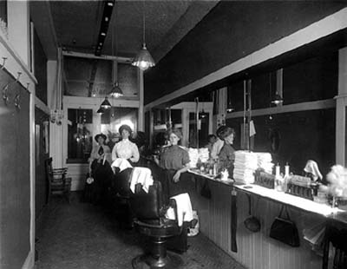
Women, war and work: WWI and after
1890: census listed 4 million “gainful” women workers (17% of the total workforce)
WWI: women’s employment in ”male” professions as well as in office/clerical positions increased
Temporary lifting of the “marriage bar” in federal
employment (reinstated at end of war & retained in
some branches of the Civil Service until 1973)
By the end of WWI, women constituted about 20% of the
workforce in manufacturing industries.
1929: 22% of the manufacturing workforce,
after a temporary dip in female employment following
men’s demobilization
1930: 10.8 m of 48.8 m “gainful workers” were women
1940: 12.8 m of 52.8 m “gainful workers” were women
https://www.ssa.gov/policy/docs/ssb/v5n7/v5n7p4.pdf
Women working as barbers in WWI
Photo courtesy of UW Digital Collections

Slide 15
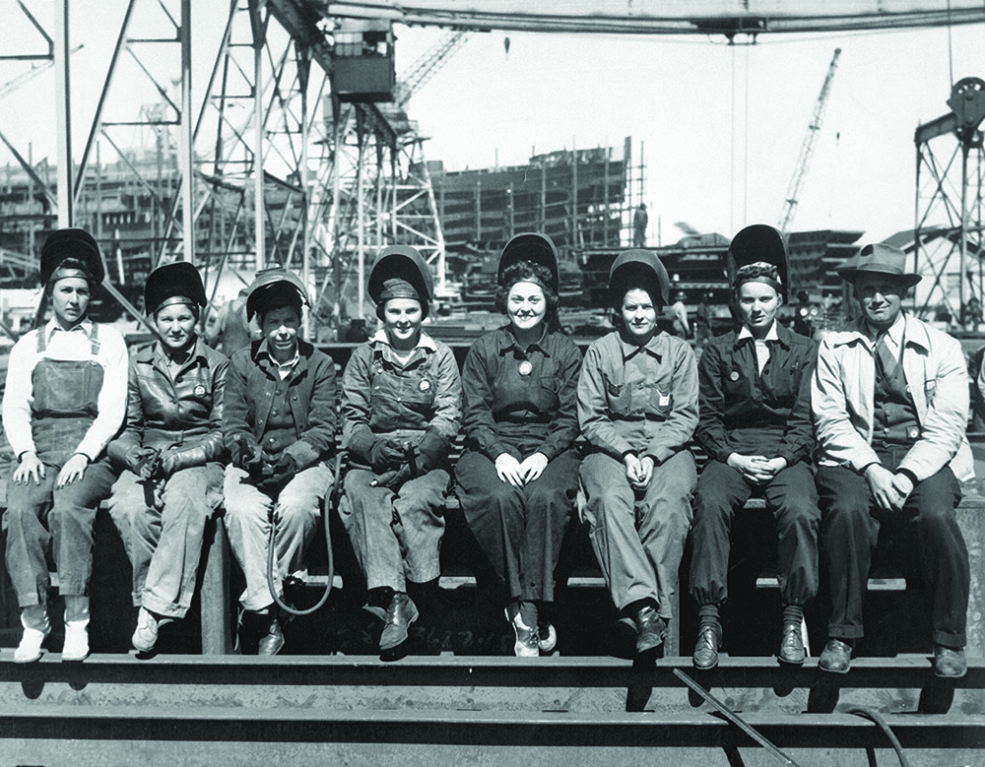
Women’s wartime employment: WWII
A watershed in the history of US women’s rights?
Or a short-lived moment of progress towards
employment equity, quickly reversed?
Approx. 6.7m more women took up paid jobs
during WWII, increasing the female labour
force by almost 50%
34% of manufacturing jobs held by women
Many in war-related industries
75% of these new women workers were
married; 60% were 35+
Entering the workforce meant that a large
number of young women did not graduate
from high school-- with long-term impacts
on their postwar employability/wages
When the U.S. entered WWII, the federal government offered women employment opportunities usually reserved for men. These women were welders at the Ingalls Shipbuilding Corporation of Pascagoula, Mississippi.
National Archives Identifier 522890

Slide 16
Postwar employment trends
Most women in defense work were laid off between autumn 1945 and spring 1946
By 1950, female labour force participation
was much as it had been in 1940
But the percentage of women in the labour force began rising again in the 1950s, including more older and married women
What did postwar women want??

Slide 17
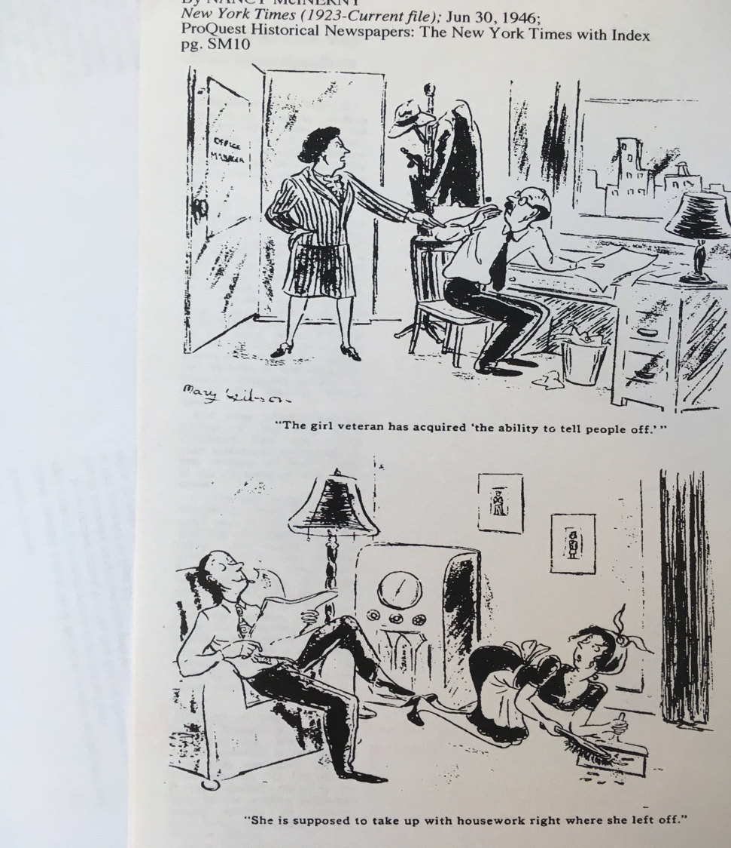
Women veterans
By June 1946, of 350,000 women who served in the armed forces in WWII, only about 65,000 were still in uniform
Women veterans were formally eligible to access GI Bill entitlements
But few women applied for start-up funds for businesses
It was also uncommon for women to receive mortgage loans through the Bill
And female applicants struggled to gain admission to overcrowded college courses
Cartoons illustrating Nancy McInerny’s story,
“The Woman Vet Has Her Headaches, Too,”
New York Times Sunday Magazine, June 30, 1946

Slide 18
Sexuality/ marriage/ family
June 1942: 18 days after Marilyn Monroe (then Norma Jean Baker) celebrated her 16th birthday, she got married. Hers was one of millions of weddings that made 1942 a record year for marriage

Slide 19
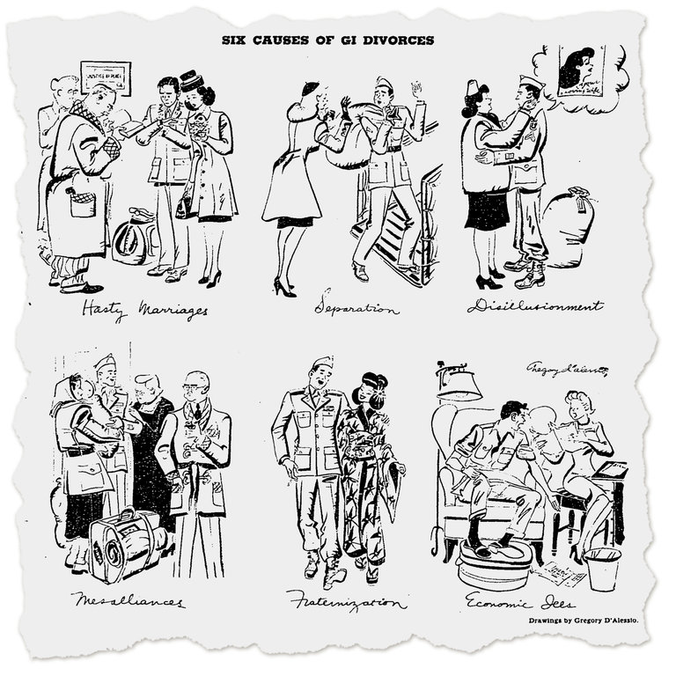
“The Whys of War Divorces”
“More than half of America’s 1,500,000 war-wed G.I.s have returned. Already one out of every four of these 800,000 men is entangled in divorce proceedings. Experts are predicting that by 1950, 1,000,000 of these wartime marriages – or two out of three – will end in divorce.”
New York Times, Feb. 3, 1946
https://www.nytimes.com/interactive/projects/cp/weddings/165-years-of-wedding-announcements/type/1941-1970/post-war-divorces?fbclid=IwAR3MVUrigakD28MP4lt0lQofQ77B14R-E23MAUGxlyIVTOEz_977q-vb8O8

Slide 20
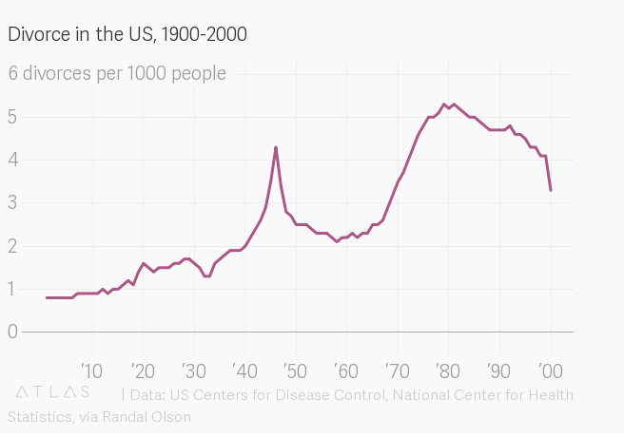
Marriage and divorce after WWII
“Divorce tapered off during the Depression, when few people had the resources to make any substantial life changes. But although World War II put a halt on decouplings, soon after there was a huge spike in divorces that would remain unmatched in US society until those baby boomers grew up and decided to exit their marriages at unprecedented rates.”
https://qz.com/1314011/the-unromantic-untold-story-of-the-great-us-divorce-spree-of-1946/

Slide 21
And yet…. a rapid return to domesticity
http://news.bbc.co.uk/1/hi/world/americas/4797243.stm

Slide 22
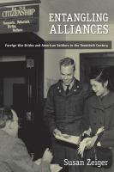
GIs and War Brides
During and shortly after WWII, more than 60,000 U.S. servicemen married women overseas, receiving free passage home. "Operation War Bride", which eventually transported an estimated 70,000 women and children, began in Britain in early 1946.
Ultimately, an estimated 300,000 foreign war brides moved to the United States following the passage of the War Brides Act of 1945 and its subsequent amendments. But the situation was more complicated for Black servicemen who wished to marry women of other ethnicities, and for white GIs who wanted to marry Asian women they had met overseas during the war or as occupation soldiers.
Many US states prohibited interracial marriage.
Read more:
Susan Zeiger,
Entangling
Alliances: Foreign
War Brides
and American
Soldiers in the
Twentieth Century
(NYU Press, 2010)
Anti-miscegenation laws weren’t finally abolished until the Loving v. Virginia case rendered them unconstitutional in 1967.
Hiroko Yamamoto and Don Roberts on Aug. 17, 1954, the day of their marriage in Kobe, Japan.
(Courtesy of the Roberts family)
https://www.washingtonpost.com/sf/national/2016/09/22/from-hiroko-to-susie-the-untold-stories-of-japanese-war-brides/?utm_term=.bb37ddcc61d0

Slide 23
Queer relationships
‘The Military’s Unexpected Role in Building San Francisco’s LBGTQ+ Community’
‘Of the more than 9,000 servicemen and women who received a blue discharge during World War II due to the ban on queer service members… many decided to settle in San Francisco, cementing the city as an LGBTQ+ hub—a legacy that originally stemmed from the town’s reputation as a hotbed for sex and gender nonconformity in the 1800s. “Ever since the Gold Rush, there was already a kind of queer world in the city, but certainly, the military role in World War II built upon that world,” Steve Estes, a history professor at Sonoma State University, tells TIME.’
https://time.com/6990773/military-san-franciscos-lbgtq-community/
Read more on this topic:
https://theconversation.com/belles-in-battle-how-queer-us-soldiers-
found-a-place-to-express-themselves-in-wwii-88019
https://www.wwiimemorialfriends.org/blog/queer-world-war-ii/

Slide 24
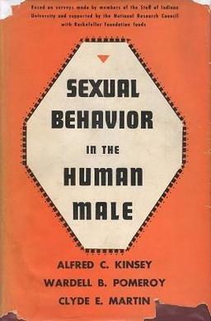
The Kinsey Reports (1948 and 1953)
A seven-point Kinsey scale system was used to evaluate subjects’ same-sex and opposite-sex attraction and sexual experience and desire.
Based on data collected from approximately 5,300 males over a fifteen-year period, the report found that nearly 46% of the male subjects had "reacted" sexually to persons of both sexes in the course of their adult lives, and 37% had at least one homosexual experience.
11.6% of white males (ages 20–35) were given a rating of 3 (about equal heterosexual and homosexual experience/response) throughout their adult lives.
The study also reported that 10% of American males surveyed were "more or less exclusively homosexual for at least three years between the ages of 16 and 55" (in the 5 to 6 range).
A second study appeared in 1953, Sexual Behavior in the Human Female.

Slide 25
“Perhaps one of the most famous trans veterans was Christine Jorgensen, who was drafted into the U.S. Army in 1945. After the war, she heard about sex reassignment surgery and traveled to Copenhagen, Denmark, where she obtained special permission to undergo a series of operations starting in 1951. She returned to the U.S. in the 1950s and her transition was the subject of a New York Daily News front page story. She became an instant celebrity, using the platform to advocate for transgender people, and also worked as an actress and nightclub entertainer. ”
https://www.wwiimemorialfriends.org/blog/queer-world-war-ii/

Slide 26
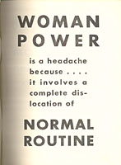
Finis!
How would you draw up the balance sheet of war-catalyzed change, Positive and negative?
Muster your thoughts for our final seminar!
https://www.archives.gov/education/lessons/wwii-women.html

