Slide 1
War, Sex and Gender in the US:
From the Civil War to WWII
Professor Susan carruthers
s.carruthers@warwick.ac.uk
Office: Fab3.76

Slide 2
Terms of engagement: lecture outline
Why study war, sex and gender? What’s at stake?
Defining the module’s key terms
A (very) brief overview of US war-making
Explaining the module’s syllabus
Some tips for seminar preparation

Slide 3
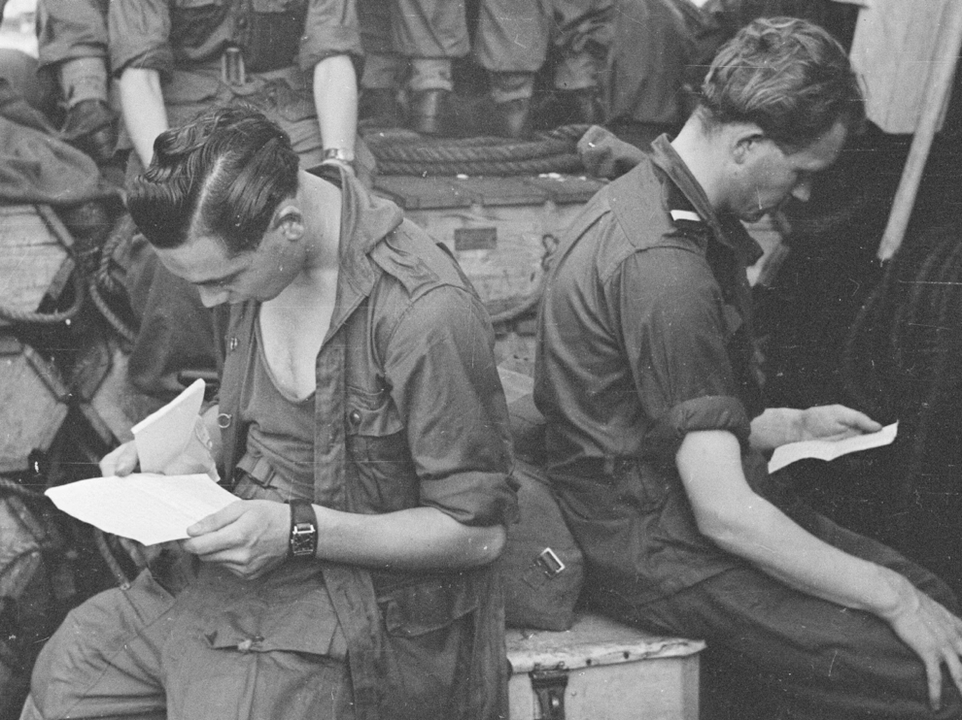
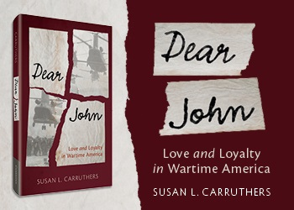
Gendered emotional work in wartime
(Cambridge University Press, 2022)

Slide 4

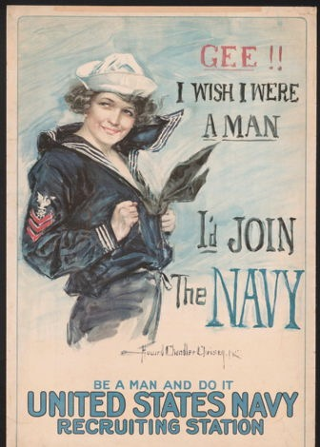
Some foundational propositions
That war– and militarism more broadly– has been a dominant force in US history
That war has had multiple and diverse consequences– emancipatory, oppressive, injurious and/or lethal– for American citizens and those aspiring to be recognized as citizens
That war (and its aftermath) relies on gendered appeals, norms and ideologies that make themselves felt in especially intense ways
That ‘wartime’ brings into focus phenomena that also exist in ‘peacetime’– though the distinction between these states of being is often blurred
Howard Chandler Christy
1917, Library of Congress
https://www.loc.gov/pictures/item/2002712088/

Slide 5
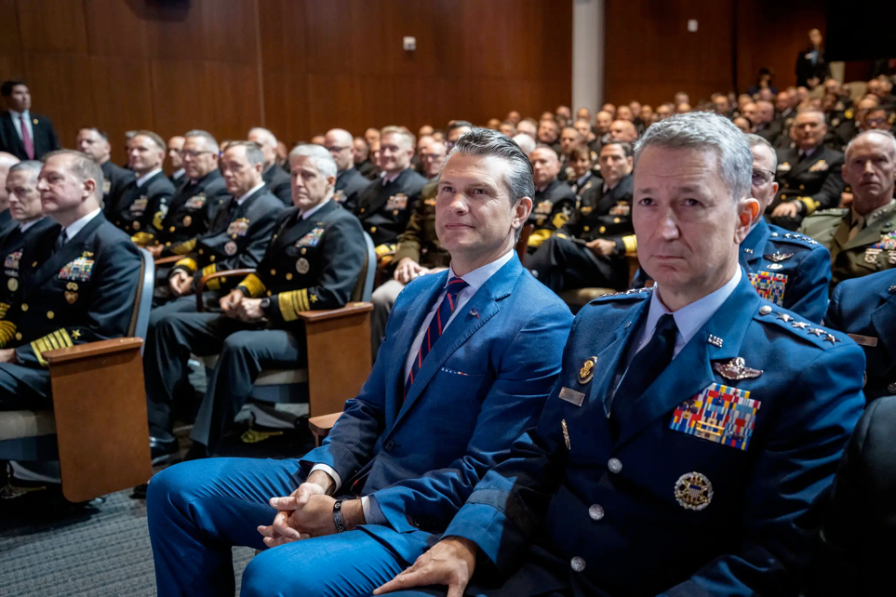
‘A Novice Defense Secretary Lectures the Brass on What It Takes to Win’
‘In his 2024 book, “The War on Warriors,” Mr. Hegseth maintained that women were not mentally suited to combat roles. “Women bring life into the world,” he wrote. “Their role in war is to make it a less deathly experience.”
In his speech to the generals, Mr. Hegseth struck a slightly different tone, arguing that the military had improperly loosened standards to accommodate women who may not be as able to carry a rucksack or lift a casualty on the battlefield.
“War does not care if you’re a man or a woman,” Mr. Hegseth said. “Neither does the enemy.”
But he insisted that he did not want to prevent women from serving in combat roles. Rather, Mr. Hegseth said, he wanted to hold them to the “highest male standard.”
“If that means no women qualify for some combat jobs, so be it,” he added.’
Greg Jaffe,
New York Times, 30 Sept. 2025
‘Defense Secretary Pete Hegseth’s vision of the military and what it should be was almost entirely defined by his 12 months of service in Iraq and his experience as a major in the Army National Guard’. Credit...Doug Mills/The New York Times
https://www.nytimes.com/2025/09/30/us/politics/hegseth-military-officers.html

Slide 6
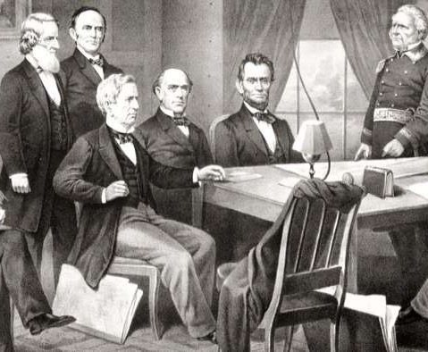
Prevailing suppositions– until the 1980s (or beyond)
War was/is a preeminently masculine field of endeavour and inquiry
Men make war, and war makes men
Women’s roles in wartime were/are largely supportive and subordinate
Military history was almost exclusively the history of men in uniform and (above all) men in combat
Mostly produced by and for a male readership
President Lincoln and his cabinet, with Lieutenant General Scott, at the start of the Civil War

Slide 7
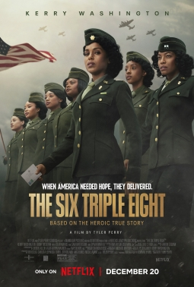
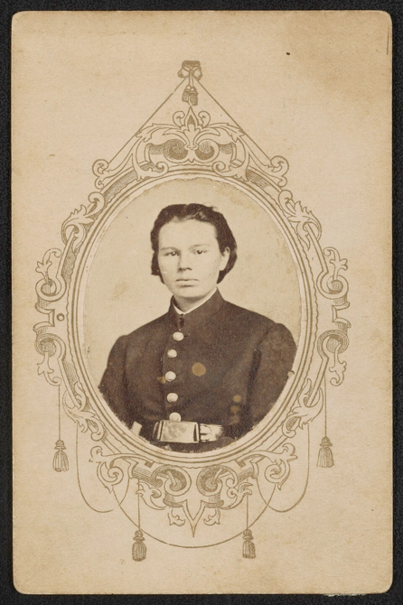
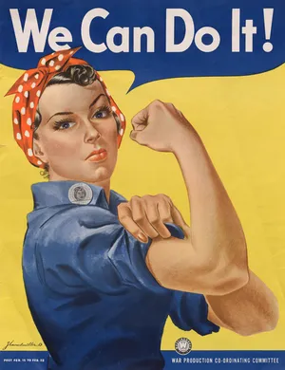
‘Hidden
her-stories’
Frances Hook, aka Private Frank Miller, Frank Henderson, and Frank Fuller, was discovered to be a woman when s/he was wounded at the Battle of Fredericktown, Missouri in the Civil War.
Library of Congress:
http://lccn.loc.gov/2016649648
Rosie the Riveter “We Can Do It!,” poster by J. Howard Miller that became associated with Rosie the Riveter.
Dir. Tyler Perry, 2024

Slide 8
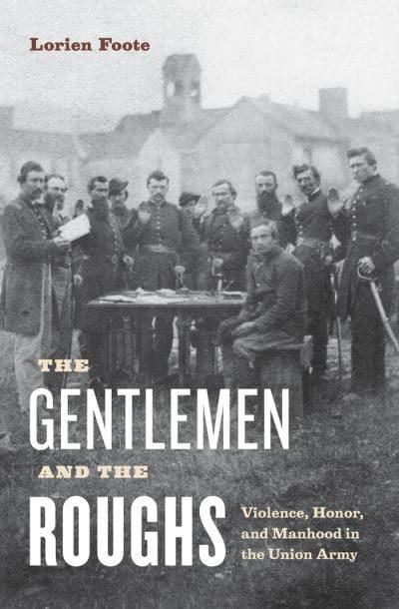
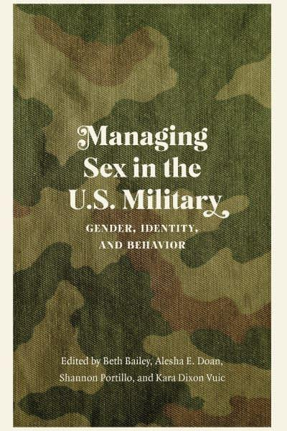
From ‘women’s history’ to gender & sexuality studies
(2010)
(2022)

Slide 9
What do we mean by ‘sex’?
And ‘gender’?

Slide 10
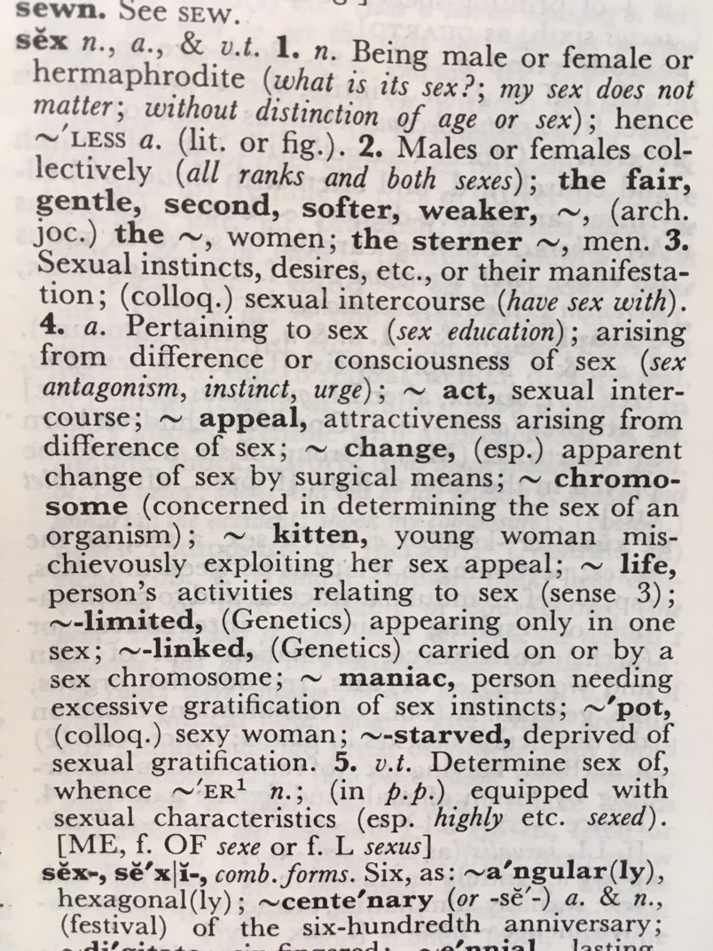
How would you amend this 1978 definition?

Slide 11
Gender: a social construction
socially prescribed ‘scripts’ that offer prompts about behaviour, appearance and demeanour– that work to differentiate ‘maleness’ from ‘femaleness’ (typically construing men and women in oppositional/antithetical terms)
gender norms change over time: i.e. today’s ideas about what it means to be male, female or non-binary aren’t the same as those prevalent 20, 50 or 100 years ago.
normative gender identities and roles are also subject to contestation at any particular point in time
studying gender is thus not reducible to the study of women-in-history, but rather how ideas about gender, and especially (in the era from 1860-1945) how American conceptions of masculinity and femininity evolved– often under pressure of wartime ‘emergency’ conditions

Slide 12
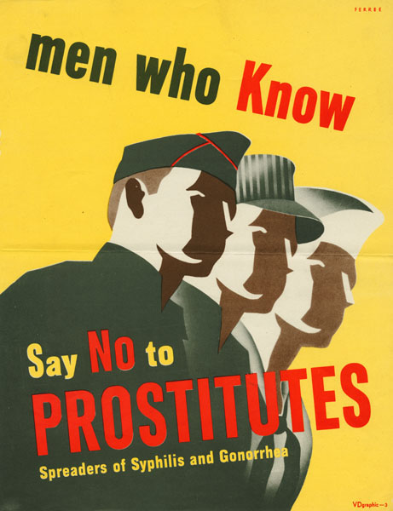
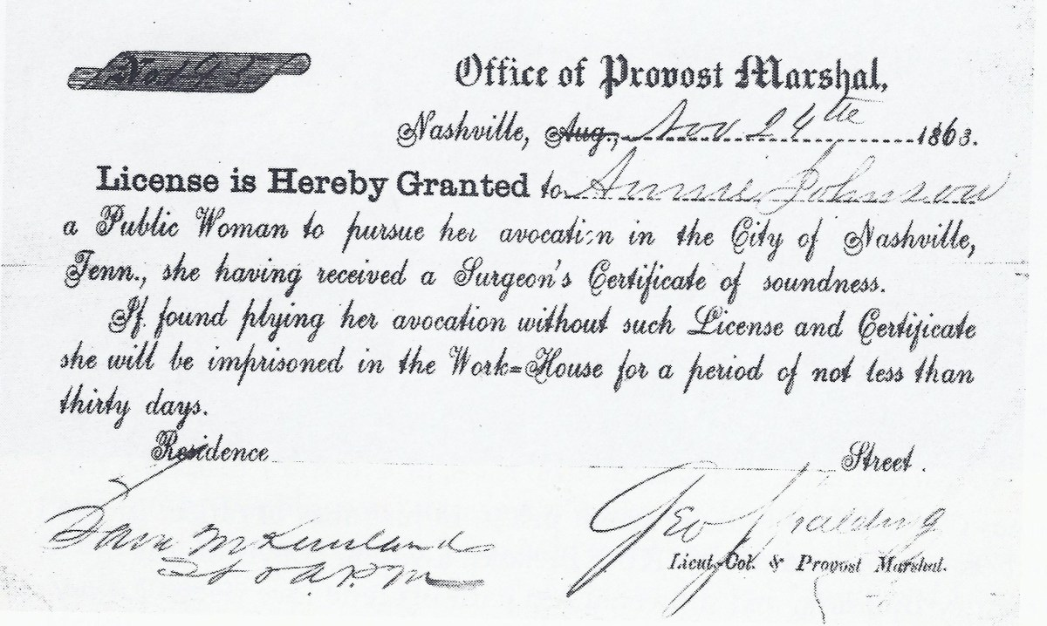
Sex: hazard and/or reward?
A license to protect sex workers, signed by George Spalding circa 1863.
The National Archives
https://www.history.com/news/civil-war-prostitution-nashville
https://www.motherjones.com/media/2010/05/us-military-std-posters/

Slide 13
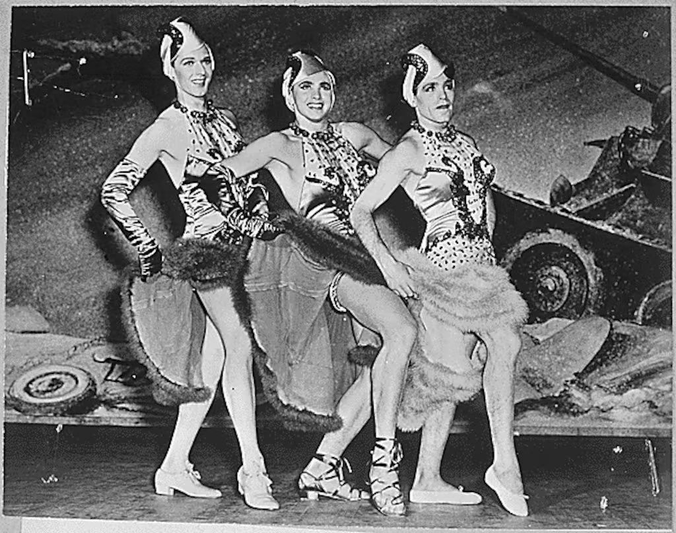
The queer
US military?
During World War II, soldiers dressed in drag for morale-boosting performances—
encouraged by
officers.
(US National Archives)
https://www.militarytimes.com/off-duty/military-culture/2023/07/06/the-us-militarys-long-history-with-drag/

Slide 14
The United States at war
A very brief overview
1861-1945

Slide 15
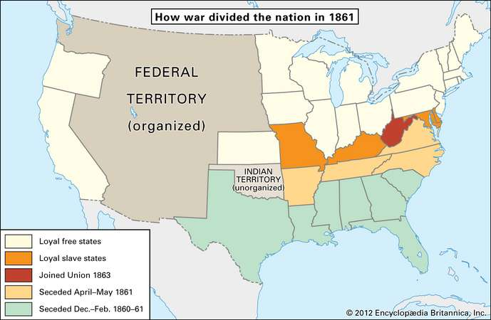
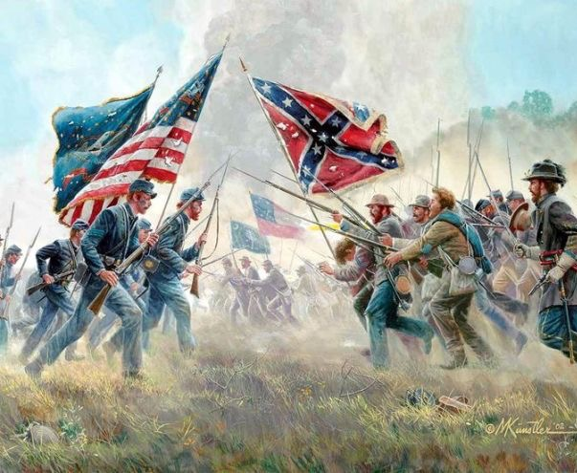
The Civil War
(1861-65)
To brush up on your Civil War history, read the article:
https://www.britannica.com/event/American-Civil-War/The-military-background-of-the-war

Slide 16
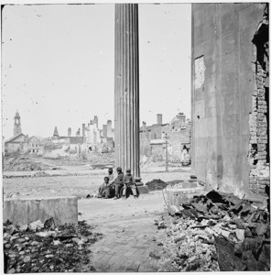
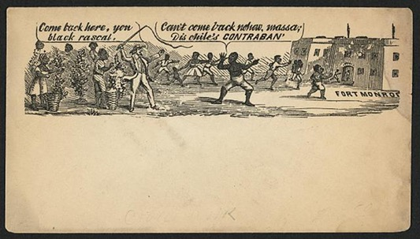
The Civil War as the first ‘total war’?
Epic losses
A world upended
No ‘home front’
Est. 620,000 military fatalities—
Approximately equal to the total US fatalities in the Revolutionary War, the War of 1812, the Mexican War, the Spanish-American War, WWI, WWII, and the Korean War combined.
Eliminating about 2% of the entire population, a war of comparable destructiveness today would result in 6 million deaths.
Chattel slavery abolished
To learn more about urban destruction in the Civil War, including the provenance of the images above, read this:
https://oxfordre.com/americanhistory/view/10.1093/acrefore/9780199329175.001.0001/acrefore-9780199329175-e-313?result=1&rskey=vkiW5v

Slide 17
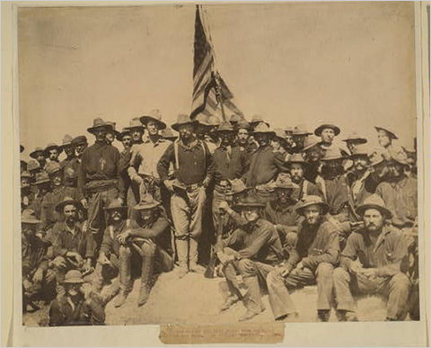
Spanish-American-Cuban War (1898 + )
A ‘splendid little war’ (John Hay to TR) between the US & Spain over Cuba & the Philippines
Lasted 3 months, 3 weeks; relatively few US military casualties
Est. 385 battle deaths; 2061 other fatalities; 1662 wounded
War in the Philippines lasted several years longer– a counterinsurgency campaign waged by US military against Filipino nationalist fighters
Source: Library of Congress. Theodore Roosevelt and his Rough Riders at the top of the hill they captured in the Battle of San Juan.
https://learning.blogs.nytimes.com/2011/07/01/july-1-1898-the-battle-of-san-juan-hill/

Slide 18
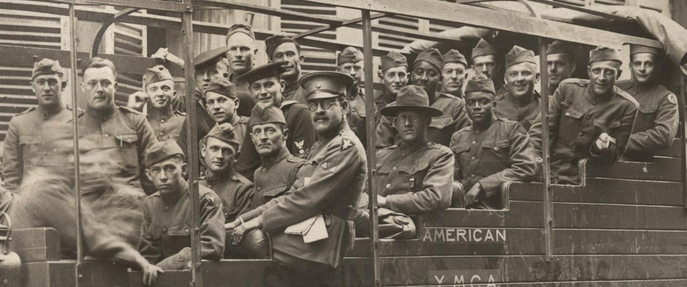
World War I (April 1917 – Nov. 1918)
https://www.theworldwar.org/doughboys
4,734,991 Americans served; 53,402 US battle deaths

Slide 19
World War II (Dec. 1941 – September 1945 +)
Some statistics about the American men who served in WWII
38.8% (6,332,000) of U.S. servicemen and all servicewomen were volunteers
61.2% (11,535,000) were draftees
Average duration of service: 33 months
Overseas service: 73% served overseas, with an average of 16 months abroad
Combat survivability (out of 1,000): 8.6 were killed in action, 3 died from other causes, and 17.7 received non-fatal combat wounds
Non-combat jobs: 38.8% of enlisted personnel had rear echelon assignments—administrative, support, or manual labor.
Average base pay: enlisted—$71.33 per month; officer—$203.50 per month
Year | Army | Navy | Marines | Coast Guard | Total
1939 | 189,839 | 125,202 | 19,432 |  | 334,473
1940 | 269,023 | 160,997 | 28,345 |  | 458,365
1941 | 1,462,315 | 284,427 | 54,359 |  | 1,801,101
1942 | 3,075,608 | 640,570 | 142,613 | 56,716* | 3,915,507
1943 | 6,994,472 | 1,741,750 | 308,523 | 151,167 | 9,195,912
1944 | 7,994,750 | 2,981,365 | 475,604 | 171,749 | 11,623,468
1945 | 8,267,958 | 3,380,817 | 474,680 | 85,783 | 12,209,238

Slide 20
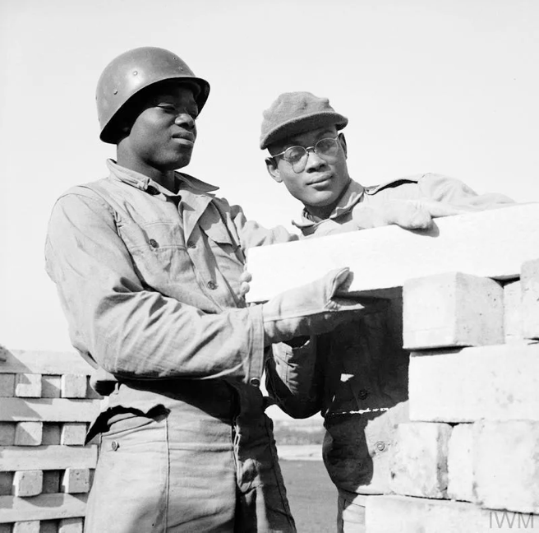
‘Minority’ participation in the US Military in WWII
Black American | 901,896
Puerto Rican | 51,438
Japanese American | 33,000
American Indian | 20,000
Chinese American | 13,311
Filipino American | 11,506
Hawaiian | 1,320
Women's Army Corps (WAC) | 150,000
Navy’s Women Accepted for Voluntary Emergency Service (WAVES) | 100,000
Coast Guard Women’s Reserves (SPARS) | 10,000
Marine Corps Women’s Reserve | 23,000
Army Nurse Corps | 60,000
Navy Nurse Corps | 14,000
Women’s Airforce Service Pilots (WASP) | 1,074
.
NB: The US Military was
racially segregated
until President Truman
signed Executive Order 9981
on July 26, 1948
Black US servicemen undertaking railway construction in Britain in 1943. Black troops were extensively employed in Britain to carry out manual roles, like truck driving and catering, for the US Forces.
https://www.iwm.org.uk/history/they-treated-us-royally-the-experiences-of-black-americans-in-britain-during-the-second-world-war
https://www.nationalww2museum.org/students-teachers/student-resources/research-starters/research-starters-us-military-numbers

Slide 21
Part I: Mobilisation
LECTURES
1) Terms of engagement: war/sex/gender
2) Forging martial masculinity
3) Pacifism, feminism and anti-war resistance
SEMINARS
1) Gender as construct and 'cause'?: the Spanish-American War (1898-99)
2) Conscripting masculinity
3) Maternalism and women's resistance to World War I

Slide 22
Part II: At War
Gendered war work
Seminar topics
4) Nursing and the evolution of gender norms
5) The Women's Army Corps and the politics of sexuality in World War II
6) Reading Week [no seminar]
7) 'Good' and 'bad girls' in the 'Good War'
LECTURES
4) What do soldiers do?
5) Women in uniform
6) Reading Week [no classes]
7) Morale, morality and sexuality in the 'Good War’

Slide 23
Part III: After War
Seminars
8) Gendered grief and 'Gold Star Mothers'
9) The 'remasculinization' of wounded veterans after World War II
10) War as an agent of progressive social change?
LECTURES
8) Mourning and memorialization
9) Wounded bodies, disordered minds, and the gendered work of veterans' rehabilitation
10) Demobilisation: restoring the gendered status quo ante?

Slide 24
Seminar preparation for week 1:
All the information you need is on the module website
https://warwick.ac.uk/fac/arts/history/students/modules/hi2c9/syllabus/week1
Required viewing/reading:
Primary sources: Library of Congress, Spanish-American War in Motion Pictures collection
Explore a selection of contemporary newsreels of the Spanish-American-Cuban war, watching them in particular with a view to how/where gender constructs appear. Make sure to watch the three I've selected here as well as a few others that catch your eye to get a feel for the flavour of the time and of this brand new cinematic medium:
https://www.loc.gov/collections/spanish-american-war-in-motion-pictures/about-this-collection/
'Roosevelt's Rough Riders': https://www.loc.gov/item/98500909/
'Love and war': https://www.loc.gov/item/98501279/
'Blanket-tossing a new recruit': https://www.loc.gov/item/98501030/
Robert Dean, 'Gender as a Cause of War' in Kara Vuic (ed), The Routledge History of Gender, War and the U.S. Military (2017), pp.167-84, e-book
Kristin L Hoganson, Fighting for American Manhood: How Gender Politics Provoked the Spanish-American and Philippine American Wars (1998); extract from the book, included in Dennis Merrill & Thomas G Paterson (eds), Major Problems in American Foreign Relations, Vol. 1 (7th ed, 2010), Hoganson

Slide 25
Suggestions for seminar preparation
Before you start reading/viewing, look at the seminar questions
Keep them in mind as you read, thinking about how you’d answer them in class
Take notes sparingly-- think primarily about concepts, themes and arguments
Stay alert to things that seem curious, surprising or counter-intuitive to you. Jot them down!
Think not just about the questions I’ve set, but what YOU want to ask/discuss about these sources
If you’re uncertain about anything– either conceptual or empirical– let me know and I’ll try to clarify

