Slide 1
Martial masculinity
Recruitment, conscription and
the ‘making of men’
Hi2C9 week 2

Slide 2
How did the US state usher men into uniform?
What expectations– about different forms of compensation—did men take with them into the armed forces?

Slide 3
Conscripting masculinity
The formal mechanisms by which the us state mustered men into military service via draft boards
The more diffuse ways in which men were enticed into military service via appeals to masculinity, among other inducements

Slide 4
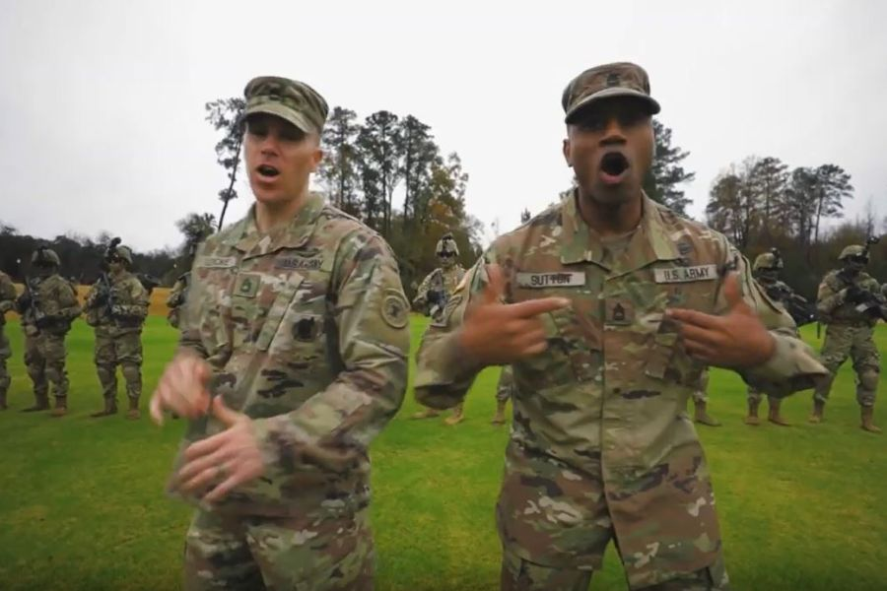
“Giving All I’ve Got” (2019)
‘“Our research tells us that hip-hop and urban culture is a powerful influence in the lives of young Americans," the leader of the Army's Strategic Outreach Directorate said... "I want them to say, 'Hey, the Army was here — the Army is cool!'”
https://www.stripes.com/news/army/army-recruiters-rap-video-brings-mixed-reviews-1.593422
https://www.youtube.com/watch?v=SDggg8G9B7o

Slide 5
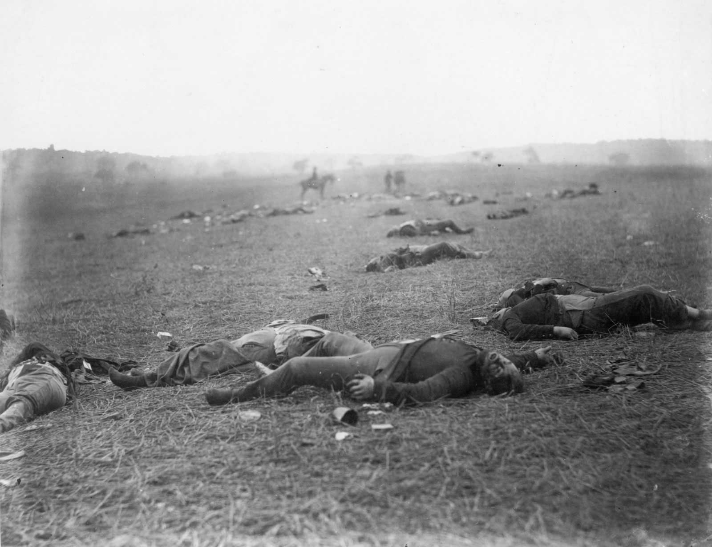
Obfuscation
War and the
unmaking
of men
Gettysburg
Timothy O'Sullivan
July 1863

Slide 6
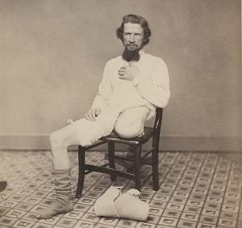
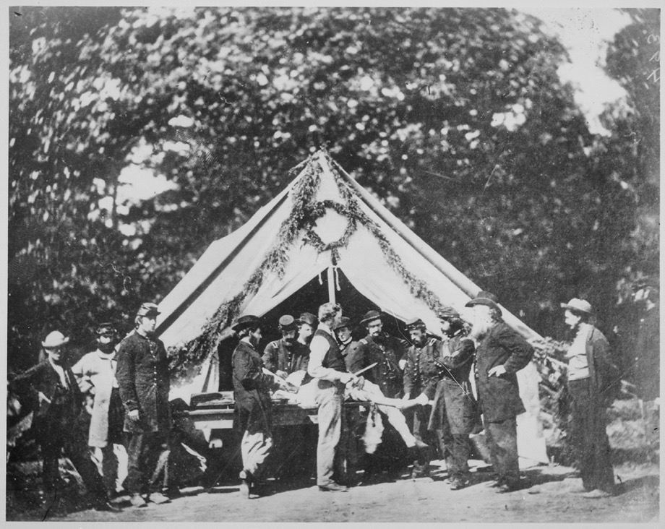
"The limbs of soldiers are in as much danger from the ardor of young surgeons as from the missiles of the enemy.”
Surgeon Julian John Chisholm, 1864
Private George W. Lemon, from George A. Otis,
Drawings, Photographs and Lithographs Illustrating the Histories of Seven Survivors of the Operation of
Amputation at the Hipjoint, During the War of the
Rebellion, Together with Abstracts of these Seven
Successful Cases (1867)
Courtesy National Library of Medicine
Amputation being performed in front of a hospital
tent, Gettysburg, July 1863
Courtesy National Archives and Records Administration
https://www.nlm.nih.gov/exhibition/lifeandlimb/maimedmen.html

Slide 7
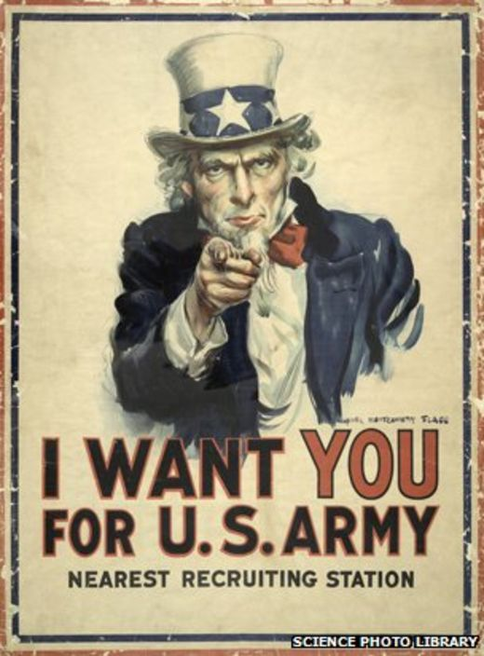
“Bring me men!”
Cajolery
Coercion
Compulsion
James Montgomery Flagg (1917)
Library of Congress
https://www.loc.gov/resource/ppmsc.03521/

Slide 8
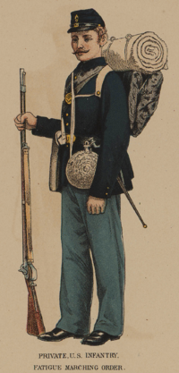
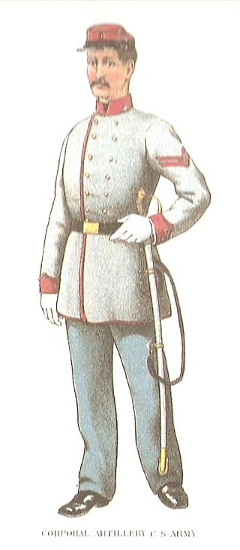
The US army in the Civil War
mistrust of large armies as potential instruments of tyranny
locally mustered militias Constitutionally enshrined, along with the individual right to bear arms (2nd Amendment)
Dec. 1860: US army’s authorized strength totaled 18,000 (incl. 1,108 commissioned officers)
the army had fought a major war with Mexico (1846-48) and was constantly engaged in “frontier wars” in the south and south-west against Native Americans
Secession in 1861 splintered the army along sectional lines
about 20% of the officer class joined the Confederate forces
2,128,948 men served in the Union Army (uniform shown, left)
1,082,119 served in the Confederate States Army (right)

Slide 9
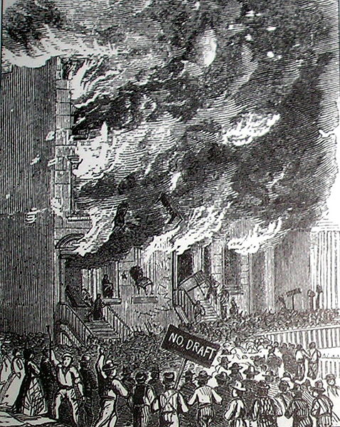
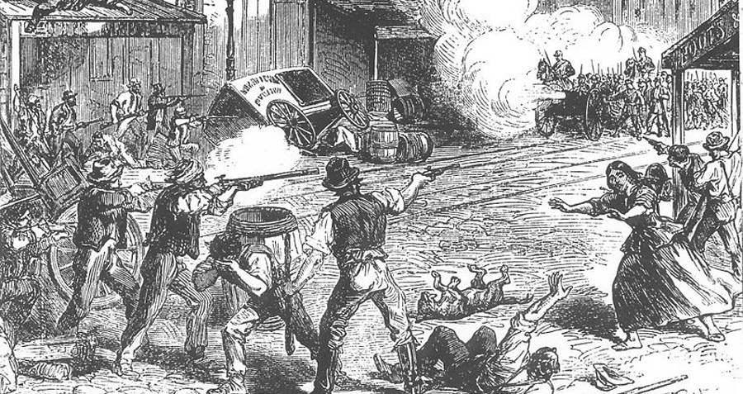
1863: Enrollment Act of Conscription
all single men (20-45 y/o) & married men (20-35) subject to the draft unless they could pay $300 for a “substitute” to take their place
draftees chosen by lottery
July 13-16, 1863: New York City draft riot. Rioters attacked African Americans
120 fatalities ensued; 4000 Federal troops called in.
Rioters attack a building on Lexington Avenue

Slide 10
President Lincoln signs
The Emancipation
Proclamation
January 1, 1863

Slide 11
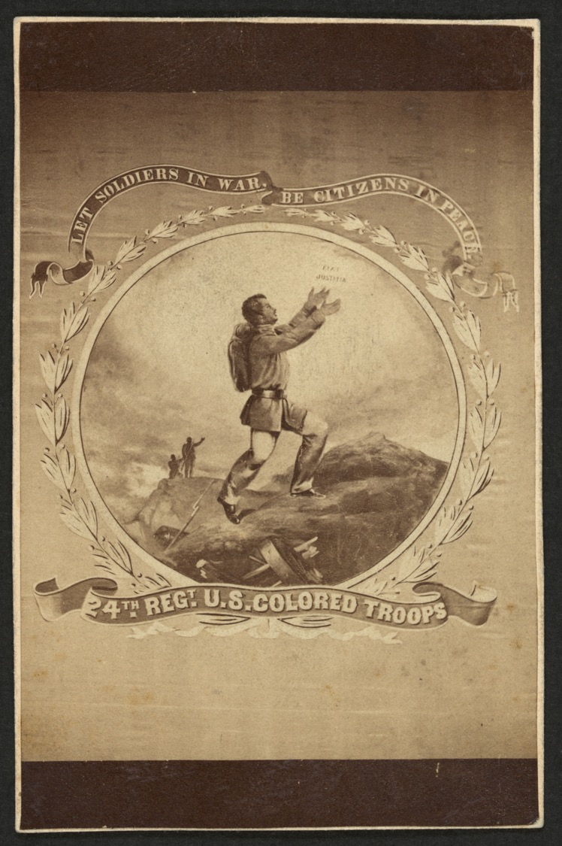
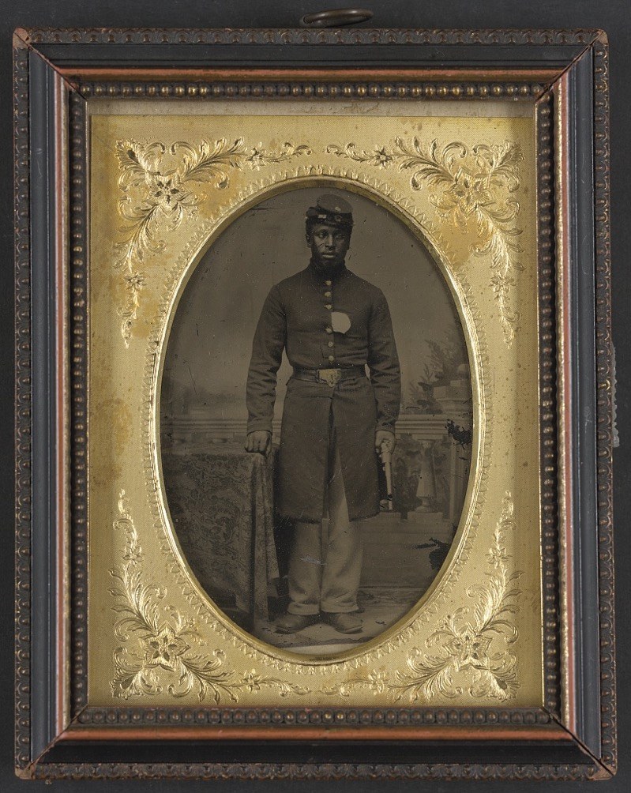
Sergeant Tom Strawn of Company B, 3rd U.S. Colored Troops (USCT) Heavy Artillery Regiment, with revolver in front of painted backdrop showing balustrade and landscape
Library of Congress: African Americans in the Civil War:
https://www.loc.gov/classroom-materials/civil-war-images-depictions-of-african-americans-in-the-war-effort/
4th Regt. U.S. Colored Troops. “Let Soldiers in War, Be Citizens in Peace”

Slide 12
Appeals to
ethnic pride and
solidarity
About 100,000 German Americans and 100,000 Irish Americans served in the Union Army

Slide 14
Collection of the New-York Historical Society, Neg. #ac03171ac03149

Slide 15
Review a gallery of Civil War recruitment posters:
https://www.theatlantic.com/national/archive/2011/10/civil-war-recruitment-posters/247420/

Slide 16
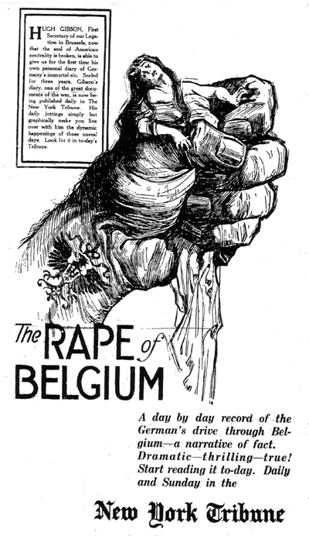
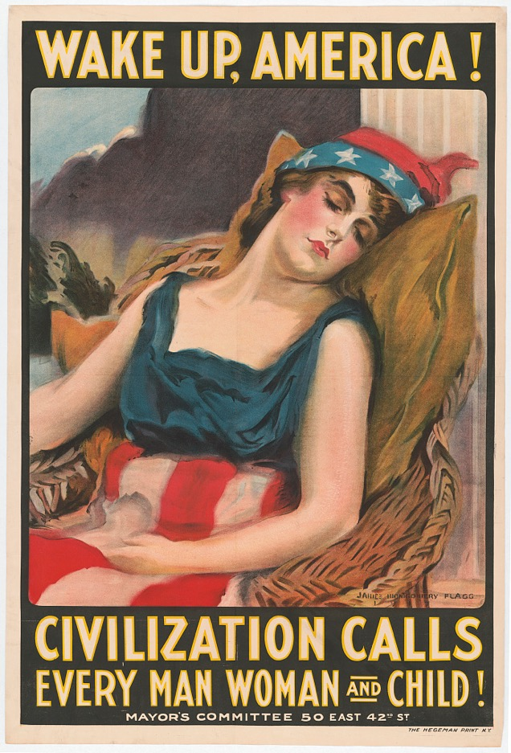
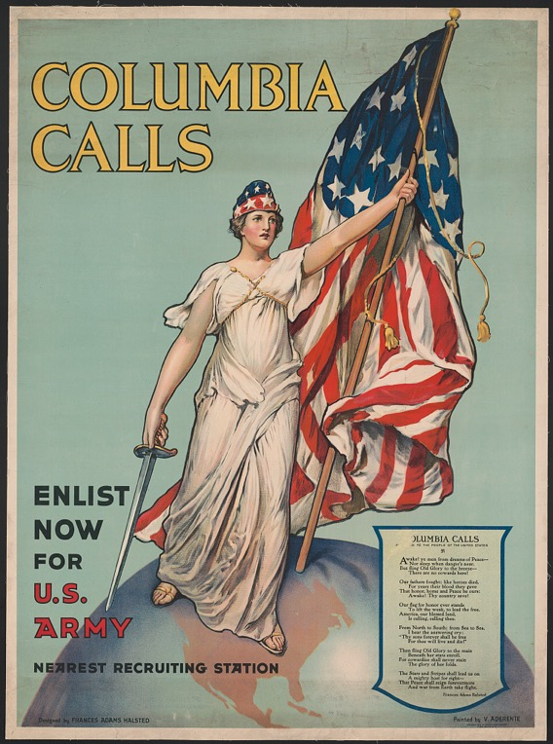
Gendered appeals: World War I
https://www.loc.gov/collections/world-war-i-posters/about-this-collection/
https://commons.wikimedia.org/wiki/File:Atrocity_Propaganda_--_The_Rape_of_Belgium.jpg

Slide 17
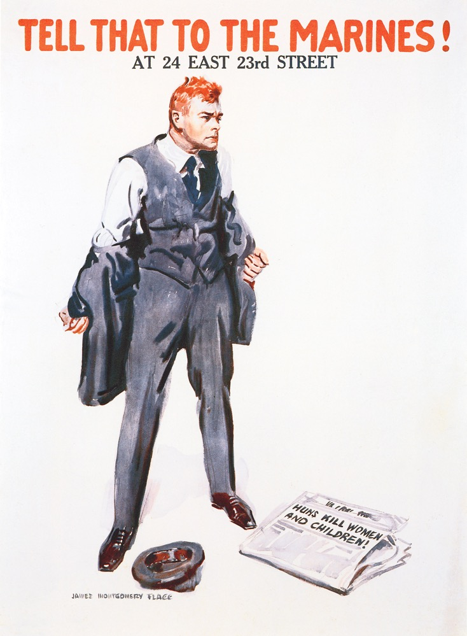
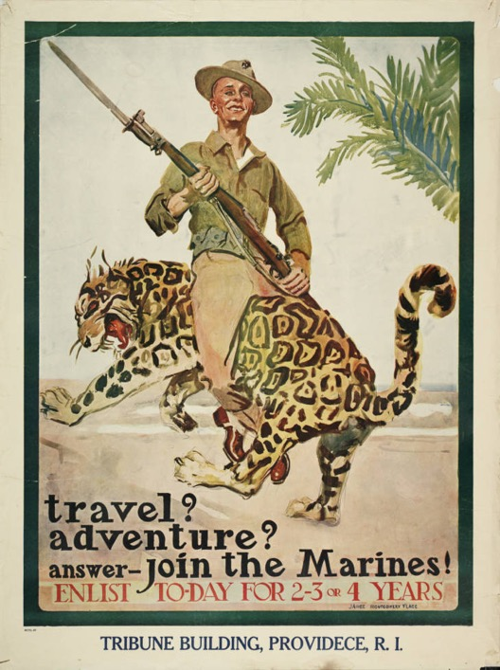
Marine Corps recruitment
James Montgomery Flagg (1917)
https://digital.libraries.psu.edu/digital/collection/warposters/id/48/
https://www.worldwar1centennial.org/index.php/usmc-ww1-centennial-home/1162-marine-corps-recruiting-posters-of-the-great-war.html

Slide 18
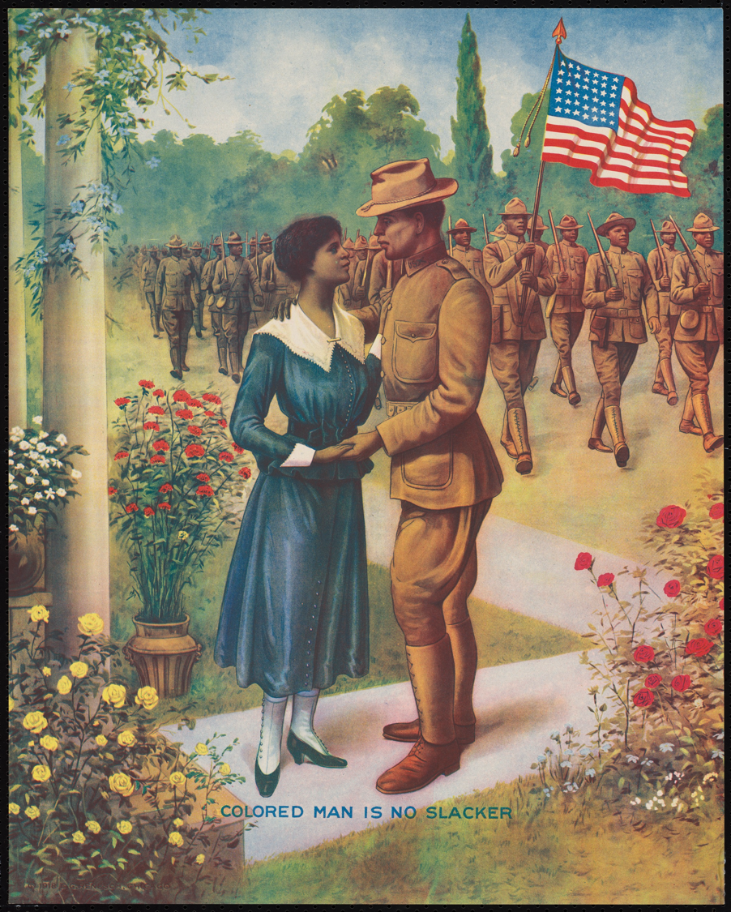
In this chromolithograph, a World War I infantryman bids farewell to his sweetheart while his comrades march carrying their nation's flag. Despite conflicting opinions on the war, and segregation and prejudice in the military, more then 350,000 African Americans served in World War I, soundly confirming the slogan on this military recruitment poster: "The Colored Man Is No Slacker.”
Though the slogan prevailed, many Black men were drafted and had no choice but to serve. In 1917, 36% of African Americans were placed in the highest draft category (Class I) compared to 24 % of white men. By war’s end, the military had inducted approx. 33% of Black draft registrants compared to roughly 25% of whites. Paradoxically, about half of all Black World War I soldiers served stateside, largely as laborers in uniform, with little hope of receiving combat training and deploying to France.
Credit: print by E.G. Renesch, Chicago, Illinois, 1918
Collection of the Smithsonian National Museum of African American History and Culture https://nmaahc.si.edu/object/nmaahc_2008.2.3

Slide 19
“Bring me men!” but not just any man
Determining “Fitness”

Slide 20
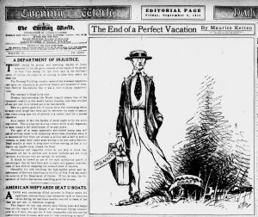
Selective Service in World War I
“It is in no sense a conscription of the unwilling, It is rather selection from a nation which has volunteered its mass.” (Woodrow Wilson)
May 18, 1917: Selective Service Act passed
4,648 local boards (approx. 1 for every 30,000 people) interviewed men to determine fitness for military service
June 5, 1917: all men 21-31 required to register
June 5, 1918: all men who reached 21 after June 5, 1917 required to register
Sept. 12, 1918: all men 18-45 required to register
24 million registered; approx. 3 m inducted
Approx. 11% draft eligible pop. refused to register
70% of army troops were conscripts
Further Library of Congress resources:
https://blogs.loc.gov/headlinesandheroes/2018/06/wwi-draft/
https://www.loc.gov/rr/news/topics/ww1draft.html?loclr=blogser
“Mr. Slacker gets his marching orders”
The Evening World (New York, NY), September 6, 1918, p. 16

Slide 21
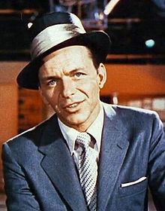
Selective Service in World War II
Sept. 1940: Selective Training and Service Act
the first peacetime draft in US history re-established the Selective Service
System of draft boards (6,400 in operation during WWII)
all men, 19-57, required to register. 49 million did so.
The initial term of service was the duration of the war + 6 months
From a 1940 strength of 460,000, the US military grew to approx. 16m,
of whom 10 million entered the services via conscription
72,000 registered as conscientious objectors
Psychiatric screening deemed 1,846,000 men ineligible for
“neuropsychiatric” reasons
4-F was the military designation for a man unfit for service– whether on
grounds of physical unfitness, mental health, or suspected homosexuality
Frank Sinatra: the most
reviled ”4-Fer”
https://twu-ir.tdl.org/handle/11274/325

Slide 22
Attributes of interest to military recruiters
Physical fitness (including physique; absence of illnesses/addictions)
Intelligence
Psychological stability/sanity– men who won’t “crack up” under duress
Literacy—though this could be, and was, taught by the armed forces
Marital status/fatherhood
Sexual orientation
Citizenship (?)

Slide 23
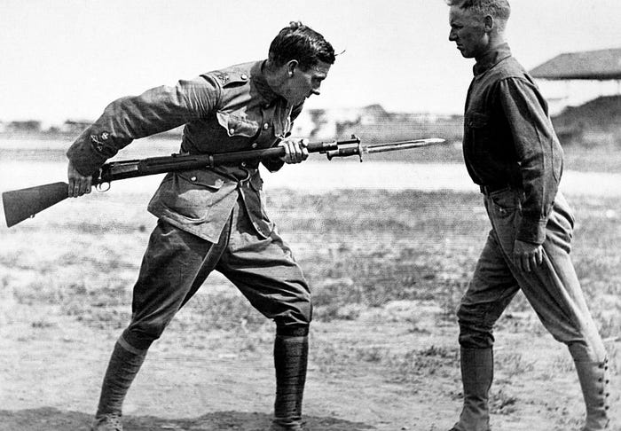
Physical fitness
World War I brought new fitness requirements for the Army.
The first manual to identify quantifiable physical objectives was developed.
This Individual Efficiency Test measured combat physical readiness with the following requirements:
running 100 yards in 14 seconds
a 12-foot broad running jump
an unassisted 8-foot wall climb
throwing a hand grenade for 30 yards into a 10’ diameter circle
an obstacle course run
https://www.businessinsider.com/us-armys-fitness-standards-2016-7?r=US&IR=T

Slide 24
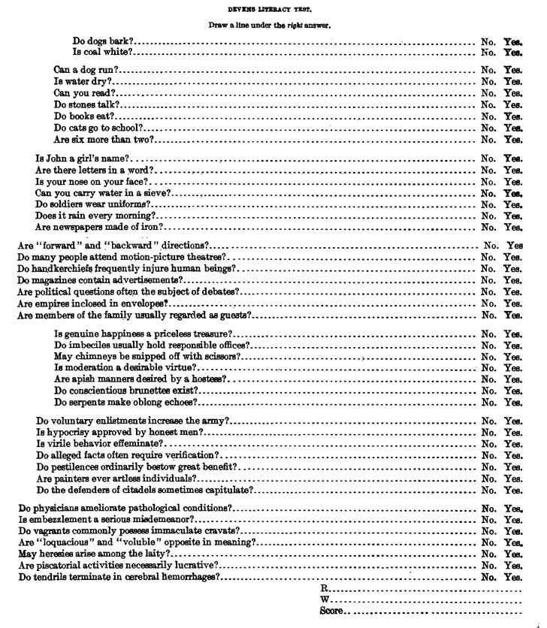
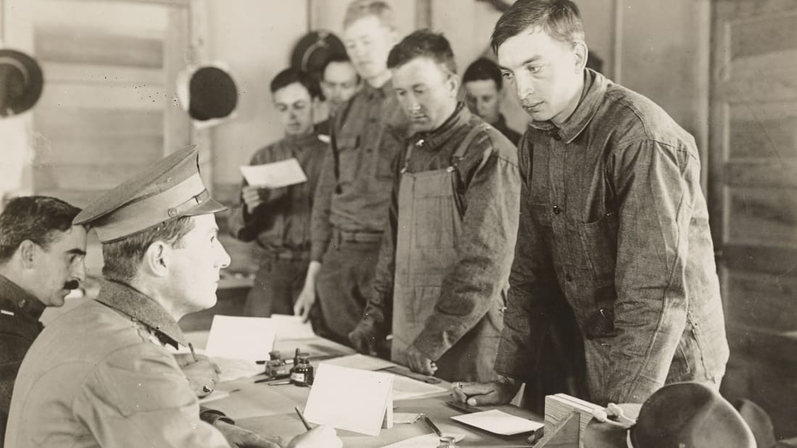
IQ Testing
“Do imbeciles usually hold responsible office?”
Tests found a 50% rate of “mental defectiveness”
among WWI recruits
http://mentalfloss.com/article/535841/would-you-be-able-pass-
world-war-i-military-literary-test

Slide 25
Sexuality and “unfitness”
March 1918: US draft boards received revised instructions barring the “psychopathic character, including the homosexual” from service
During WWII, the US military made more extensive efforts to prevent gay men and lesbians from serving—“degenerates” liable to corrupt esprit and discipline
Homosexuality understood as psychopathology
Draft Boards asked questions designed to establish whether young men “liked girls”
Some Boards used “homosexual vocabulary” to see whether it elicited a response
They also evaluated appearance, thinking that “effeminate” bodily traits offered tell-tale clues
Attempts to keep gay men out led some men to feign queerness to get themselves exempted– “hoaxosexuals”
https://www.rollingstone.com/culture/culture-news/how-exclusion-from-the-military-strengthened-gay-identity-in-america-125267/
From Margot Canaday, The Straight State, p.63

