Slide 1
Pacifism, feminism and anti-war resistance: the politics of maternalism
Hi2c9 week 3

Slide 2
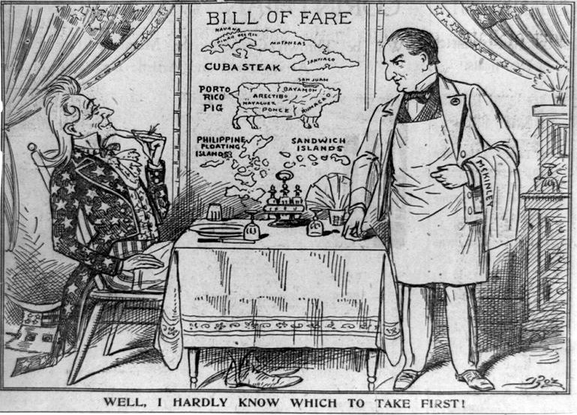
America’s anti-war and anti-imperialist traditions
From the Boston Globe, May 28, 1898. This cartoon illustrates the anti-imperialist sentiment of the period, depicting Uncle Sam as a smug diner pondering which country to consume first, as President William McKinley waits on him.
https://shec.ashp.cuny.edu/items/show/2471

Slide 3
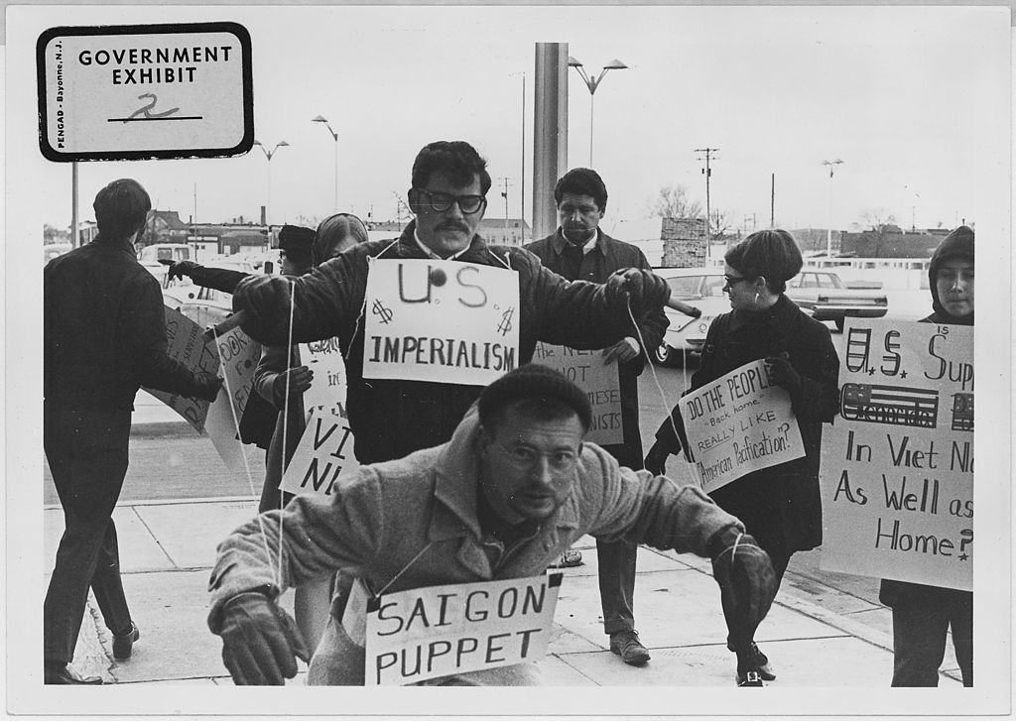
Protesters carry signs and act out "Saigon Puppet" demonstration in front of Wichita City Building,
Kansas.
1967
Photo credit:
US National
Archives and
Records
Administration

Slide 4
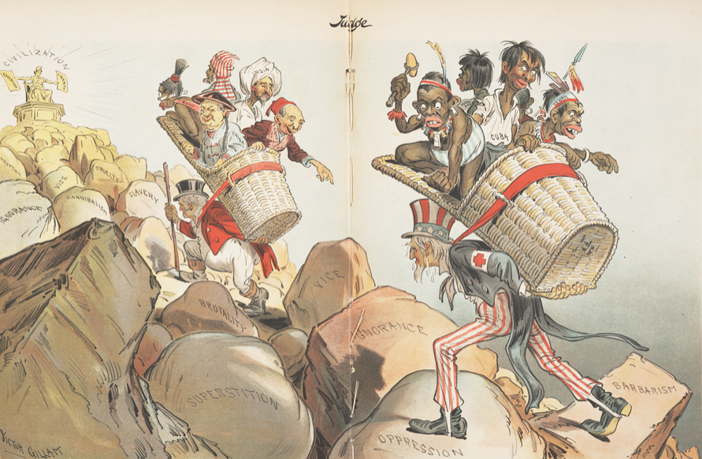
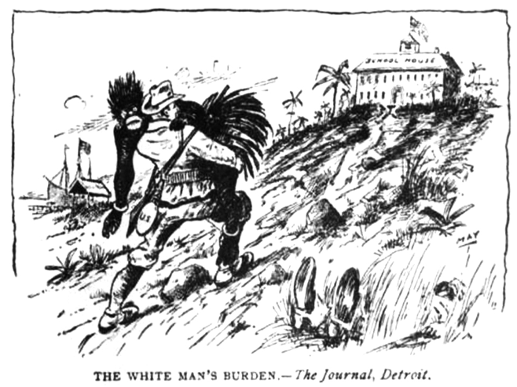
Racially motivated anti-imperialism
"The White Man's Burden" illustration
(Detroit Journal, 1898)
"'The White Man's Burden' (Apologies to Rudyard Kipling)" shows John Bull (U.K.) and Uncle Sam (U.S.) delivering colonized populations to civilization (Victor Gillam, Judge magazine, 1 April 1899). The people in the basket carried by Uncle Sam are labelled Cuba, Hawaii, Samoa, "Porto Rico", and the Philippines, while the people in the basket carried by John Bull are labelled Zulu, China, India, "Soudan", and Egypt. https://en.wikipedia.org/wiki/The_White_Man%27s_Burden#/media/File:%22The_White_Man's_Burden%22_Judge_1899_(cropped).png

Slide 5
Women’s peace activism
A convergence of causes

Slide 6
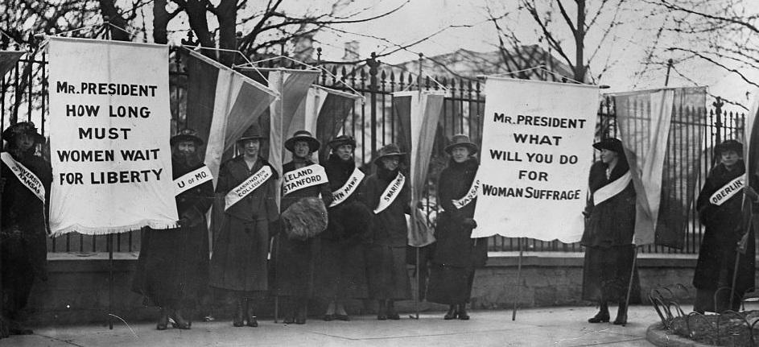
The women’s suffrage movement
1848: Women’s rights convention,
Seneca Falls, NY
Early 1900s: leadership of the suffrage movement passed to two organizations.
The National American Woman Suffrage Association (NAWSA), led by Carrie Chapman Catt, was a moderate organization. The NAWSA undertook campaigns to enfranchise women in individual states, while lobbying Wilson and Congress to pass a woman suffrage Constitutional Amendment.
In the 1910s, NAWSA’s membership numbered in the millions.
The National Woman’s Party (NWP), led by Alice Paul, was more militant. The NWP took more radical actions, including picketing the White House to convince President Wilson and Congress to pass a woman suffrage amendment.
https://www.womenshistory.org/resources/general/woman-suffrage-movement
1920: 19th Amendment ratified

Slide 7
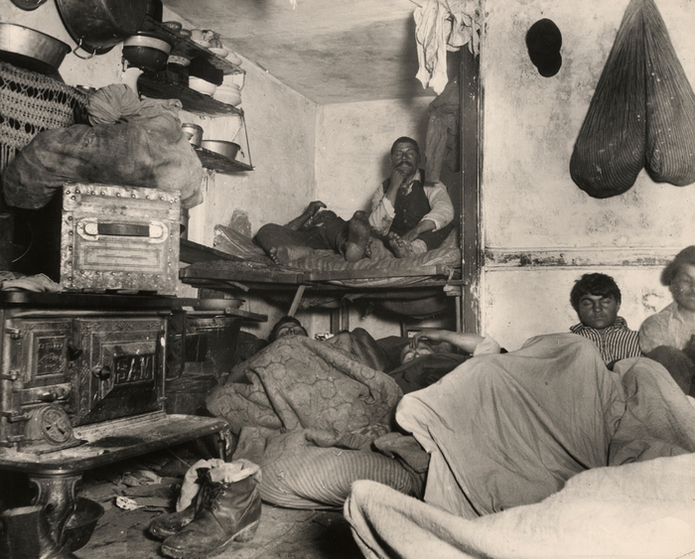
The Progressive Era and women’s activism (1890s-1920s)
Reform movements dedicated primarily to mitigating the “evils” associated with rapid industrialization, urbanization and immigration,
Women figured prominently in Progressive social welfare reform-- ”Maternalism”
The “Club Movement”
Particularly involved in causes relating to women, children and the family
“Demoralizing” conditions in overcrowded slums
Child labour
Temperance
Birth control (eugenics)
Jacob Riis, How the Other Half Lives (1900)

Slide 8
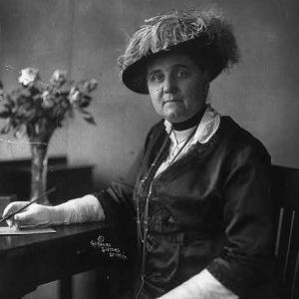
Jane Addams and the “settlement house” movement
‘Addams found her true calling while in London with her friend Ellen Gates Starr in 1888. The pair visited Toynbee Hall, a settlement house on the city’s East End that provided much-needed services to poor industrial workers. Addams vowed to bring that model to the United States, which was in the early years of escalating industrialization and immigration.
In 1889, Addams and Starr founded Hull House in Chicago’s poor, industrial west side, the first settlement house in the United States. The goal was for educated women to share all kinds of knowledge, from basic skills to arts and literature with poorer people in the neighborhood.
In 1915, she headed the Women's Peace Party and shortly thereafter also became president of the International Congress of Women.
She was awarded the Nobel Prize for Peace in 1931.
Jane Addams (1860-1935)
https://www.womenshistory.org/education-resources/biographies/jane-addams

Slide 9
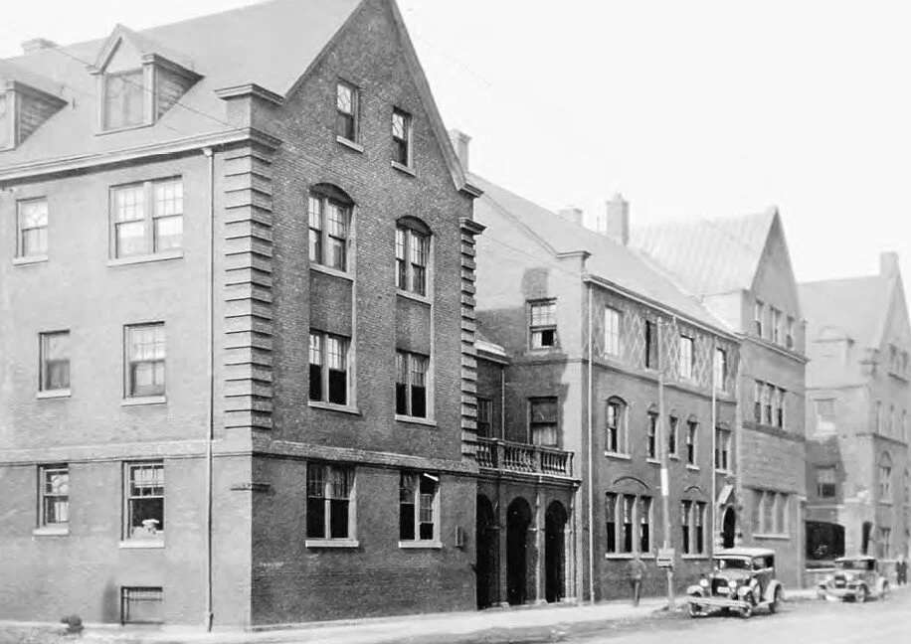
Hull House,
Chicago
Settlement
houses as
incubators of
tolerance:
a microcosmic
model of
peaceful
co-existence

Slide 10
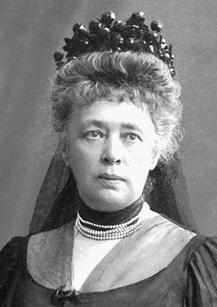
A transnational movement of feminist pacifists
Global backdrop: intensification of conflict, particularly imperialist wars in the late c19/early c20th
Increasing lethality of weaponry
An international movement in favour of ‘arbitration’
Attempts to establish norms governing the conduct of warfare
Hague Conference first convenes 1893
Women’s leading role in this transnational movement
Varied invocations of gender
Peace construed as a women’s issue– or a mother’s issue
Some peace activists adopted this view, tapping into biologically deterministic constructions of women as life-giving ‘reproducers of humanity’; intrinsically nurturing; inculcators of civilized values; etc
Some invoked the gendered harms war entails; that women always suffer more– not only by losing their sons but also as victims of sexual violence/rape
Many female activists also connected the cause of peace with that of suffrage: if women were more active in the national political sphere, and on the international stage, there’d be less emphasis on combative displays of strength, and less recourse to aggression as a means of dispute settlement
Recommended further reading: Patricia Owens et al (eds), Women’s International Thought: Towards A New Canon (Cambridge University Press, 2021), ch. 7, ‘World Peace’
Bertha von Suttner,
Nobel Peace Prize 1905

Slide 11
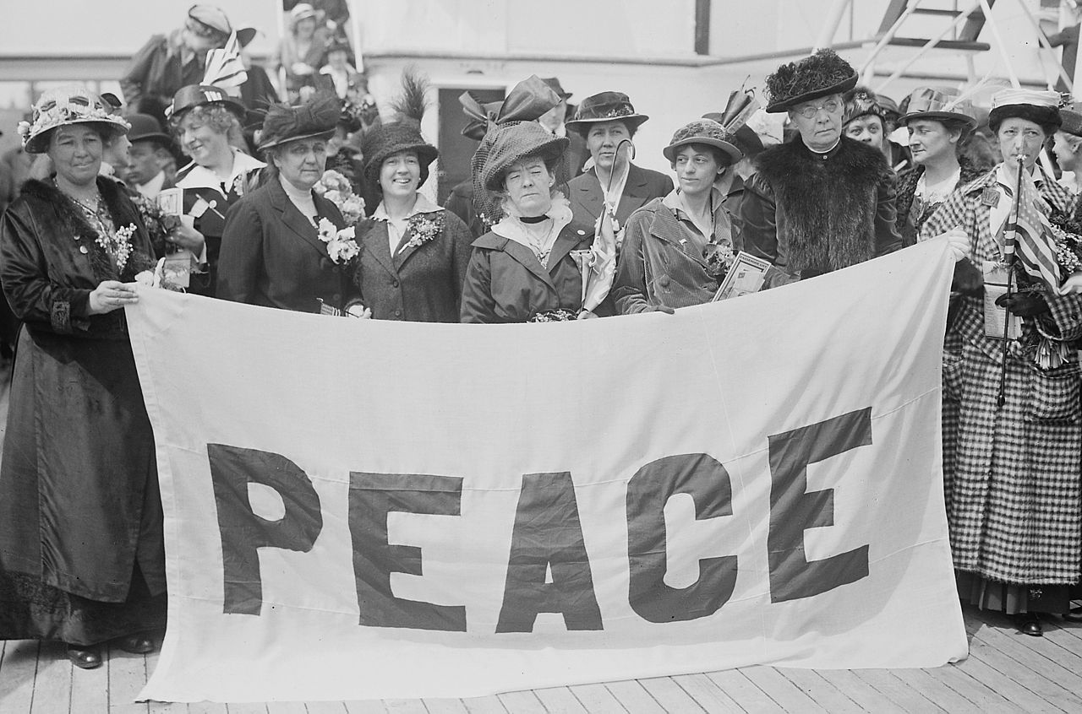
1915:
Henry Ford chartered an ocean liner, inviting anti-war activists to sail to Europe.
Female delegates to the 1915 Women's Peace Conference in The Hague, aboard the MS Noordam. April 1915. 1,300 delegates from 12 countries participated. Photograph shows the American delegates to the International Congress of Women held at the Hague, the Netherlands in 1915. The delegates include: feminist and peace activist Emmeline Pethick-Lawrence (1867-1954), social activist and writer Jane Addams (1860-1935), and Annie E. Malloy, president of the Boston Telephone Operators Union. (Photo credit: Library of Congress)

Slide 12
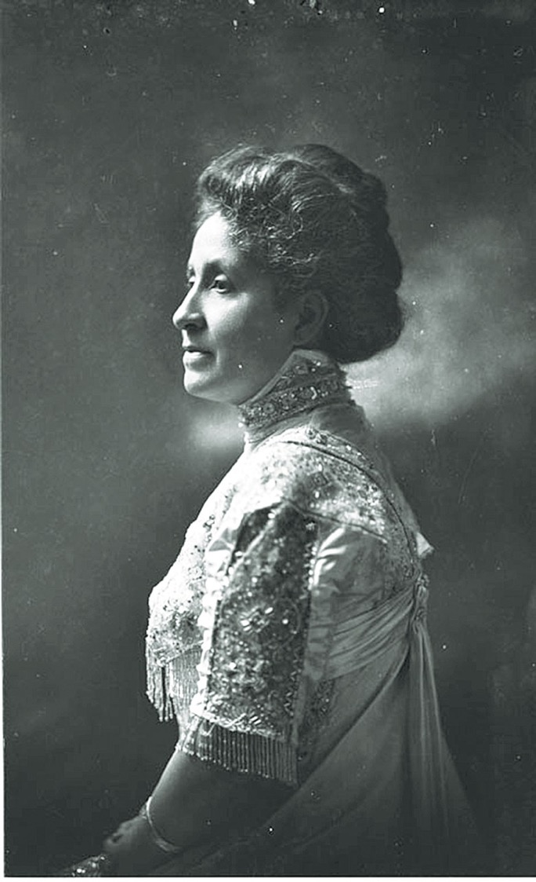
Women’s postwar activism
Women activists gathered in Paris and Zurich in 1919 to continue the fight for a more just and lasting peace.
Mary Church Terrell, a founding member of the National Association for the Advancement of Colored People (NAACP) and the Women’s International League for Peace and Freedom (WILPF) warns that racism will be an ongoing source of conflict unless eradicated.
She called on white mothers to “teach their children to accord by the sublime principles of justice and liberty and equality” and to “teach them to judge men and women by their intrinsic merits rather than their race, color or religion.”
Mary Church Terrell
(1863-1954)

Slide 13
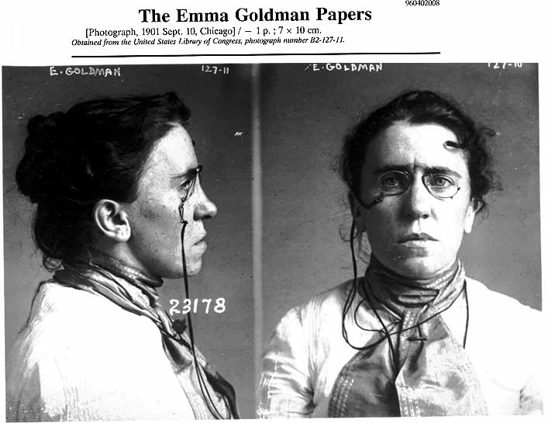
Radical resistance to WWI
The notorious Emma Goldman, feared and revered, who dedicated her life to the cause of freedom
(b. 1869, Kovno, Lithuania)
Mug shot taken in 1901 when Goldman was implicated in the assassination of President McKinley. Library of Congress
Read more about Goldman’s life
and politics:
http://www.lib.berkeley.edu/goldman/MeetEmmaGoldman/index.html

Slide 14
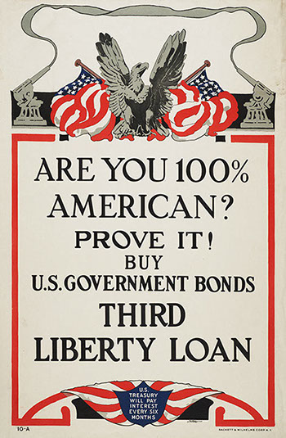
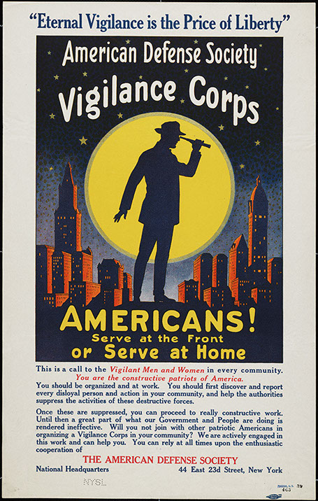
Coercive state powers
Espionage Act (1917) intended to prohibit interference with military operations or recruitment, to prevent insubordination in the military, and to prevent the support of US enemies during wartime
Goldman was charged under this Act. More recently so, too, were Chelsea Manning, Julian Assange, and Edward Snowden
Sedition Act (1918) made it a crime to "willfully utter, print, write, or publish any disloyal, profane, scurrilous, or abusive language about the form of the Government of the United States" or to "willfully urge, incite, or advocate any curtailment of the production" of the things "necessary or essential to the prosecution of the war."
“report every disloyal
person and action in your
community”
http://exhibitions.nysm.nysed.gov/WWI/phone/war-at-home.html

Slide 15
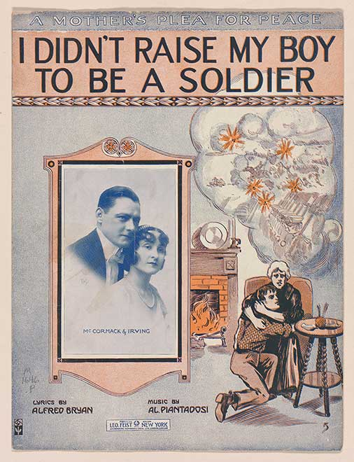
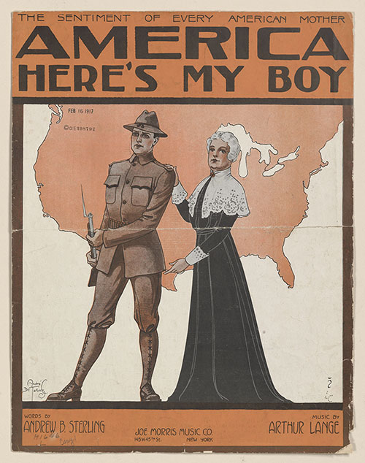

Slide 16
The US military
And mothers

Slide 17
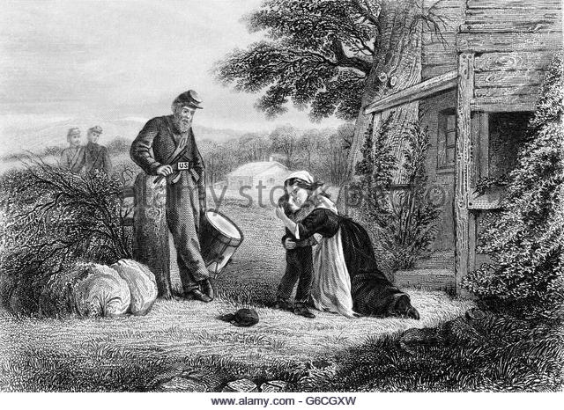
Soldiers and sentimentality: the Civil War
While mothers have worried about war,
sometimes hesitating to deliver their sons
into the arms of the military, the latter has
also persistently worried about mothers:
Can maternal love be instrumentalized?
What if soldiers yearn for home too much?
Do American “moms” raise sons that are
suitable stuff for martial recruitment, or
do intrusive, suffocating mothers raise
“namby-pamby,” “sissified” sons liable
to crack under pressure?
Jan. 1862: THE MOTHERS SACRIFICE KISSING HER YOUNG SON ABOUT TO BECOME A DRUMMER BOY FOR UNION TROOPS IN AMERICAN CIVIL WAR,
Charles Phelps Cushing

Slide 18
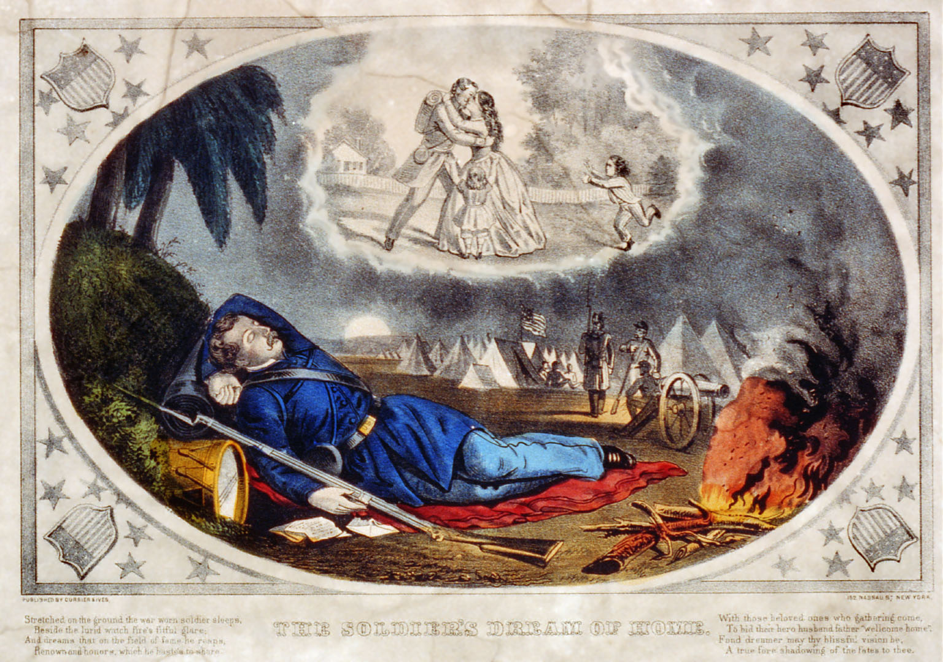
“Nostalgia” was
understood as a
clinical condition—
one that might
prove fatal
“The Soldier’s
Dream of Home”
Currier & Ives
Library of Congress

Slide 19
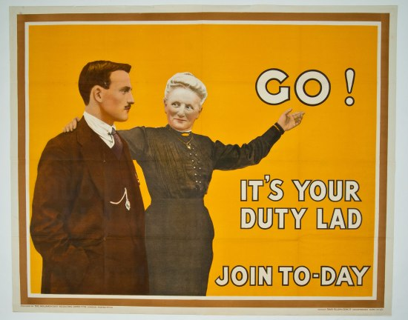
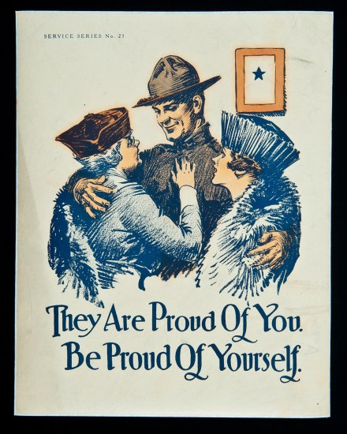
“Mother love” in the Great War
British World War I recruitment poster (above). Published by the Parliamentary Recruiting Committee, London, 1915.
https://americanhistory.si.edu/blog/mothers-world-war-i

Slide 20
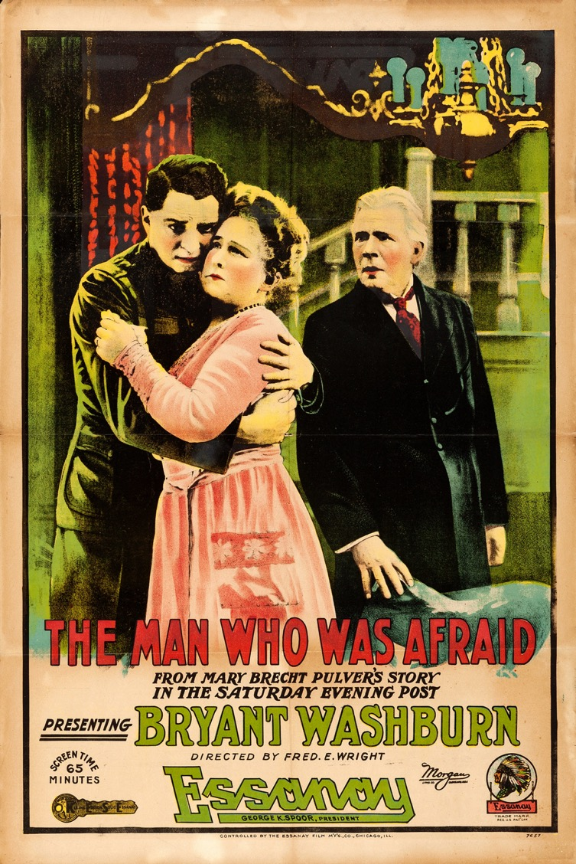
“Bad” mothers
Movie poster, 1917
See discussion in Zeiger’s essay

Slide 21
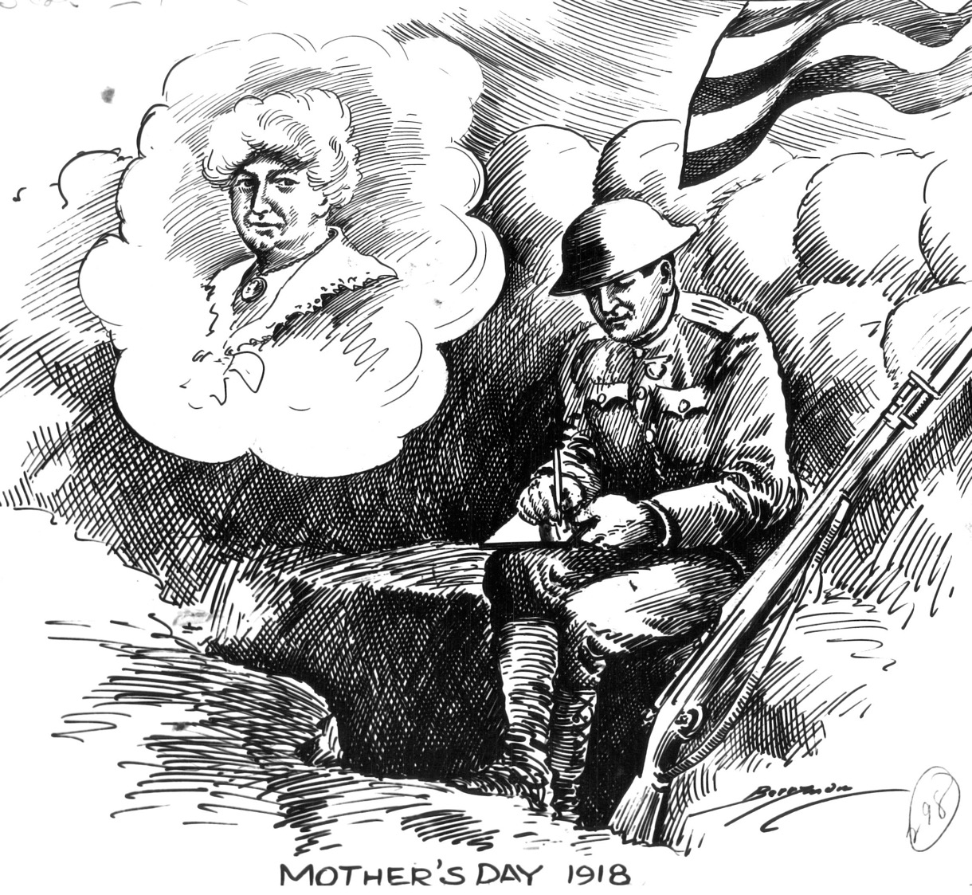
Mother’s Day, May 12, 1918 Cartoonist Clifford Berryman captures the spirit of Mother's Day. Here, amidst the chaos of battle, a soldier writes a letter to his mother, her image clearly in his mind.
National Archives, Records of the U.S. Senate
https://museum.archives.gov/featured-document-display-write-mom-thats-order

Slide 22
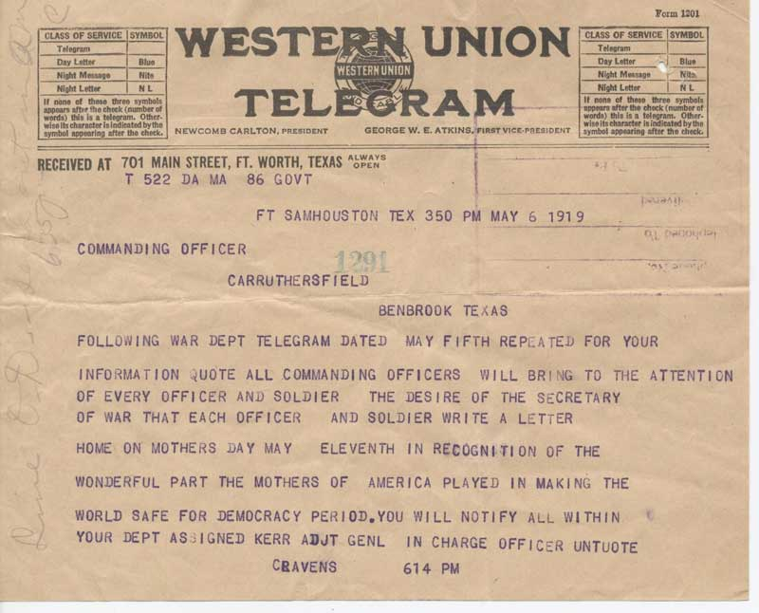
“By the date of this communication, May 6, 1919, those moms had been waiting almost six months for their children to come home. Although the Armistice was announced in November 1918, it took over a year to transport the millions of American troops stationed overseas back to the United States.”
Mother's Day Telegram, May 6, 1919 National Archives, Records of the Army Air Forces

Slide 23

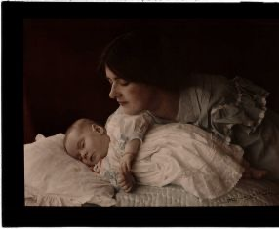
Shifting interwar views on mothers
A turn-of-the-century mother watches over her sleeping baby.
(Image: © Henry Essenhigh Corke (1883-1919); Autochrome. Collection of National Media Museum)

Slide 24
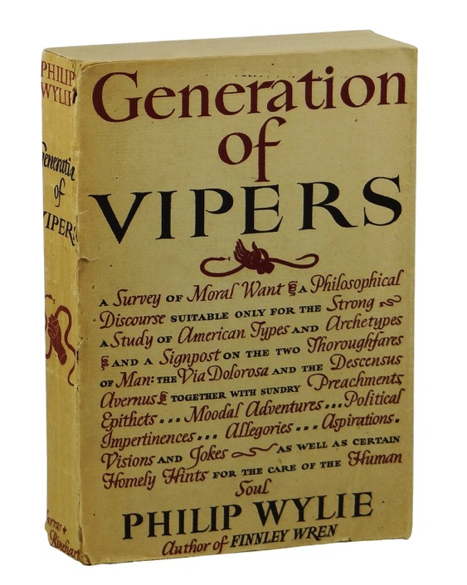
“Mom”: an all-American monster
"[L]et us look at mom. She is a middle-aged puffin with an eye like a hawk that has just seen a rabbit twitch far below. She is about twenty-five pounds overweight, with no sprint, but sharp heels and a hard backhand which she does not regard as a foul but a womanly defense. In a thousand of her there is not sex appeal enough to budge a hermit ten paces off a rock ledge. She none the less spends several hundred dollars a year on permanents and transformations, pomades, cleansers, rouges, lipsticks, and the like — and fools nobody except herself.”
1942

Slide 25
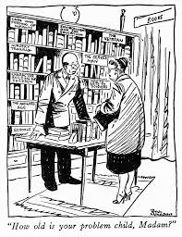
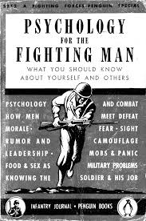
Neuro-psychiatric (NP) cases in WWII
“He [the new recruit] probably wouldn’t
admit it, but worst of all for him is the
fact that there are no women in the
Army. He misses his girl friend, his wife,
or his mother. And he secretly longs
for someone in skirts to bake him a cake,
mend his socks, put away his belongings,
or comfort him when he is tired and
aching from the hard work of training.”
From ch. XV, “The Soldier’s Personal
Adjustment”
(July 1943)

