Slide 1
Women in uniform
Gender, sexuality and soldiering
HI2C9 week 5

Slide 2
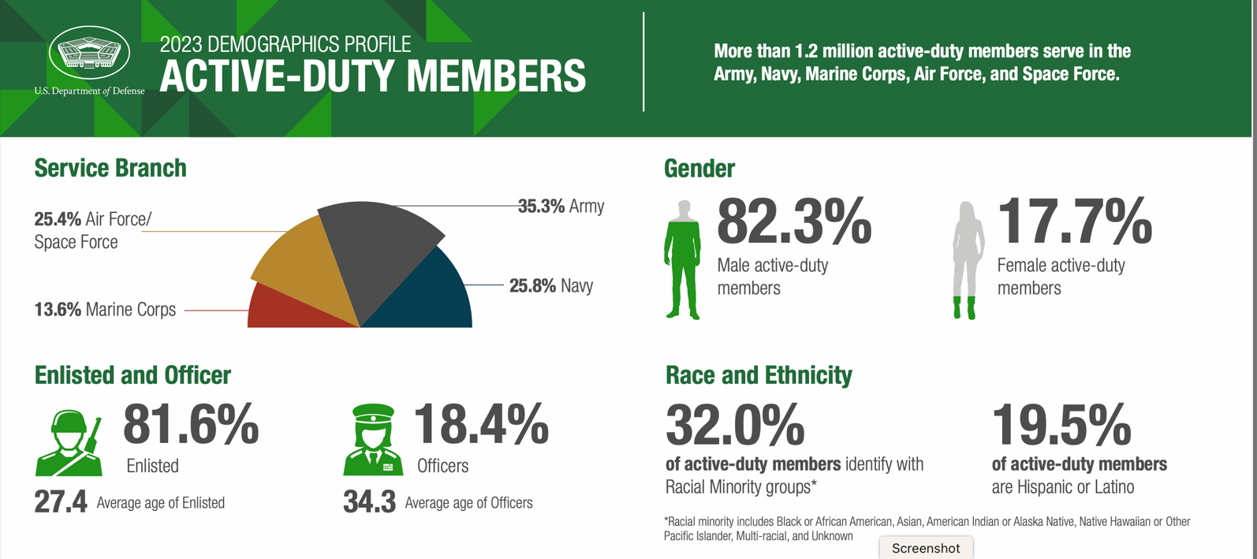
In World War II, approximately 350,000 American women served in uniform
In 2023, 225,119 women served in the armed forces—17.7% of the total.
https://www.war.gov/News/News-Stories/Article/Article/4006144/dods-2023-demographics-report-indicates-more-women-fewer-separations/

Slide 3

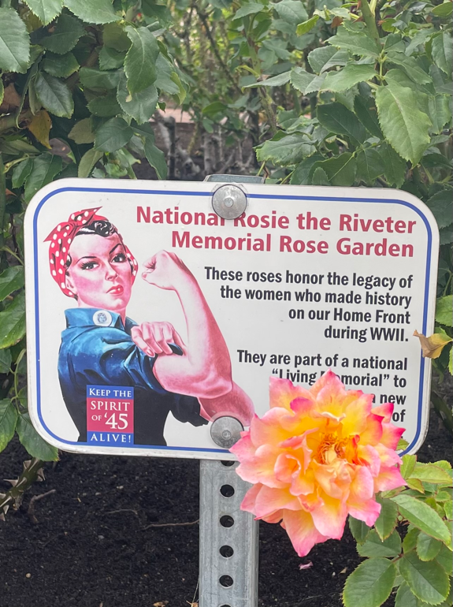
So why isn’t women’s military service more prominently memorialized?
Rosie the Riveter memorial at the Inez Grant
Parker Memorial Rose Garden, San Diego, CA,
2024

Slide 4
Women soldiers: an oxymoron?
“Men simply cannot treat women like other men. And it’s silly to think that a few months’ training can make them into some kind of sexless soldiers.”
Brian Mitchell, Weak Link: The Feminization of the American Military (1989)
Quoted by Leisa D. Meyer, Creating GI Jane: Sexuality and Power in the Women’s Army Corps During World War II (Columbia University Press, 1996), p. 3

Slide 5
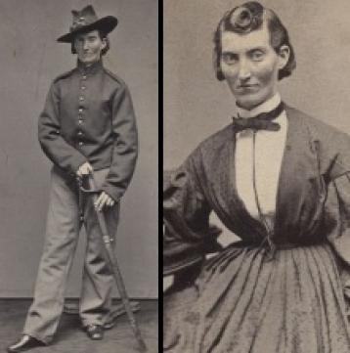
“Cross-dressing” soldiers in the Civil War
Writing in 1888, Mary Livermore (of the U.S. Sanitary Commission) remembered that:
“Some one has stated the number of women soldiers known to the service as little less than four hundred. I cannot vouch for the correctness of this estimate, but I am convinced that a larger number of women disguised themselves and enlisted in the service, for one cause or other, than was dreamed of. Entrenched in secrecy, and regarded as men, they were sometimes revealed as women, by accident or casualty. Some startling histories of these military women were current in the gossip of army life.”
https://www.archives.gov/publications/prologue/1993/spring/women-in-the-civil-war-1.html
Frances Clayton disguised herself as "Frances Clalin”
to fight in the Civil War. (Library of Congress)
https://www.battlefields.org/learn/articles/female-soldiers-civil-war

Slide 6
On October 21, 1909, Ida Tarbell of The American Magazine wrote to Gen. F. C. Ainsworth, the adjutant general: "I am anxious to know whether your department has any record of the number of women who enlisted and served in the Civil War, or has it any record of any women who were in the service?"
She received swift reply from the Records and Pension Office, a division of the Adjutant General's Office (AGO), under Ainsworth's signature. The response read in part:
“I have the honor to inform you that no official record has been found in the War Department showing specifically that any woman was ever enlisted in the military service of the United States as a member of any organization of the Regular or Volunteer Army at any time during the period of the civil war. It is possible, however, that there may have been a few instances of women having served as soldiers for a short time without their sex having been detected, but no record of such cases is known to exist in the official files.”
Ainsworth’s response was untruthful.
https://www.archives.gov/publications/prologue/1993/spring/women-in-the-civil-war-1.html

Slide 7
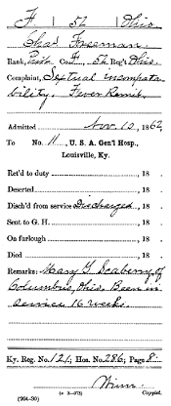
Discharge document for a soldier with "Sextual incompatibility."
Mary Scaberry, aka Charles Freeman, Fifty-second Ohio Infantry. Scaberry enlisted as a private in the summer of 1862 at the age of seventeen. On November 7, Scaberry was admitted to the General Hospital in Lebanon, Kentucky, suffering from a serious fever. Scaberry was transferred to a hospital in Louisville, and on the tenth, hospital personnel discovered a “sextual incompatibility”.
(NARA, Records of the Adjutant General's Office, 1780's—1917, RG 94)
https://www.archives.gov/publications/prologue/1993/spring/women-in-the-civil-war-2.html

Slide 8
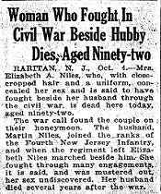
Much extant information on male-presenting Civil War soldiers is found in their obituaries.
NARA, Records of the Adjutant General's Office, 1780's - 1917, RG 94)
https://www.archives.gov/publications/prologue/1993/spring/women-in-the-civil-war-3.html

Slide 9
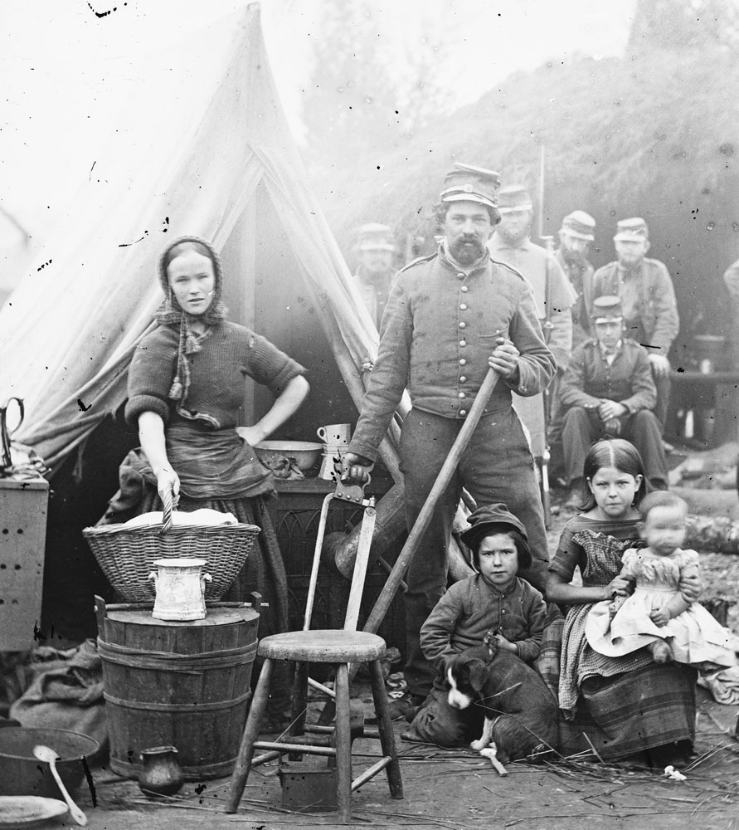
“Camp followers:” a frequently sexualized slur
Tent life of the 31st Pennsylvania Infantry
at Queen's farm, vicinity of Fort Slocum,
Washington, DC (1861)
A "camp follower" military family.

Slide 10
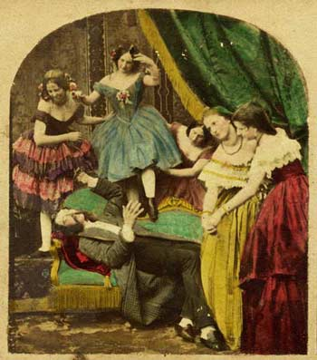
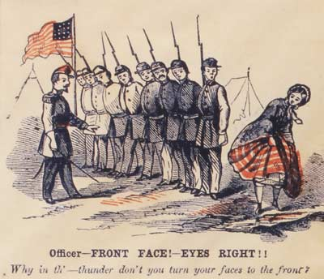
Sex and
Civil War soldiers
Civil War era
pornography,
delivered by mail
order to men
at the front
https://case.edu/affil/skuyhistcontraception/online-2012/Civil-War.html

Slide 11
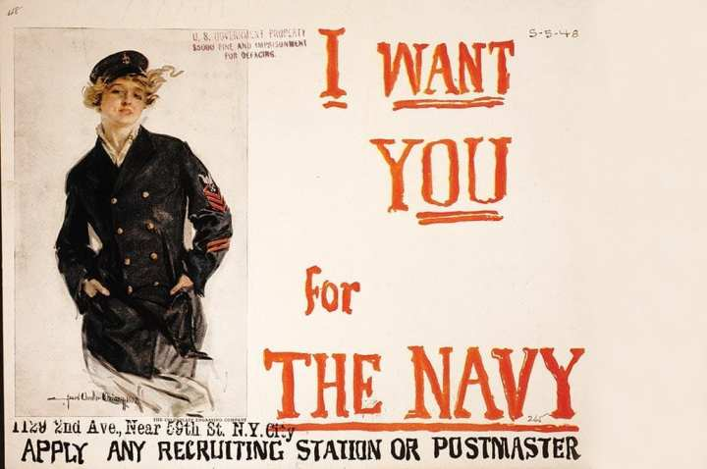
Enlisting women in the two worlds wars

Slide 12
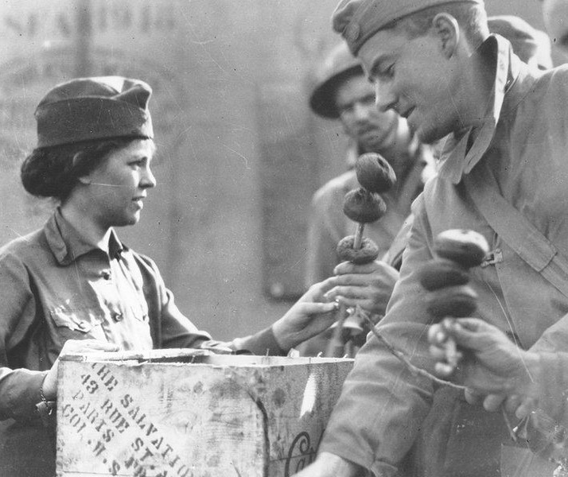
World War I
More than 16,000 US women traveled to Europe with the AEF in a variety of capacities:
With the Army Nurse Corps (white women only)
With the American Red Cross
With religious charitable organizations-- like the Young Women’s Christian Association, YMCA, the Salvation Army, & the Jewish Welfare Board-- providing support for American troops
See Susan Zeiger’s book
In Uncle Sam’s Service
A WW1 Salvation Army “Doughnut Dollie” serves two US soldiers in France
https://www.worldwar1centennial.org/index.php/california-interviews/6496-the-salvation-army-doughnut-dollies-of-ww1.html

Slide 13
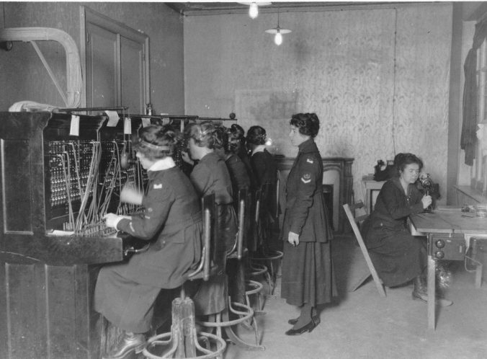
The first female soldiers?: the “Hello Girls”
During WWI, the US army felt women would make the best telephone
switchboard operators to connect calls at the front. They would need to be fluent in
both English and French.
The US government issued a contract to Western Electric and about 7,600 women applied.
The company selected and trained them; the first group of 100 arrived in March 1918 and eventually 223 ‘Hello Girls’ served in France.
Their non-military status– despite belonging
to the Army Signal Corps-- meant they were denied recognition as veterans until 1977.
https://www.kansasww1.org/the-hello-girls/

Slide 14
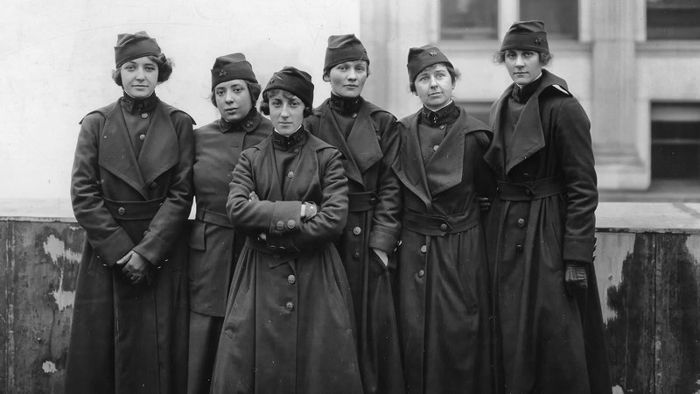
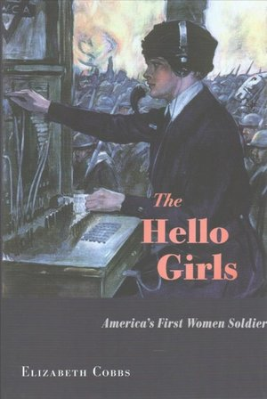
Six members of the U.S. Army Signal Corps preparing to ship off for France in 1918, where they and 217 other women served as switchboard operators.
Photo credit: Harvard University Press
Listen to a talk by Prof Elizabeth Cobbs on the “Hello Girls”
https://www.youtube.com/watch?v=mbQWCU9OU20

Slide 15
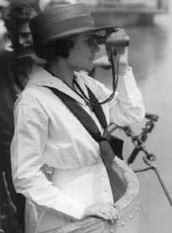
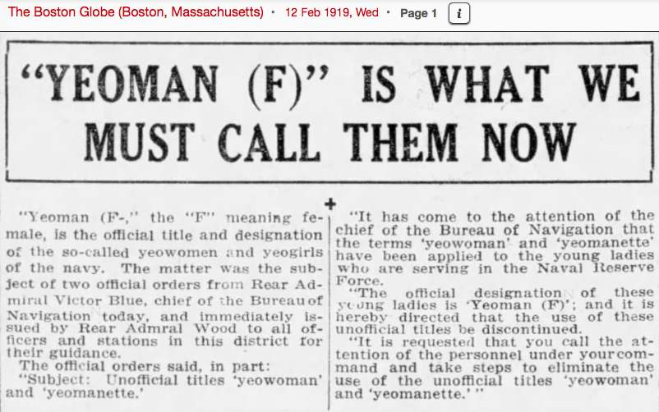
The Navy’s “Yeomanettes” (1917-21)
Around 12,000 women enlisted in the Navy under the title, “Yeoman (F).” Most served stateside on naval bases, replacing men who had deployed to Europe. While many female recruits performed clerical duties, some worked as truck drivers, mechanics, radio operators, telephone operators, translators, camouflage artists and munition workers.
They received the same pay as male recruits of $28.75 per month.
A yeoman (F) on Submarine K-5 gazes through her binoculars. (80-G-1025873)
https://www.archives.gov/publications/prologue/2006/fall/yeoman-f.html

Slide 16
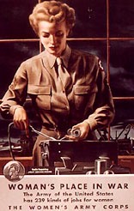
The Women’s Army
Auxiliary Corps (May1942-July 1943)/
Women’s Army Corps in WWII
https://www.womensmemorial.org/history/detail/?s=wwiiwomens-army-corps

Slide 17
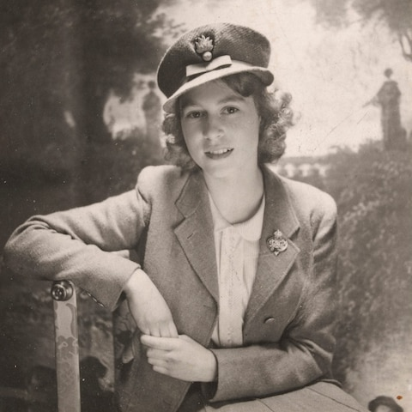
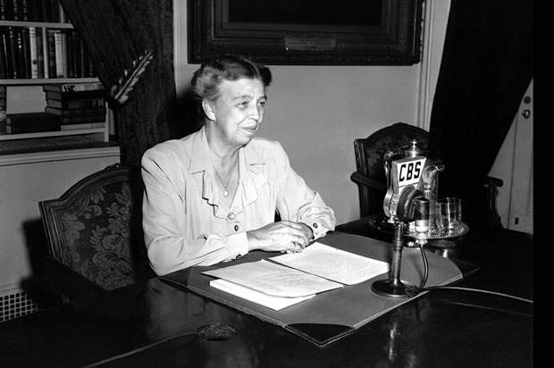
Why the WAACS?
Bi-partisan pressure from some prominent, politically active women, arguing that women should be allowed to play substantial roles in support of the war effort, led by Rep. Edith Nourse Rogers (R-Mass)
Support from First Lady Eleanor Roosevelt
A shortage– and anticipated crisis-- of “manpower” in the military, especially in clerical and communications roles
The example of the British Auxiliary Territorial Service (ATS) impressed Chief of Staff George Marshall
The most famous member of Britain’s ATS, Princess Elizabeth.
Eleanor Roosevelt delivering
her Sunday night broadcast,
Dec. 7, 1941

Slide 18
Eligibility requirements for WAAC officer candidates
U.S. citizens
21 to 45 years old
could be married, but must have no dependents (i.e. children still living at home)
NB: pregnancy resulted in discharge from the WAAC/WAC whether the woman was married or single
at least five feet tall
weighing 100 pounds or more
Initially, over 35,000 women from all over the country applied for fewer than 1,000 anticipated positions
On 20 July, 1942 the first officer candidate training class of 440 women started a six-week course at Fort Des Moines
the average officer candidate was 25 years old, had attended college, and was working as an office administrator, executive secretary, or teacher. One out of every five had enlisted because a male member of her family was in the armed forces
Information from THE WOMEN'S ARMY CORPS: A COMMEMORATION OF WORLD WAR II SERVICE By Judith A. Bellafaire CMH Publication 72-15 https://history.army.mil/brochures/WAC/WAC.HTM

Slide 19
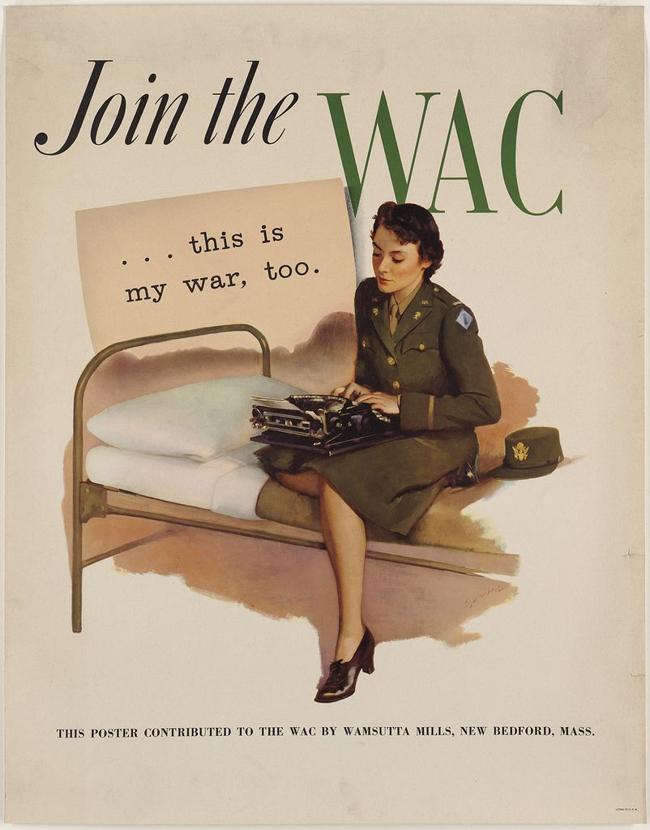
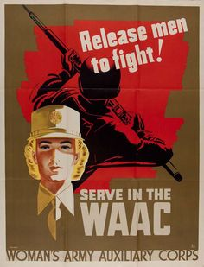
Glamour. Patriotism. Temporary substitution.
http://libcdm1.uncg.edu/cdm/singleitem/collection/WVHP/id/6777/rec/1

Slide 20
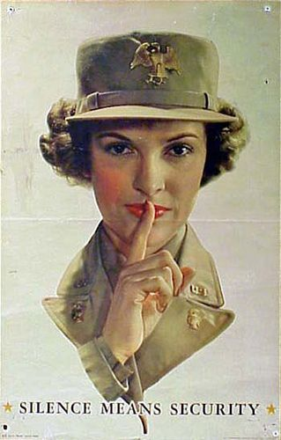
Why the backlash?
Why did so much malicious rumour swirl around the Waacs and then the Wacs?
Why did objections to women in uniform so often centre on servicewomen’s sexuality?
What does it tell us about wartime America that Wacs were often slurred as either/both lesbians and/or prostitutes whose military service was (supposedly) specially planned to satisfy male soldiers’ sexual needs?
Why didn’t men’s military service in all-male units generate so much publicly expressed anxiety about homosexuality?
Why did the armed forces care about men and women’s sexual orientation??

Slide 21
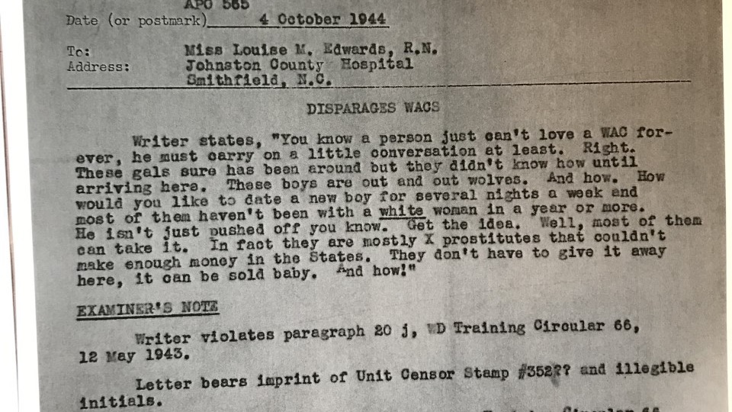
Sgt.
RD Holt
Extract from RG 496, Records of the General HQ, Southwest Pacific Area, box 24, US National Archives

Slide 22
“Winnie the Wac” (b. 1943) drawn by GI Vic Herman for army newspapers,
modeled on– or uncannily resembling?-- real-life Wac Althea Semanchik (b. 1921)
Sexualizing
women’s service
“So you think there is anything
Wrong with my chassis?”
”It was awfully nice of you boys
to give up your seats.”
For more on “Winnie” http://www.tcj.com/winnie-the-wac/
http://www.duryeapa.com/Semanchik/Semanchik.htm

Slide 25
Recruiting for, and selling, the WAAC
We’re In The Army Now (US Army Signal Corps, 1943)
How does this film attempt to
reassure American viewers
about the wisdom of creating
a women’s auxiliary corps, and
about the kinds of women who
volunteered?
Original print:
US National Archives, College Park, MD
National Archives Identifier: 35838
https://archive.org/details/WereInTheArmyNow

Slide 26
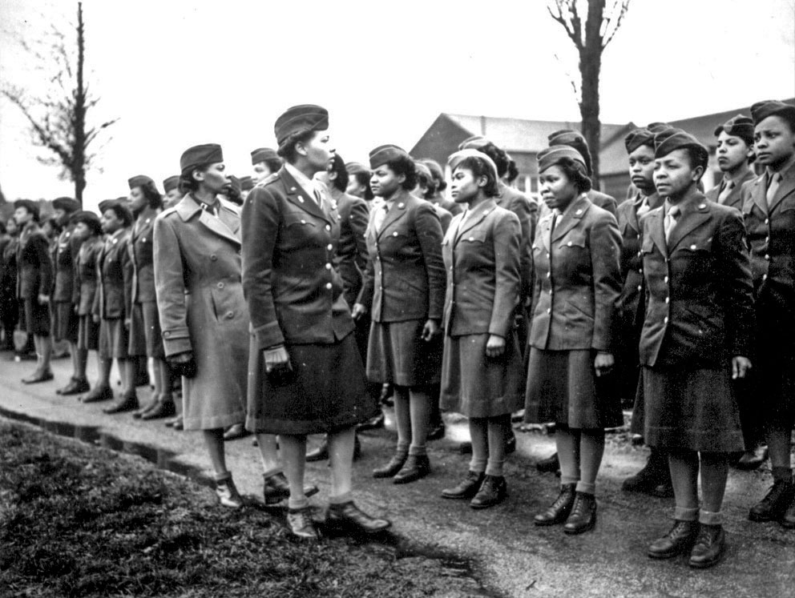
African American Wacs
“Battalion Commander Maj. Charity Adams and Executive Officer Capt. Abbie Noel Campbell inspect the first Soldiers of the 6888th Central Postal Directory Battalion to arrive in England, February 15, 1945. The only African-American Women's Army Corps unit sent to Europe during World War II, the 6888th was responsible for clearing years' worth of backlogged mail… [T]hey processed some 65,000 pieces of mail a shift and worked three shifts a day.”
NB: The 6888th served in Birmingham,
Rouen and Paris.
Photo Credit: Courtesy of the National Archives
https://www.army.mil/article/181382/sorting_the_mail_blazing_a_trail_african_american_women_in_wwii

Slide 27
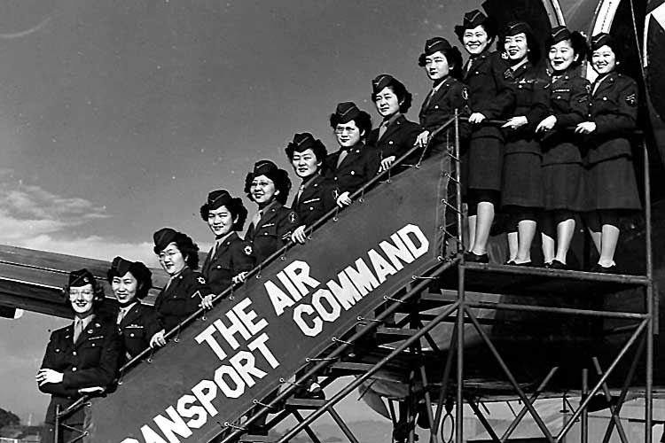
Japanese American Women in the Women’s Army Corps (1946)
Photo credit:
U.S. Army Signal Corps Collection
http://nisei.hawaii.edu/object/io_1153874063772.html
Japanese American women served in the Women's Army Corps (WAC), Army Nurse Corps (ANC), and Cadet Nurse Corps (CNC). The ANC began accepting Japanese American women in February 1943, while the WAC began enlisting them in September of that same year. Japanese American women had previously been denied entry to the WAAC. All told, 142 Japanese American women volunteered. 48 trained at the Military Intelligence Service Language School. http://www.goforbroke.org/learn/history/combat_history/world_war_2/ja_women_us_military_ww2.php

Slide 28
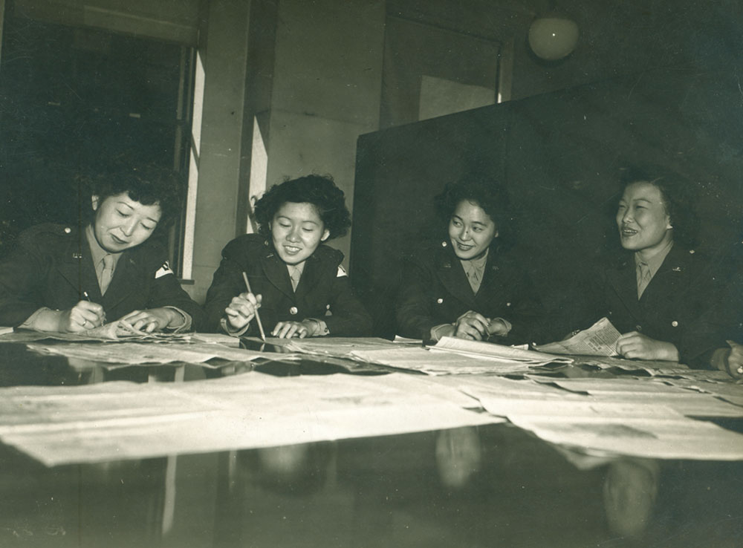
WAC officers,
courtesy of the US Government
and Bonnie and Ken Kasamatsu

Slide 29
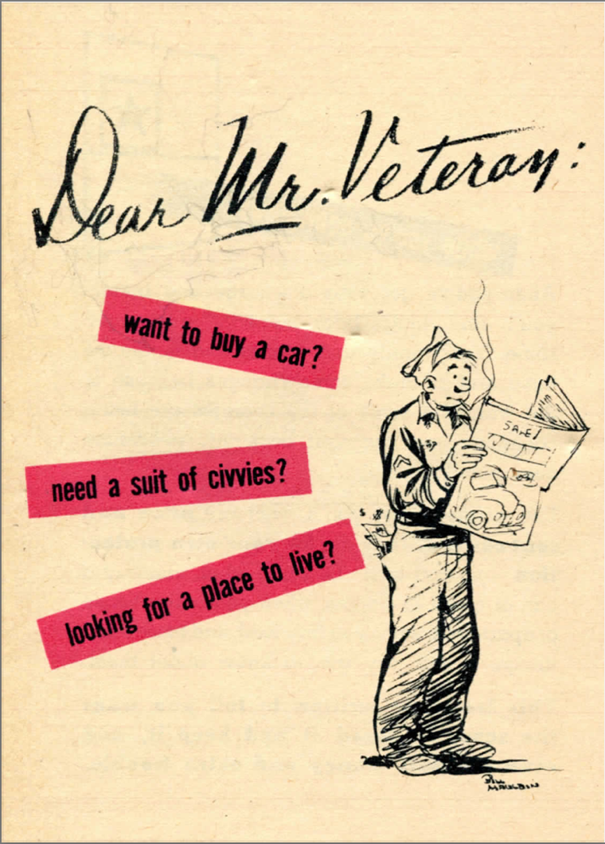
The female veteran: an invisible category
https://www.nationalww2museum.org/sites/default/files/2017-07/dear-mr-veteran_0.pdf

