Slide 1
Death, mourning and memorialization
The public and private Gendered meanings of death in wartime
HI2C9 Week 8
Please note that this set of slides contains some disturbing images

Slide 2
Dying/grieving
Another gendered dyad?

Slide 3
Body counts and bodies that count
Congressional Research Service, American War and Military Operations Casualties: Lists and Statistics (Updated September 24, 2019) https://fas.org/sgp/crs/natsec/RL32492.pdf
Who counts?
Soldier dead; combat fatalities
Non-combat deaths? (e.g. infectious disease; training; vehicular accidents; “friendly fire” victims; suicides)
Army Nurse Corps fatalities
WWI: Julia Stimson's records showed 134 deaths in the Army Nurse Corps in the United States, primarily from influenza. 102 women serving with the AEF died in service from 1917 to 1919. http://kimberlyjensenblog.blogspot.com/2015/05/deaths-in-army-nurse-corps-during-world.html
WWII: Sixteen medals were awarded posthumously to nurses who died as a result of enemy fire.
https://history.army.mil/books/wwii/72-14/72-14.HTM
In World War II, 160 women in the WAC died from various non-combat causes:
https://www.armyheritage.org/75-information/soldier-stories/326-wacwwii

Slide 4
Distant encounters with death
Displaying or obscuring the fallen?

Slide 5
Official sensitivity to images of wartime fatalities
The Pentagon Coffin Coverage Ban 2003-9
As the U.S. military prepared to invade Iraq in March 2003, the Pentagon announced:
“There will be no arrival ceremonies for, or media coverage of, deceased military personnel returning to or departing from Ramstein air base or Dover base, to include interim stops”
Ramstein, Germany, and Dover, Delaware, are the two main air bases through which U.S. soldiers’ remains return. https://www.rcfp.org/journals/the-news-media-and-the-law-summer-2004/letting-loose-images-war/
Obama lifted the ban in 2009, but rules for “embedded” journalists with US forces in Afghanistan continued to prohibit taking photographs of, or video-recording, US personnel killed in action. https://nppa.org/news/564

Slide 6
Coffins being loaded onto a US plane in
Kuwait. Published by the Seattle Times
under the headline
“The somber task of honoring the fallen.”
“It kind of helps me to
know what these mothers are going through, and I try to watch over their children as they
head home.”
Tami Silicio April 2004
http://100photos.time.
com/photos/tami-
silicio-coffin-ban

Slide 7
Visualizing death in wartime
Rebel artillery soldiers, killed in the trenches of "Fort Hell," at the storming of Petersburgh, Va., April 2d, 1865. The one in the foreground has U.S. belts on, probably taken from a Union soldier prisoner, his uniform is grey cloth trimmed with red. This view was taken the morning after the fight. Library of Congress Prints and Photographs Division Washington, D.C. http://hdl.loc.gov/loc.pnp/pp.print

Slide 8
Making the dead speak in World War II
The redemptive power
of wartime death—
a goad to civilian
Americans to work harder
and make more sacrifices
with less complaint
James J. Kimble, "Spectral Soldiers: Domestic Propaganda, Visual Culture, and Images of Death on the World War II Home Front," Rhetoric & Public Affairs, 2017
https://www.shu.edu/arts-sciences/news/upload/project_muse_650967.pdf

Slide 9
“Playing the death card”
George Roeder,
The Censored War:
American Visual Experience
during World War Two (1993)
George Strock,
Dead Marines at Buna Beach, New Guinea
Life, Sept. 20, 1943
https://lens.blogs.nytimes.com/2013/03/28/a-photo-that-was-hard-to-get-published-but-even-harder-to-get/

Slide 10
Intimate encounters with death in wartime
Private/public grief

Slide 11
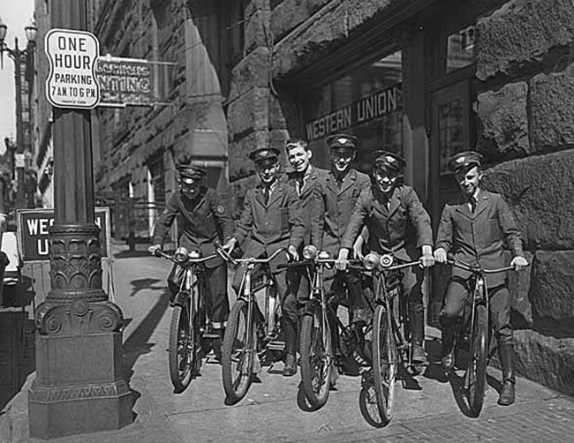
Casualty notification
World War II poster
US National Archives
Western Union Telegram
delivery ‘boys’

Slide 13
A mother petitions the Quartermaster
General, wanting to know exactly how her
Son, Lt. Broadway Sims, died.
She also asks where, and how, he was buried.
https://www.pbs.org/newshour/education/students-teachers-uncover-remnants-world-war-ii

Slide 14
A “good death”?
A nineteenth century convention prominent during– but substantially challenged by– mass death during the Civil War
A “good” death involved several elements, bodily, spiritual and familial:
An absence of suffering
A quick “clean” passage from life to death
Repentance of sins– reconciliation with God– acceptance of fate
Loving thoughts of home/knowing oneself to be loved
For more on this topic, see Drew Gilpin Faust, "The Civil War Soldier and the Art of Dying," Journal of Southern History 67, 1 (Feb. 2001), pp.3-38

Slide 15
Last words: posthumous love letters
July 14, 1861, Camp Clark, Washington
“My very dear Sarah: The indications are very strong that we shall move in a few days — perhaps tomorrow. Lest I should not be able to write again, I feel impelled to write a few lines that may fall under your eye when I shall be no more …
I have no misgivings about, or lack of confidence in the cause in which I am engaged, and my courage does not halt or falter… I am willing — perfectly willing — to lay down all my joys in this life, to help maintain this Government, and to pay that debt …
Sarah my love for you is deathless, it seems to bind me with mighty cables that nothing but Omnipotence could break; and yet my love of Country comes over me like a strong wind and bears me unresistibly on with all these chains to the battle field.”
Major Sullivan Ballou, the letter’s author, was killed a week later at the First Battle of Bull Run, July 21, 1861. The letter was never mailed to his 24-year old wife, Sarah, who lived to the age of 80.
Listen to the letter being read in an episode of Ken Burns’ Civil War Documentary series:
https://www.youtube.com/watch?v=1VK1KcZoDu0
Read the complete letter:
https://www.pbs.org/kenburns/civil-war/war/historical-documents/sullivan-ballou-letter/

Slide 16
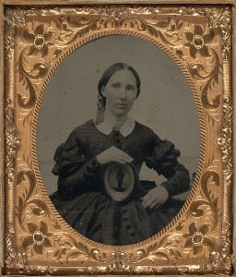
Gendered prescriptions for grieving
“Men were not exempt from mourning rituals, but certainly had more flexibility in [grief’s] presentation. Men were often expected to wear black suits or coats in mourning. This was less strict, and did not last as long; a widower mourned for three months after the loss of his wife, as opposed to two and a half years for women who lost husbands.
Some men sported a black armband to display that they were in mourning. This was seen in a large scale after the death of Abraham Lincoln in 1865, when the whole country entered into a phase of mourning.”
http://www.civilwarmed.org/good-death/

Slide 17
Vogue
offers women
advice on
fashionable
mourning
styles in
World War I,
questioning
whether
mourning was
going out of
style
Left: November 15, 1917, p.60
Above: June 15, 1918, p.30
NB: Vogue is accessible via ProQuest

Slide 18

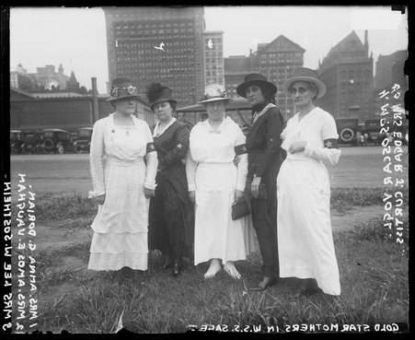
Wearing grief on one’s sleeve
In 1918, President Woodrow Wilson approved a recommendation by the Women’s Committee of National Defense to wear a black armband with a gold star — an update on traditional signs of mourning. The point was to emphasize “the glory of death, not the sadness.”
1918 Gold Star Mothers. Group portrait of (left to right) Mrs. Anna G. Dorian, Mrs. Amos E. Vaughan, Mrs. Lee W. Sosthein, Mrs. Oscar Vogl, and Mrs. Edgar J. Curtiss wearing dark arm bands with light stars on them and standing in Grant Park in the Loop community area of Chicago, Illinois.
Text on image reads: Gold Star mothers in W.S.S. sage. Chicago History Museum

Slide 19
Bereaved women must “live bravely”
“If our soldiers can face death with cheerfulness, if they can spring forward to their fate with shouts of victory and exult in that for which they die, shall we cast a shadow over their triumph and go about garbed in mourning when they have died so gloriously? Doubtless, as they awaited their doom, many manly hearts ached with homesickness and longing for those who were left behind, but they knew that if the battle was to be won it could not be with regrets or repining. While the heart ached, the face was bright, the voice cheerful, the spirit undaunted. So we, too, must meet our fate, whatever it may be, in the same spirit and show to the world that as our men can die bravely, women can live bravely.”
A badge was suggested by many who felt it our duty to emulate the example of the British women and wear no mourning, yet who desire to honor our dead. To meet this demand and to secure uniformity, the Woman’s Committee of the Council of National Defense adopted, and the President approved, a black band 3 inches wide upon which shall be placed a gold star for each member of the family lost in the service of our country, and which shall be worn on the left arm.”
Duluth [MN] News-Tribune 16 June 1918: p. 7
https://thevictorianbookofthedead.wordpress.com/2022/05/25/great-war-mourning-band-with-gold-star-suggested-1918/

Slide 20
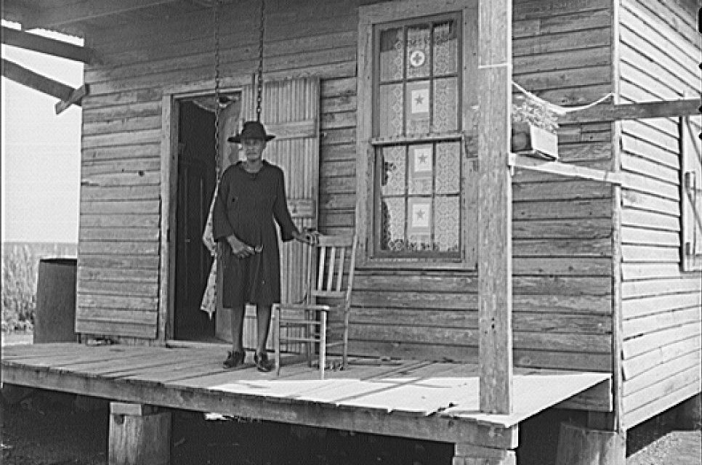
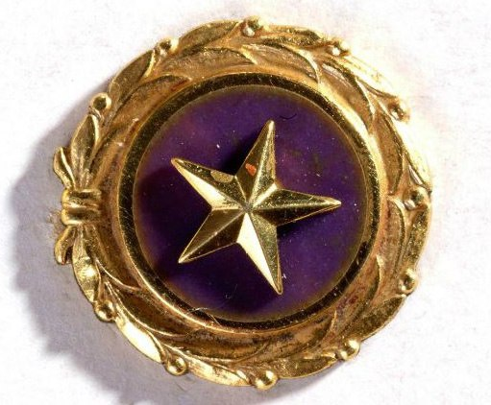
American Gold Star Mothers, Inc.
Founded 1928. Still in existence
https://www.americangoldstarmothers.org/gold-star-mothers-and-families.html
Gold Star pin from the era of World War II. Gold star surrounded by gold laurel wreaths. This pin is worn by mothers who have lost a child in military service.
A mother of three soldiers in Plaquemines Parish, Louisiana, displays three gold stars in her window, World War II. Photograph by John Vachon, Library of Congress.

Slide 21
Burial and memorialization
Recycling grief for patriotic purposes

Slide 22
Arlington National Cemetery
On July 16, 1862, Congress passed legislation authorizing the U.S. federal government to purchase land for national cemeteries for military dead, putting the U.S. Army Quartermaster General in charge of this program. Arlington was founded in 1864, built in the grounds of a mansion that had been the home of Confederate General Robert E. Lee.
Graves of formerly enslaved people who fought
in the Civil War, marked “citizen”.
Veterans continued to be buried weekly at Arlington,
where there are more than 14,000 graves.
Carol M. Highsmith
Library of Congress Catalog: http://lccn.loc.gov/2011635737
https://www.arlingtoncemetery.mil/about

Slide 23
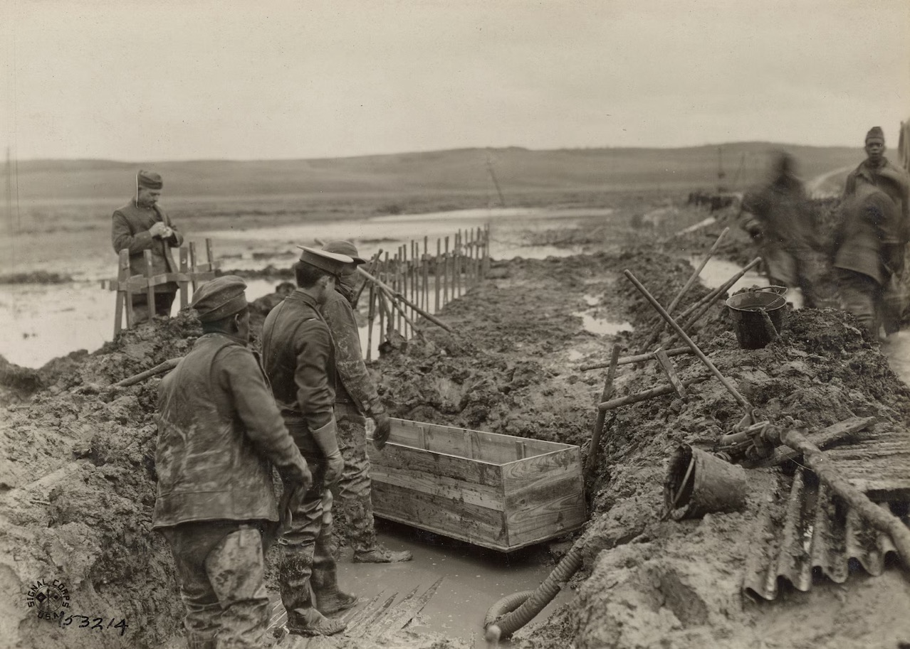
“Black hands buried the putrid bodies of white American soldiers in France.”*
They then had to dig up more than 40,000 corpses for repatriation to the US.
* WEB Du Bois
“The Graves Registration Service removes bodies near Grandpre, Ardennes, France, for reburial. Much of the grisly work was done by African American soldiers in labor battalions. The men are wearing waders, and one has a mask.”
(National Archives and Records Administration)
https://www.washingtonpost.com/history/2021/05/31/world-war-i-exhumed-memorial-day/

Slide 24
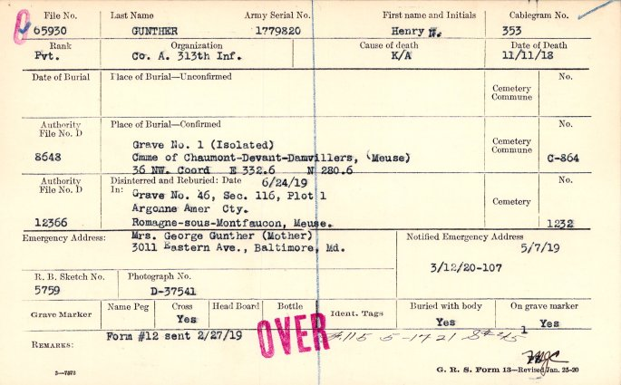
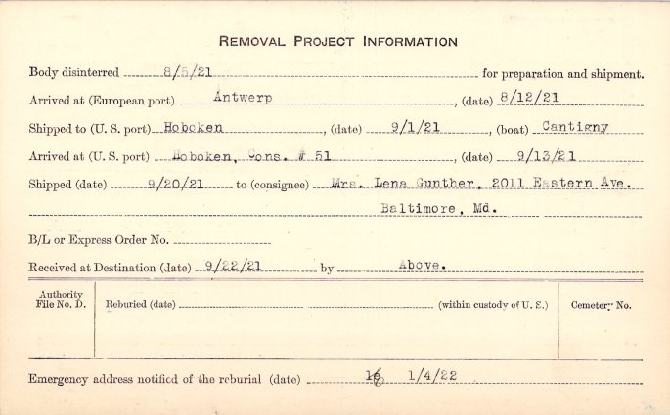
The American dead of World War I: repatriation or burial overseas?
Burial Card for Pvt Henry Gunther, front (NAID 109037714), Card Register of Burials of Deceased American Soldiers, RG 92
Burial Card for Pvt Henry Gunther, reverse (NAID 109037714), Card Register of Burials of Deceased American Soldiers, RG 92
The burial card for Pvt Gunther confirms that he was killed in action November 11, 1918. It also provides information as to his burial arrangements, next of kin, disinterment, and shipment of his remains.
https://text-message.blogs.archives.gov/2018/11/08/now-available-online-burial-cards-of-world-war-i-soldiers/

Slide 25
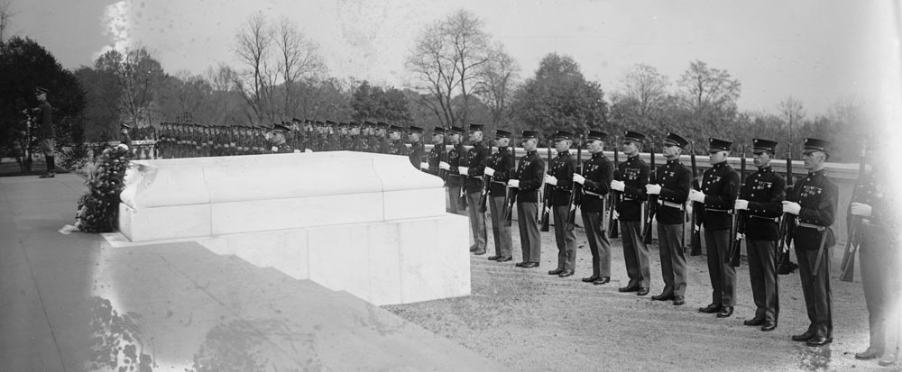
Commemorating the “Unknown Soldier”
Tomb of the Unknown Soldier, Arlington National Cemetery, on 11 November 1922.

Slide 26
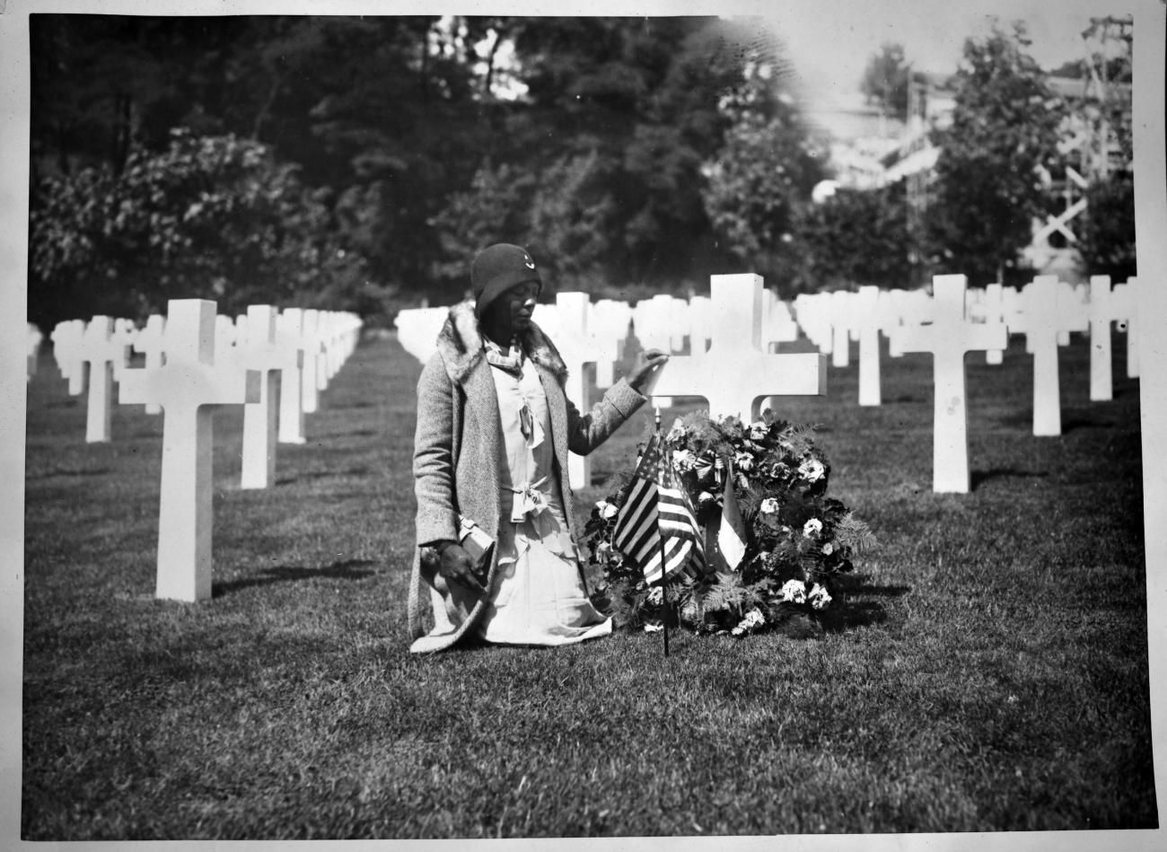
The Gold Star Mothers and Widows pilgrimages (1930-33)
Over the course of the program 6,654 women participated.
“Fatherhood lacked the civic dimensions and emotional intensity attributed to motherhood, which meant that paternal claims carried less weight.”
Rebecca Jo Plant, Mom: The Transformation
Of Motherhood in Modern America
(University of Chicago Press, 2012), p. 64.
An African American pilgrim of Party “L” at Suresnes American Cemetery, France,
July 26, 1930.
US National Archives
https://www.abmc.gov/news-events/news/women-and-world-war-i-commemoration-gold-star-mothers-and-widows-pilgrimages-1930

