Slide 1
Wounded bodies, disordered minds
The remasculinization of injured veterans
HI2C9 week 9

Slide 2
From soldier to civilian:
as simple as a change of clothes?
https://envisioningtheamericandream.com/2014/05/26/gi-joe-to-joe-college-2/

Slide 3
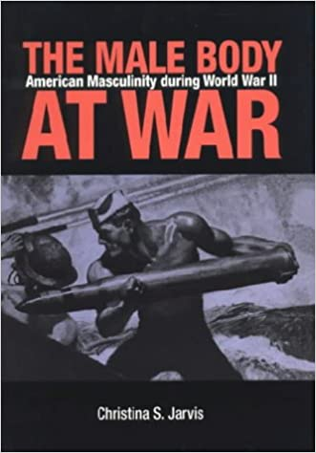
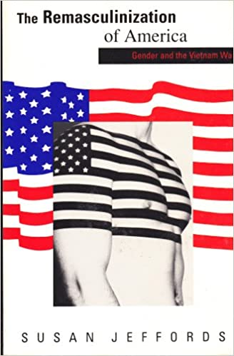
“Remasculinization”
Individual
bodies
and the
‘body politic’
1989

Slide 4

The veteran: hero or social problem?
hero or
problem?
hero or
problem?
Dir. Martin Scorsese, 1976

Slide 5
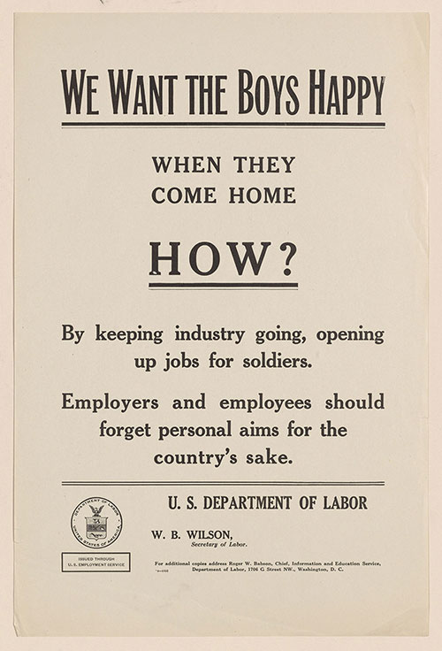
An ambiguous figure
The homecoming veteran as “conquering hero”
The veteran as entitled
The veteran as angry & aggrieved
The veteran as troubled & disturbed
The veteran as a rebuke to militarists
The veteran as target
The veteran as man
U.S. Employment Service, Information and Education Service. THE NATION OWES a great debt of gratitude to the soldiers in France and WE WANT THE BOYS HAPPY WHEN THEY COME HOME. HOW?
Broadsides,1919. Printed Ephemera Collection, Rare Book and Special Collections Division, Library of Congress

Slide 6
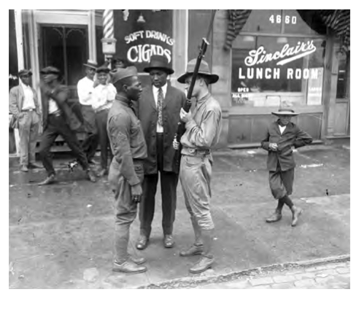
Racialized violence, lynching, and African American veterans
In 2016, the Equal Justice Initiative of Montgomery, Alabama, released an unprecedentedly thorough survey of American racial violence and terror between 1877 and 1950.
Lynching in America tallied 4075 lynchings, at least eight hundred more than any previous count.
Read it here:
https://eji.org/reports/targeting-black-veterans/
The report concludes that, during the same period,
“no one was more at risk of experiencing violence and targeted racial terror than black veterans.”
https://www.newyorker.com/news/news-desk/the-tragic-forgotten-history-of-black-military-veterans
Chicago, 1919, Chicago Tribune

Slide 7
Damaged bodies
Remaking men after war
https://ohiomemory.ohiohistory.org/archives/4211

Slide 8
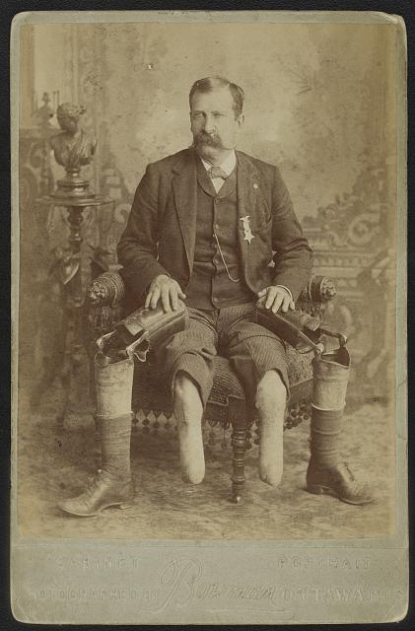
The work of recuperation
Engineering normative male bodies
Returning men to productive employment
Waged work as the key marker of masculinity
Restoring reproductive capability
Title: John W. January, veteran of Co. B, 14th Illinois Cavalry Regiment, with prosthetic legs/ Photographed by Bowman, Ottawa, Ills.
Photograph shows identified veteran who was a prisoner of war at Andersonville, Georgia, and lost his feet from scurvy and gangrene.
Library of Congress, Control Number 2016652279

Slide 9
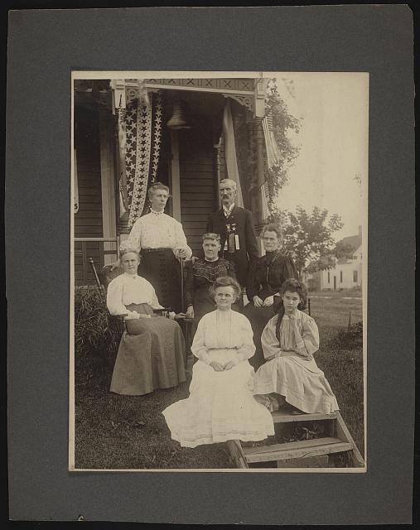
Reconsolidating male-headed households
Portrait of New York veteran of the
Civil War with his family.
Library of Congress
https://www.loc.gov/resource/ppmsca.53066/

Slide 10
Facial reconstruction and the
restoration of romantic possibility
“Thanks to you,” one veteran wrote to American sculptor Anna Ladd, “I will have a home…. The woman I love... will be my wife.”
Anna Coleman Ladd Papers, Archives
Of American Art, SI
"...The woman I love
no longer finds me
repulsive, as she had
a right to do."
https://www.smithsonianmag.com/arts-culture/faces-of-war-145799854/

Slide 11
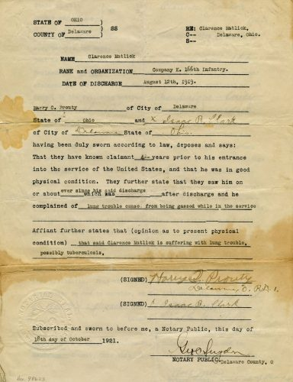
Declining fatalities,
rising rates of ’survivable’ injuries
During WWI, 224,000 US soldiers suffered injuries that sidelined them from the front.
Roughly 4,400 returned home missing part or all of a limb.
Some suffered life-long disability as a result of having
been gassed in the trenches.
This was the fate of veteran Clarence Matlack, who submitted an affidavit complaining of lung trouble after gas exposure during World War I.
Via Ohio Memory.
https://ohiomemory.ohiohistory.org/archives/4211

Slide 12
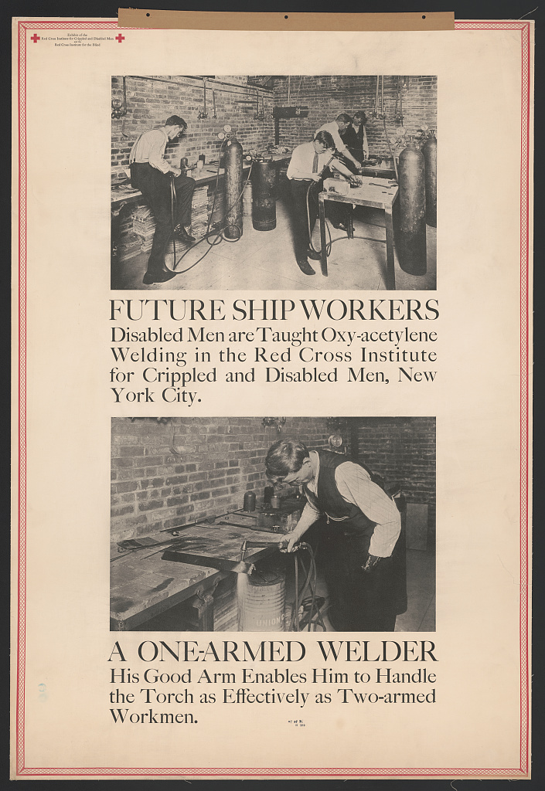
Making the body productive
The American Red Cross founded the Institute for Crippled and Disabled Men in New York City in 1917 to train amputees and individuals with damaged limbs.
Soon, injured veterans became a main constituency.
Here men with partial arm amputations are taught welding.
Library of Congress
https://blogs.loc.gov/loc/2017/12/world-war-i-injured-veterans-and-the-disability-rights-movement/

Slide 13
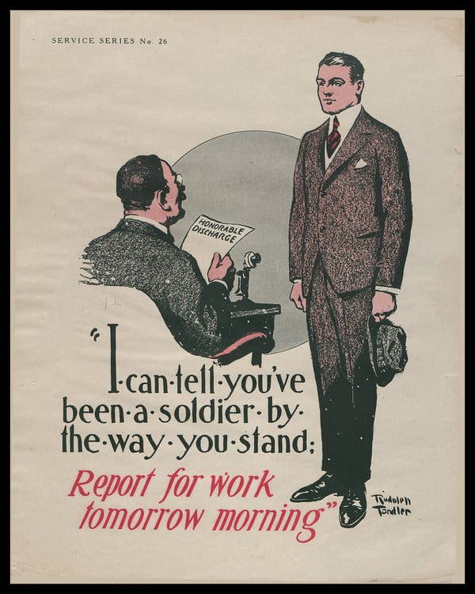
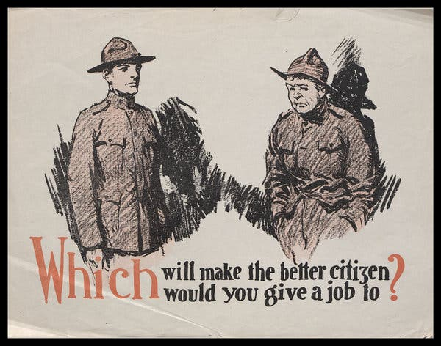
Re-education for WWI veterans
Instructions for veterans on how to comport
oneself in pursuit of a job
https://www.nytimes.com/2019/07/31/magazine/world-war-i-veterans-treatment.html

Slide 14
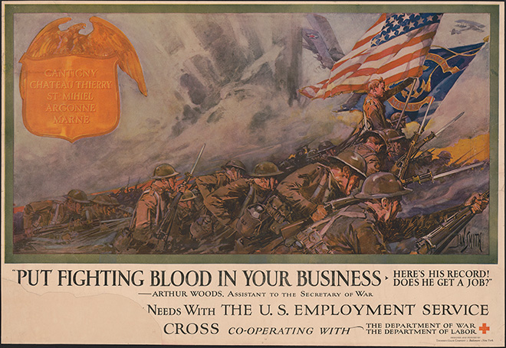
Re-educating
employers
Dan Smith. Put Fighting Blood in Your Business. Here's His record! Does He Get a Job!—Arthur Woods, Assistant to the Secretary of War [lists the Battles of St. Mihiel and Meuse-Argonne]. Baltimore, New York: Thomsen-Ellis Company, between 1917–1919. Lithograph. Prints and Photographs Division, Library of Congress (180.00.00)

Slide 15
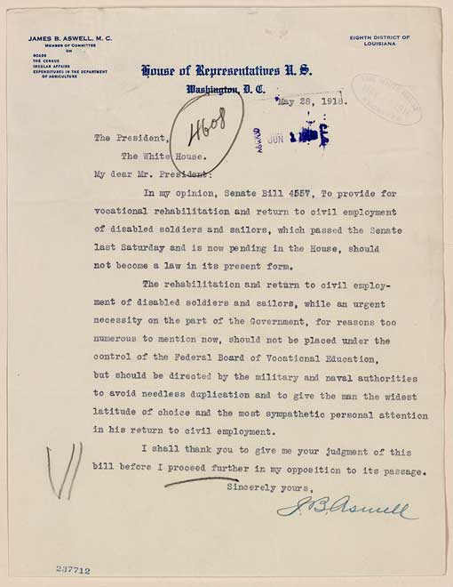
Footing the bill
Congress passed the Smith-Sears Vocational Rehabilitation Act (1918)
This legislation expanded the role of a federal board in assisting disabled veterans with rehabilitation and in finding productive employment.
1930: establishment of the Veterans Administration,
a federal agency tasked with providing welfare and healthcare services to veterans. It is still in existence.
Aug. 1945: WWI veterans occupied ¾ of the VA hospital system’s 51,000 psychiatric beds.
In this letter to President Woodrow Wilson, Louisiana Congressman James B. Aswell argued that the armed forces should be the proper agencies to assist disabled veterans.
Library of Congress

Slide 16
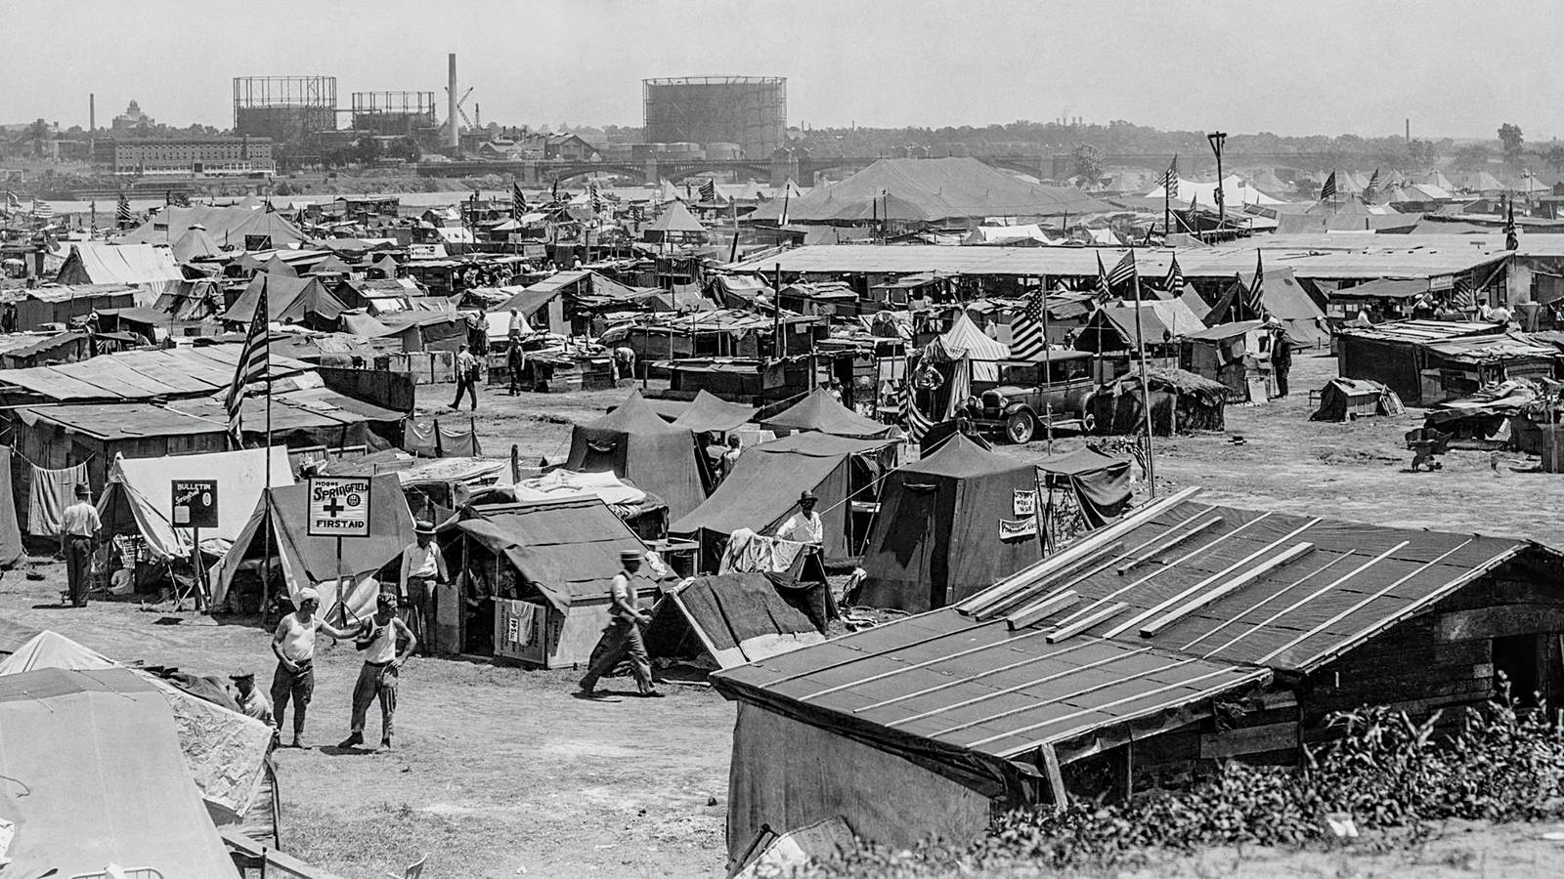
The Bonus Army encampment, Anacostia

Slide 17
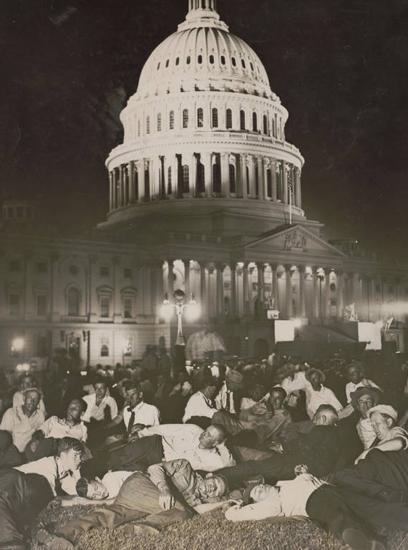
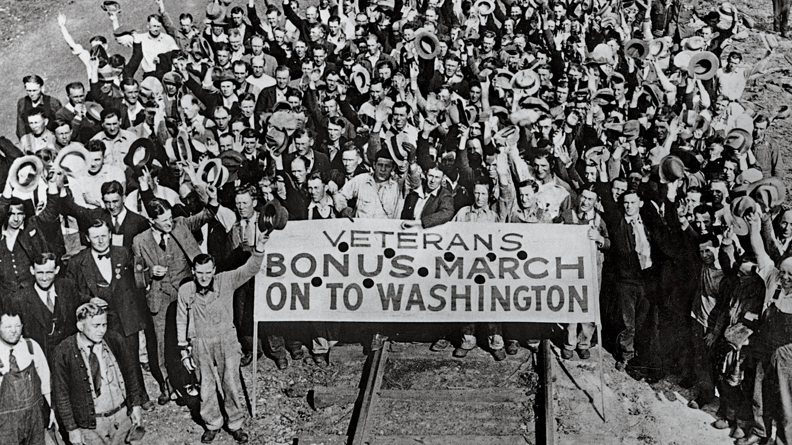
The “bonus march” (1932)
The bonus marchers, who were demanding wages for their service in World War I, spent the night in front of the U.S. Capitol on July 13, 1932. Library of Congress
https://www.npca.org/articles/1915-the-forgotten-march

Slide 18
“Invisible injuries”
Evolving
understandings of
psychological/
Traumatic
injury in wartime
NB: The clinical diagnosis Post-Traumatic
Stress Disorder (PTSD) was first included in
the Diagnostic and Statistical Manual (DSM III)
of the American Psychiatric Association in 1980.
https://www.ptsd.va.gov/professional/treat/essentials/history_ptsd.asp

Slide 19
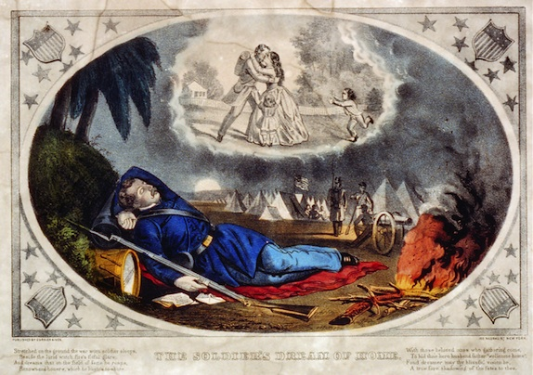
“Nostalgia” in the Civil War
American medical handbooks from the mid-19th century offered wide-ranging definitions of nostalgia, combining both psychological and physiological effects of the malady.
Statistics recorded in the multi-volume Medical and Surgical History of the War of Rebellion (1888), show the malaise “developed to a morbid degree” among white Union soldiers over the course of the war with some 5,213 cases identified, resulting in 58 deaths.
The statistics also reveal 334 cases and 16 deaths among the Union’s Black soldiers.
Currier & Ives, “The Soldiers’ Dream of Home” (1861-65)

Slide 20
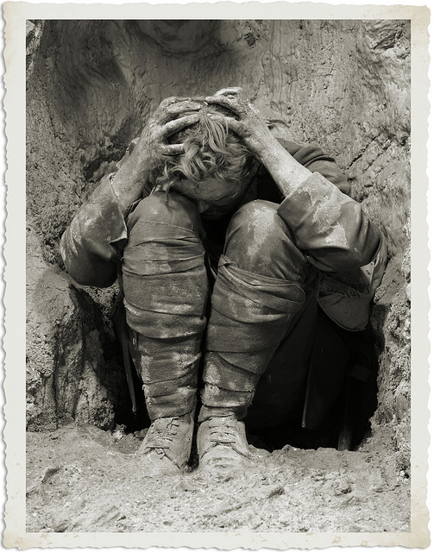
“Shell shock” in the Great War
The term “shell shock” first appeared in The Lancet in 1915.
Symptoms were bafflingly varied: amnesia; mutism; paralysis; hysteria– a female malady.
Shellshock was often seen as a failure of manliness.
Opinions differed as to the source of injury: whether it resulted from percussive blasts or from microscopic
fragments of shell that had embedded themselves in soldiers’ brains.
“Nearly 100,000 US soldiers were removed from fighting for psychiatric injuries; 40,000 of them were discharged. By 1921, approximately 9,000 veterans had undergone treatment for psychological disability in veterans’ hospitals.
As the decade progressed, greater numbers of veterans received treatment for “war neurosis”.
Ultimately, whether mental or physical, 200,000 veterans would return home with a permanent disability.
https://blogs.loc.gov/loc/2017/12/world-war-i-injured-veterans-and-the-disability-rights-movement/
https://encyclopedia.1914-1918-online.net/article/war-psychiatry-and-shell-shock-2-0/

Slide 21
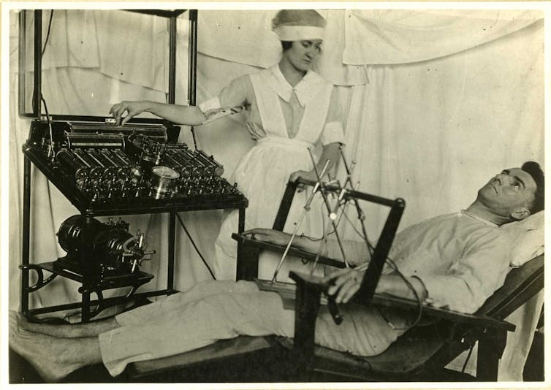
Electric treatments were prescribed in psychoneurotic cases post-WWI.
Otis Historical Archives National Museum of Health and Medicine, CC BY
https://theconversation.com/from-shell-shock-to-ptsd-a-century-of-invisible-war-trauma-74911

Slide 22

“Neuro-psychiatric” (NP) cases in WW II
By the end of WWII, the US military had rejected or discharged approx. 2.5 million Americans from service on ”neuro-psychiatric” grounds
But WHY (even after attempts to screen out likely ‘NP’ cases) did some men break down? And would EVERY man “crack” if exposed to sufficient duress?
“Battle fatigue” an alternative name
Photos show US soldiers in World War II exhibiting signs of psychological stress.
National Archives

Slide 23
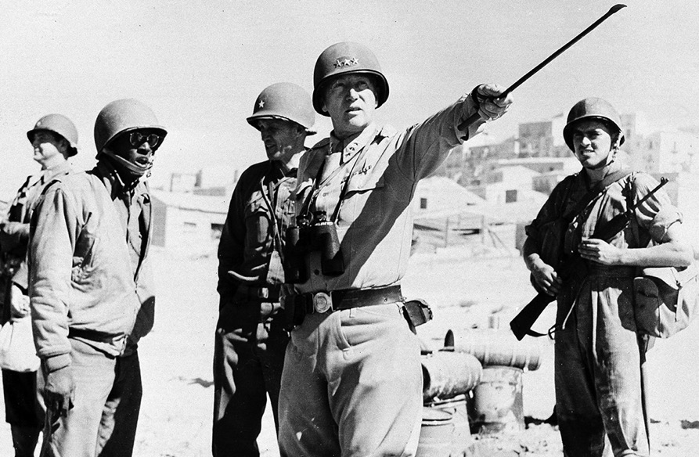
“Invisible injuries” and social stigma
Greater social stigma attached to mental illness
The possibility that “unseen” injuries might be faked by malingerers
Malingerers and “goldbricks” = cowards (by definition, unmanly, un-military men)
Medical uncertainty about the causes of psychological harm in wartime
Dispute over whether every man had a “breaking point” in wartime
Ethical dilemmas for clinicians– ”fixing” traumatized soldiers only to send them back again into battle
Treatment and cure uncertain
“Firm and drastic measures are at times necessary… but this does not excuse brutality, abuse of the sick, nor exhibition of uncontrollable temper in front of subordinates.”
— Gen. Dwight D. Eisenhower
General George Patton drew critical attention in 1943 for assaulting two soldiers suffering from shell shock in Sicily.
Image source: Associated Press

Slide 24
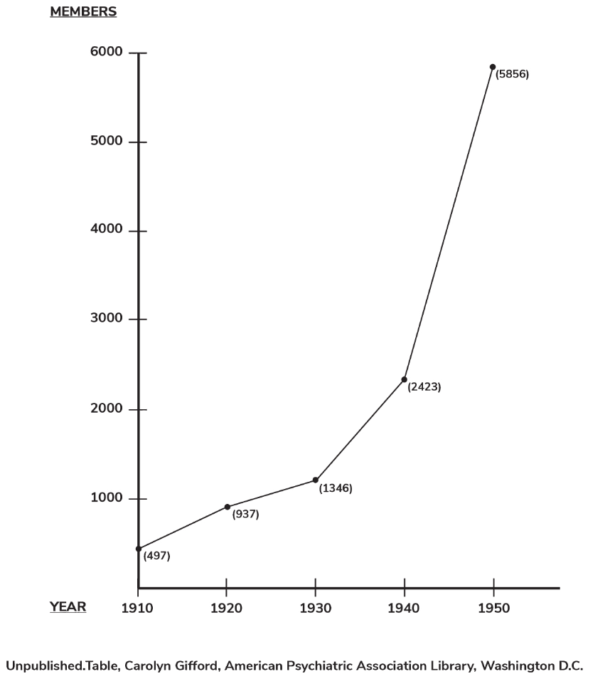
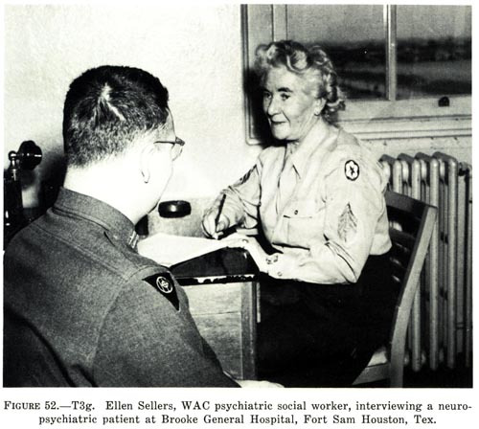
The wartime and postwar rise of the American psychiatric profession
Membership of the American Psychiatric Association
https://achh.army.mil/history/book-wwii-neuropsychiatryinwwiivoli-chapter20

Slide 25
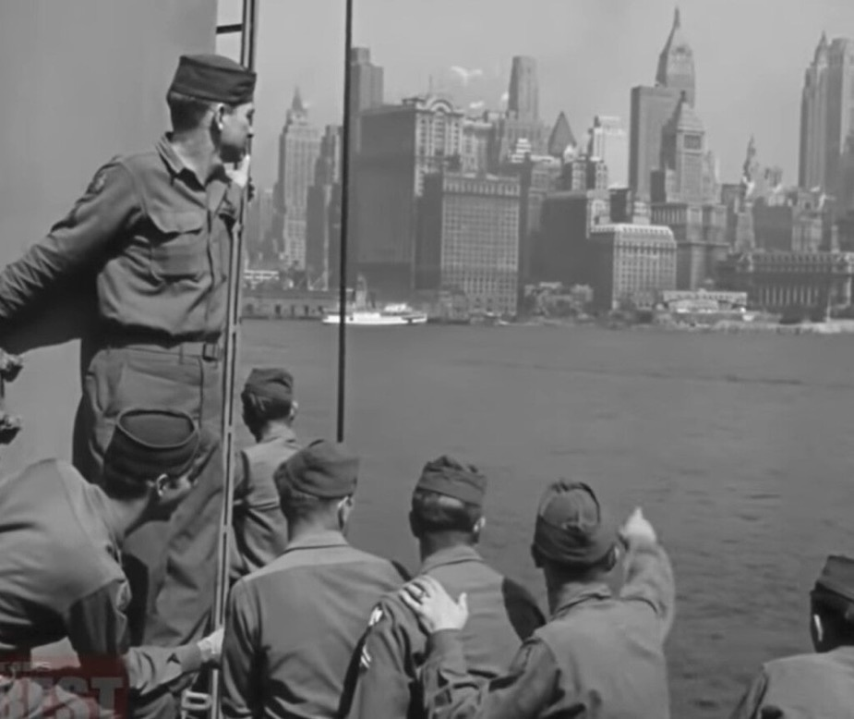
Gendered prescriptions for the “remasculinization” of returning veterans
Returning veterans arrive at New York Harbor.
https://historycollection.com/bringing-the-boys-home-americas-demobilization-after-wwii/

Slide 26
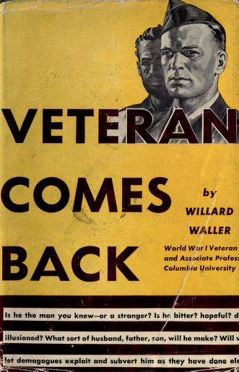
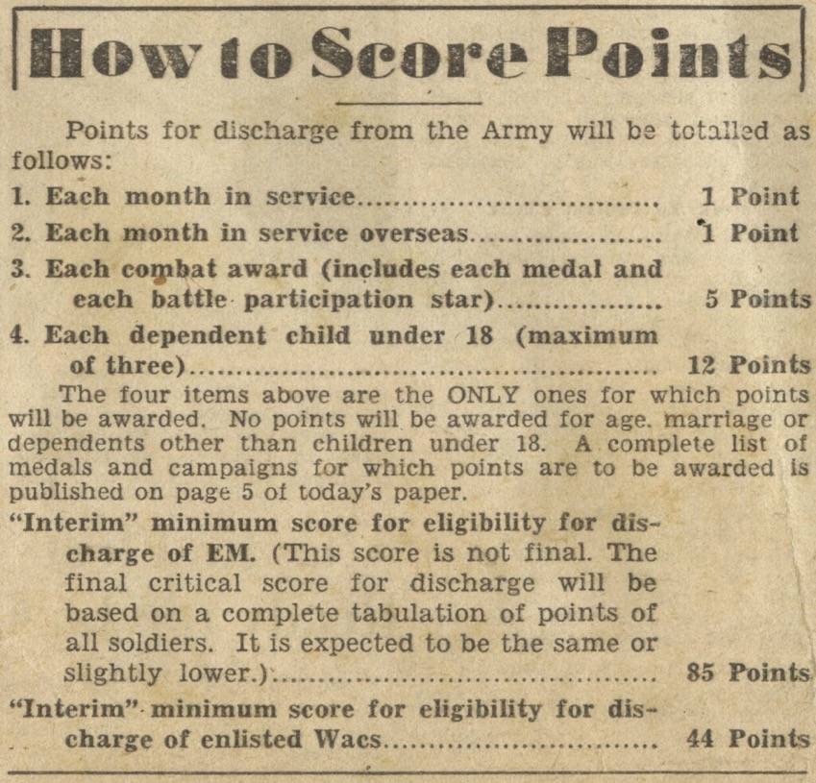
Demobilization and
re-integration
https://archive.org/details/veterancomesback00wallrich

Slide 27
Hollywood and the romance of rehabilitation: The Best Years of Our Lives (Nov. 1946)
Dir. William Wyler
The plot follows the homecoming of three newly
demobilized veterans: Homer Parrish, Al Stephenson
and Fred Derry.
Each man suffers from a war-induced condition:
Homer is a double amputee; Al an alcoholic, and
Fred a “neuropsychiatric case.” Their recoveries are
all contingent on their finding– and accepting– the
love of a good woman.
Homer’s homecoming:
https://www.youtube.com/watch?v=w0UnTPbk4nQ
Fred’s traumatic flashback:
https://www.youtube.com/watch?v=xN1lXQVLZeA

Slide 28
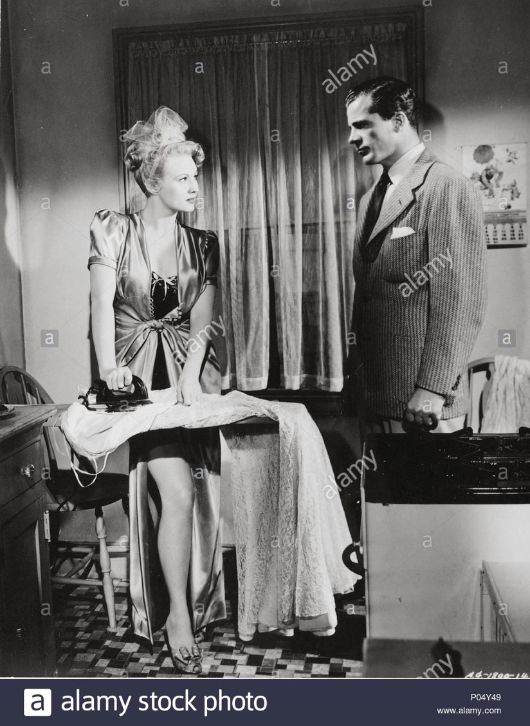
Romantic rejections and
accommodations
Fred’s faithless wife, Marie, represents an
obstacle to his recovery and happiness (left).
Wilma must reassure Homer of her steadfastness
despite his disability (above).

Slide 29
Let There Be Light (1946)
U. S. Army Film (Professional Medical Film) PMF 5019 filmed in spring 1945 at Mason General Hospital, Long Island, NY
Top right: a still from the film depicting veterans in group therapy
Right: Director John Huston in officer’s uniform, a captain in the Army Signal Corps

Slide 30
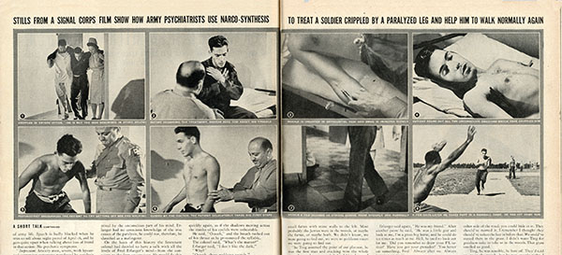
“The army’s own actions seemed to undermine its stated concern for the soldiers’ privacy: it had supplied nearly a dozen still photos from Let There Be Light to illustrate a 29 October 1945, Life magazine article on the stateside treatment of battle-fatigue casualties. The photos clearly showed the faces of two men in the film and identified them as psychiatric patients. The army never explained why these photos were acceptable for Life’s civilian readers while the film was not.” https://www.historynet.com/let-there-be-light-how-a-ptsd-film-worried-army.htm
Although the army cit magazine. (LIFE Magazine)

Slide 31
Questions to consider as you watch:
Which specific audiences do you think this documentary was produced for?
How does the film explain the origins of men’s neuro-psychiatric disturbances?
Combat exposure vs early childhood experience
Where do women figure here–primarily agents of harm and/or tender carers? (Pay attention to how women, particularly mothers and intimate partners, are discussed by the psychiatrists and men in treatment, as well as women directly captured on film.)
How do you read the film’s politics of race? Is this a liberal portrayal of Black Americans?
What does the film suggest about the prospects of recovery for ‘NP cases’?
Why do you imagine the War Department, having commissioned the film, then suppressed it until 1980?
TASK: Pick out the scene you found most revealing. Come to class prepared to discuss it.

