Slide 1
A Cultural Revolution?

Slide 2
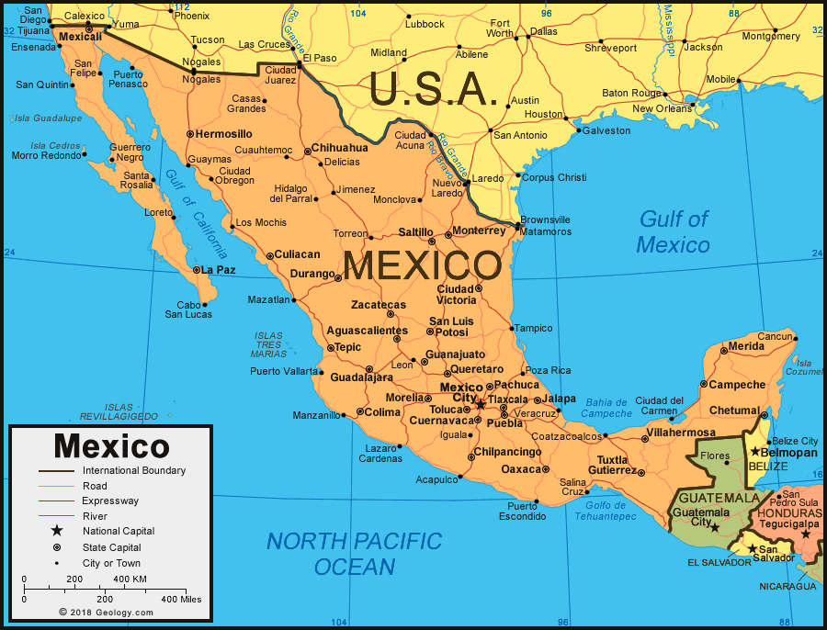
Seminar Questions
To what extent was the Mexican Revolution a cultural revolution?
What were the aims of state cultural programs?
How successful were they?

Slide 3
What is being assessed?
Argument: does the work give a persuasive answer to the question, with good use of evidence?
Knowledge: is the work based on a thorough factual knowledge of relevant historical events?
Understanding: does the work give a critical analysis of sources, theories, methods, and/or debates that are relevant to the topic at hand?
Presentation: is the work clearly written, logically organised, and correctly referenced?

Slide 4
Essay feedback: Footnotes and referencing
1. Knight, Alan. The Mexican Revolution. Vol II. Cambridge: Cambridge University Press, 1986, Pp 28.
2. Ibid. 26.
3. John Womack, “The Mexican Revolution, 1910-1920”, in Leslie Bethell, (ed.), Mexico Since Independence (Cambridge, Cambridge University Press, 1991), 123.
4. Knight. The Mexican Revolution, 1986, 42.
5. Womack, “The Mexican Revolution”, 1991, 155.
6. Dahl, Robert “What Political Institutions Does Large-Scale Democracy Require?” Political Science Quarterly , vol. 120, no. 2, 2005, pp. 187–97.
7. Guardino, Peter, The Time of Liberty: Popular Political Culture in Oaxaca 1750-1850, (Duke University Press, Durham, 2005), 1 – 19, 156 - 223
8. Hamnett, Brian R, “Destabilization and Fragmentation, 1770–1867.”. (Cambridge: Cambridge University Press, 2019), 189
Be consistent
Don’t repeat the full information every time (only the first time)
Make sure everything you have in the footnotes is also in the bibliography.
Article names in Italics/ Book titles in Italics
Just the book title for a single-authored book. Only need chapter titles for edited volumes. (eg. different authors wrote different chapters).

