Slide 1
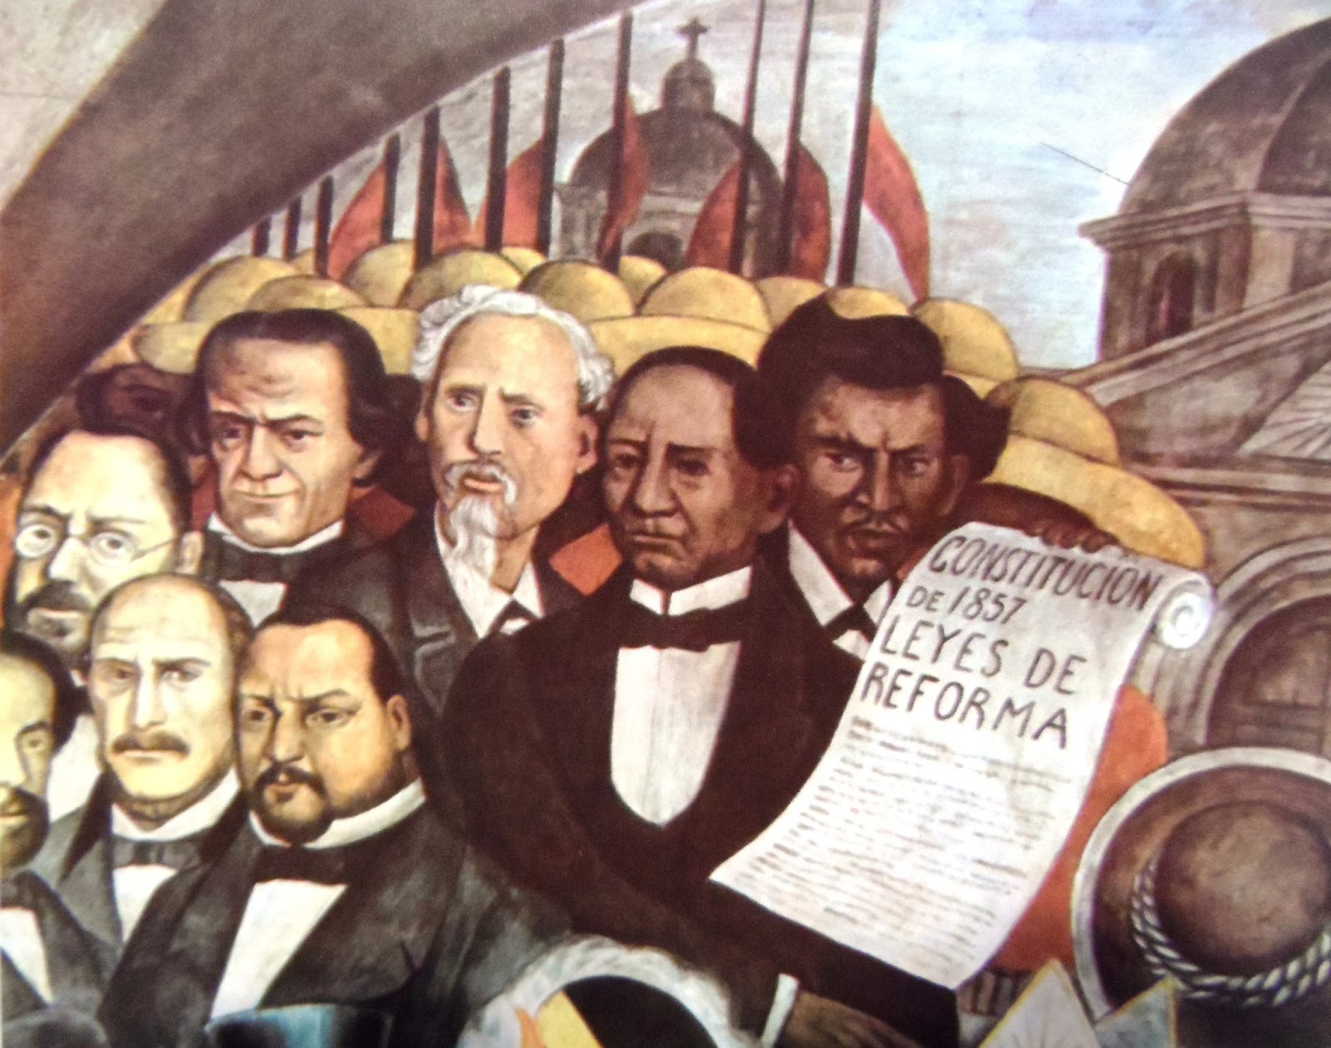
Civil War and Benito Juárez (1848-1876)
Seminar

Slide 2
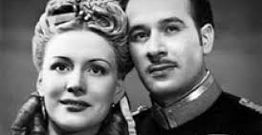
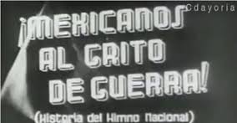
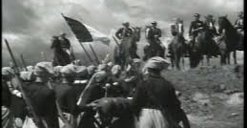
Mexicanos al Grito de Guerra, Dir. Álvaro Gálvez y Fuentes and Ismael Rodríguez, 1943
Golpe de estado 42:00: https://www.youtube.com/watch?v=iw-B5nW3ark
Royalists and Juárez Speech 01:02: https://www.youtube.com/watch?v=iw-B5nW3ark
Seth Fien, "Myths of Cultural Imperialism and Nationalism in Golden Age Mexican Cinema“ in Joseph, G., Rubestien, A. and Zolov, E. (eds.) Fragments of a Golden Age. Duke, 2001.

Slide 3
Golpe de estado scene.
Assistant 1: “This is the state of our resources.”
Juárez: “We will have to make many sacrifices.”
Assistant 2: “This is the state of the treasury.”
Zuloaga: “We’ll have to introduce new taxes. We need to stop that madman who thinks he’s president.”
Juárez: “I’m thinking that afterall, we don’t need any money to win. It’s enough to have justice on our side. Everything else will follow.”
Zuloaga: “ It doesn’t matter if we do something unjust. I’ll accept Jecker’s loan.”
Assistant 2: “But that would mean putting the nation in foreign hands.”
Zuloaga: “All the same, we need the money.”
Juárez: “We’ll reduce our salaries by half. We’ll die of hunger before asking for a foreign loan. In the current circumstances we can’t betray the nation.”

Slide 4
Royalists and Juárez Speech
Our national dignity has been attacked and our independence may be threatened. Foreign forces have invaded under the pretext of reclaiming a debt by force, something that they don’t have the right to do. I appeal to your patriotism, I urge you to forget partisanship and attend to the most important calling for men, for the people, of the defence of the nation. Europe think American countries are weak. We would never provoke them, but if they come looking for us in this continent which is our home, we’ll show their invincible armies that a small country can be big, that a weak country can be strong, that a poor country can be powerful. When motivated by the love of liberty and justice, Mexico will show them that the respect of the rights of others means peace.

Slide 5
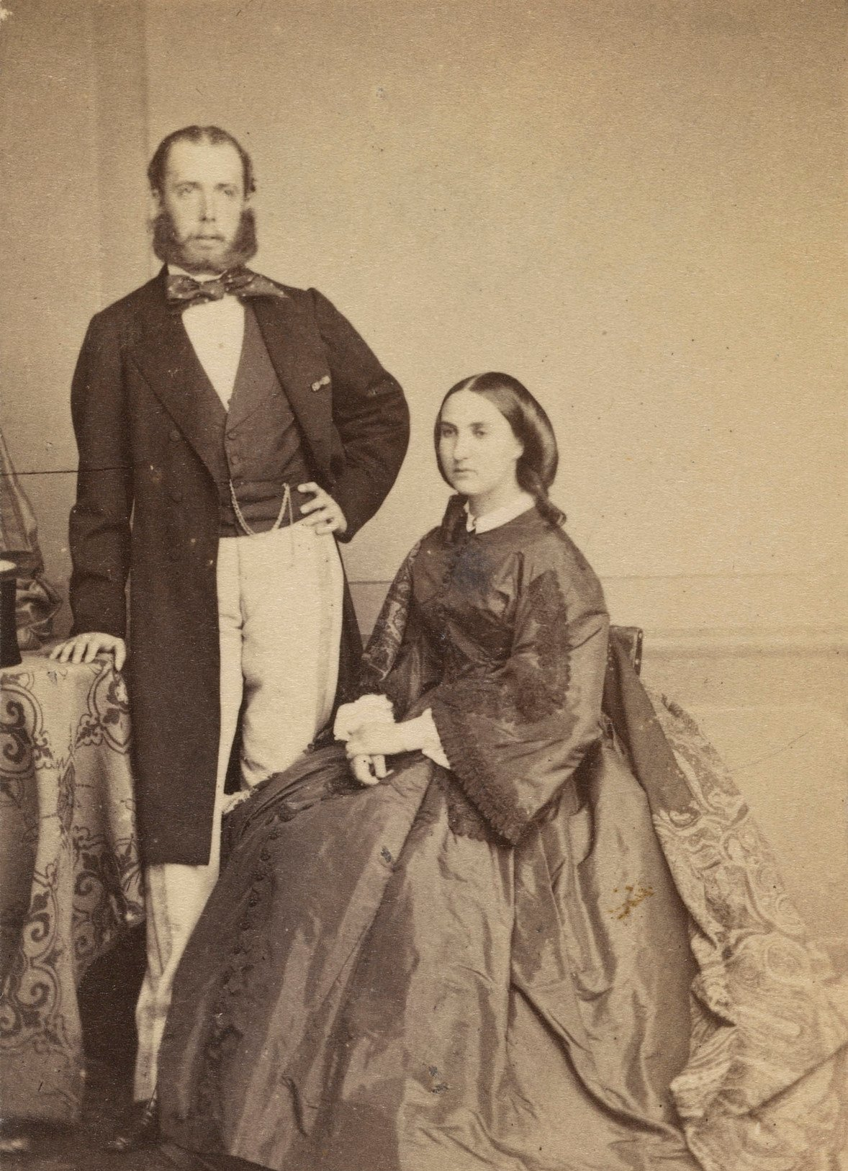
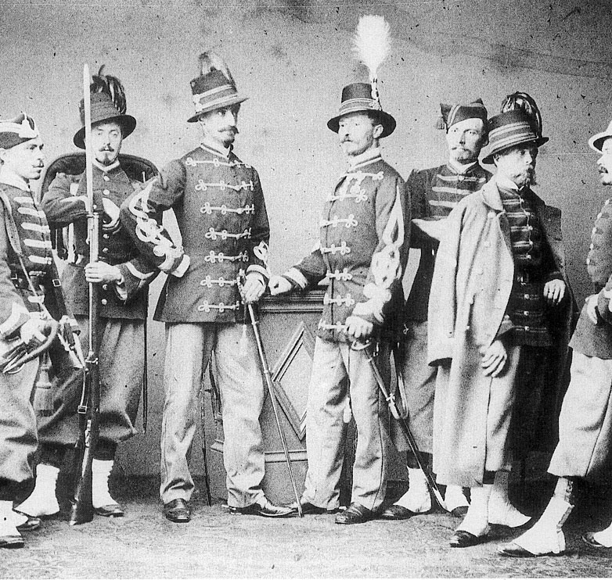
Primary Sources
What can the primary sources tell us about the French Intervention and the Liberal Government?
How might they be useful? How might they be less useful?

Slide 6
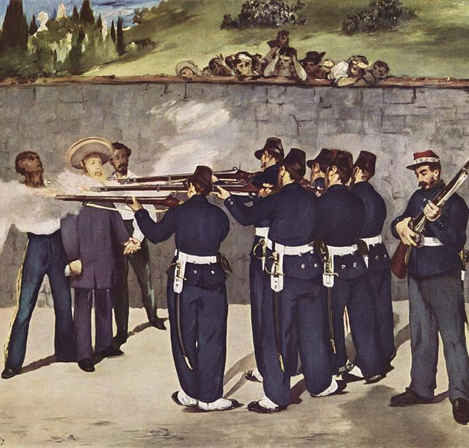
Seminar Questions
Why and how did Benito Juárez come to power?
Why did the French Intervention precipitate a civil war?
Why did the Liberals win?

Slide 7
Essay Questions

