Slide 1
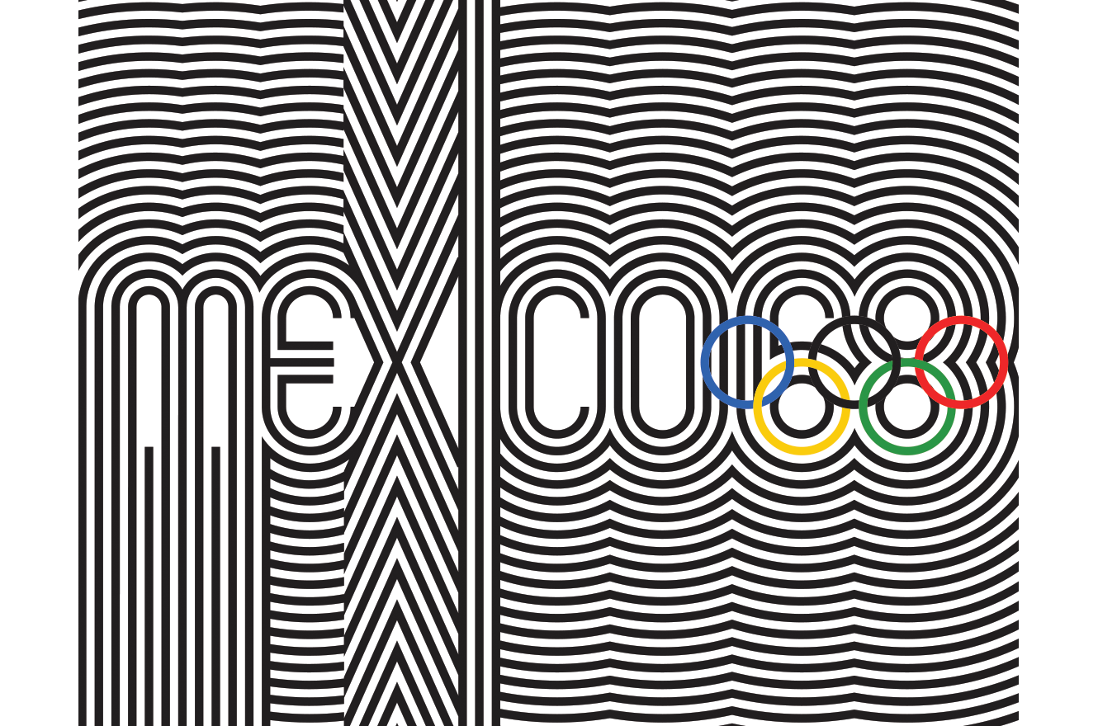

Slide 2
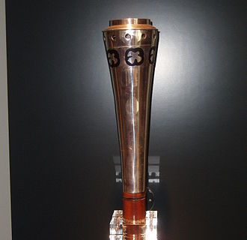
Questions for Discussions
What do you know about Mexican history, geography, people, languages etc?
What was happening globally in 1968?
What were the aims of the Modern Olympic Movement?
Why might governments be interested in holding the Olympic Games?
What do cities need to do to prepare for the Olympic Games or big sporting events?

Slide 3
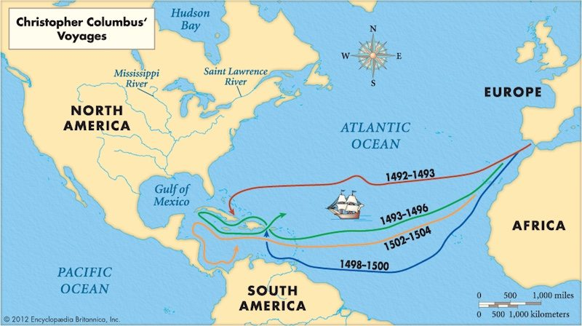
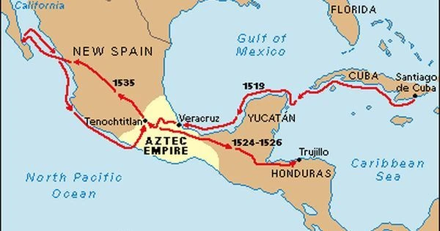
First Contact in The Americas and Mexico

Slide 4
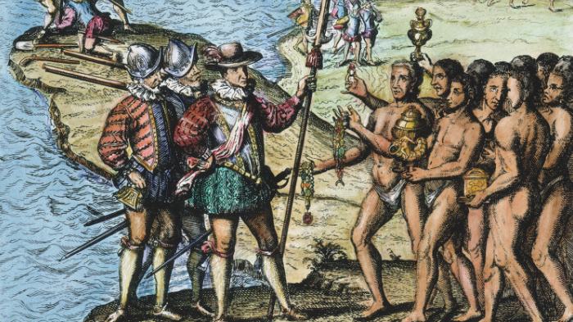

Slide 5
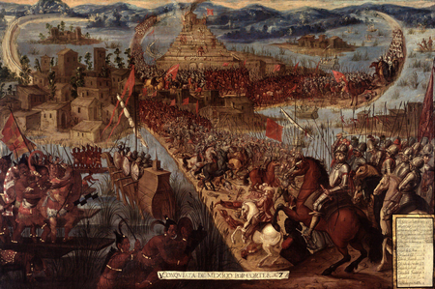
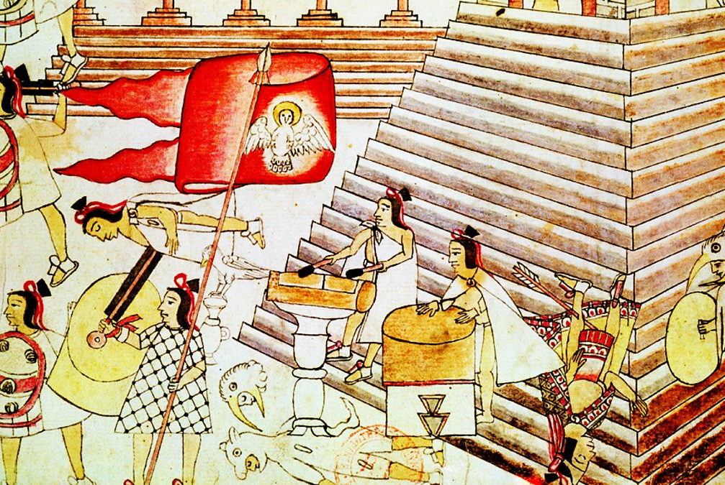
Tenochtitlan

Slide 6
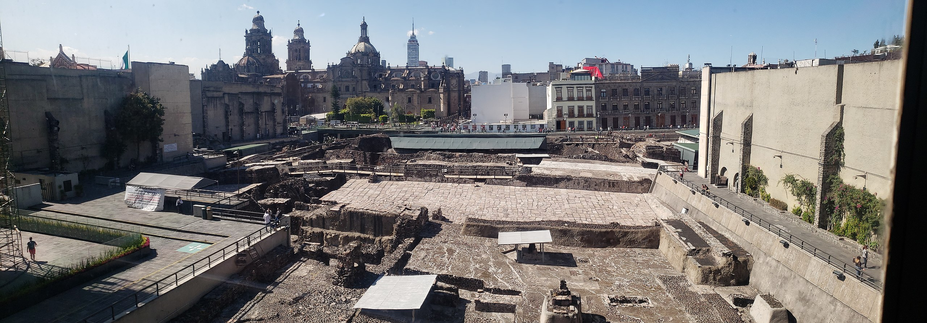
Templo Mayor (Tenochtitlan Today)

Slide 7
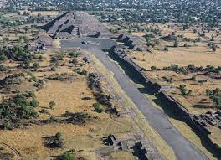
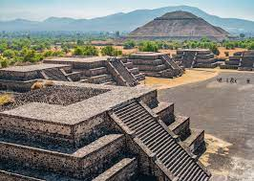
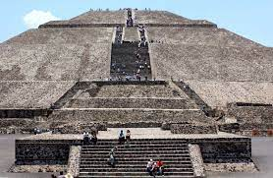
Teotihuacan

Slide 8
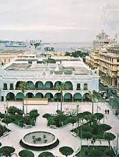
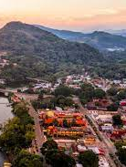
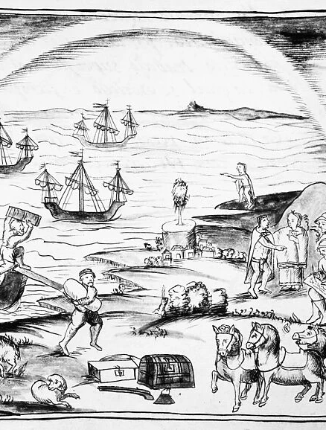
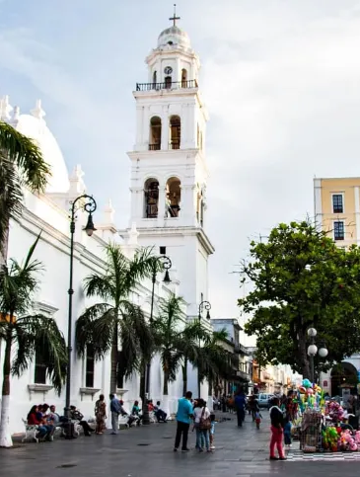
Veracruz

Slide 9
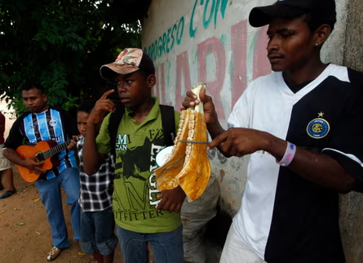
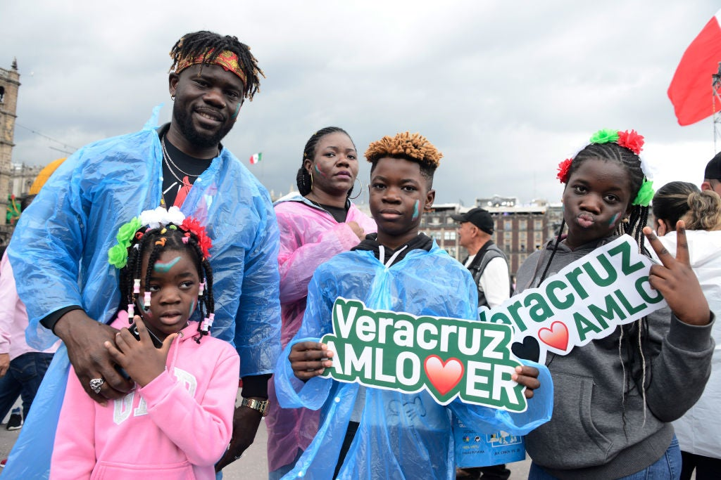

Slide 10
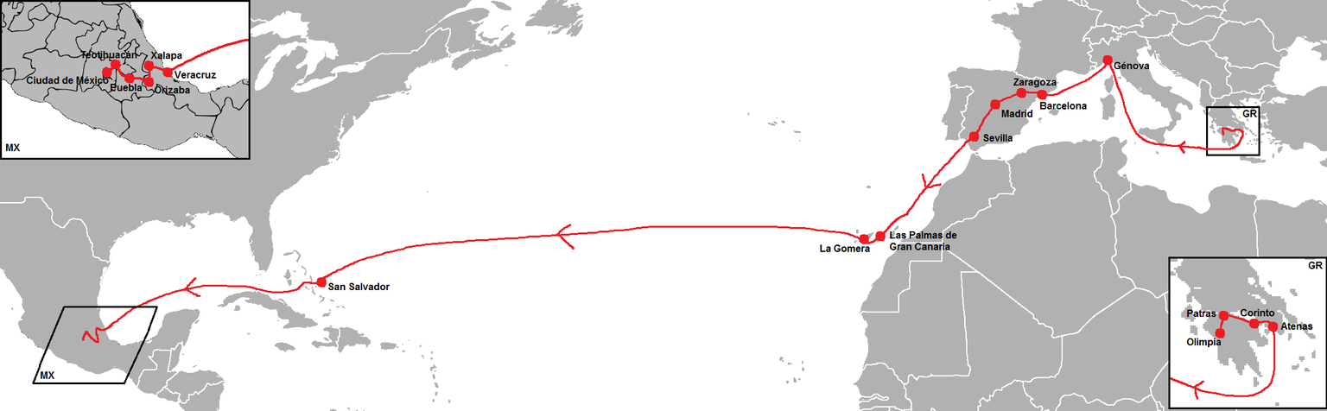
The Route for The Olympic Torch 1968

Slide 11
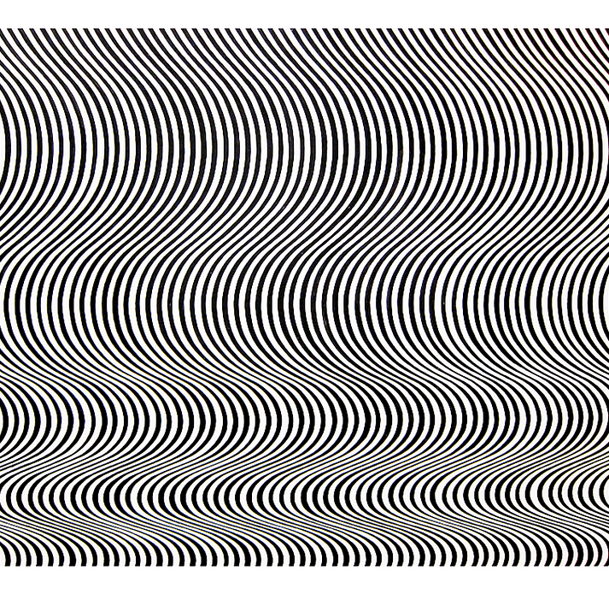
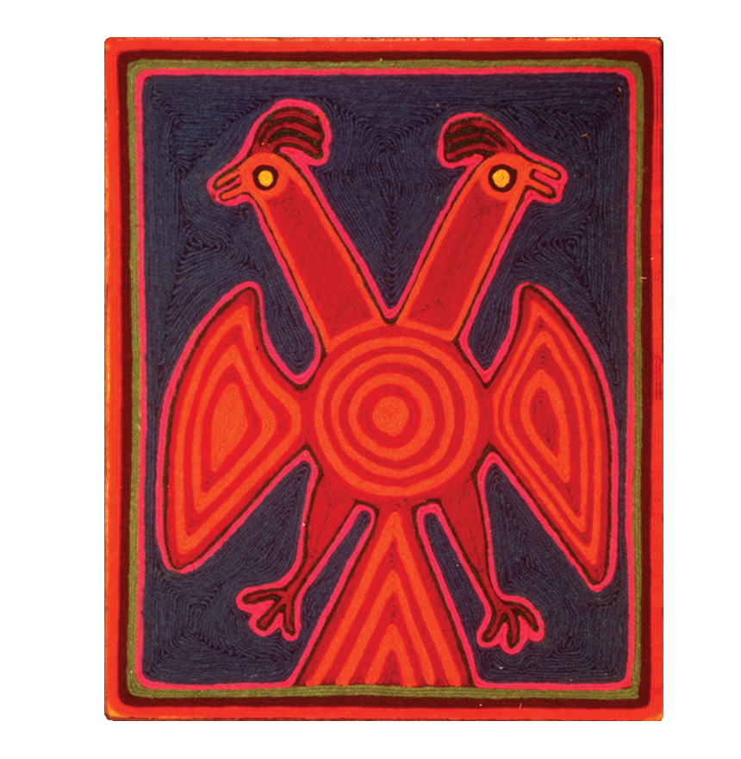
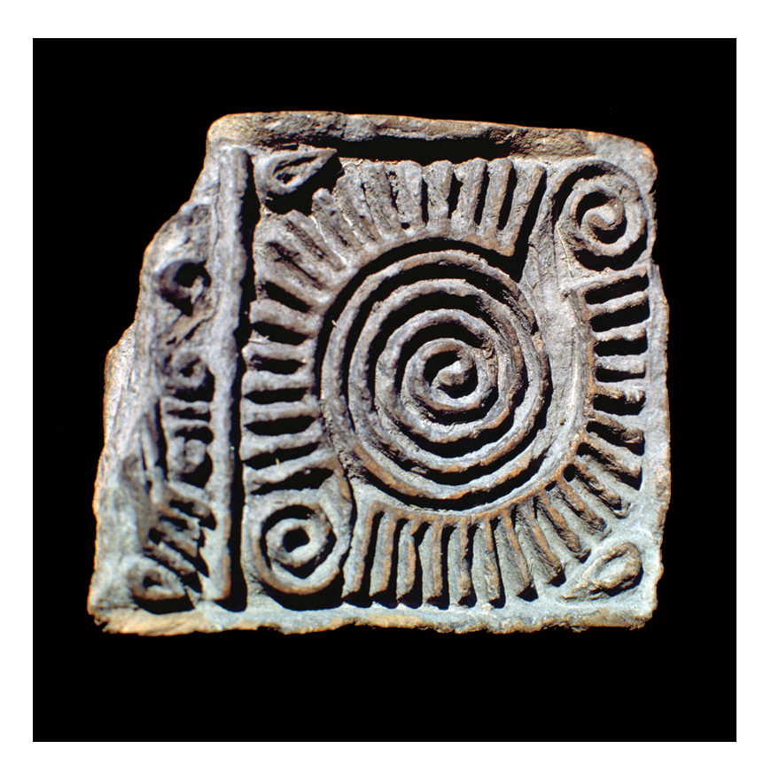

Op Art
Mexican Art

Slide 12
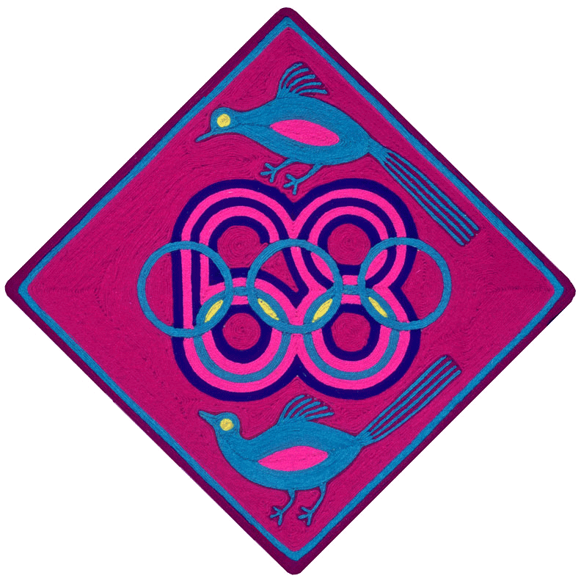
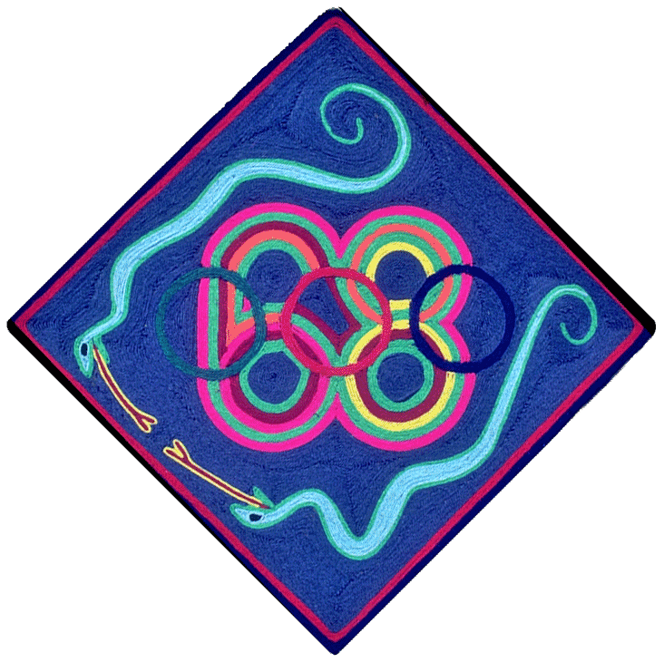

Slide 13
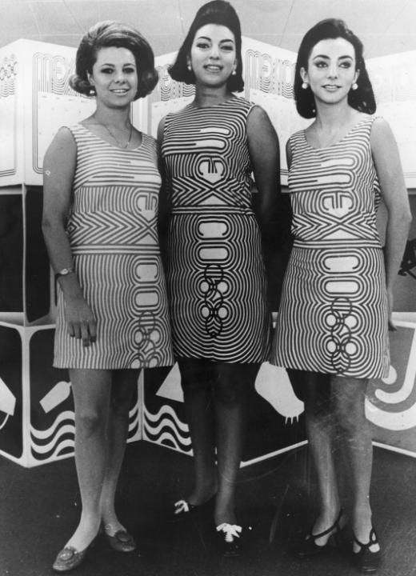
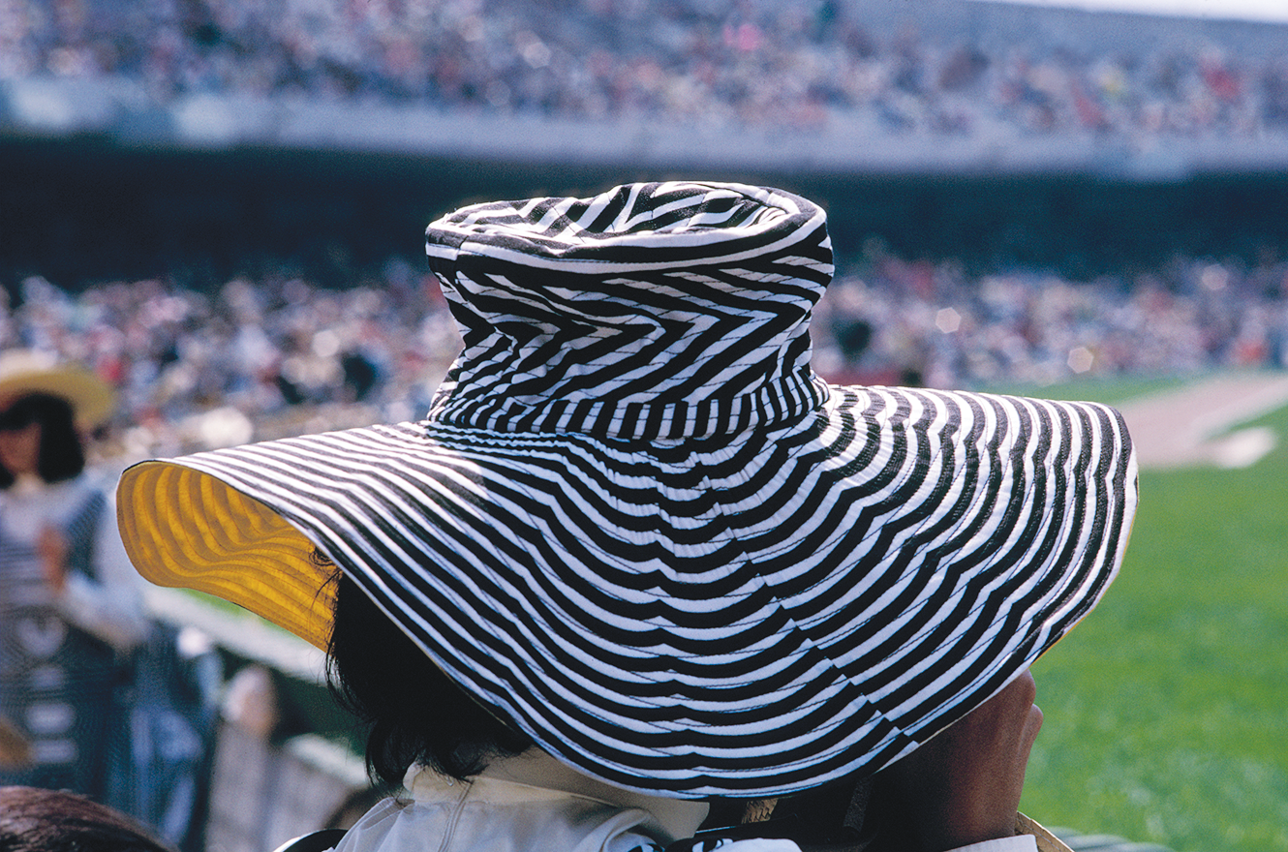

Slide 14
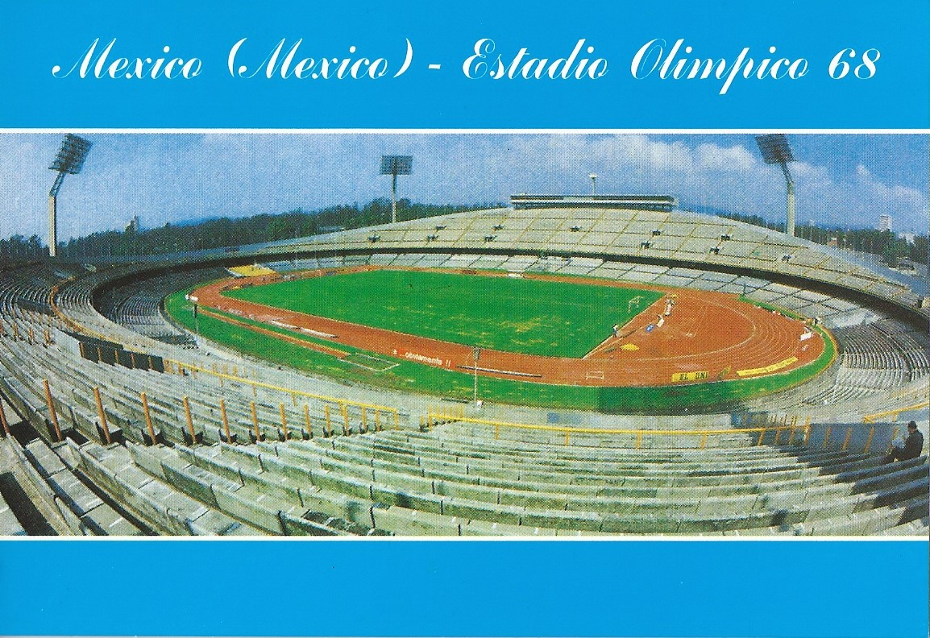
Olympic torch and opening ceremony 1968
https://olympics.com/en/video/mexico-1968-opening-ceremony

Slide 15
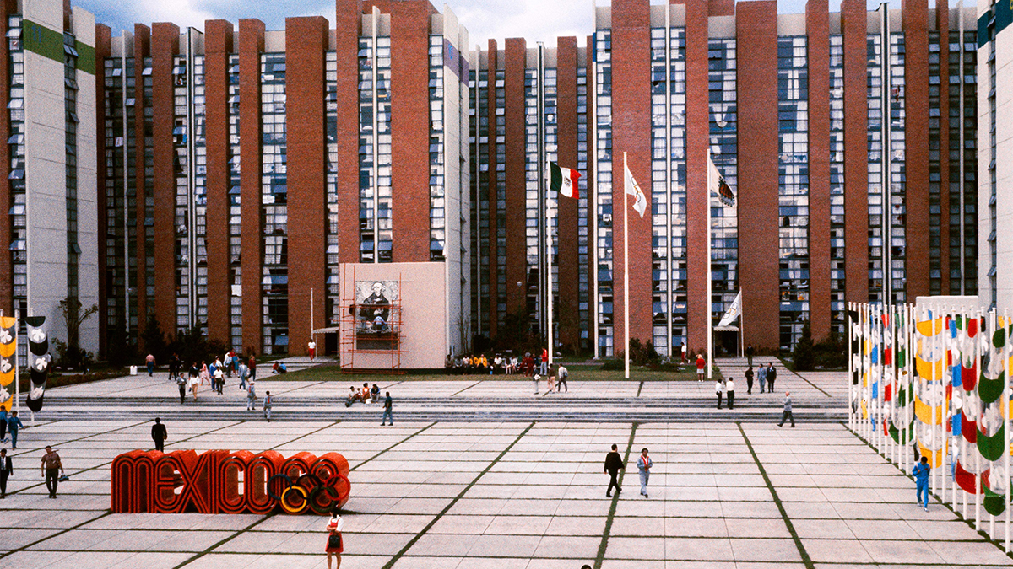

Slide 16
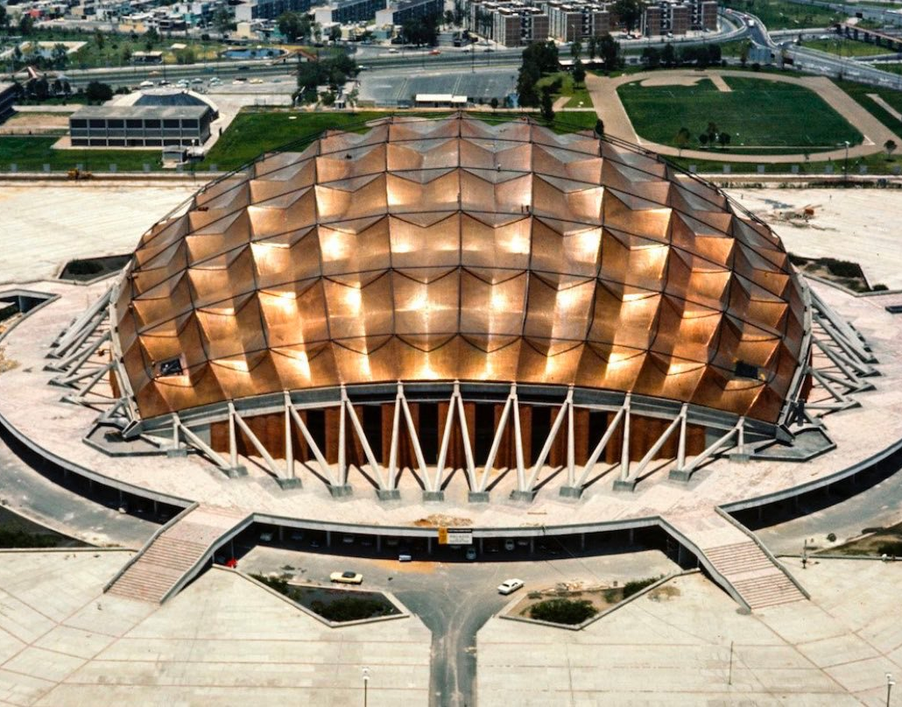
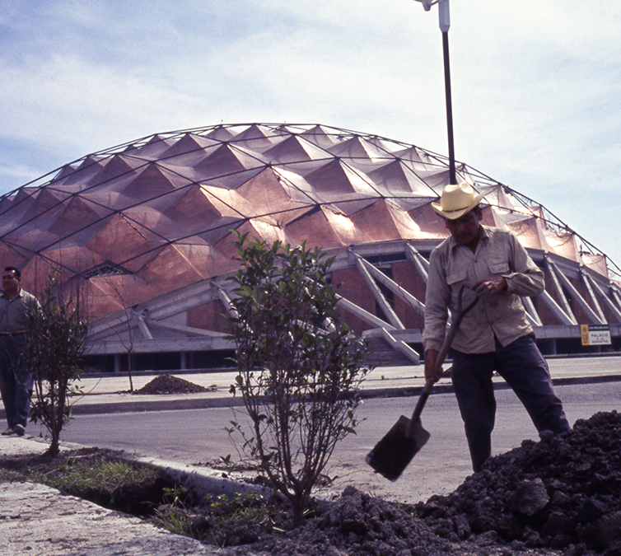
Palacio de los Deportes Félix Candela, Enrique Castañeda Tamborel and Antonio Peyri. Original capacity: 22,379

Slide 17
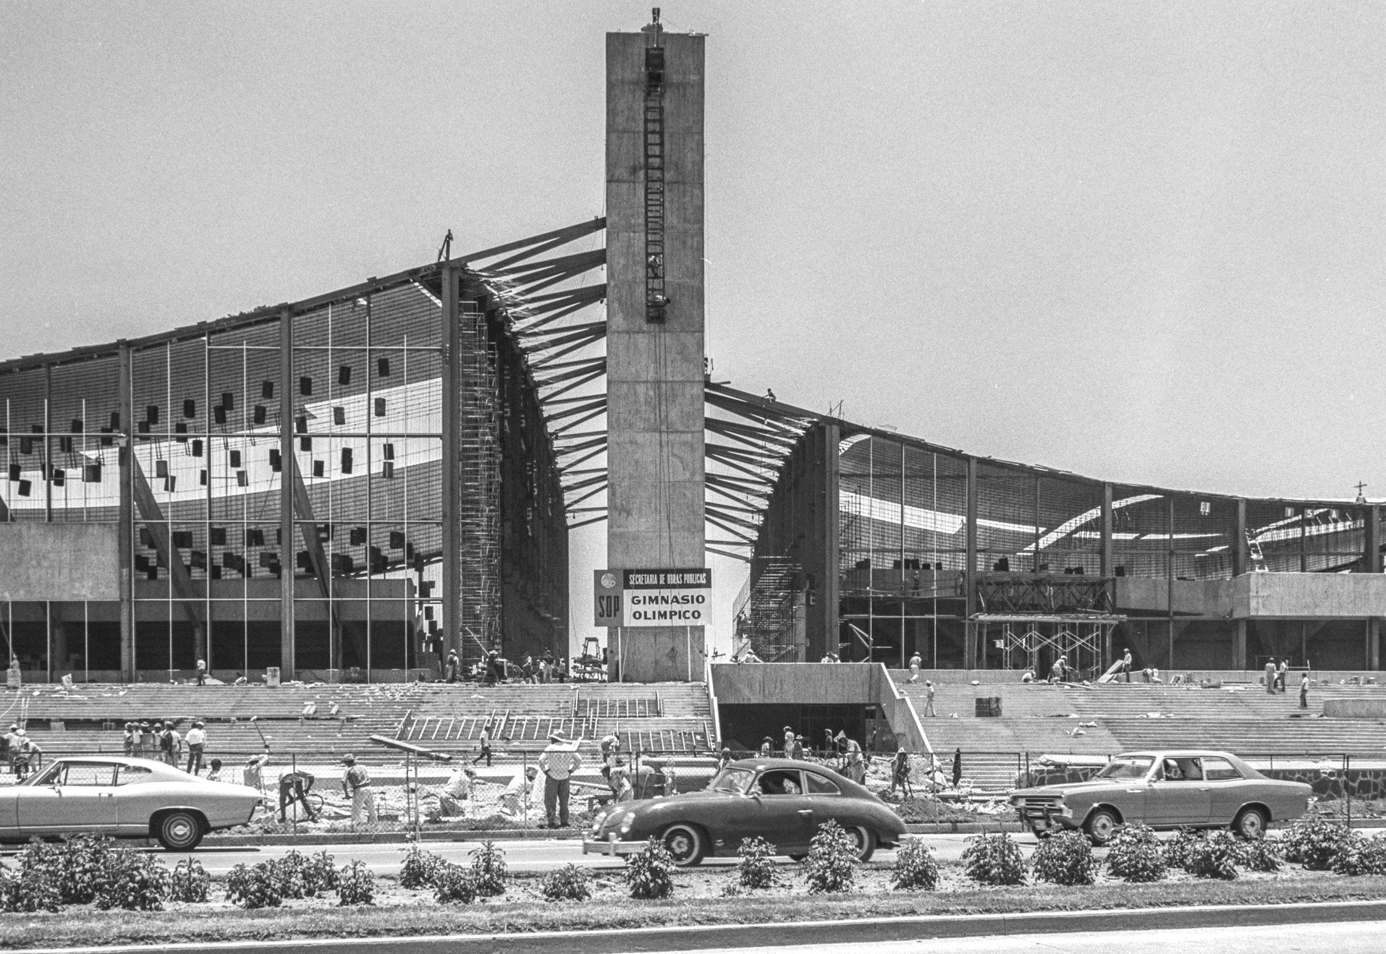
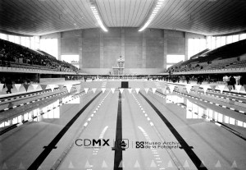
Alberca Olímpica, Manuel Rosen, Antonio Recamier y Edmundo Gutiérrez Bringas, 13 September 1968. Original capacity:

Slide 18
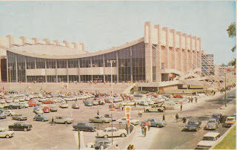
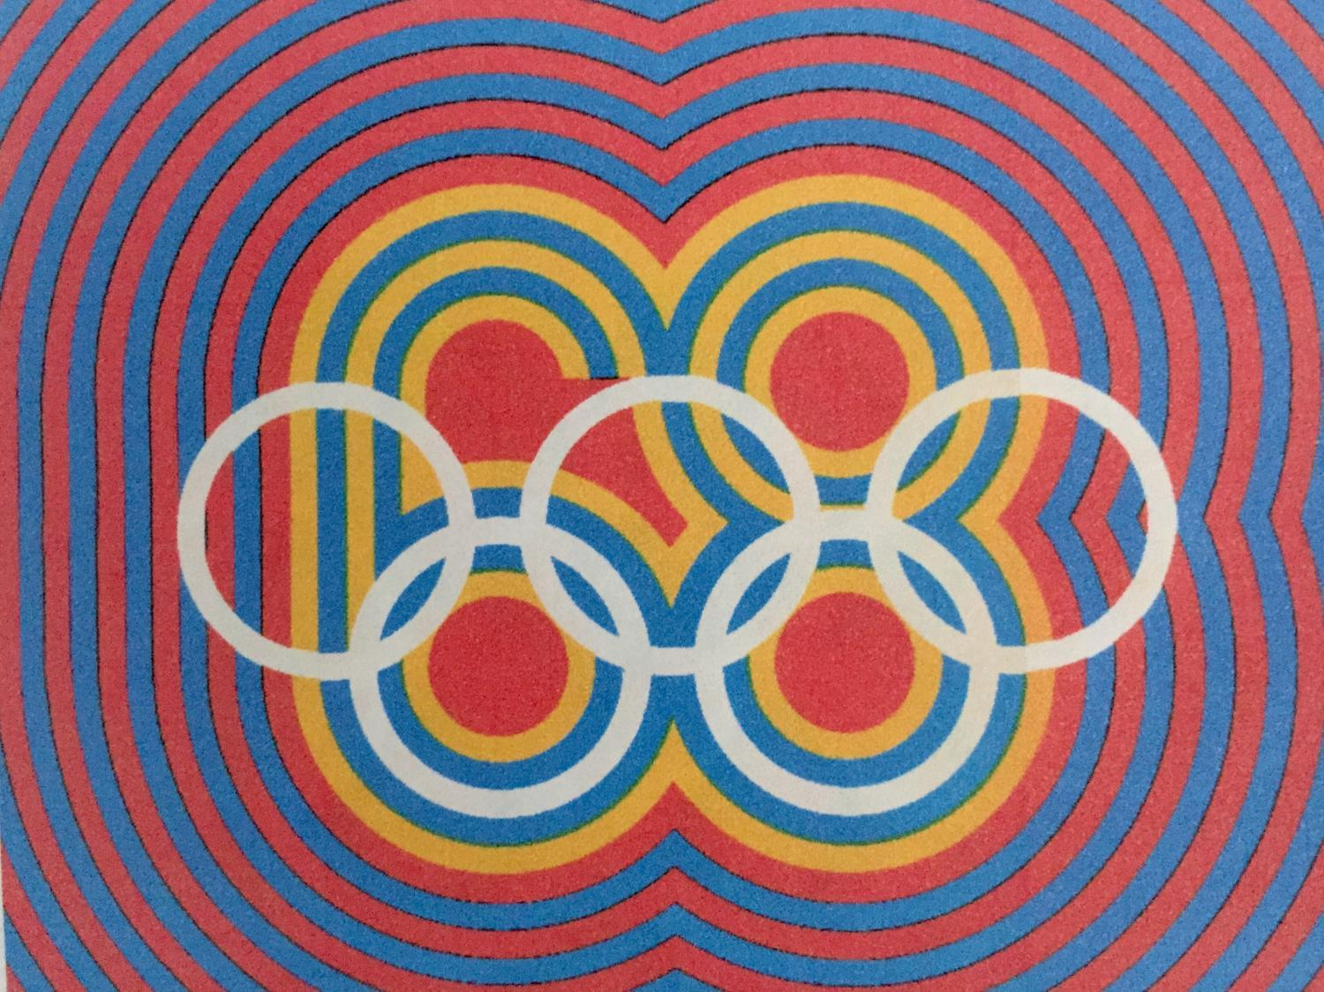
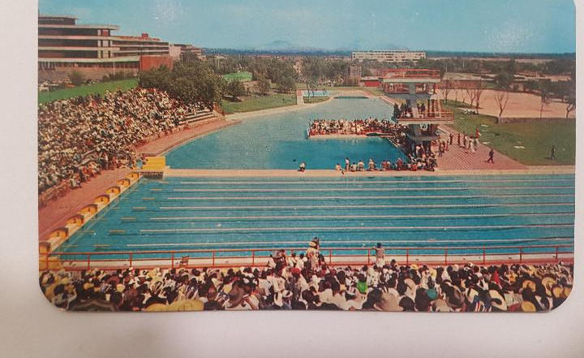
The Olympic Pool

Slide 19
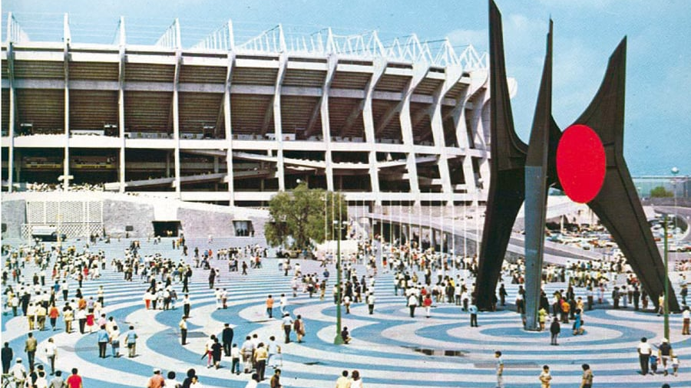

Slide 20
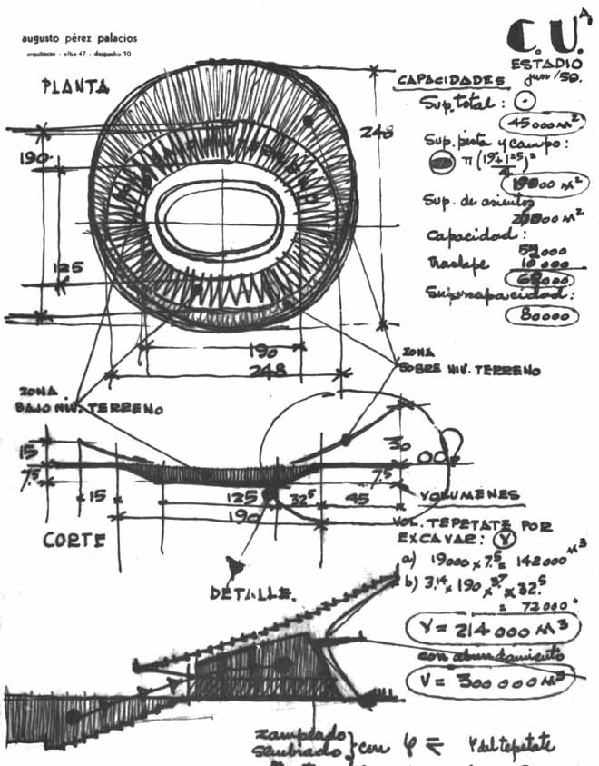
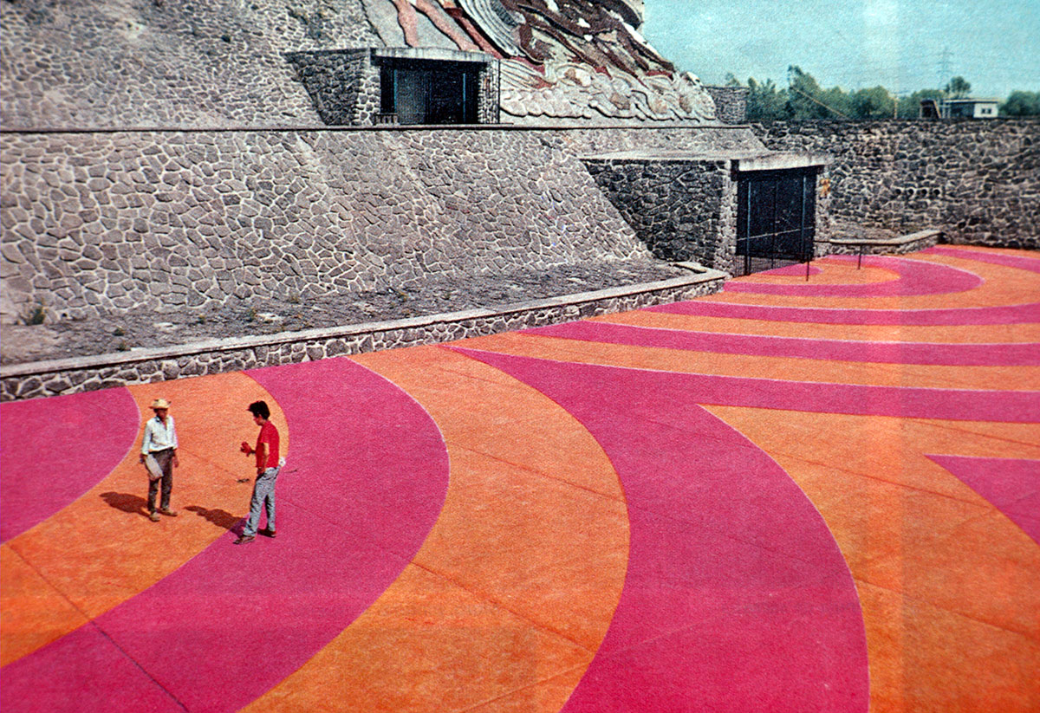
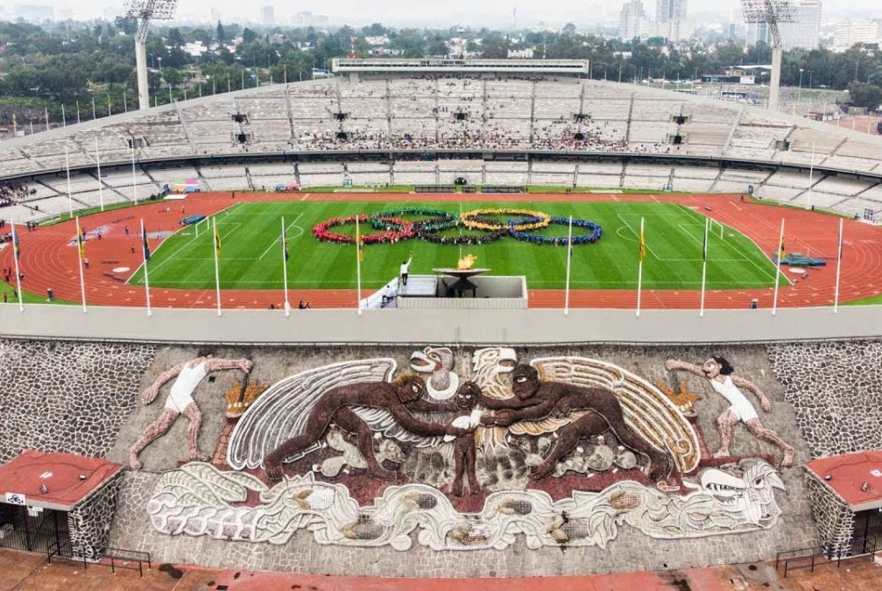
Estadio Olímpico Universitario, Mexico City, 1952, Augusto Pérez Palacios, Jorge Bravo,Raúl Salinas Moro Mural Diego Rivera, The University, Family and Sport

Slide 21
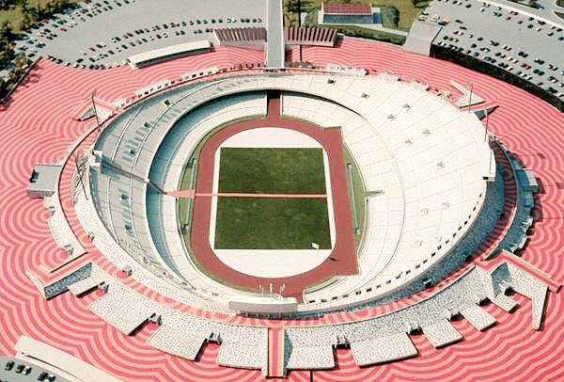
The Cultural Olympiad and Design
Eduardo Terrazas, Director of Urban Design, 1968 talks about the Olympic logo and the aims of the government in hosting the Olympics (1:49): https://www.youtube.com/watch?v=8XbJFyHW-vo

Slide 22
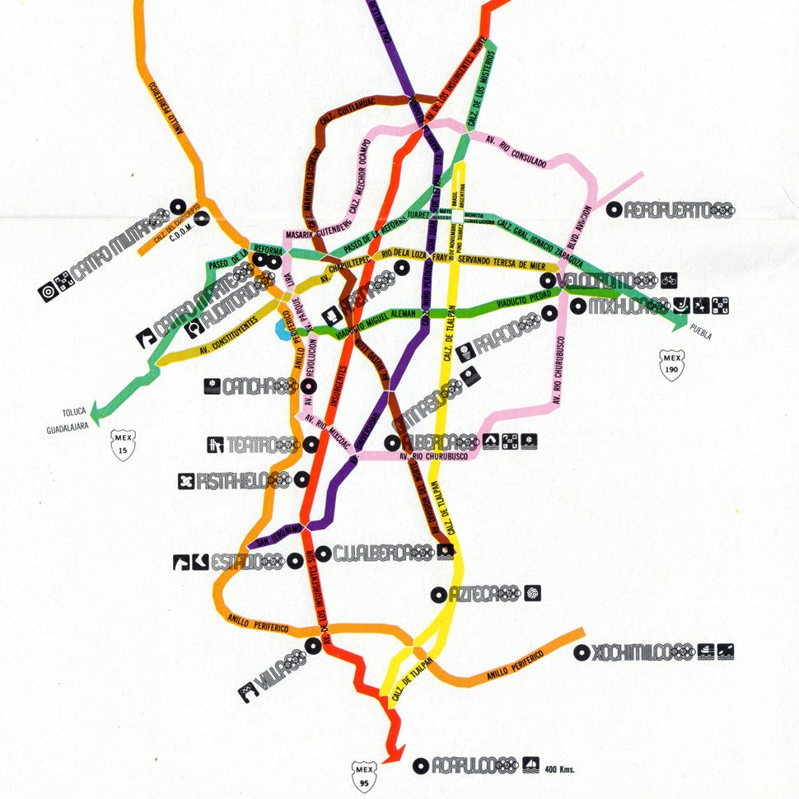
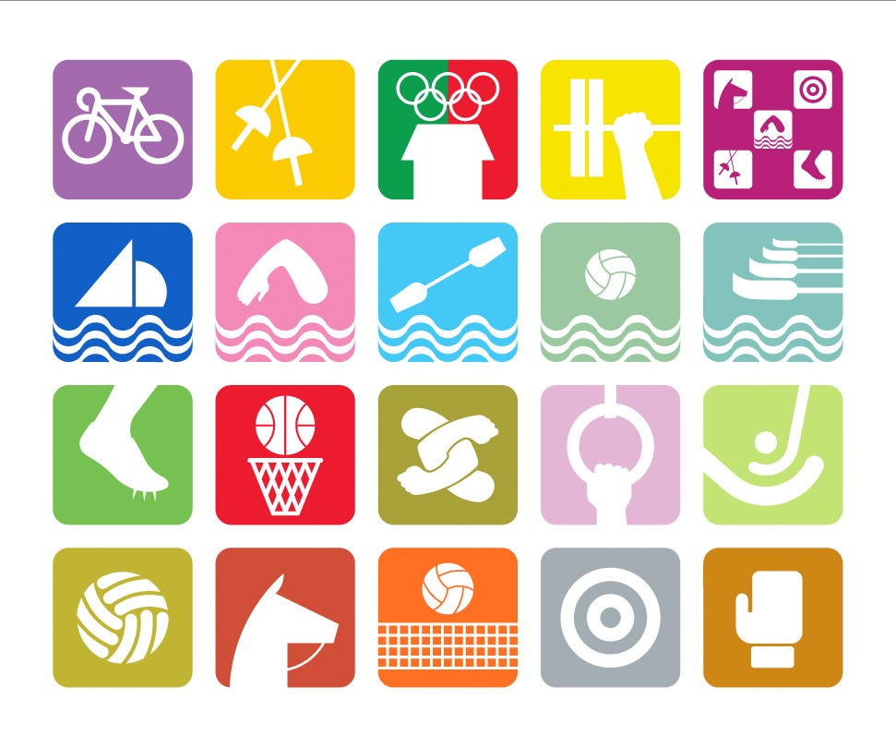

Slide 23
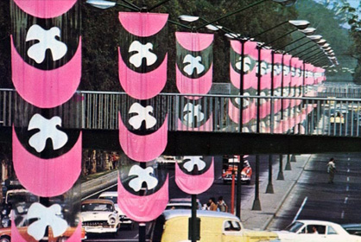
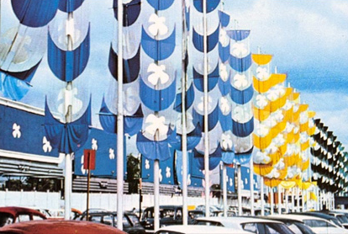

Slide 24
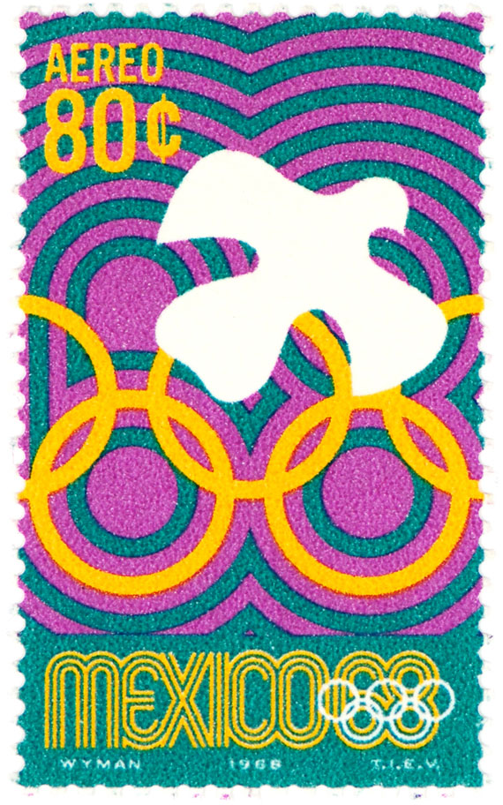
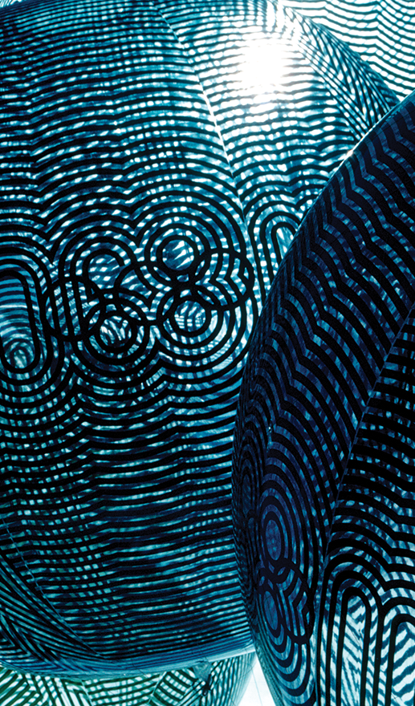
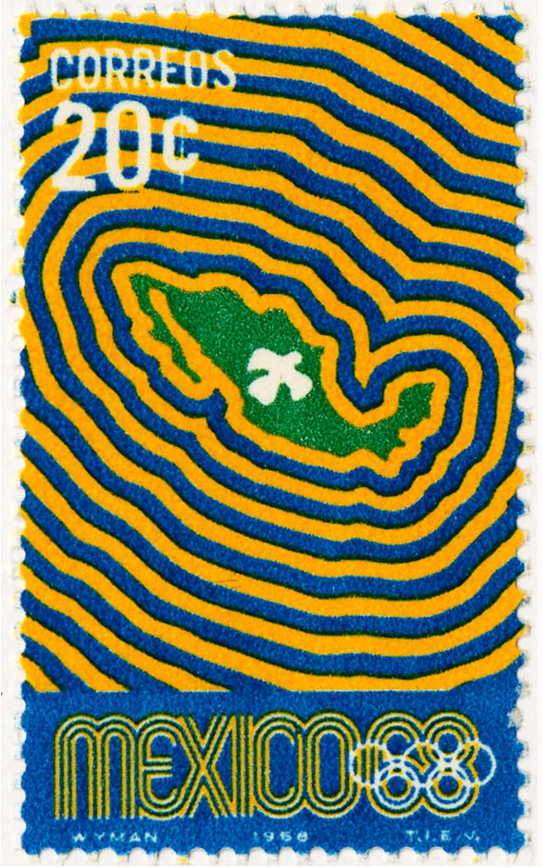

Slide 25
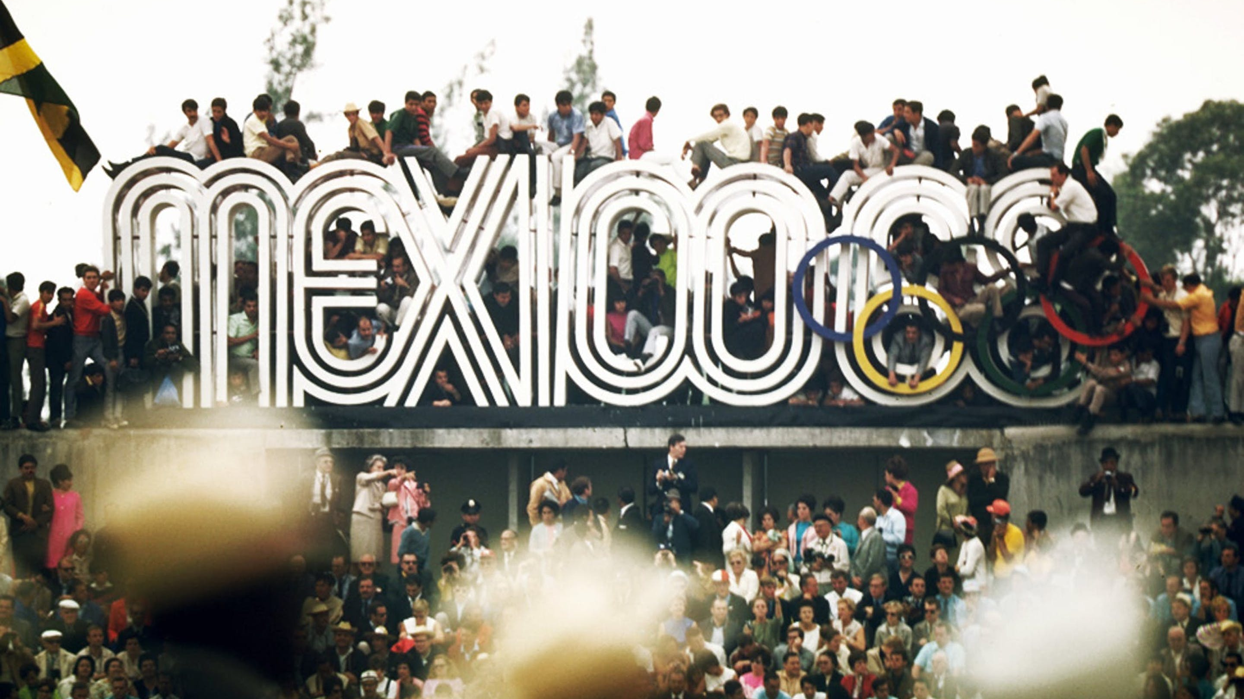

Slide 26
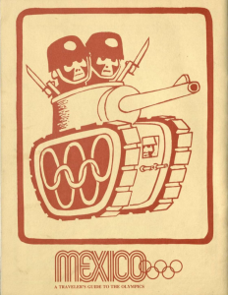
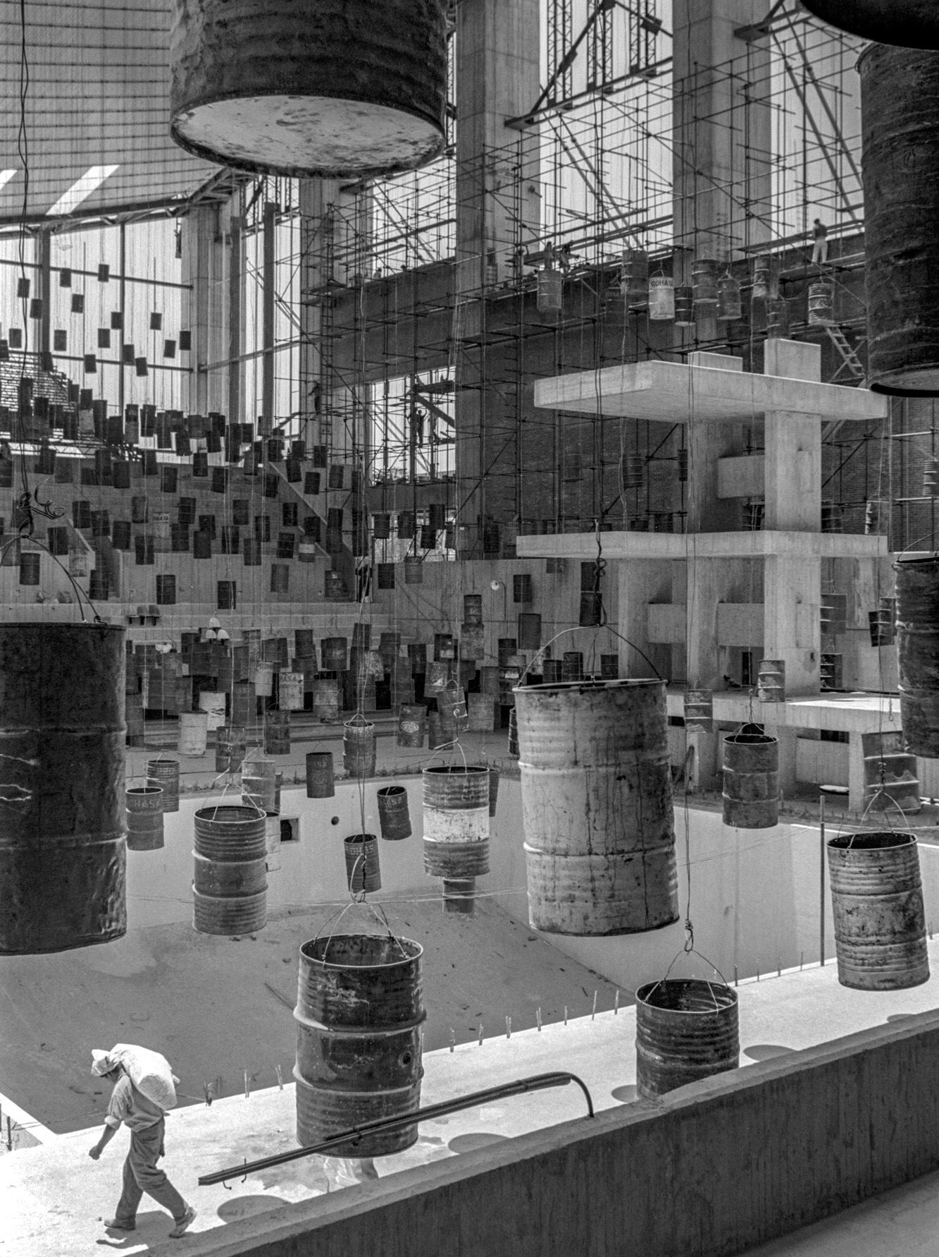
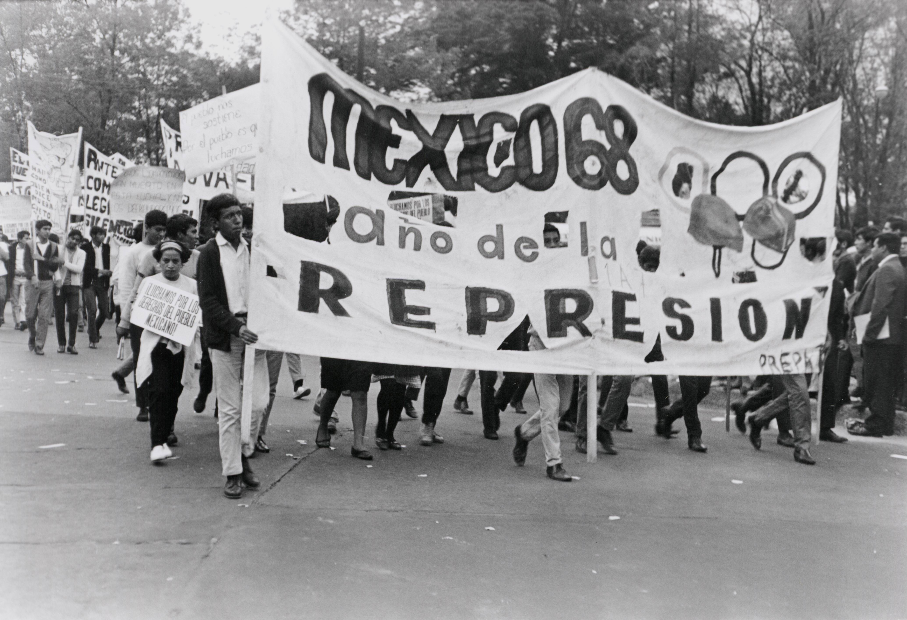
Back page of the pamphlet, Mexico 1968,Rare Books Collection, University of North Carolina Chapel Hill: https://blogs.lib.unc.edu/rbc/2018/02/19/1968-student-uprisings/

Slide 27

Escuela de Cultura Popular Revolucionaria Mártires del ’68.
Manta 68, 2008.
From the Blowout to the Movement, 1985

